Slide 1

All-Site Call
October 2, 2026

Slide 2
Agenda
10 min | Study Updates
5 min | Ceribell Q&A
10 min | Screening & Screen Failure Form
5 min | Informed Consent
5 min | DCC Reminders
15 min | Enrollment Experiences: Memorial Hermann Texas Medical Center & Nemours Children’s Hospital
10 min | Open questions and discussion

Slide 3
Study Updates
Vince

Slide 4

Award & Contract updates
Yr 1 UG NCE has ended early, effective 8/31/2026
        UM-Hub contracts will be modified as soon as our sub with UVA reflects the new end date.
        MI is working to pay-out all site events eligible for payment with a first “ready” date in WebDCU through 8/31.
        UH / Yr2 start effective: 9/1/2026
          An Updated subrecipient form is anticipated by ORSP. Email sent 10/1 (details about the new form - next slides)
          UM invoicing and payment for any activity that reads ready after 8/31 is on hold until your updated agreement can be activated. (How to locate payment information - next slides)
7 SIREN Hub-spoke agreements* pending FE:
        Continue to work to execute if any of these spokes are due payment for activity conducted through 8/31, which the hub has received a payment from MI.
Duke - MUSC; Temple - Cooper; UCLA - UCI (add-on); UCSD - Rady
UChicago - Northwestern; UPMC - Allegheny (add-on); Yale - MGH
*UVA has received NIH acknowledgement that hub-spoke agreements for KESETT do not meet the criteria of sub-awards requiring NIH pre-approval effective June 15.

Slide 5
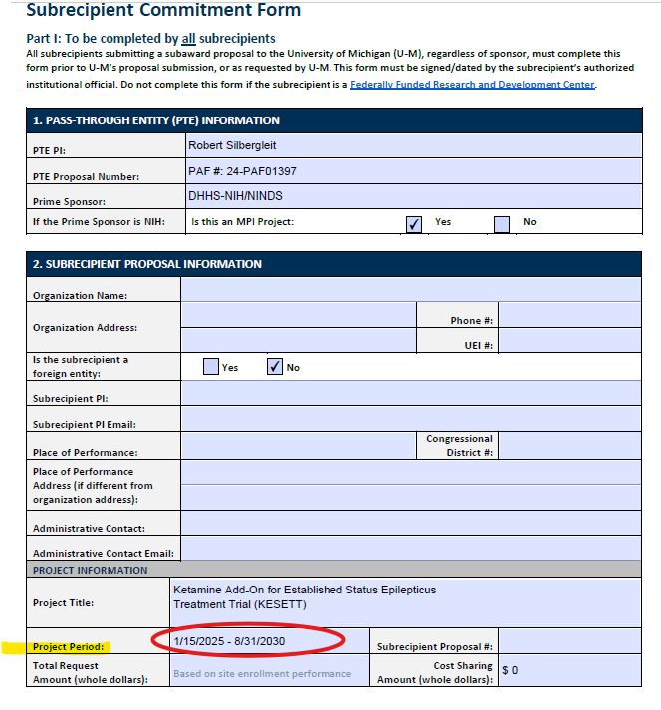
New Subrecipient form
Complete the rest of Page 1 as per your original subrecipient form.
Project period updated through UH and has been pre-populated.

Slide 6
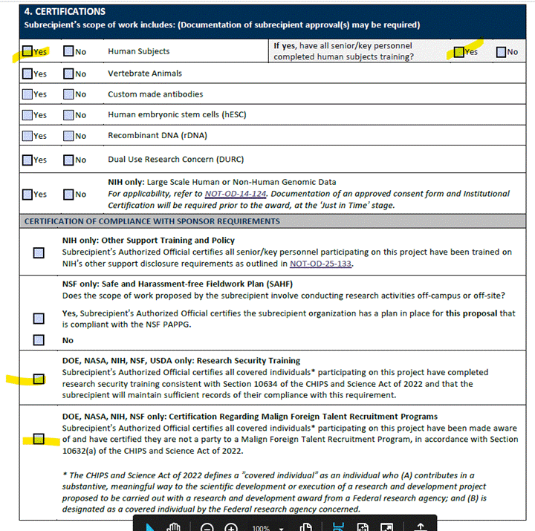
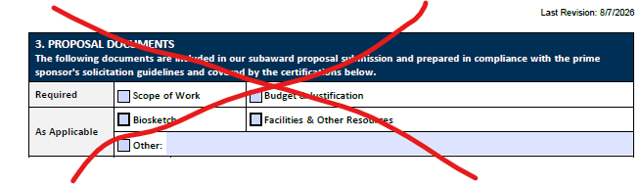
New Subrecipient form
Ignore proposal documents.
Complete new fields (highlighted) applicable to KESETT. The rest can be left blank.

Slide 7
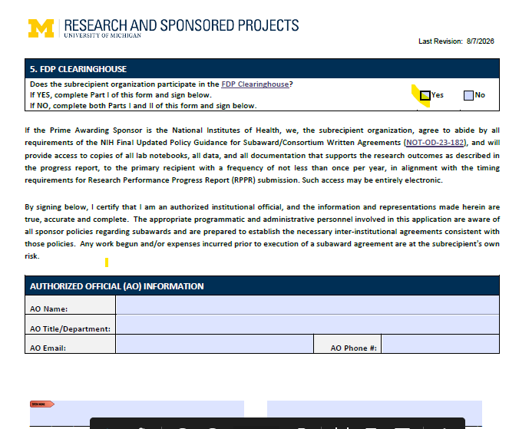
New Subrecipient form
FDP Clearninghouse participation.
If Yes. Form is complete following AO signature and return to MI.
If NO, the same fields for filling out when FDP = NO captured on your original subrecipient field need to be complete (next pages).
AO signature required and return to MI
Please reach out if you have any questions: dkolk@umich.edu

Slide 8
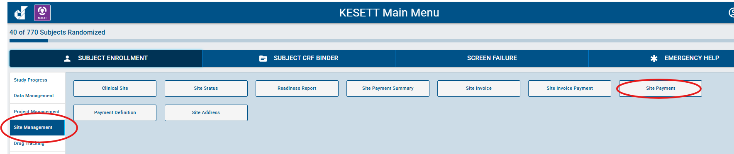
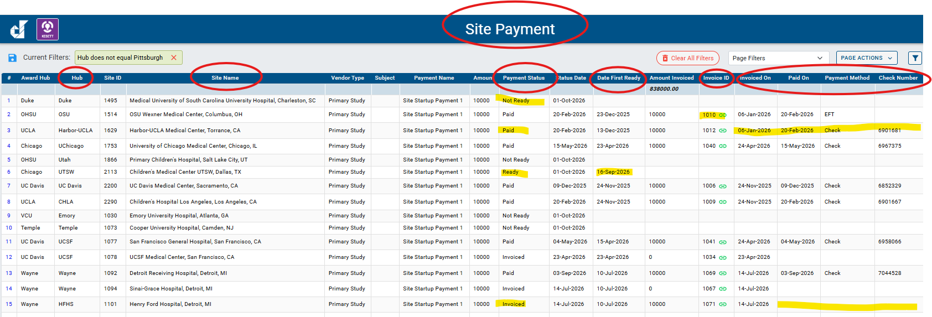
Payment Information

Slide 9
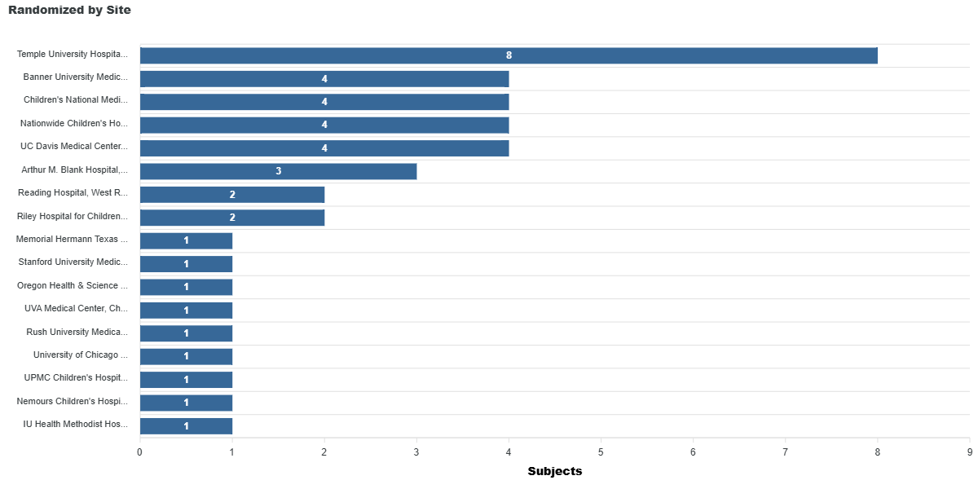
Total enrollment: 40
13 in Sept.!
Adults: 24
Pediatric: 16
Sites Enrolled: 17
Target Enrollment: 770
🙌 1st Enrollments at:
Stanford
UVA
Rush

Slide 10
EFIC activities completed: 59!
Submitted to CIRB: 54
CIRB Approval: 51
Released to Enroll: 32

Slide 11
Submitted Pending Approval (7) | Approved Pending Readiness call (16) | Readiness call Occurred (4) | Released to Enroll (32)
Children’s Hospital Los Angeles | Christiana Hospital | Froedtert Hospital | Yale New Haven Hospital | UPMC Children's Hospital
University of Utah Healthcare | Hennepin County Medical Center | Henry Ford Hospital | Temple University Hospital | Memorial Hermann TMC
Primary Children's Hospital | Sinai Grace Hospital | Jefferson Einstein Philadelphia | University of Michigan | IU Health Methodist Hospital
 | Detroit Receiving Hospital | Orlando Regional Medical Center | UC Davis Medical Center | Riley Hospital for Children
 | University of Illinois |  | UVA Medical Center | University of Cincinnati
 | Harbor-UCLA |  | Oregon Health & Sciences Univ | OSU Wexner Medical Center
 | UCI Medical Center |  | Arthur M. Blank Hospital | UCSF Medical Center
 | Ronald Reagan UCLA |  | Harborview Medical Center | San Francisco General Hospital
 | University of New Mexico Hospital |  | Reading Hospital | UPMC Presbyterian Hospital
 | Northwestern Memorial Hospital |  | Banner University | University of Chicago
 | UCSD - La Jolla |  | Children's National | University of Iowa
 | UCSD - Hillcrest Hospital |  | Nationwide Children's Hospital | Stanford University
 | University of Alabama |  | University of Minnesota | Johns Hopkins Hospital
 | Emory University Hospital |  | Children's Hospital of Wisconsin | Rush University Medical Center
 | Rady Children’s Hospital/UCSD |  | Nemours Children’s Hospital | Jeanes Hospital
 |  |  | University of Maryland | Duke University Hospital

Slide 12
Site Readiness
Upload all outstanding regulatory documents
  Site documents
  Study team trainings and people documents
Ensure eDOA is up to date
  Study pharmacist on the eDOA with Training and documentation
Input site addresses / IP shipping address
  IP shipping address and regulatory documents need to match
Clinical & Pharmacy workflow
  Order sets and drug administration

Slide 13
Following CIRB approval
Schedule your readiness call
  1-3 weeks
Pharmacy ready for drug
Clinical team training is completed
Ceribell is ready to be implemented
Local sign-offs
CIRB Approval
Readiness call
Receive Drug
Screening
1-3
3-5
1
Weeks
Days
Week
Schedule call
Complete Call action items

Slide 14
Readiness Calls SOP
Vince/Megan will contact site to schedule once CIRB report is Received
We will share the site-specific Readiness Checklist
  Site study team completes Checklist at least 24-48 hours in advance to confirm call
  Aim to have very few/no remaining action items after the call
Site required attendees | Site PI, Primary SC
Site recommended attendees | Co-Is, SSC, Pharmacy representatives, Hub PI, Hub PM

Slide 15
Sites pending CIRB Submission
Central EFIC Activities Pending (2) | EFIC Activities in Process (4) | EFIC Complete (5)
Medical University of South Carolina | Massachusetts General Hospital | VCU Medical Center
Baystate Medical Center | AHN Allegheny General Hospital | Children's Medical Center UTSW
 | University Medical Center New Orleans | University of Pennsylvania & Penn Presbyterian
 | Kings County Hospital & NYC Bundle | Cooper University Hospital
 |  | SUNY Upstate Medical University

Slide 16
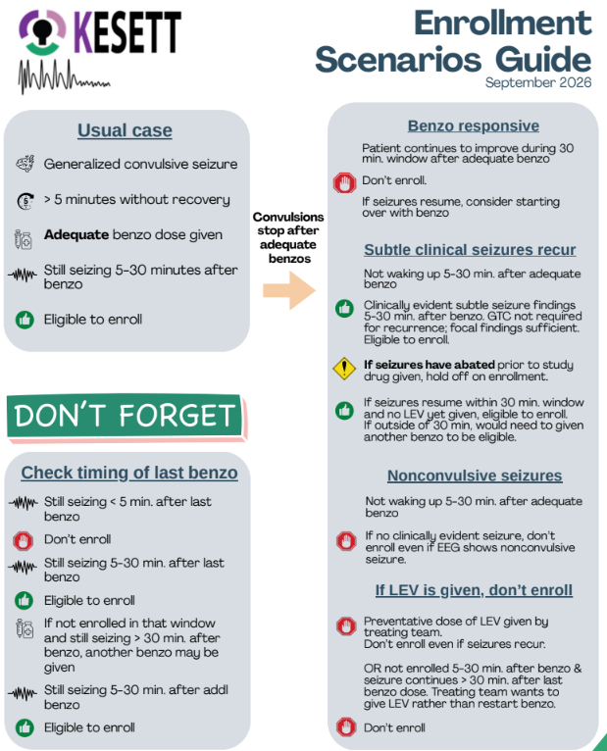

Enrollment
Scenarios
Guide

Slide 17
Ceribell Q&A
Michelle Hofmann &
Courtney Fietsam from Ceribell

Slide 18
Screening &
Screen Failure Form
Robert

Slide 19
How are screening data used?
Provides context in several domains:
Scientific: Top box in the CONSORT patient flow diagram
Regulatory: Reported to the DSMB and others
Operational: Assess enrollment trial-wide
Helps sites and leadership address accrual lapses
Suggests possible workflow improvements
Notes:
Why does it matter?

Slide 20
Choice of a denominator
Our goals in choosing a denominator were to:
Have easy criteria that could be easily compared across sites
Criteria easily searchable in administrative data
Criteria that were more sensitive than specific
Avoid criteria requiring extensive chart review
Avoid criteria requiring subjective clinical judgement
Notes:
As written in MoP and DCGs
Not the same as trial criteria - we want to understand patients sites are seeing and where the eligibility criteria are excluding patients, in addition to understanding what eligible patients are being missed
Includes preventative LEV as written
Sites enter for their enrolling population (e.g., adult only sites don’t need to enter peds patients)

Slide 21
Screening log criteria
Screen failures should be comprehensive of all patients age 1 year and older seen in the ED and who meet the following criteria:
Administered intravenous levetiracetam, valproate, or fosphenytoin;
for the treatment of seizures or status epilepticus
(ICD-10 codes G40.%, R56.9, R56.%, or equivalent)
The screening log does NOT include those enrolled in KESETT.
Notes:
As written in MoP and DCGs
Not the same as trial criteria - we want to understand patients sites are seeing and where the eligibility criteria are excluding patients, in addition to understanding what eligible patients are being missed
Includes preventative LEV as written
Sites enter for their enrolling population (e.g., adult only sites don’t need to enter peds patients)

Slide 22
Making screening easier
We know there are a LOT of screens by these criteria.
To make things easier you can
Report directly from administrative data or very brief chart reviews.
Demographics (sex, race, ethnicity, age) from administrative data.
Eligibility criteria do NOT need to be comprehensively reported
Ok to move on after finding the first obvious exclusion
Notes:
As written in MoP and DCGs
Not the same as trial criteria - we want to understand patients sites are seeing and where the eligibility criteria are excluding patients, in addition to understanding what eligible patients are being missed
Includes preventative LEV as written
Sites enter for their enrolling population (e.g., adult only sites don’t need to enter peds patients)

Slide 23
Making screening easier
Consider screening eligibility criteria in the following order…
Continuing or recurring seizures in the ED after >5 minute seizure?
Study team available to enroll if other eligible?
Benzodiazepine refractory or already intubated?
Too small?
EFIC not allowed (opt out bracelet, prisoner, pregnant)?
Other excluded causes of seizure or contraindication?
Notes:
As written in MoP and DCGs
Not the same as trial criteria - we want to understand patients sites are seeing and where the eligibility criteria are excluding patients, in addition to understanding what eligible patients are being missed
Includes preventative LEV as written
Sites enter for their enrolling population (e.g., adult only sites don’t need to enter peds patients)

Slide 24
Screening strategies
Consider entering those the study team screens directly in real time.
      These can likely be more complete.
But…patients meeting screening log criteria need to be entered whether the study team was contacted on day of service or not.
Enter in WebDCU from an administrative search at least monthly
      These will usually be more abbreviated
Notes:
As written in MoP and DCGs
Not the same as trial criteria - we want to understand patients sites are seeing and where the eligibility criteria are excluding patients, in addition to understanding what eligible patients are being missed
Includes preventative LEV as written
Sites enter for their enrolling population (e.g., adult only sites don’t need to enter peds patients)

Slide 25

Easier screening
=
Not fewer screens, but fewer data

Slide 26
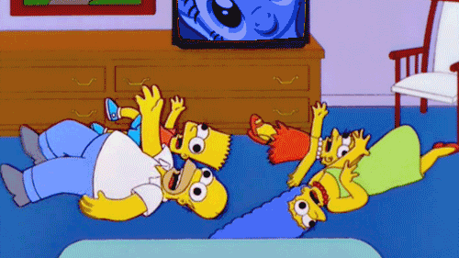

Slide 27
24/7 Hotline
1-844-4KESETT (1-844-453-7388)
Can be used by clinical and/or study teams
Screening/eligibility questions, procedural questions, AE reporting, etc.

Slide 28
Informed Consent
Vince

Slide 29
EFIC Consent
All enrollments are expected to occur under EFIC guidelines without obtaining prospective consent
Pre enrollment opportunity to decline will be offered if it does not delay treatment
  May be performed with family at the bedside and/or LAR

Slide 30
Consent to Continue
Once the LAR is available and as soon as it is feasible, the LAR will be informed of the participant’s enrollment in the study.
  Only the LAR can provide consent on behalf of the participant (not other family members).
Refer to your local institutional guidance and state laws on LAR determination and priority.
LAR and family identification and tracking will typically be a shared responsibility between the social workers and the study team.
  Work with your social worker and clinical teams

Slide 31

Rare Consent Outcomes
Withdrawal of participation
  Data from before withdrawal is maintained
  No new data can be collection from after time of withdrawal
No determination of consent or notification
  Consent does not need to be obtained after end of study has been reached
  Attempt to contact the participant/LAR
  Document process in the Informed Consent Log CRF
  Final outcome will be discussed and approved by trial leadership.
Death before consent outcome is determined
  Once LAR should be informed of the participant’s participation
  If this conversation cannot occur in the hospital, send a LAR notification letter

Slide 32
Notification Only
Participant/LAR notified and study discussed but no consent determination was reached.
  Consent does not need to be obtained after end of study has been reached
  Attempt to contact the participant/LAR to inform them the study has ended

Slide 33
REDCap Forms (CCC access only)
Consent Document
  Remote e-consent
  In person e-consent (includes Consent Attestation)
Consent Attestation - Research team attestation of consent process
  Remote e-consent
  Paper consent
Participant Contact Information form - Contact information & Paper form upload
  All enrollments

Slide 34
e-Consent
RedCap Electronic consent is the prefered way to collect informed consent forms for SIREN
  Reduces consent document errors and deviations
Test link to be used by all sites.
  Review Site specific language, HIPAA authorizations, Other site forms
  Available on KESETT.Org Workbench
Live Links are sent after release for enrollment and in WebDCU site documents

Slide 35
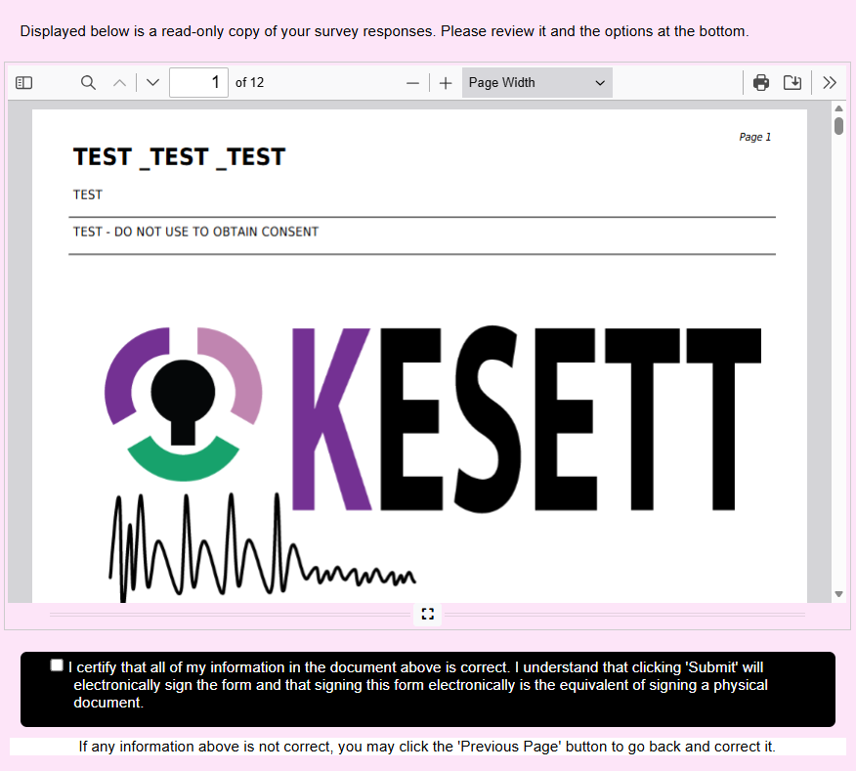
Ensure Verification is completed and form is submitted

Slide 36
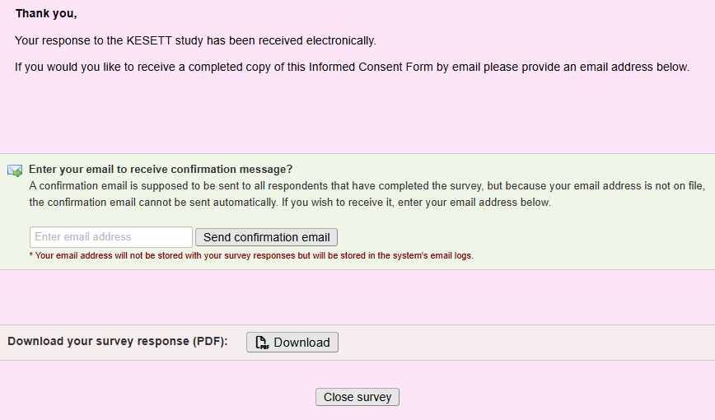
Copy can be sent to the signers email
Download option if you wish to utilize it

Slide 37
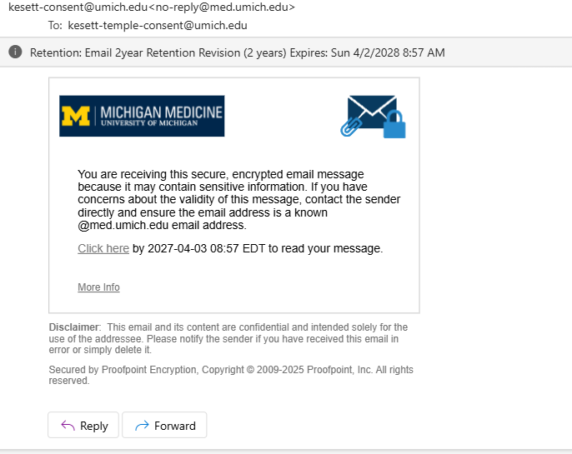
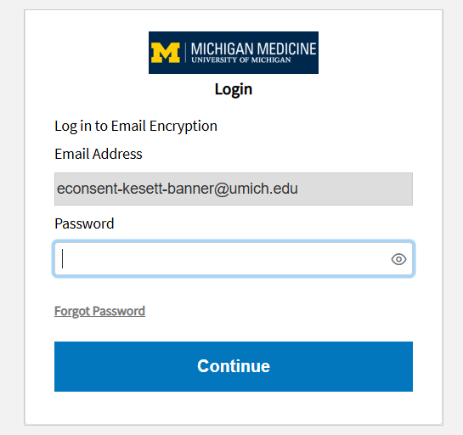
e-Consent
All study team members with consent responsibility will receive a secure email containing the signed consent form
  Email is sent to a group email and is password protected.
The Password can be reset every time an email is received if needed. Team member(s) obtaining consent should be accessing the document

Slide 38
Data Coordinating Center (DCC)
Morgan

Slide 39
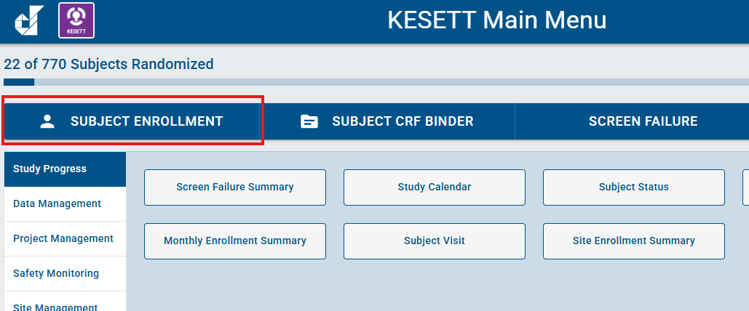
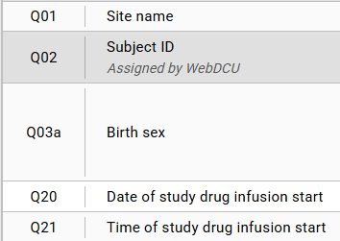
KESETT Enrollment: Step 1
Where to start in WebDCU when enrolling a new subject?
  Complete and save the Subject Enrollment table within 8 hours of start of study drug infusion
Notes:
PRIOR TO WEBDCU: KESETT is a step forward randomization design, so there is not a randomization form to complete in WebDCU. Rather, sites will grab the ‘Use Next’ vial (or ‘Backup’ if the ‘Use Next’ vial is no longer available) and begin study drug infusion.
STEP 1: Within 8 hours of initiation of study drug infusion, you will add a new record to the Subject Enrollment table, then complete and save the record. Subject Enrollment is irreversible so please check all entered data prior to saving the form.

Slide 40

KESETT Enrollment: Step 2
Where to go from Subject Enrollment?
  Open the Subject CRF Binder. This can be accomplished from the Subject Enrollment table via the green arrow on Q33
  Complete and submit F501 Rapid EEG & F502 Study Drug Infusion, also within 8 hours of start of study drug infusion. They will be green and checkmarked once they are submitted.
Notes:
STEP 2: From here, you will open the Subject CRF Binder, complete, and submit F501 (Rapid EEG) and F502 (Study Drug Infusion), also within this 8-hour window.

Slide 41
KESETT Enrollment: Step 2
Purpose of quick submission:
  Subject Enrollment: notifies the central and site team that a subject has been enrolled at the site
  F501 Rapid EEG: Kicks off the central reader process if rEEG was obtained
  F502 Study Drug Infusion: indicates to the central team which arm the participant was randomized to and triggers drug vial restock
Notes:
Documentation of Rapid EEG into F501: will tell the central EEG Readers that they will have EEG data to read for this new subject.
Documentation of the Study Drug ID into F502: will tell the central team which treatment assignment the participant received as well as informing the central pharmacy that replacement study drug needs to be shipped to your site.

Slide 42
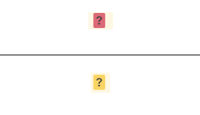
DCR Actionable Symbols & Statuses
Red question mark box
  Open DCR that has not yet been responded to by the site
Yellow question mark box
  Responded DCR that has not yet been closed by the central team
Notes:
Red = site action needed.
Yellow = no site action needed.
This information can also be found in the SIREN WebDCU User Manual for your reference.

Slide 43
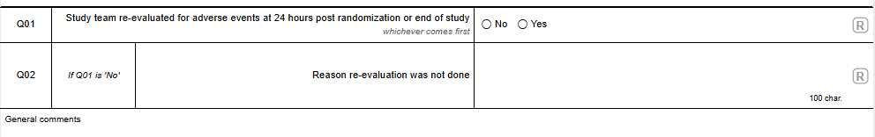
F519 Hour 24 Assessment for Adverse Events
New case report form
  Posts at the Baseline visit
  To be completed at 24 hours from study drug infusion (or hospital discharge, death, or withdrawal of consent if sooner than 24 hours)
  The purpose of this form is for sites to attest that they have evaluated for reportable AEs at 24 hours. Sites should evaluate again at least at the subject’s End of Study visit.

Slide 44
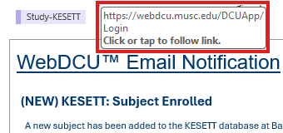
WebDCU v1 vs v2 Links
v1: https://webdcu.musc.edu/
v2: https://webdcu.musc.edu/DCUApp/Login
Notes:
Need to hover over ‘WebDCU’ portion of underlined content for link to work.

Slide 45
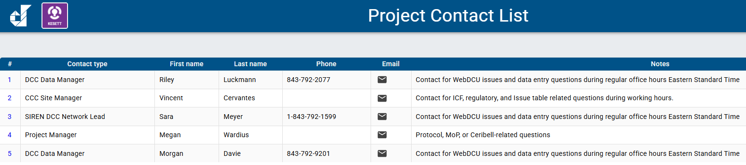
DCC Contact Information
Please do not reply to the webdcu@musc.edu address when receiving automated emails from the DCC.
  These replies do not go to the KESETT Data Managers and are not reviewed regularly
  Contact information for KESETT personnel can be found in WebDCU
    KESETT Main Menu > Toolbox > Project Contact List

Slide 46
DCC Resources
SIREN Website
  SIREN WebDCUv2 User Manual
  Data Collection Guidelines
Contact us
  Riley Luckmann (luckmann@musc.edu)
  Morgan Davie (daviem@musc.edu)
  Sara Meyer (butlers@musc.edu)

Slide 47
Enrollment Experiences
Memorial Hermann Texas Medical Center
Co-I: Dorian Alexander (PI: Kayleigh Fisher)
PSC: Misha Bhatti

Slide 48
Enrollment Experiences
Nemours Children’s Hospital
PI: Amy Thompson
PSC: Claire Loiselle

Slide 49
Open
Questions and Discussion

Slide 50

New FAQs
📂
Check out the FAQs on the website > FAQs tab

Slide 51
Thank you!
kesett.org
Next All-site call: Friday, November 6

Slide 52
Enrollment Video

Slide 53
Training:
Study Team & Clinical Team
Megan

Slide 54
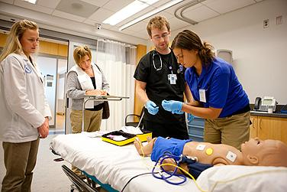
Educate, monitor, re-educate
Change of shift
Simulated mock enrollments
Academic “detailing”
Notes:
Clinical staff training. Dependence on Guideline concordant usual care, adequate dosing of benzodiazepines, need to wait for effect, stepwise progression to second and third line (not returning to first line after determining to benzo refractory), giving a chance to wake up.
Study should never delay treatment of status. Not for an opt-out discussion. Not for EEG prior to treatment. Pharmacy must be as fast as usual care.

Slide 55
Resources Available
Kesett.org > Education & Training tab
  Enrollment video
  Clinical team slide deck
  Safety of ketamine video
  IM videos
  Ceribell training videos

Slide 56
Suggested methods
Faculty meetings
Charge nurse meetings
In-service meetings
Mock enrollments/seizure codes
Email
Info sheets

Slide 57
Discussion:
Experiences with mock enrollments?
What has worked well for clinical team trainings and/or Ceribell trainings at your site?
What other resources would help?

Slide 58
Screening
Patients who meet one of the below criteria:
Administered one of the following for the treatment of seizures or status epilepticus
    LEV,
    valproate (valproic acid), or
    fosphenytoin intravenously
OR
Patients in the ED who have had a witnessed seizure and are determined to be experiencing a continuing seizure event who were screened in real time by the study team.

Slide 59
Screen Failure
Patients that meet the below criteria and were not enrolled regardless of when they were screened and if the study team was present
Administered one of the following for the treatment of seizures or status epilepticus
    LEV,
    valproate (valproic acid), or
    fosphenytoin intravenously
Patients to whom the study team is alerted to in real time but are not enrolled should be entered as screen failures within 5 days of screening.
An administrative review should also be performed at least monthly to identify patients who met the criteria above but were not alerted to the study team or enrolled.

Slide 60
Enrollment in WebDCU
DCC Riley Luckmann

Slide 61

KESETT – step forward randomization
KESETT is a step forward randomization design, which means we do not have a Randomization Form in WebDCU that assigns a treatment when submitted.
Instead, sites will grab the ‘Use Next’ vial (or ‘Backup’ vial if no ‘Use Next’ is available) and use it to treat the KESETT participant.
Data entry into WebDCU will occur after enrollment.
  This includes documentation of Study Drug ID, which will tell the DCC which treatment assignment the participant received.
The KESETT database in WebDCU is a real, live database. No testing or fake data should ever be entered by sites.

Slide 62
Within 8 hours of KESETT study drug administration…

Slide 63
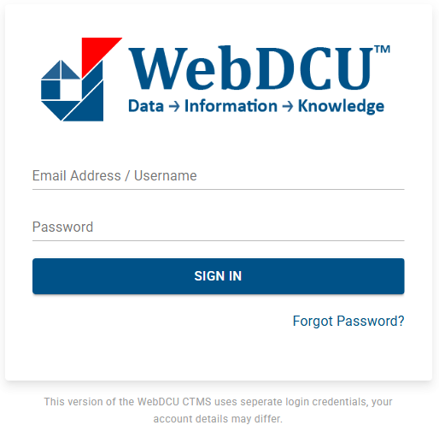
1. Log into WebDCUv2
https://webdcu.musc.edu/DCUApp/Login

Slide 64

2. Click on the KESETT tile

Slide 65
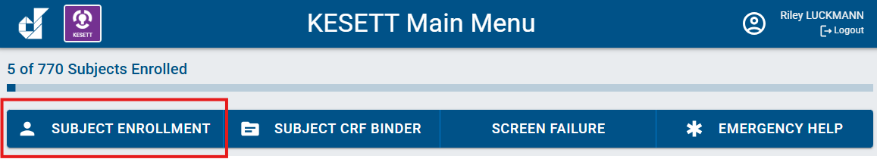
3. Select the Subject Enrollment button from the main menu bar

Slide 66
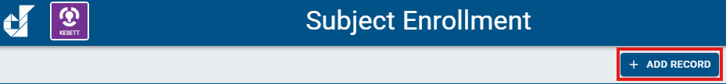
4. Select ‘Add Record’

Slide 67
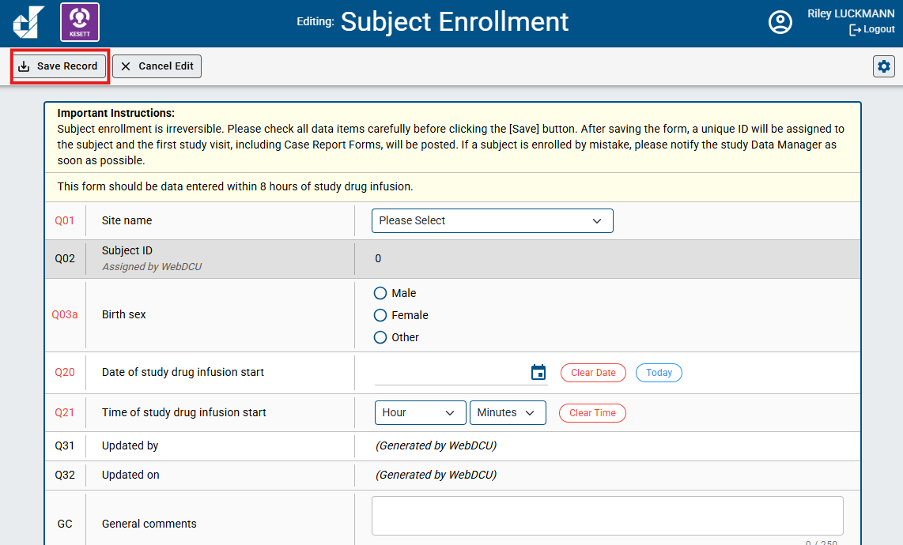
5. Enter the Subject Enrollment form and select ‘Save Record’
*As the instructions indicate, Subject Enrollment is irreversible. It should not be data entered until a patient has already received KESETT study drug. In Q20 and Q21, you will have to indicate the Date and time of study drug infusion start.

Slide 68
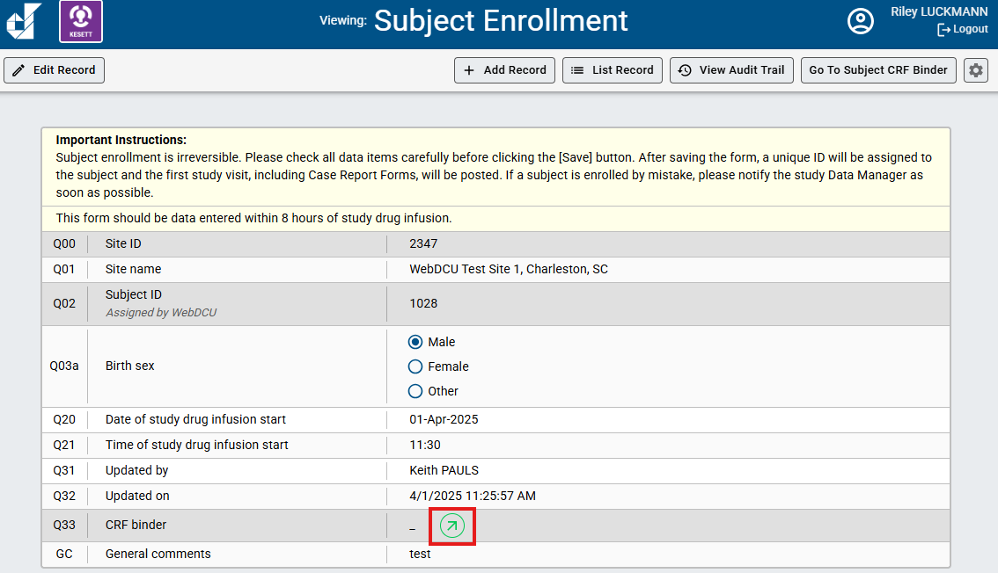
6. Click the green arrow to go to the Subject CRF Binder

Slide 69
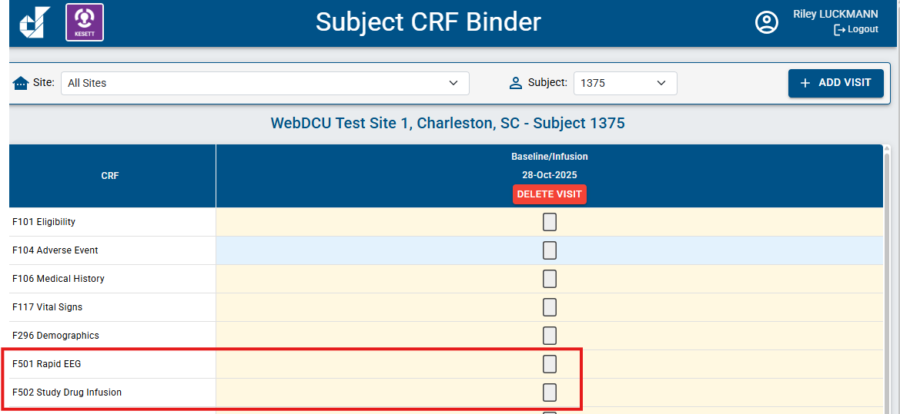
7. Enter and submit other enrollment CRFs
F501 Rapid EEG
F502 Study Drug Infusion

Slide 70
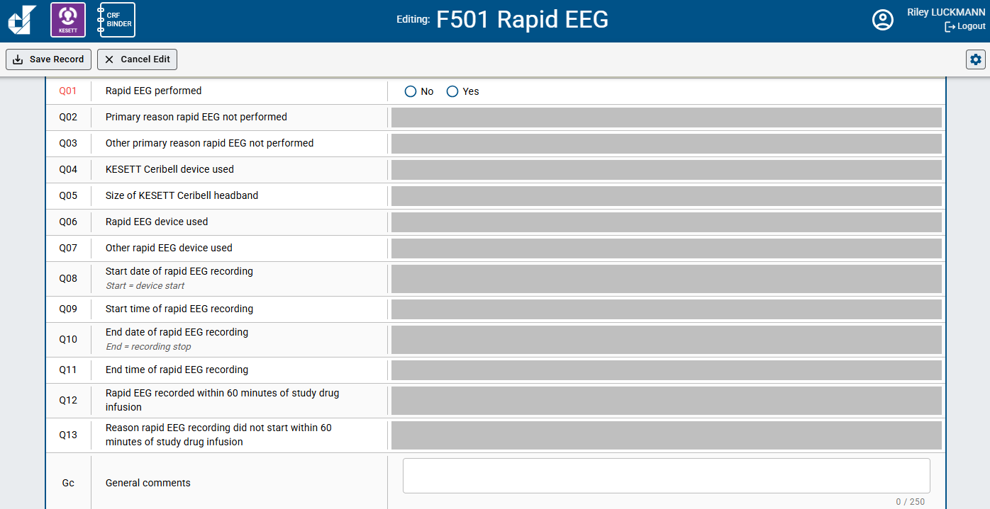
F501 Rapid EEG

Slide 71
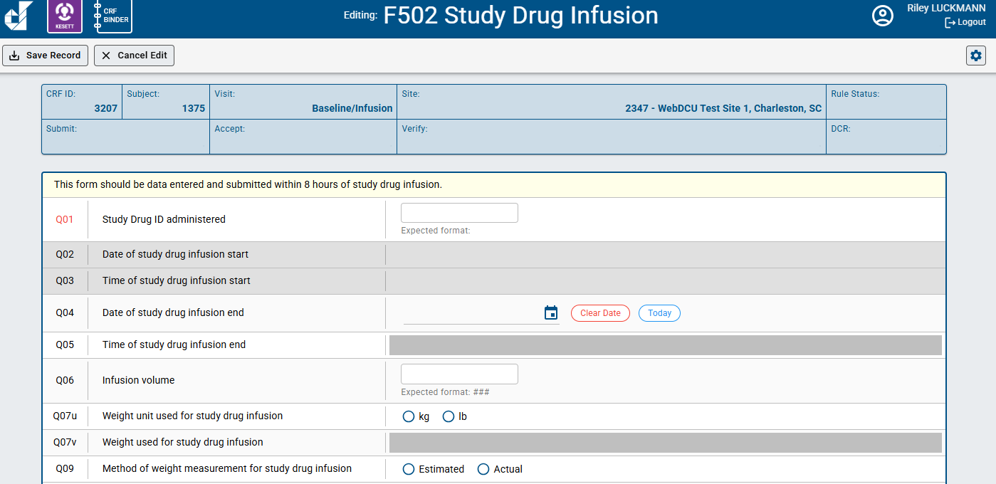
F502 Study Drug Infusion

Slide 72
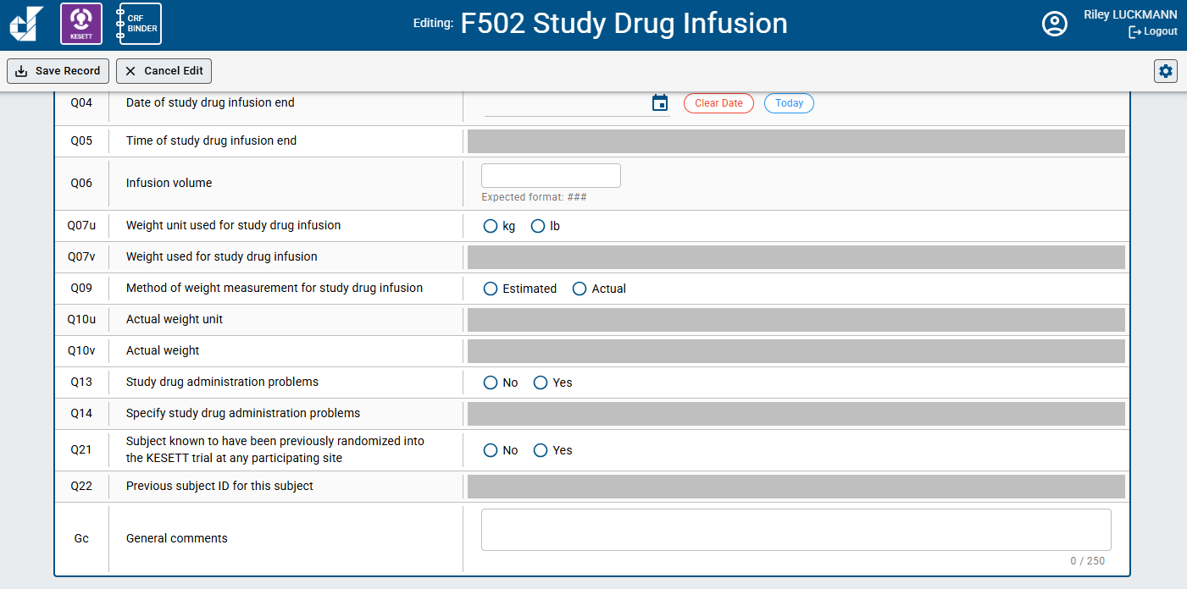
F502 Study Drug Infusion

Slide 73
CIRB Review Process & Initial Site Submission Table
Vince

Slide 74
EFIC Activities

Slide 75
EFIC Activities
Site Alone
  2 In-person community events
Site & UAB
  2 Virtual focus groups
UAB
  Community surveys
  Social media ads
  Website
Notes:
CC in Blue PD in Green

Slide 76
CC Community Event Documentation
CCC is reviewing and asking for clarifications
Key information to include
  Why this event was chosen
  duration of event and team presence
  Which team members attended
  Community attendance - At event and contacted
  Number engaged in extened conversations (consulted)
  Examples of conversations, questions, or impact
  Demographics - At event and extended discussion
  Overall reception and feedback including any opt-outs

Slide 77
Investigators X, and Y along with PSC Z attended the Gotham Farmers Market to introduce the KESETT study. The study members had a booth at the market for the full duration (09:00 to 14:00) and handed out EFIC-approved fliers and pamphlets. The market patrons were non-specific members of the general public, although attending study members noticed that most patrons who stopped to learn about the study either knew someone with epilepsy, were healthcare workers, or were interested in the neurosciences. The most common question revolved around what a patron without a history or predisposition of seizures could do to support the study. Study members encouraged the patrons to inform people they know of the study and encourage others to register their interest in the Focus Groups via the survey provided in the UAB-created website. Patrons tended to understand the concept of EFIC and did not have any questions regarding that topic. Overall, market patrons responded encouragingly to this study and did not have many questions or comments. No opt out mechanisms were requested.

Slide 78
Investigators X and Y along with PSC Z attended the Gotham Farmers Market to talk to people for it’s 5 hour duration. Gotham Farmers Market is one of the cities largest and well attended gatherings, drawing over 10,000 visitors every week from a wide area. The market is dedicated to diversity and food justice and attracts customers of all socioeconomic groups by emphasizing acceptance of EBT/SNAP, WIC and Senior FMNP. Many people stopped by the booth to pick up fliers and brochures about the study and the study team was able to have discussions with about 200 people. Discussions differed in duration. Most were brief, but many (10 or more) were 10 minutes or longer. The event allowed us to talk to young and old people of many colors and backgrounds. Many of the patrons who stopped to learn about the study either knew someone with epilepsy, some were interested in science, some with prior experience with research, and some were healthcare workers. People talked to expressed support for the research. One father of a child with epilepsy described their difficulty dealing with the disease and expressed gratitude for the study Many of those with whom we talked who didn’t have epilepsy or seizures, asked what they could do to help. They were told to help spread the word by telling friends and family about it. Some expressed interest in the focus groups as well. People tended to understand the concept of EFIC and did not ask questions about that much. Overall, those with whom we engaged responded encouragingly to this study and did have any concerns. No opt out mechanisms were requested.

Slide 79
CC Virtual Focus Groups
Event documentation entered into WebDCU by the UAB EFIC team
Site responsibilities:
  Recruit attendees
  Provide list of attendees and why they were invited to UAB
  Propose times to the UAB facilitator
  Present study information on the call (facilitator guide)
  Answer attendee questions
  Keep record of what organizations or groups were contacted

Slide 80
Focus Group Invitation
10
8
5
CONFIRM
GOAL
CONDUCT

Slide 81



Focus Group Best Practices
Limit team member attendance with brief introductions
Concise presentation to allow ample time for community member input
Pre review the facilitator guide

Slide 82
Focus Group Recruitment
Who?
  Local epilepsy and seizure disorder community
  Interested or invested community members
    Do not need to have a direct link to epilepsy or seizures
  Diverse backgrounds
  Representative of your community
  Include concerns specific for your community
    Minorities and underrepresented
    Low income or unhoused
    Faith based
Notes:
Have another reason for attendance other than clinical or research background

Slide 83
Post EFIC Information
Report any additional opt-outs
Focus group attendees - How/why they were selected
The “why” is very important to the IRB. Please give a 2-3 sentence summary for each meeting describing the individuals that attended.
Names of the groups that were invited to participate in the focus groups.
These can be a specific organization such as an epilepsy foundation chapter, or a population targeted such as neurology clinic patients
Paragraph from the local Principal Investigator
Assessment of their overall perspective of the community meetings, in-person events, the feedback received, and the utility of these meetings/events.

Slide 84
Opt-outs
At in person events & focus groups- Reported in the CC form in WebDCU
PD activities such as the social media campaign will direct to the website and your team contact information
Study team should keep a list of opted-out community members to mail a wristband to.
Prior to CIRB approval- Opt outs reported to the CCC in final EFIC details
Post IRB approval - Maintained locally and submitted to the CIRB at yearly SCR
Opt out will be mailed by the study team or CCC using the Opt out letter under review by Advarra

Slide 85
Focus Group RecruitmentIdeas
Inviting interested persons from your in-person events
Low acuity patients from your ED who have already been seen and are stable
Engaging patients from your outpatient clinics
Community groups and engaged community members

Slide 86

Focus Group Recruitment Ideas
Posting on social media sites
  Next Door
  Facebook groups
  Institutional pages
Leverage existing community relationships at your site
  Research Community Advisory Boards
  Patient advocacy groups
Contact community groups
  Elected officials / city council
  Religious leaders and groups
  PTAs
  Retirement and neighborhood communities
  Community resource organizations
  Local epilepsy support groups and/or foundation chapters

Slide 87
Site Readiness
Vince

Slide 88
Source Documents

Slide 89
Source Docs & CRFs
Source document for all data recorded in the CRFs is the 1st location where those data are recorded.
  eCRF itself (data is observed & directly data entered)
*Add note to General comments filed stating “direct data entry”
  Paper case report form representative of the study eCRF
  Electronic health record
  Paper medical record

Slide 90
Source Doc Hierarchy:
Clinical Outcomes at 15- & 60-min
Contemporaneous observation & documentation of attending physician’s determination
Directly recorded on paper or electronic CRF
Direct communication with the attending physician
Directly recorded on paper or electronic CRF
Medical record - explicit study-specific documentation
Medical record - implicit review (should be used in very rare cases)
Notes:
Defined in MoP

Slide 91
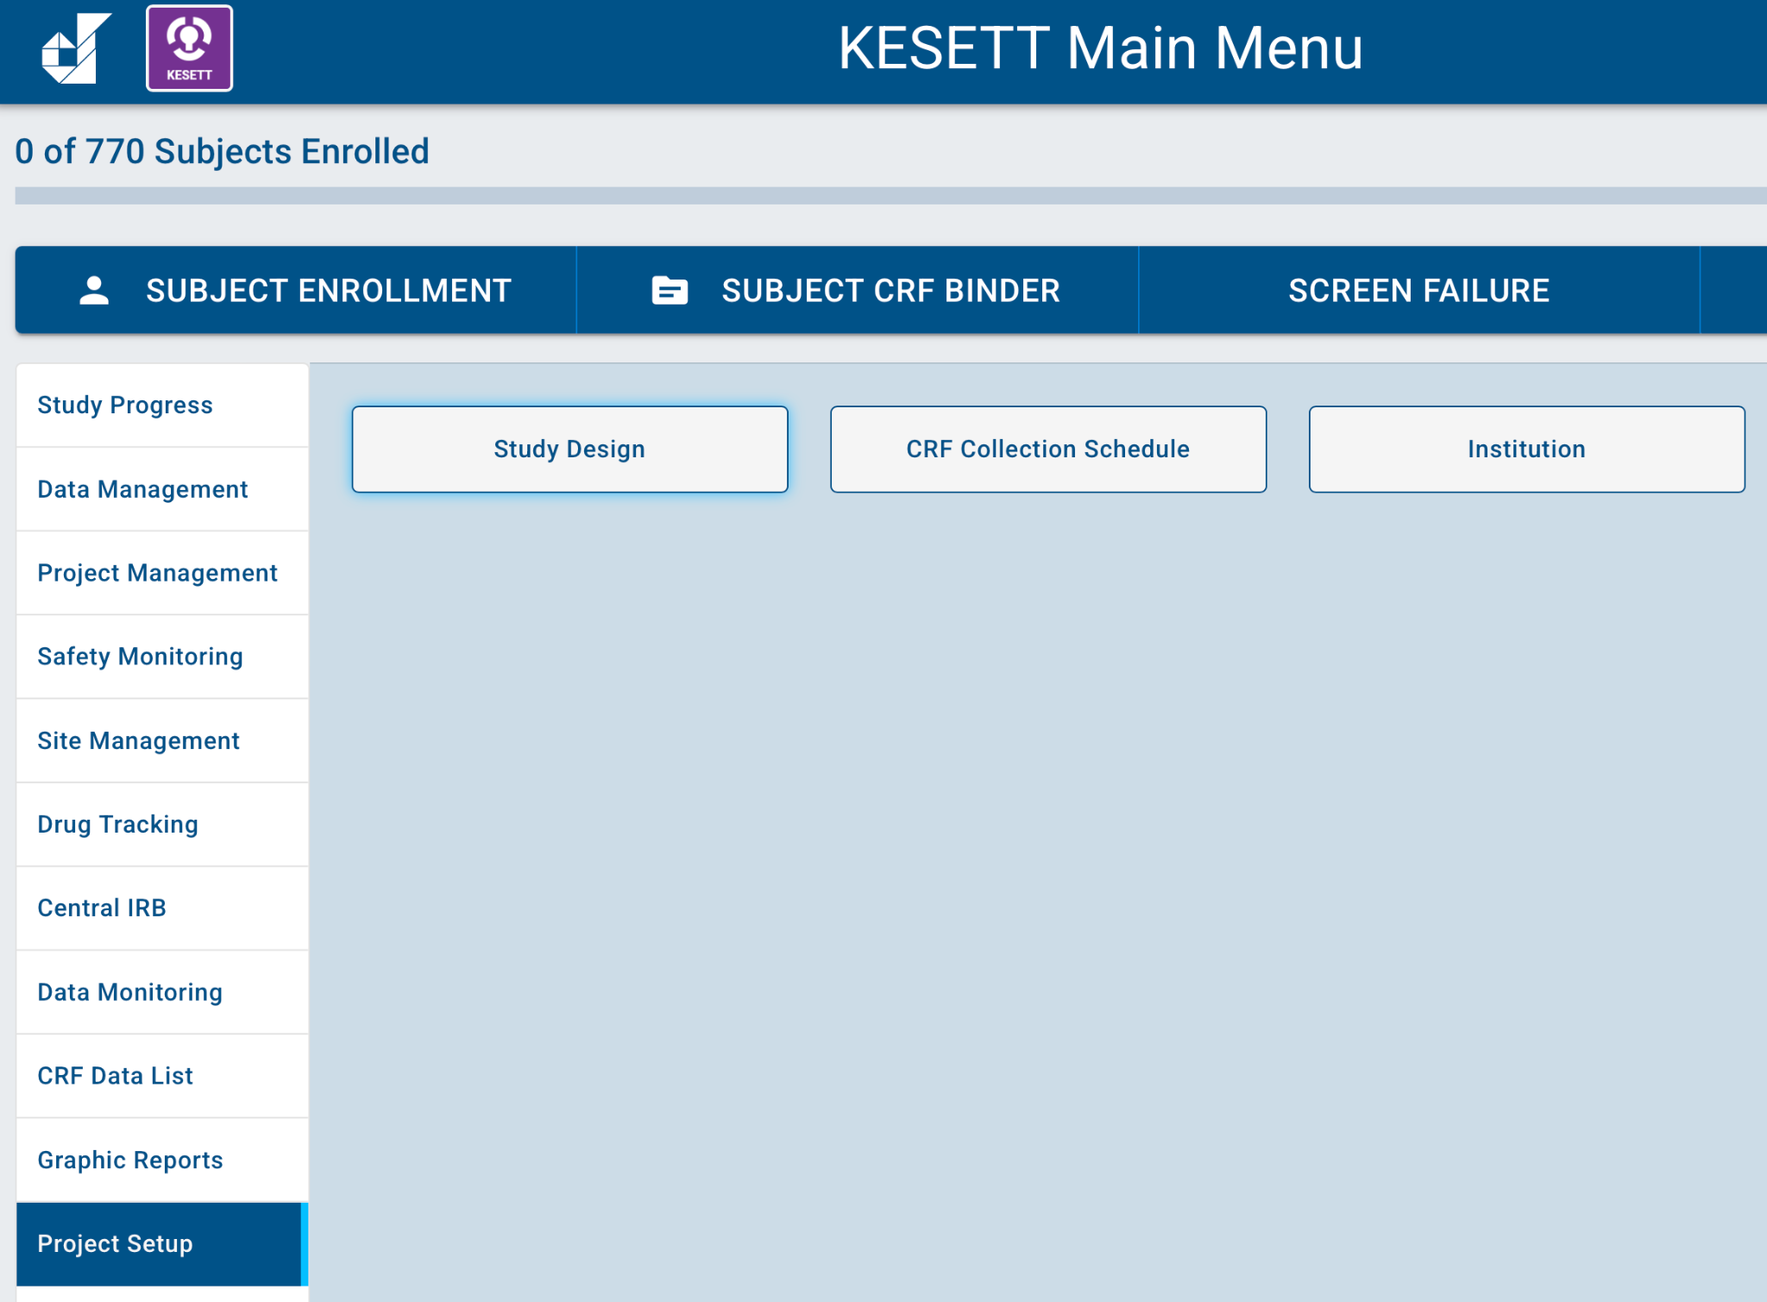
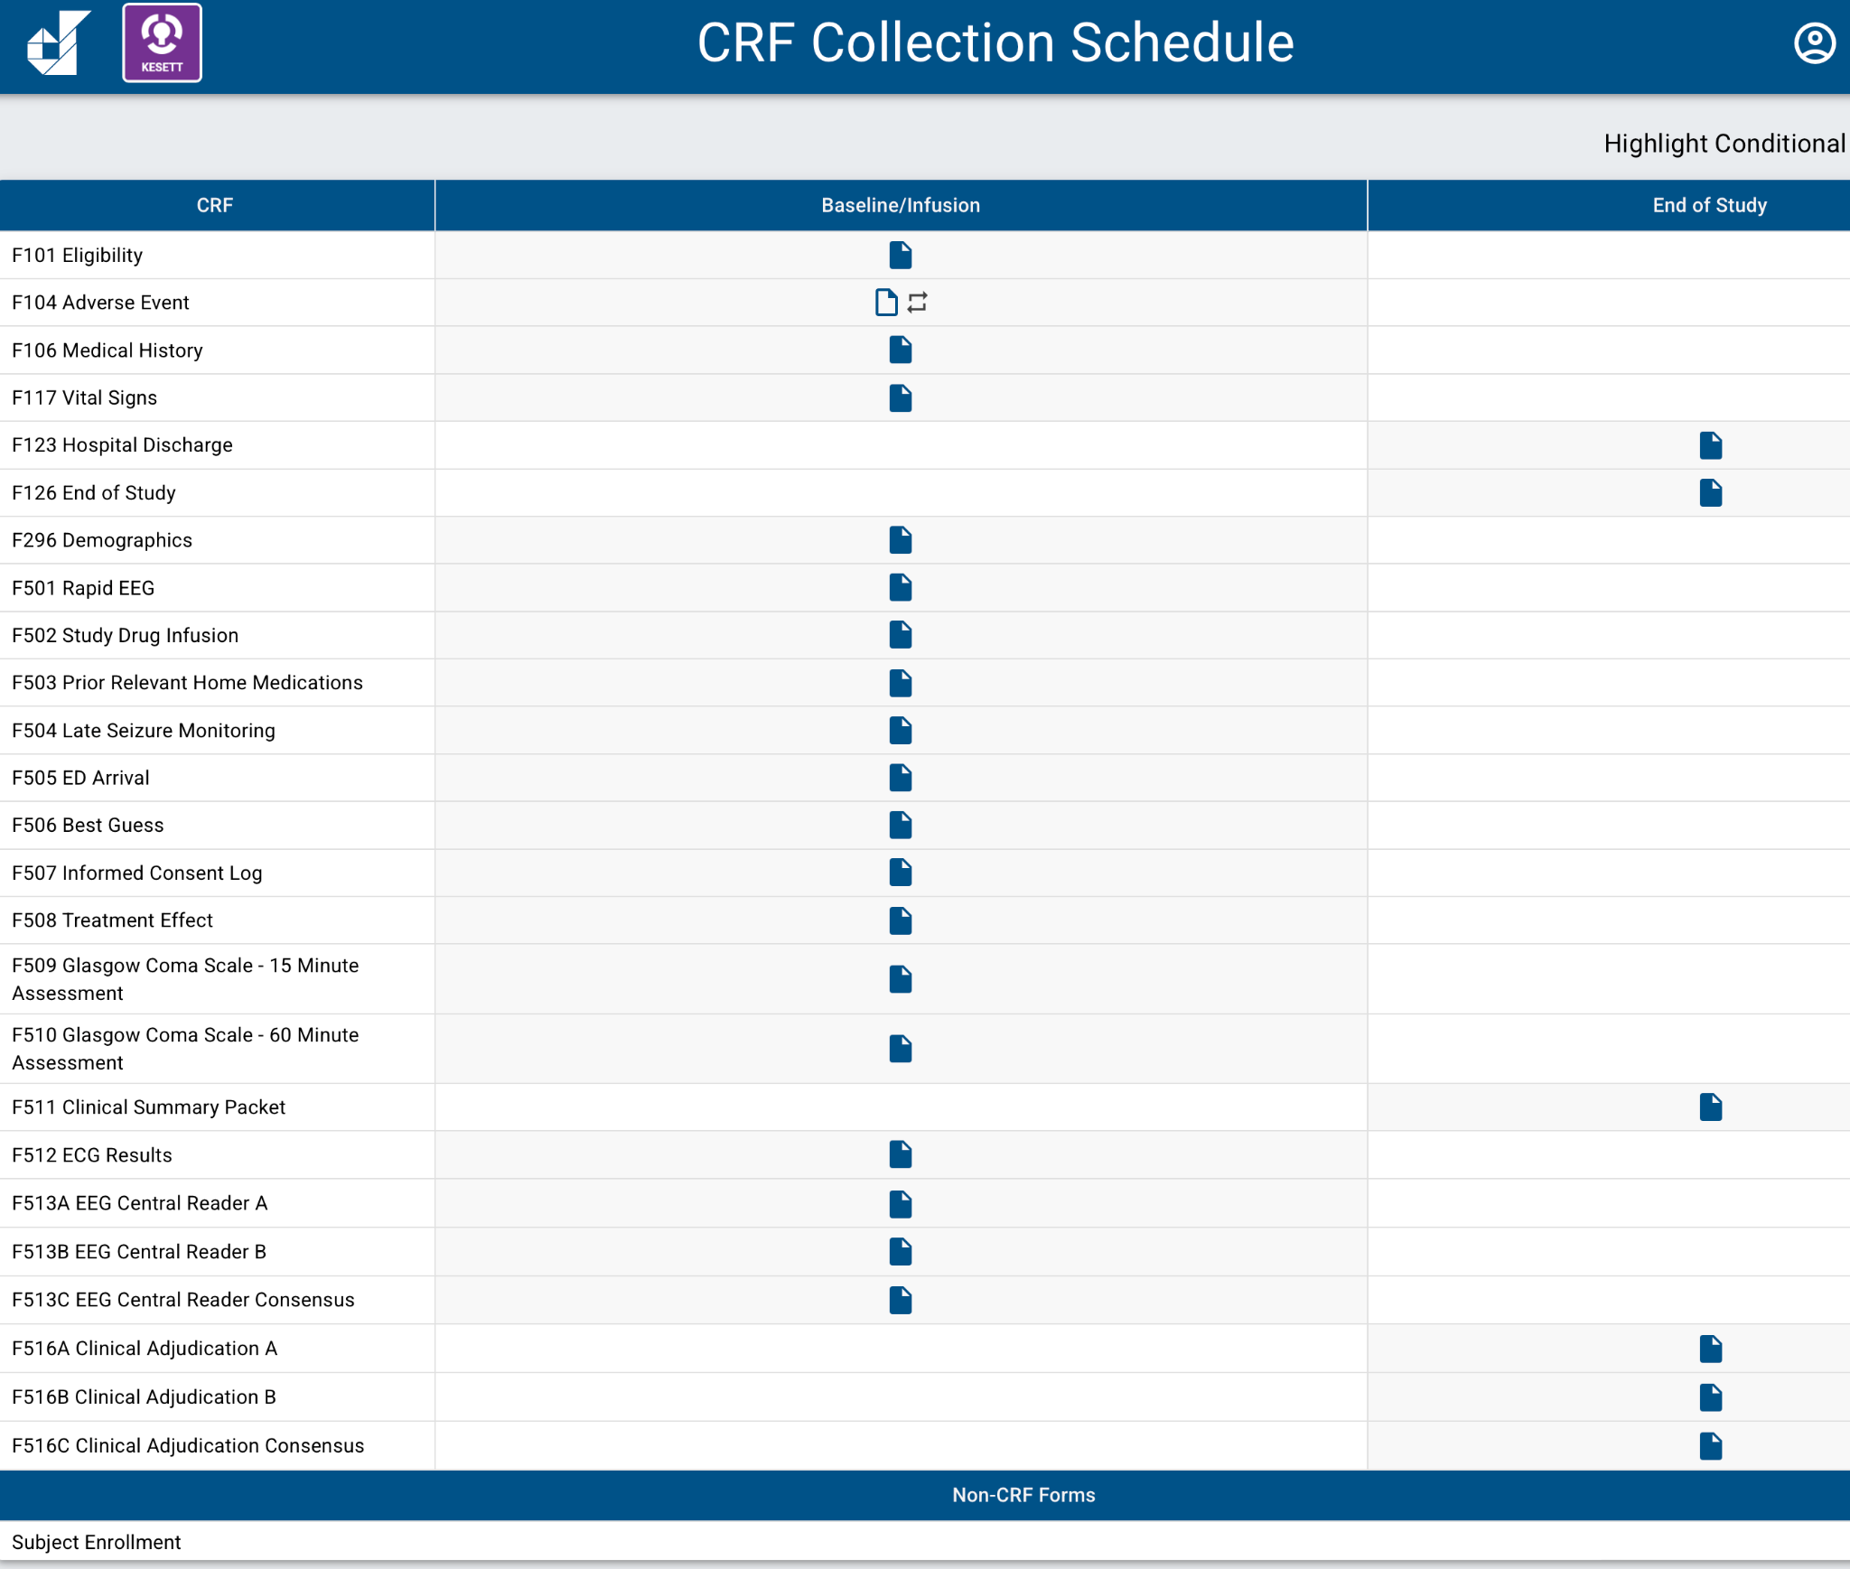
Source Docs & CRFs
Use CRFs as guide if you are creating your own source documents for clinical and study teams

Slide 92
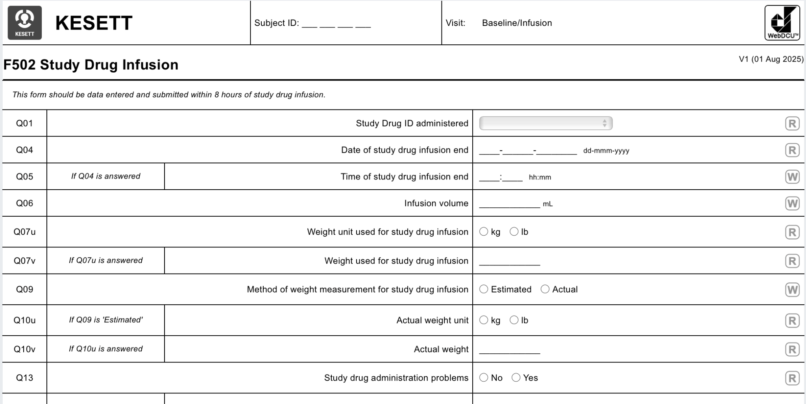
Source Docs & CRFs
Can export/print as pdf or use as guide to build your own form
Remember GCP guidelines & ALCOA-C if using a paper source document!
Notes:
Paper worksheets must be signed and dated by the person collecting the data and retained as source.

Slide 93
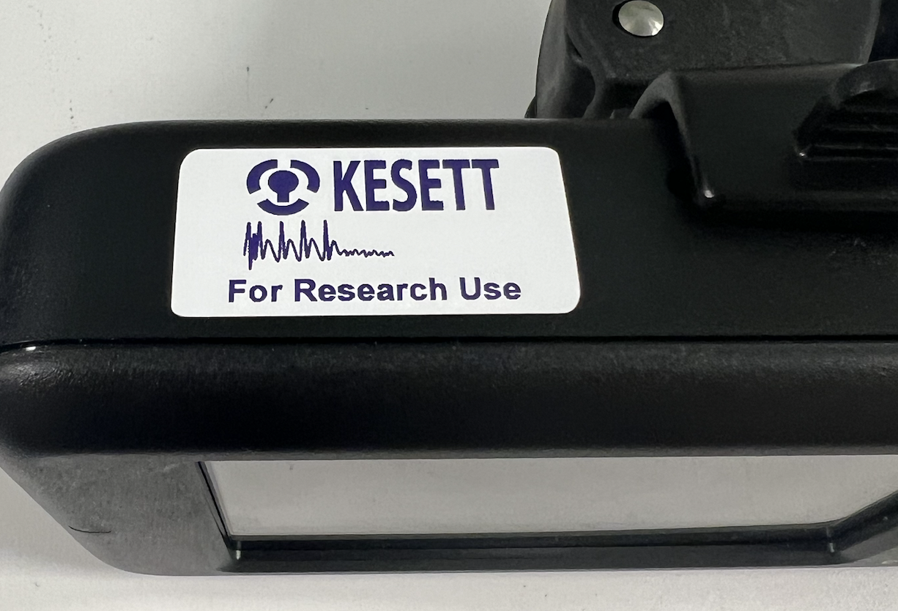
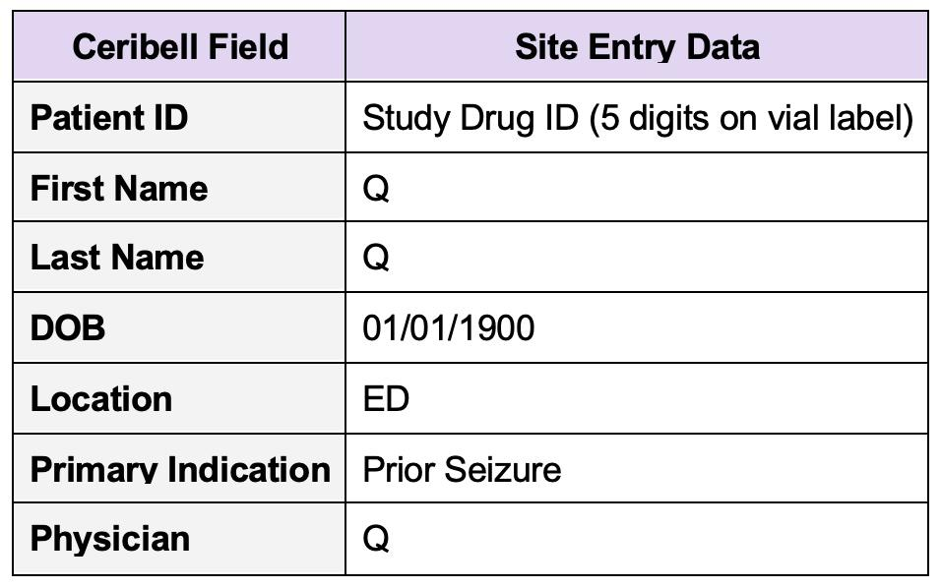
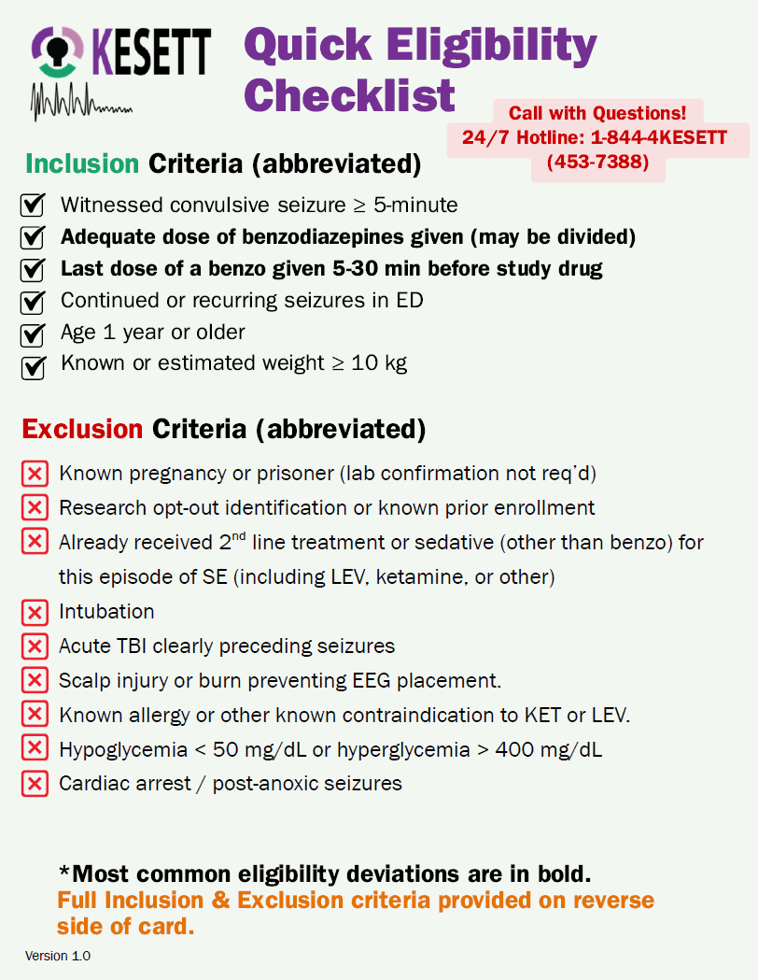
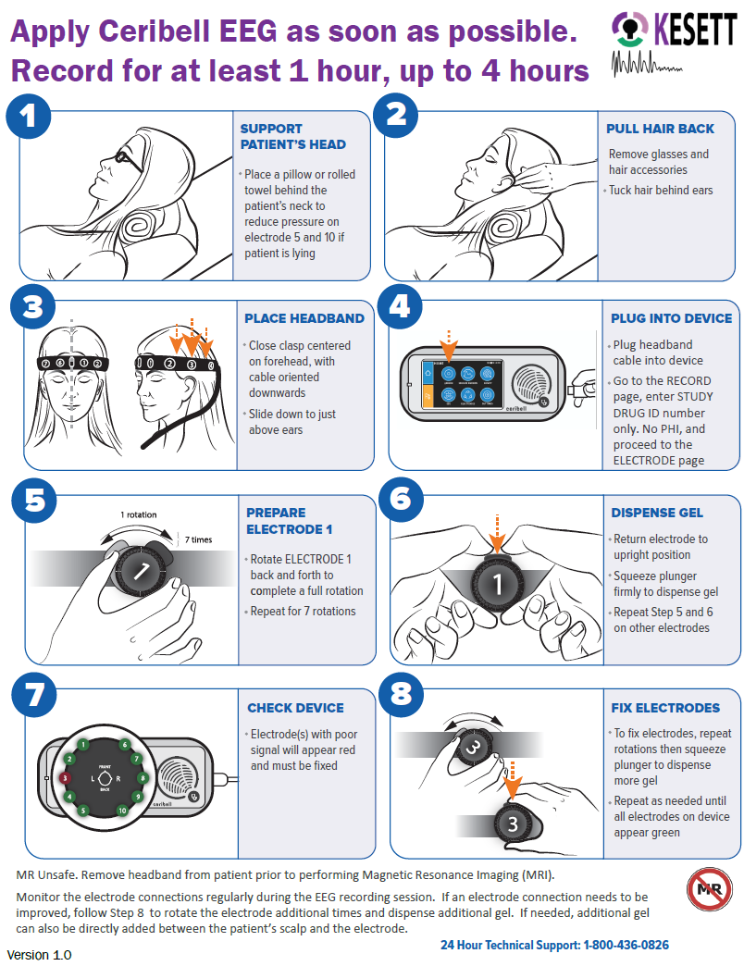
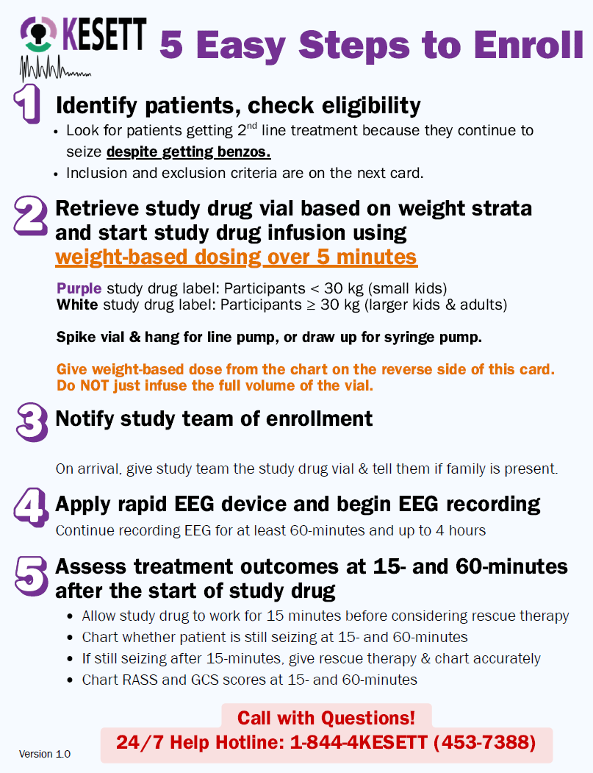
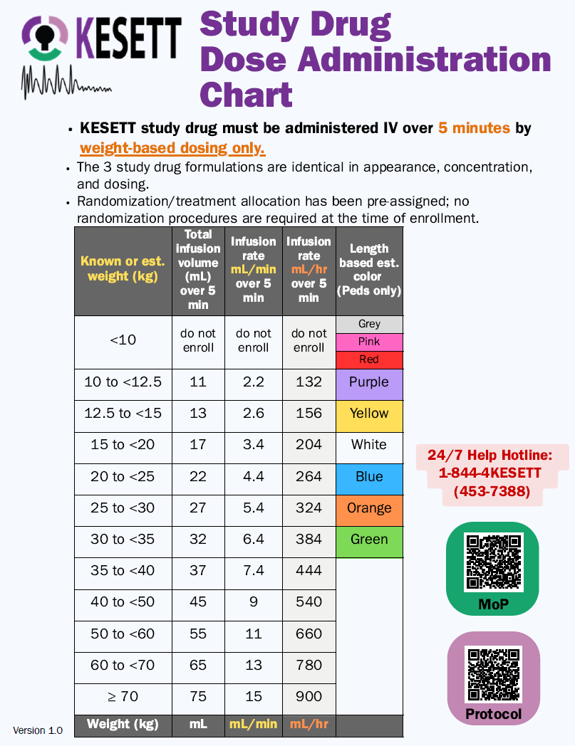
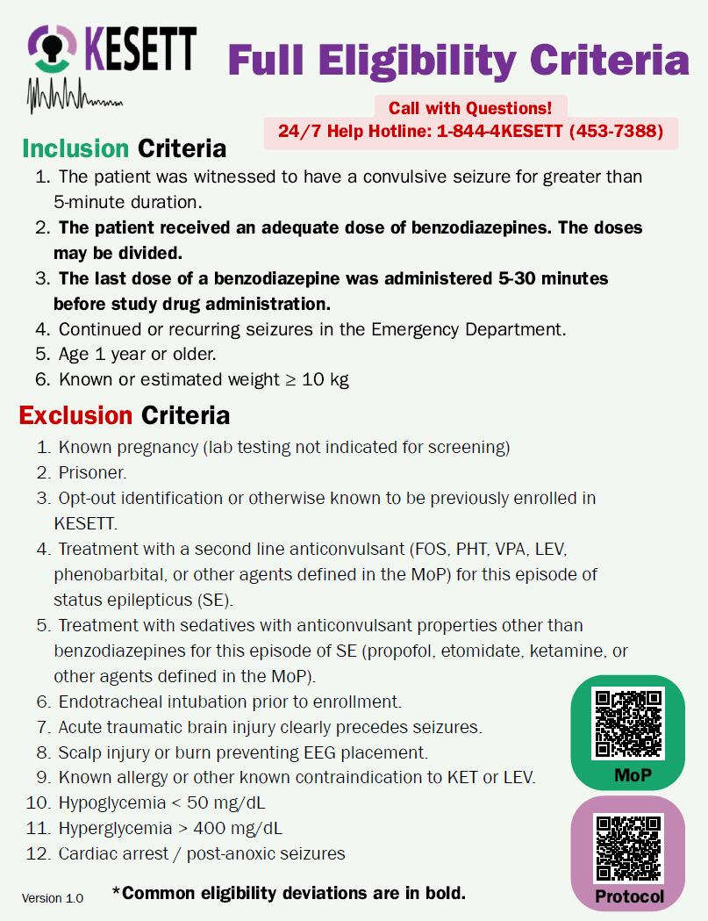
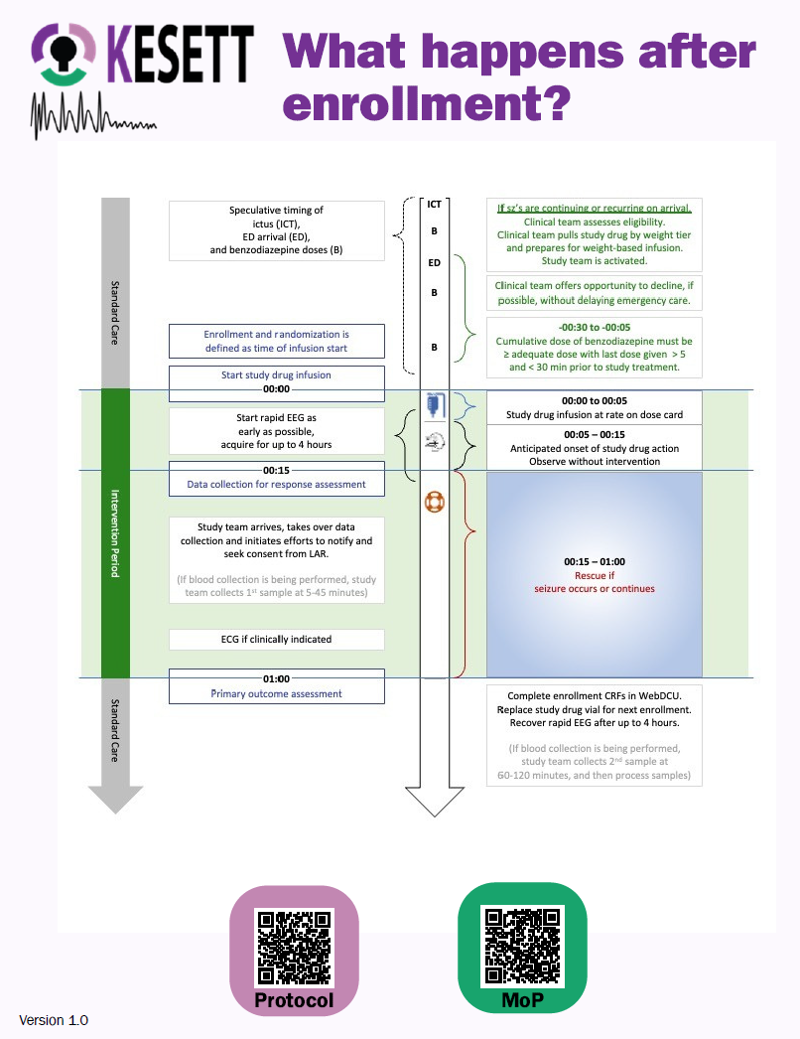

Study “Kit” Materials: Centrally provided
Ceribell (unless using own clinical device):
  Recorder device
  KESETT stickers for recorder
  Ceribell headbands
  KESETT stickers for headband boxes
Ceribell headband basket for IV pole
Protocol Reminder Cards
Length-based-weight estimation
measuring tape
  Can also be used to measure head circumference
Notes:
Centrally provided
Other than the study drug
IV poles not provided by study
Protocol reminder cards file will be available in case sites want to produce extra copies, create poster, etc.

Slide 94
Ceribell Training
“Intake” call is optional
  Discuss device and use in study with Ceribell liaison and PM
IT training/support is available
  Email, 24/7 support number, meetings
In-person, on-site training for study team is required if not already using device clinically
  Conducted by local commercial reps
  Site can determine who should attend the training
  Designate a group of ‘super-users’
  Scheduled as your site approaches CIRB submission

Slide 95
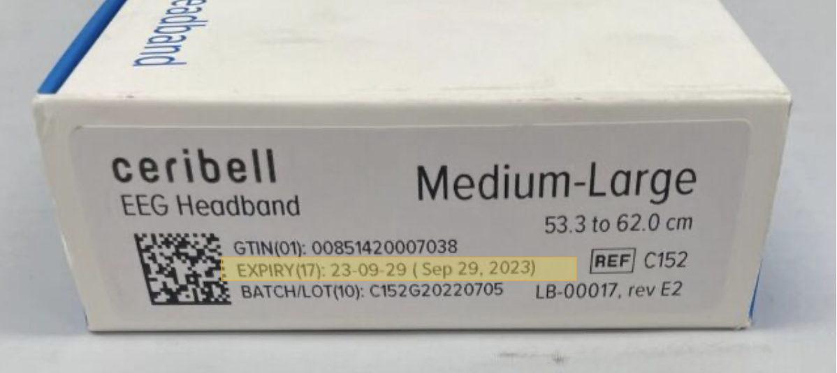
Ceribell Supply Logistics
> Device provided after site contract is executed to allow local approvals.
> Headbands sent to sites after CIRB approval
> Headbands come in 2 sizes:
Small (C151)
Medium/Large (C152)
> Each site will have a set par for number of headbands on site.
> Headbands expire after ~6 months;
will have expiration date on box.
Notes:
Headbands are consumable so will be resupplied throughout the trial.
Par depends on enrollment population (adult/peds/both) and logistics of your EDs (separate, together, etc.)
Expired headbands are not a safety issue but may impact quality of recording; can use expired headbands for trainings

Slide 96
Ceribell: Headband Inventory & Resupply
Sites will complete monthly inventory survey.
  Can be completed anytime; must be completed at least 1x/month
  Responses submitted by 1st of month will be used to place monthly resupply orders by central team on 3rd of month.
Central team uses survey responses to bring each site up to full par.
  Sites receive shipment tracking info once order is fulfilled.
  Will use shipping address in WebDCU
Urgent resupply can be triggered by the site or central team.
  Site can use survey to indicate urgent request.
  Central team will monitor use based on enrollment CRFs.
Notes:
Headbands are consumable so will be resupplied throughout the trial.
Par depends on enrollment population (adult/peds/both) and logistics of your EDs (separate, together, etc.)
Expired headbands are not a safety issue but may impact quality of recording; can use expired headbands for trainings

Slide 97
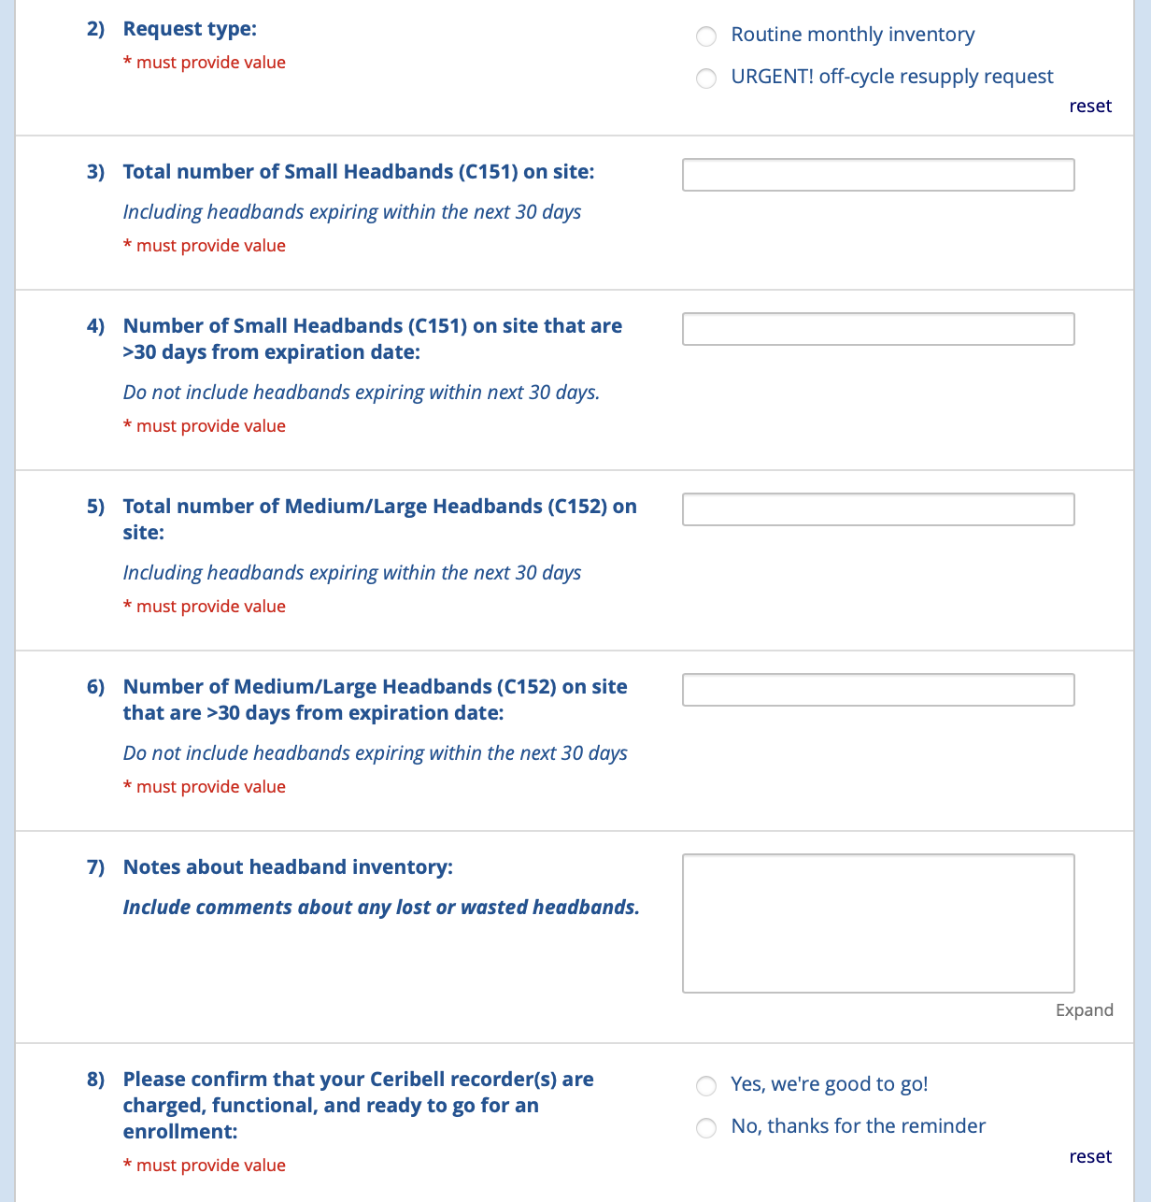
Ceribell Inventory Survey
REDCap survey
Link in MoP
Notes:
Headbands are consumable so will be resupplied throughout the trial.
Par depends on enrollment population (adult/peds/both) and logistics of your EDs (separate, together, etc.)
Expired headbands are not a safety issue but may impact quality of recording; can use expired headbands for trainings

Slide 98
Inclusion Criteria
1. The patient was witnessed to have a convulsive seizure for greater than 5-minute duration.
2. The patient received an adequate dose of benzodiazepines. The doses may be divided.
3. The last dose of a benzodiazepine was administered 5-30 minutes before study drug administration.
4. Continued or recurring seizures in the Emergency Department.
5. Age 1 year or older.
6. Known or estimated weight ≥ 10 kg

Slide 99
Exclusion Criteria
1. Known pregnancy (lab testing not indicated for screening)
2. Prisoner.
3. Opt-out identification or otherwise known to be previously enrolled in KESETT.
4. Treatment with a second line anticonvulsant (FOS, PHT, VPA, LEV, phenobarbital, or other agents defined in the MoP) for this episode of status epilepticus (SE).
5. Treatment with sedatives with anticonvulsant properties other than benzodiazepines for this episode of SE (propofol, etomidate, ketamine, or other agents defined in the MoP).
6. Endotracheal intubation prior to enrollment.
7. Acute traumatic brain injury clearly precedes seizures.
8. Scalp injury or burn preventing EEG placement.
9. Known allergy or other known contraindication to KET or LEV.
10. Hypoglycemia < 50 mg/dL
11. Hyperglycemia > 400 mg/dL
12. Cardiac arrest / post-anoxic seizures

Slide 100
Abbreviated Eligibility
Inclusion
1. Convulsive seizure > 5 minutes
2. Seizures continue/recur in ED
3. Seizure despite adequate dose of benzos
4. Seizure despite properly timed benzo
5. Age ≥ 1 year & est. wgt > 10kg
Exclusion
1. Hypoglycemia, TBI, cardiac arrest
2. Known contraindication to drugs or EEG
3. Already received 2nd line agent or anesthetic
4. Already intubated
5. EFIC prohibited - known pregnancy, prisoner or opt out identification

Slide 101
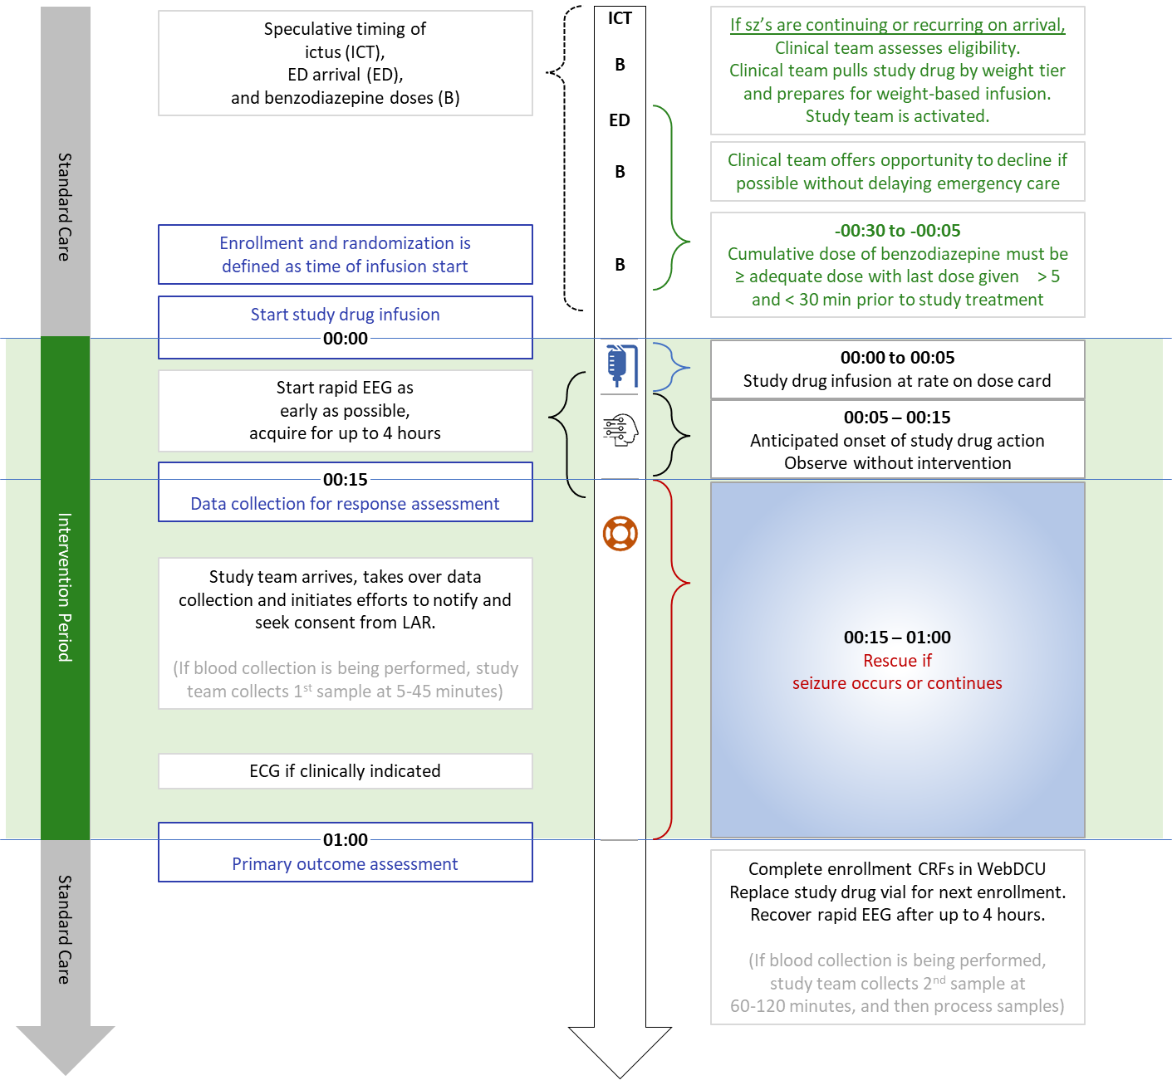

Slide 102
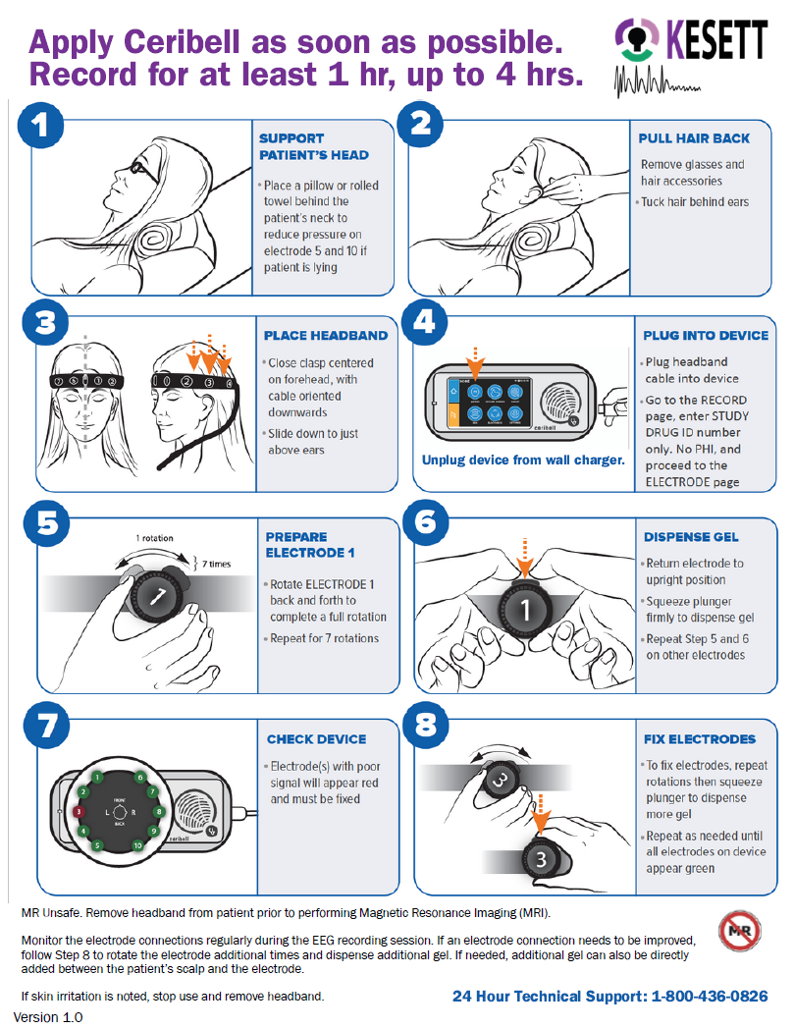
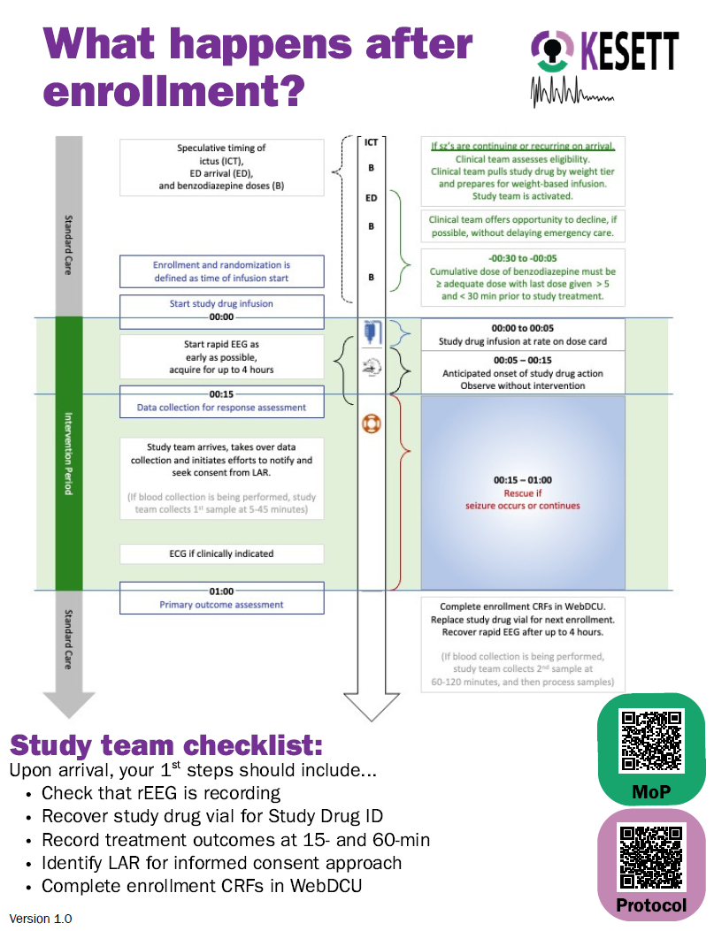

Slide 103
Study team coverage
24-hour study team phone number / pager
Alert to enrollment occurs immediately after drug is started
Study team arrival ~30 minutes
Overnight enrollments may occur
Site team can decide how to implement KESETT coverage.
Clinical team
  Conduct opt out if feasible
  Enroll
  Apply Ceribell
  Assess for treatment outcomes at 15-min (continuing seizures, RASS, GCS)

Slide 104
Data Collection & Documentation Tips
Vital Signs
  Prior to study drug start
Medical History & Demographics
  Patient or LAR vs EMR
Sign & date all source documentation
Have all sources available

Slide 105
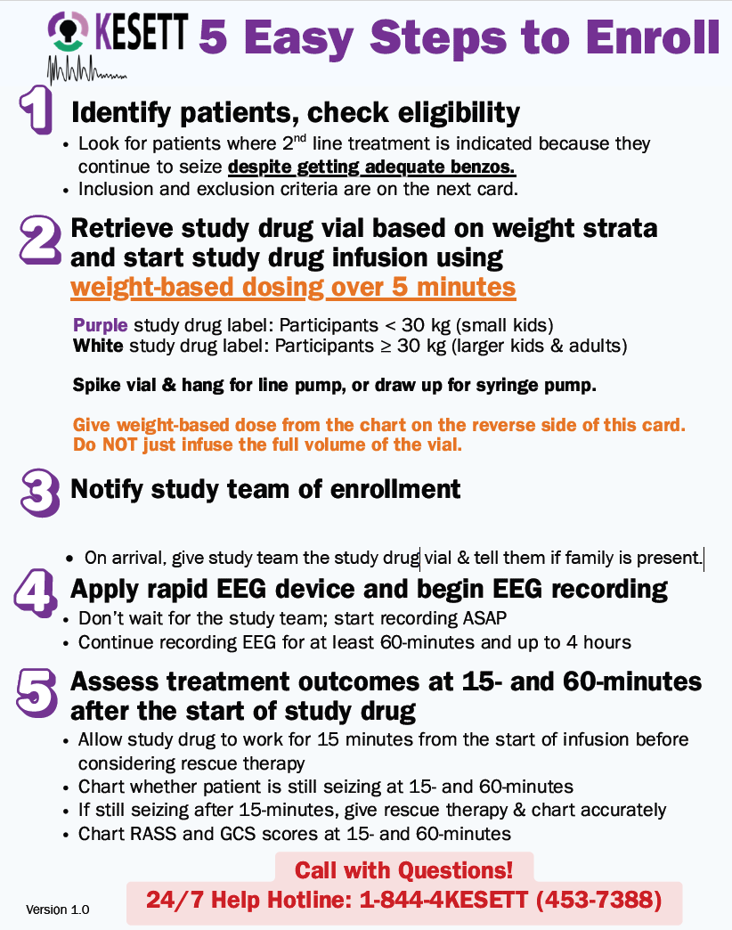

Protocol Premises
KESETT should never delay treatment of status epilepticus
KESETT is based upon guideline-
concordant treatment of status

Slide 106
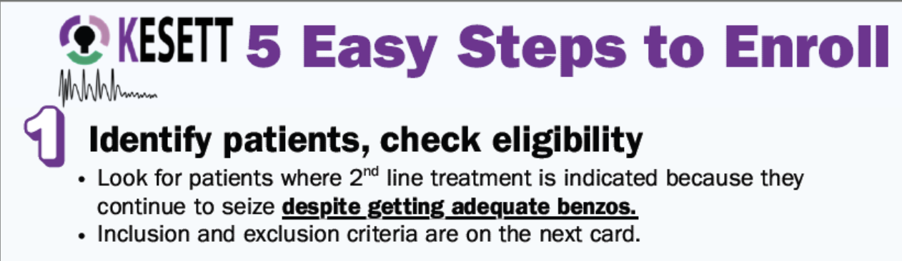
Clinical team needs to be aware of study and screening
Study team can assist via EHR alerts, EMS alerts, etc.
Leverage key teams such as ED pharmacy
Provider will assess eligibility and enroll; investigator will confirm eligibility later for CRF entry

Slide 107
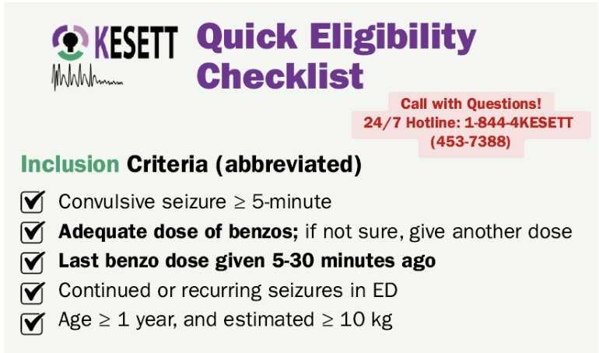
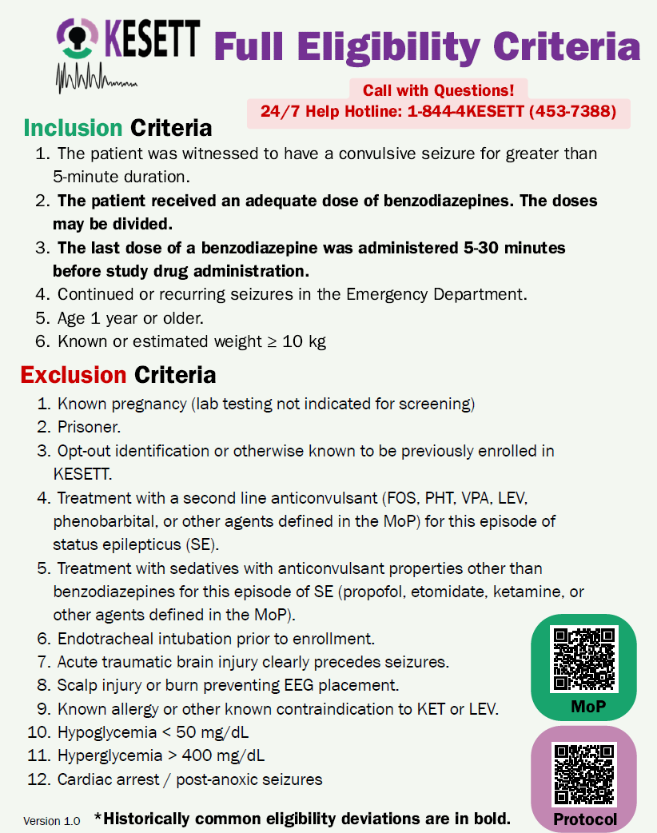
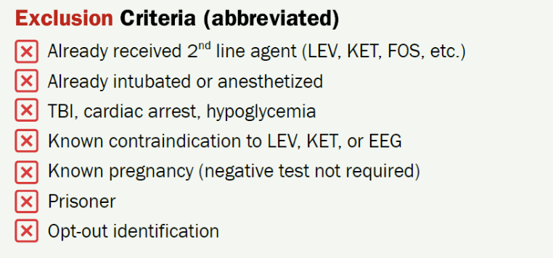

Slide 109




Slide 111

Vials
Vials contain LEV and KET, or LEV alone
Same concentration in all vials
Purple tier 35mL - Weight 30kg
Notes:
Study drug comes in a single vial that contains both levetiracetam and ketamine or placebo.
Purple labeled vials are for children <30 kg, white are for larger children and adults.
All vials contain the same concentrations of study drug. Only difference is the vial fill volume - purple has 35 cc, white has 90 cc. The purpose of the tiers is to minimize the risk of accidental overdose.
Best practice is to keep drug in the resuscitation bay omnicell or pyxis. Storage in a nearby ED pharmacy may be acceptable if it doesn’t cause delay. Storage in investigational pharmacy is unacceptable because of risk of delay.
Resuscitation areas treating kids and adults will receive one pre-randomized vial for each tier. Resuscitation areas treating only adults will receive one white tier pre-randomized vial.
Enrollments entered in WebDCU trigger the central pharmacy to ship a replacement pre-randomized vial on the next business day. Sites will have a backup vial that is moved to the resuscitation area after an enrollment, until the new randomized vial arrives. When the new randomized vial is received, it is placed in the resuscitation area and the backup vial is moved back to a pharmacy storage location outside of the resuscitation. High enrolling sites may have their par of randomized vials increased.

Slide 112

Drug ID on the vial
White tier 90mL - Weight 30kg
Use next vials and backup vials
Storage, replacement and shipping

Slide 113

Retrieved KESETT study drug spiked and inverted on hanger tab
Reminder Cards with instructions
Length-based weight-estimation tool
Your institutional pump
Study Ceribell with headbands in a basket below

Slide 114

Cavalry to the rescue!
Study team actions:
Write in your pager #!
1. Start or confirm EEG
2. Retrieve vial ID number
3. Record treatment outcomes at 15- and 60-min; ensure source docs are consistent
4. Identify LAR for informed consent approach; collect medical hx, home meds, race, ethnicity as needed
5. Complete enrollment CRFs in WebDCU within 8 hours
Study team needs to arrive as soon as possible
Notes:
Start EEG if not started already
Get vial number
Enter enrollment in WebDCU (with vial number)
Collect data (on worksheet or direct data entry) especially primary outcome
Ensure charting on source documents is accurate and consistent with worksheet
Seek LAR for notification and consent to continue
Collect data directly from participant or family (race, ethnicity, medical history, drug reconciliation)

Slide 115
Ideally within 5-15 minutes of study drug start
  Do not delay treatment
First hour is most important EEG data collection
Protocol cards include instructions

Slide 117

Ceribell Procedures
No PHI should be entered into research device
  Study Drug ID = 5 digits from vial label will identify the record
Stickers on headband boxes & recorder as reminder

Slide 118
Ceribell Procedures (cont.)
Record EEG for at least 1 hour and up to 4 hours
  OK to replace with clinical EEG if indicated, ideally after 1 hour mark
  Remove before MRI or CT; can be replaced afterwards
  Skin check at 2 hours per manufacturer
  Recover & reset device after recording complete
EEG waveform is viewable at the bedside; not readily available for site review in the portal

Slide 121
Have plan for how assessments will be performed and data documented
  In presence and absence of study team
  E.g., Worksheet, Smartphrase
Access the CRF study book in WebDCU to view what data points are required
  Project Management > CRF Collection Schedule > All CRFs in Header

Slide 123
eConsent
Vince

