Slide 1

All-Site Call
June 5, 2026

Slide 2
Agenda
 | Study updates
 | Enrollment Experiences: Arthur Blank
 | Enrollment reminders
 | AE monitoring and Reporting
 | Ceribell questions
 | Informed consent procedures
 | DCC updates
 | Discussion: Open questions & Pediatric enrollment questions/considerations

Slide 3
Study Updates
Megan

Slide 4

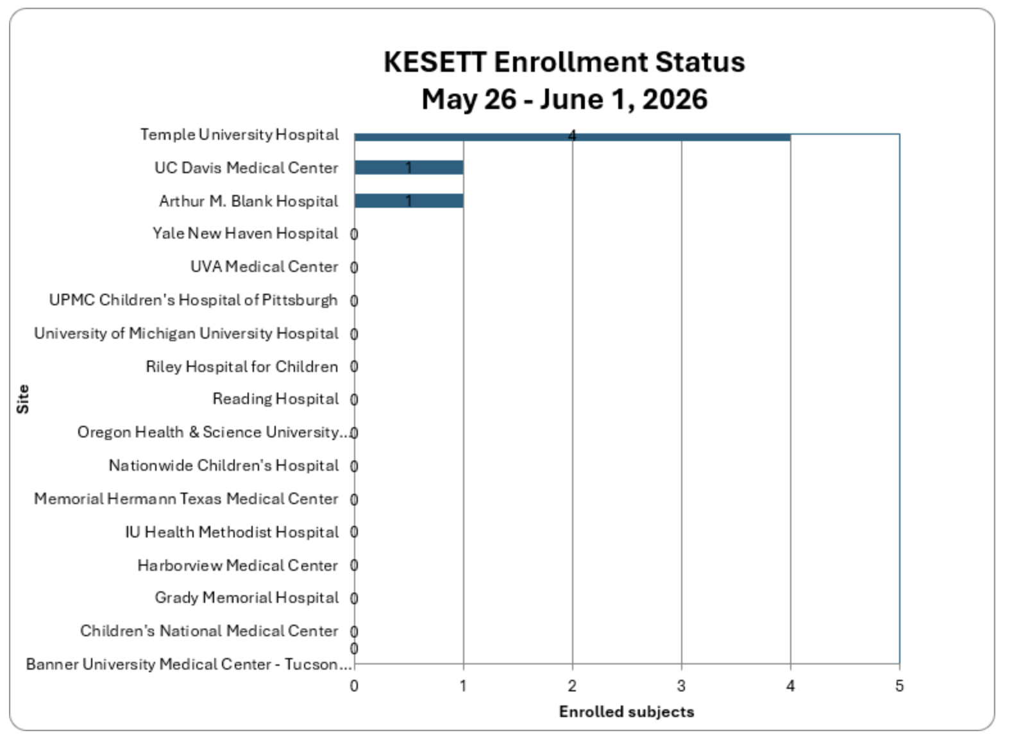
5
As of 06/05/2026-
Total enrollment: 7
Sites Released to Enroll: 17
Sites with Enrollments: 3
Target Enrollment: 770

Slide 5
Sites with initial EFIC activities completed: 49 / 66
Sites Submitted to CIRB: 39 / 66
Sites with CIRB Approval: 32 / 66
Sites Released to Enroll: 17 / 66

Slide 6

Submitted Pending Review (4) | EFIC Revisions in progress (3) | Approved Pending release (15) | Released to enroll (17)
Rady Children’s Hospital | Stanford University | UCSF Medical Center | Nationwide Children's Hospital | Yale New Haven Hospital
UCSD Health La Jolla | University of Minnesota Medical Center & Masonic | San Francisco General Hospital | Memorial Hermann | Temple University Hospital
UCSD Hillcrest Hospital | University of Illinois Hospital | OSU Wexner Medical Center | Grady Memorial Hospital | University of Michigan
University of Utah Hospital |  | UPMC Presbyterian Hospital | UPMC Children's Hospital | UC Davis Medical Center
 |  | University of Chicago & Comer | IU Health Methodist Hospital | UVA Medical Center
 |  | University of Iowa | Riley Hospital for Children | Oregon Health & Sciences University Hospital
 |  | Froedtert Hospital |  | Arthur M. Blank Hospital
 |  | University of Maryland |  | Harborview Medical Center
 |  | Johns Hopkins Hospital |  | Reading Hospital
 |  | Emory University Hospital |  | Banner – Tucson Campus
 |  | Jefferson Einstein Philadelphia |  | Children's National
 |  | Nemours Children’s Hospital
 |  | Children's Hospital of Wisconsin
 |  | Rush University Medical Center
 |  | University of Alabama Hospital

Slide 7
Enrollment Experiences
Arthur M. Blank Hospital
PI: Claudia Morris
SC: Sarah Beharry

Slide 8
Study Timeline
Award entered an NCE in January pending completion of Y1 milestones
February 2026: 1st site released to enroll
February 2026: 1st participant randomized
End of May 2026: 50% sites CIRB approved
End of June 2026: 50% sites released to enroll

Slide 9
Contracts & Payments
Award entered a NCE in January
Contract extensions in progress between Michigan & hubs: required before site payments can be processed
Milestone start-up payments ($10,000 ea. including F&A):
  #1: Local IRB ceding approval; eDOA accepted; Local Context Form; UAB intake meeting; plans for 2 in-person CC events
  #2: Readiness call completed & open to enrollment

Slide 10
Ancillary Studies
KPOP: KESETT-Pharmacokinetics Outcomes, and Pharmacodynamics Study (MPI: Coles & Rosenthal)
  Scored outside the NINDS pay line but within the historical range for select-pay considerations
  Planning for resubmission July 2026
COGNISE: COGnition and Neurodegenerative biomarkers In Status Epilepticus (PI: Zawar)
  Long term follow up to study cognitive & functional outcomes after ESE
  Submitted Feb 2026; earliest start Dec 2026

Slide 11
Enrollment reminders
Robert Silbergleit

Slide 12

Eligibility: Psychogenic Non-Epileptic Seizures (PNES)
aka pseudoseizures
aka functional dissociative seizures

Slide 13
Psychogenic Nonepileptic Seizures (PNES)
Visual diagnosis by experienced epileptologists
Missed PNES 20% of the time
Called Epileptic seizures PNES 13% of the time
Erba G et al, PMID: 26949106.

Slide 14

PNES in RAMPART and ESETT
63 / 893 (7%) unique patients in RAMPART
37 / 384 (9%) unique patients in ESETT
20% of patients with PNES were re-enrollers
29% of enrollments in those with PNES were re-enrollments
J Neurol Neurosurg Psychiatry. 2021 Dec;92(12):1341-1345. PMID: 34362852;
Notes:
What might we expect to see based on our past trial experience? Patients with PNES made up 7-9% of the unique patients enrolled in RAMPART and ESETT. I say unique patients because the ITT analysis only included the first enrollment in patients inadvertently enrolled more than once. But recurrent presentations were more common in patients with PNES than in the overall study cohort. So the percent of enrollments was a tiny bit higher, around 10%. About 20% of patients that had a diagnosis of PNES on at least one enrollment had multiple enrollments. To put it another way about 29% of enrollments in patients with PNES were re-enrollments as compared to 13% in the overall cohort. Interestingly, it was common for some subjects with PNES and multiple enrollments to be diagnosed with real SE on one enrollment and with PNES on another, reflecting either co-existence of these diagnoses in some subjects or misclassification or misdiagnosis on one or the other presentation.
In general, benzos work well in PNES. 85% had resolution on ED arrival as compared to 68% in the overall cohort in RAMPART. They get endotracheally intubated less often, but this still happens in about 4%. They are less likely to be admitted but still often are admitted and when they are admitted their LOS is 3.3 days overall and those admitted to the ICU have an average ICU LOS of over 2 days. Which I think speaks to the challenge of diagnosis in some patients.

Slide 15

How to manage this problem?
Avoid enrolling PNES patients when possible.
Review and document when it still happens.
End of study and eligibility.
ITT sample size anticipates re-enrollments and PP excludes eligibility deviations.
Offer bracelets and flag charts when possible.

Slide 16
Eligibility: Exclusion #7
Acute traumatic brain injury clearly precedes seizures.
Per clinical history from the clinical team, EMS report, or medical record. Includes obvious head trauma causing seizure.
Intent is to exclude those where treatment and outcome are driven by their moderate to severe TBI rather than SE
Does NOT exclude those with post-traumatic epilepsy
Does NOT exclude those who hit their head while convulsing

Slide 17
Eligibility: Exclusions #10 & 11
Hypoglycemia less than 50 mg/dL.
Hyperglycemia greater than 400 mg/dL.
By finger-stick glucose test result recorded in the ED or reported by EMS.
Bedside glucose not required for the study but expected in almost all cases.

Slide 18
Adverse Events
Vince

Slide 19
Assessing for Adverse Events
First 24 hours - All serious and non-serious AEs
Until end of study - All Serious AEs
Serious Adverse events
  Fatal
  Life-threatening
  Cause or prolong hospitalization
  Result in disability or require intervention to prevent permanent impairment

Slide 20
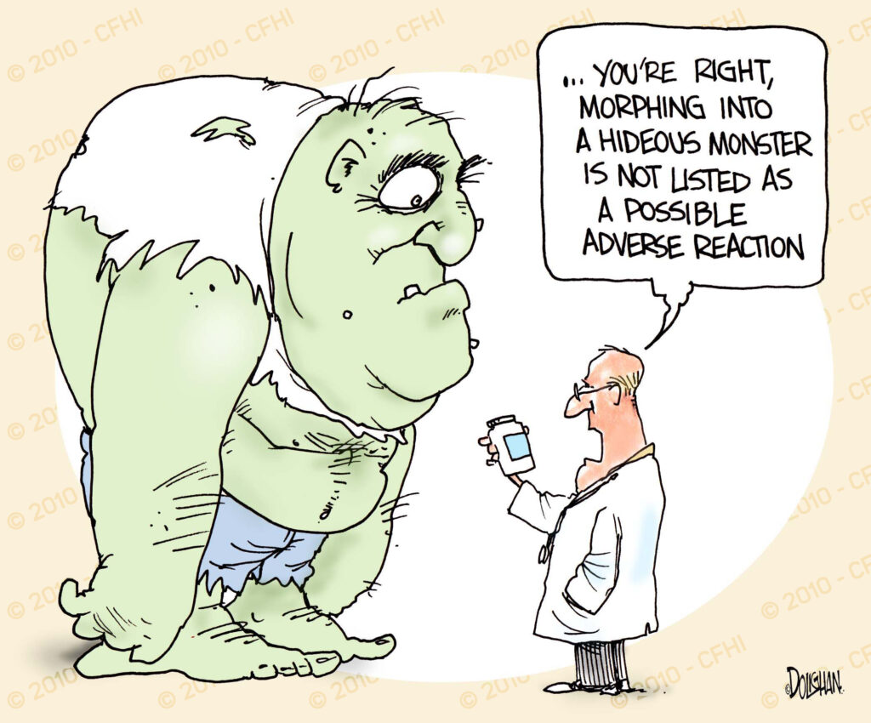
Severity & Relatedness
Grade 1-5
  Use the CTCAE dictionary for event-specific severity
  Use the CTCAE general scheme for events not included in the dictionary
Relatedness
  Use the algorithm
    Located in data collection guidelines

Slide 21

What not to report
Events existing prior to randomization unless substantially worsened
Abnormal labs that are not clinically significant
Abnormal labs that are part of another AE
Repeating events as separate AEs
  Repeated events can be reported once
Seizures in the first hour unless significantly worsened (i.e. leading to death, intubation, etc.)

Slide 22
Monitoring for Adverse Events
Utilize your EHR
  Emergency Department Summary
  Daily progress notes
  Discharge summary
Discuss with the care team
  Talk to your ED providers once patient is stable
  Go up to the care floor and talk to with nursing

Slide 23
Reporting Adverse Events
Non-serious submitted within 5 days of study team discovery
SAEs submitted within 24 hours of study team discovery
Complete form 104 in WebDCU
  Investigator that reviewed the AE must be named
Watch for queries and respond promptly!

Slide 24
AE Narratives
Focused and concise (not comprehensive) - think 1000 characters
Support other elements (seriousness, relatedness, event type)
Do not include identifiers
Only the pertinent PMH and HPI
Describe the event, the response, and the outcome
Create a followable timeline
Name drug and dose given when relevant

Slide 25
Ceribell Q&A:
Michelle Hofmann & Courtney Fietsam

Slide 26
Obtaining Informed Consent
Vince

Slide 27
Consent Outcomes
Consent Obtained
  Subject
  LAR (Not other family members)
Consent Declined
  Respecting the choices of participants or their LAR’s
  Making sure choices are informed and authentic
  Preserving the integrity of data collection when possible
No determination of consent or notification
Notification only
Notification only - subject deceased

Slide 28
When to approach
Per EFIC guidelines, at the earliest feasible opportunity
  Stable in the ED
  After transfer to a floor or ICU
An In-person conversation is expected when LAR is available at the hospital or patient is awake
Collect PMH and Demographics
Document in WebDCU form
  First entry is expected within 24 hours of enrollment
  ‘Notification only’ is okay to start

Slide 29

Consent Declined
Study intervention is over, but individuals still may wish to decline further use of data
  Do NOT pressure participants to remain in the study
  Involve the site PI
  Clarify what they want to stop
  Help them find what they want
  If not, take “no” for an answer

Slide 30
Consent Declined Goals
Take time to help participants and LAR make informed choices
All hands on deck to help
There is often a win-win solution
Always respectfully honor whatever they decide

Slide 31

Consent Declined
What data can we use?
Data from before withdrawal is maintained
No new data can be collection from after time of withdrawal
Vital status from public sources

Slide 32
Death before consent outcome
Consent should not be pursued further
Once LAR or family member is located, they should be informed of the participant’s participation
  Study team should document the notification conversation
  If this conversation cannot occur in the hospital, send the CIRB-approved LAR notification letter
    A copy of the family notification letter (with return receipt) should be kept with the study documents.

Slide 33
No determination of consent or notification
In the rare case where
  No LAR consent is obtained
  The LAR is never available
  Participant remains incapable of consent at six months
Documentation of the attempt process and condition of the participant will be recorded on the Informed Consent Log CRF
  Final outcome will be discussed and approved by trial leadership.

Slide 34
Data Coordinating Center (DCC)
Riley

Slide 35
KESETT Enrollment
NO Randomization form to complete →
  Instead, grab the ‘Use Next’ vial (or ‘Backup’ if ‘Use Next’ not available) and begin study drug infusion.
Within 8 hours of start of infusion →
  Add a new record to the Subject Enrollment table, complete, and save the record.
  Open the Subject CRF Binder and…
    Complete and submit F501 Rapid EEG.
    Complete and submit F502 Study Drug Infusion.
Notes:
KESETT is a step forward randomization design, so there is not a randomization form to complete in WebDCU. Rather, sites will grab the ‘Use Next’ vial (or ‘Backup’ if the ‘Use Next’ vial is no longer available) and begin study drug infusion.
Within 8 hours of initiation of study drug infusion, you will add a new record to the Subject Enrollment table, then complete and save the record. From here, you will open the Subject CRF Binder, complete, and submit F501 (Rapid EEG) and F502 (Study Drug Infusion), also within this 8-hour window.
Documentation of the Study Drug ID into F502 will tell the DCC which treatment assignment the participant received.

Slide 36
Data Timelines
CRF data must be submitted within 5 days of collection. This also applies to:
  Screen Failure forms
  Queries/DCRs (should respond to within 5 days of generation)
Exceptions:
  Subject Enrollment, F501 Rapid EEG, F502 Study Drug Infusion: must be submitted within 8 hours of study drug administration
  Form 104 Adverse Event: SAEs and queries/DCRs must be submitted within 24 hours of knowledge of event
Notes:
CRF data must be submitted within 5 days of collection. This includes Screen Failures and DCRs.
Exceptions include the the aforementioned Subject Enrollment form, F501 (Rapid EEG), and F502 (Study Drug Infusion), which need to be submitted within 8 hours of administration of the study drug.
Another exception includes SAEs and DCRs documented on F104 (Adverse Event), which need to be submitted within 24 hours of knowledge of the event.

Slide 37
F126 End of Study
To get to this form in the Subject CRF binder:
  click ‘Add New Visit’ > select ‘End of Study’ from the drop-down box > enter the date of the End of Study visit > and click ‘Add Visit’ to populate the EOS form
When is the End of Study?
  This visit date should represent:
    If the subject completes the full trial, the EOS date is Day 30 or hospital discharge, whichever comes first
    If the participant dies prior to Day 30 or hospital discharge, the EOS date is date of death
    If the participant declines/withdraws consent for full participation, the EOS date is at the date that consent is declined/withdrawn

Slide 38
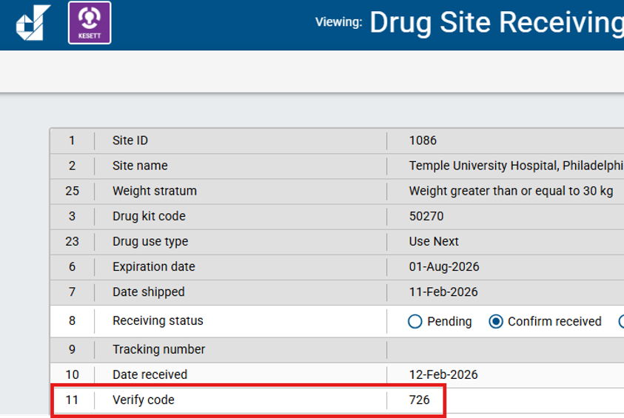
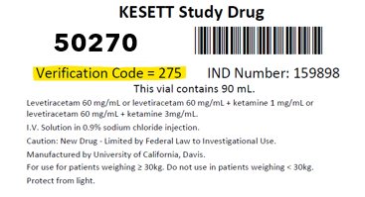
Study Drug - Site Pharmacy
Verification Code = 724
Drug Site Receiving - completed by pharmacy team
  Pharmacy team members must be on the eDOA to receive WebDCU access
  Verify code: 3-digit code found on the vial

Slide 39
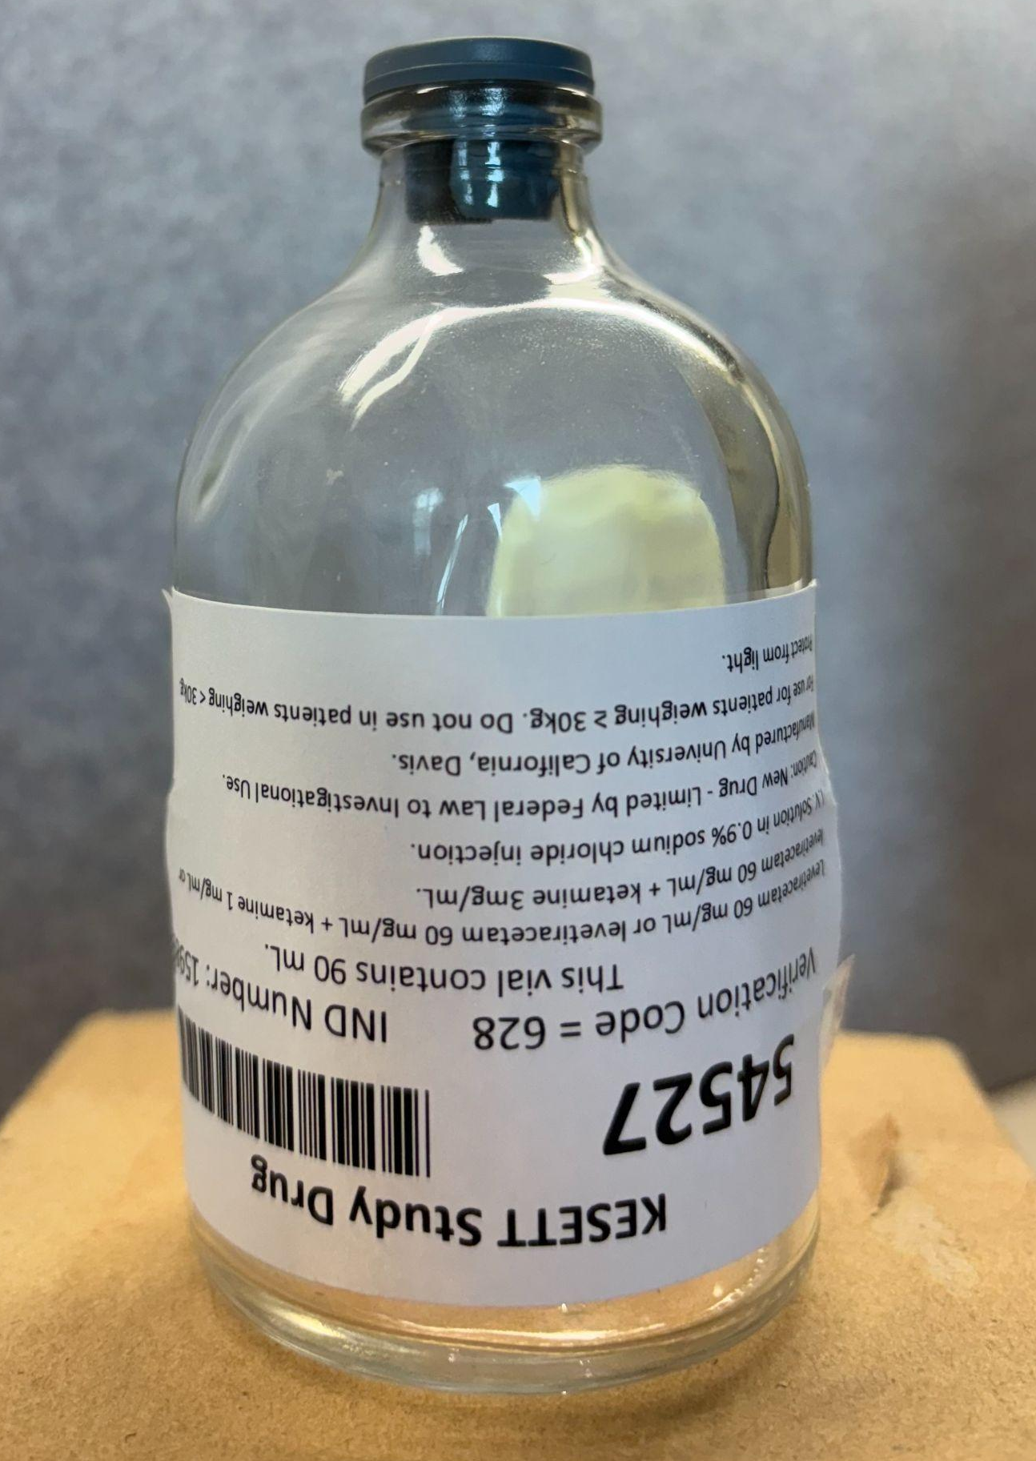
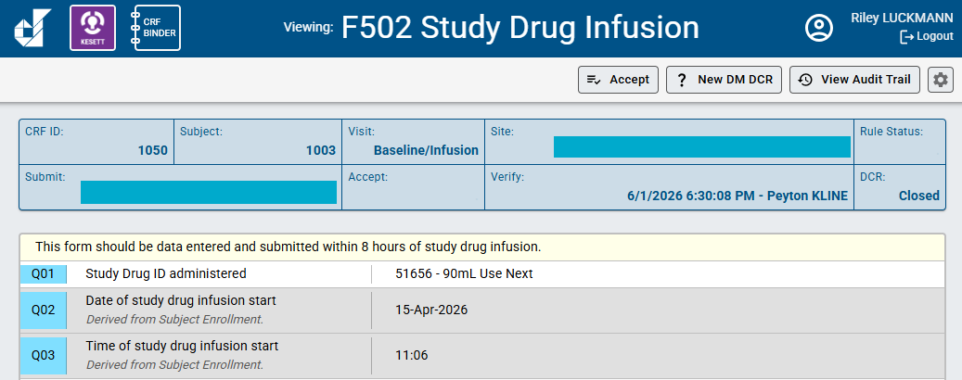
Study Drug - Study Team
F502 Study Drug Infusion - completed by clinical team
  Study Drug ID administered: 5-digit code found on the vial
54527 - 90mL Use Next

Slide 40
Screen Failure Update
The instructions have been revised to align with the MOP’s current language:
  Screen failures should be comprehensive of all patients age 1 year and older who meet the following criteria:
      Patients seen in the ED of the enrolling site and;
      administered LEV, valproate (valproic acid), or fosphenytoin intravenously and;
      for the treatment of seizures or Status Epilepticus.
The A08 ‘Age’ No Save missing data check has been removed - sites can save and submit the form when A08 is left blank if age of the patient is unknown.
Q13 ‘The last dose of a benzodiazepine was administered 5-30 minutes before study drug administration’ has been removed from the inclusion criteria as the literal interpretation of this question would always be responded to as ‘No’ since screen failures in KESETT will not be administered study drug.
Notes:
Look for new printable form for Screen Failure

Slide 41
DCC Resources
SIREN Website
  SIREN WebDCUv2 User Manual
  Data Collection Guidelines
Contact us
  Riley Luckmann (luckmann@musc.edu)
  Morgan Davie (daviem@musc.edu)
  Sara Meyer (butlers@musc.edu)

Slide 42
Questions & discussion
Thank you!
kesett.org
Next All-site call: Friday, July 10

Slide 43

New FAQs
Do VNS or VP shunts exclude patients from KESETT?
How should we clean the Ceribell device?
Check out the FAQs on the website > FAQs tab

Slide 44
Enrollment Video

Slide 45
Training:
Study Team & Clinical Team
Megan

Slide 46
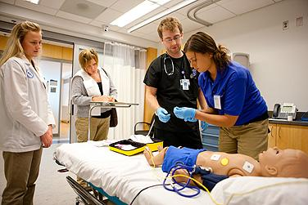
Educate, monitor, re-educate
Change of shift
Simulated mock enrollments
Academic “detailing”
Notes:
Clinical staff training. Dependence on Guideline concordant usual care, adequate dosing of benzodiazepines, need to wait for effect, stepwise progression to second and third line (not returning to first line after determining to benzo refractory), giving a chance to wake up.
Study should never delay treatment of status. Not for an opt-out discussion. Not for EEG prior to treatment. Pharmacy must be as fast as usual care.

Slide 47
Resources Available
Kesett.org > Education & Training tab
  Enrollment video
  Clinical team slide deck
  Safety of ketamine video
  IM videos
  Ceribell training videos

Slide 48
Suggested methods
Faculty meetings
Charge nurse meetings
In-service meetings
Mock enrollments/seizure codes
Email
Info sheets

Slide 49
Discussion:
Experiences with mock enrollments?
What has worked well for clinical team trainings and/or Ceribell trainings at your site?
What other resources would help?

Slide 50
Screening
Patients who meet one of the below criteria:
Administered one of the following for the treatment of seizures or status epilepticus
    LEV,
    valproate (valproic acid), or
    fosphenytoin intravenously
OR
Patients in the ED who have had a witnessed seizure and are determined to be experiencing a continuing seizure event who were screened in real time by the study team.

Slide 51
Screen Failure
Patients that meet the below criteria and were not enrolled regardless of when they were screened and if the study team was present
Administered one of the following for the treatment of seizures or status epilepticus
    LEV,
    valproate (valproic acid), or
    fosphenytoin intravenously
Patients to whom the study team is alerted to in real time but are not enrolled should be entered as screen failures within 5 days of screening.
An administrative review should also be performed at least monthly to identify patients who met the criteria above but were not alerted to the study team or enrolled.

Slide 52
Enrollment in WebDCU
DCC Riley Luckmann

Slide 53

KESETT – step forward randomization
KESETT is a step forward randomization design, which means we do not have a Randomization Form in WebDCU that assigns a treatment when submitted.
Instead, sites will grab the ‘Use Next’ vial (or ‘Backup’ vial if no ‘Use Next’ is available) and use it to treat the KESETT participant.
Data entry into WebDCU will occur after enrollment.
  This includes documentation of Study Drug ID, which will tell the DCC which treatment assignment the participant received.
The KESETT database in WebDCU is a real, live database. No testing or fake data should ever be entered by sites.

Slide 54
Within 8 hours of KESETT study drug administration…

Slide 55
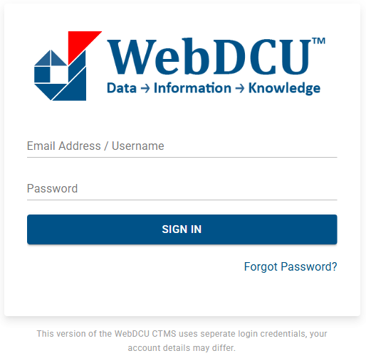
1. Log into WebDCUv2
https://webdcu.musc.edu/DCUApp/Login

Slide 56

2. Click on the KESETT tile

Slide 57
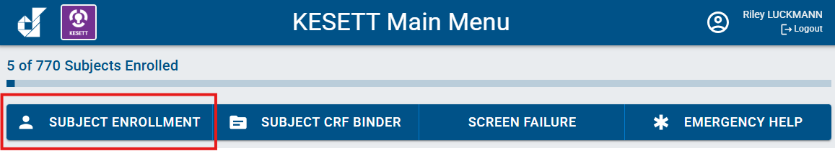
3. Select the Subject Enrollment button from the main menu bar

Slide 58

4. Select ‘Add Record’

Slide 59
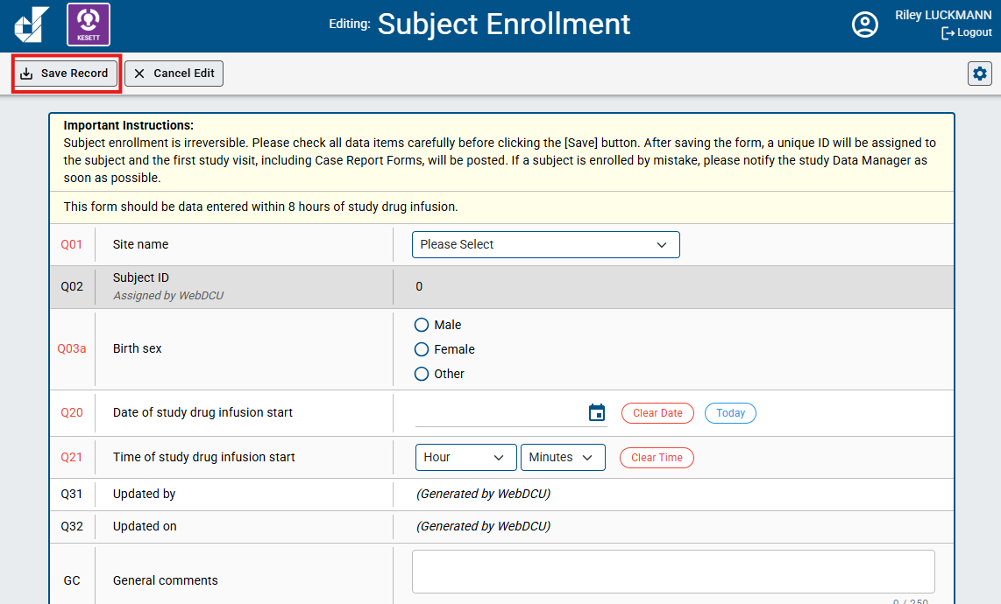
5. Enter the Subject Enrollment form and select ‘Save Record’
*As the instructions indicate, Subject Enrollment is irreversible. It should not be data entered until a patient has already received KESETT study drug. In Q20 and Q21, you will have to indicate the Date and time of study drug infusion start.

Slide 60
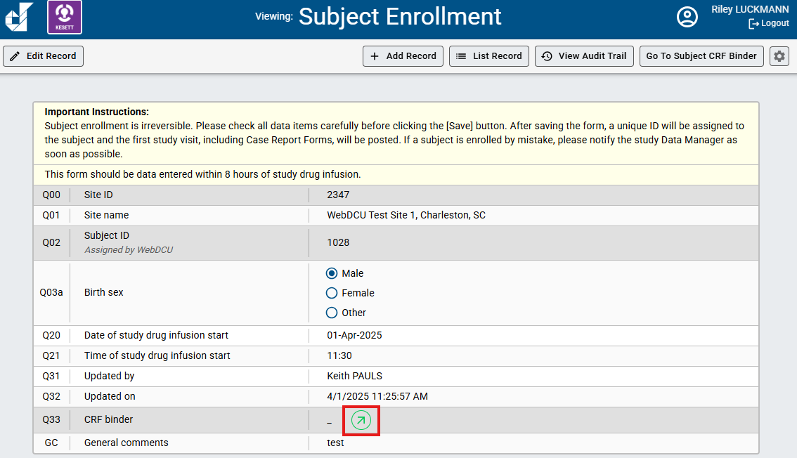
6. Click the green arrow to go to the Subject CRF Binder

Slide 61
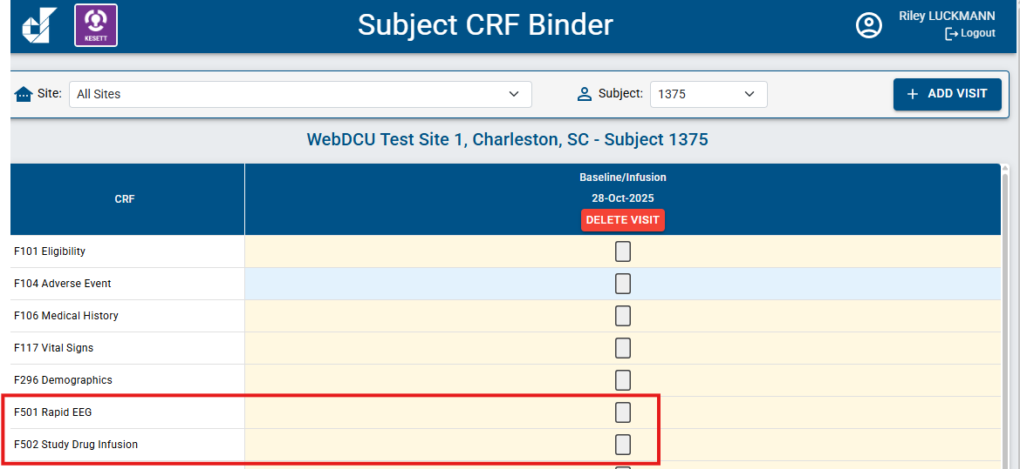
7. Enter and submit other enrollment CRFs
F501 Rapid EEG
F502 Study Drug Infusion

Slide 62
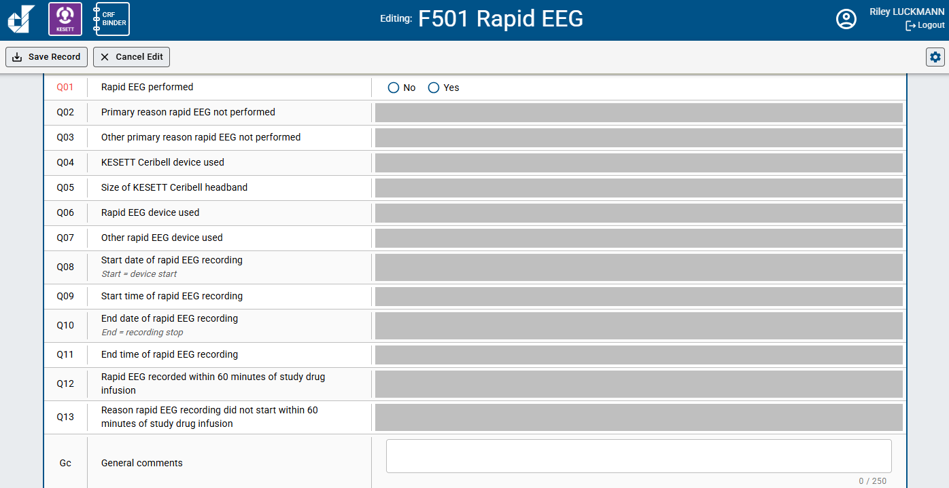
F501 Rapid EEG

Slide 63
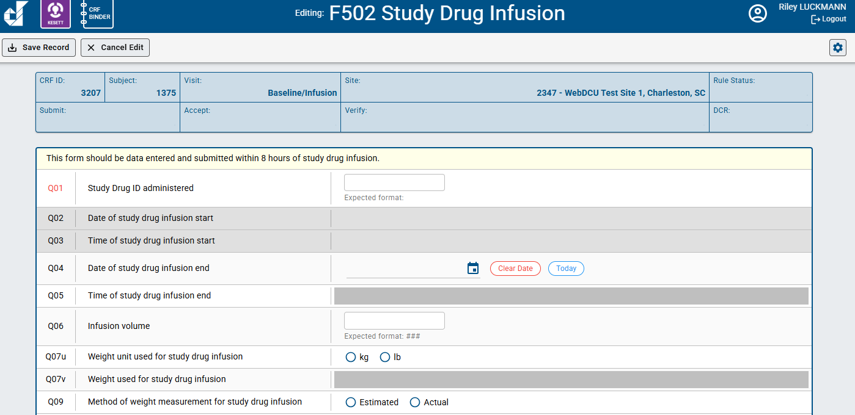
F502 Study Drug Infusion

Slide 64
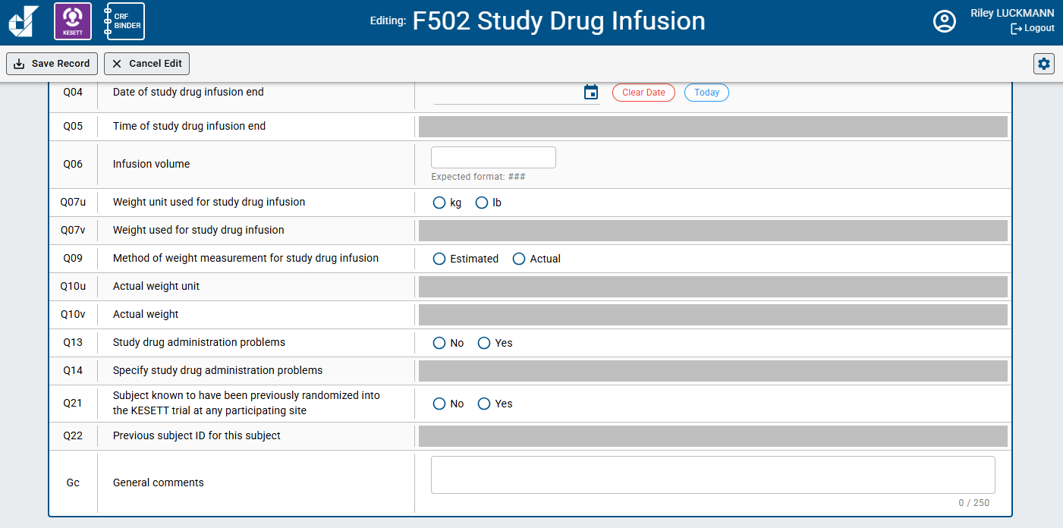
F502 Study Drug Infusion

Slide 65
CIRB Review Process & Initial Site Submission Table
Vince

Slide 66
IRB Approval Process (“One-step”)
Site submits local ICF language to CCC
Site information added to local ICFs
CIRB Protocol & EFIC Plan Approval
Local IRB Submission and Acknowledge
CIRB Site Approval
EFIC Activities and UAB report creation
Return Site CIRB Documents to Local IRB
CCC submits site application to CIRB

Slide 67
Items Complete by end of EFIC
  CC Events documented and containing requested details
  LIRB complete and documented in WebDCU
  CIRB Initial site submission form completed
  Local Consent language agreed upon by CCC and local IRB

Slide 68
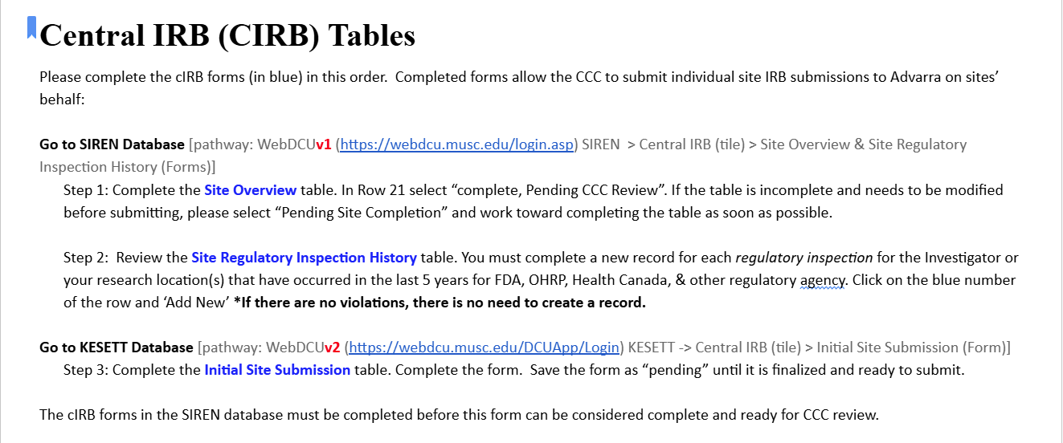

Slide 69
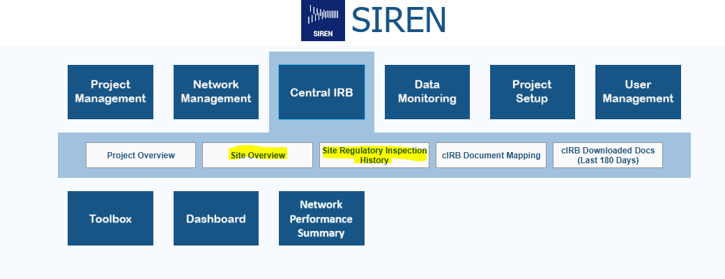
Central IRB (CIRB) Tables
Steps 1 & 2 in WebDCU v1 > SIREN:

Slide 70
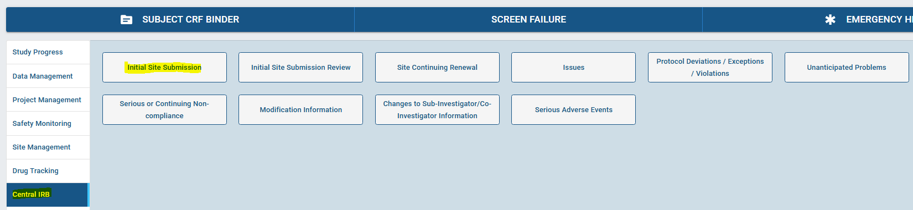
Central IRB (CIRB) Tables
Step 3 in WebDCU v2 > KESETT:

Slide 71
Initial Site Submission Table Tips
Refer to the KESETT Regulatory Document Approval Parameters guide
Q120: In which therapeutic areas does the investigator have research experience?
  Select from list of choices in Reg Doc Approval Parameters

Slide 72
EFIC Activities

Slide 73
EFIC Activities
Site Alone
  2 In-person community events
Site & UAB
  2 Virtual focus groups
UAB
  Community surveys
  Social media ads
  Website
Notes:
CC in Blue PD in Green

Slide 74
CC Community Event Documentation
CCC is reviewing and asking for clarifications
Key information to include
  Why this event was chosen
  duration of event and team presence
  Which team members attended
  Community attendance - At event and contacted
  Number engaged in extened conversations (consulted)
  Examples of conversations, questions, or impact
  Demographics - At event and extended discussion
  Overall reception and feedback including any opt-outs

Slide 75
Investigators X, and Y along with PSC Z attended the Gotham Farmers Market to introduce the KESETT study. The study members had a booth at the market for the full duration (09:00 to 14:00) and handed out EFIC-approved fliers and pamphlets. The market patrons were non-specific members of the general public, although attending study members noticed that most patrons who stopped to learn about the study either knew someone with epilepsy, were healthcare workers, or were interested in the neurosciences. The most common question revolved around what a patron without a history or predisposition of seizures could do to support the study. Study members encouraged the patrons to inform people they know of the study and encourage others to register their interest in the Focus Groups via the survey provided in the UAB-created website. Patrons tended to understand the concept of EFIC and did not have any questions regarding that topic. Overall, market patrons responded encouragingly to this study and did not have many questions or comments. No opt out mechanisms were requested.

Slide 76
Investigators X and Y along with PSC Z attended the Gotham Farmers Market to talk to people for it’s 5 hour duration. Gotham Farmers Market is one of the cities largest and well attended gatherings, drawing over 10,000 visitors every week from a wide area. The market is dedicated to diversity and food justice and attracts customers of all socioeconomic groups by emphasizing acceptance of EBT/SNAP, WIC and Senior FMNP. Many people stopped by the booth to pick up fliers and brochures about the study and the study team was able to have discussions with about 200 people. Discussions differed in duration. Most were brief, but many (10 or more) were 10 minutes or longer. The event allowed us to talk to young and old people of many colors and backgrounds. Many of the patrons who stopped to learn about the study either knew someone with epilepsy, some were interested in science, some with prior experience with research, and some were healthcare workers. People talked to expressed support for the research. One father of a child with epilepsy described their difficulty dealing with the disease and expressed gratitude for the study Many of those with whom we talked who didn’t have epilepsy or seizures, asked what they could do to help. They were told to help spread the word by telling friends and family about it. Some expressed interest in the focus groups as well. People tended to understand the concept of EFIC and did not ask questions about that much. Overall, those with whom we engaged responded encouragingly to this study and did have any concerns. No opt out mechanisms were requested.

Slide 77
CC Virtual Focus Groups
Event documentation entered into WebDCU by the UAB EFIC team
Site responsibilities:
  Recruit attendees
  Provide list of attendees and why they were invited to UAB
  Propose times to the UAB facilitator
  Present study information on the call (facilitator guide)
  Answer attendee questions
  Keep record of what organizations or groups were contacted

Slide 78
Focus Group Invitation
10
8
5
CONFIRM
GOAL
CONDUCT

Slide 79



Focus Group Best Practices
Limit team member attendance with brief introductions
Concise presentation to allow ample time for community member input
Pre review the facilitator guide

Slide 80
Focus Group Recruitment
Who?
  Local epilepsy and seizure disorder community
  Interested or invested community members
    Do not need to have a direct link to epilepsy or seizures
  Diverse backgrounds
  Representative of your community
  Include concerns specific for your community
    Minorities and underrepresented
    Low income or unhoused
    Faith based
Notes:
Have another reason for attendance other than clinical or research background

Slide 81
Post EFIC Information
Report any additional opt-outs
Focus group attendees - How/why they were selected
The “why” is very important to the IRB. Please give a 2-3 sentence summary for each meeting describing the individuals that attended.
Names of the groups that were invited to participate in the focus groups.
These can be a specific organization such as an epilepsy foundation chapter, or a population targeted such as neurology clinic patients
Paragraph from the local Principal Investigator
Assessment of their overall perspective of the community meetings, in-person events, the feedback received, and the utility of these meetings/events.

Slide 82
Opt-outs
At in person events & focus groups- Reported in the CC form in WebDCU
PD activities such as the social media campaign will direct to the website and your team contact information
Study team should keep a list of opted-out community members to mail a wristband to.
Prior to CIRB approval- Opt outs reported to the CCC in final EFIC details
Post IRB approval - Maintained locally and submitted to the CIRB at yearly SCR
Opt out will be mailed by the study team or CCC using the Opt out letter under review by Advarra

Slide 83
Focus Group RecruitmentIdeas
Inviting interested persons from your in-person events
Low acuity patients from your ED who have already been seen and are stable
Engaging patients from your outpatient clinics
Community groups and engaged community members

Slide 84

Focus Group Recruitment Ideas
Posting on social media sites
  Next Door
  Facebook groups
  Institutional pages
Leverage existing community relationships at your site
  Research Community Advisory Boards
  Patient advocacy groups
Contact community groups
  Elected officials / city council
  Religious leaders and groups
  PTAs
  Retirement and neighborhood communities
  Community resource organizations
  Local epilepsy support groups and/or foundation chapters

Slide 85
Discussion:
What are recent wins or challenges for EFIC activities at your site?

Slide 86
Site Readiness
Vince

Slide 87
Readiness: What should we be doing?
Use the checklist! KESETT.org > Getting started > Blue button
Work on uploading regulatory documents
Site Addresses in WebDCUv2 - Site management > Site Address
Initial Site submission table
Training
  Protocol – Read Protocol, IM video and quiz on the Website > Upload quiz results to WebDCU
  Data – IM video on the Website > Upload cert to WebDCU
  Regulatory – IM Video on the Website > Upload cert to WebDCU
    Required for KESETT as WebDCUv2 has some new features
  Pharmacy – Have pharmacists on the eDOA review the pharmacy manual and sign the attestation on the website > Upload attestation to WebDCU
  Clinical – Attestation by the site PI (protocol signature page) > Upload to WebDCU
Study Team
Notes:
https://docs.google.com/document/d/1j3cjjD-eb2j3xNXZcpZei0zmUs64g3ek/edit?usp=sharing&ouid=109082613593533021113&rtpof=true&sd=true

Slide 88
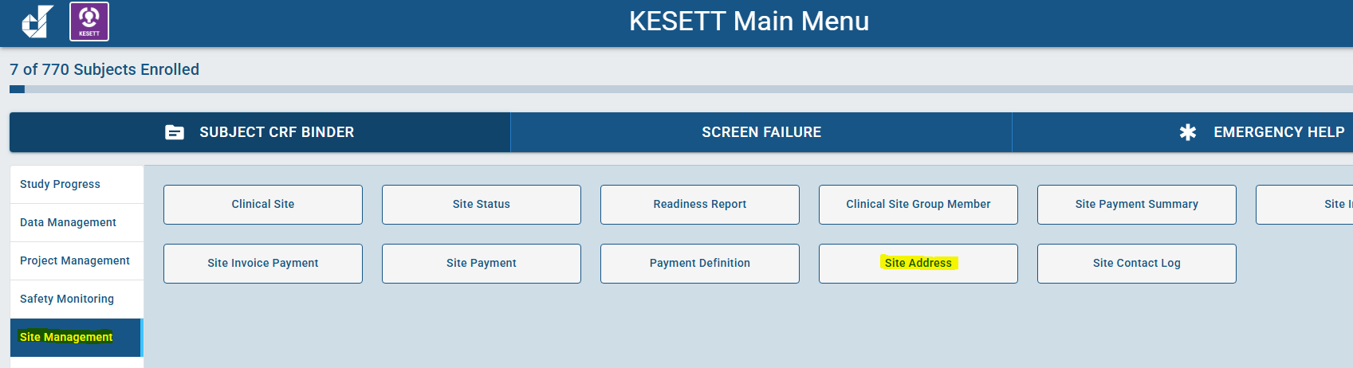
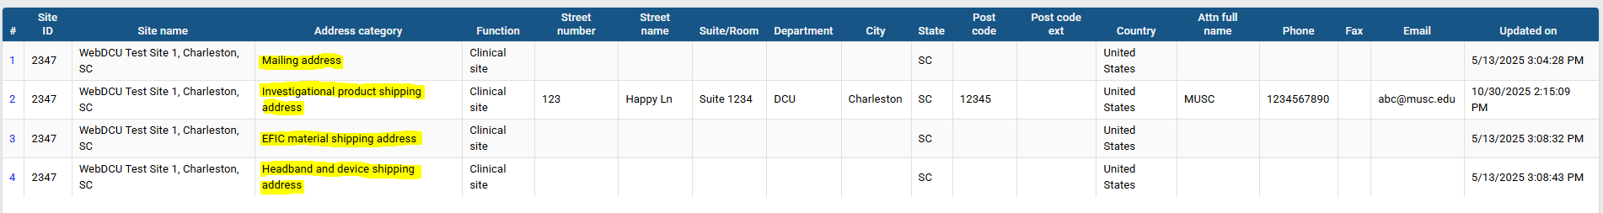
Site Addresses

Slide 89
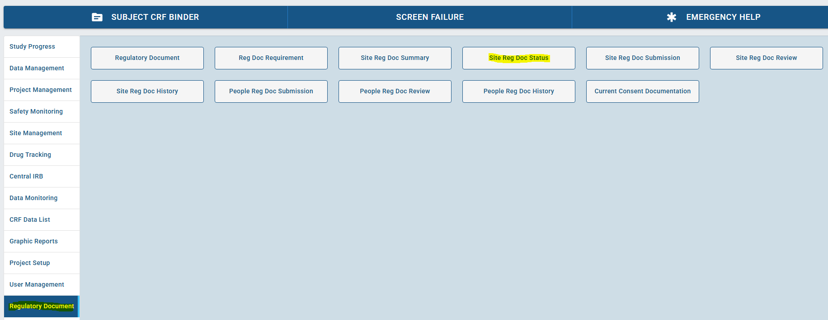
Regulatory Documents

Slide 90
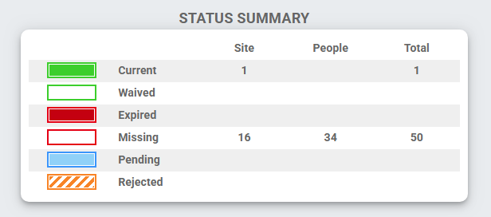
Regulatory Documents

Slide 91
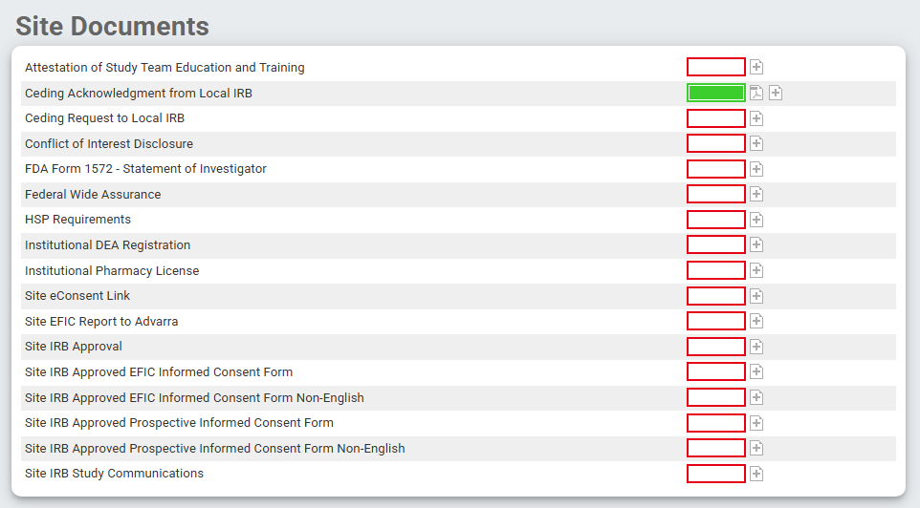
Regulatory Documents

Slide 92
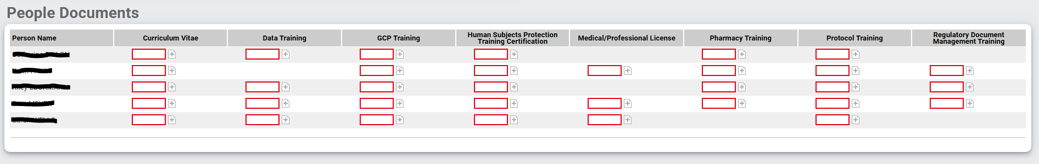
Regulatory Documents

Slide 93
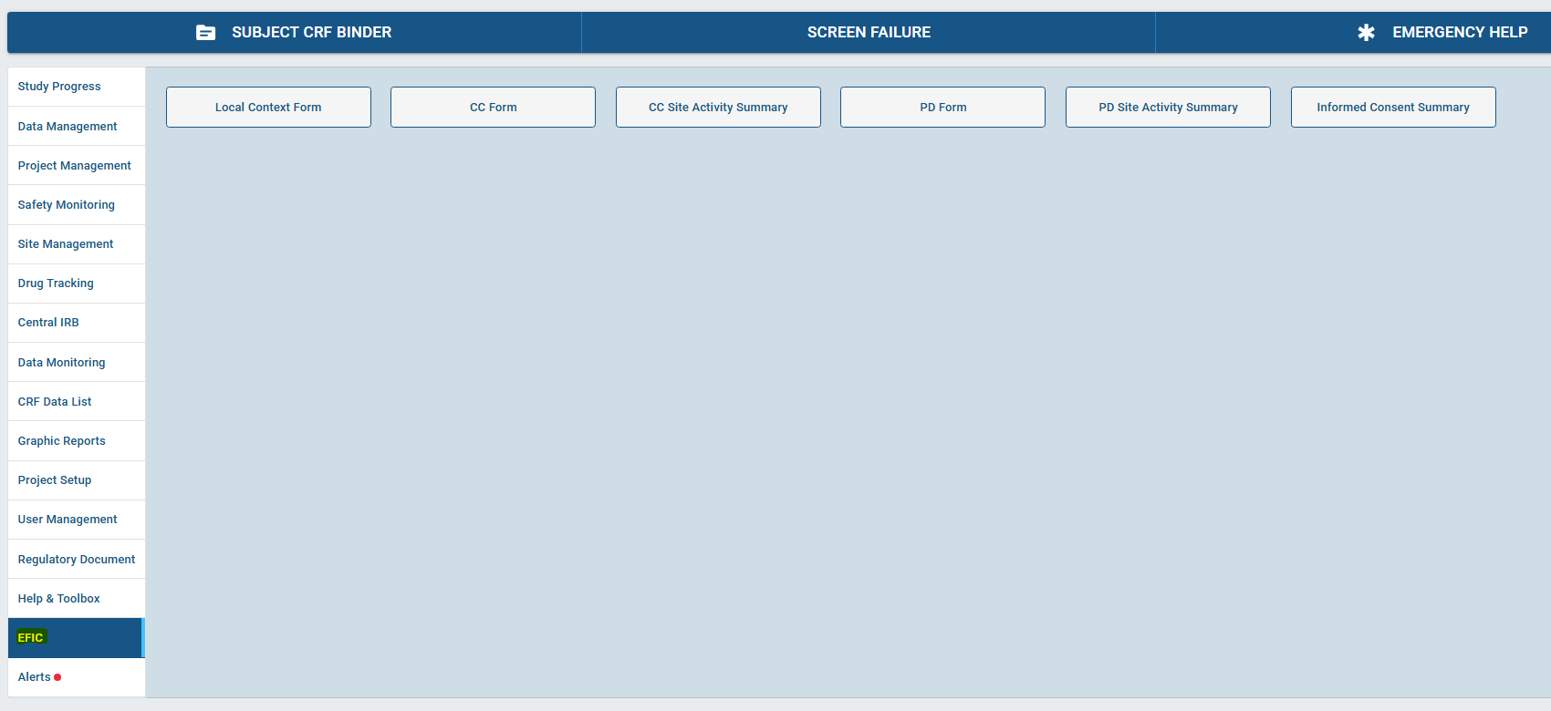
EFIC

Slide 94
Readiness Calls SOP
Vince/Megan will contact site to schedule once EFIC report is finalized by UAB and CIRB submission is complete/in queue
Once scheduled, we will share the site-specific Readiness Checklist
  Site study team completes Checklist at least 24-48 hours in advance to confirm call
  Aim to have very few/no remaining action items after the call
Site required attendees | Site PI, Primary SC
Site recommended attendees | Co-Is, SSC, Pharmacy representatives, Hub PI, Hub PM

Slide 95
Release to enroll
After readiness call, if CIRB approved & no major outstanding issues, site will be Released to Receive Study Supplies
  Triggers study drug shipment
Once study drug is checked in at site, final administrative review > Released to Enroll

Slide 96
Study Team Coverage
Study team is to arrive ideally within 30 minutes of an enrollment
  Ceribell assistance if needed
  Study drug vial ID recovery
  Informed consent
Enrollment CRFs to be completed within 8 hours

Slide 97
Discussion:
What strategies are you using to provide study team coverage on weekends & nights?

Slide 98
Source Documents

Slide 99
Source Docs & CRFs
Source document for all data recorded in the CRFs is the 1st location where those data are recorded.
  eCRF itself (data is observed & directly data entered)
*Add note to General comments filed stating “direct data entry”
  Paper case report form representative of the study eCRF
  Electronic health record
  Paper medical record

Slide 100
Source Doc Hierarchy:
Clinical Outcomes at 15- & 60-min
Contemporaneous observation & documentation of attending physician’s determination
Directly recorded on paper or electronic CRF
Direct communication with the attending physician
Directly recorded on paper or electronic CRF
Medical record - explicit study-specific documentation
Medical record - implicit review (should be used in very rare cases)
Notes:
Defined in MoP

Slide 101
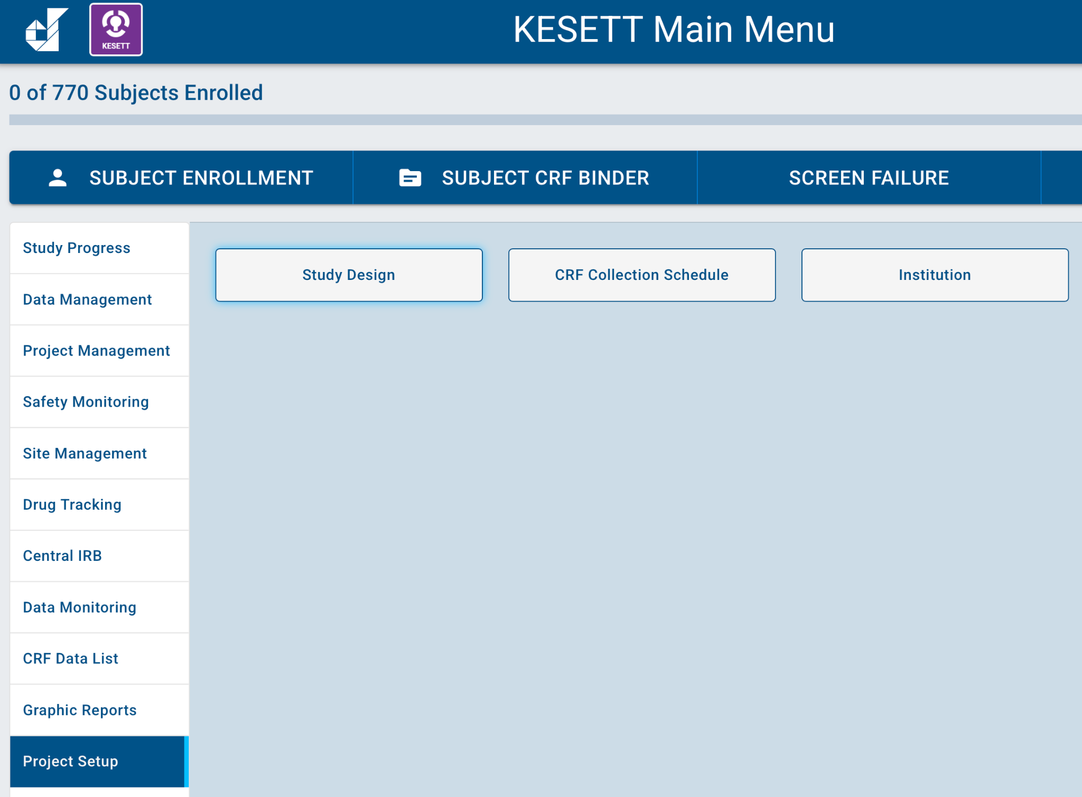
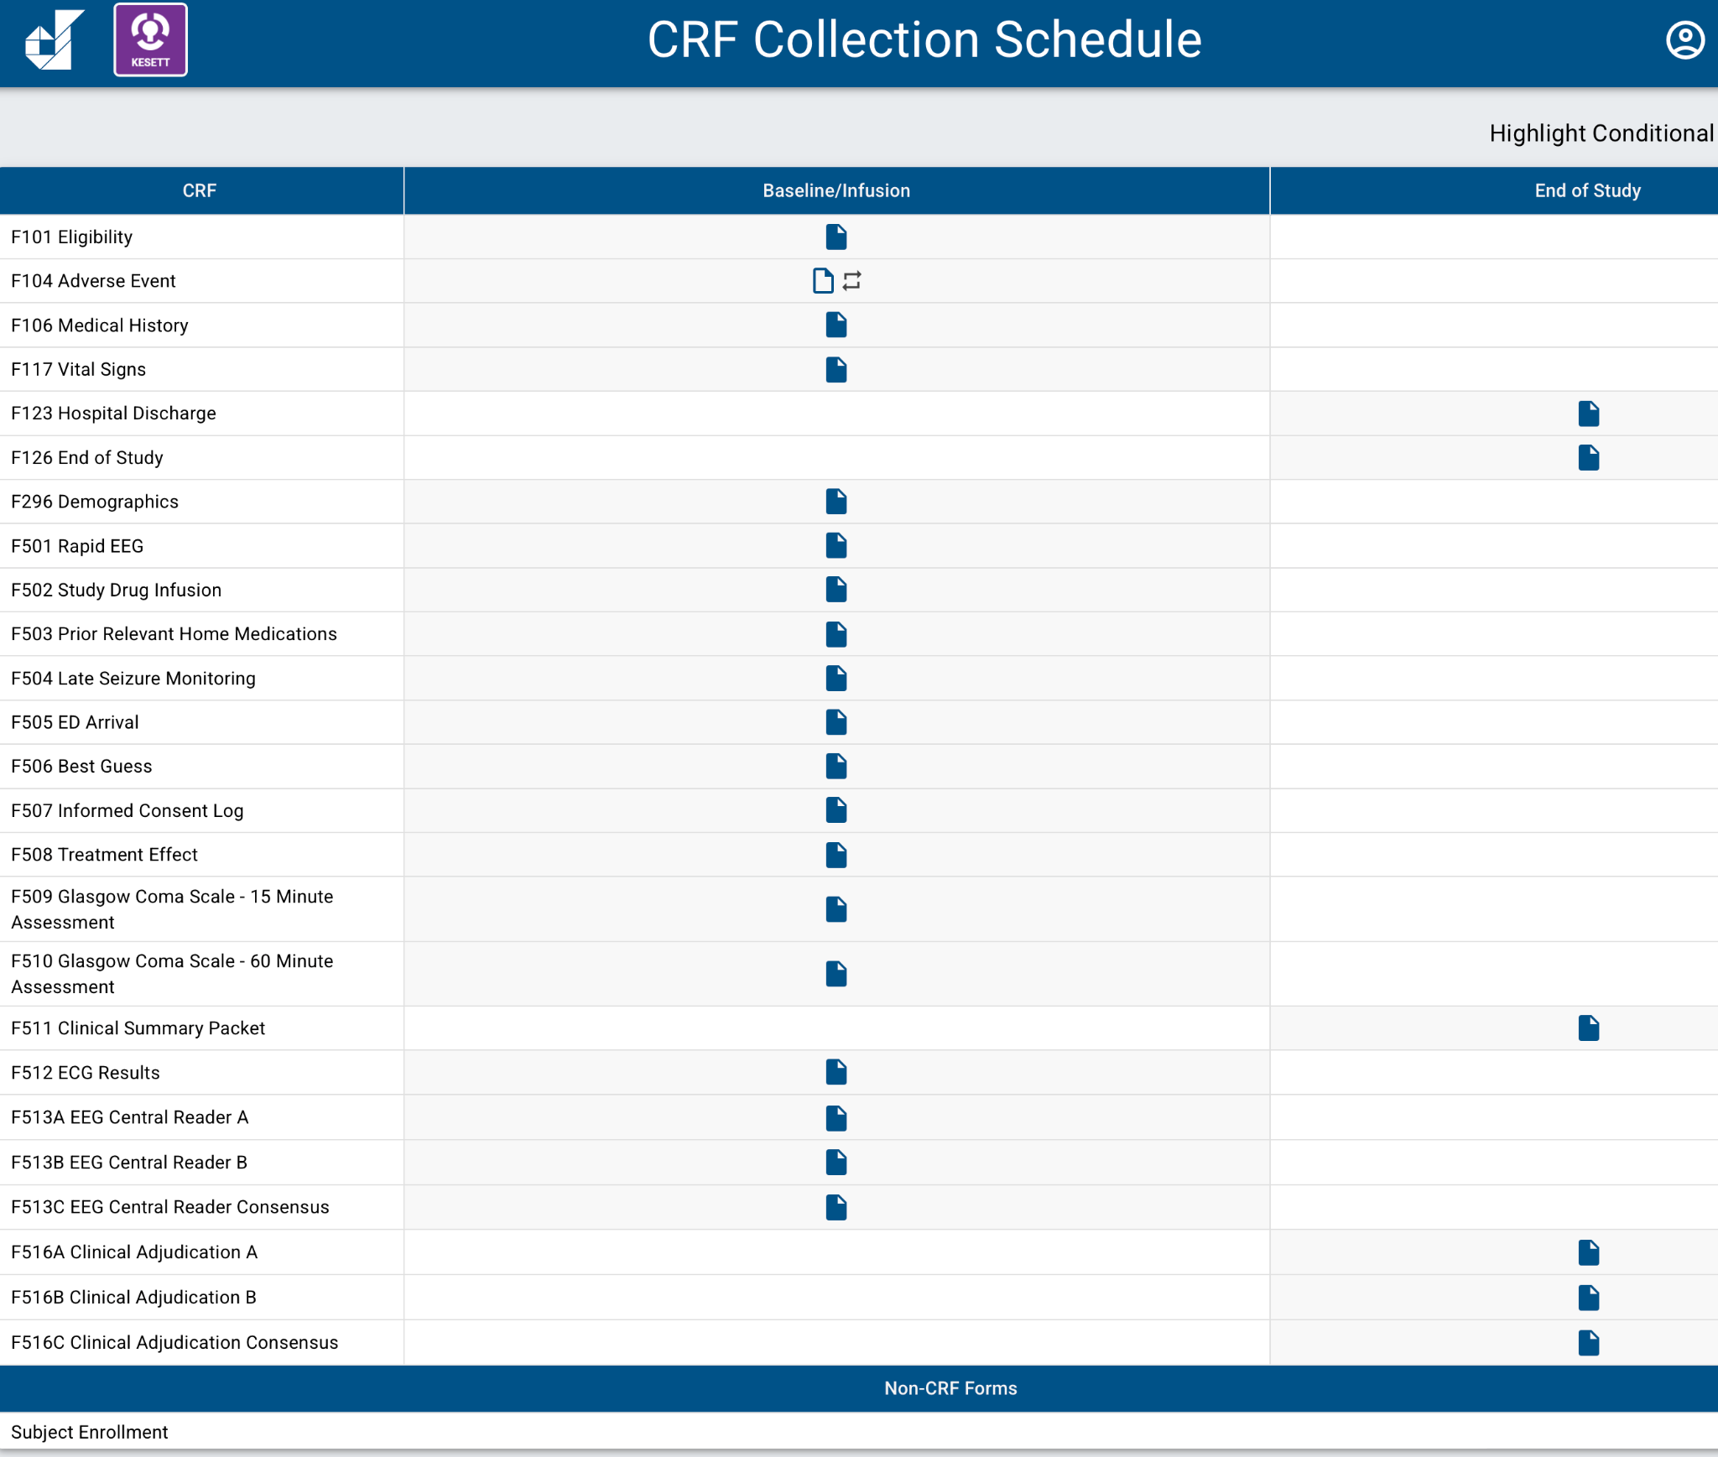
Source Docs & CRFs
Use CRFs as guide if you are creating your own source documents for clinical and study teams

Slide 102
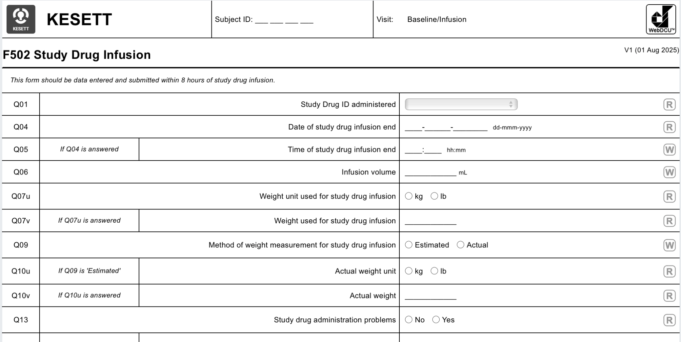
Source Docs & CRFs
Can export/print as pdf or use as guide to build your own form
Remember GCP guidelines & ALCOA-C if using a paper source document!
Notes:
Paper worksheets must be signed and dated by the person collecting the data and retained as source.

Slide 103
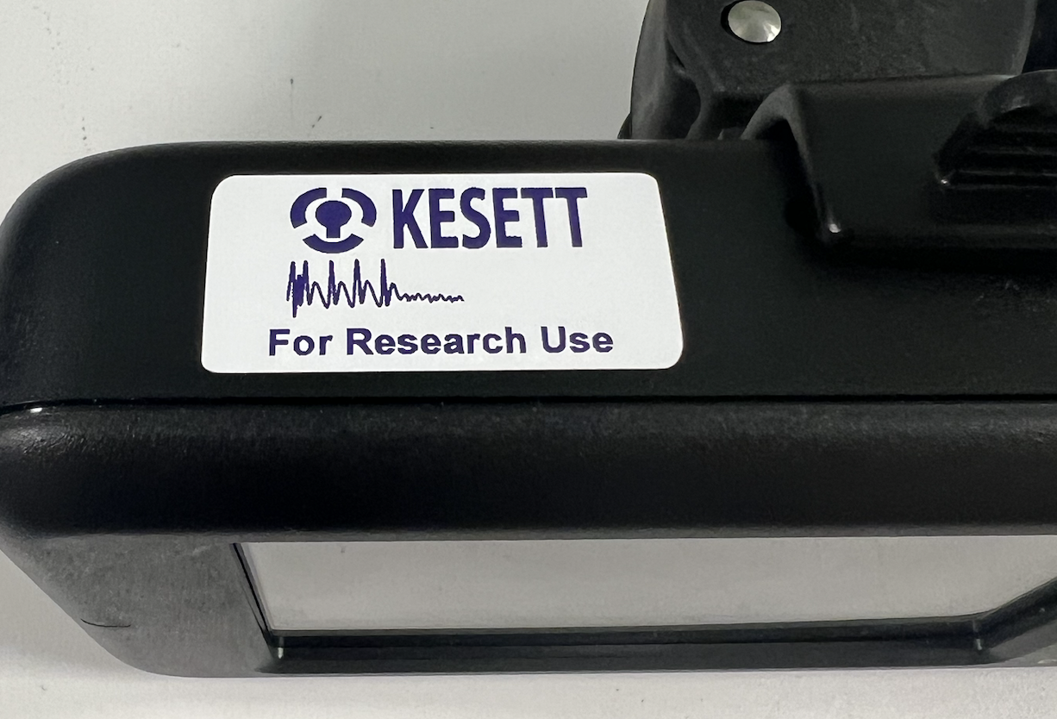
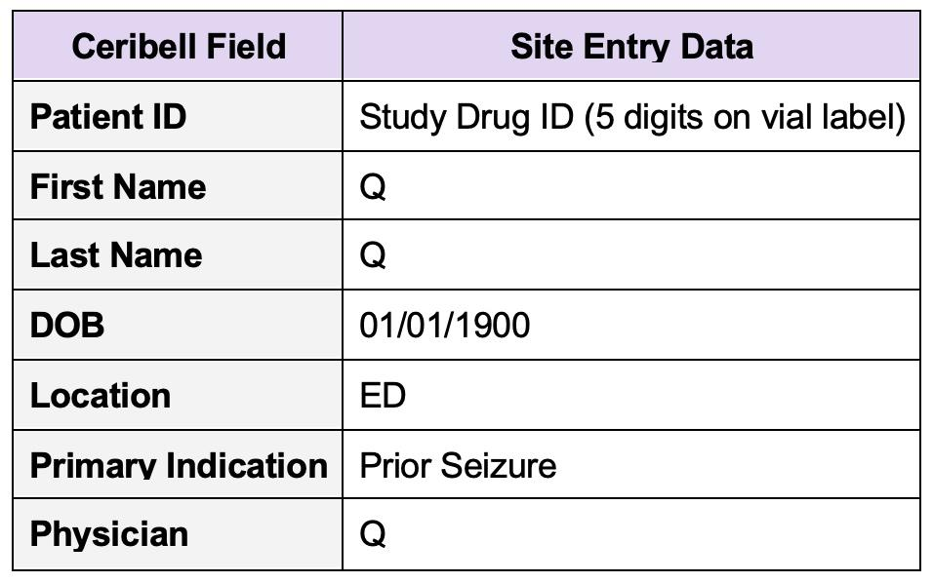
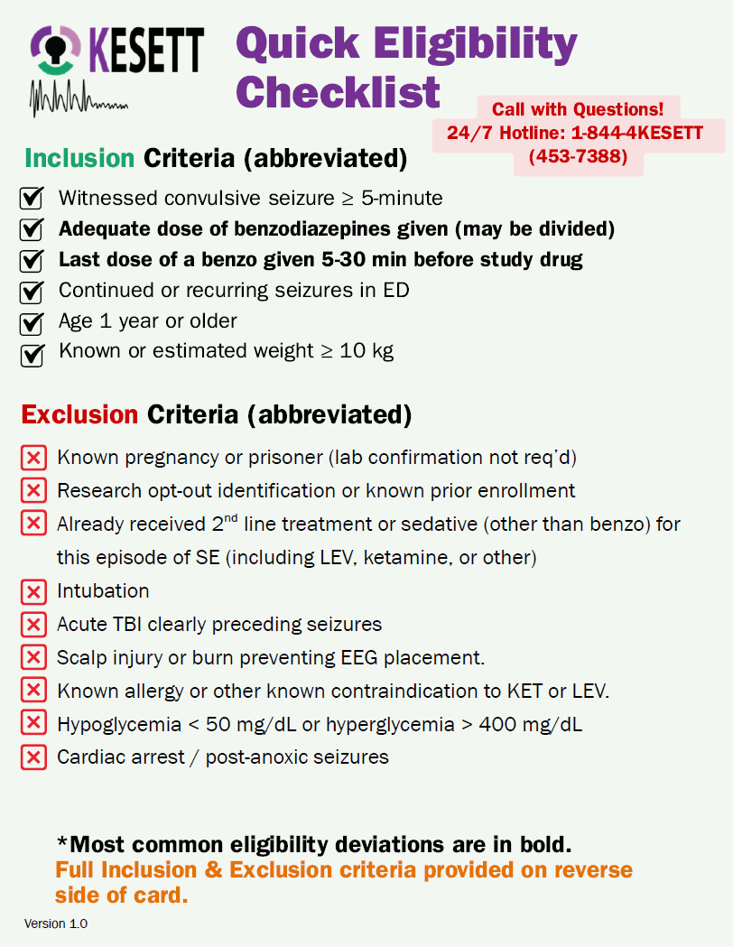
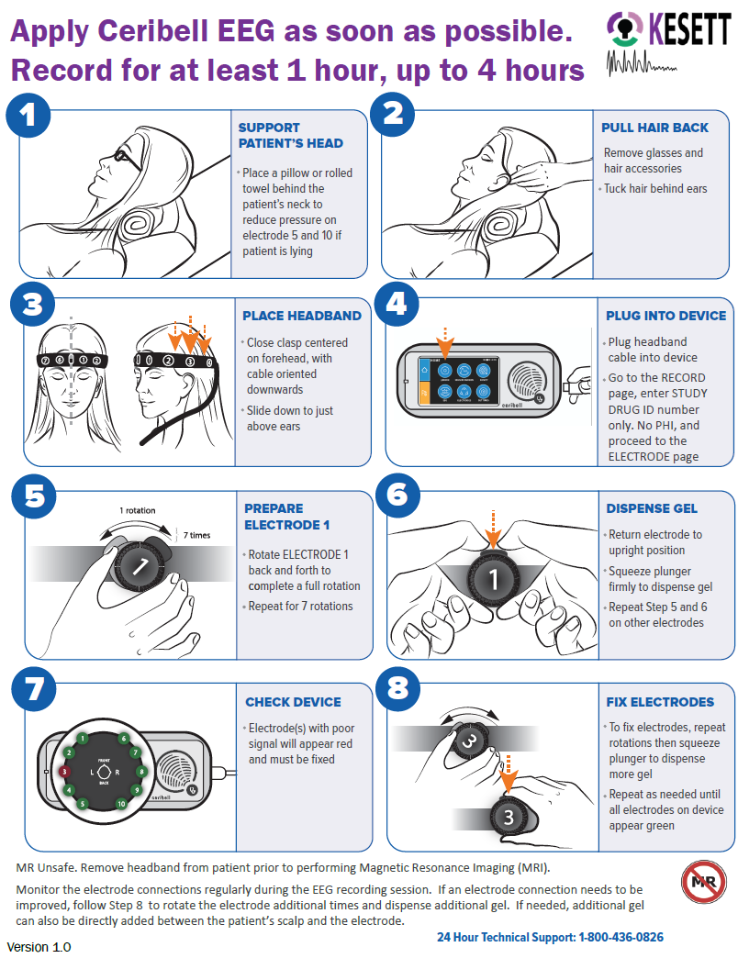
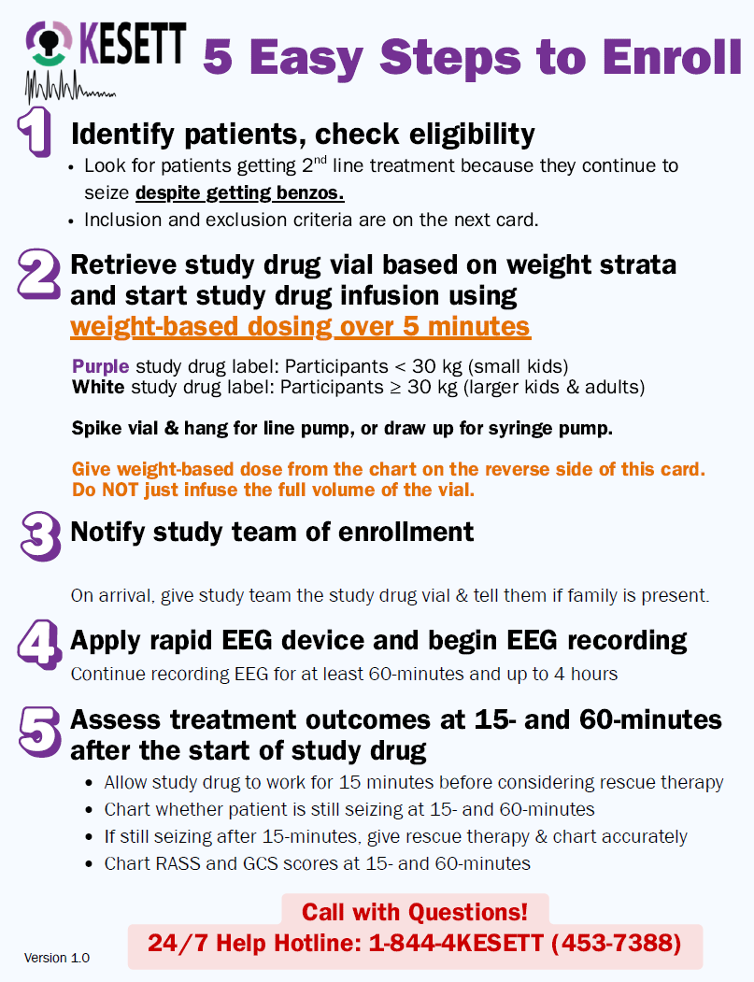
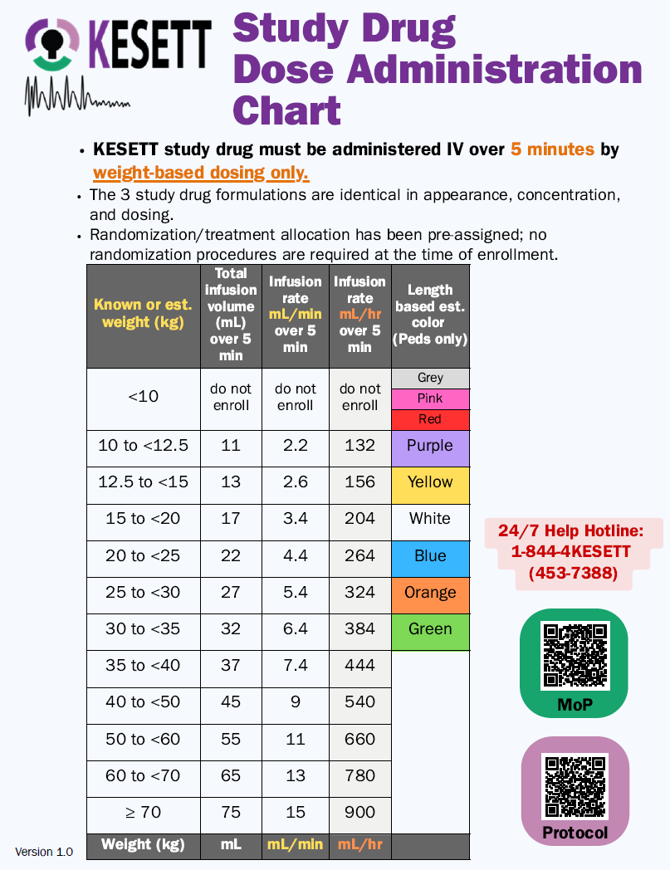
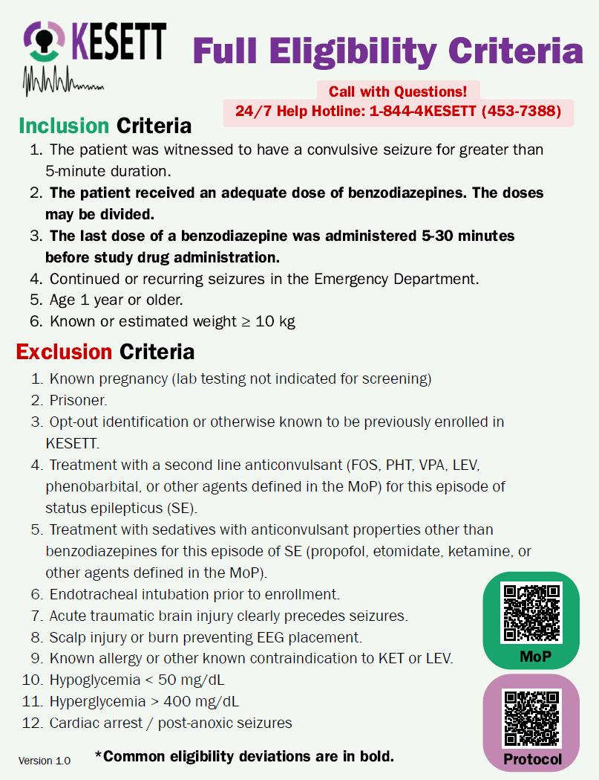
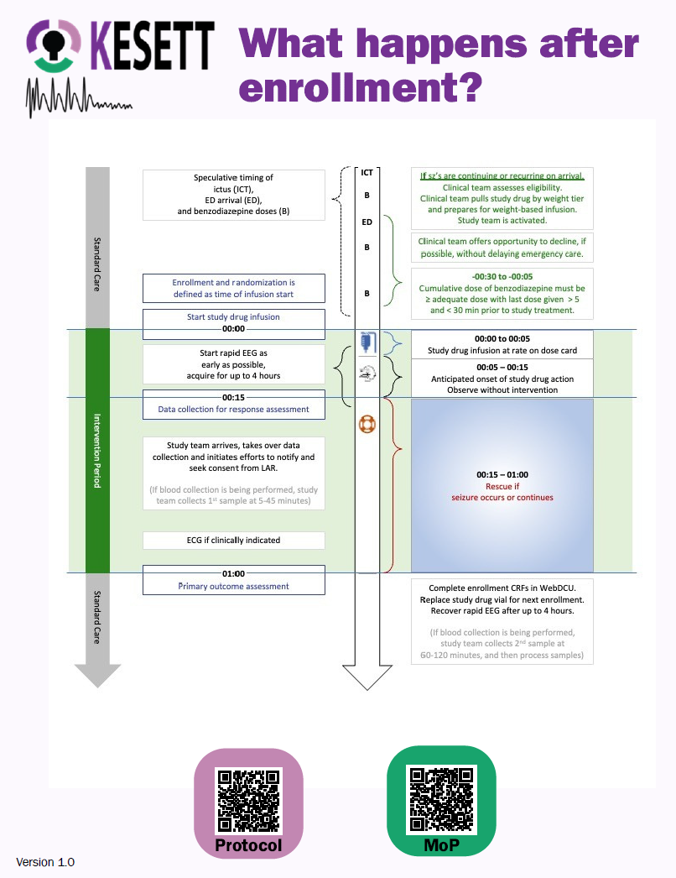

Study “Kit” Materials: Centrally provided
Ceribell (unless using own clinical device):
  Recorder device
  KESETT stickers for recorder
  Ceribell headbands
  KESETT stickers for headband boxes
Ceribell headband basket for IV pole
Protocol Reminder Cards
Length-based-weight estimation
measuring tape
  Can also be used to measure head circumference
Notes:
Centrally provided
Other than the study drug
IV poles not provided by study
Protocol reminder cards file will be available in case sites want to produce extra copies, create poster, etc.

Slide 104
Ceribell Training
“Intake” call is optional
  Discuss device and use in study with Ceribell liaison and PM
IT training/support is available
  Email, 24/7 support number, meetings
In-person, on-site training for study team is required if not already using device clinically
  Conducted by local commercial reps
  Site can determine who should attend the training
  Designate a group of ‘super-users’
  Scheduled as your site approaches CIRB submission

Slide 105
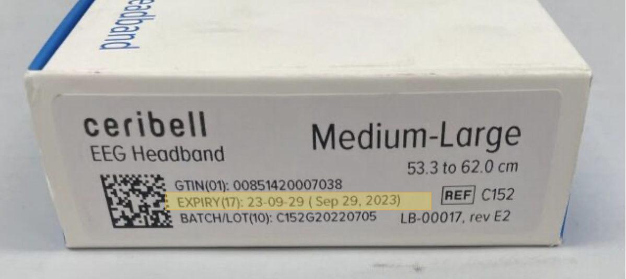
Ceribell Supply Logistics
> Device provided after site contract is executed to allow local approvals.
> Headbands sent to sites after CIRB approval
> Headbands come in 2 sizes:
Small (C151)
Medium/Large (C152)
> Each site will have a set par for number of headbands on site.
> Headbands expire after ~6 months;
will have expiration date on box.
Notes:
Headbands are consumable so will be resupplied throughout the trial.
Par depends on enrollment population (adult/peds/both) and logistics of your EDs (separate, together, etc.)
Expired headbands are not a safety issue but may impact quality of recording; can use expired headbands for trainings

Slide 106
Ceribell: Headband Inventory & Resupply
Sites will complete monthly inventory survey.
  Can be completed anytime; must be completed at least 1x/month
  Responses submitted by 1st of month will be used to place monthly resupply orders by central team on 3rd of month.
Central team uses survey responses to bring each site up to full par.
  Sites receive shipment tracking info once order is fulfilled.
  Will use shipping address in WebDCU
Urgent resupply can be triggered by the site or central team.
  Site can use survey to indicate urgent request.
  Central team will monitor use based on enrollment CRFs.
Notes:
Headbands are consumable so will be resupplied throughout the trial.
Par depends on enrollment population (adult/peds/both) and logistics of your EDs (separate, together, etc.)
Expired headbands are not a safety issue but may impact quality of recording; can use expired headbands for trainings

Slide 107
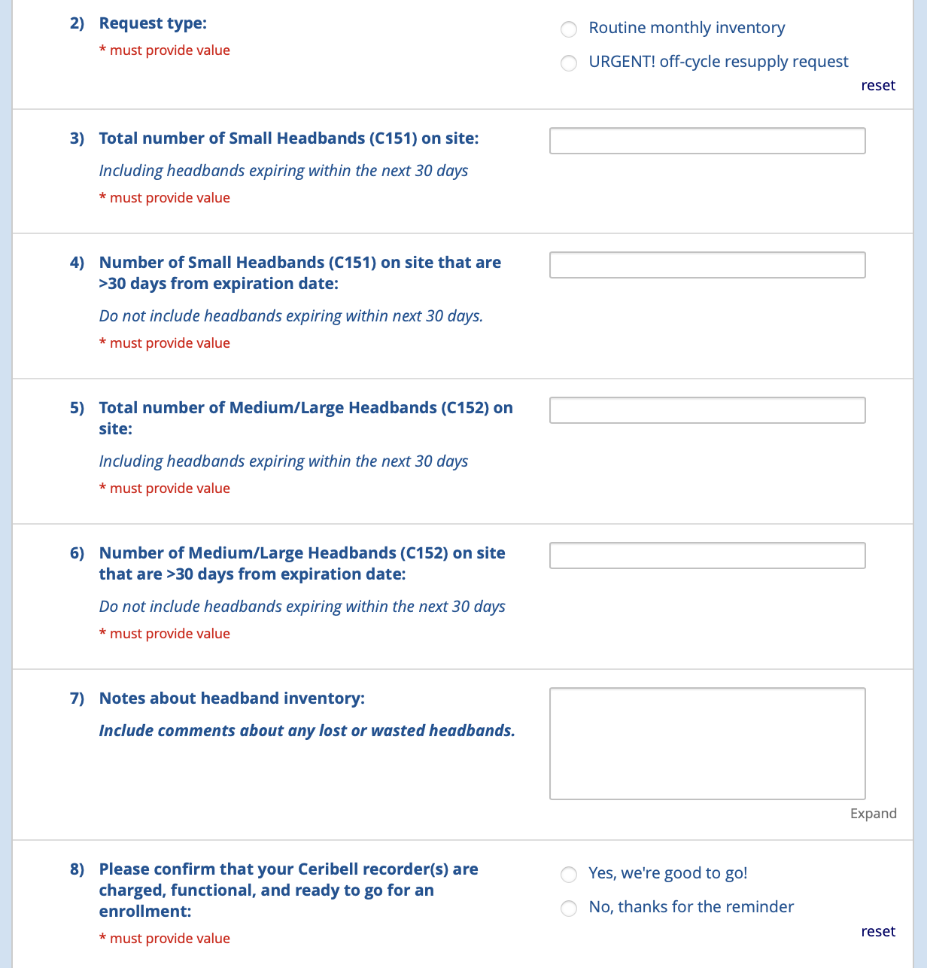
Ceribell Inventory Survey
REDCap survey
Link in MoP
Notes:
Headbands are consumable so will be resupplied throughout the trial.
Par depends on enrollment population (adult/peds/both) and logistics of your EDs (separate, together, etc.)
Expired headbands are not a safety issue but may impact quality of recording; can use expired headbands for trainings

Slide 108
Inclusion Criteria
1. The patient was witnessed to have a convulsive seizure for greater than 5-minute duration.
2. The patient received an adequate dose of benzodiazepines. The doses may be divided.
3. The last dose of a benzodiazepine was administered 5-30 minutes before study drug administration.
4. Continued or recurring seizures in the Emergency Department.
5. Age 1 year or older.
6. Known or estimated weight ≥ 10 kg

Slide 109
Exclusion Criteria
1. Known pregnancy (lab testing not indicated for screening)
2. Prisoner.
3. Opt-out identification or otherwise known to be previously enrolled in KESETT.
4. Treatment with a second line anticonvulsant (FOS, PHT, VPA, LEV, phenobarbital, or other agents defined in the MoP) for this episode of status epilepticus (SE).
5. Treatment with sedatives with anticonvulsant properties other than benzodiazepines for this episode of SE (propofol, etomidate, ketamine, or other agents defined in the MoP).
6. Endotracheal intubation prior to enrollment.
7. Acute traumatic brain injury clearly precedes seizures.
8. Scalp injury or burn preventing EEG placement.
9. Known allergy or other known contraindication to KET or LEV.
10. Hypoglycemia < 50 mg/dL
11. Hyperglycemia > 400 mg/dL
12. Cardiac arrest / post-anoxic seizures

Slide 110
Abbreviated Eligibility
Inclusion
1. Convulsive seizure > 5 minutes
2. Seizures continue/recur in ED
3. Seizure despite adequate dose of benzos
4. Seizure despite properly timed benzo
5. Age ≥ 1 year & est. wgt > 10kg
Exclusion
1. Hypoglycemia, TBI, cardiac arrest
2. Known contraindication to drugs or EEG
3. Already received 2nd line agent or anesthetic
4. Already intubated
5. EFIC prohibited - known pregnancy, prisoner or opt out identification

Slide 111
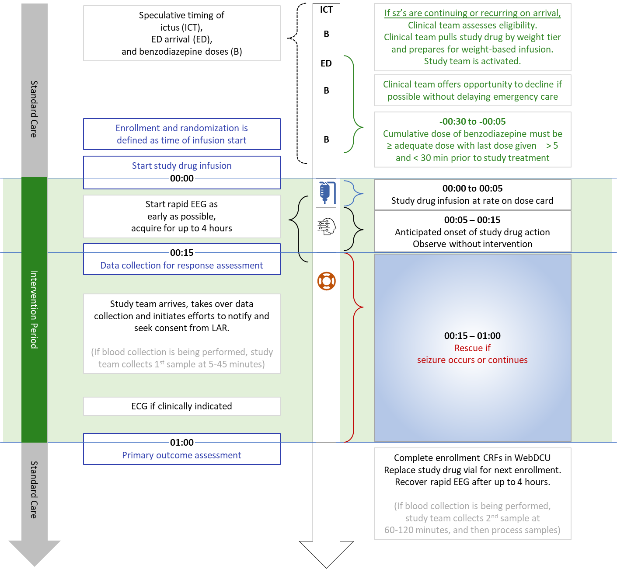

Slide 112
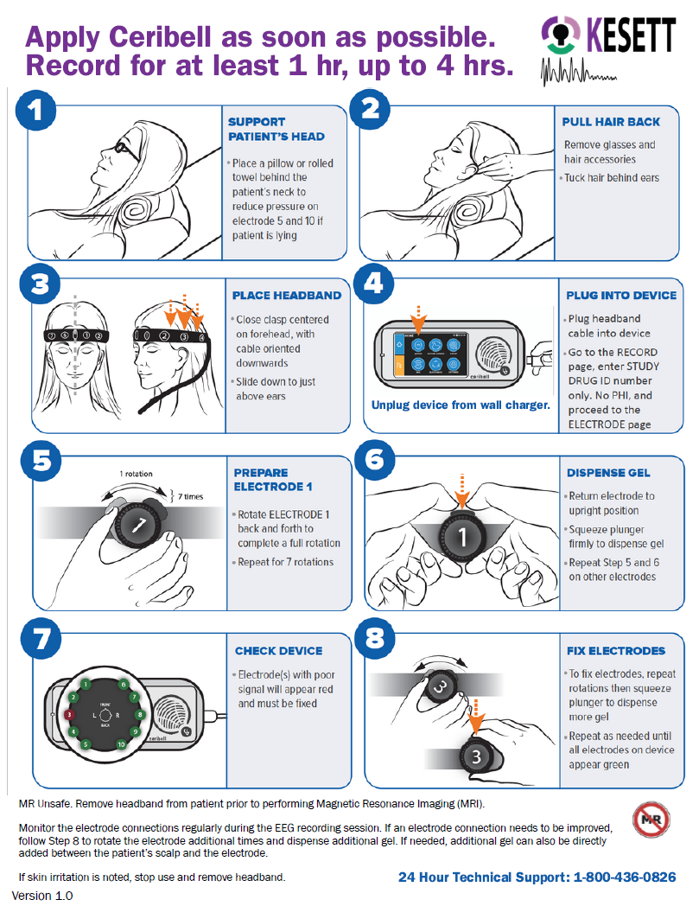
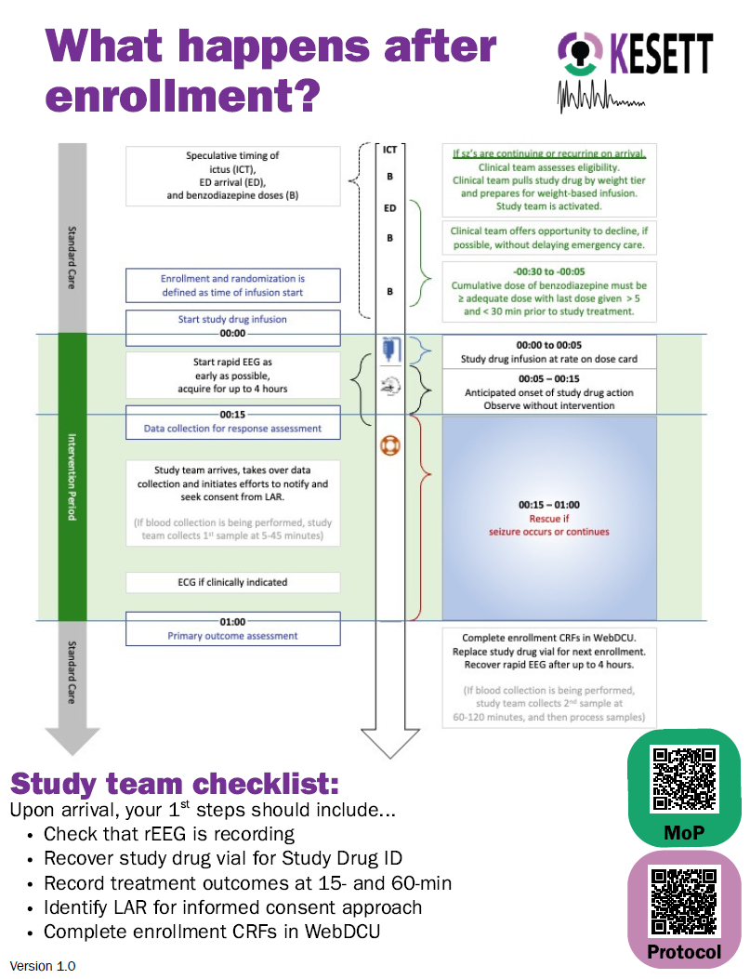

Slide 113
Study team coverage
24-hour study team phone number / pager
Alert to enrollment occurs immediately after drug is started
Study team arrival ~30 minutes
Overnight enrollments may occur
Site team can decide how to implement KESETT coverage.
Clinical team
  Conduct opt out if feasible
  Enroll
  Apply Ceribell
  Assess for treatment outcomes at 15-min (continuing seizures, RASS, GCS)

Slide 114
Data Collection & Documentation Tips
Vital Signs
  Prior to study drug start
Medical History & Demographics
  Patient or LAR vs EMR
Sign & date all source documentation
Have all sources available

Slide 115
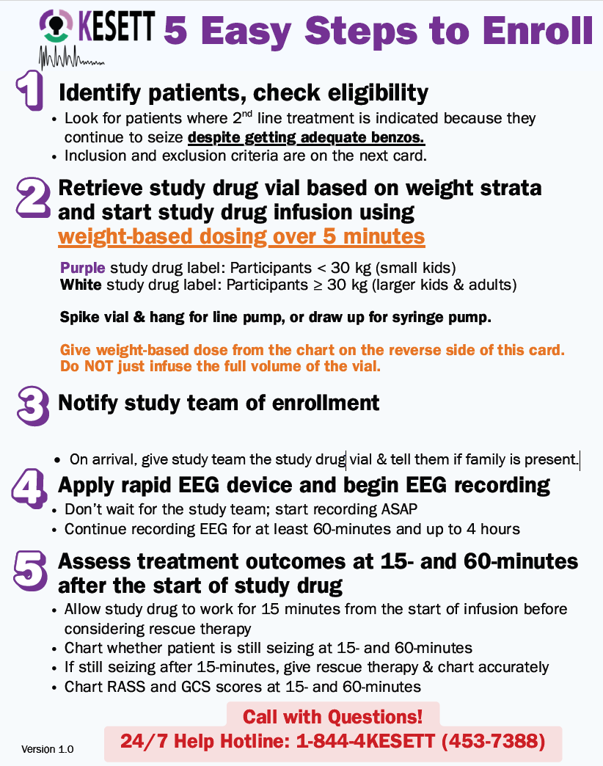

Protocol Premises
KESETT should never delay treatment of status epilepticus
KESETT is based upon guideline-
concordant treatment of status

Slide 116
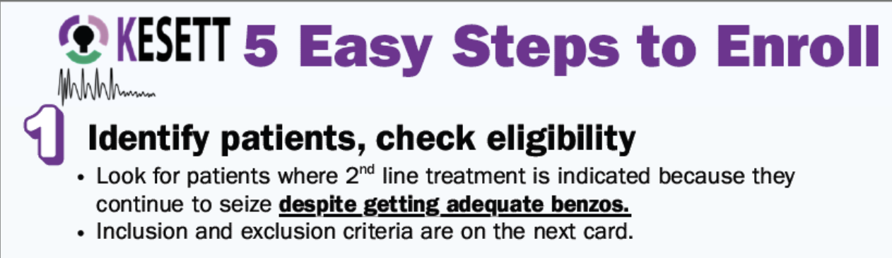
Clinical team needs to be aware of study and screening
Study team can assist via EHR alerts, EMS alerts, etc.
Leverage key teams such as ED pharmacy
Provider will assess eligibility and enroll; investigator will confirm eligibility later for CRF entry

Slide 117
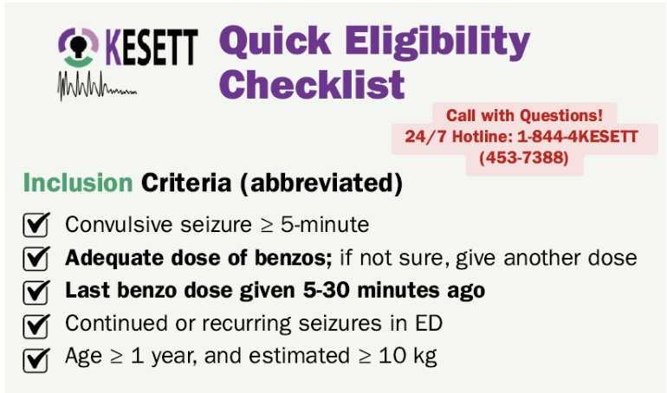
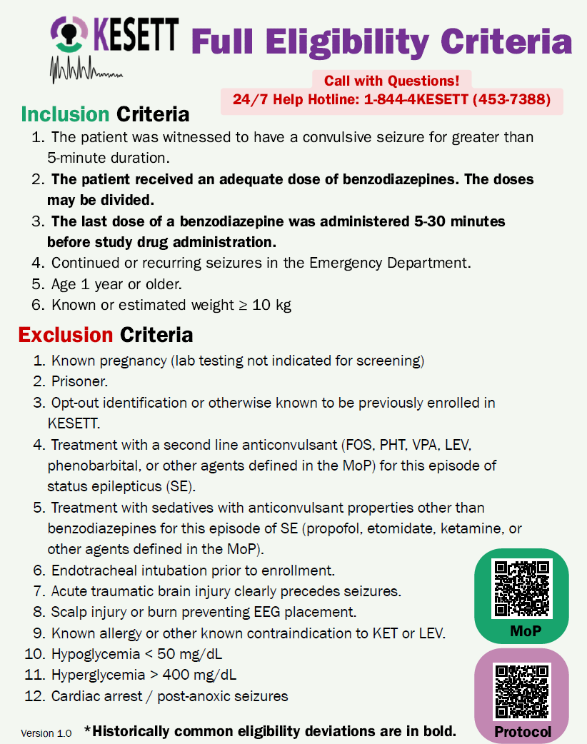
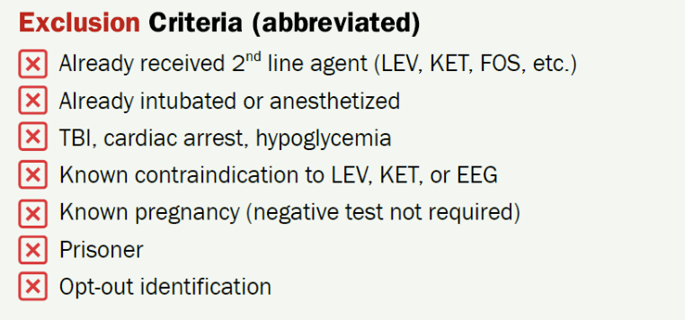

Slide 119
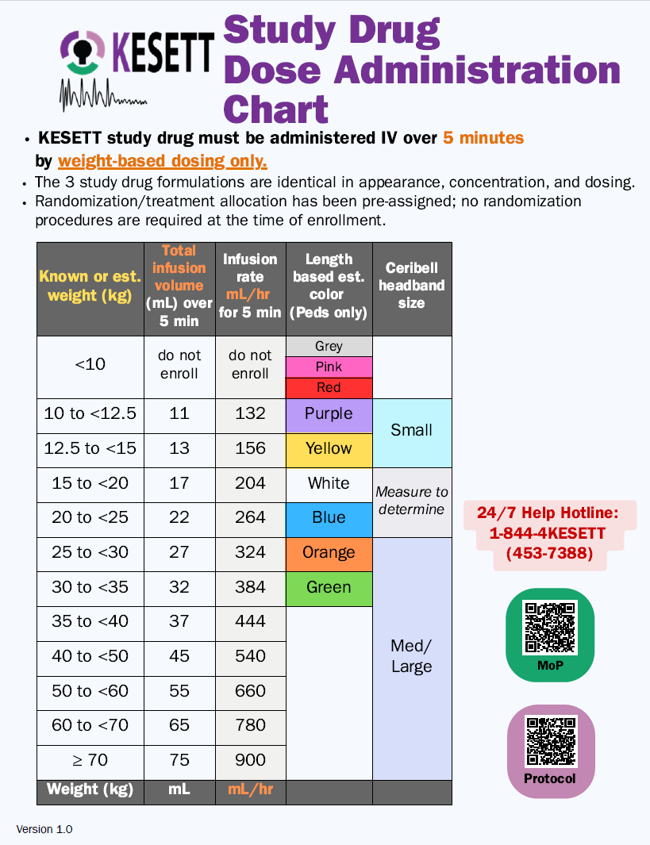
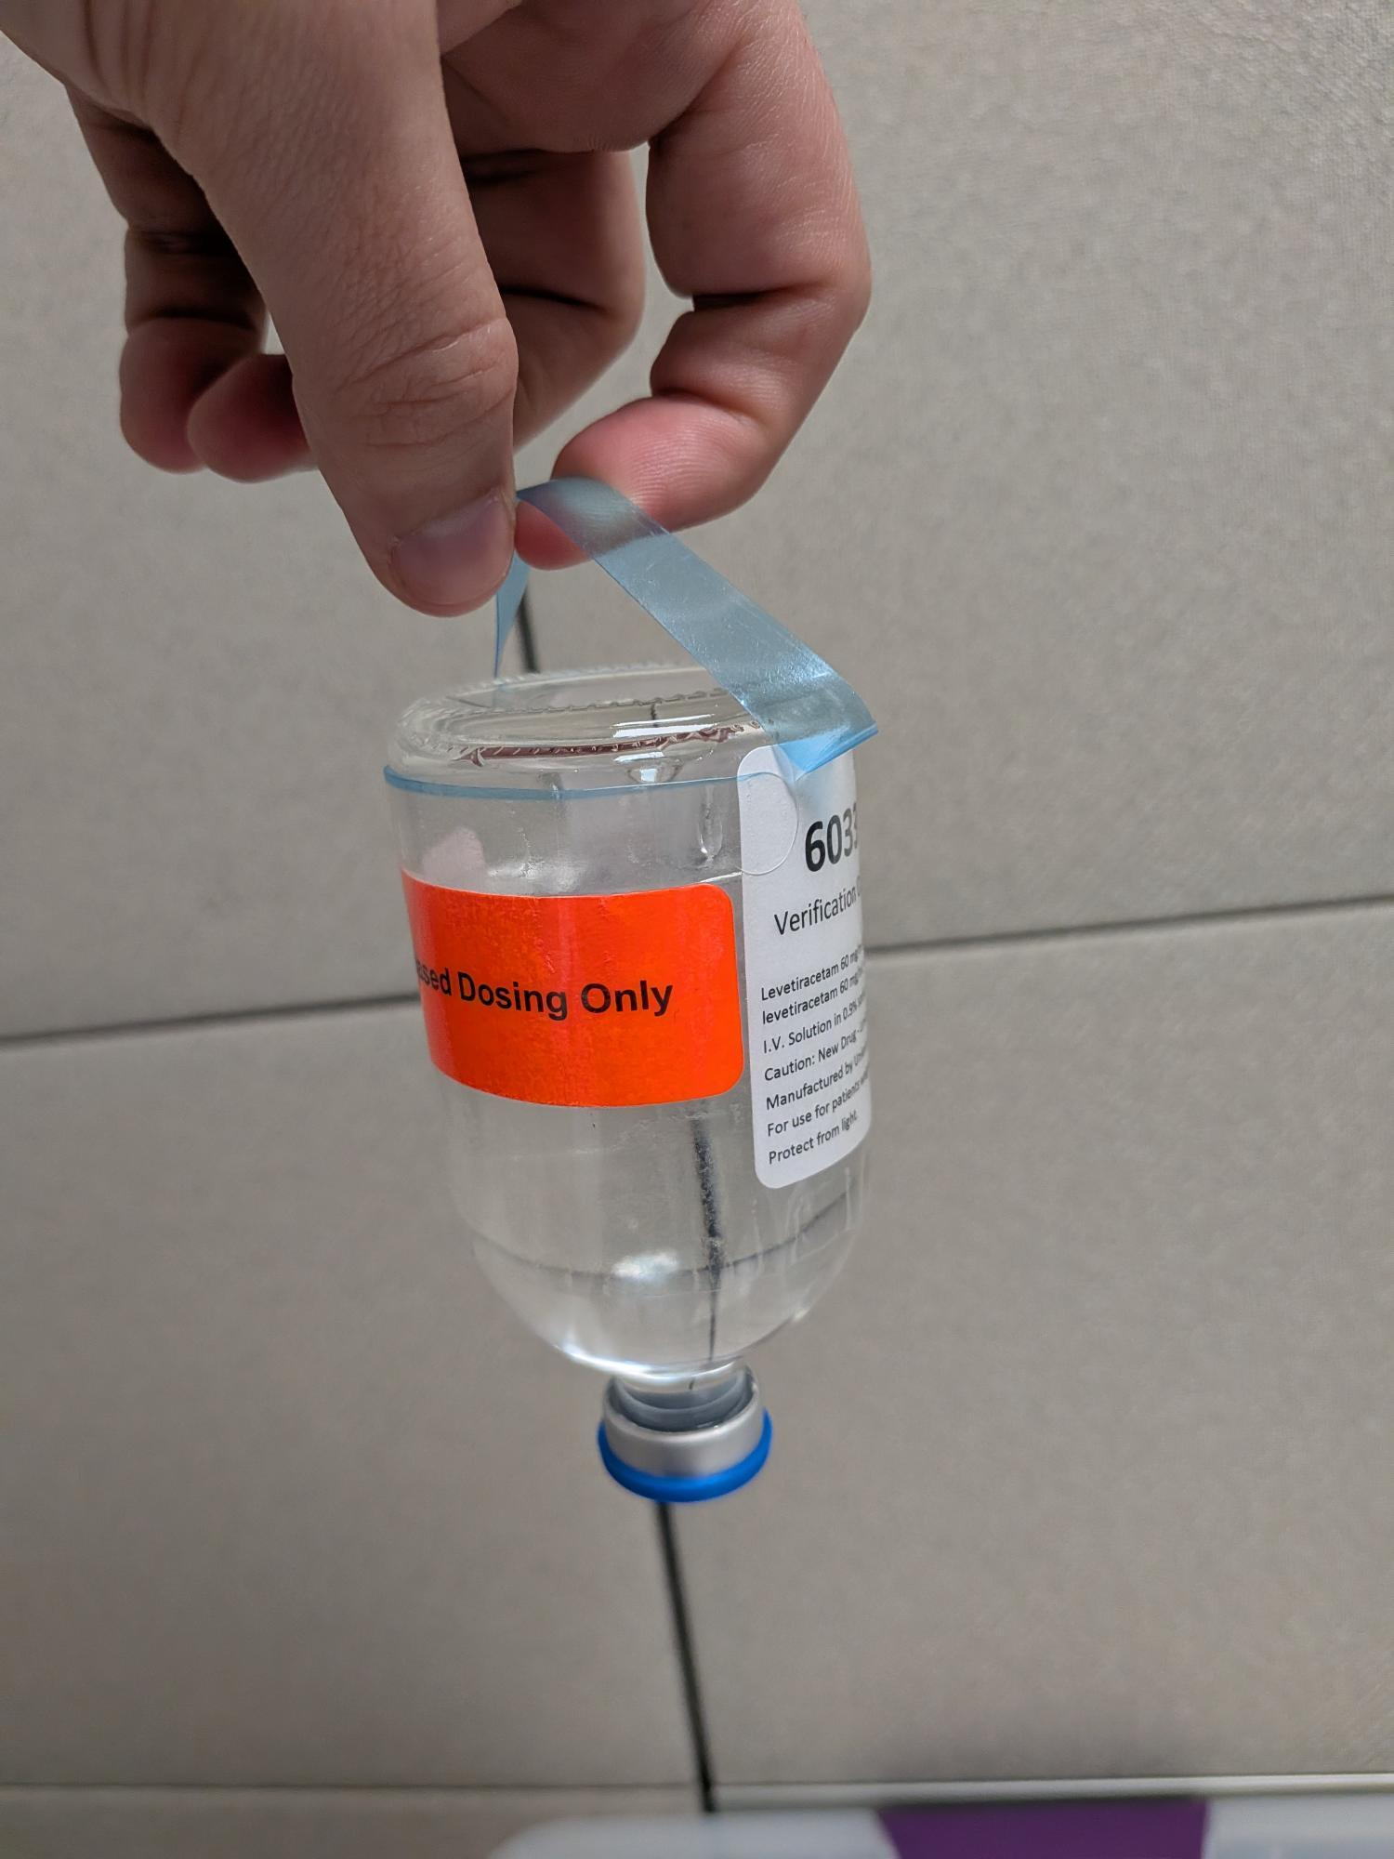
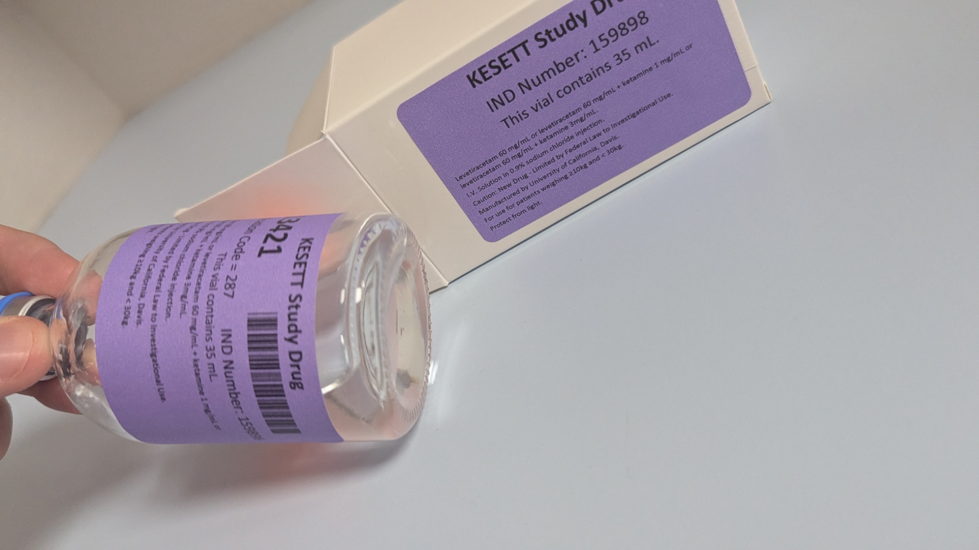

Slide 121

Vials
Vials contain LEV and KET, or LEV alone
Same concentration in all vials
Purple tier 35mL - Weight 30kg
Notes:
Study drug comes in a single vial that contains both levetiracetam and ketamine or placebo.
Purple labeled vials are for children <30 kg, white are for larger children and adults.
All vials contain the same concentrations of study drug. Only difference is the vial fill volume - purple has 35 cc, white has 90 cc. The purpose of the tiers is to minimize the risk of accidental overdose.
Best practice is to keep drug in the resuscitation bay omnicell or pyxis. Storage in a nearby ED pharmacy may be acceptable if it doesn’t cause delay. Storage in investigational pharmacy is unacceptable because of risk of delay.
Resuscitation areas treating kids and adults will receive one pre-randomized vial for each tier. Resuscitation areas treating only adults will receive one white tier pre-randomized vial.
Enrollments entered in WebDCU trigger the central pharmacy to ship a replacement pre-randomized vial on the next business day. Sites will have a backup vial that is moved to the resuscitation area after an enrollment, until the new randomized vial arrives. When the new randomized vial is received, it is placed in the resuscitation area and the backup vial is moved back to a pharmacy storage location outside of the resuscitation. High enrolling sites may have their par of randomized vials increased.

Slide 122
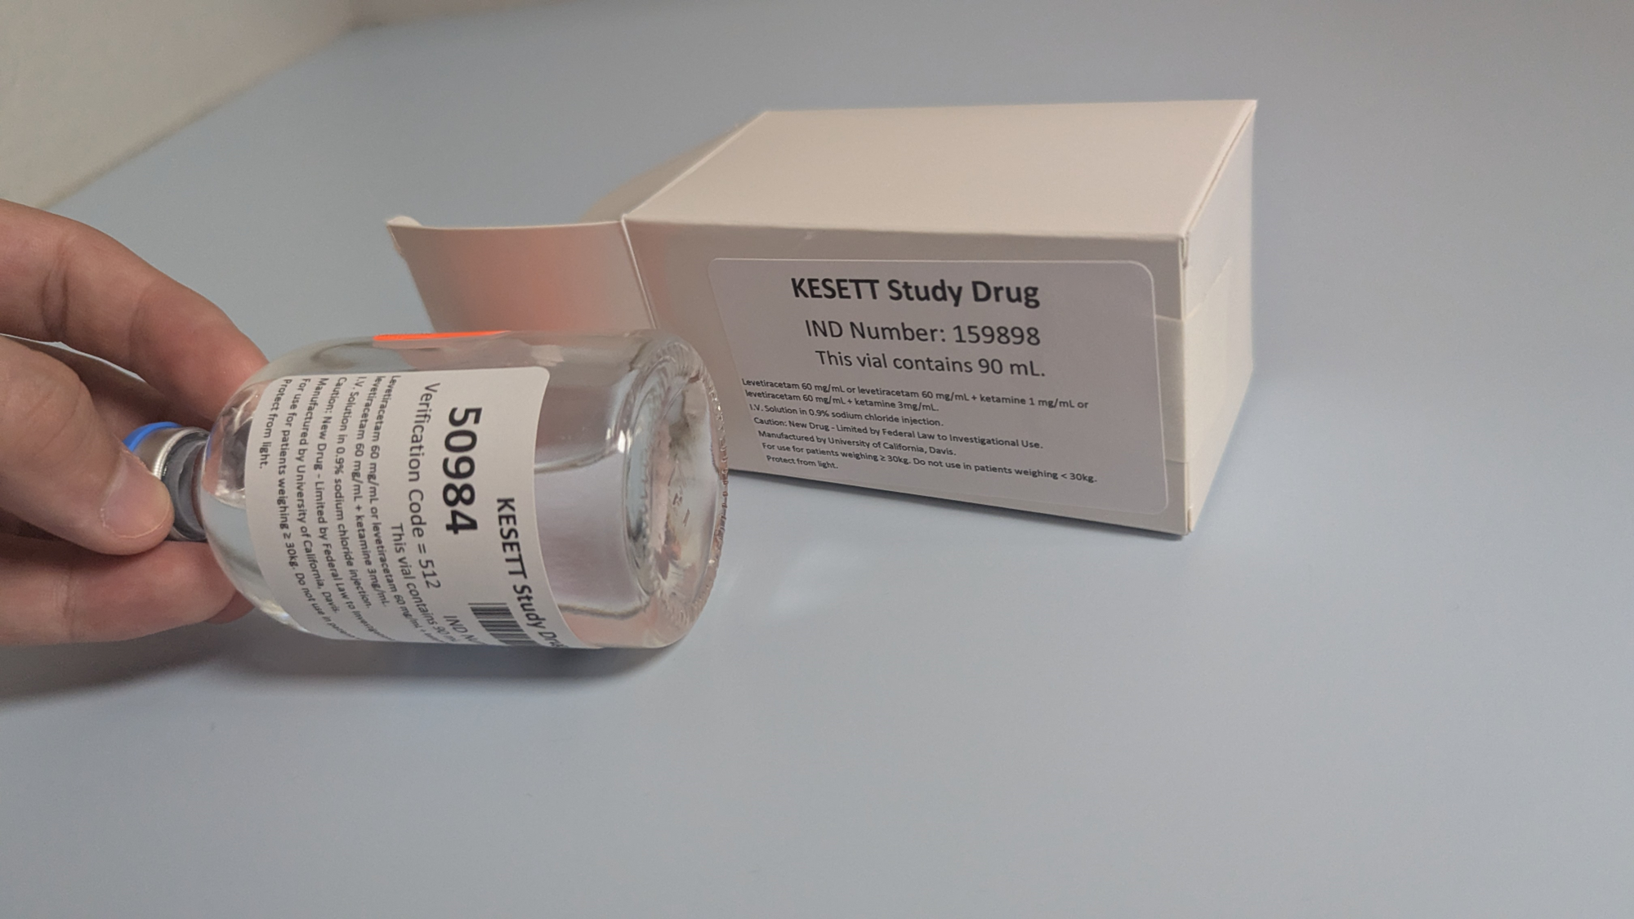
Drug ID on the vial
White tier 90mL - Weight 30kg
Use next vials and backup vials
Storage, replacement and shipping

Slide 123

Retrieved KESETT study drug spiked and inverted on hanger tab
Reminder Cards with instructions
Length-based weight-estimation tool
Your institutional pump
Study Ceribell with headbands in a basket below

Slide 124

Cavalry to the rescue!
Study team actions:
Write in your pager #!
1. Start or confirm EEG
2. Retrieve vial ID number
3. Record treatment outcomes at 15- and 60-min; ensure source docs are consistent
4. Identify LAR for informed consent approach; collect medical hx, home meds, race, ethnicity as needed
5. Complete enrollment CRFs in WebDCU within 8 hours
Study team needs to arrive as soon as possible
Notes:
Start EEG if not started already
Get vial number
Enter enrollment in WebDCU (with vial number)
Collect data (on worksheet or direct data entry) especially primary outcome
Ensure charting on source documents is accurate and consistent with worksheet
Seek LAR for notification and consent to continue
Collect data directly from participant or family (race, ethnicity, medical history, drug reconciliation)

Slide 125
Ideally within 5-15 minutes of study drug start
  Do not delay treatment
First hour is most important EEG data collection
Protocol cards include instructions

Slide 127

Ceribell Procedures
No PHI should be entered into research device
  Study Drug ID = 5 digits from vial label will identify the record
Stickers on headband boxes & recorder as reminder

Slide 128
Ceribell Procedures (cont.)
Record EEG for at least 1 hour and up to 4 hours
  OK to replace with clinical EEG if indicated, ideally after 1 hour mark
  Remove before MRI or CT; can be replaced afterwards
  Skin check at 2 hours per manufacturer
  Recover & reset device after recording complete
EEG waveform is viewable at the bedside; not readily available for site review in the portal

Slide 131
Have plan for how assessments will be performed and data documented
  In presence and absence of study team
  E.g., Worksheet, Smartphrase
Access the CRF study book in WebDCU to view what data points are required
  Project Management > CRF Collection Schedule > All CRFs in Header

Slide 133

Sites Released to Enroll: 9 / 69
Sites with Readiness Calls completed: 15 / 69
Yale New Haven Hospital
Temple University Hospital
University of Michigan
UC Davis Medical Center
Oregon Health & Sciences University
Arthur M. Blank Hospital
Harborview Medical Center
UVA Medical Center
Reading Hospital
Yale New Haven Hospital
Temple University Hospital
University of Michigan
UC Davis Medical Center
UVA Medical Center
Arthur M. Blank Hospital
Reading Hospital
Harborview Medical Center
Oregon Health & Sciences University
Children's National Medical Center
Nationwide Children's Hospital
Banner University Medical Center
Memorial Hermann Texas Medical Center
UPMC Children's Hospital of Pittsburgh
Grady Memorial Hospital

Slide 134
Sites Submitted to CIRB: 21 / 68
Sites with CIRB Approval: 10 / 68
Arthur M. Blank Hospital
Banner University Medical Center
Children's National Medical Center
Grady Memorial Hospital & Emory University Hospital
Harborview Medical Center
Jefferson Einstein Philadelphia Hospital
Memorial Hermann TMC
Nationwide Children’s Hospital
Nemours Children’s Hospital of Delaware
OHSU Wexner Hospital
OSU Wexner Medical Center
Reading Hospital
Stanford University
Temple University Hospital
UC Davis Medical Center
University of Michigan University
UPMC Presbyterian & Children’s Hospital of Pittsburgh
UVA Medical Center
Yale New Haven Hospital
🎉
Banner University Medical Center - Tucson
Children’s National Medical Center
Jefferson Einstein Philadelphia Hospital
Oregon Health & Scinces University Hospital
Reading Hospital
Temple University Hospital
UC Davis Medical Center
University of Michigan University Hospital
UVA Medical Center
Yale New Haven Hospital

Slide 135
Sites with Local IRB Ceding Acknowledgement in WebDCU:
44 / 68
Riley Hospital for Children/IU Health
Ronald Reagan UCLA Medical Center
Rush University Medical Center
Stanford University Medical Center
Temple University Hospital
UC Davis Medical Center
University of Alabama
University of Cincinnati Medical Center
University of Illinois Hospital
University of Maryland Medical Center
University of Michigan University Hospital
University of Minnesota Masonic Children's
University of Minnesota Medical Center
University of New Mexico Hospital
University of Utah Healthcare
UPMC Presbyterian & Children’s of Pittsburgh
UVA Medical Center
VCU Medical Center
Yale New Haven Hospital
Banner University Medical Center
Children’s Hospital Los Angeles
Children's Hospital of Wisconsin
Children's Medical Center UTSW
Children's National Medical Center
Froedtert Hospital
Harbor-UCLA Medical Center
Harborview Medical Center
IU Health Methodist Hospital
Jefferson Einstein Philadelphia Hospital
Johns Hopkins Hospital
Memorial Hermann Texas Medical Center
Nationwide Children's Hospital
Northwestern Memorial Hospital
Oregon Health & Sciences University Hospital
OSU Wexner Medical Center
Reading Hospital

Slide 136


Slide 137
Sites with CIRB Approval: 22 / 69
Arthur M. Blank Hospital
Banner University Medical Center
Children's National Medical Center
Emory University Hospital
Grady Memorial Hospital
Harborview Medical Center
IU Health Methodist Hospital
Jefferson Einstein Philadelphia Hospital
Memorial Hermann
Nationwide Children's Hospital
Nemours Children’s Hospital
Oregon Health & Sciences University
OSU Wexner Medical Center
Reading Hospital
Riley Hospital for Children/IU Health
Temple University Hospital
UC Davis Medical Center
University of Michigan
UPMC Children's Hospital of Pittsburgh
UPMC Presbyterian Hospital
UVA Medical Center
Yale New Haven Hospital

Slide 138
eConsent
Vince

Slide 139
e-Consent
RedCap Electronic consent is the prefered way to collect informed consent forms for SIREN
EFIC enrollments only
Best for remote verification
Site Specific link
  Will include site language
  Will include local HIPAA waivers and experimental bill of rights
    Please send these to Vince and double check they are in your build
Part 11 compliant

Slide 140

Test link to be used by all sites.
Site specific builds will have unique links in WebDCU

Slide 141

In person vs over phone will dictate the attestation pathway
Ensure correct relationship is being selected
Participation Y/N will require a signature either way

Slide 142

Attestation of consent by the authorized study team member collecting consent
If collected on paper or remote this will be sent in a seperate form

Slide 143

Verification that selections are collect and agreement to signature
Required for clinical trial eConsent

Slide 144

Copy can be sent to the signers email
If this is a remote consent they can also download a copy

Slide 145

All study team members with consent responsibility will receive an email copy and notification
Secure email sent automatically

Slide 146

Following consent a participant contact form will be sent via email to the group

Slide 147

Paper and Remote Consent
Participant contact form will ask how consent was obtained if on paper upload the scanned PDF here
Attestation will be sent in a separate email

