Slide 1

All-Site Call
April 3, 2026

Slide 2
Agenda
 | Study updates
 | Enrollment Workflow
 | Adverse Event reporting
 | DCC updates
 | Training: Study team & Clinical team
 | eConsent

Slide 3
Study Updates
Megan

Slide 4
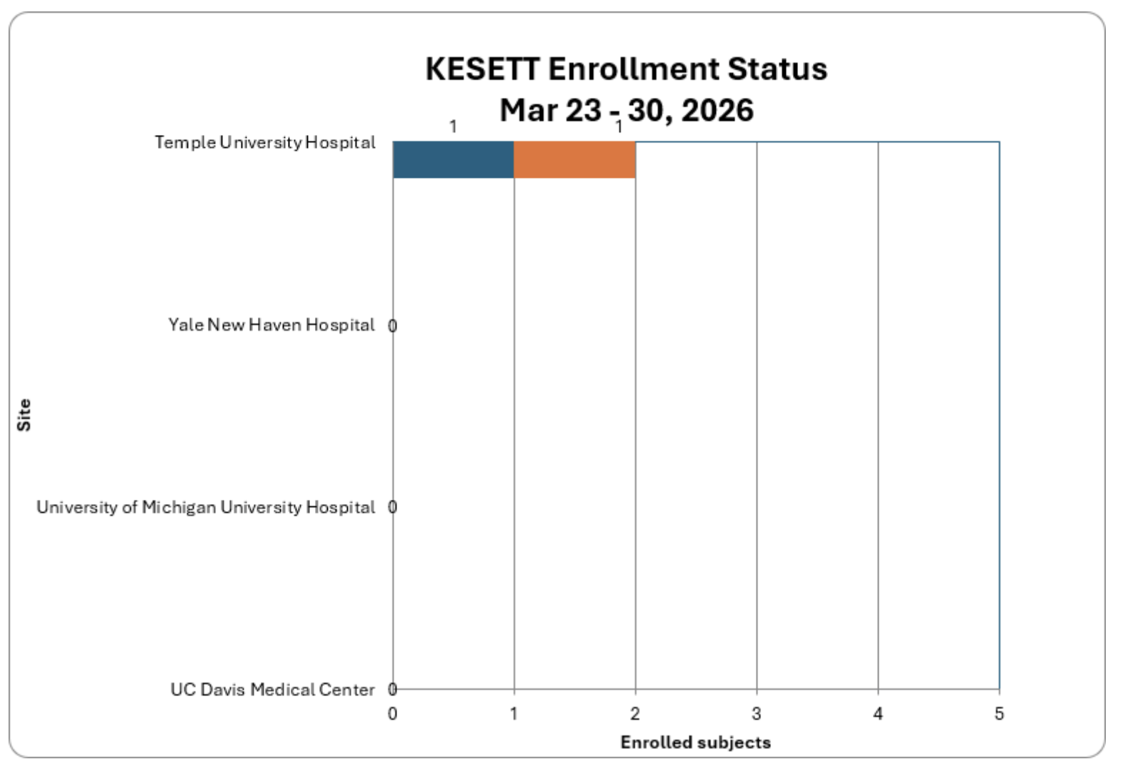

Total enrollment: 2
Sites Released to Enroll: 4
Sites with Enrollments: 1
Target Enrollment: 770
Orange: New enrollments in past week
Blue: Enrollments from > 1 week ago

Slide 5

Sites Released to Enroll: 4 / 68
Sites with Readiness Calls completed: 9 / 68
Temple University Hospital
Yale New Haven Hospital
University of Michigan University Hospital
UC Davis Medical Center
Harborview Medical Center
Temple University Hospital
UC Davis Medical Center
University of Michigan University Hospital
OHSU Hospital
Yale New Haven Hospital
Children’s National Medical Center
UVA Medical Center
Memorial Hermann Texas Medical Center

Slide 6
Sites Submitted to CIRB: 21 / 68
Sites with CIRB Approval: 10 / 68
Arthur M. Blank Hospital
Banner University Medical Center
Children's National Medical Center
Grady Memorial Hospital & Emory University Hospital
Harborview Medical Center
Jefferson Einstein Philadelphia Hospital
Memorial Hermann TMC
Nationwide Children’s Hospital
Nemours Children’s Hospital of Delaware
OHSU Wexner Hospital
OSU Wexner Medical Center
Reading Hospital
Stanford University
Temple University Hospital
UC Davis Medical Center
University of Michigan University
UPMC Presbyterian & Children’s Hospital of Pittsburgh
UVA Medical Center
Yale New Haven Hospital
🎉
Banner University Medical Center - Tucson
Children’s National Medical Center
Jefferson Einstein Philadelphia Hospital
Oregon Health & Scinces University Hospital
Reading Hospital
Temple University Hospital
UC Davis Medical Center
University of Michigan University Hospital
UVA Medical Center
Yale New Haven Hospital

Slide 7
Sites with Local IRB Ceding Acknowledgement in WebDCU:
44 / 68
Riley Hospital for Children/IU Health
Ronald Reagan UCLA Medical Center
Rush University Medical Center
Stanford University Medical Center
Temple University Hospital
UC Davis Medical Center
University of Alabama
University of Cincinnati Medical Center
University of Illinois Hospital
University of Maryland Medical Center
University of Michigan University Hospital
University of Minnesota Masonic Children's
University of Minnesota Medical Center
University of New Mexico Hospital
University of Utah Healthcare
UPMC Presbyterian & Children’s of Pittsburgh
UVA Medical Center
VCU Medical Center
Yale New Haven Hospital
Banner University Medical Center
Children’s Hospital Los Angeles
Children's Hospital of Wisconsin
Children's Medical Center UTSW
Children's National Medical Center
Froedtert Hospital
Harbor-UCLA Medical Center
Harborview Medical Center
IU Health Methodist Hospital
Jefferson Einstein Philadelphia Hospital
Johns Hopkins Hospital
Memorial Hermann Texas Medical Center
Nationwide Children's Hospital
Northwestern Memorial Hospital
Oregon Health & Sciences University Hospital
OSU Wexner Medical Center
Reading Hospital

Slide 8
Sites with initial EFIC activities completed: 31 / 68
Arthur M. Blank Hospital
Banner University Medical Center - Tucson
Children’s Hospital of Wisconsin
Children’s National Medical Center
Christiana Hospital
Cooper University Hospital
Emory University
Froedtert Hospital
Grady Memorial Hospital
Harborview Medical Center
Hospital of the University of Pennsylvania
IU Health Methodist Hospital
Jefferson Einstein Philadelphia Hospital
Memorial Hermann Texas Medical Center
Nationwide Children’s Hospital
Oregon Health & Sciences University Hospital
OSU Wexner Medical Center
Penn Presbyterian Medical Center
Reading Hospital
Riley Hospital for Children/IU Health
San Francisco General Hospital
Stanford
Temple University Hospital
UC Davis Medical Center
UCSF Medical Center
University of Michigan University Hospital
University of Iowa Medical Center
UPMC Presbyterian Hospital
UPMC Children’s Hospital of Pittsburgh
UVA Medical Center
Yale New Haven Hospital

Slide 9
Enrollment Experiences
Temple University Hospital
PI: Derek Eisenberg
PSC: Austin Hsin

Slide 10
Study Timeline
Award entered an NCE in January pending completion of Y1 milestones
February 2026: 1st site released to enroll
February 2026: 1st participant randomized
End of May 2026: 50% sites CIRB approved
End of June 2026: 50% sites released to enroll

Slide 11
Contracts & Payments
Award entered a NCE in January
Contract extensions in progress between Michigan & hubs: required before site payments can be processed
Milestone start-up payments ($10,000 ea. including F&A):
  #1: Local IRB ceding approval; eDOA accepted; Local Context Form; UAB intake meeting; plans for 2 in-person CC events
  #2: Readiness call completed & open to enrollment

Slide 12
Ancillary Studies
KPOP: KESETT-Pharmacokinetics Outcomes, and Pharmacodynamics Study (MPI: Coles & Rosenthal)
  Scored outside the NINDS pay line but within the historical range for select-pay considerations
  Planning for resubmission July 2026
COGNISE: COGnition and Neurodegenerative biomarkers In Status Epilepticus (PI: Zawar)
  Long term follow up to study cognitive & functional outcomes after ESE
  Submitted Feb 2026; earliest start Dec 2026

Slide 13
Enrollment Workflow

Slide 14
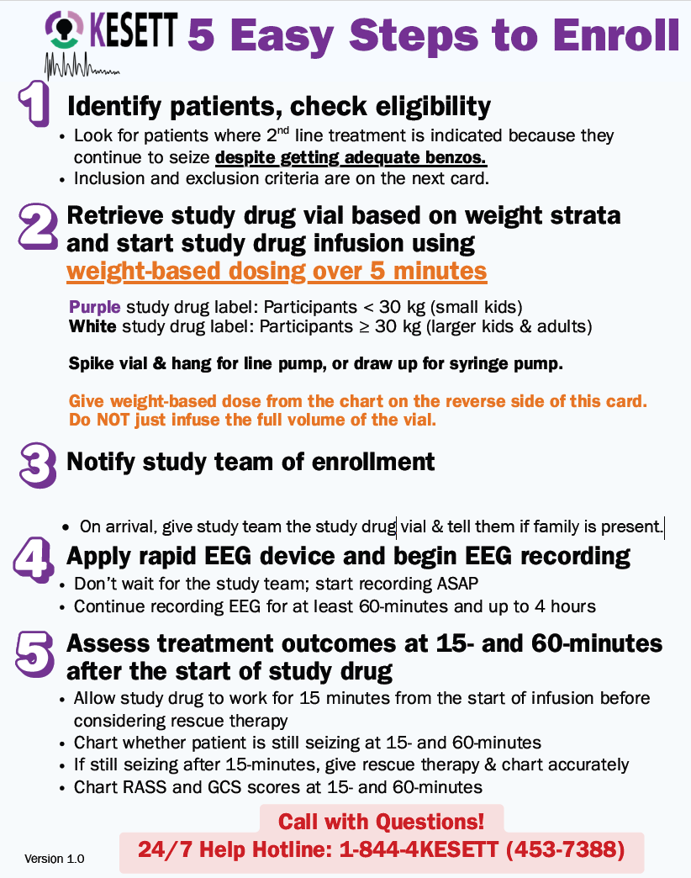

Protocol Premises
KESETT should never delay treatment of status epilepticus
KESETT is based upon guideline-
concordant treatment of status

Slide 15
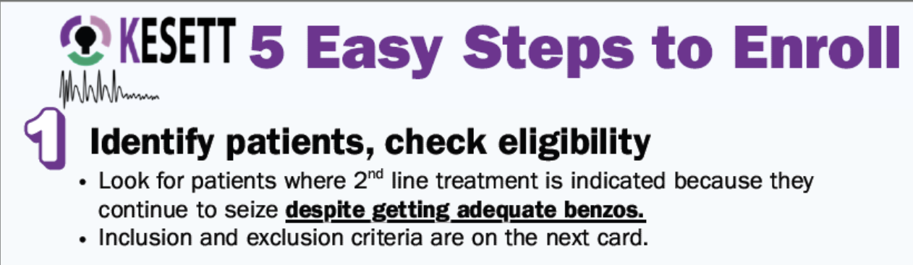
Clinical team needs to be aware of study and screening
Study team can assist via EHR alerts, EMS alerts, etc.
Leverage key teams such as ED pharmacy
Provider will assess eligibility and enroll; investigator will confirm eligibility later for CRF entry

Slide 16
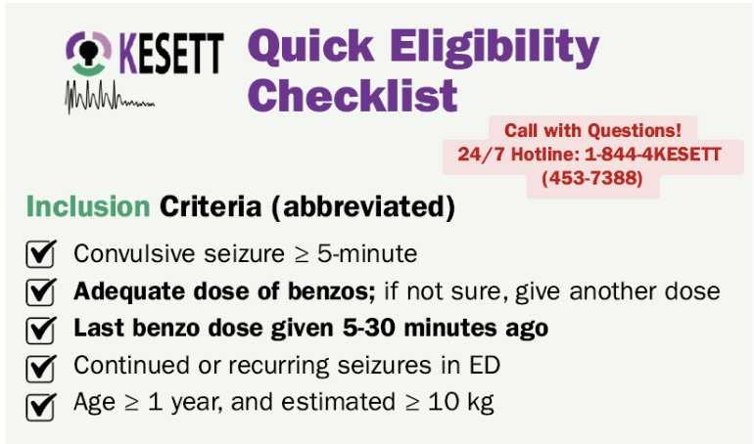
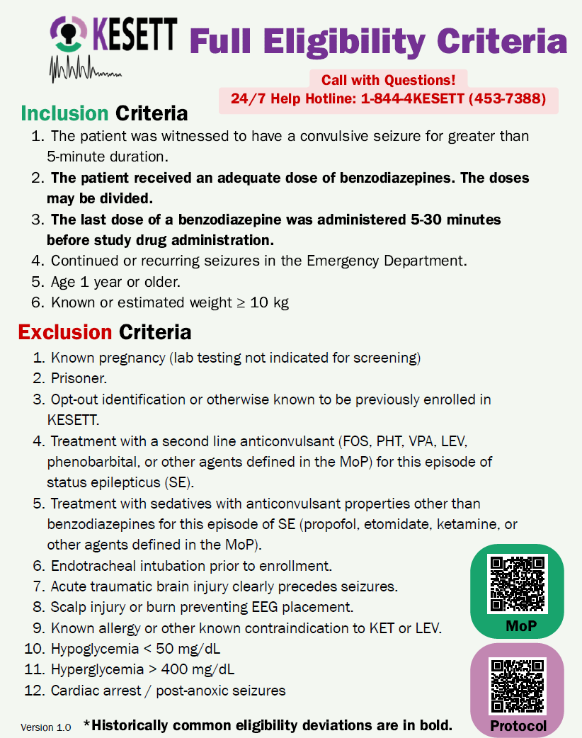
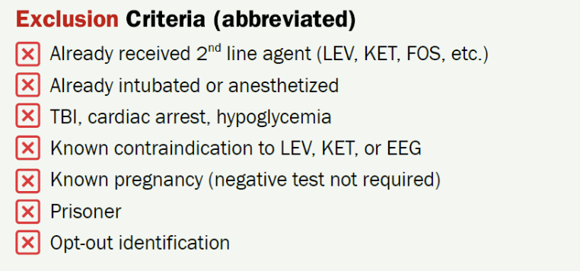

Slide 17
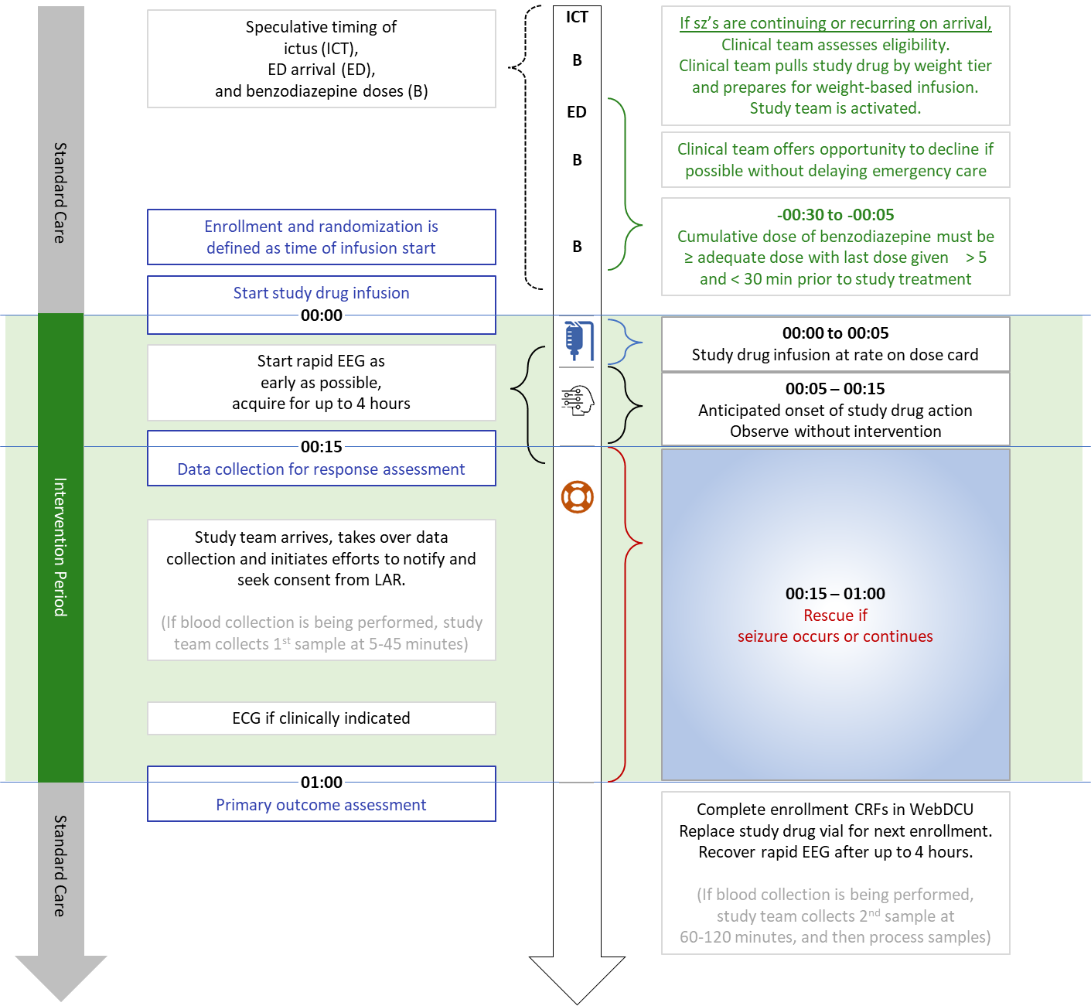

Slide 18
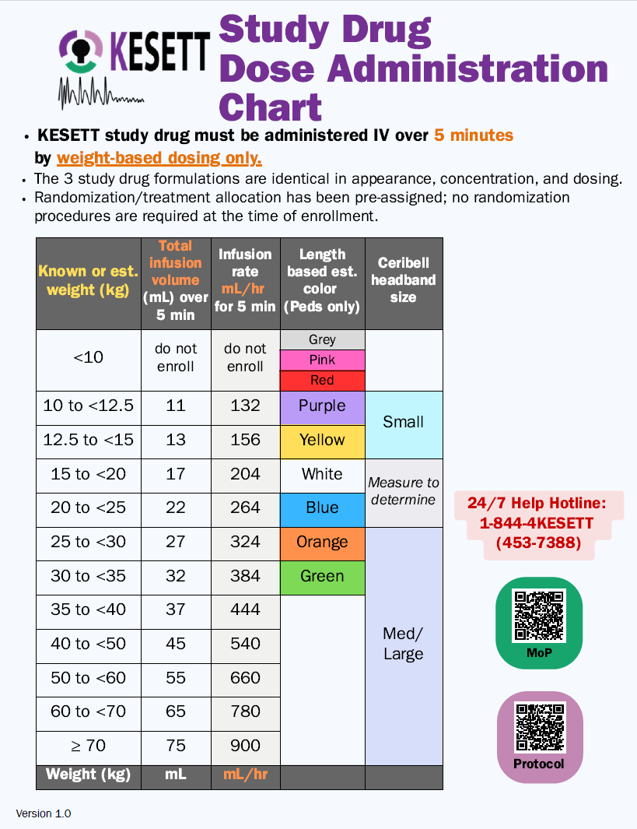
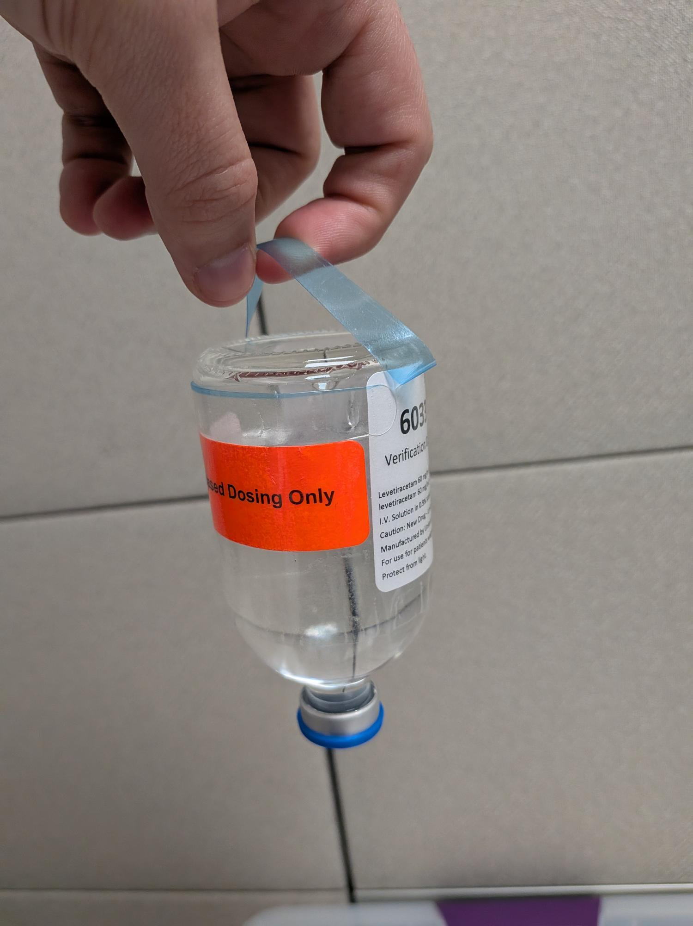
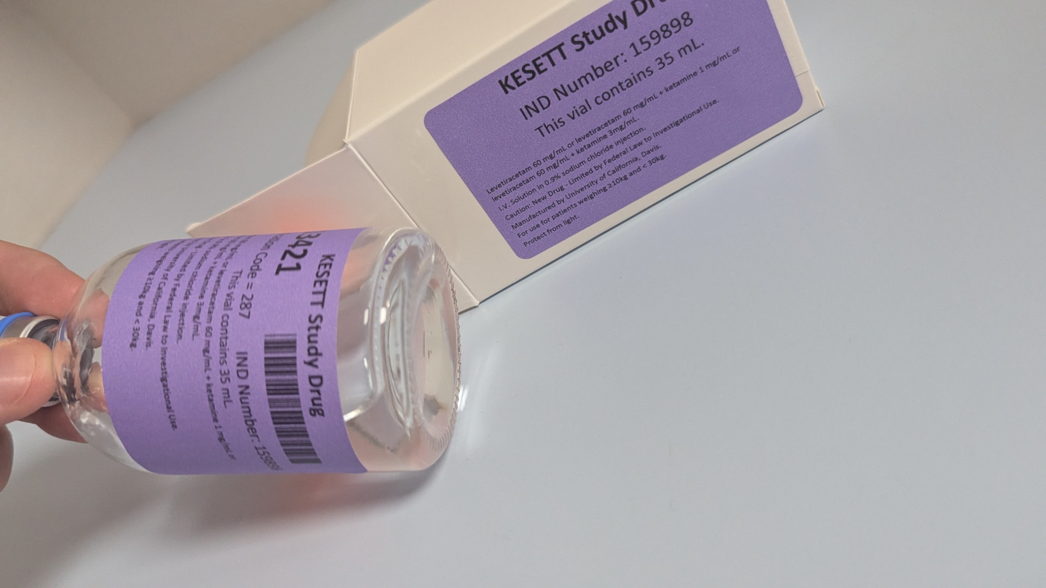

Slide 19


Slide 20

Vials
Vials contain LEV and KET, or LEV alone
Same concentration in all vials
Purple tier 35mL - Weight 30kg
Notes:
Study drug comes in a single vial that contains both levetiracetam and ketamine or placebo.
Purple labeled vials are for children <30 kg, white are for larger children and adults.
All vials contain the same concentrations of study drug. Only difference is the vial fill volume - purple has 35 cc, white has 90 cc. The purpose of the tiers is to minimize the risk of accidental overdose.
Best practice is to keep drug in the resuscitation bay omnicell or pyxis. Storage in a nearby ED pharmacy may be acceptable if it doesn’t cause delay. Storage in investigational pharmacy is unacceptable because of risk of delay.
Resuscitation areas treating kids and adults will receive one pre-randomized vial for each tier. Resuscitation areas treating only adults will receive one white tier pre-randomized vial.
Enrollments entered in WebDCU trigger the central pharmacy to ship a replacement pre-randomized vial on the next business day. Sites will have a backup vial that is moved to the resuscitation area after an enrollment, until the new randomized vial arrives. When the new randomized vial is received, it is placed in the resuscitation area and the backup vial is moved back to a pharmacy storage location outside of the resuscitation. High enrolling sites may have their par of randomized vials increased.

Slide 21
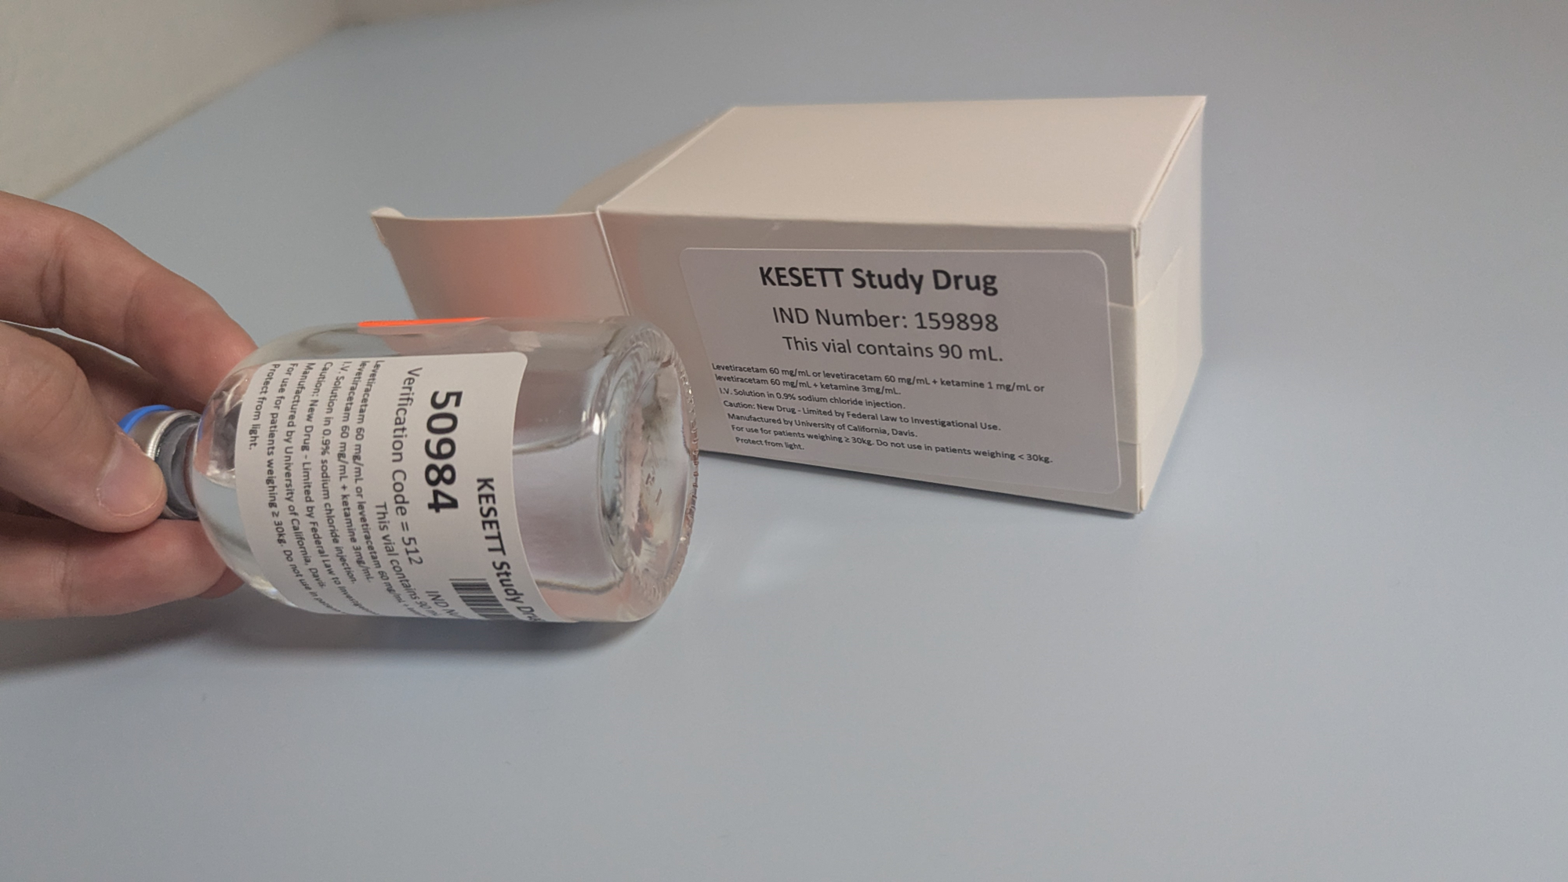
Drug ID on the vial
White tier 90mL - Weight 30kg
Use next vials and backup vials
Storage, replacement and shipping

Slide 22
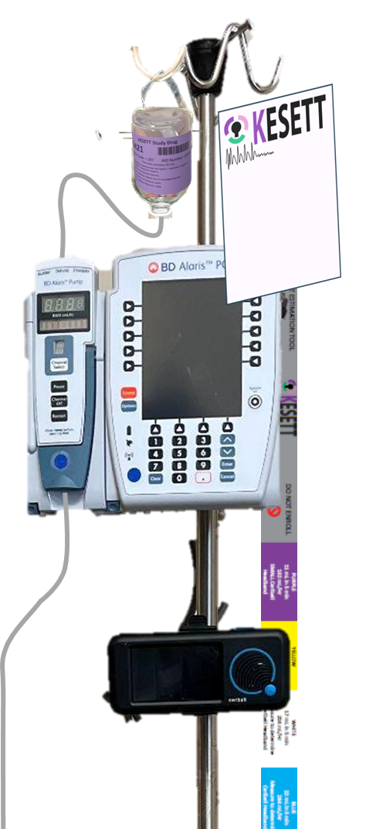
Retrieved KESETT study drug spiked and inverted on hanger tab
Reminder Cards with instructions
Length-based weight-estimation tool
Your institutional pump
Study Ceribell with headbands in a basket below

Slide 23
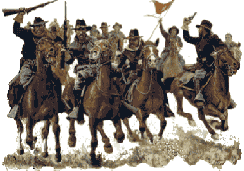
Cavalry to the rescue!
Study team actions:
Write in your pager #!
1. Start or confirm EEG
2. Retrieve vial ID number
3. Record treatment outcomes at 15- and 60-min; ensure source docs are consistent
4. Identify LAR for informed consent approach; collect medical hx, home meds, race, ethnicity as needed
5. Complete enrollment CRFs in WebDCU within 8 hours
Study team needs to arrive as soon as possible
Notes:
Start EEG if not started already
Get vial number
Enter enrollment in WebDCU (with vial number)
Collect data (on worksheet or direct data entry) especially primary outcome
Ensure charting on source documents is accurate and consistent with worksheet
Seek LAR for notification and consent to continue
Collect data directly from participant or family (race, ethnicity, medical history, drug reconciliation)

Slide 24
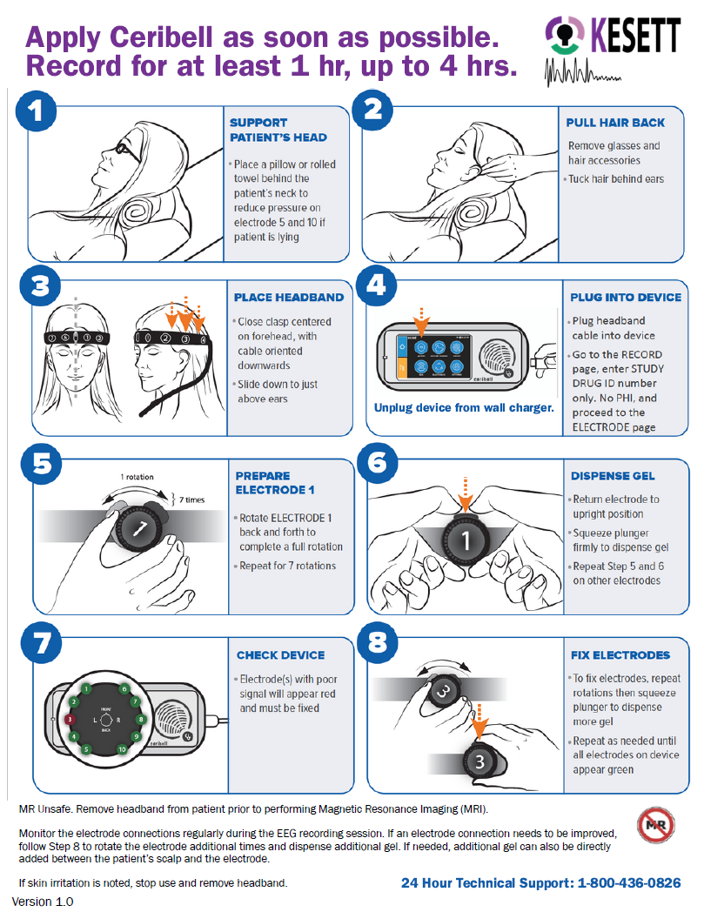
Ideally within 5-15 minutes of study drug start
  Do not delay treatment
First hour is most important EEG data collection
Protocol cards include instructions

Slide 26
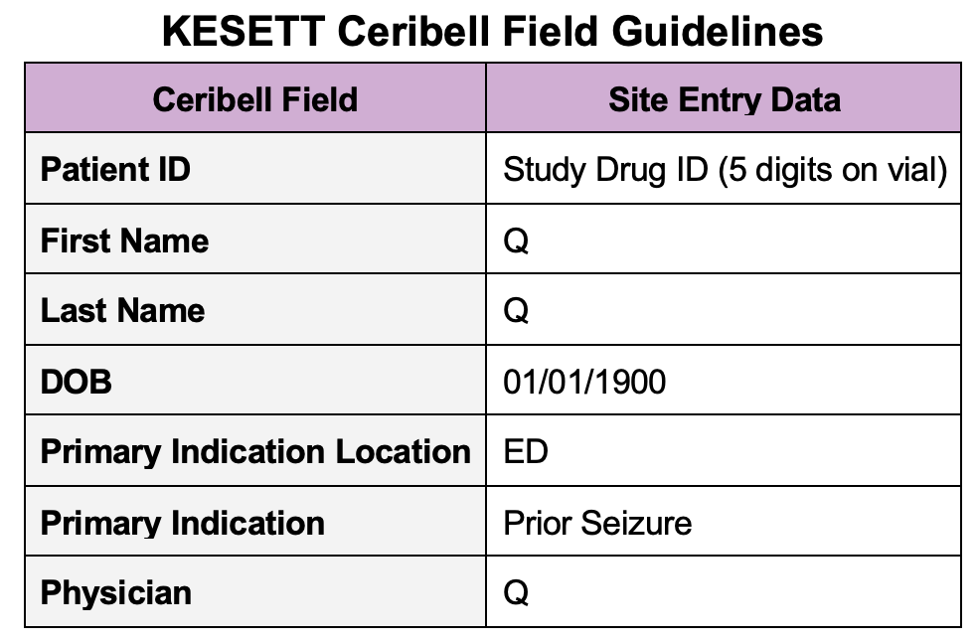
Ceribell Procedures
No PHI should be entered into research device
  Study Drug ID = 5 digits from vial label will identify the record
Stickers on headband boxes & recorder as reminder

Slide 27
Ceribell Procedures (cont.)
Record EEG for at least 1 hour and up to 4 hours
  OK to replace with clinical EEG if indicated, ideally after 1 hour mark
  Remove before MRI or CT; can be replaced afterwards
  Skin check at 2 hours per manufacturer
  Recover & reset device after recording complete
EEG waveform is viewable at the bedside; not readily available for site review in the portal

Slide 28
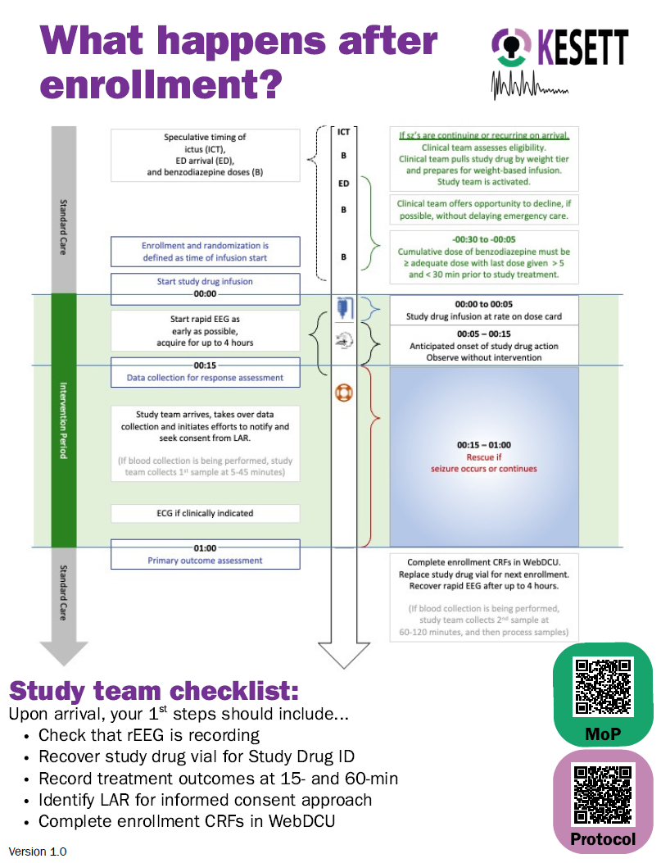

Slide 30
Have plan for how assessments will be performed and data documented
  In presence and absence of study team
  E.g., Worksheet, Smartphrase
Access the CRF study book in WebDCU to view what data points are required
  Project Management > CRF Collection Schedule > All CRFs in Header

Slide 32
Adverse Event
Reporting
Robert

Slide 33
Adverse Event Reporting
Serious and nonserious AE in the first 24 hours
Serious adverse events (SAEs) until participant’s end of study
  Discharge from hospital, death, or 30 days since enrollment

Slide 34
Reminders:
Report the pathology / diagnosis, not individual symptoms or outcome
Report the pahtology / diagnosis, not the treatment
Don’t report pre-existing pathology, unless substantially worsened
Don’t report abnormal labs if they are not clinically significant
Recurrent seizures in 1st hour are considered pre-existing condition and therefore not considered AEs unless significantly worsened leading to death, intubation, or otherwise clinically significant (CS

Slide 35
Type of Events on CRF
The events type question uses trial-specified definitions
Event type does NOT mean something
  Is an AE or not, or serious or not, or is reportable or not
Refer to MoP for definitions
Life-threatening hypotension
Life-threatening cardiac arrhythmias
Acute recurrent seizure
Acute anaphylaxis
Respiratory Failure
Laryngospasm
Emergence reaction
Adverse events related to cardiac conduction abnormalities

Slide 36
Acute recurrent seizures
Recurrent seizures in 1st hour are considered pre-existing condition and therefore not considered reportable AEs…
…unless significantly worsened leading to death, intubation, or otherwise clinically significant

Slide 37
Agitation & Emergence Reactions
Additional guidance added to MoP Section 8.1
Agitation in 1st hour is usually considered a pre-existing condition and therefore is not considered reportable AEs…
…unless significantly worsening leading to death, intubation, or otherwise clinically significant complications
Also report agitation when it is NOT consistent with with typical post-ictal phenomena
  ketamine emergence reactions
  delirium tremons

Slide 38

Follow up procedures
After 24 hours
AE’s
At participant’s end of study (hospital discharge, death, or 30 days from enrollment)
SAE’s and secondary outcomes
Report within 24 hours of knowledge of event

Slide 39
Data Coordinating Center (DCC)
Morgan

Slide 40
WebDCU Access
KESETT is the first SIREN study hosted in WebDCUv2
https://webdcu.musc.edu/DCUApp/Login
Permissions are granted based on eDOA roles and responsibilities.
KESETT is a live database. DO NOT enter test data.
Notes:
KESETT is the 1st SIREN study hosted in WebDCU version 2. The link is different than WebDCU version 1, so when you are logging in to find KESETT, please make sure you are using the correct link.
Permissions are granted based on eDOA roles and responsibilities. If you do not have permissions, reach out to your site’s PSC to make sure you are on the DOA with the appropriate roles and responsibilities. If anyone is in need of regulatory permissions to work on the DOA or reg docs, please email us at the DCC.
As a reminder, KESETT is a live database, so please do not be entering any test data.

Slide 41
Screen Failures
Screen failures will be collected throughout the study. Sites will complete the Screen Failure form in WebDCU™.
Screen failures should be comprehensive of all patients >=1 year who meet the following criteria:
Patients seen in the ED of the enrolling site and;
administered LEV, valproate (valproic acid), or fosphenytoin intravenously for the treatment of seizures or status epilepticus and;
not enrolled in KESETT.
Notes:
Screen failures will be collected throughout the duration of the study.
Sites will document instances of screen failures into the Screen Failure form in WebDCU.
Screen failures will include all patients at least 1 year in age who also 1) have been seen in the ED of the enrolling site, 2) were administered LEV, valproic acid, or fosphenytoin intravenously to treat seizures or status epilepticus, and 3) have not been previously enrolled in KESETT.

Slide 42
Screen Failures
Screen failures should be logged in WebDCU for:
Patients to whom the study team is alerted to in real time, but are not enrolled.
Patients who met SF criteria but were not alerted to the study team or enrolled.
  These can be identified in a variety of ways per local practice. Commonly expected to be performed by study coordinators via a search of electronic medical record data followed by manual chart review.
  Should be performed at least monthly
Notes:
Sites will enter screen failures into WebDCU for patients whom 1) the study team is alerted to in real time but are not already previously enrolled,
2) and those who met screen failure criteria but were not alerted to the study team nor enrolled. Patients under this second circumstance can be identified in a variety of ways per local practices. This is commonly anticipated to be performed by study coordinators via a search through EMR data followed by a manual chart review.
Whichever local practice your site identifies, this should be completed on at least a monthly basis.

Slide 43
KESETT Enrollment
NO Randomization form to complete →
  Instead, grab the ‘Use Next’ vial (or ‘Backup’ if ‘Use Next’ not available) and begin study drug infusion.
Within 8 hours of start of infusion →
  Add a new record to the Subject Enrollment table, complete, and save the record.
  Open the Subject CRF Binder and…
    Complete and submit F501 Rapid EEG.
    Complete and submit F502 Study Drug Infusion.
Notes:
KESETT is a step forward randomization design, so there is not a randomization form to complete in WebDCU. Rather, sites will grab the ‘Use Next’ vial (or ‘Backup’ if the ‘Use Next’ vial is no longer available) and begin study drug infusion.
Within 8 hours of initiation of study drug infusion, you will add a new record to the Subject Enrollment table, then complete and save the record. From here, you will open the Subject CRF Binder, complete, and submit F501 (Rapid EEG) and F502 (Study Drug Infusion), also within this 8-hour window.
Documentation of the Study Drug ID into F502 will tell the DCC which treatment assignment the participant received.

Slide 44
Infusion date/time entry
Item | Form | Question #
Study drug infusion start date/time | Subject Enrollment | Q20/Q21
Study drug infusion end date/time | F502 Study Drug Infusion | Q04/Q05
Notes:
Please note that the infusion start and end times are located on separate forms. The study drug infusion START date & time are collected on the Subject Enrollment form and the END date & time are collected on F502 Study Drug Infusion.
If either of these dates or times need to be revised after data entry, you will then navigate back to the appropriate form to make the revision.

Slide 45
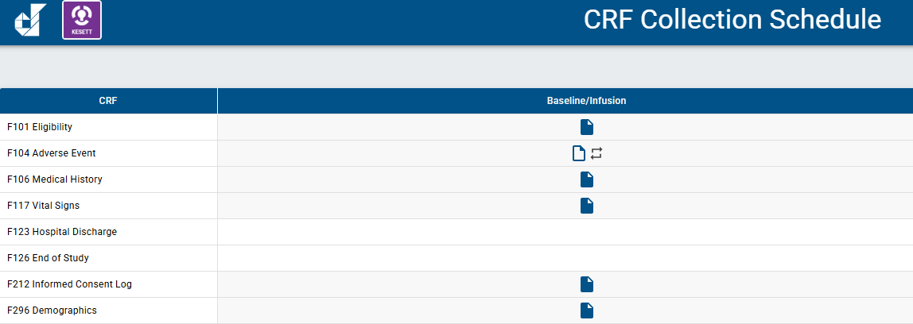
Printable CRFs
KESETT > Project Setup > CRF Collection Schedule
Notes:
To access printable CRFs in WebDCU, you’ll navigate to the Project Setup tab, then the CRF Collection Schedule table. From here, you will click on the CRF name, as indicated by the red arrow. This selection then pulls up a printable version of the form.
This can be a helpful tool if your preference is to have physical copies of the CRFs at your disposal.

Slide 46
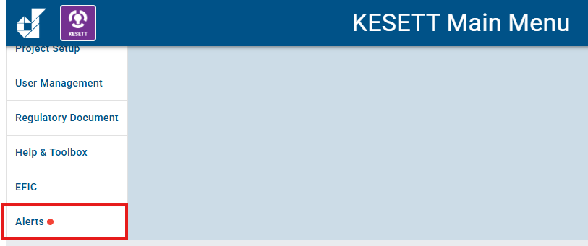
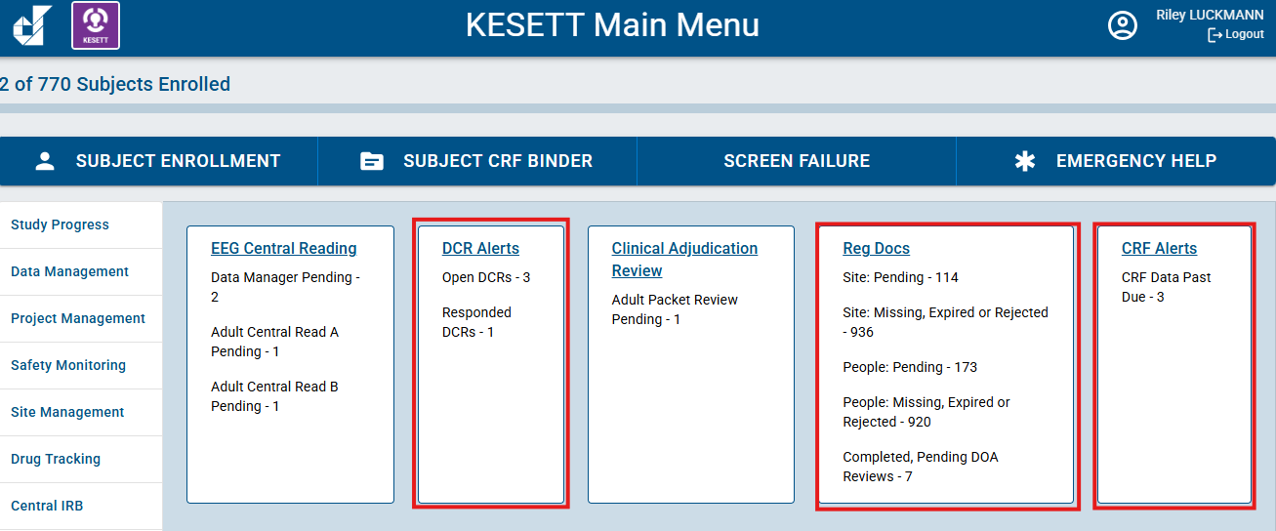
Alerts
Notes:
We wanted to also offer a reminder that the Alerts tab at the bottom of the menu bar on the left side of the screen gives a helpful count of overdue items at your site. This includes DCR alerts, reg doc statuses, and CRF Alerts. By clicking on any of those items, WebDCU will automatically take you to a filtered page showing the appropriate items that may need attention.

Slide 47
Data Timelines
CRF data must be submitted within 5 days of collection. This also applies to:
  Screen Failure forms
  Queries/DCRs (should respond to within 5 days of generation)
Exceptions:
  Subject Enrollment, F501 Rapid EEG, F502 Study Drug Infusion: must be submitted within 8 hours of study drug administration
  Form 104 Adverse Event: SAEs and queries/DCRs must be submitted within 24 hours of knowledge of event
Notes:
CRF data must be submitted within 5 days of collection. This includes Screen Failures and DCRs.
Exceptions include the the aforementioned Subject Enrollment form, F501 (Rapid EEG), and F502 (Study Drug Infusion), which need to be submitted within 8 hours of administration of the study drug.
Another exception includes SAEs and DCRs documented on F104 (Adverse Event), which need to be submitted within 24 hours of knowledge of the event.

Slide 48
DCC Resources
SIREN Website
  Data Collection Guidelines
  WebDCUv2 User Manual
Contact us
  Riley Luckmann (luckmann@musc.edu)
  Morgan Davie (daviem@musc.edu)
  Sara Meyer (butlers@musc.edu)

Slide 49
Training:
Study Team & Clinical Team
Megan

Slide 50
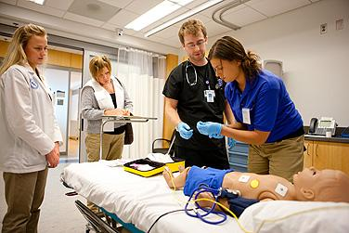
Educate, monitor, re-educate
Change of shift
Simulated mock enrollments
Academic “detailing”
Notes:
Clinical staff training. Dependence on Guideline concordant usual care, adequate dosing of benzodiazepines, need to wait for effect, stepwise progression to second and third line (not returning to first line after determining to benzo refractory), giving a chance to wake up.
Study should never delay treatment of status. Not for an opt-out discussion. Not for EEG prior to treatment. Pharmacy must be as fast as usual care.

Slide 51
Resources Available
Kesett.org > Education & Training tab
  Enrollment video
  Clinical team slide deck
  Safety of ketamine video
  IM videos
  Ceribell training videos

Slide 52
Suggested methods
Faculty meetings
Charge nurse meetings
In-service meetings
Mock enrollments/seizure codes
Email
Info sheets

Slide 53
Discussion:
Experiences with mock enrollments?
What has worked well for clinical team trainings and/or Ceribell trainings at your site?
What other resources would help?

Slide 54
eConsent
Vince

Slide 55
e-Consent
RedCap Electronic consent is the prefered way to collect informed consent forms for SIREN
EFIC enrollments only
Best for remote verification
Site Specific link
  Will include site language
  Will include local HIPAA waivers and experimental bill of rights
Part 11 compliant

Slide 56
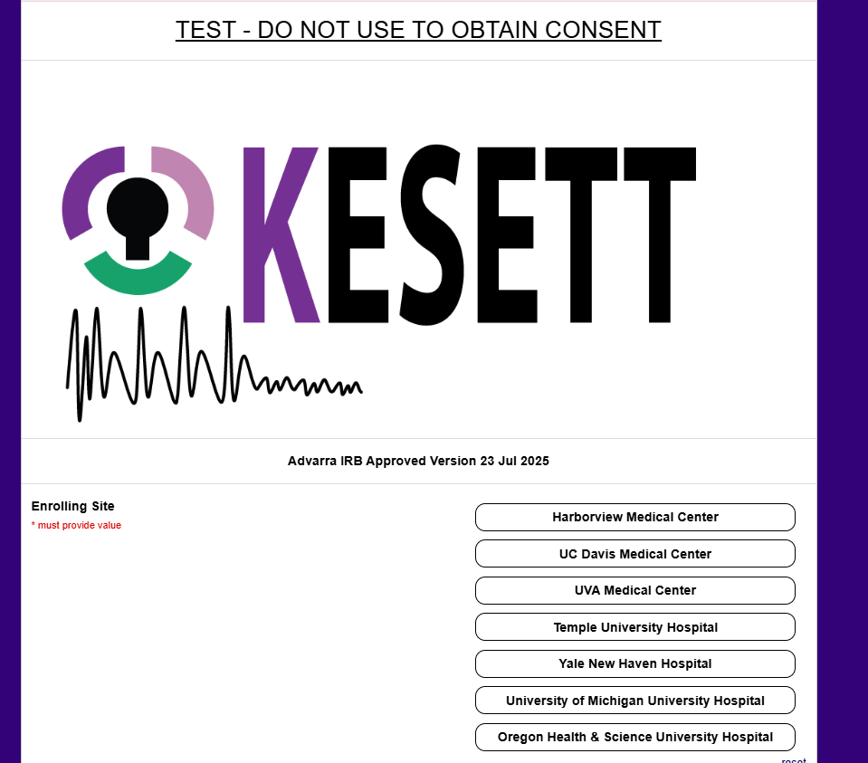
Test link to be used by all sites.
Site specific builds will have unique links in WebDCU

Slide 57
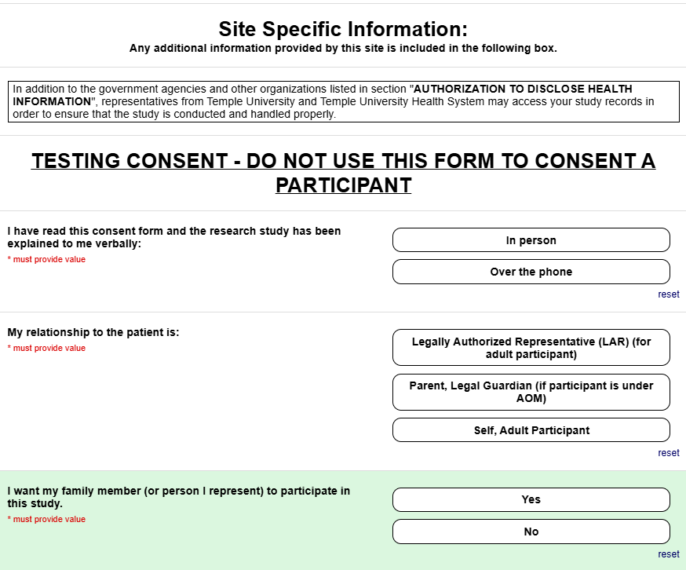
In person vs over phone will dictate the attestation pathway
Ensure correct relationship is being selected
Participation Y/N will require a signature either way

Slide 58
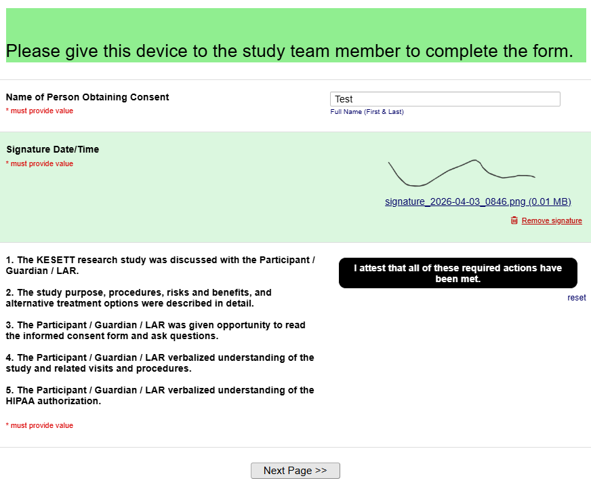
Attesttation of consent by the authorized study team member collecting consent
If collected on paper or remote this will be sent in a seperate form

Slide 59
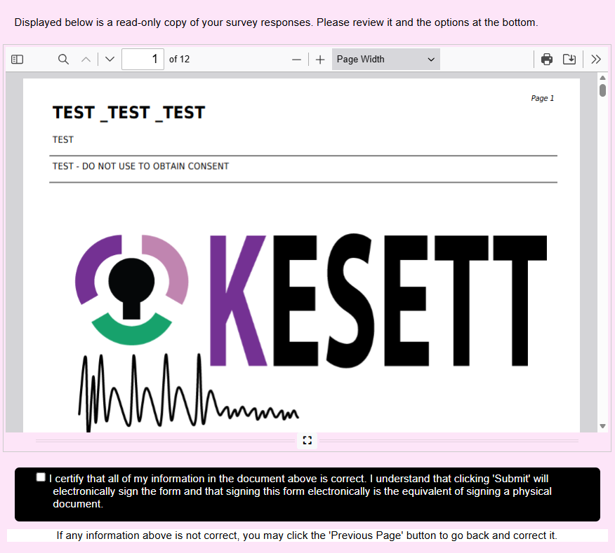
Verification that selections are collect and agreement to signature
Required for clincal trial eConsent

Slide 60
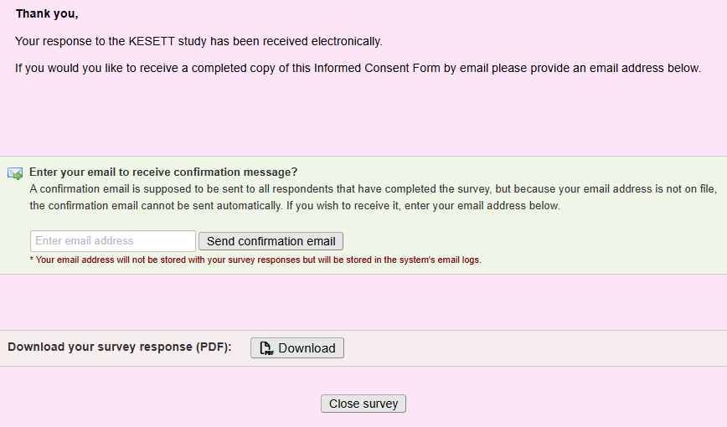
Copy can be sent to the signers email
If this is a remote consent they can also download a copy

Slide 61
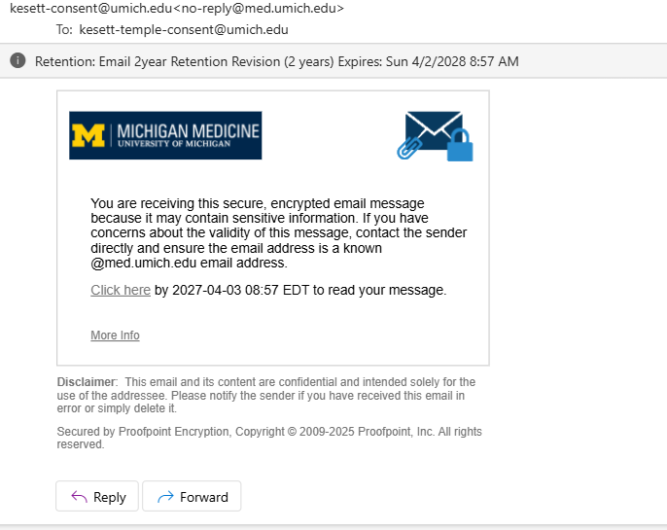
All study team members with consent responsibilty will receive an email copy and notification
Secure email sent automatically

Slide 62
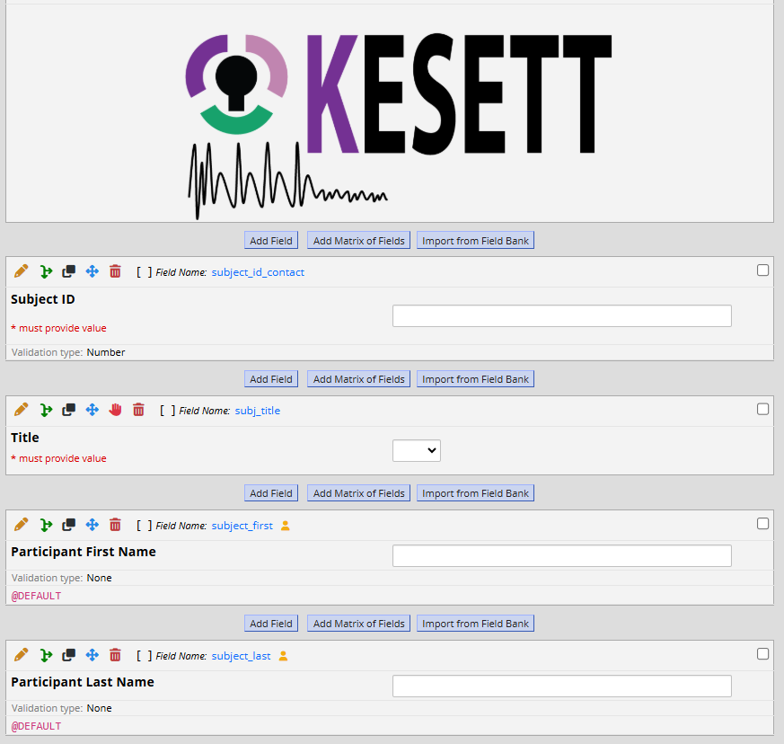
Following consent a participant contact form will be sent via email

Slide 63
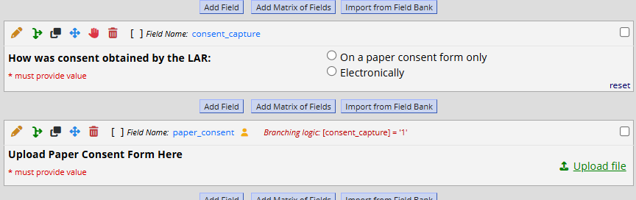
Paper and Remote Consent
Paritcipant contact form will ask how consent was obtained if on paper upload the scaned PDF here
Attestation will be sent in a seperate email

Slide 64

New FAQs
Do VNS or VP shunts exclude patients from KESETT?
How should we clean the Ceribell device?
Check out the FAQs on the website > FAQs tab

Slide 65
Thank you!
kesett.org
Next All-site call: Friday, May 1

Slide 66
Enrollment Video

Slide 67
Screening
Patients who meet one of the below criteria:
Administered one of the following for the treatment of seizures or status epilepticus
    LEV,
    valproate (valproic acid), or
    fosphenytoin intravenously
OR
Patients in the ED who have had a witnessed seizure and are determined to be experiencing a continuing seizure event who were screened in real time by the study team.

Slide 68
Screen Failure
Patients that meet the below criteria and were not enrolled regardless of when they were screened and if the study team was present
Administered one of the following for the treatment of seizures or status epilepticus
    LEV,
    valproate (valproic acid), or
    fosphenytoin intravenously
Patients to whom the study team is alerted to in real time but are not enrolled should be entered as screen failures within 5 days of screening.
An administrative review should also be performed at least monthly to identify patients who met the criteria above but were not alerted to the study team or enrolled.

Slide 69
Enrollment in WebDCU
DCC Riley Luckmann

Slide 70

KESETT – step forward randomization
KESETT is a step forward randomization design, which means we do not have a Randomization Form in WebDCU that assigns a treatment when submitted.
Instead, sites will grab the ‘Use Next’ vial (or ‘Backup’ vial if no ‘Use Next’ is available) and use it to treat the KESETT participant.
Data entry into WebDCU will occur after enrollment.
  This includes documentation of Study Drug ID, which will tell the DCC which treatment assignment the participant received.
The KESETT database in WebDCU is a real, live database. No testing or fake data should ever be entered by sites.

Slide 71
Within 8 hours of KESETT study drug administration…

Slide 72
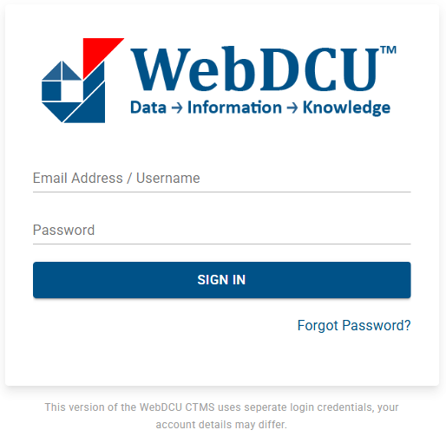
1. Log into WebDCUv2
https://webdcu.musc.edu/DCUApp/Login

Slide 73

2. Click on the KESETT tile

Slide 74
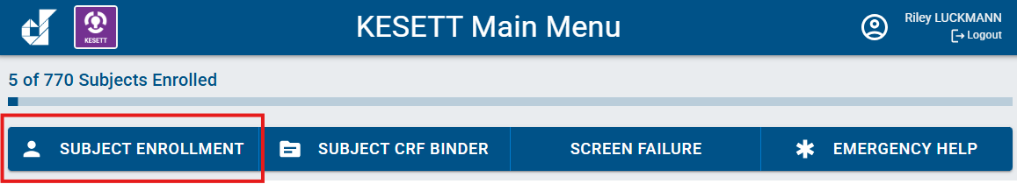
3. Select the Subject Enrollment button from the main menu bar

Slide 75
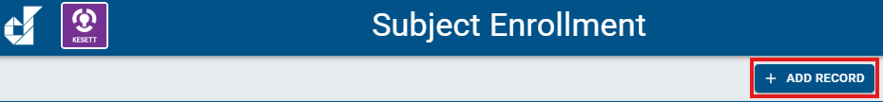
4. Select ‘Add Record’

Slide 76
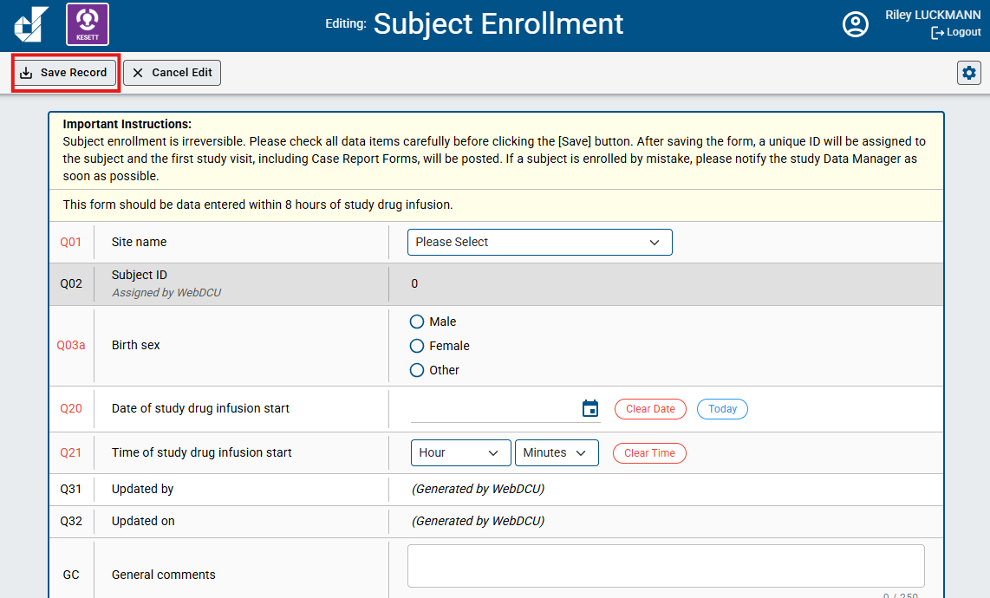
5. Enter the Subject Enrollment form and select ‘Save Record’
*As the instructions indicate, Subject Enrollment is irreversible. It should not be data entered until a patient has already received KESETT study drug. In Q20 and Q21, you will have to indicate the Date and time of study drug infusion start.

Slide 77
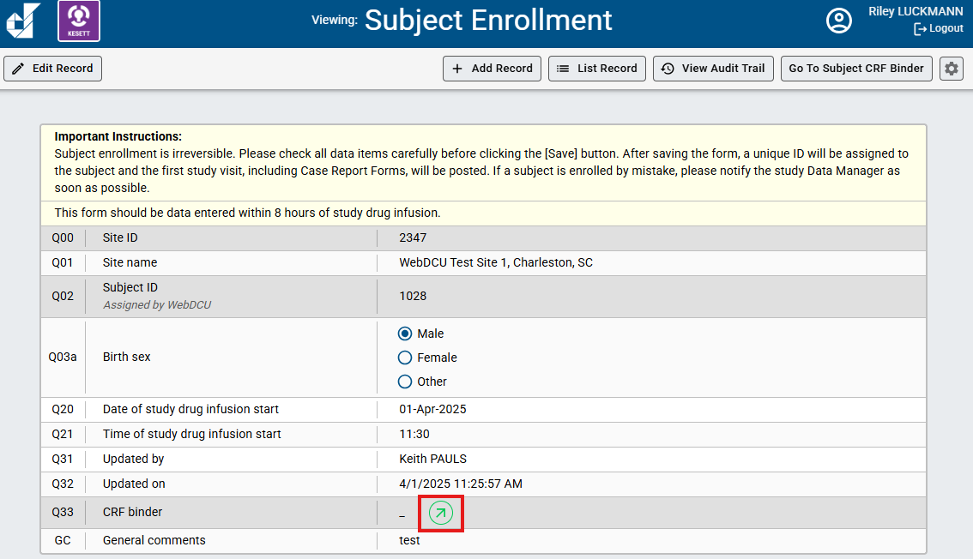
6. Click the green arrow to go to the Subject CRF Binder

Slide 78
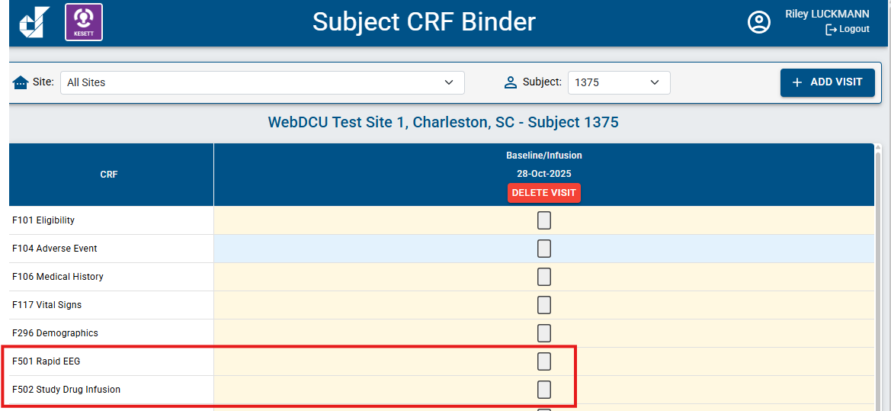
7. Enter and submit other enrollment CRFs
F501 Rapid EEG
F502 Study Drug Infusion

Slide 79
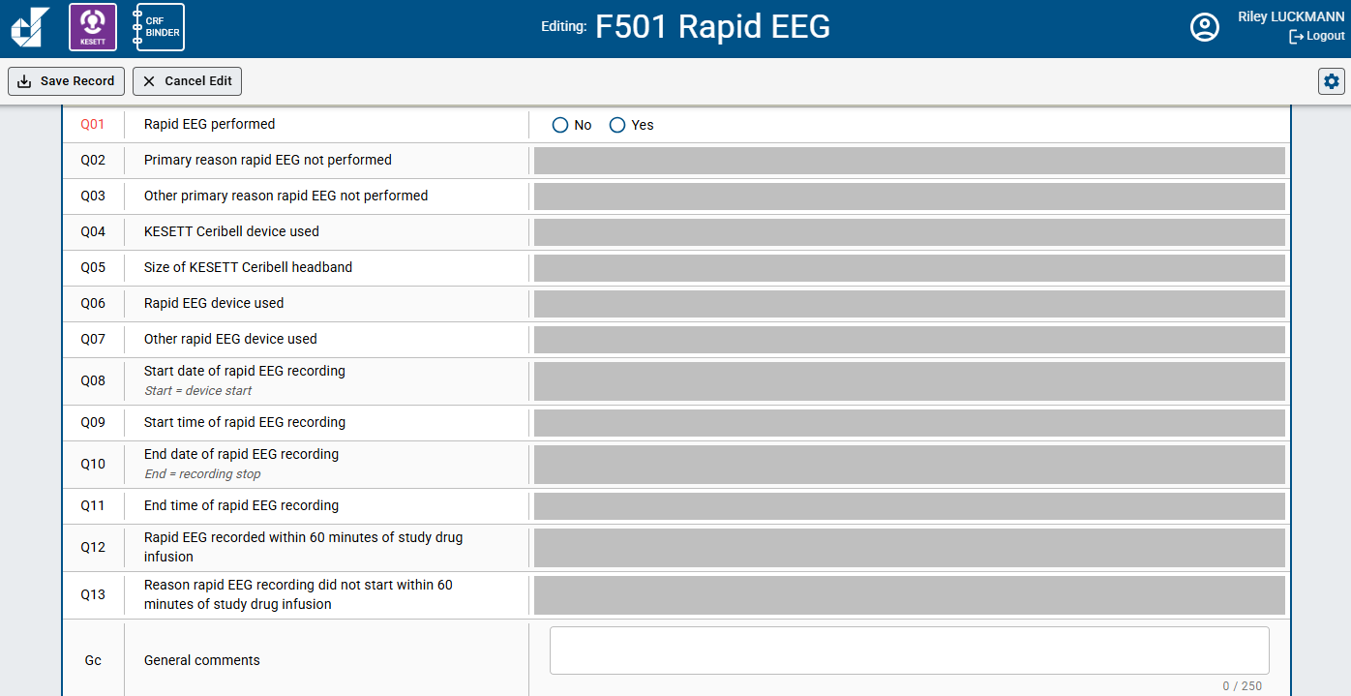
F501 Rapid EEG

Slide 80
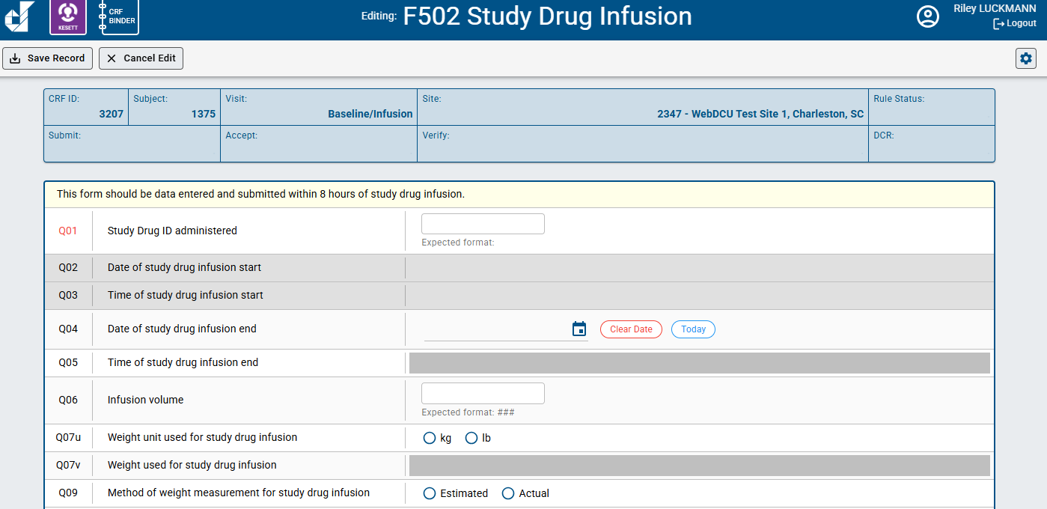
F502 Study Drug Infusion

Slide 81
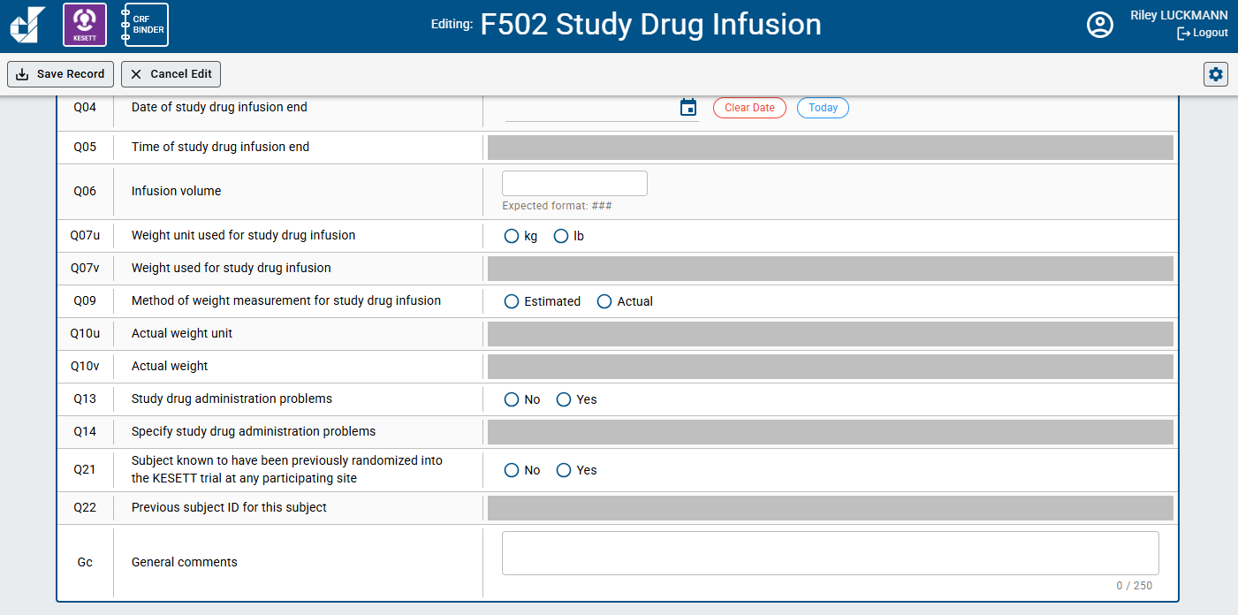
F502 Study Drug Infusion

Slide 82
CIRB Review Process & Initial Site Submission Table
Vince

Slide 83
IRB Approval Process (“One-step”)
Site submits local ICF language to CCC
Site information added to local ICFs
CIRB Protocol & EFIC Plan Approval
Local IRB Submission and Acknowledge
CIRB Site Approval
EFIC Activities and UAB report creation
Return Site CIRB Documents to Local IRB
CCC submits site application to CIRB

Slide 84
Items Complete by end of EFIC
  CC Events documented and containing requested details
  LIRB complete and documented in WebDCU
  CIRB Initial site submission form completed
  Local Consent language agreed upon by CCC and local IRB

Slide 85
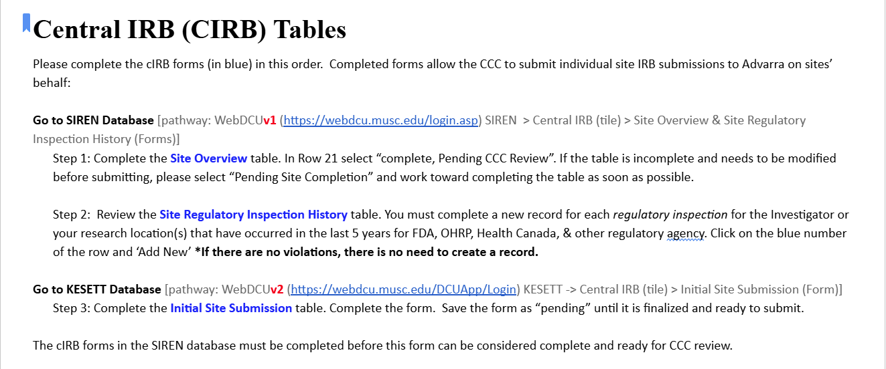

Slide 86
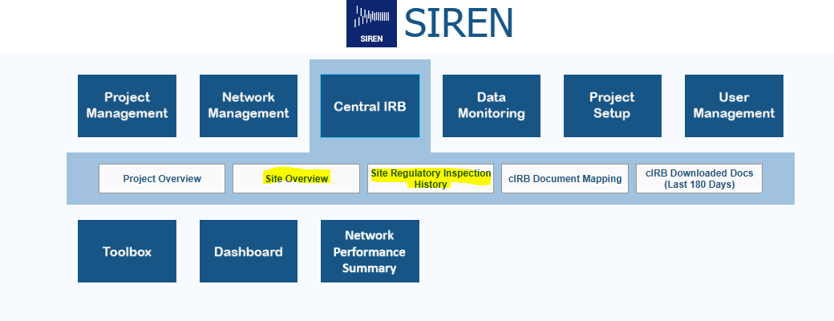
Central IRB (CIRB) Tables
Steps 1 & 2 in WebDCU v1 > SIREN:

Slide 87
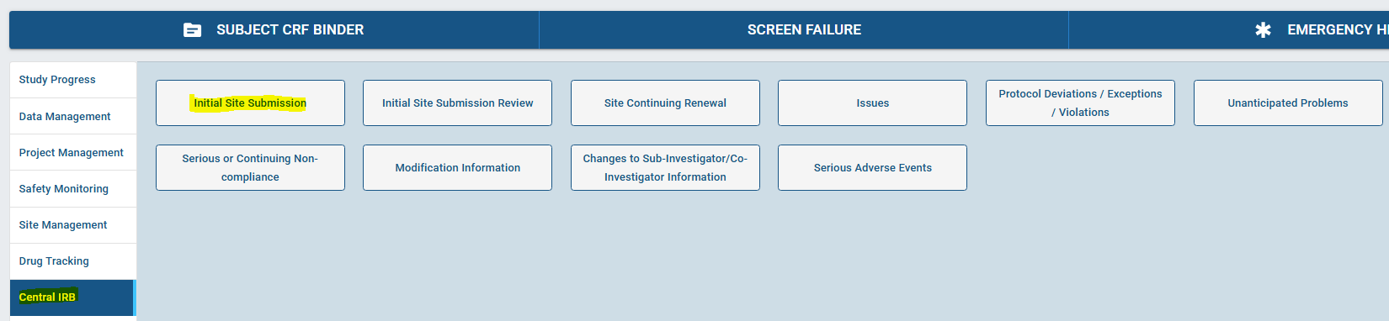
Central IRB (CIRB) Tables
Step 3 in WebDCU v2 > KESETT:

Slide 88
Initial Site Submission Table Tips
Refer to the KESETT Regulatory Document Approval Parameters guide
Q120: In which therapeutic areas does the investigator have research experience?
  Select from list of choices in Reg Doc Approval Parameters

Slide 89
EFIC Activities

Slide 90
EFIC Activities
Site Alone
  2 In-person community events
Site & UAB
  2 Virtual focus groups
UAB
  Community surveys
  Social media ads
  Website
Notes:
CC in Blue PD in Green

Slide 91
CC Community Event Documentation
CCC is reviewing and asking for clarifications
Key information to include
  Why this event was chosen
  duration of event and team presence
  Which team members attended
  Community attendance - At event and contacted
  Number engaged in extened conversations (consulted)
  Examples of conversations, questions, or impact
  Demographics - At event and extended discussion
  Overall reception and feedback including any opt-outs

Slide 92
Investigators X, and Y along with PSC Z attended the Gotham Farmers Market to introduce the KESETT study. The study members had a booth at the market for the full duration (09:00 to 14:00) and handed out EFIC-approved fliers and pamphlets. The market patrons were non-specific members of the general public, although attending study members noticed that most patrons who stopped to learn about the study either knew someone with epilepsy, were healthcare workers, or were interested in the neurosciences. The most common question revolved around what a patron without a history or predisposition of seizures could do to support the study. Study members encouraged the patrons to inform people they know of the study and encourage others to register their interest in the Focus Groups via the survey provided in the UAB-created website. Patrons tended to understand the concept of EFIC and did not have any questions regarding that topic. Overall, market patrons responded encouragingly to this study and did not have many questions or comments. No opt out mechanisms were requested.

Slide 93
Investigators X and Y along with PSC Z attended the Gotham Farmers Market to talk to people for it’s 5 hour duration. Gotham Farmers Market is one of the cities largest and well attended gatherings, drawing over 10,000 visitors every week from a wide area. The market is dedicated to diversity and food justice and attracts customers of all socioeconomic groups by emphasizing acceptance of EBT/SNAP, WIC and Senior FMNP. Many people stopped by the booth to pick up fliers and brochures about the study and the study team was able to have discussions with about 200 people. Discussions differed in duration. Most were brief, but many (10 or more) were 10 minutes or longer. The event allowed us to talk to young and old people of many colors and backgrounds. Many of the patrons who stopped to learn about the study either knew someone with epilepsy, some were interested in science, some with prior experience with research, and some were healthcare workers. People talked to expressed support for the research. One father of a child with epilepsy described their difficulty dealing with the disease and expressed gratitude for the study Many of those with whom we talked who didn’t have epilepsy or seizures, asked what they could do to help. They were told to help spread the word by telling friends and family about it. Some expressed interest in the focus groups as well. People tended to understand the concept of EFIC and did not ask questions about that much. Overall, those with whom we engaged responded encouragingly to this study and did have any concerns. No opt out mechanisms were requested.

Slide 94
CC Virtual Focus Groups
Event documentation entered into WebDCU by the UAB EFIC team
Site responsibilities:
  Recruit attendees
  Provide list of attendees and why they were invited to UAB
  Propose times to the UAB facilitator
  Present study information on the call (facilitator guide)
  Answer attendee questions
  Keep record of what organizations or groups were contacted

Slide 95
Focus Group Invitation
10
8
5
CONFIRM
GOAL
CONDUCT

Slide 96



Focus Group Best Practices
Limit team member attendance with brief introductions
Concise presentation to allow ample time for community member input
Pre review the facilitator guide

Slide 97
Focus Group Recruitment
Who?
  Local epilepsy and seizure disorder community
  Interested or invested community members
    Do not need to have a direct link to epilepsy or seizures
  Diverse backgrounds
  Representative of your community
  Include concerns specific for your community
    Minorities and underrepresented
    Low income or unhoused
    Faith based
Notes:
Have another reason for attendance other than clinical or research background

Slide 98
Post EFIC Information
Report any additional opt-outs
Focus group attendees - How/why they were selected
The “why” is very important to the IRB. Please give a 2-3 sentence summary for each meeting describing the individuals that attended.
Names of the groups that were invited to participate in the focus groups.
These can be a specific organization such as an epilepsy foundation chapter, or a population targeted such as neurology clinic patients
Paragraph from the local Principal Investigator
Assessment of their overall perspective of the community meetings, in-person events, the feedback received, and the utility of these meetings/events.

Slide 99
Opt-outs
At in person events & focus groups- Reported in the CC form in WebDCU
PD activities such as the social media campaign will direct to the website and your team contact information
Study team should keep a list of opted-out community members to mail a wristband to.
Prior to CIRB approval- Opt outs reported to the CCC in final EFIC details
Post IRB approval - Maintained locally and submitted to the CIRB at yearly SCR
Opt out will be mailed by the study team or CCC using the Opt out letter under review by Advarra

Slide 100
Focus Group RecruitmentIdeas
Inviting interested persons from your in-person events
Low acuity patients from your ED who have already been seen and are stable
Engaging patients from your outpatient clinics
Community groups and engaged community members

Slide 101

Focus Group Recruitment Ideas
Posting on social media sites
  Next Door
  Facebook groups
  Institutional pages
Leverage existing community relationships at your site
  Research Community Advisory Boards
  Patient advocacy groups
Contact community groups
  Elected officials / city council
  Religious leaders and groups
  PTAs
  Retirement and neighborhood communities
  Community resource organizations
  Local epilepsy support groups and/or foundation chapters

Slide 102
Discussion:
What are recent wins or challenges for EFIC activities at your site?

Slide 103
Site Readiness
Vince

Slide 104
Readiness: What should we be doing?
Use the checklist! KESETT.org > Getting started > Blue button
Work on uploading regulatory documents
Site Addresses in WebDCUv2 - Site management > Site Address
Initial Site submission table
Training
  Protocol – Read Protocol, IM video and quiz on the Website > Upload quiz results to WebDCU
  Data – IM video on the Website > Upload cert to WebDCU
  Regulatory – IM Video on the Website > Upload cert to WebDCU
    Required for KESETT as WebDCUv2 has some new features
  Pharmacy – Have pharmacists on the eDOA review the pharmacy manual and sign the attestation on the website > Upload attestation to WebDCU
  Clinical – Attestation by the site PI (protocol signature page) > Upload to WebDCU
Study Team
Notes:
https://docs.google.com/document/d/1j3cjjD-eb2j3xNXZcpZei0zmUs64g3ek/edit?usp=sharing&ouid=109082613593533021113&rtpof=true&sd=true

Slide 105
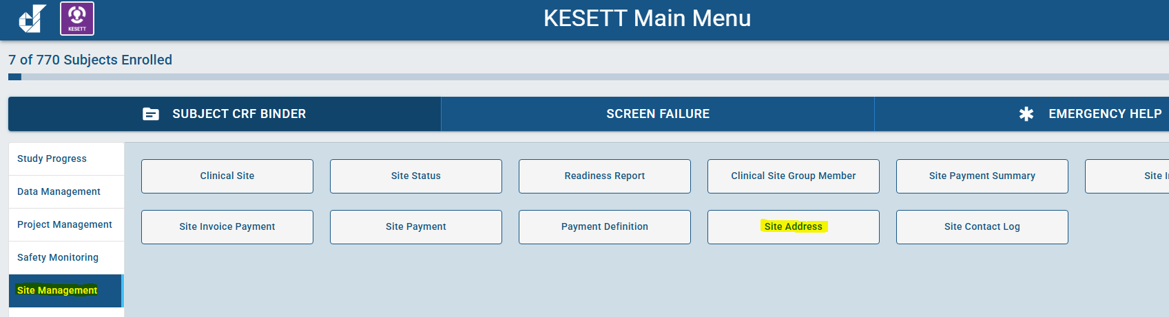
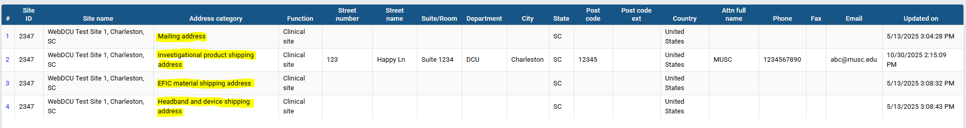
Site Addresses

Slide 106
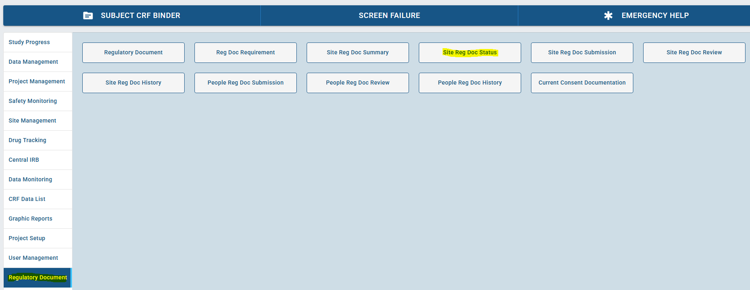
Regulatory Documents

Slide 107
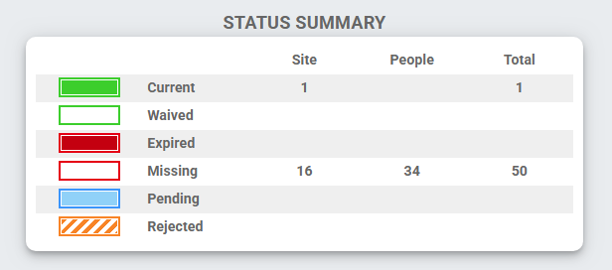
Regulatory Documents

Slide 108
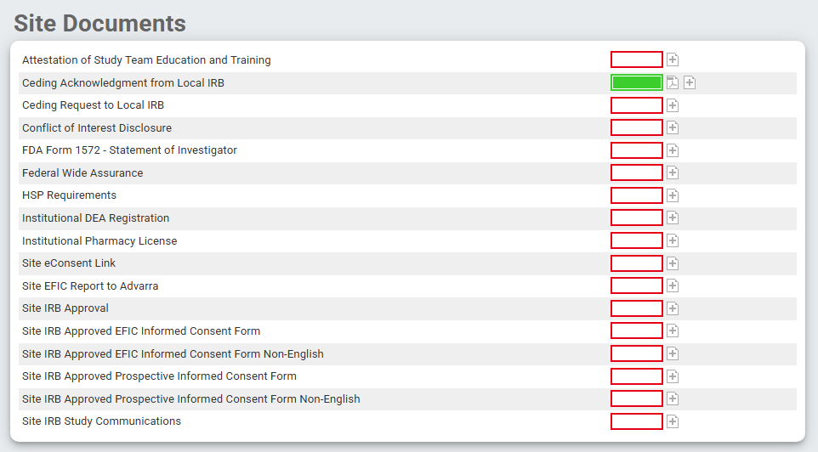
Regulatory Documents

Slide 109
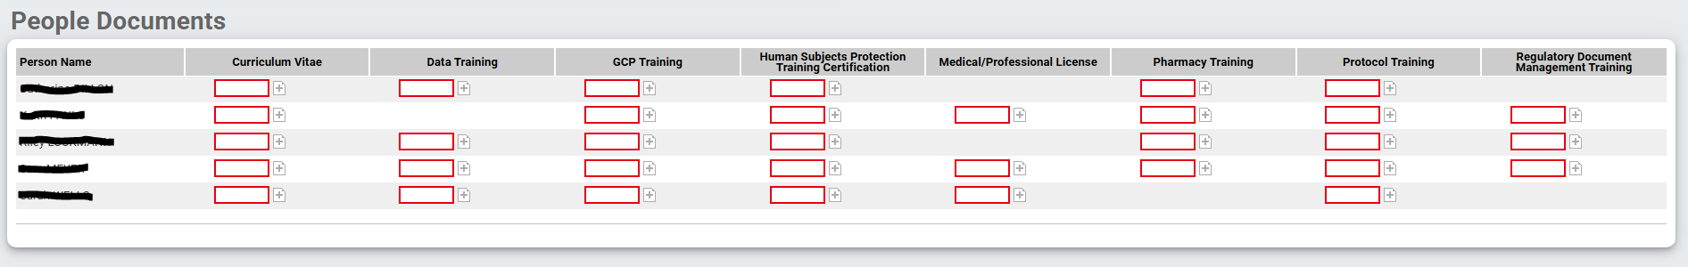
Regulatory Documents

Slide 110
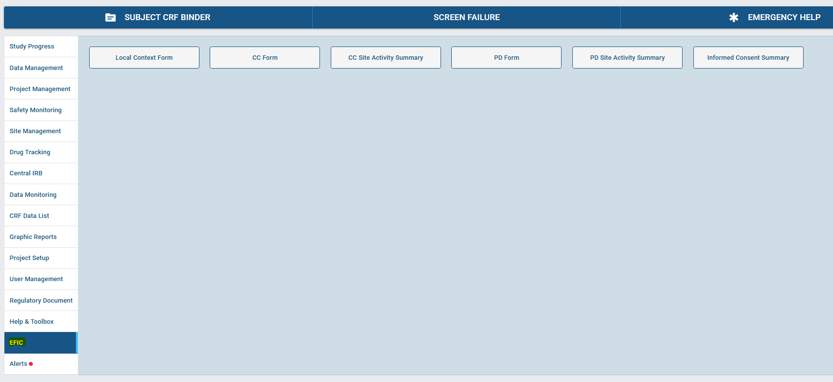
EFIC

Slide 111
Readiness Calls SOP
Vince/Megan will contact site to schedule once EFIC report is finalized by UAB and CIRB submission is complete/in queue
Once scheduled, we will share the site-specific Readiness Checklist
  Site study team completes Checklist at least 24-48 hours in advance to confirm call
  Aim to have very few/no remaining action items after the call
Site required attendees | Site PI, Primary SC
Site recommended attendees | Co-Is, SSC, Pharmacy representatives, Hub PI, Hub PM

Slide 112
Release to enroll
After readiness call, if CIRB approved & no major outstanding issues, site will be Released to Receive Study Supplies
  Triggers study drug shipment
Once study drug is checked in at site, final administrative review > Released to Enroll

Slide 113
Study Team Coverage
Study team is to arrive ideally within 30 minutes of an enrollment
  Ceribell assistance if needed
  Study drug vial ID recovery
  Informed consent
Enrollment CRFs to be completed within 8 hours

Slide 114
Discussion:
What strategies are you using to provide study team coverage on weekends & nights?

Slide 115
Source Documents

Slide 116
Source Docs & CRFs
Source document for all data recorded in the CRFs is the 1st location where those data are recorded.
  eCRF itself (data is observed & directly data entered)
*Add note to General comments filed stating “direct data entry”
  Paper case report form representative of the study eCRF
  Electronic health record
  Paper medical record

Slide 117
Source Doc Hierarchy:
Clinical Outcomes at 15- & 60-min
Contemporaneous observation & documentation of attending physician’s determination
Directly recorded on paper or electronic CRF
Direct communication with the attending physician
Directly recorded on paper or electronic CRF
Medical record - explicit study-specific documentation
Medical record - implicit review (should be used in very rare cases)
Notes:
Defined in MoP

Slide 118
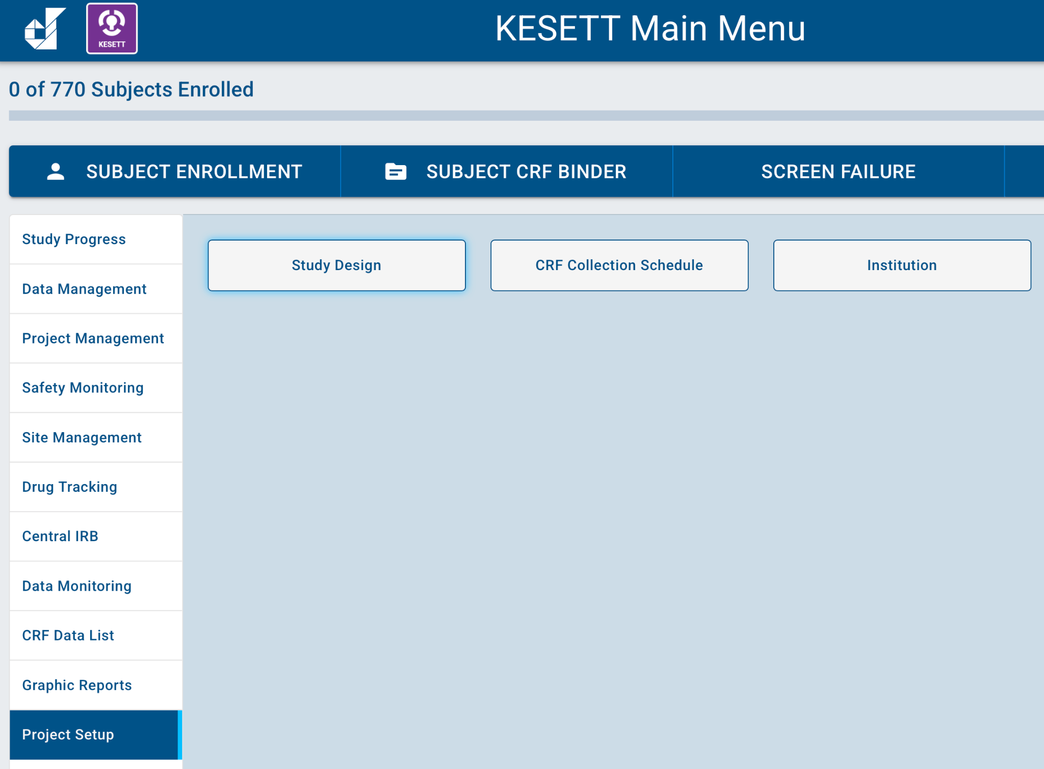
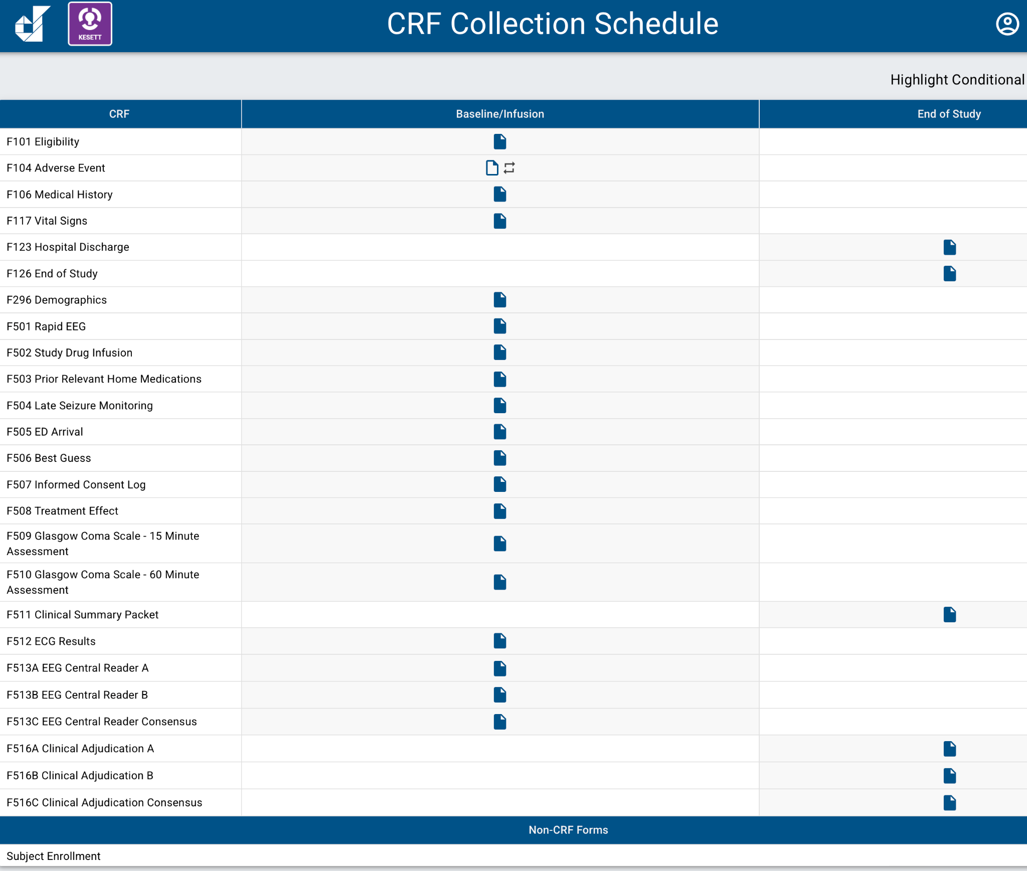
Source Docs & CRFs
Use CRFs as guide if you are creating your own source documents for clinical and study teams

Slide 119
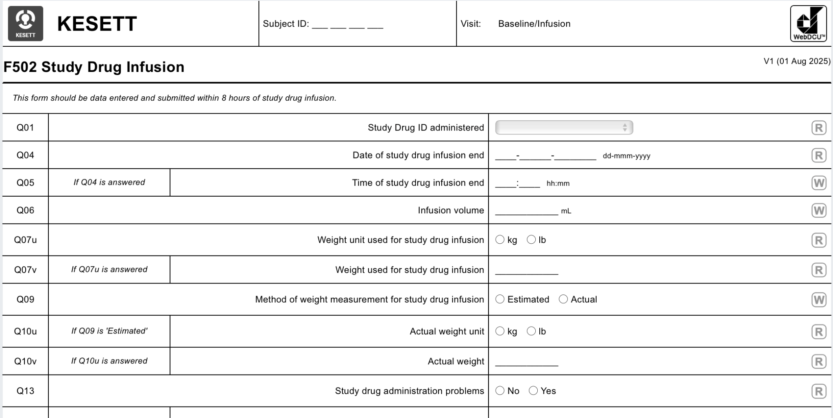
Source Docs & CRFs
Can export/print as pdf or use as guide to build your own form
Remember GCP guidelines & ALCOA-C if using a paper source document!
Notes:
Paper worksheets must be signed and dated by the person collecting the data and retained as source.

Slide 120








Study “Kit” Materials: Centrally provided
Ceribell (unless using own clinical device):
  Recorder device
  KESETT stickers for recorder
  Ceribell headbands
  KESETT stickers for headband boxes
Ceribell headband basket for IV pole
Protocol Reminder Cards
Length-based-weight estimation
measuring tape
  Can also be used to measure head circumference
Notes:
Centrally provided
Other than the study drug
IV poles not provided by study
Protocol reminder cards file will be available in case sites want to produce extra copies, create poster, etc.

Slide 121
Ceribell Training
“Intake” call is optional
  Discuss device and use in study with Ceribell liaison and PM
IT training/support is available
  Email, 24/7 support number, meetings
In-person, on-site training for study team is required if not already using device clinically
  Conducted by local commercial reps
  Site can determine who should attend the training
  Designate a group of ‘super-users’
  Scheduled as your site approaches CIRB submission

Slide 122

Ceribell Supply Logistics
> Device provided after site contract is executed to allow local approvals.
> Headbands sent to sites after CIRB approval
> Headbands come in 2 sizes:
Small (C151)
Medium/Large (C152)
> Each site will have a set par for number of headbands on site.
> Headbands expire after ~6 months;
will have expiration date on box.
Notes:
Headbands are consumable so will be resupplied throughout the trial.
Par depends on enrollment population (adult/peds/both) and logistics of your EDs (separate, together, etc.)
Expired headbands are not a safety issue but may impact quality of recording; can use expired headbands for trainings

Slide 123
Ceribell: Headband Inventory & Resupply
Sites will complete monthly inventory survey.
  Can be completed anytime; must be completed at least 1x/month
  Responses submitted by 1st of month will be used to place monthly resupply orders by central team on 3rd of month.
Central team uses survey responses to bring each site up to full par.
  Sites receive shipment tracking info once order is fulfilled.
  Will use shipping address in WebDCU
Urgent resupply can be triggered by the site or central team.
  Site can use survey to indicate urgent request.
  Central team will monitor use based on enrollment CRFs.
Notes:
Headbands are consumable so will be resupplied throughout the trial.
Par depends on enrollment population (adult/peds/both) and logistics of your EDs (separate, together, etc.)
Expired headbands are not a safety issue but may impact quality of recording; can use expired headbands for trainings

Slide 124

Ceribell Inventory Survey
REDCap survey
Link in MoP
Notes:
Headbands are consumable so will be resupplied throughout the trial.
Par depends on enrollment population (adult/peds/both) and logistics of your EDs (separate, together, etc.)
Expired headbands are not a safety issue but may impact quality of recording; can use expired headbands for trainings

Slide 125
Inclusion Criteria
1. The patient was witnessed to have a convulsive seizure for greater than 5-minute duration.
2. The patient received an adequate dose of benzodiazepines. The doses may be divided.
3. The last dose of a benzodiazepine was administered 5-30 minutes before study drug administration.
4. Continued or recurring seizures in the Emergency Department.
5. Age 1 year or older.
6. Known or estimated weight ≥ 10 kg

Slide 126
Exclusion Criteria
1. Known pregnancy (lab testing not indicated for screening)
2. Prisoner.
3. Opt-out identification or otherwise known to be previously enrolled in KESETT.
4. Treatment with a second line anticonvulsant (FOS, PHT, VPA, LEV, phenobarbital, or other agents defined in the MoP) for this episode of status epilepticus (SE).
5. Treatment with sedatives with anticonvulsant properties other than benzodiazepines for this episode of SE (propofol, etomidate, ketamine, or other agents defined in the MoP).
6. Endotracheal intubation prior to enrollment.
7. Acute traumatic brain injury clearly precedes seizures.
8. Scalp injury or burn preventing EEG placement.
9. Known allergy or other known contraindication to KET or LEV.
10. Hypoglycemia < 50 mg/dL
11. Hyperglycemia > 400 mg/dL
12. Cardiac arrest / post-anoxic seizures

Slide 127
Abbreviated Eligibility
Inclusion
1. Convulsive seizure > 5 minutes
2. Seizures continue/recur in ED
3. Seizure despite adequate dose of benzos
4. Seizure despite properly timed benzo
5. Age ≥ 1 year & est. wgt > 10kg
Exclusion
1. Hypoglycemia, TBI, cardiac arrest
2. Known contraindication to drugs or EEG
3. Already received 2nd line agent or anesthetic
4. Already intubated
5. EFIC prohibited - known pregnancy, prisoner or opt out identification

Slide 130
Study team coverage
24-hour study team phone number / pager
Alert to enrollment occurs immediately after drug is started
Study team arrival ~30 minutes
Overnight enrollments may occur
Site team can decide how to implement KESETT coverage.
Clinical team
  Conduct opt out if feasible
  Enroll
  Apply Ceribell
  Assess for treatment outcomes at 15-min (continuing seizures, RASS, GCS)

