Slide 1

POST-ICECAP Virtual Investigator Meeting
May 11, 2026
POST-ICECAP
Patterns Of Survivors’ Recovery Trajectories in the ICECAP Trial

Slide 2
Agenda
Welcome & Overview
Stories of Recovery
Study Updates
TTM & Coma Q&A
Screen Failure Form
Monitoring Reminders
BTACT Quality Check
Retention Best Practices
Open Q&A

Slide 3
Overview
Sachin Agarwal & Clifton Callaway

Slide 4
Goals and Objectives
Recovery Trajectories
Initial illness severity and interventions
Rehabilitation Practices
Identification of subgroups
Disorders of Consciousness

Slide 5
Story of Recovery & Resilience
Nick Case
UPMC/University of Pittsburgh

Slide 6
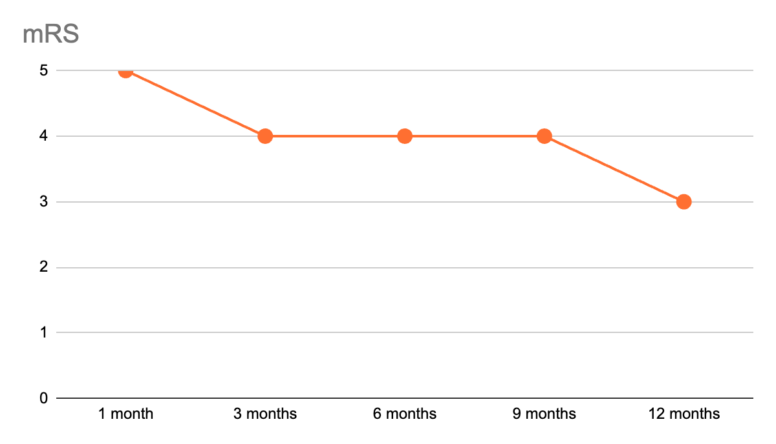
A 65-year-old male suffers an OHCA from a blocked artery in his heart.
1 month: in the ICU with a tracheostomy and feeding tube, not following commands, being treated for pneumonia. Woke up on day 32 (mRS 5)
3 months: in a SNF, trach and feeding tube out, cognitively intact, in a wheelchair. (mRS 4)
6 months: home, PT/OT for leg weakness, walking with assistance. (mRS 4)
9 months: home, nerve damage found in leg, walking further distances unassisted. (mRS 4)
12 months: home, walking independently. (mRS 3)

Slide 7
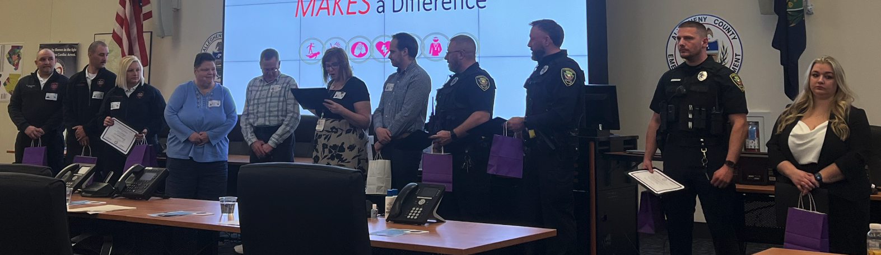
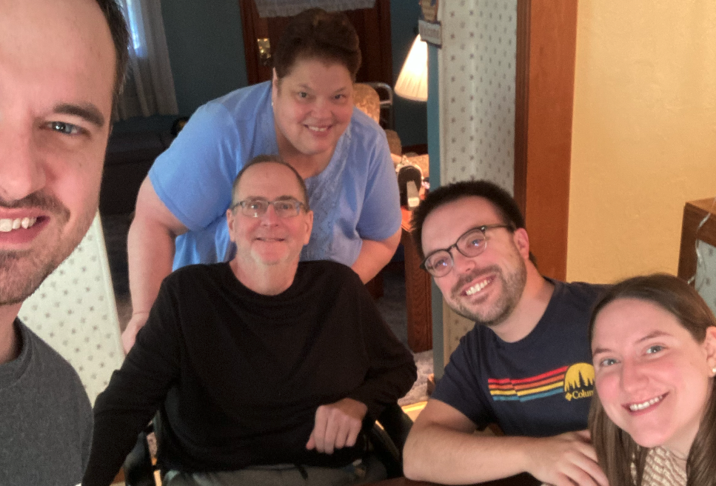

Shared with patient permission.

Slide 8
Delayed Cognitive Recovery Case
Dr. Rachel Beekman
Yale New Haven Hospital

Slide 9
CASE DETAILS
58-year-old M with CAD, AF, COPD, OSA on CPAP who presented following OHCA.
USOH when eating peanuts, wife heard him choking. When she got downstairs, he was blue and unresponsive.
Wife provided bystander CPR. 911 arrived after 6 minutes. ROSC achieved at 16 minutes.
Initial rhythm PEA
Post-ROSC labs: pH 7.0, lactate 7.7, PvCO2 106
FOUR score prior to intubation: 5 (brainstem 4, respiratory 1). Pupils 2mm and Npi 4 bilaterally.
rCAST 13 (high end of moderate severity), PCAC 3 (ARDS secondary to aspiration)
IVTM started, goal 33 °C achieved 2 hours after ED arrival.

Slide 10
CASE EXAM
Exam at one week: FOUR 8; off propofol but on Keppra, clonazepam 2g q8h, Depakote, and fycompa
  Eyes closed but open to pain
  Flexion to pain
  Pupil and corneal intact
  Breathing above set ventilator rate (unable to tolerate PSV)
Exam at 1.5 weeks: FOUR 6; off propofol but on Keppra, clonazepam 1g q8h, Fycompa
  Eyes closed but open to pain
  No response to noxious
  Pupil and corneal intact
  Breathing above set rate on ventilator (unable to tolerate PSV)

Slide 11
CASE OUTCOME
Followed by me weekly from 2 weeks on:
  No change in exam at 2 weeks, intermittent mild ocular or facial myoclonus, not correlated with EEG
  Weaned clonazepam off. Stable to improving EEG.
  No response to Ambien trial, started amantadine @ week 3.
  Week 4: eyes open to voice, blinking spontaneously, no tracking or regarding, grimacing to stimulation. Discontinued fycompa. EEG stable.
  Week 5: looks to sound on left and right but does not track, has mouth movements that appear more purposeful (licking lips, pouting).
  Week 6: eyes spontaneously open and looking around the room. Does not track examiner. Closes eyes and moves tongue in mouth but very delayed to ask, inconsistent. Amantadine dose increased.
  Week 7: Eyes open, looking around room but not tracking an object. Regards examiner on both sides. Sticks out tongue to command. Closes and opens eyes to command. No movement in extremities.
  Week 8: Tracks examiner around the room. Smiles to command, closes eyes to command, opens mouth to command. Nods to questioning but inconsistent responses. Remains weak in all 4 extremities.
Discharged to LTACH on week 9, MCS + state but not yet emerged to confusional state. Presumed critical illness neuropathy (also affecting diaphragm) but able to tolerate PSV 10/5 consistently and improving with vent weaning.
Seen at rehab at 6 months. Awake, interactive, smiling. Mouthing words. Still alternating between PSV and volume control ventilation. Minimal movement in all 4 extremities, severe contractures.

Slide 12
Study Updates
Natalie Fisher
University of Michigan CCC

Slide 13
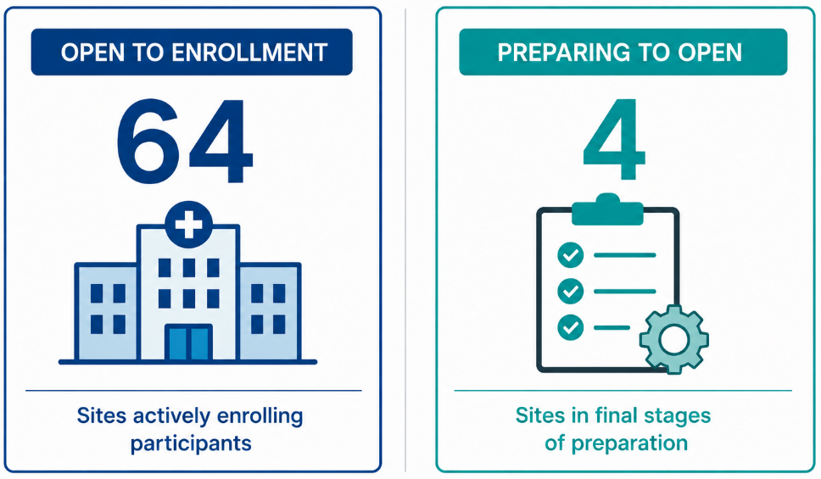
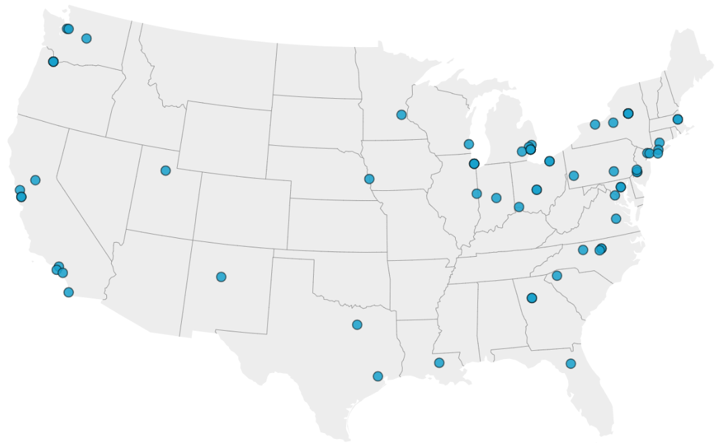
POST-ICECAP Sites
Notes:
Included in these are the three rehab sites - Spaulding in Boston, Moss Rehab in Philadelphia and TIRR in Houston Texas

Slide 14

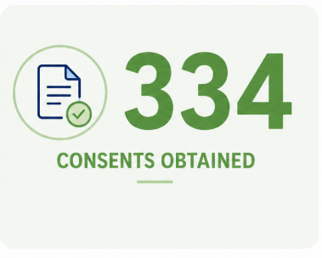
Overall Enrollment Progress

Slide 15
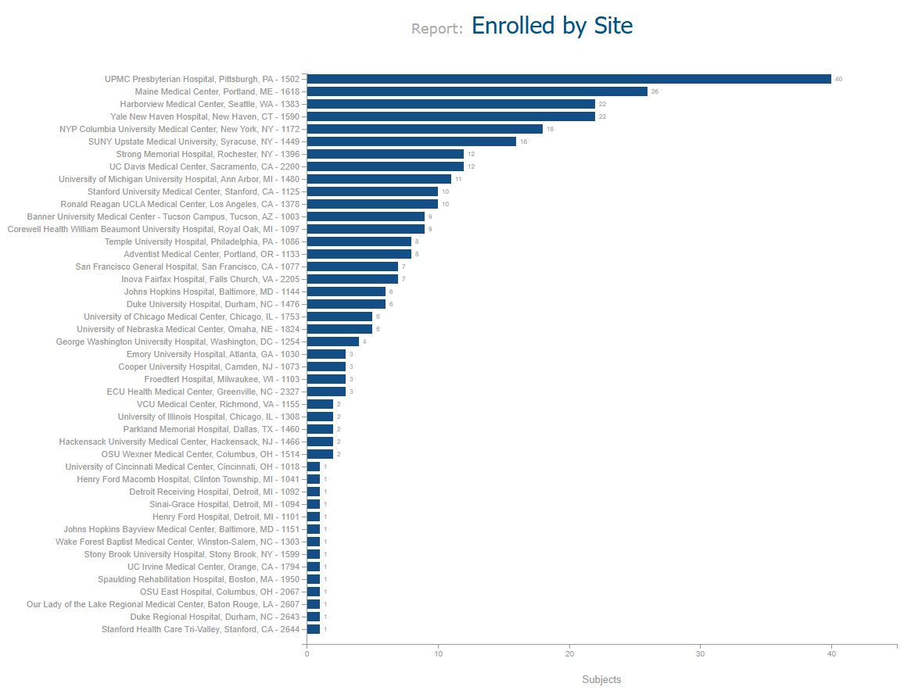
Enrollment
Lots of variability between sites
Screening and approaching survivors is most important

Slide 16
Recruitment Strategies
Simplify study design - no more in person visits
Respond to any eligibility criteria same-day
Use Newsletters for any updates
Acknowledge and celebrate site milestones
Add sites that are high-volume with motivated teams
Leverage screen failure form to optimize the recruitment processes of existing sites
Notes:
A report is generated every 30 days, detailing potentially eligible and/or missed participants at each site. The data collected provides valuable insights into recruitment barriers at each site.

Slide 17
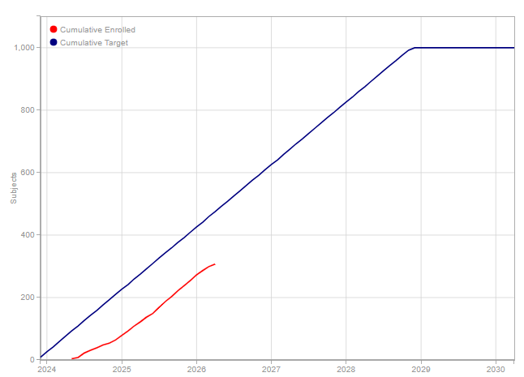
Target: 1000 participants
April 2024 - 0
April 2025 - 113
April 2026 - 324
Overall Retention rate: 95%; 65% of sites with 100%

Slide 18

Monitoring Update
Welcome Amy Schroeder!

Slide 19

Monitoring Visit Update
Haven’t heard from us yet?
If your site is interested in a monitoring visit, please reach out to us!

Slide 20

Office Hours
For all issues related to the Protocol, Questionnaires, Outcomes, & WebDCU please use email
POST-ICECAP-contact@umich.edu

Slide 21
TTM, Coma and OHCA
Sachin Agarwal
Columbia University

Slide 22

Exclusion Criteria | No. | %
Did not survive to 1 month | 764 | 49
Did not receive TTM | 409 | 26
Not in coma | 195 | 12
Declined informed consent | 63 | 4

Slide 23
Operational Definitions
TTM
Coma
Out-Of-Hospital CA

Slide 24
TTM Definition: Unchanged Aspects
Qualification is based on intent and a structured plan executed within 24 hours of cardiac arrest
All target temperatures, including fever control and durations, are acceptable
Any definitive temperature control device, e.g., surface or intravascular cooling, ECMO, or cooling blankets, either initiated or ordered within 24 hours of cardiac arrest.
Notes:
for example, an order during the first 24 hours to turn on a cooling device if temperature > 37.5℃ would be “active fever control” even if turning on the device was never required.

Slide 25
TTM Definition: Proposed Additions
Currently, fever control using medications alone is not sufficient
Protocol-driven fever prevention (even without a device), either initiated or ordered within 24 hours of cardiac arrest.
A documented nursing or institutional protocol or order set that includes Temperature target (e.g., <37.5°C or normothermia) AND escalation steps to intensify temperature-control measures if the target is not achieved or maintained.
Escalation steps: may include increasing pharmacologic intensity (e.g., PRN → scheduled antipyretics), addition of non-invasive cooling measures (e.g., cooling blanket), or transition to device-based temperature management.
Notes:
Scheduled antipyretics qualify only if part of a protocol that includes a temperature target AND predefined escalation beyond medications if needed.

Slide 26
TTM: Situations That Do NOT Qualify
PRN antipyretics alone (e.g., “acetaminophen if fever”)
One-time or sporadic medication orders
Passive or ad hoc measures (e.g., ice packs, fans) without a structured protocol
Sedation or neuromuscular blockade without a structured protocol or used for other indications alone.
Informal or unwritten practices (e.g. “call MD if T>37.5ºC”)

Slide 27
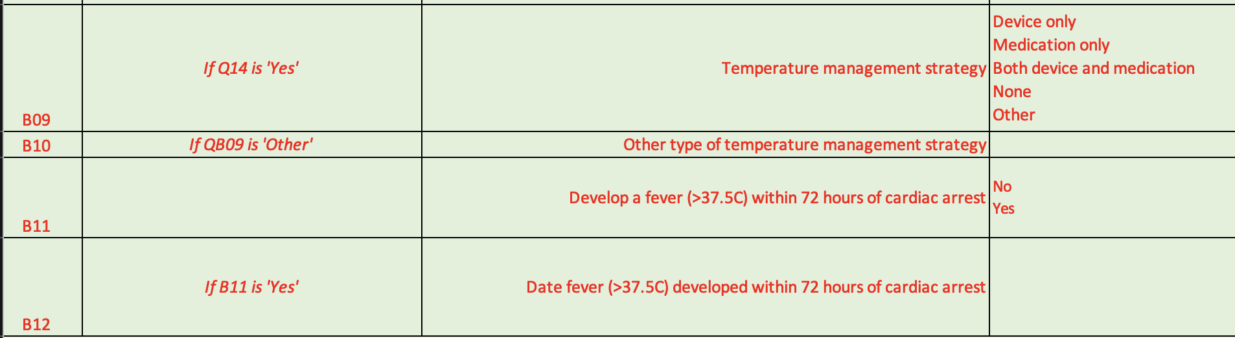
TTM: Changes in Screening Failure Form
New questions in screening log about whether device or medication was used

Slide 28
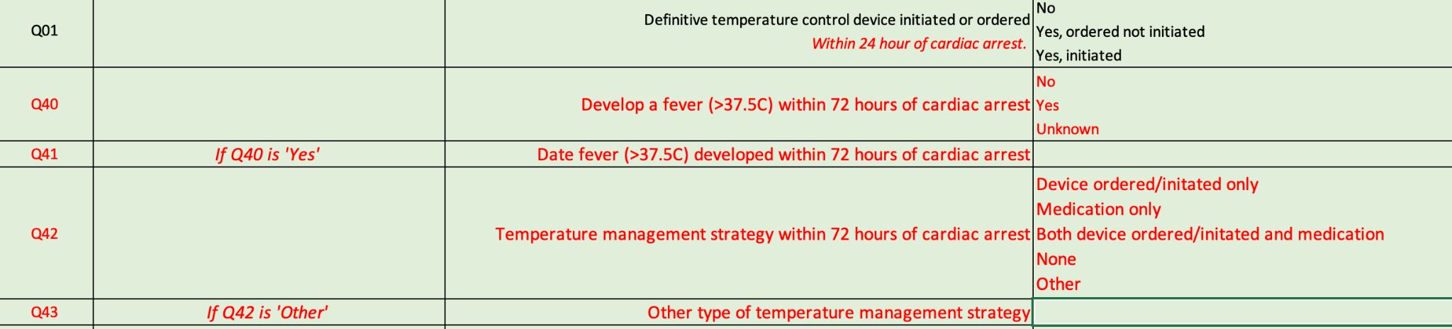
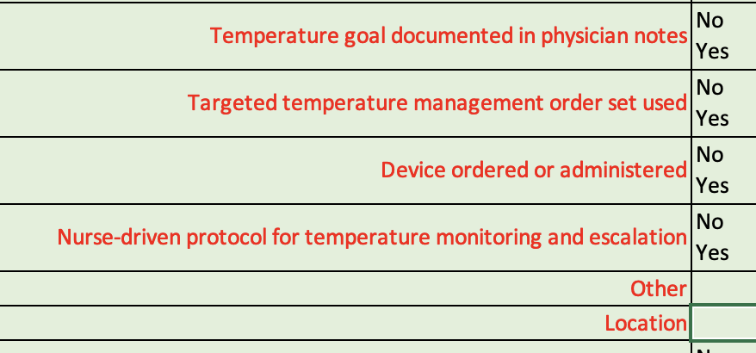
TTM: Changes to F501 - Hospital Summary
& F101- Eligibility
New question in CRFs about whether T>37.5ºC happened in first 72 hours (and how to find the response)

Slide 29
TTM Q&A

Slide 30
Coma
Coma after resuscitation from cardiac arrest is a patient who is endotracheally intubated and not following commands
Confusing Scenarios:
Sedation or NM blockade for Intubation, ECMO placement, TTM
Non-convulsive status epilepticus masking a good neurological exam
Patient started following commands within 12-24 hrs of OHCA.
Definite coma (no confounders) - Eligible
Indeterminate coma (confounded exam) - POST-ICECAP-contact@umich.edu
Early recovery (12-24 hrs) - Excluded

Slide 31
Coma Q&A

Slide 32
Out-of-Hospital CA
Includes cardiac arrests prior to arrival in the emergency department
Witnessed by EMS - on the scene or en route from a scene
In a hospital building as a visitor or an employee
At an outpatient office or urgent care
Excludes occurrences after patient is already under hospital care
Experiences cardiac arrest in your ED after seeking care for an unrelated condition
Patient came to another hospital ED with an unrelated condition and experience cardiac arrest in their ED or en route to your center

Slide 33
OHCA Q&A

Slide 34
Common Data Entry Mistakes - Screen Failure Form
Sarah Wells
MUSC

Slide 35
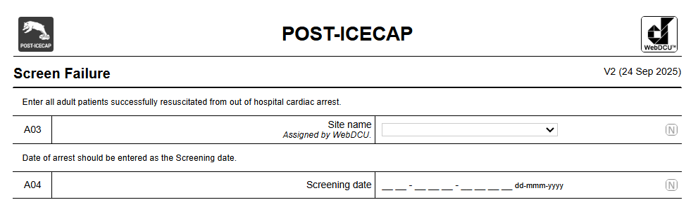
A04 - Screening Date
Notes:
we would like all OHCA patients admitted to any of the ICUs to be entered in the screen-failure form
Screening date in A04 should be date of cardiac arrest.

Slide 36
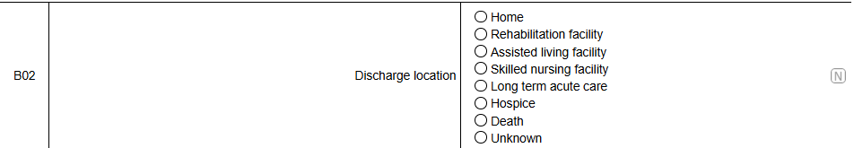
B02 - Discharge Location
Notes:
This fields should be left blank if the patient is still hospitalized. Unknown should only be selected if it is truly unknown. You can always come back later to complete this questions and the DCC will contact you monthly.

Slide 37
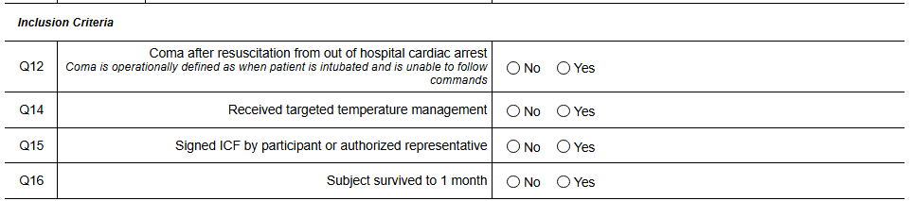
Q16 - Subject survived to 1 month
Notes:
If Q16 Subject survived to 1 month is ‘No’, then Discharge location should not be ‘Unknown’.

Slide 38
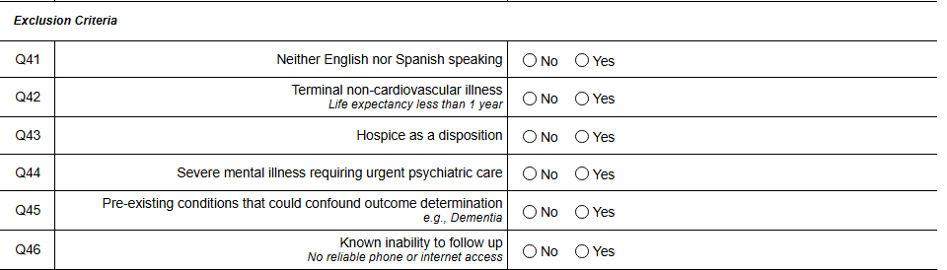
Q43 - Hospice as a disposition
Notes:
If Q43 Hospice as a disposition is ‘Yes’, then B02 Discharge location should be ‘Hospice’

Slide 39
Review of Screening Data for Optimization
Screened | Total of Screen Failures and Subject Enrollments entered in WebDCU.
Eligible | Total of Eligible patients and Subject Enrollments entered in WebDCU.
Approached for consent | The total Screen Failure A10 Informed Consent is ‘declined’ or ‘Obtained' and the total Subject Enrollment Q07 Informed Consent obtained prior to study participation is ‘Yes’.
Consented | The total Screen Failure A10 Informed Consent is ‘Obtained’ and the total Subject Enrollment Q07 Informed Consent obtained prior to study participation is ‘Yes’.
Pending Enrollment | The total number of patients who consented but are pending survival to 1 month
Enrolled | The total number of patients who consented and survived to 1 Month based on F308 Q30.

Slide 40
Screen Failure Cascading Report
Cascading (Sequenced) Eligibility Criteria | Number Excluded from among those not excluded by previous criteria | Decreasing number of screens left after those removed for each criterion | Percent of all Screened
 | . | 1568 | .
Not in coma | 195 | 1373 | 12%
Did not receive TTM | 409 | 964 | 26%
Known inability to follow | 44 | 920 | 3%
Did not survive to 1 month | 764 | 156 | 49%
Terminal non-CV illness | 14 | 142 | 1%
Pre-existing conditions | 23 | 119 | 1%
Severe mental illness | 3 | 116 | 0%
Hospice as a disposition | 8 | 108 | 1%
Neither English nor Spanish speaking | 11 | 97 | 1%
Declined informed consent | 63 | 34 | 4%
Unknown/Unclear | 34 | 0 | 2%
Notes:
The first column indicates that 195 patients out of 1568 have been excluded for not being in a coma. Then you will see that 409 patients out of the remaining 1373 were excluded for not receiving TTM which is something that we can address as that is 26% of the total screened patients.
Most patients we are screening are not surviving to the 1 Month visit which is almost 50%.

Slide 41
CRF Review -
Pittsburgh Cardiac Arrest Category Score
Amy Schroeder
SIREN CCC

Slide 42
Core Completion Principles
Anchor Point
Sedation Status
Study Requirement
The assessment must be performed closest to 6 hours after sustained ROSC and stabilization.
Perform the exam prior to sedation, or when sedation is as light as clinically possible.
Exam should still be performed and recorded during sedation.
Mandatory for all subjects. Captures critical illness severity early in the recovery trajectory.
Watch the PCACscore video for assessment background and tips on calculating the score.

Slide 43
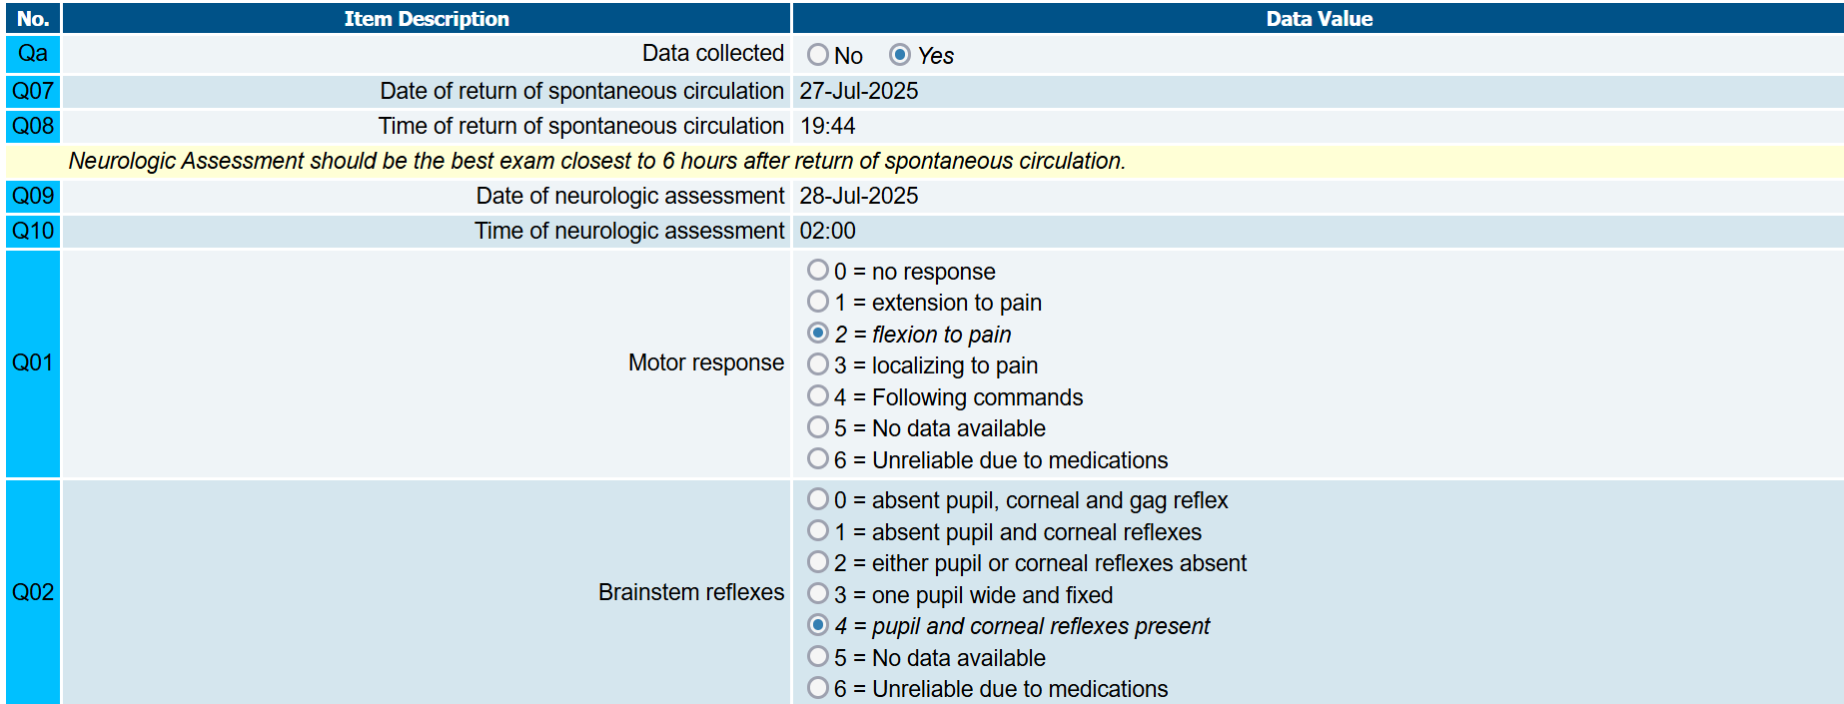
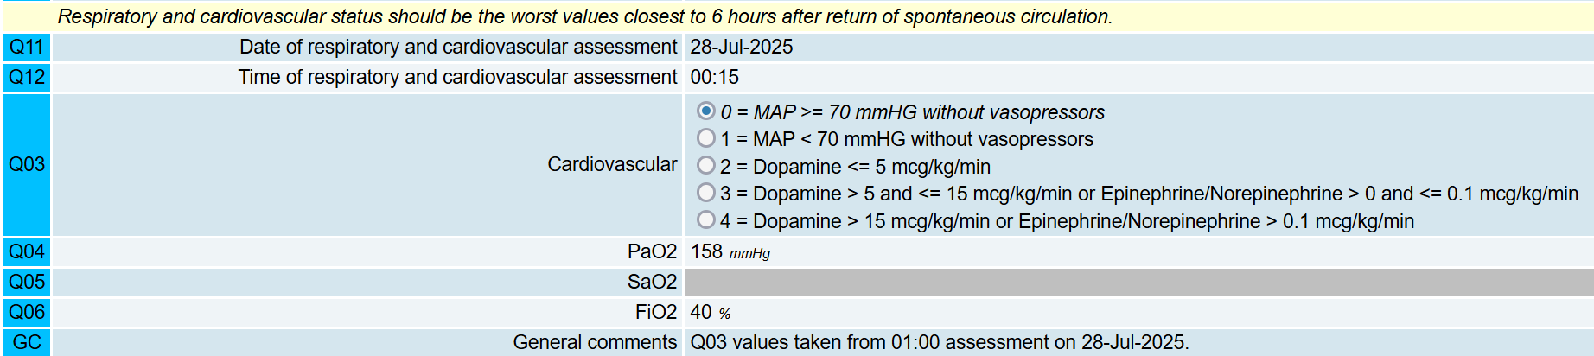
F506: Pittsburgh Cardiac Arrest Category Score

Slide 44

Neurologic Exam: The "Best" Rule
Exam Parameters
Capture the BEST exam closest to 6 hours post-ROSC.
Unknown ROSC Time?
Leave Q08 blank. Dismiss the rule violation in WebDCU and explain that data is missing due to unknown ROSC.

Slide 45
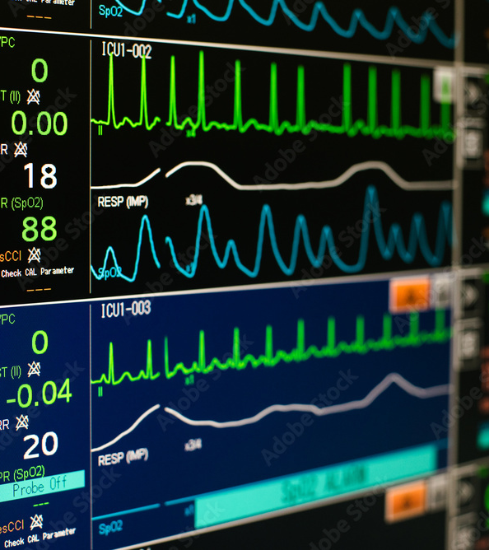
Respiratory & Cardiovascular
The "Worst" Rule Applied
Physiological Stress
Respiratory and Cardiovascular status should be recorded as the WORST values closest to 6 hours after sustained ROSC.
•
Captures max respiratory support required
•
Reflects peak hemodynamic instability
•
Standardizes 6h prognostic markers
https://www.cardiacdirect.com/wp-content/uploads/2021/06/patient-monitor-screen.png
Source: www.cardiacdirect.com

Slide 46
Form 506 Summary Matrix
Domain | Logic Applied | Metric Focus
Timing Reference | ROSC Clock | 6 hours post sustained ROSC
Neurologic | BEST Exam | Brainstem reflexes & motor response
Respiratory | WORST Value | ABG (PaO2 or SaO2) & FiO2
Cardiovascular | WORST Value | MAP & Vasopressor requirements

Slide 47
Laboratory Standards: Arterial Only
Source Integrity
Data Hierarchy
Data Quality
Both PaO2 and SaO2 must come from an arterial blood gas (ABG).
Venous samples are not included.
If PaO2 is not available, SaO2 may be used as a secondary option.
Ensure lab time stamps align with the clinical stabilization window for maximum accuracy.
Lab time is used for “Time of Respiratory and cardiovascular assessment in Q12”

Slide 48
Data Mapping: Q11 & Q12
These questions capture the Date and Time when respiratory values were obtained:
Q11/12
•
PaO2 (Q04) OR
•
SaO2 (Q05)
•
FiO2 (Q06) - closest possible
Timestamp Requirements
REQUIRED: Indicate exactly when the cardiovascular values (Q03) were obtained in GC.

Slide 49
Top 3 Avoidable Entry Errors
SpO2 vs. SaO2
The 6-Hour Anchor
Missing CV Reference
Common Mistake: Entering SpO2 from the vitals monitor.
Common Mistake: Picking the worst/best values from the entire 6-hour period.
Common Mistake: Leaving General Comments blank regarding Q03.
Requirement: Use from an Arterial Blood Gas. Vital sign saturation is not the same metric.
Requirement: Capture the best/worst values AT (closest to) the 6-hour mark, not a summary of the whole window.
Requirement: enter the specific time the cardiovascular assessment was performed in the comments.

Slide 50
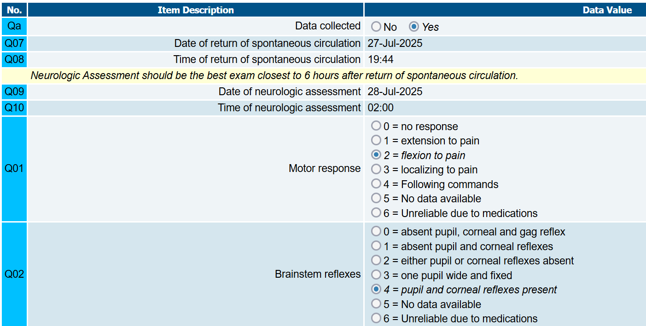
Example - Neurological Assessment
Anchor time point:
Date/time of ROSC + 6 hours
27Jul2025 19:44 -> 28Jul2025 01:44
Motor Responses: withdrawal to pain in all extremities
Brainstem Reflexes: Pupil and corneal reflexes intact
Unreliable due to medications is an option when clinically appropriate, but if the neuro assessment is completed under sedation, that data should be entered.

Slide 51
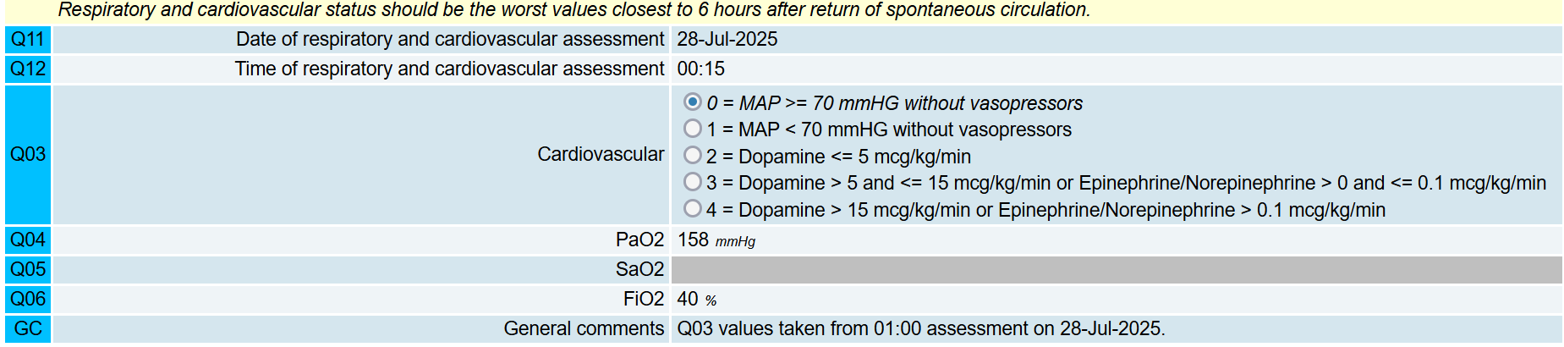
Example - Cardiovascular and Respiratory Assessment
Anchor time point:
Date/time of ROSC + 6 hours
27Jul2025 19:44 -> 28Jul2025 01:44
Date/Time in Q11/12 reflects ABG draw time (Q04)
Confirmed no pressor support, MAP >70
PaO2 from ABG;
FiO2 from VS at same time
General comment added to reflect time of Q03 data

Slide 52
CRF Review -
Hospital Summary
Amy Schroeder
SIREN CCC

Slide 53

Hospital Summary
Therapy Recommendations
Recommended therapies at the time of hospital discharge
Discharge summary disposition recommended services
Orders placed
PT/OT/Speech/Psych evaluations and recommendations at discharge
This form is meant to capture recommendations at discharge, not necessarily services accepted or received

Slide 54
BTACT Quality Check
Nicholas Pek
Columbia University

Slide 55
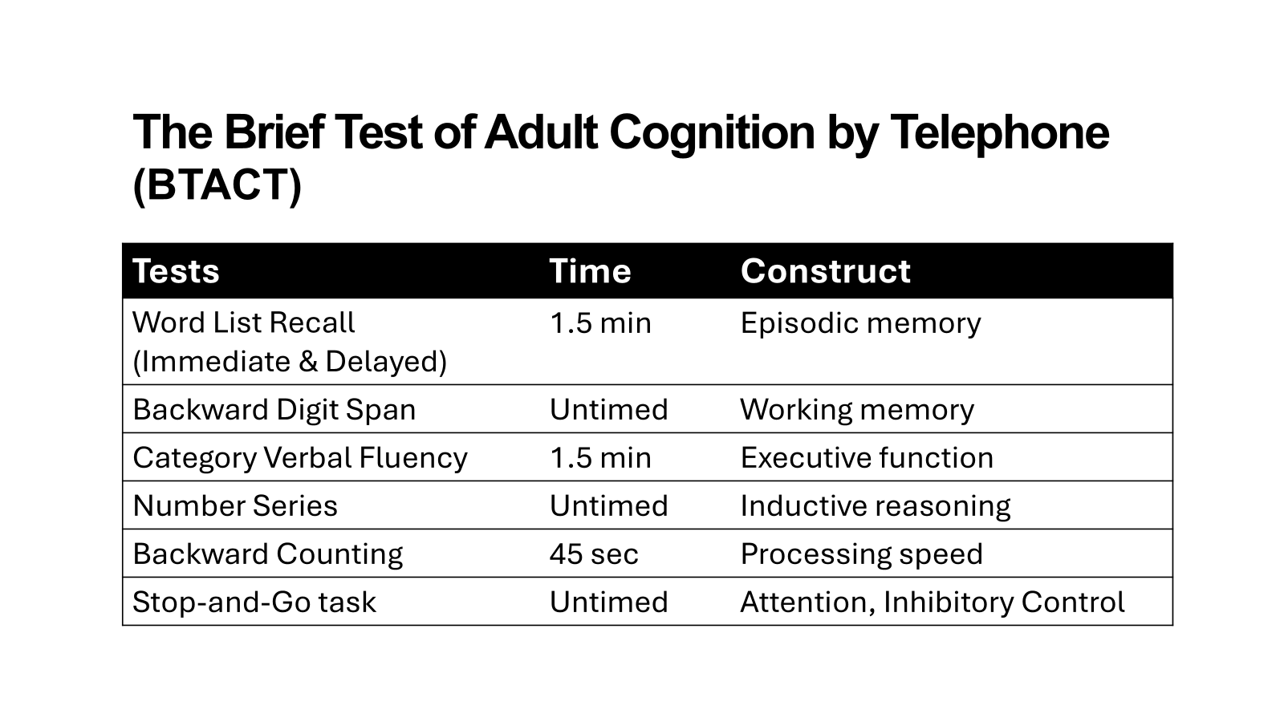
Notes:
Brief neuropsychological battery assessing memory, executive functioning, and processing speed.
Comprised of seven subtests with scores combined into composite indices of cognitive functioning.
Designed for efficient administration, primarily via telephone across multi-site studies.
Currently is the preferred neuropsychological test in traumatic brain injury studies and we intend to standardize it for cardiac arrest trials in the future.

Slide 56
The Brief Test of Adult Cognition by Telephone (BTACT)
Training, Certification, Re-certification
Examiner’s Training Manual
Administration Guide and Scoring Training Videos
Certification Test: Vignette 1, Vignette 2
NOAs send scanned copies of scoring sheets at POST-ICECAP-contact@umich.edu for certification.
Notes:
in that regard, we have created ….

Slide 57
Quality Check
Conducted centralized quality assurance review of all BTACT forms across multiple sites.
Independently double-scored all submitted forms to assess scoring consistency.
Identified and classified discrepancies as major or minor errors.
  Major error → affects final score
  Minor error → does not affect final score
Created a process of providing individualized feedback to sites.
Notes:
to address errors in administration, scoring, and documentation.

Slide 58
Participating NOAs
Total NOAs trained = 126
Sample included = 31 NOAs for 388 forms
50% had a Bachelors degree
38% with prior neuropsychological administration
3% with BTACT

Slide 59
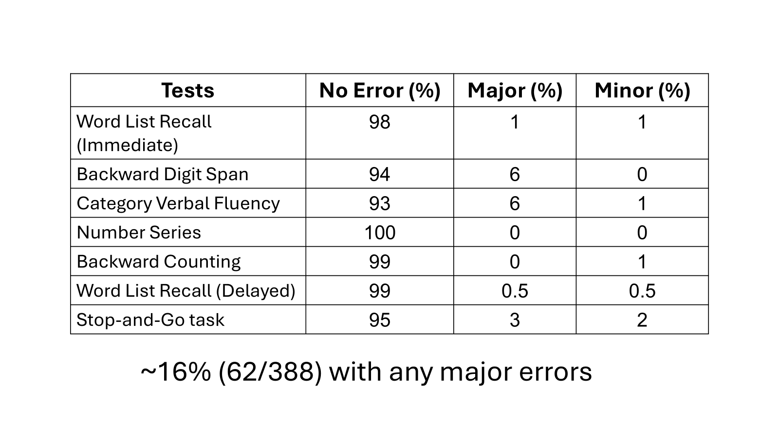
Who was part of the QC project?
389 BTACT administrations reviewed across 31 sites.
43 Neuropsychological Outcomes Assessors (NOAs)
NOAs came from diverse professional backgrounds, including academic, clinical, and medical settings.
All NOAs completed standardized training and certification prior to administering the BTACT.

Slide 60
Moving Forward
Data Clarification Requests (DCRs) have been finalized and distributed.
  Please check the ‘Alerts’ tab on WebDCU for any queries requiring your attention.
The overall goal of this QA project was to use identified error trends to improve training and standardization efforts.
Manuscript preparation is underway.
If you have any questions or concerns regarding the BTACT or the QC project please reach out to njp2151@cumc.columbia.edu.

Slide 61
Retention Best Practices
Anne Ellison
SUNY Upstate
Katie Meehl
Yale
Dalton Wesemann
Adventist

Slide 62

Retention Best Practices
*Patient-centered approach- Offer choices- They are in control
What are the Goals?
Patient’s (ASK THEM!)
PI’s (TALK TO THEM! Read their work.)
Site’s (The mission of SUNY Upstate Medical University is to improve the health of the communities we serve through education, biomedical research and patient care.)
- We want to know what happens when you leave. We care about how you are doing and what is happening in our community.
Yourself (Self-Assessment) Navigating the conversation of research with patients and families after/during critical illness.
7.0 Participant Retention
High rates of participant retention should be maintained throughout the study, and each site should strive for 100% retention.
Study site personnel must make every effort to complete each participant’s study visit within the allowable visit windows.
A study participant will be counted as retained when the mRS is obtained at 365 days post OHCA.
-POSTICECAP Outcomes MoP
Content:
https://www.linkedin.com/in/ladyglaucomflecken/
"Patients survive. So do the people who love them."
~Kristin Flanary, aka Lady Glaucomflecken
Anne Ellison BS, CCRP
Research Coordinator, Emergency Medicine
ELLISANN@upstate.edu
315-651-2119

Slide 63


Retention Best Practices - Yale
Be flexible, reach out early
Clear communication
  What does commitment, compensation, etc. look like
  Contact information
Engage with family/LAR
Feel free to reach out!
Kathryn Meehl
kathryn.meehl@yale.edu
910-228-9587

Slide 64


Retention Best Practices
ADVENTIST
Compensation
Meet patient where they are
Emphasize benefit to others
Provide resources
Dalton Wesemann, MPH
Contact: cprem@ohsu.edu
Website: Center for Policy and Research in Emergency Medicine

Slide 65
Open Q&A
Natalie Fisher, Nicholas Pek, Sarah Wells, Sachin Agarwal, Clifton Callaway
For clarifications, contact: POST-ICECAP-contact@umich.edu

