Slide 1
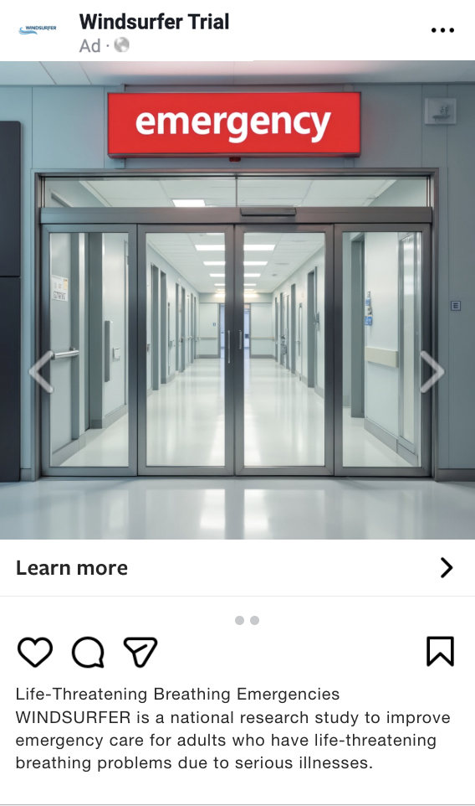
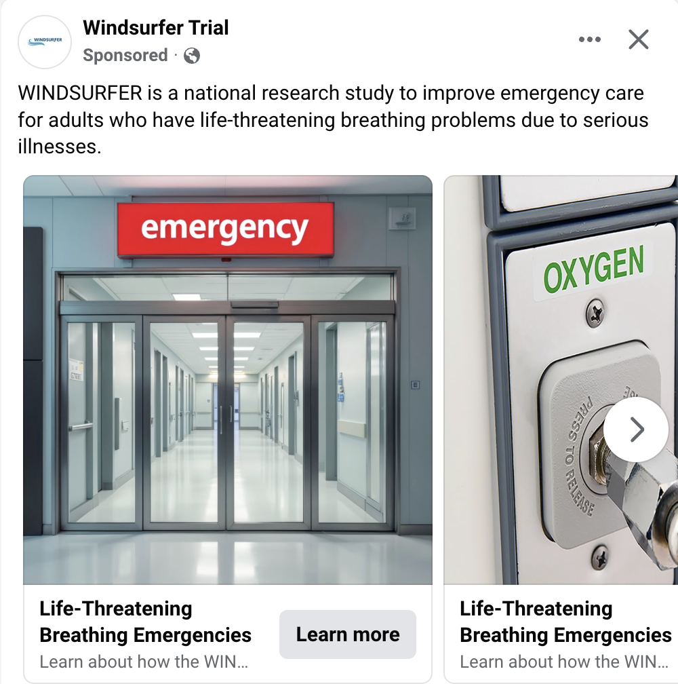
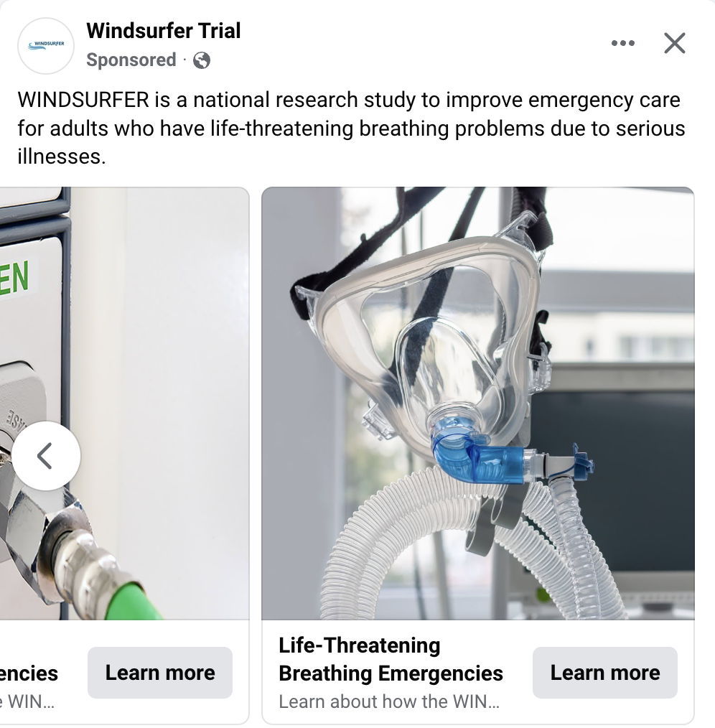




Social Media Ads
Instagram
Facebook
Primary text for the social media ad was updated per Advarra’s request on page 3. That language will be reflected in this ad

Slide 2


Ad Placement:

Slide 3
WINDSURFER Trial
Social Ad Text
HEADLINE: Life-Threatening Breathing Emergencies
DESCRIPTION: Learn about how the WINDSURFER study may affect you or someone you know.
PRIMARY TEXT: WINDSURFER is a national research study to improve emergency care for adults with life-threatening breathing problems. Because this study involves emergency treatment, patients may be enrolled without informed consent at the time of the emergency.

