Slide 1

WIN ratio analysis to Determine a strategy of non-invasive SUpport
for Respiratory Failure in the EmeRgency Department

Slide 2
Introductions
Leads of the WINDSURFER Study
  Ohio State University
  University of Arizona
  Baystate Medical Center
  University of Michigan
  Medical University of South Carolina
  NIH SIREN network
Grants from the National Heart, Lung and Blood Institute
Notes:
Introduce the leaders of the study

Slide 3
Introductions
Local Team
  [Names]
  [Institution]
Community Consultation (Engagement) Team
  [Names]
  Center of Injury Sciences, University Alabama at Birmingham
Notes:
Introduce the local study team, including site PI, coordinator and institution.
Introduce the UAB team. Explain that the UAB team’s role is to conduct community consultation (engagement) activities for the study.

Slide 4
We are asking for your thoughts because
you are a member of the community where
WINDSURFER will take place

Slide 5
Purpose of the Interview
You are being asked to participate in research
The interview will last 30 minutes
The WINDSURFER study looks at how doctors treat life-threatening breathing emergencies in the Emergency Department
We will determine if certain oxygen strategies are better for improving breathing emergencies
You will learn more about the study and emergency research
You will be asked to share your feedback

Slide 6
Voluntary Participation
It is up to you to decide if you want to participate in this interview
Participation is voluntary and you can withdraw at any time
We will make an audio recording of the interview
This interview is confidential, and we will take measures to protect your identity and the information we gather
The audio recording will not include your name or other identifying information
Please do not use anyone’s names when you talk about your personal experiences
We will collect some demographic information from you at the end of the interview
The only risk in participating in this interview is that your identity may be known to researchers
The knowledge we gain from these interviews may help us to better understand if the planned study procedures are appropriate for your community

Slide 7
Ground Rules
You are the expert, and we are here to learn from you
There are no right or wrong answers
I will be taking some notes now, and we will also transcribe the recorded interview later
Please keep your video off
Questions or comments off the topic will be answered after the recorded session
The recording will be kept securely - no one will have access except for those who need to review the recording for research purposes

Slide 8
Consent to Continue
Do you have any questions?
Would you like to continue with the interview?
Notes:
If subjects agrees, proceed with next slide.
If subject disagrees, stop.
Do not start recording yet.

Slide 9
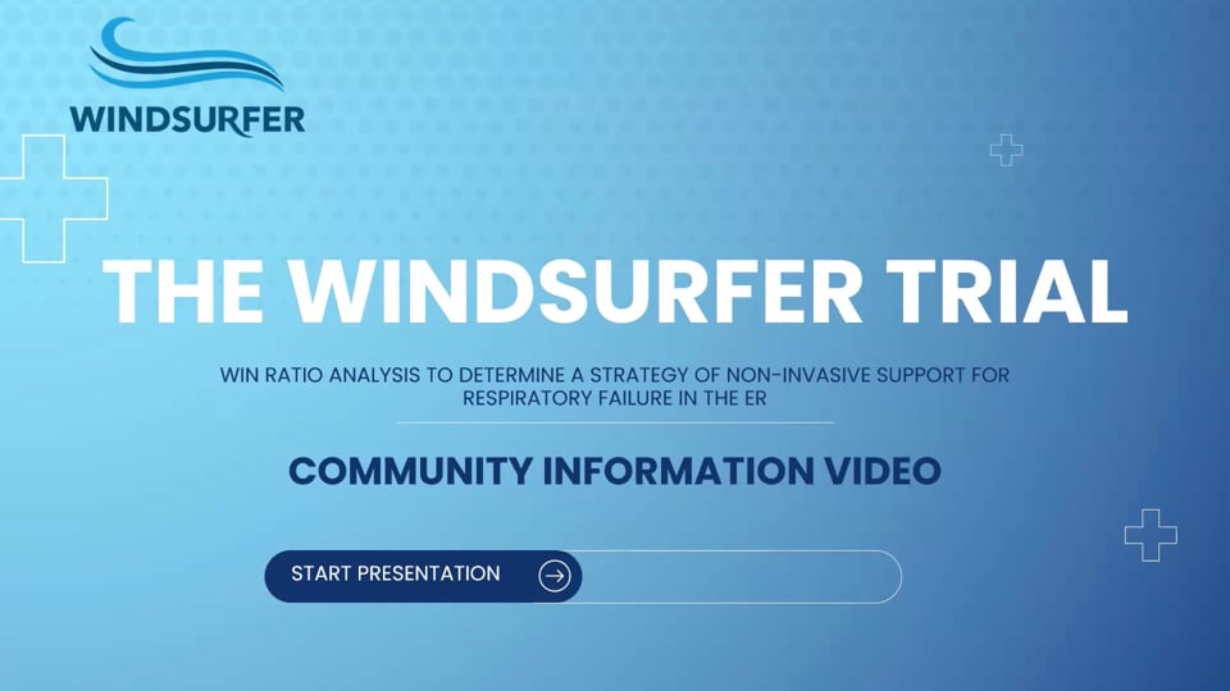
<<WINDSURFER Video Inserted Here>>
Notes:
https://vimeo.com/1183507661?share=copy&fl=sv&fe=ci

Slide 10
Would you like to participate in this interview for the research study?
Notes:
START RECORDING.
TURN INTERVIEWEE VIDEO OFF FOR RECORDED INTERVIEW.

Slide 11
What questions or thoughts do you have
after watching the video?

Slide 12


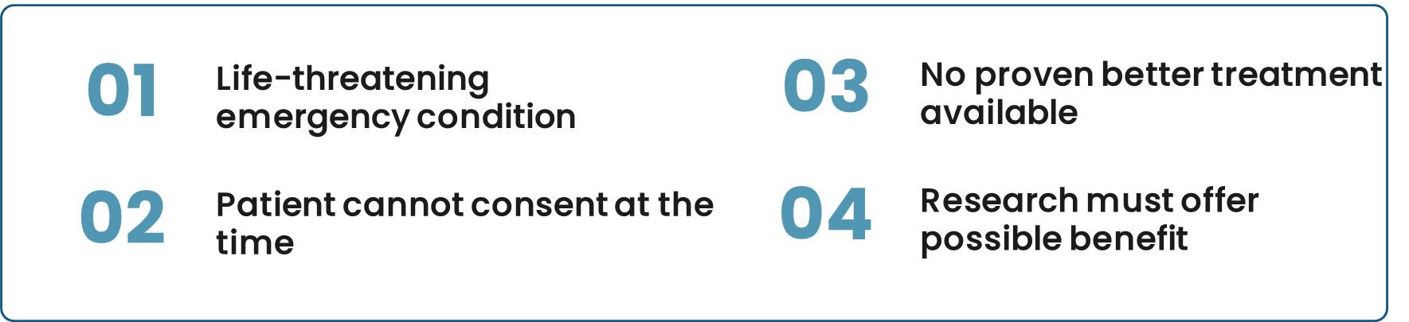
What are your thoughts about emergency medical research?
WHAT IS
EFIC
EFIC, or Exception from Informed Consent, allows research in life-threatening emergencies when a patient cannot give consent and waiting would be unsafe. It is only used when the study meets strict federal requirements to protect patients.
When Can EFIC Be Used?

Slide 13
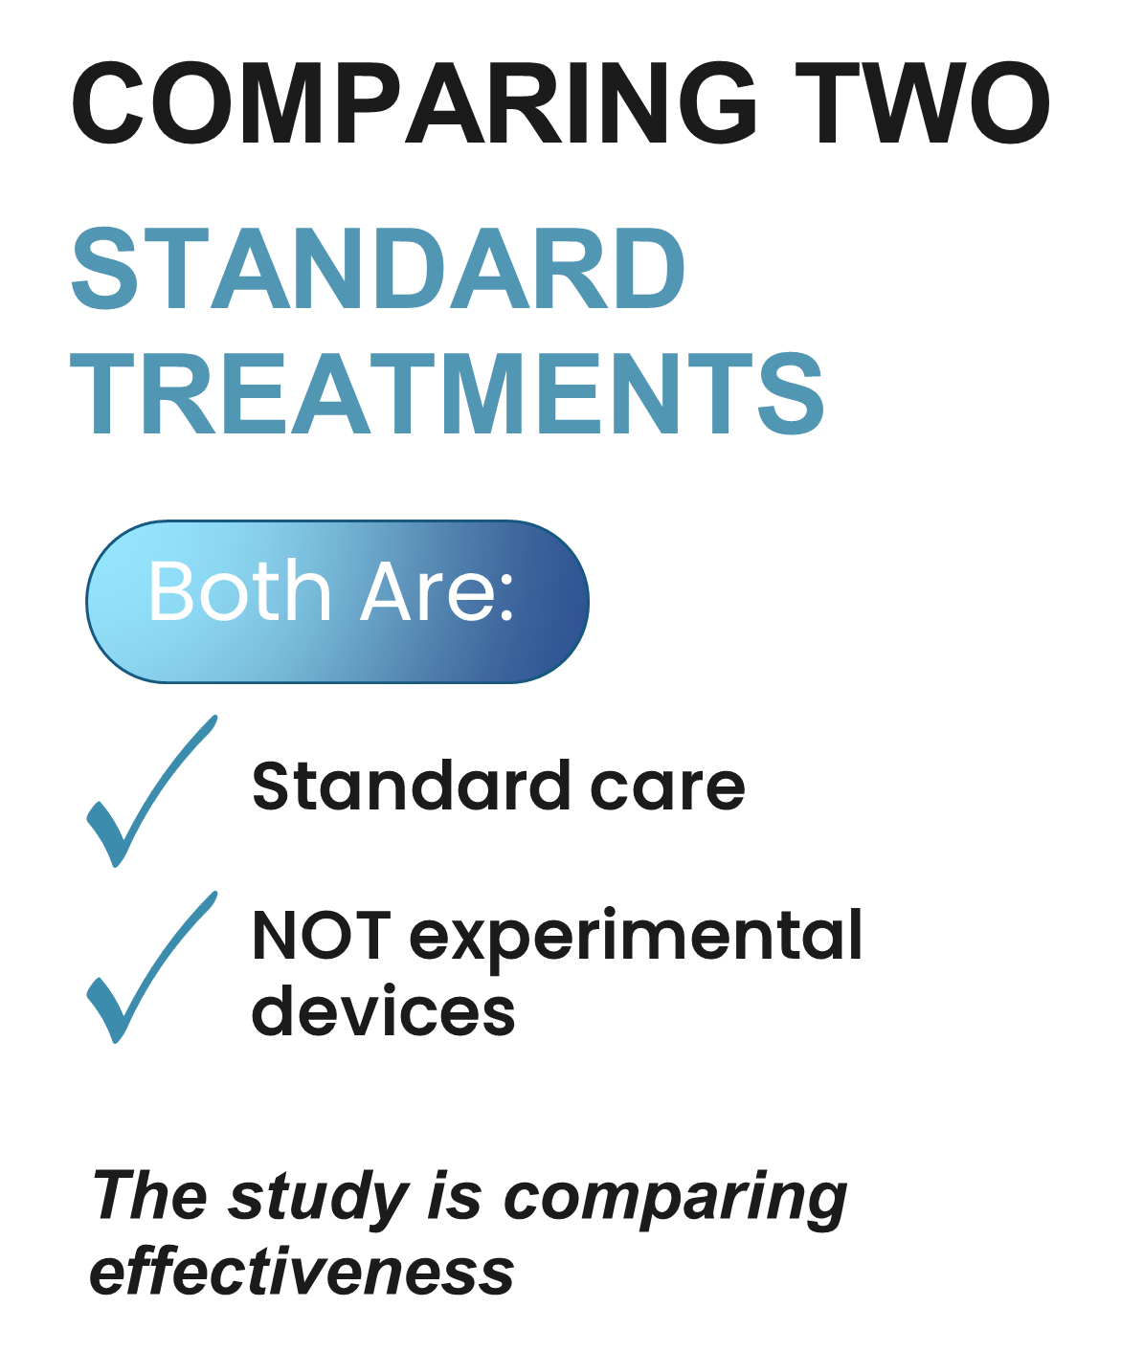
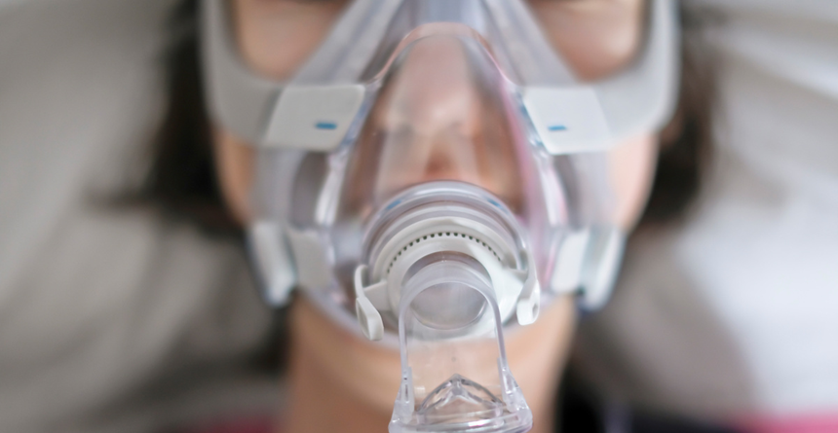
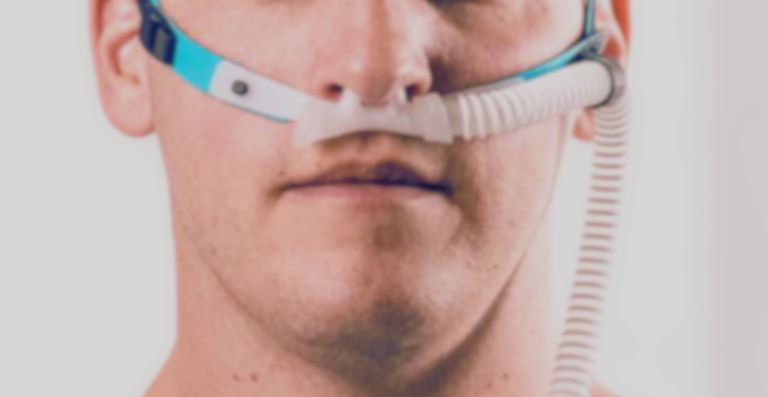
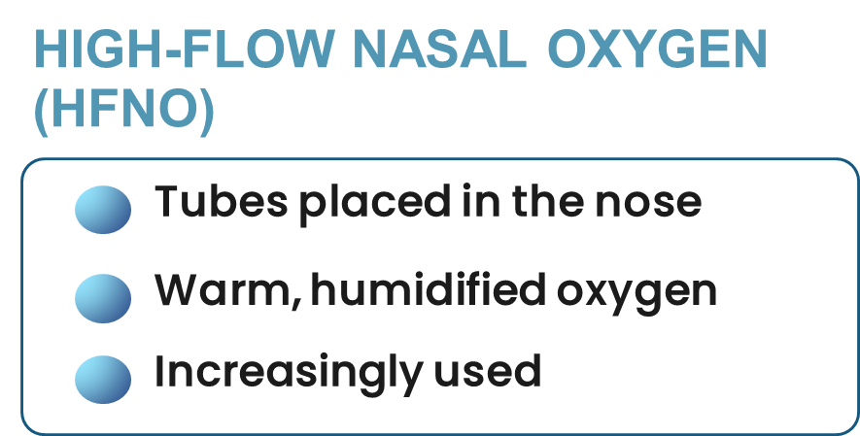
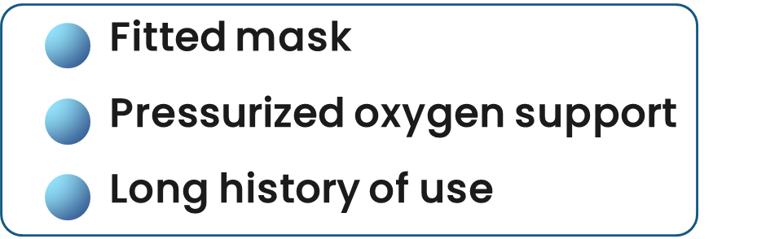
What questions do you have about
the WINDSURFER study?
NON-INVASIVE POSITIVE PRESSURE VENTILATION (NIPPV)

Slide 14
If you were severely ill and needed emergency breathing care, would you want to be entered into the WINDSURFER research study, even though you couldn’t give consent?
We would still try to get consent for continued participation after you are stable and your legally authorized representative (someone who can make medical decisions on your behalf) can be identified

Slide 15
If one of your family members were severely ill and needed emergency breathing care, would you want them to be entered into the WINDSURFER research study, even if they or you couldn’t give consent?
We would still try to get your consent on behalf of your family member for their continued participation
after your arrival at the hospital

Slide 16
Do you believe that the WINDSURFER study
should be done in your community?
Could you tell us the reason for your answer?

Slide 17
Do you have any other questions, comments or suggestions before I end the recording?
Notes:
STOP RECORDING
TURN PARTICIPANT VIDEO ON

Slide 18
Demographics
We collect some basic information about those who have participated in the interview
This information is collected anonymously
This helps us to determine if we are reaching the right people and gathering opinions from anyone who may be affected by the study
<<Insert URL and/or QR code>>
Notes:
Insert link and/or QR code

Slide 19
Contact Information
If you have any questions, comments or complaints:
  Local Principal Investigator:
  <<insert PI name>>
  <<insert PI phone number and/or email>>
Contact the Advarra Institutional Review Board (IRB) if you have questions regarding your rights as a research participant.
  Contact the IRB if you have questions, complaints or concerns which you do not feel you can discuss with the investigator.
  The Advarra IRB may be reached at 877-992-4724 or adviser@advarra.com

