Slide 1
KESETT All-Site Call
12/5/2025

Slide 2
House Keeping
Contracts extended through 2026
Sites have begun going to the CIRB for Approval
Study trainings are posted on the KESETT website

Slide 3
Site Readiness

Slide 4
WebDCU Readiness
Work on uploading regulatory documents
Site Addresses in WebDCUv2 - Site management > Site Address
CIRB tables
Training
  Protocol – Read Protocol, IM video and quiz on the Website > Upload quiz results to WebDCU
  Data – IM video on the Website > Upload cert to WebDCU
  Regulatory – IM Video on the Website > Upload cert to WebDCU
    Required for KESETT as WebDCUv2 has some new features
  Pharmacy – Have pharmacists on the eDOA review the pharmacy manual and sign the attestation on the website > Upload attestation to WebDCU
  Clinical – Attestation by the site PI (protocol signature page) > Upload to WebDCU
Study Team

Slide 5
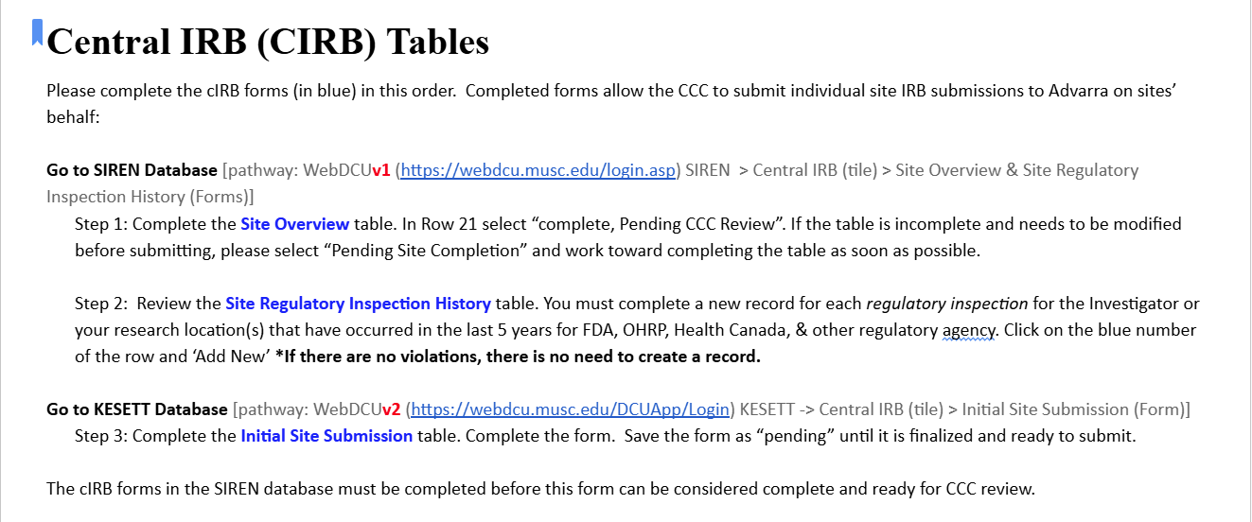

Slide 6
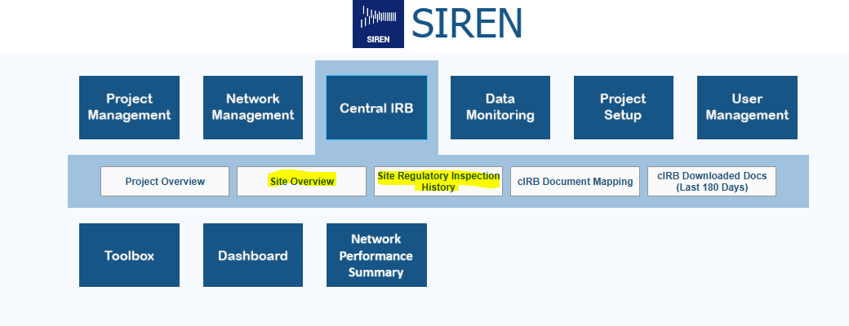
Central IRB (CIRB) Tables
Steps 1 & 2 in WebDCU v1 > SIREN:

Slide 7
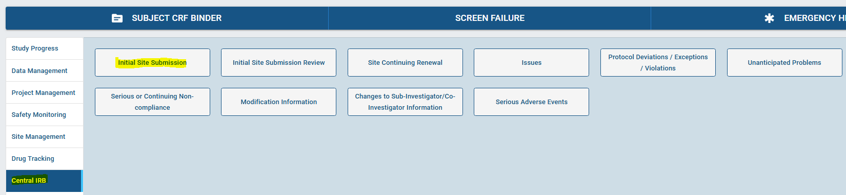
Central IRB (CIRB) Tables
Step 3 in WebDCU v2 > KESETT:

Slide 8
IRB Approval Process
Site submits local ICF language to CCC
Site information added to local ICFs
✅
CIRB Protocol Approval
Local IRB Ceding Acknowledge
CIRB Site Approval
Return Site CIRB Documents to Local IRB
Site completes initial site submission form
CCC submits site application to CIRB

Slide 9
Preparing for CIRB Submission
4-6 weeks from end of EFIC campaign
  CCC will send email with remaining tasks
1-2 weeks from end of EFIC campaign
  Follow-up email with prep for CIRB submission
1-2 weeks from IRB review date
  Readiness checklist and Readiness call email

Slide 10
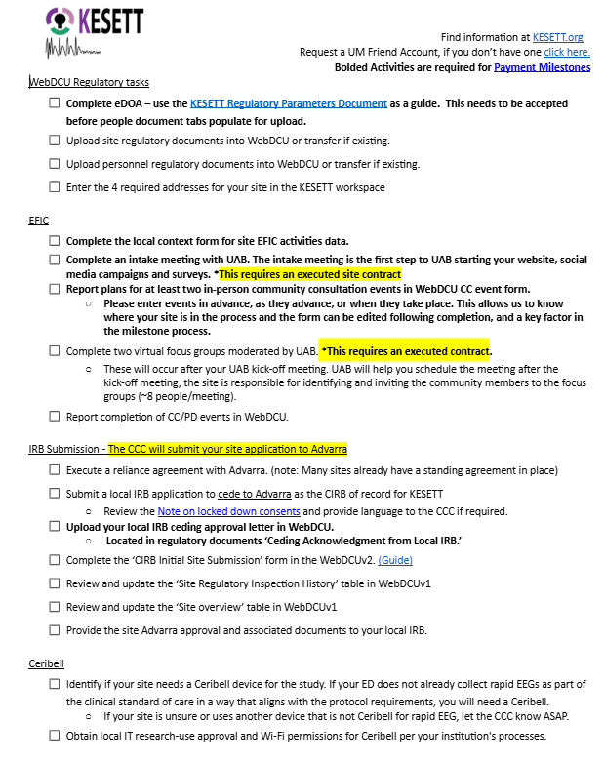
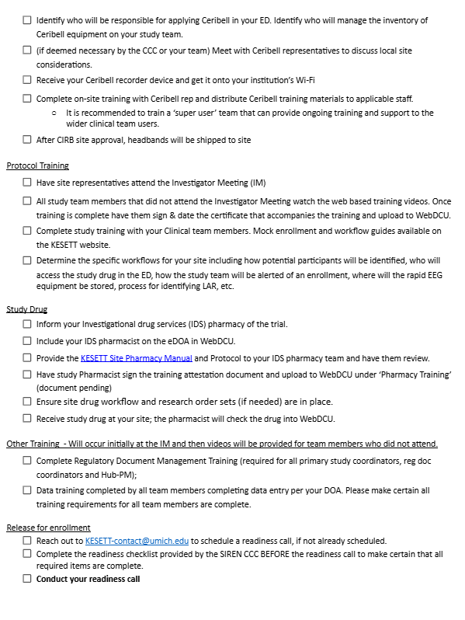

Slide 11
Study Materials & Ceribell Supply
Notes:
Centrally provided
Other than the study drug
IV poles not provided by study
Protocol reminder cards file will be available in case sites want to produce extra copies, create poster, etc.

Slide 12
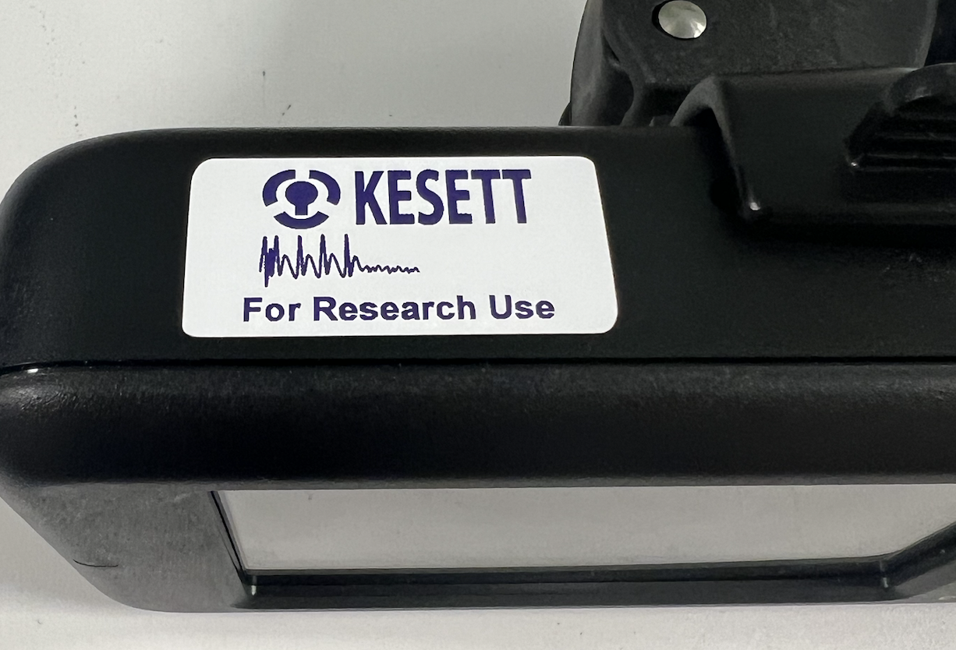
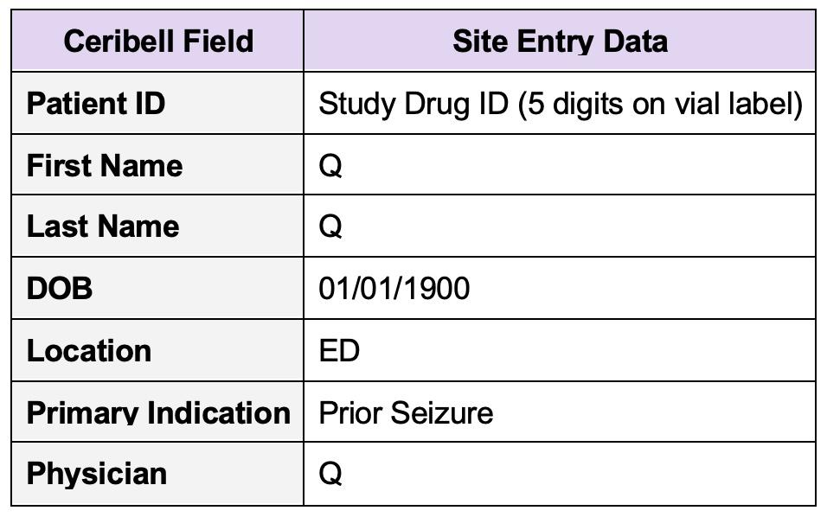
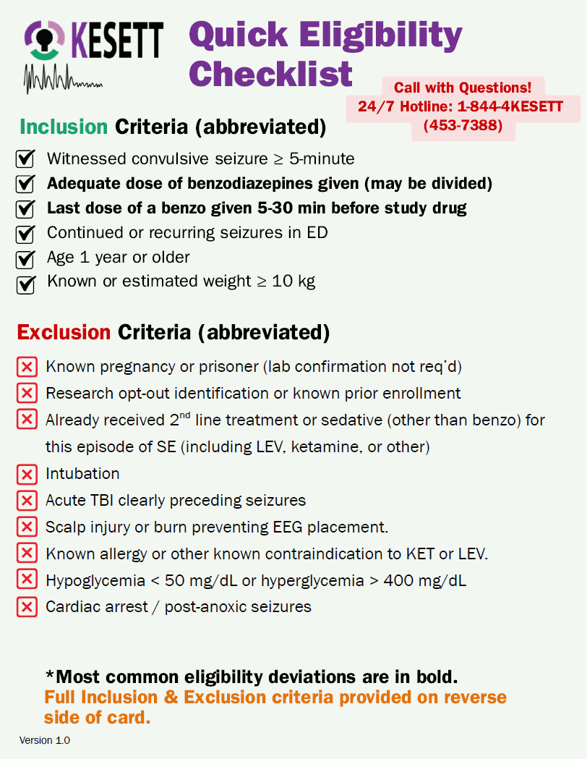
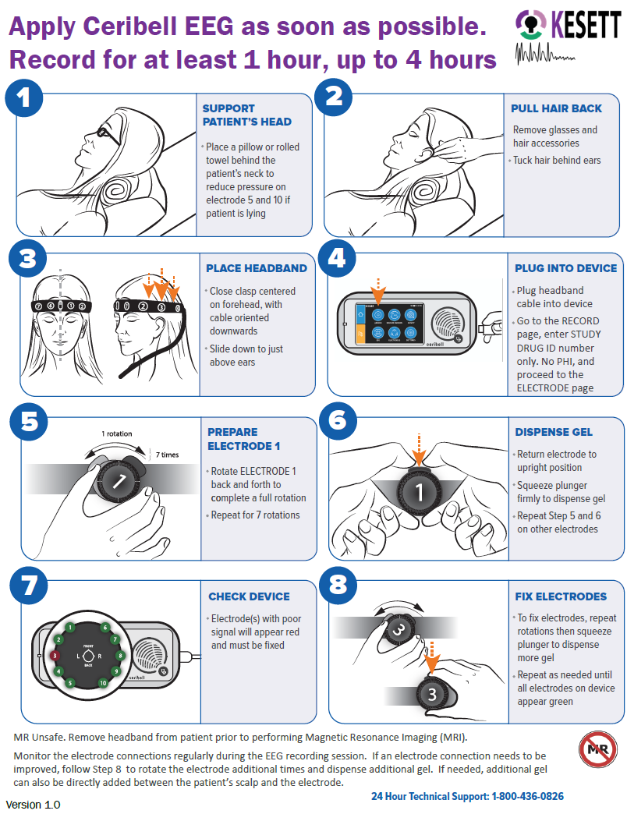
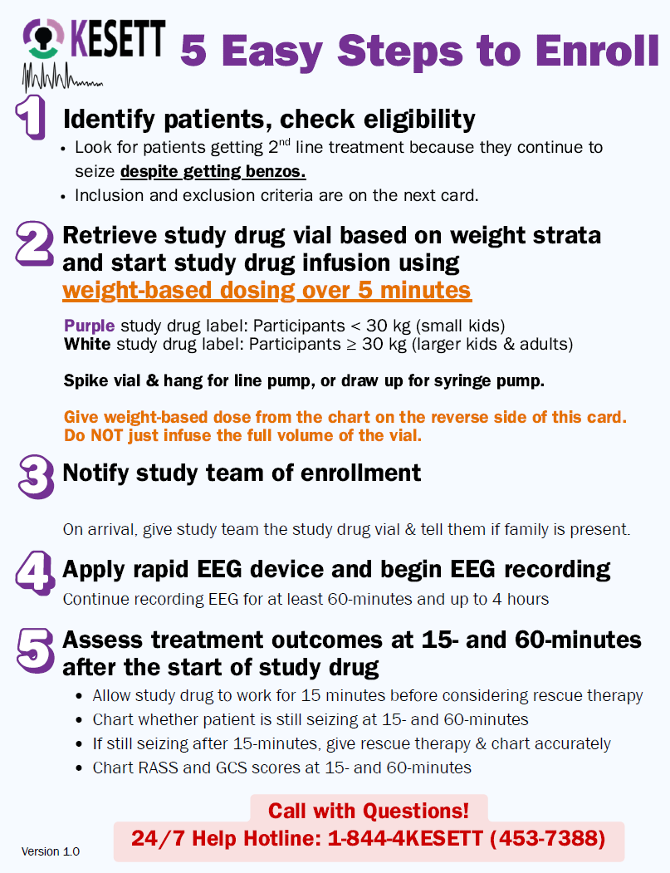
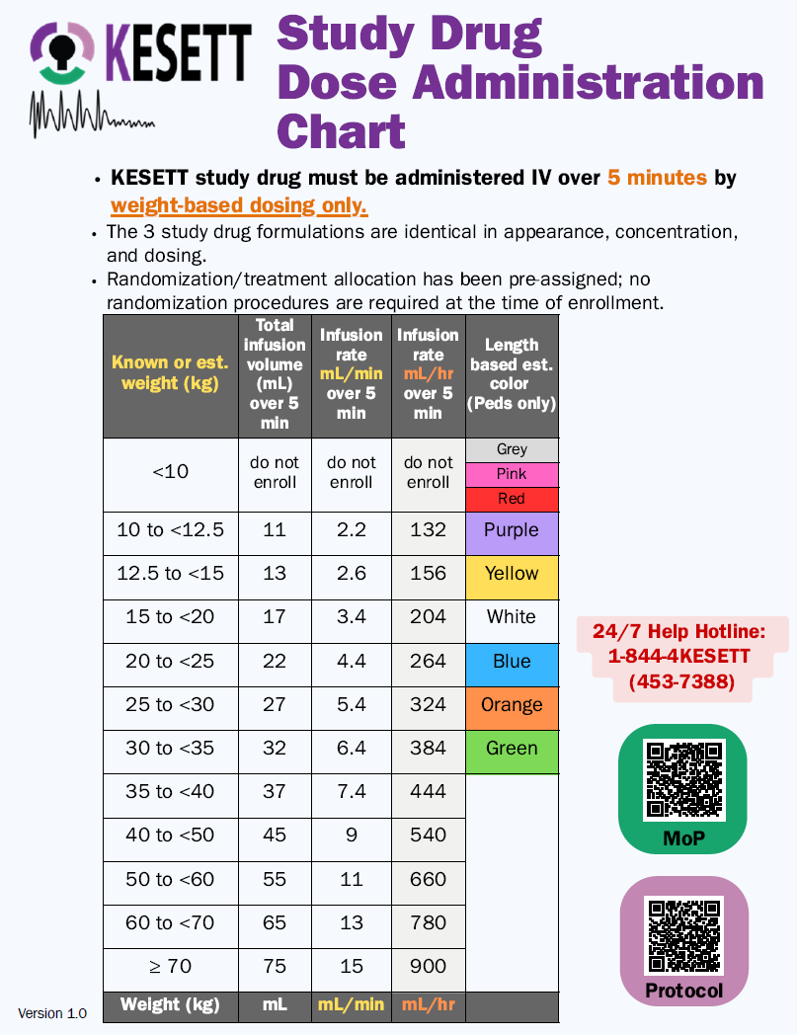
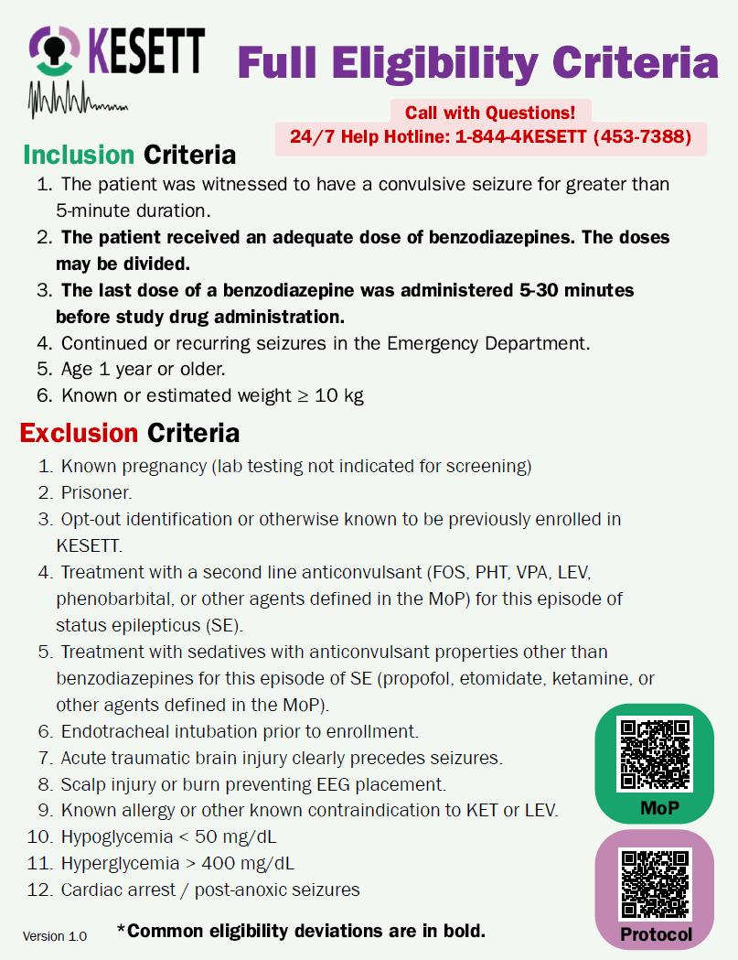
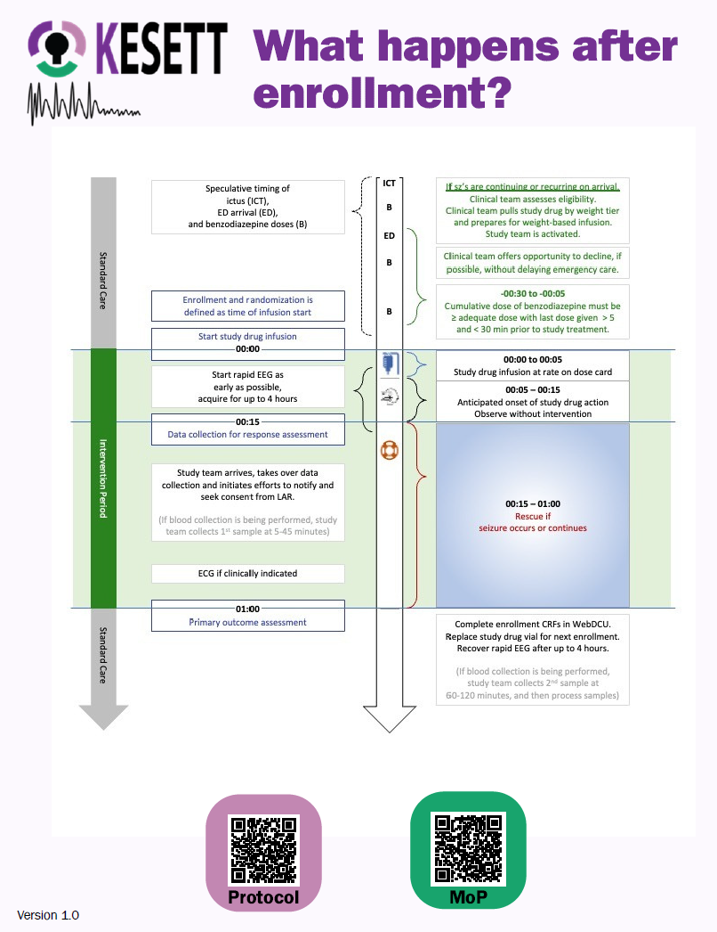

Study “Kit” Materials: Centrally provided
Ceribell (unless using own clinical device):
  Recorder device
  KESETT stickers for recorder
  Ceribell headbands
  KESETT stickers for headband boxes
Ceribell headband basket for IV pole
Protocol Reminder Cards
Length-based-weight estimation
measuring tape
  Can also be used to measure head circumference
Notes:
Centrally provided
Other than the study drug
IV poles not provided by study
Protocol reminder cards file will be available in case sites want to produce extra copies, create poster, etc.

Slide 13
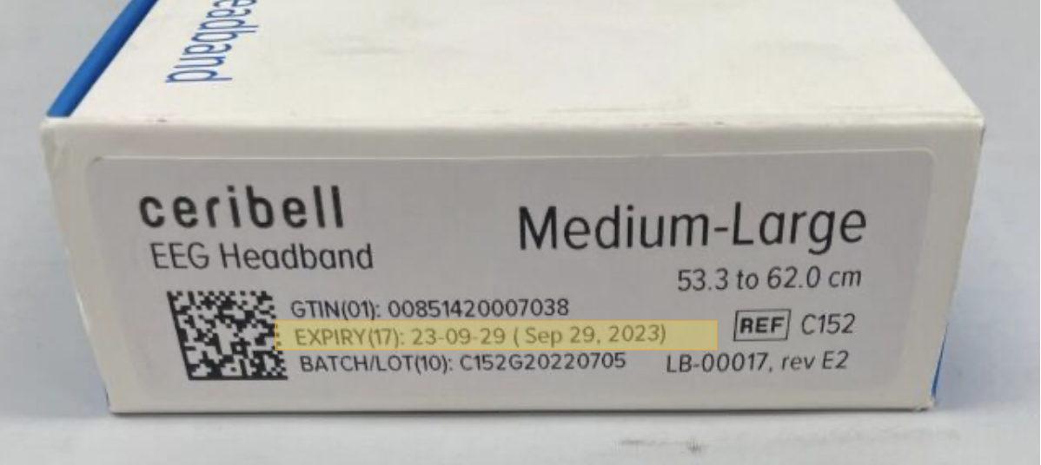
Ceribell Supply Logistics
> Device provided after site contract is executed to allow local approvals.
> Headbands will be sent to sites as you approach site activation.
> Headbands come in 2 sizes:
Small (C151)
Medium/Large (C152)
> Each site will have a set par for number of headbands on site.
> Headbands expire after ~6 months;
will have expiration date on box.
Notes:
Headbands are consumable so will be resupplied throughout the trial.
Par depends on enrollment population (adult/peds/both) and logistics of your EDs (separate, together, etc.)
Expired headbands are not a safety issue but may impact quality of recording; can use expired headbands for trainings

Slide 14
Ceribell: Headband Inventory & Resupply
Sites will complete monthly inventory survey.
  Can be completed anytime; must be completed at least 1x/month
  Responses submitted by 1st of month will be used to place monthly resupply orders by central team on 3rd of month.
Central team uses survey responses to bring each site up to full par.
  Sites receive shipment tracking info once order is fulfilled.
  Will use shipping address in WebDCU
Urgent resupply can be triggered by the site or central team.
  Site can use survey to indicate urgent request.
  Central team will monitor use based on enrollment CRFs.
Notes:
Headbands are consumable so will be resupplied throughout the trial.
Par depends on enrollment population (adult/peds/both) and logistics of your EDs (separate, together, etc.)
Expired headbands are not a safety issue but may impact quality of recording; can use expired headbands for trainings

Slide 15
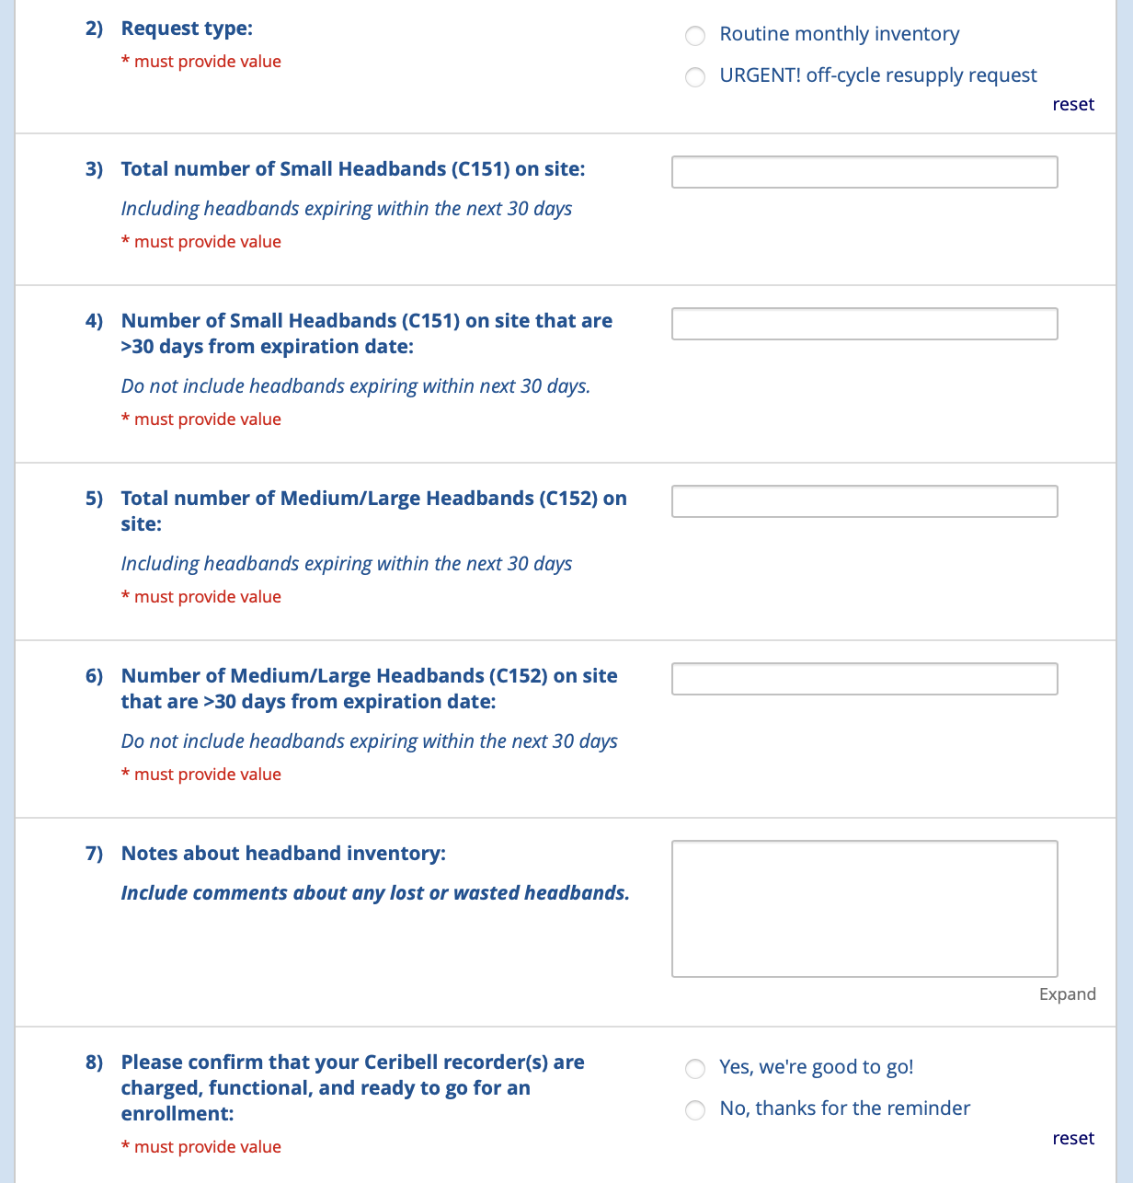
Ceribell Inventory Survey
REDCap survey
Link in MoP
Notes:
Headbands are consumable so will be resupplied throughout the trial.
Par depends on enrollment population (adult/peds/both) and logistics of your EDs (separate, together, etc.)
Expired headbands are not a safety issue but may impact quality of recording; can use expired headbands for trainings

Slide 16
EFIC Activities

Slide 17
Local EFIC activities/pending UAB | UAB Campaigns in process | EFIC Complete | Pending CIRB Submission
Banner University Medical Center | Children’s Hospital Los Angeles | Arthur M. Blank Hospital | UVA Medical Center
Baystate Medical Center | Children's National Medical Center | Christiana Hospital | Harborview Medical Center
Children's Hospital of Wisconsin | Harbor-UCLA Medical Center | Cooper University Hospital | Temple University Hospital
Children's Medical Center UTSW | Memorial Hermann Texas | Emory University | Yale New Haven Hospital
Children's of Alabama | Northwestern Memorial Hospital | Grady Memorial Hospital
Detroit Receiving Hospital | Oregon Health & Sciences University | University of Pennsylvania
Duke Regional Hospital | Reading Hospital | Jefferson Einstein Philadelphia
Duke University Hospital | Ronald Reagan UCLA Medical Center | Nemours Children’s Hospital
Froedtert Hospital | Rush University Medical Center | Penn Presbyterian Medical Center
Hennepin County Medical Center | San Francisco General Hospital
Henry Ford Hospital | Stanford University Medical Center
IU Health Methodist Hospital | UC Davis Medical Center
Johns Hopkins Hospital | UCSF Medical Center
Kings county Hospital | University of Chicago Medical Center
Masonic Children's Hospital | University of Illinois Hospital
Massachusetts General Hospital | University of Iowa Medical Center
Medical University of South Carolina | University of Michigan University Hospital
Nationwide Children's Hospital | UPMC Children's Hospital of Pittsburgh
Orlando Regional Medical Center | UPMC Presbyterian Hospital
OSU Wexner Medical Center | VCU Medical Center
Parkland Memorial Hospital
Primary Children's Hospital
Riley Hospital for Children/IU Health
Sinai Grace Hospital
SUNY Upstate Medical University
UCSD
University Medical Center New Orleans
University of Alabama Hospital
University of Cincinnati Medical Center
University of Maryland Medical Center
University of New Mexico Hospital
University of Utah Healthcare

Slide 18
EFIC
Site Alone
  2 In-person community events
Site & UAB
  2 Virtual focus groups
UAB
  Community surveys
  Social media ads
  Website
Notes:
CC in Blue PD in Green

Slide 19
Focus Group Invitation
10
8
5
CONFIRM
GOAL
CONDUCT

Slide 20



Focus Group Best Practices
Limit team member attendance with brief introductions
Concise presentation to allow ample time for community member input
Pre review the facilitator guide

Slide 21
Focus Group Recruitment
Inviting interested persons from your in-person events
Low acuity patients from your ED who have already been seen and are stable
Engaging patients from your outpatient clinics
Posting fliers in waiting rooms

Slide 22

Focus Group Recruitment
Posting on social media sites
  Next Door
  Facebook groups
  Institutional pages
leverage existing community relationships at your site
  Research Community Advisory Boards
  Patient advocacy groups
Contact community groups
  Elected officials / city council
  Religious leaders and groups
  PTAs
  Retirement and neighborhood communities
  Community resource organizations
  Local epilepsy support groups and/or foundation chapters

Slide 23
Data Coordinating Center (DCC)

Slide 24
WebDCU Access
Permissions coming soon based on eDOA: we will send out an email to all Site PIs and PSCs when access is granted.
If you already have a WebDCUv1 account: log into WebDCUv2 with your v1 username and password. If this does not work, select the Forgot Password? button and set your password. *WebDCUv1 and WebDCUv2 passwords are independent once you set them.
If you do not have a WebDCUv1 account: you will receive an email from the DCC with your username and temporary password.

Slide 25
WebDCU
KESETT is a live database.
Sites CANNOT test in the system.
DO NOT enter test data.

Slide 26
DCC Contacts
Riley Luckmann - luckmann@musc.edu
Morgan Davie - daviem@musc.edu
Sara Meyer - butlers@musc.edu

