Slide 1
KESETT All-Site Call
11/7/2025

Slide 2





Housekeeping
EFIC Focus group participants will be compensated - $50 gift card
Clinical team training slides coming soon
Most IM videos posted on the KESETT Website
Data collection guide posted
FAQ Posted in MoP

Slide 3
Readiness
Work on uploading regulatory documents
Site Addresses in WebDCUv2 - Site management > Site Address
Initial Site submission table
Training
  Protocol – Read Protocol, IM video and quiz on the Website > Upload quiz results to WebDCU
  Data – IM video on the Website > Upload cert to WebDCU
  Regulatory – IM Video on the Website > Upload cert to WebDCU
    Required for KESETT as WebDCUv2 has some new features
  Pharmacy – Have pharmacists on the eDOA review the pharmacy manual and sign the attestation on the website > Upload attestation to WebDCU
  Clinical – Attestation by the site PI (protocol signature page) > Upload to WebDCU
Study Team

Slide 4
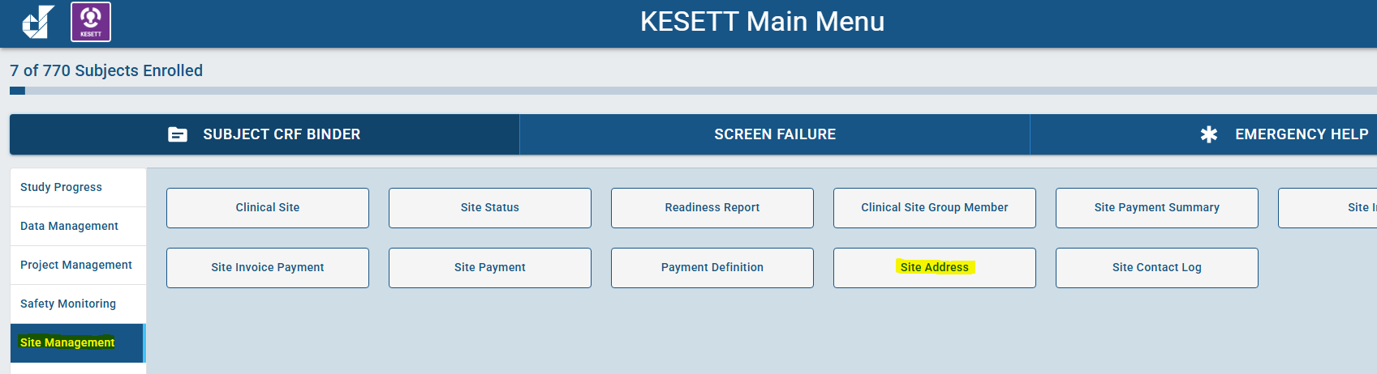
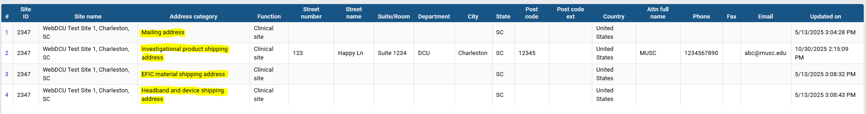


Site Addresses

Slide 5
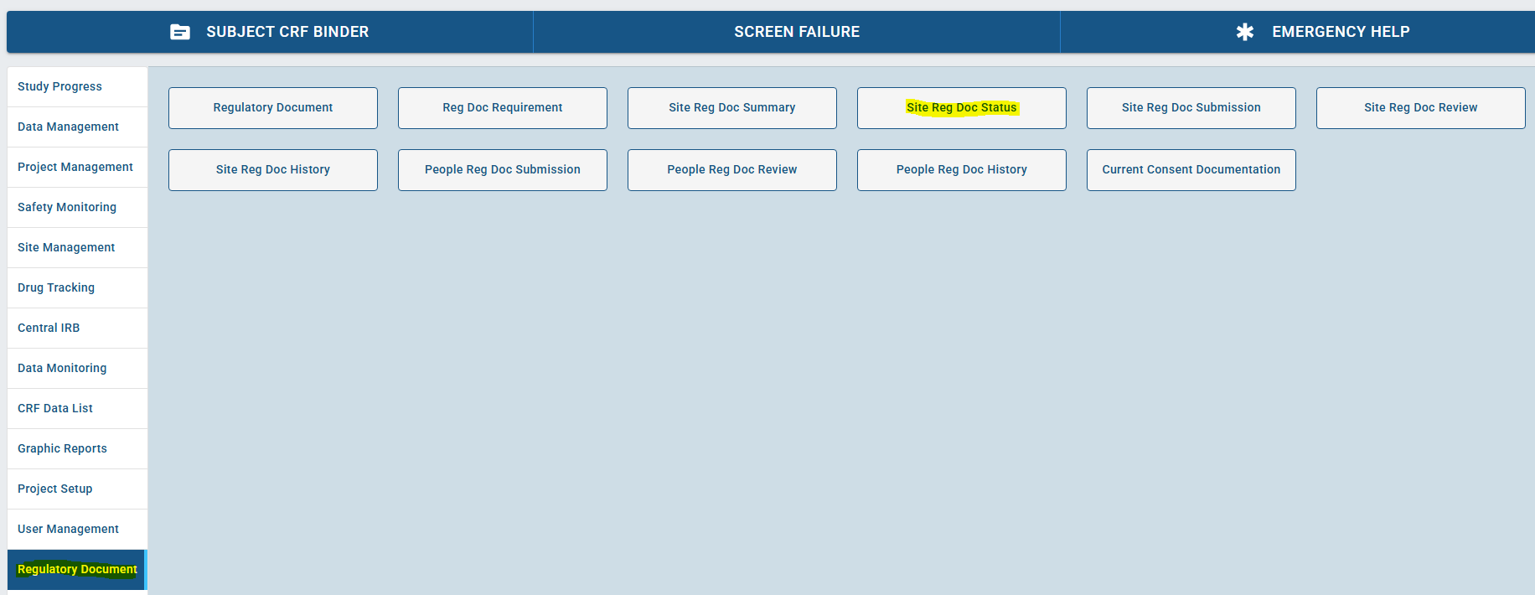
Regulatory Documents

Slide 6
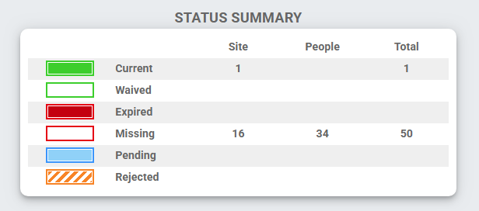
Regulatory Documents

Slide 7
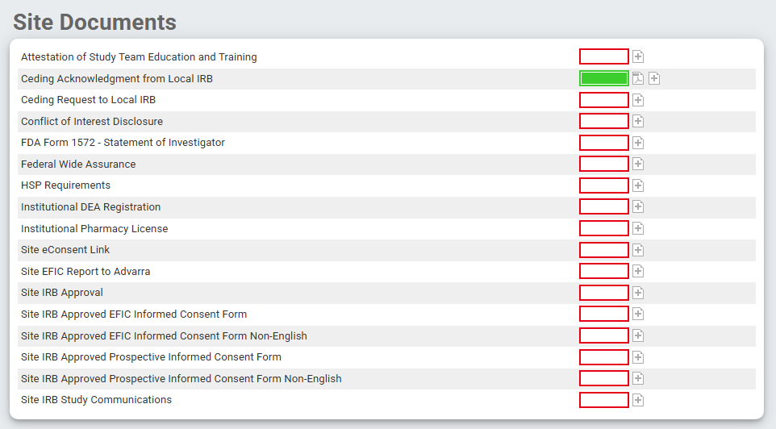
Regulatory Documents

Slide 8
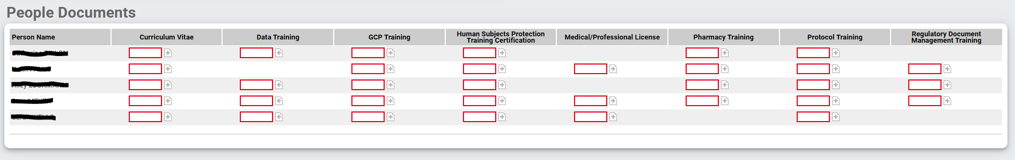
Regulatory Documents

Slide 9
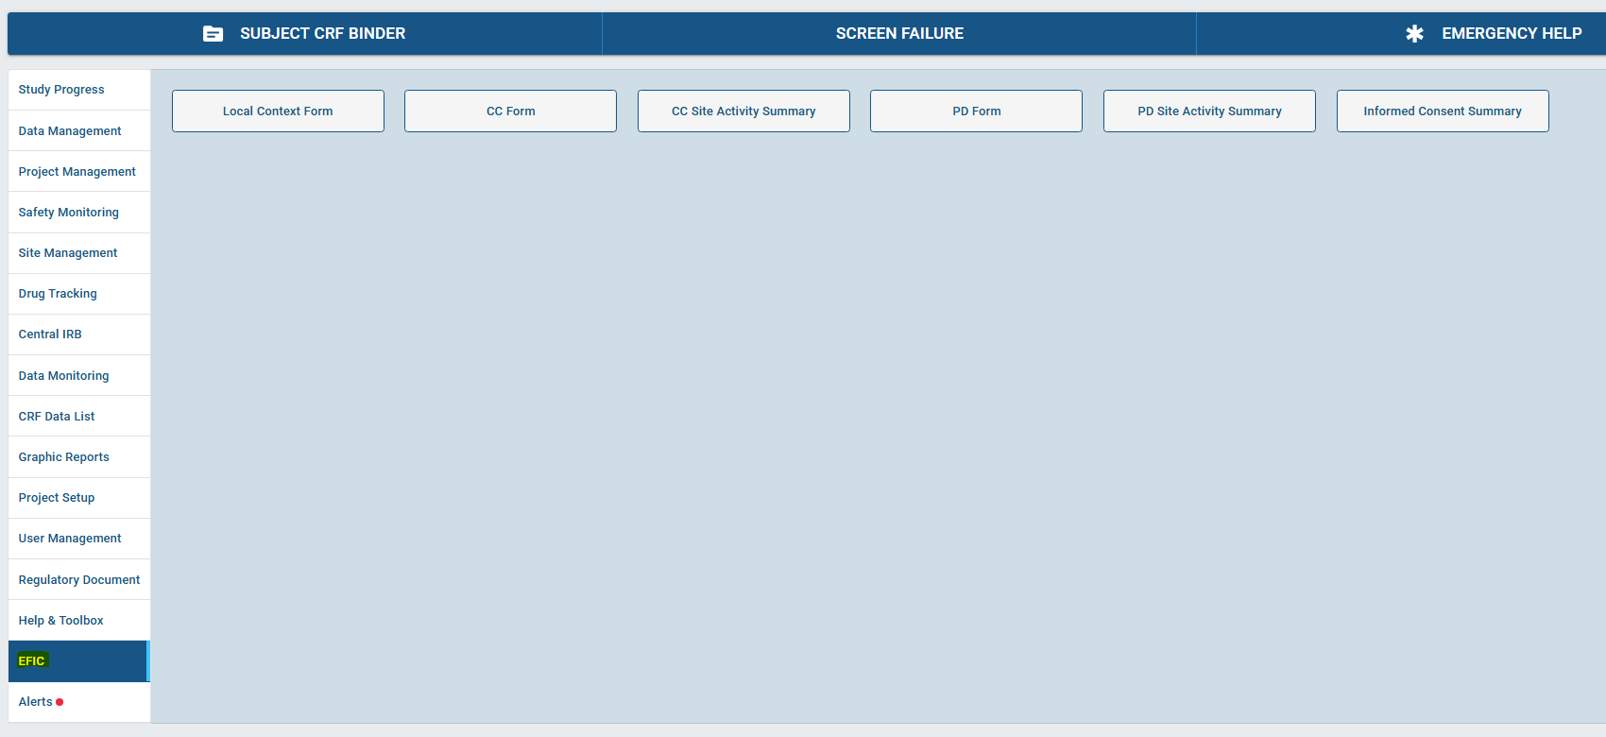
EFIC

Slide 10
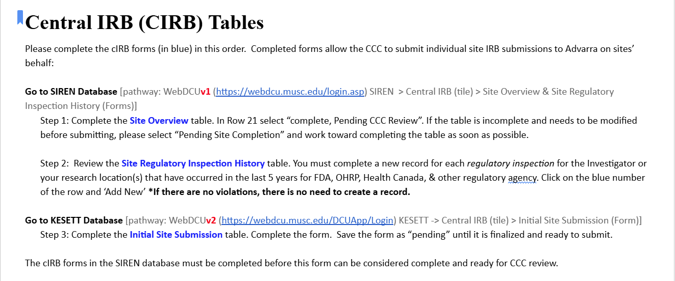

Slide 11
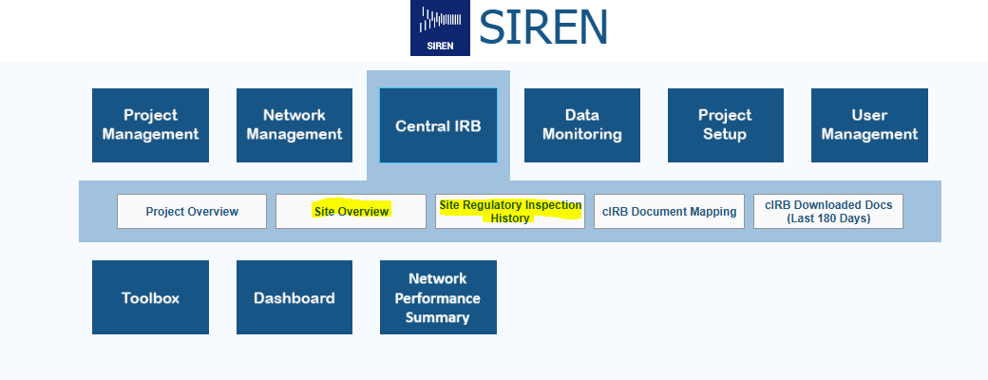
Central IRB (CIRB) Tables
Steps 1 & 2 in WebDCU v1 > SIREN:

Slide 12
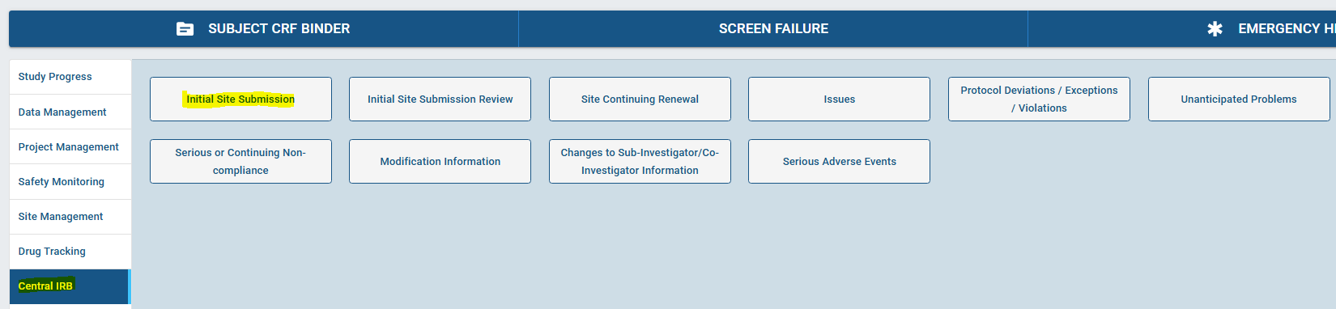
Central IRB (CIRB) Tables
Step 3 in WebDCU v2 > KESETT:

Slide 13
Enrollment Video

Slide 14
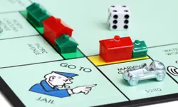

Premises
KESETT should never delay treatment of
status epilepticus
KESETT is based upon guideline
Concordant treatment of status

Slide 15
Inclusion Criteria
1. The patient was witnessed to have a convulsive seizure for greater than 5-minute duration.
2. The patient received an adequate dose of benzodiazepines. The doses may be divided.
3. The last dose of a benzodiazepine was administered 5-30 minutes before study drug administration.
4. Continued or recurring seizures in the Emergency Department.
5. Age 1 year or older.
6. Known or estimated weight ≥ 10 kg

Slide 16
Exclusion Criteria
1. Known pregnancy (lab testing not indicated for screening)
2. Prisoner.
3. Opt-out identification or otherwise known to be previously enrolled in KESETT.
4. Treatment with a second line anticonvulsant (FOS, PHT, VPA, LEV, phenobarbital, or other agents defined in the MoP) for this episode of status epilepticus (SE).
5. Treatment with sedatives with anticonvulsant properties other than benzodiazepines for this episode of SE (propofol, etomidate, ketamine, or other agents defined in the MoP).
6. Endotracheal intubation prior to enrollment.
7. Acute traumatic brain injury clearly precedes seizures.
8. Scalp injury or burn preventing EEG placement.
9. Known allergy or other known contraindication to KET or LEV.
10. Hypoglycemia < 50 mg/dL
11. Hyperglycemia > 400 mg/dL
12. Cardiac arrest / post-anoxic seizures

Slide 17
Abbreviated Eligibility
Inclusion
1. Convulsive seizure > 5 minutes
2. Seizures continue/recur in ED
3. Seizure despite adequate dose of benzos
4. Seizure despite properly timed benzo
5. Age ≥ 1 year & est. wgt > 10kg
Exclusion
1. Hypoglycemia, TBI, cardiac arrest
2. Known contraindication to drugs or EEG
3. Already received 2nd line agent or anesthetic
4. Already intubated
5. EFIC prohibited - known pregnancy, prisoner or opt out identification

Slide 18
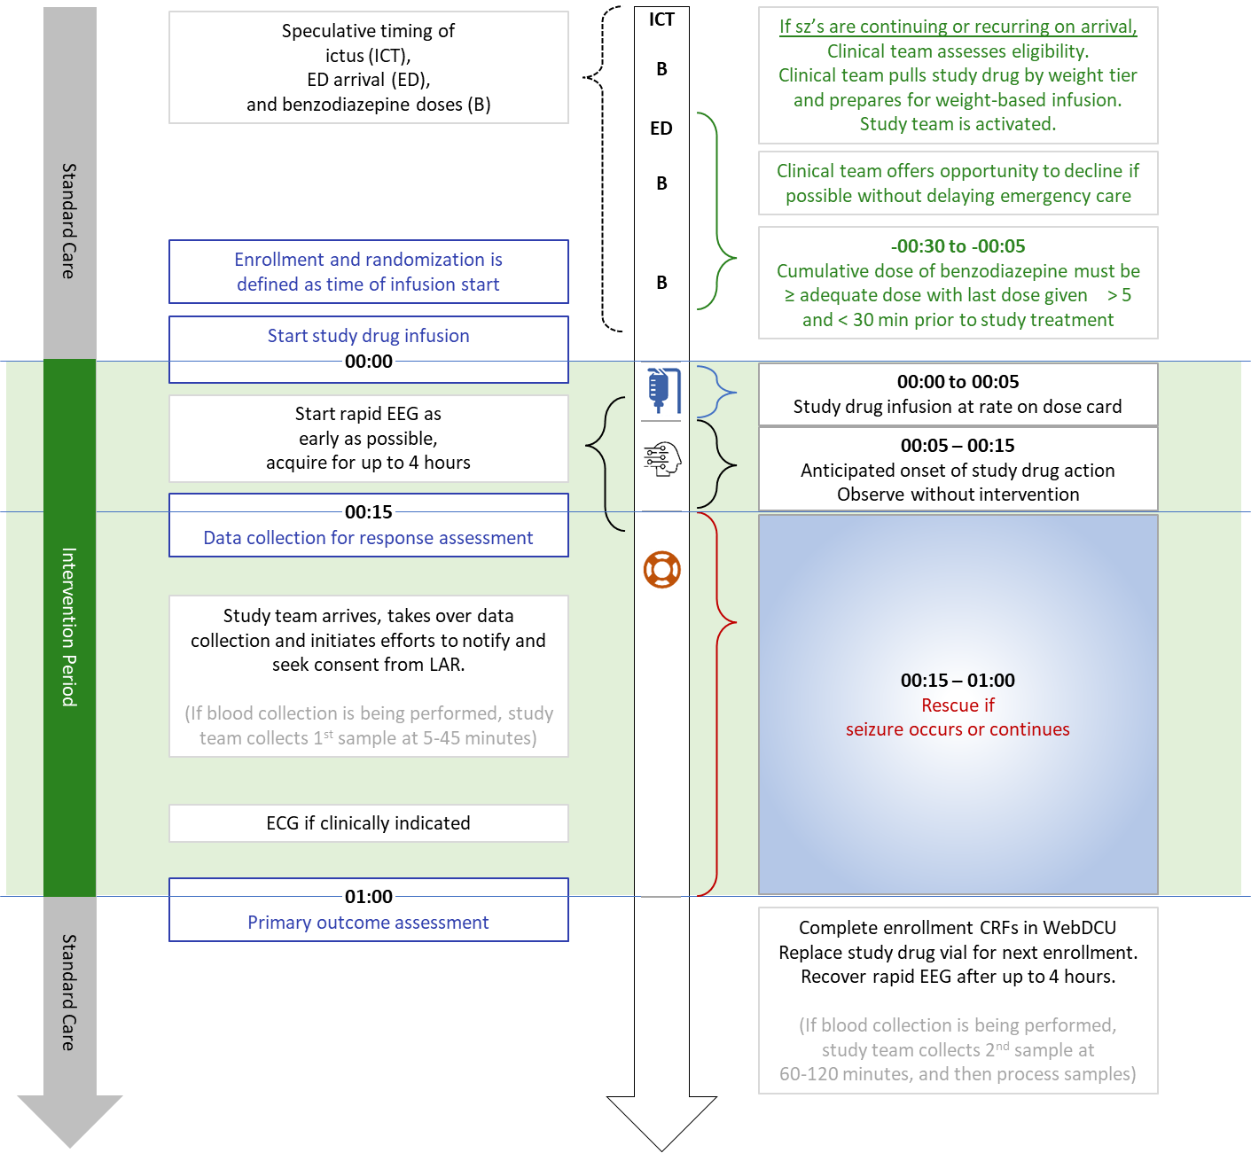

Slide 21
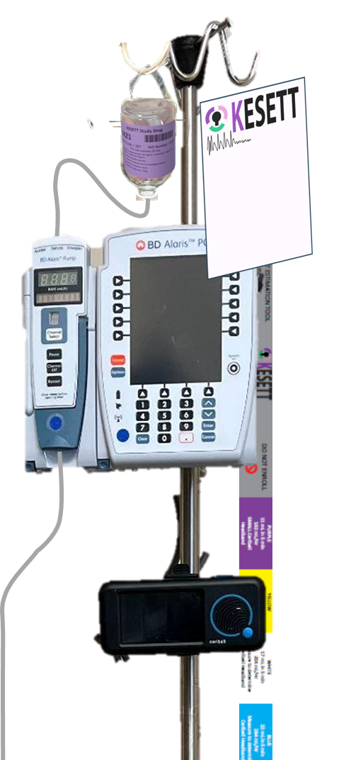
Retrieved KESETT study drug spiked and inverted on hanger tab
Reminder Cards with instructions
Length-based weight-estimation tool
Your institutional pump
Study Ceribell with headbands in a basket below

Slide 22
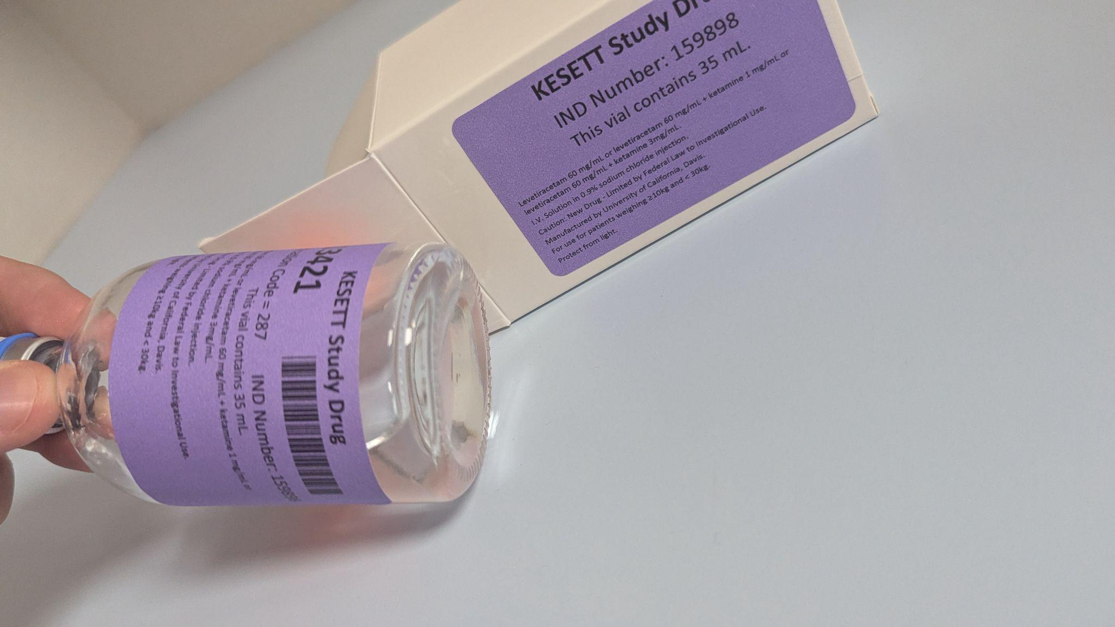
Vials
Vials contain LEV and KET (or LEV alone)
Same concentration in all vials
Purple tier 35mL - Weight 30kg
Notes:
Study drug comes in a single vial that contains both levetiracetam and ketamine or placebo.
Purple labeled vials are for children <30 kg, white are for larger children and adults.
All vials contain the same concentrations of study drug. Only difference is the vial fill volume - purple has 35 cc, white has 90 cc. The purpose of the tiers is to minimize the risk of accidental overdose.
Best practice is to keep drug in the resuscitation bay omnicell or pyxis. Storage in a nearby ED pharmacy may be acceptable if it doesn’t cause delay. Storage in investigational pharmacy is unacceptable because of risk of delay.
Resuscitation areas treating kids and adults will receive one pre-randomized vial for each tier. Resuscitation areas treating only adults will receive one white tier pre-randomized vial.
Enrollments entered in WebDCU trigger the central pharmacy to ship a replacement pre-randomized vial on the next business day. Sites will have a backup vial that is moved to the resuscitation area after an enrollment, until the new randomized vial arrives. When the new randomized vial is received, it is placed in the resuscitation area and the backup vial is moved back to a pharmacy storage location outside of the resuscitation. High enrolling sites may have their par of randomized vials increased.

Slide 23
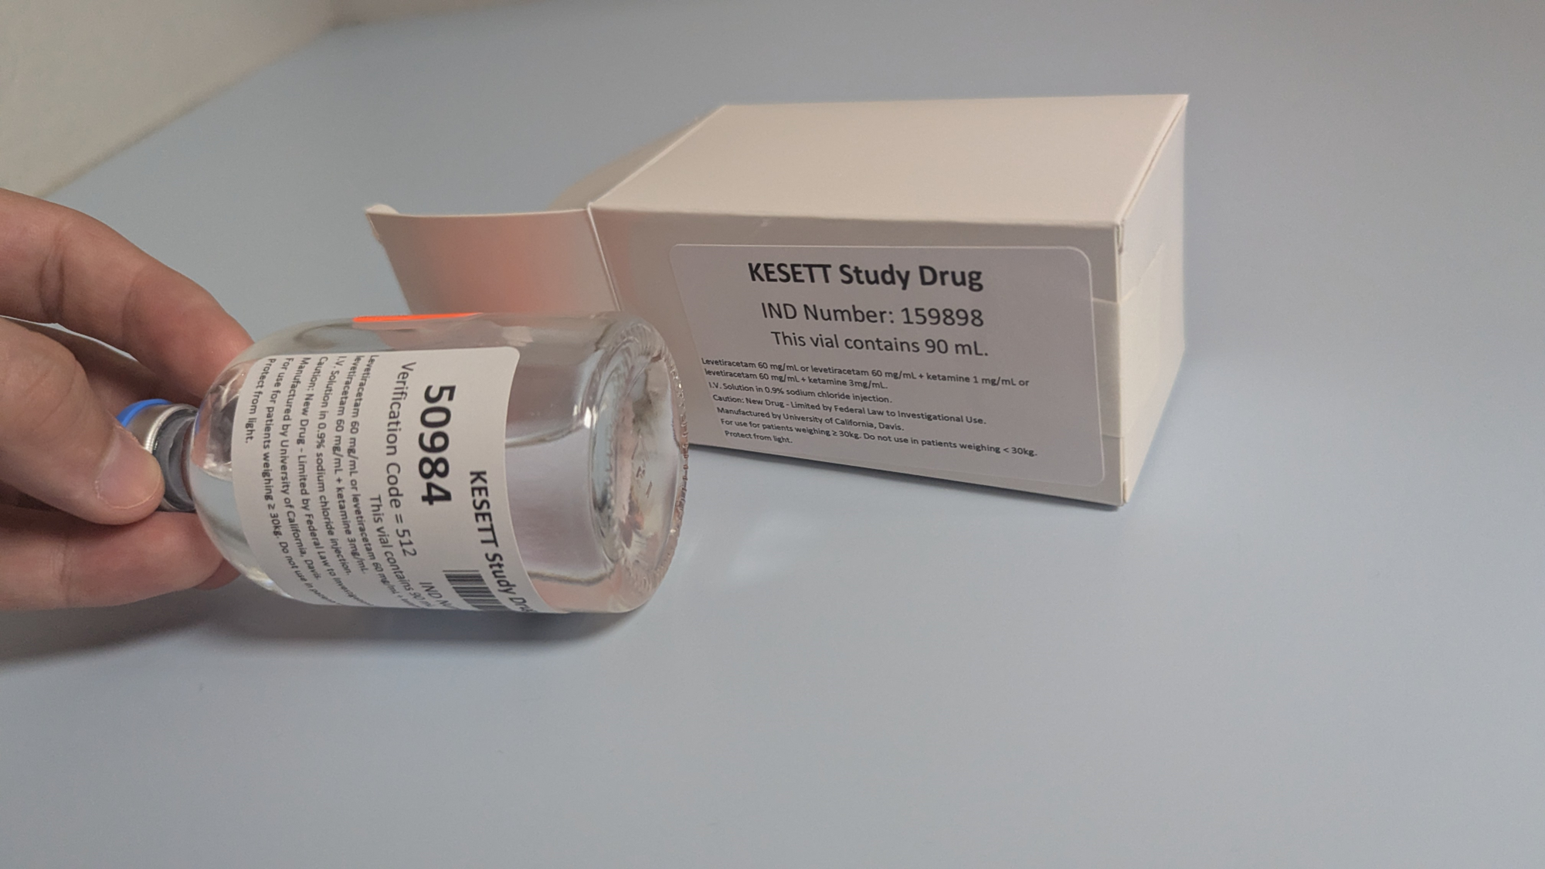
Drug ID on the vial
White tier 90mL - Weight 30kg
Use next vials and backup vials
Storage, replacement and shipping

Slide 24


Slide 25
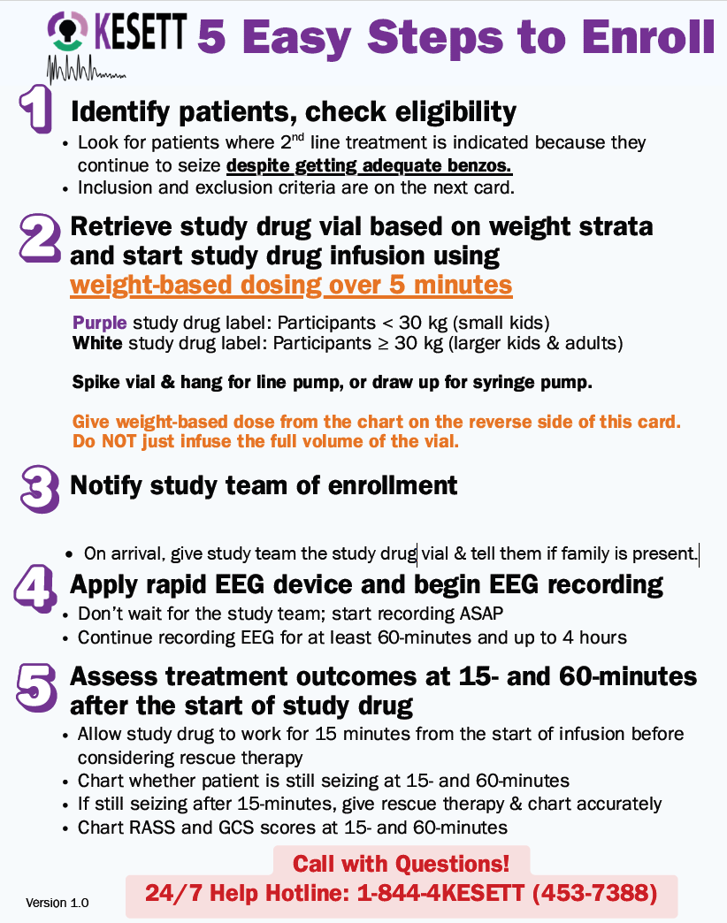
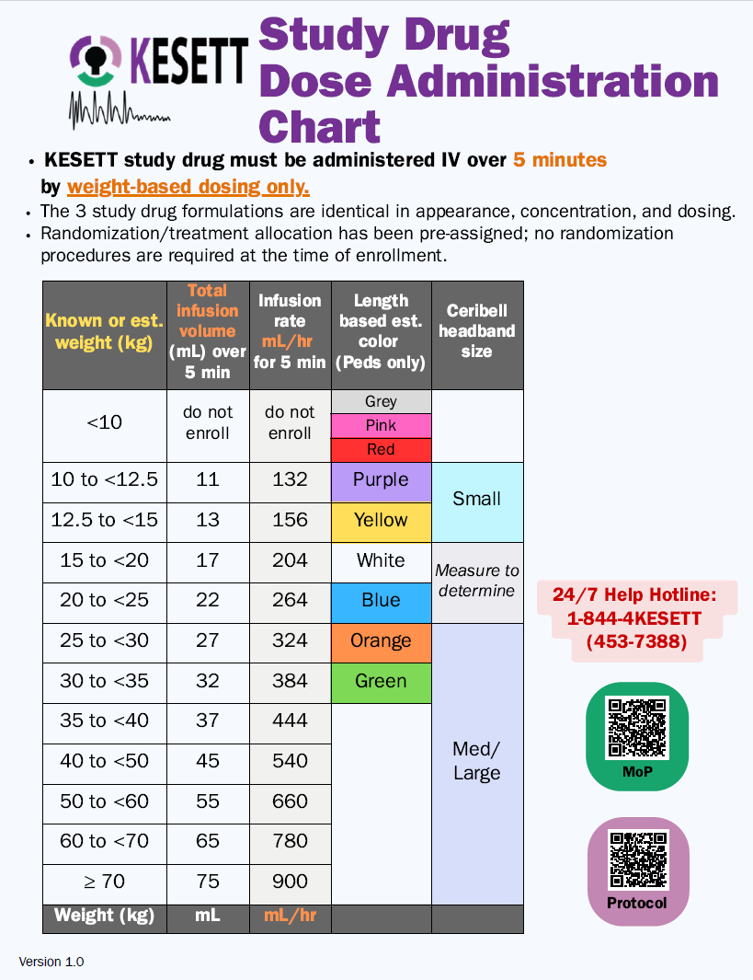

Slide 26
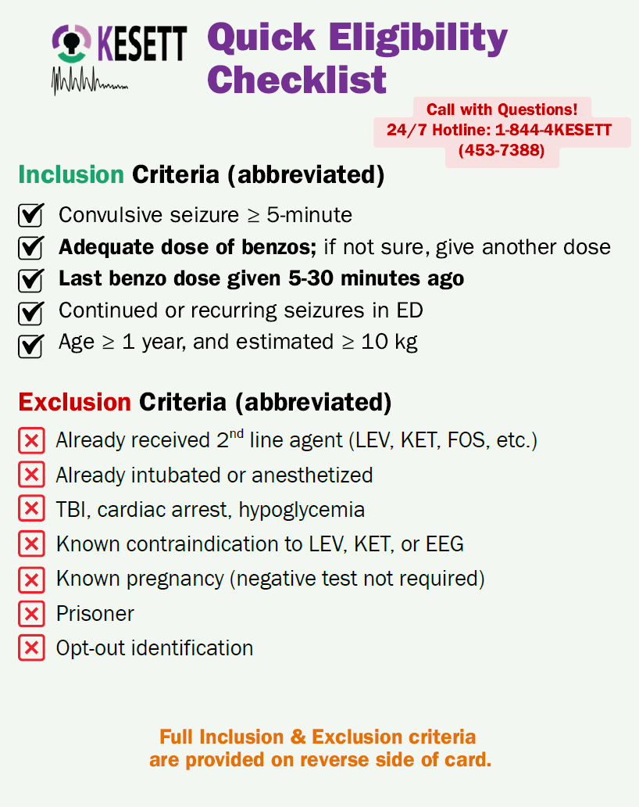
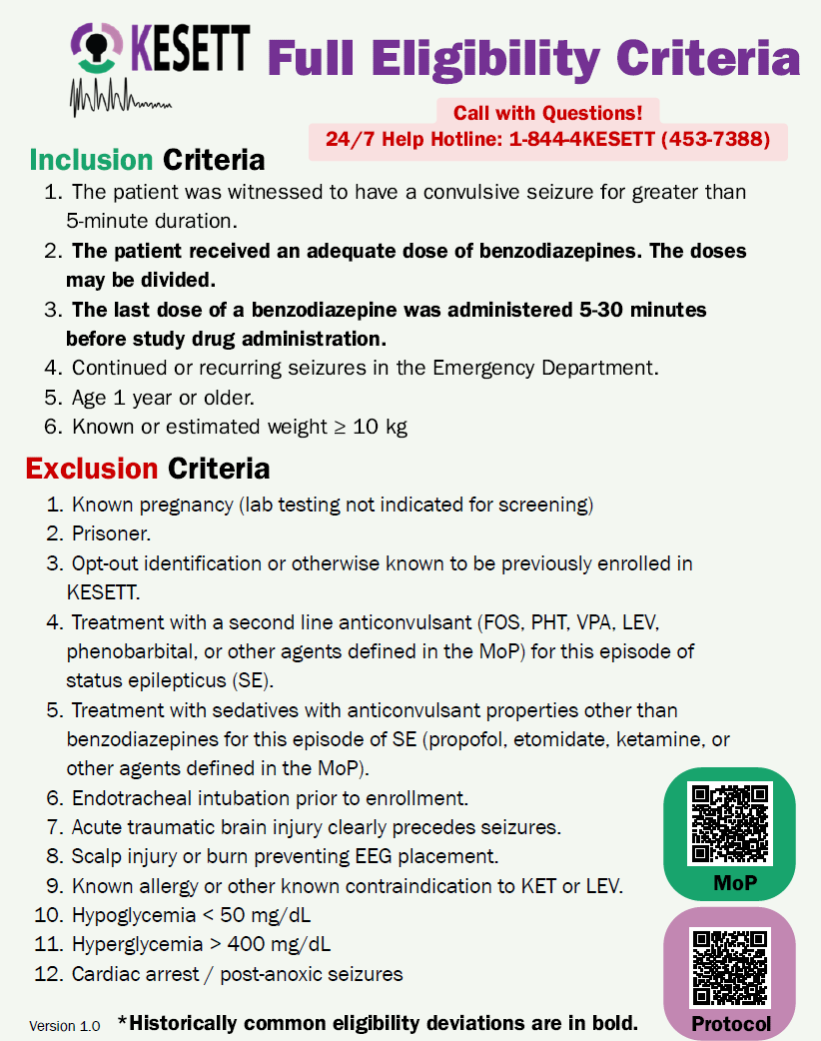

Slide 27
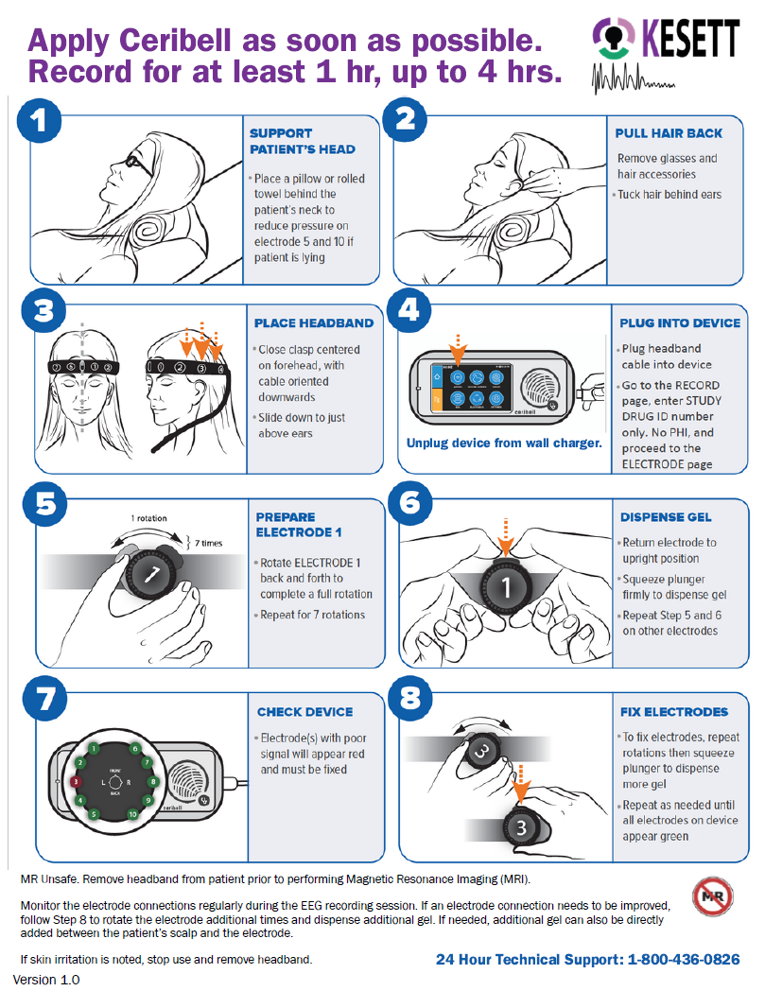
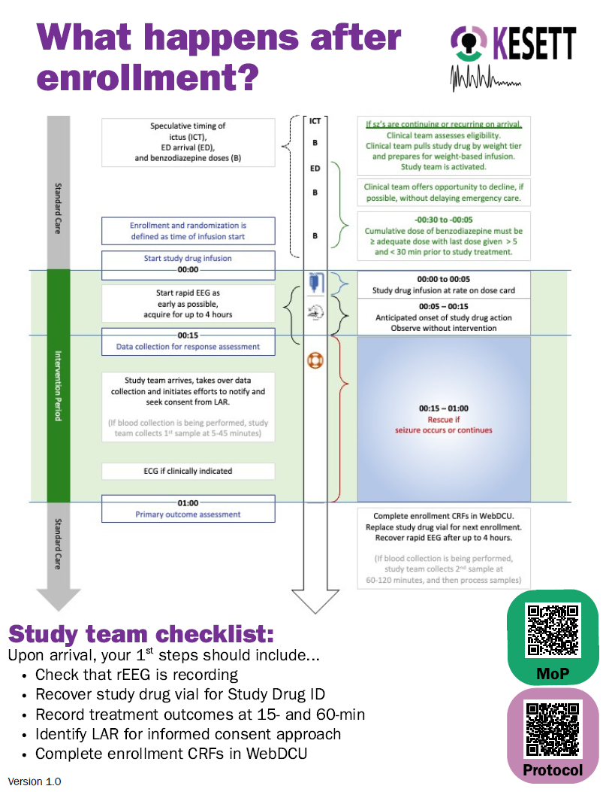

Slide 28
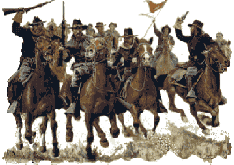
Cavalry to the rescue
1. Start or confirm EEG
2. Retrieve vial ID number
3. Record treatment outcomes at 15- and 60-min ensure source docs are consistent
4. Identify LAR for informed consent approach collect medical hx, home meds, race, ethnicity as needed
5. Complete enrollment CRFs in WebDCU within 8 hours
Study team needs to arrive as soon as possible
Notes:
Start EEG if not started already
Get vial number
Enter enrollment in WebDCU (with vial number)
Collect data (on worksheet or direct data entry) especially primary outcome
Ensure charting on source documents is accurate and consistent with worksheet
Seek LAR for notification and consent to continue
Collect data directly from participant or family (race, ethnicity, medical history, drug reconciliation)

Slide 29
Study team coverage
24-hour study team phone number / pager
Alert to enrollment occurs immediately after drug is started
Study team arrival ~30 minutes
Overnight enrollments may occur
Site team can decide how to implement KESETT coverage.
Clinical team
  Conduct opt out if feasible
  Enroll
  Apply Ceribell
  Assess for treatment outcomes at 15-min (continuing seizures, RASS, GCS)

Slide 30
e-Consent
RedCap Electronic consent is the prefered way to collect Informed consent forms for SIREN
Best for remote verification
Site Specific link
  Will include site language
  Will include local HIPAA waivers
Part 11 compliant

Slide 31

Follow up
After 24 hours
Check for adverse events - non-serious adverse event are only reported if they occur in the first day
At participant’s end of study (hospital discharge or 30 days)
Collect serious adverse events and secondary outcomes

Slide 32
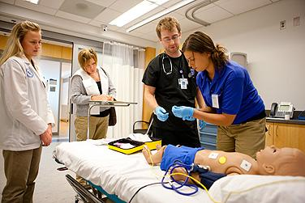
Educate, monitor, re-educate
Change of shift
Simulated mock enrollments
Academic “detailing”
Notes:
Clinical staff training. Dependence on Guideline concordant usual care, adequate dosing of benzodiazepines, need to wait for effect, stepwise progression to second and third line (not returning to first line after determining to benzo refractory), giving a chance to wake up.
Study should never delay treatment of status. Not for an opt-out discussion. Not for EEG prior to treatment. Pharmacy must be as fast as usual care.

Slide 33
Screening
Patients who meet one of the below criteria:
Administered one of the following for the treatment of seizures or status epilepticus
    LEV,
    valproate (valproic acid), or
    fosphenytoin intravenously
OR
Patients in the ED who have had a witnessed seizure and are determined to be experiencing a continuing seizure event who were screened in real time by the study team.

Slide 34
Screen Failure
Patients that meet the below criteria and were not enrolled regardless of when they were screened and if the study team was present
Administered one of the following for the treatment of seizures or status epilepticus
    LEV,
    valproate (valproic acid), or
    fosphenytoin intravenously
Patients to whom the study team is alerted to in real time but are not enrolled should be entered as screen failures within 5 days of screening.
An administrative review should also be performed at least monthly to identify patients who met the criteria above but were not alerted to the study team or enrolled.

Slide 35
Enrollment in WebDCU
DCC Riley Luckmann

Slide 36
KESETT – step forward randomization
KESETT is a step forward randomization design, which means we do not have a Randomization Form in WebDCU that assigns a treatment when submitted.
Instead, sites will grab the ‘Use Next’ vial (or ‘Backup’ vial if no ‘Use Next’ is available) and use it to treat the KESETT participant.
Data entry into WebDCU will occur after enrollment.
  This includes documentation of Study Drug ID, which will tell the DCC which treatment assignment the participant received.
The KESETT database in WebDCU is a real, live database. No testing or fake data should ever be entered by sites.

Slide 37
Within 8 hours of KESETT study drug administration…

Slide 38
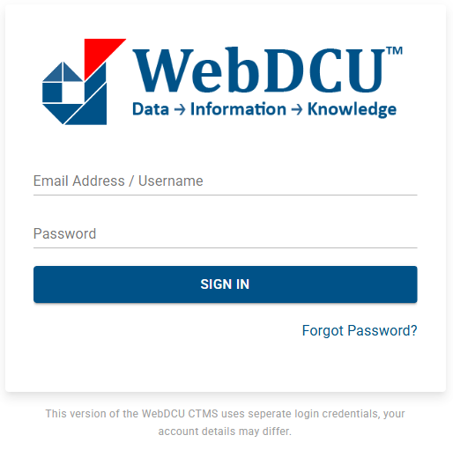
1. Log into WebDCUv2
https://webdcu.musc.edu/DCUApp/Login

Slide 39

2. Click on the KESETT tile

Slide 40
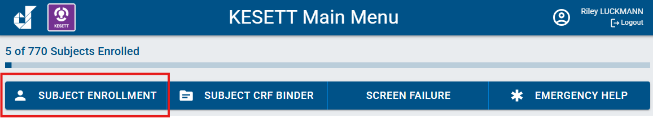
3. Select the Subject Enrollment button from the main menu bar

Slide 41

4. Select ‘Add Record’

Slide 42
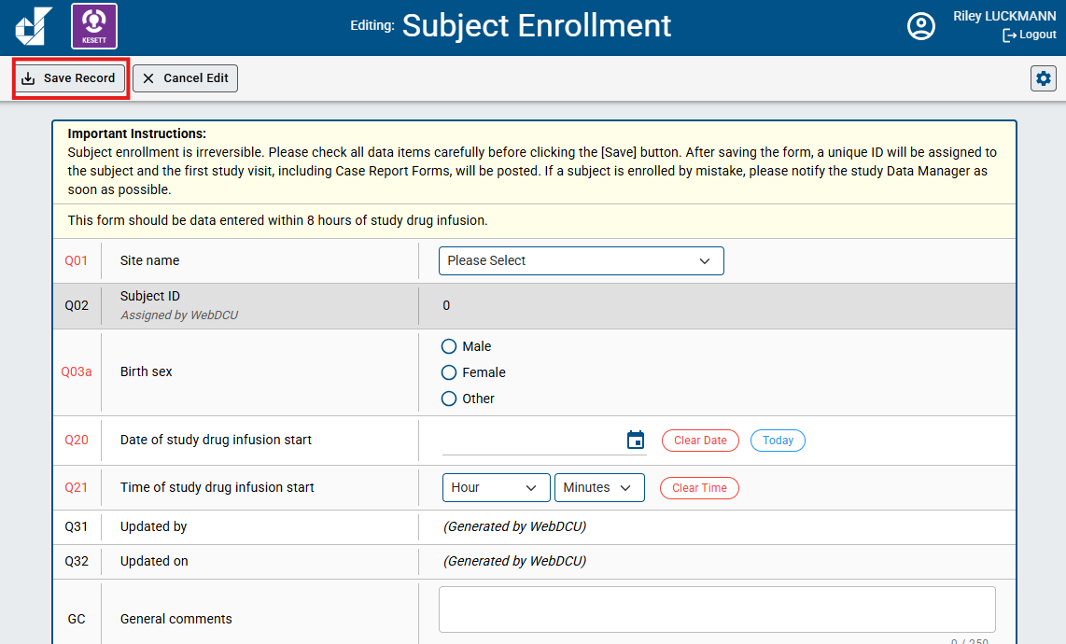
5. Enter the Subject Enrollment form and select ‘Save Record’
*As the instructions indicate, Subject Enrollment is irreversible. It should not be data entered until a patient has already received KESETT study drug. In Q20 and Q21, you will have to indicate the Date and time of study drug infusion start.

Slide 43
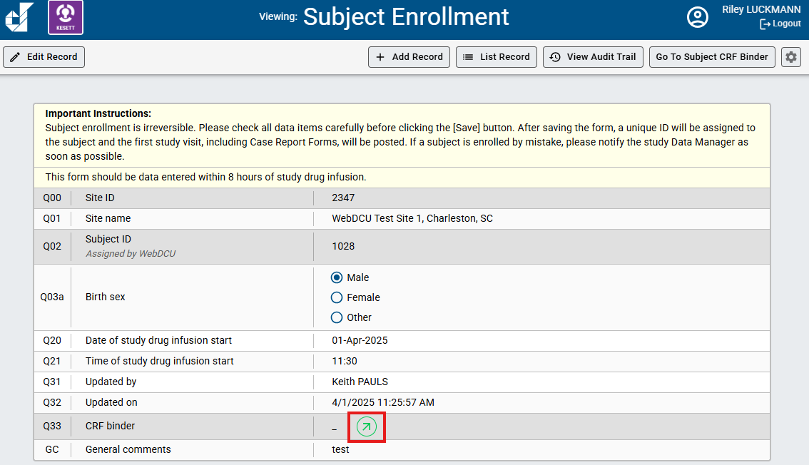
6. Click the green arrow to go to the Subject CRF Binder

Slide 44
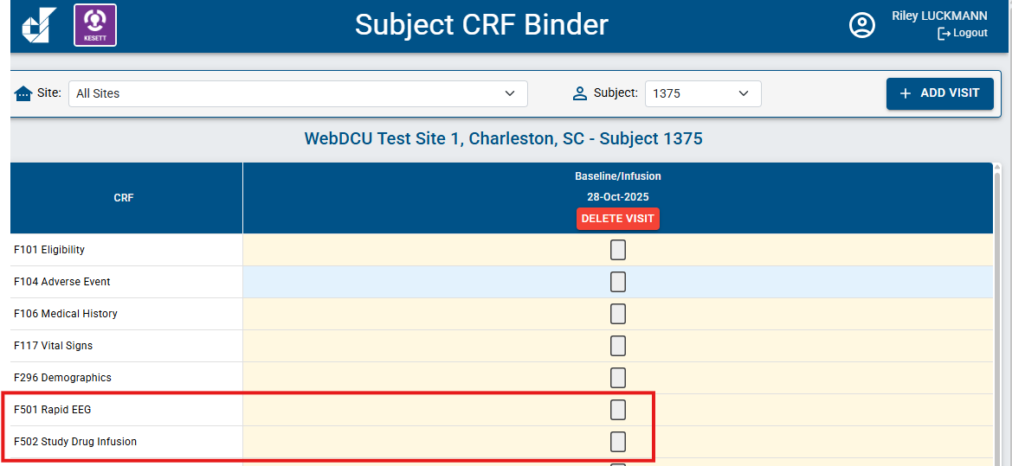
7. Enter and submit other enrollment CRFs
F501 Rapid EEG
F502 Study Drug Infusion

Slide 45
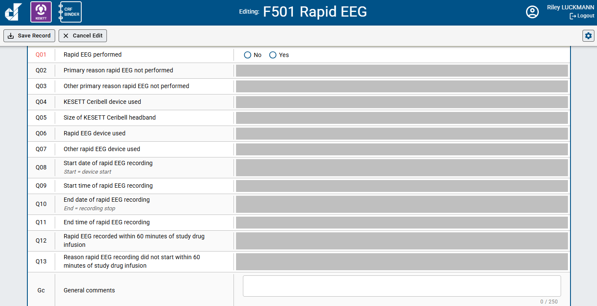
F501 Rapid EEG

Slide 46
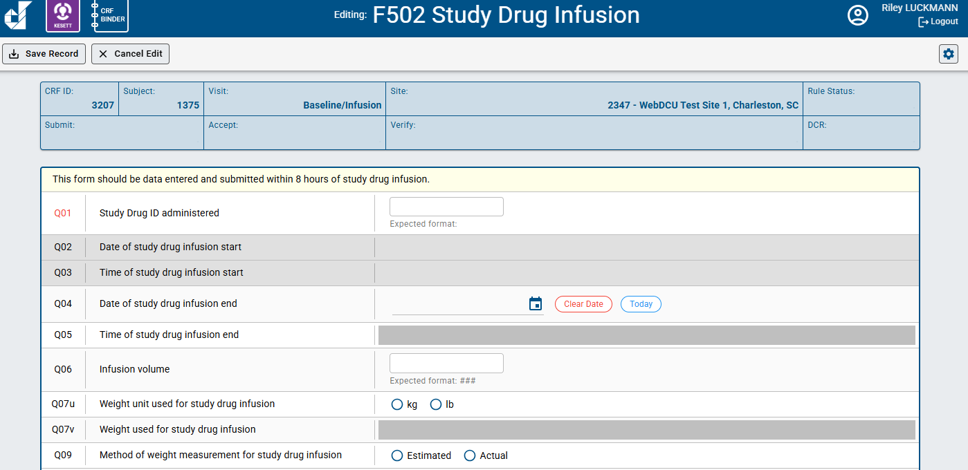
F502 Study Drug Infusion

Slide 47
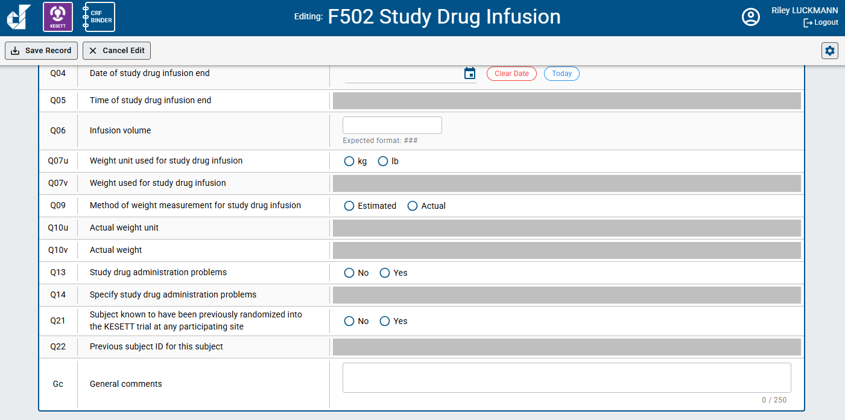
F502 Study Drug Infusion

Slide 48
WebDCU Questions or Access Issues?
DCC Contacts:
Riley Luckmann
luckmann@musc.edu
Morgan Davie
daviem@musc.edu
Sara Meyer
butlers@musc.edu

