Slide 1

WIN ratio analysis to Determine a strategy of non-invasive SUpport
for Respiratory Failure in the EmeRgency Department
Henry E. Wang, MD; Jarrod Mosier, MD; Mark Tidswell, MD; Lai Wei, PhD;
Valerie Durkalski-Mauldin, PhD; Elizabeth Munroe, MD; William Meurer, MD
The Ohio State University; University of Arizona; Baystate Medical Center;
University of Michigan, Medical University of South Carolina; SIREN Network

Slide 2
Grant Support
UG3-HL175260 (CCC) – OSU
U24-HL175258 (DCC) – MUSC
Ohio State University (CCC Lead)
Medical University of South Carolina (DCC Lead/SIREN DCC)
University of Michigan (SIREN CCC)
SIREN network

Slide 3
CCC Grant
DCC Grant
OSU (SCC)
Contact MPI: Wang
MUSC (DCC)
Contact MPI: Durkalski
Arizona
SCC MPI: Mosier
Baystate
MPI: Tidswell
Michigan (SIREN CCC)
Co-I: Meurer
OSU
MPI: Wei
UAB (CCPD)
Co-I: Jansen/Stephens
SIREN
Enrolling Sites

Slide 4

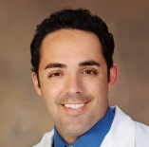
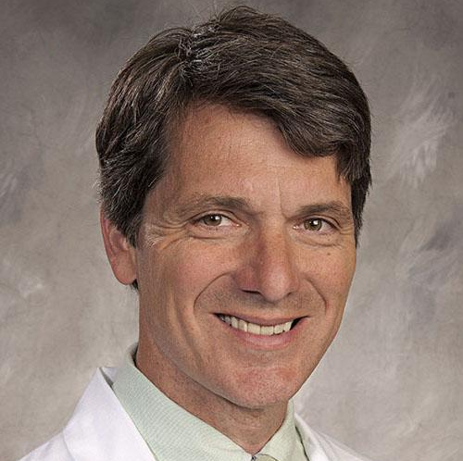
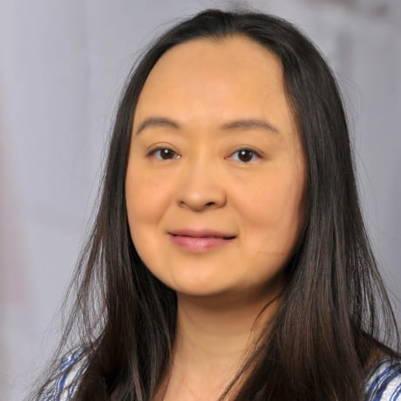

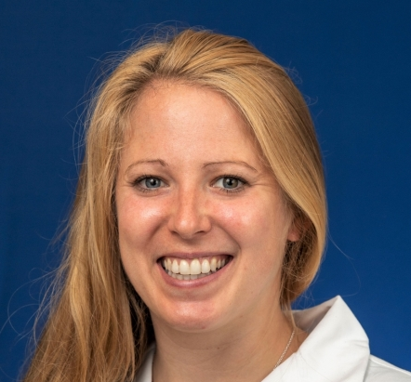
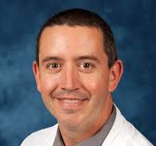
The Investigators
Henry E. Wang, MD, MS – The Ohio State University (EM, Contact MPI)
Jarrod Mosier, MD – University of Arizona (EM, CCM; MPI)
Mark Tidswell, MD – Baystate Medical Center (PCCM; MPI)
Lai Wei, PhD – The Ohio State University (Biostats, DCC MPI)
Valerie Durkalski-Mauldin, PhD – Medical University of South Carolina (Biostats, DCC Contact MPI, SIREN DCC)
Elizabeth Munroe, MD – Intermountain Medical Center (PCCM, ESI)
William Meurer, MD – University of Michigan (EM, SIREN CCC)

Slide 5
Core and MPI Sites
SIREN Award Hub | Site | Enrolling Hospital | City | Site Type | Site PI
Washington | UW | Harborview Med Ctr | Seattle | Core | Nick Johnson
UCLA | UCSD | UCSD Health LaJolla | San Diego | Core | Gabe Wardi
UCLA | UCSD | UCSD Medical Center - Hillcrest | San Diego | Core | Gabe Wardi
Temple | Temple | Temple Univ Hosp | Philadelphia | Core | Anran Wang, MD
Hopkins | Johns Hopkins | Johns Hopkins Hosp | Baltimore | Core | Ruben Troncoso
Hopkins | Johns Hopkins | Johns Hopkins Bayview Med Ctr | Baltimore | Core | Ruben Troncoso
NORCARES/UC Davis | Intermountain | Intermountain Med Ctr | Murray | Core | Troy Madsen
CORE-EM/VCU | VCU | VCU Med Ctr | Richmond | Core | Lisa H. Merck
Pittsburgh | Pittsburgh | UPMC Presbyterian Hospital | Pittsburgh | Core | Byron Drumheller
Yale | Yale | Yale New Haven Hosp | New Haven | Core | Justin Belsky
OHSU | Cincinnati | Univ of Cincinnati Med Ctr | Cincinnati | Core | Jason McMullan
Chicago | UChicago | Univ of Chicago Med Ctr | Chicago | Core | David Beiser
Wayne | HFHS | Henry Ford Hosp | Detroit | Core | Joe Miller
Duke | Wake | Wake Forest | Winston-Salem | Core | Simon Mahler
Minnesota | Minnesota | Hennepin County Med Ctr | Minneapolis | Core | James Miner
OHSU | OSU | OSU Wexner Med Ctr | Columbus | MPI | Jason Bischof
OHSU | OSU | OSU East Hospital | Columbus | MPI | Jason Bischof
CORE-EM/VCU | Arizona | Banner Univ Med Ctr (Tucson) | Tucson | MPI | Jarrod Mosier
Yale | Baystate | Baystate Med Ctr | Springfield | MPI | Howard Smithline

Slide 6
Reserve Sites
SIREN Award Hub | Site | Enrolling Hospital | City | Site Type | Site PI
Temple | Temple | Cooper Univ Hosp | Camden | Reserve | Christopher Jones
OHSU | Univerity of Utah | Univ of Utah | Salt Lake City | Reserve | Scott Youngquist
Pittsburgh | Pittsburgh | Allegheny General Hospital | Pittsburgh | Reserve | Jestin Carlson
Wayne | Wayne | Detroit Receiving | Detroit | Reserve | Brian O'Neil
Wayne | Wayne | Sinai-Grace Hosp | Detroit | Reserve | Brian O'Neil
Minnesota | Minnesota | Univ of Minnesota Med Ctr | Minneapolis | Reserve | James Miner
Minnesota | Minnesota | Riverside Med Ctr | Minneapolis | Reserve | James Miner

Slide 7

Timeline
Project start: September 15, 2025
Must start enrollment by: June 1, 2026

Slide 8
Background and Rationale

Slide 9
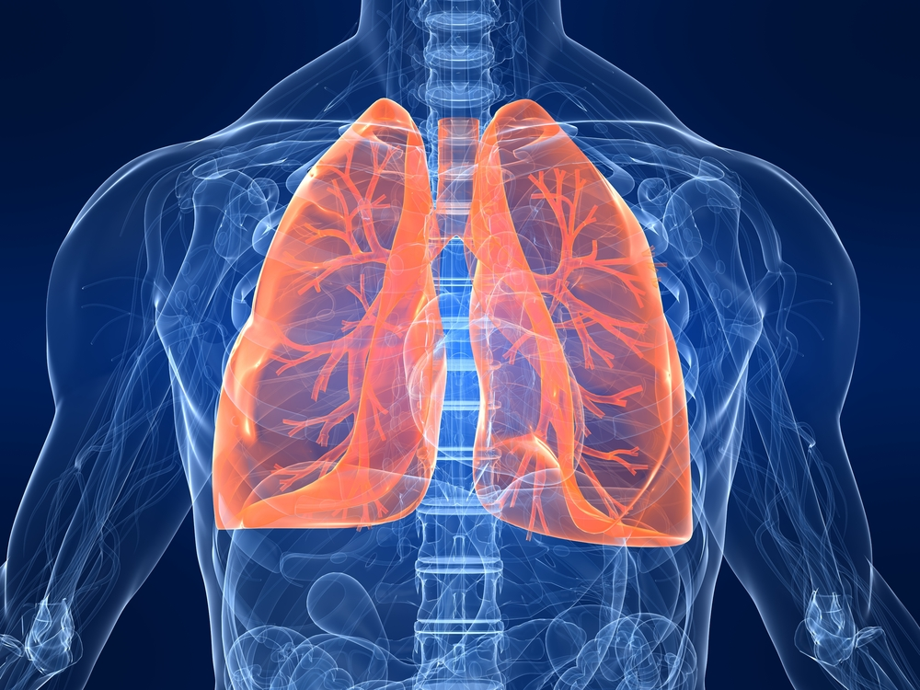
Acute Hypoxemic Respiratory Failure (AHRF)
Syndrome of impaired breathing resulting in critically low blood oxygen levels
Causes:
  Lung infections
  Acute decompensated heart failure
  Acute exacerbation of chronic obstructive pulmonary disease
  Sepsis
  Autoimmune diseases
  Inhalation injuries

Slide 10
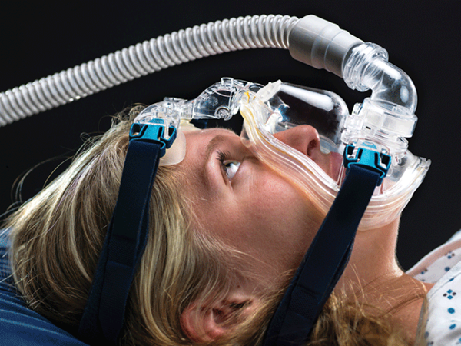
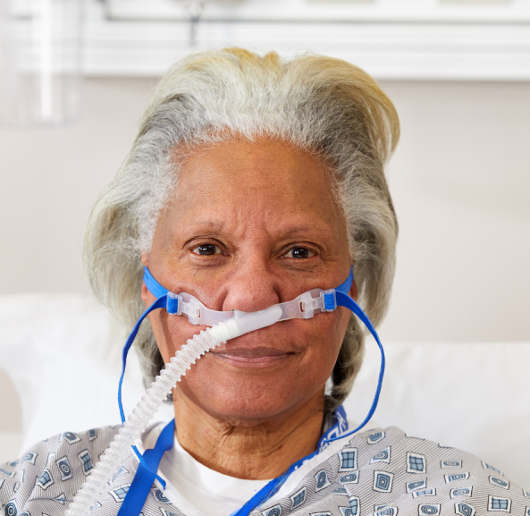
Non-Invasive Respiratory Support (NIRS)
Non-Invasive Positive Pressure Ventilation (NIPPV)
Heated High-Flow Nasal Oxygen (HFNO)

Slide 11
Trade-Offs Between NIPPV and HFNO
Factor | NIPPV | HFNO
Mechanism | High pressured oxygen delivered through a tight-fitting face mask | High flows of heated and humidified oxygen through special nasal cannula
Pros | Familiar to clinicians Long history of clinical use | Comfortable Allows eating and talking Less injury to lungs
Cons | Mask uncomfortable Prevents eating and talking May cause patient self-inflicted lung injury (P-SILI) | Less familiar to clinicians Shorter history of clinical use Many ED clinicians do not believe HFNO as effective as NIPPV

Slide 12
Limitations of Prior Studies
Mainly ICU patients
Intubation as primary outcome
  Limited eval of mortality, vent days, NIRS hours
Limited to niche populations
  Acute COPD
  Hypercapnic respiratory failure
  Post-cardiothoracic surgery patients
  Immunocompromise
  COVID-19
  Pre-oxygenation for intubation
FLORALI Trial
RENOVATE Trial
Doshi Trial

Slide 14
Objective
Determine the best approach to non-invasive respiratory support treatment of acute hypoxemic respiratory failure in the Emergency Department

Slide 15
Aims
Aim I: Compare the effect of ED NIRS strategies (NIPPV vs. HFNO) upon AHRF composite outcome - MAPE (death, ventilator days, NIRS hours)
Aim II: Determine the effect of ED NIRS strategies upon secondary outcomes (new or worsening pneumonia/pneumonitis, ARDS, shock)

Slide 16
Design
Two-arm, multicenter randomized superiority trial
Maximum sample size of 500 with equal allocation
Unblinded with objective outcomes
One planned interim analysis for superiority
Anticipating completing enrollment in 48mos (~10-11 enrollments per month)

Slide 17
Patients
Exclusion
Need for emergent intubation
Isolated acute exacerbation of advanced chronic obstructive pulmonary disease
Isolated acute decompensation of advanced heart failure
Craniofacial anatomy or features not amenable to NIPPV or HFNO
Hemodynamic instability (vasopressors (norepinephrine >0.2mcg/kg/min, or equivalent) required to maintain MAP ≥ 65 mmHg)
Cardiac arrest
Respiratory arrest
Tracheostomy (open) or laryngectomy stoma
Pre-existing “do not resuscitate” or “do not intubate” order
Prisoner
Known pregnancy
Previous enrollment in WINDSURFER
Inclusion
Age ≥18 years old
Acute Hypoxemic Respiratory Failure: [Respiratory rate ≥25 breaths/min] AND [Requiring ≥6 liters/min supplemental oxygen to maintain SpO2 >90%]
ED clinician determined need for NIRS
Patient located in ED
<2 hours after identification of AHRF
<6 hours after ED arrival/triage

Slide 18
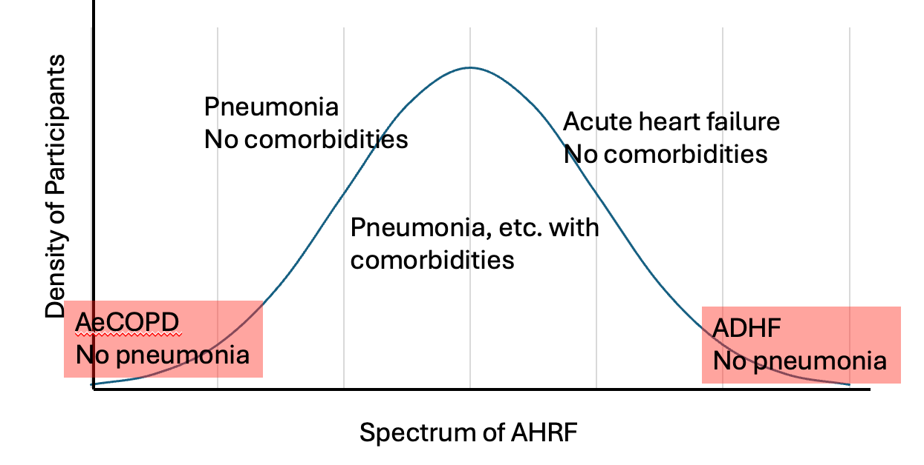
Chronic home oxygen therapy.
One or more hospital visits for acute exacerbation of COPD in the last 12 months.
Home use of non-invasive positive pressure ventilation for respiratory support.
Diagnosis of emphysema and treatment or referral for lung volume reduction surgery, endobronchial valves, or lung transplantation.
Participation in pulmonary rehabilitation for COPD in the past year.
GOLD 3 or 4 classification, or FEV1 less than 50%.
Medical Record specifies New York Heart Association or American Heart Association Class C or D heart failure, or World Health Organization (if pulmonary hypertension) functional class 3 or 4.
Any outpatient therapy for advanced heart failure including
i. Nitrates plus hydralazine.
ii. Entresto, Ivabradine.
iii. Home infusion of Inotropes.
iv. Automated implanted cardiac defibrillator (AICD) or Life Vest..
v. Mechanical circulatory support device.
c) IV or SC Pulmonary artery vasodilators

Slide 19
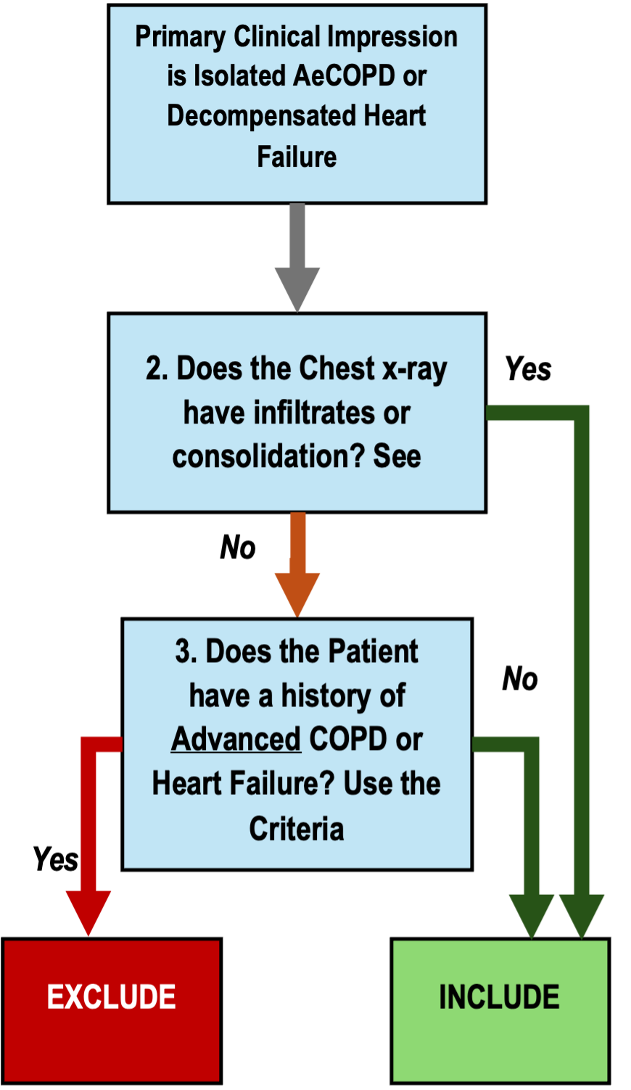

Slide 20
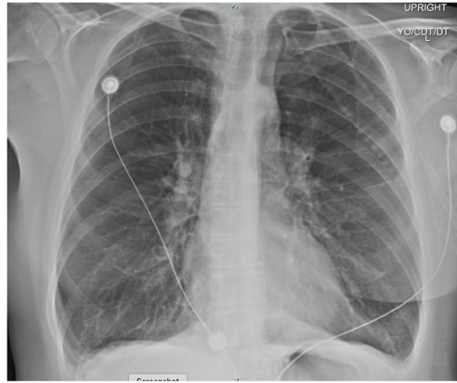
1. AeCOPD
2. No
3. Home O2
EXCLUDE

Slide 21
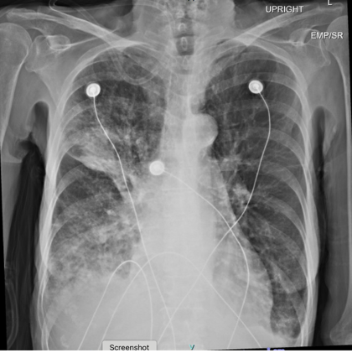
1. AeCOPD
2. Yes
3. Home O2
INCLUDE

Slide 22
Intervention
1) Strategy of NIPPV
2) Strategy of HFNO
Standard NIPPV/HFNO equipment
For at least 24 hours or until
  Death
  Intubation
  Liberation from NIRS

Slide 23
Intervention
NIPPV initiation:
  Bilevel Positive Airway Pressure (BIPAP).
  The FiO2 will initially be set at 1.0.
  The end-expiratory positive airway pressure (EPAP) will initially be set at least 5 cm H₂O.
  The inspiratory positive airway pressure (IPAP) will initially be set at least 8 cm H₂O.
  The facemask leak will be adjusted to minimize mask leak.
NIPPV titration:
  EPAP will be increased by 2-5 cm H20 every 5-10 minutes (maximum total of 15 cm H2O) until FiO2 is <0.6 and SpO2 >90%.
  FiO2 will be weaned to a goal oxygen saturation >90% with the goal FiO2 <0.6.
  FiO2 should continue to be weaned until a minimum of 0.21 as long as oxygen saturation remains in goal.
  If any EPAP is not tolerated, it can be reduced by 2-5 cmH2O until the maximum tolerated. IPAP will be adjusted by 2-3 cmH2O increments to achieve a respiratory rate <30 but limiting tidal volume to <9.5ml/kg (predicted body weight).
HFNO initiation:
  The FiO2 at 1.0,
  Temperature set to comfort.
  Flow rate 40LPM
  If the patient does not tolerate 40 LPM initially, the flow can be reduced to 30 LPM.
  If the patient is already on temporizing HFNO at randomization, then the initiating flow can be set at their current flow rate.
HFNO titration:
  Increase flow by 10lpm every 5-10 minutes until the maximum flow is achieved for that system (40-70 LPM), such that the maximum flow rate is achieved within 20-30 minutes.
  After the flow rate is at maximum for the device, the FiO2 can be weaned to a goal SpO2 >90%, with the goal FiO2 <0.6.
  FiO2 should continue to be weaned until a minimum of 0.21 as long as oxygen saturation remains in goal.
  If the maximum flow is not tolerated, the flow can be decreased by 5LPM increments until the maximum tolerated flow as long as the respiratory rate is <30 breaths per minute.

Slide 24
Guidelines
When to start weaning
How to wean (to avoid biasing)
Indications for intubation
Indications for liberation

Slide 25
Outcomes
Composite:
Major Adverse Pulmonary Events (MAPE)
  Death (to 28 days)
  Ventilator Days (to 28 days)
  NIRS hours (to 24 hours)

Slide 26
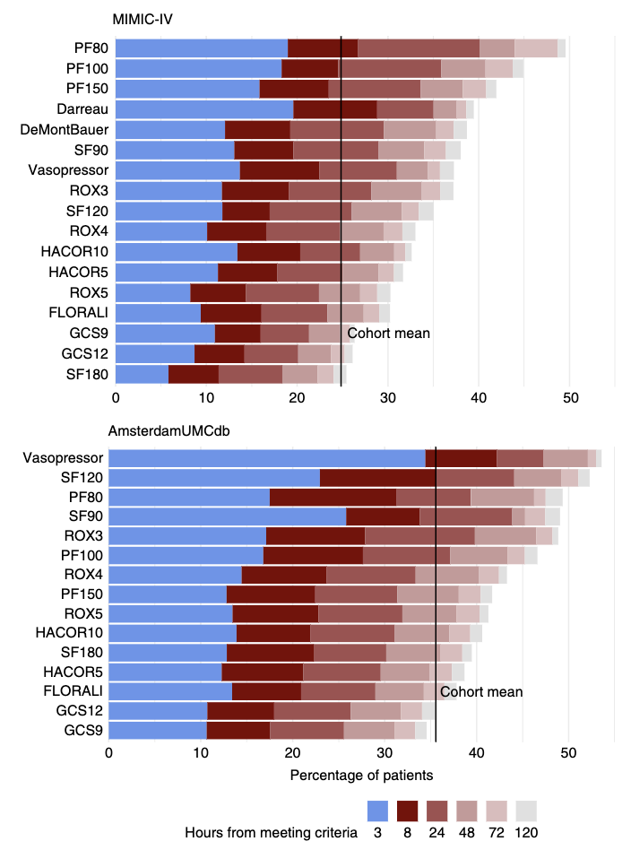
Why Not Intubation?
Subjective, variable
Fails to capture other important dimensions of recovery
In win ratio, intubation accounted for by ventilator days
Yarnell, AJRCCM 2023

Slide 27
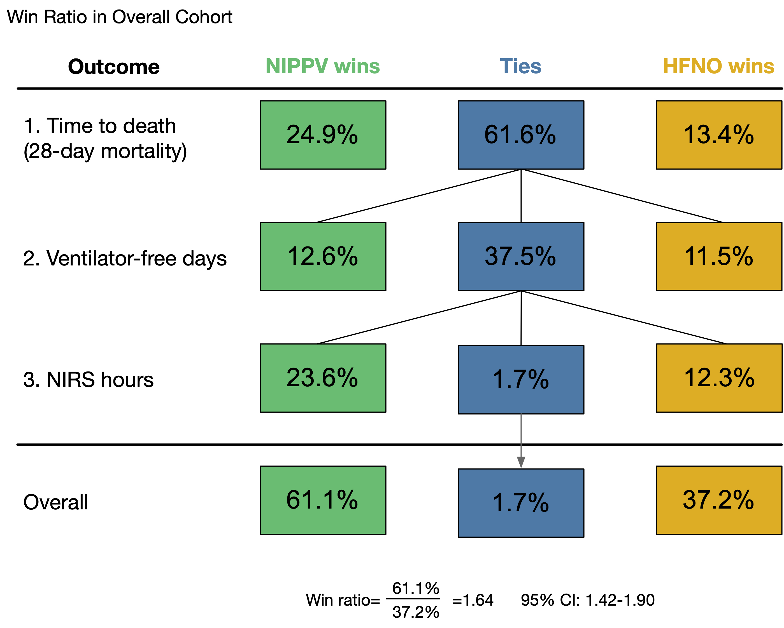
Win Ratio
Pairwise comparison of all subjects in the trial
“Wins” tallied for each comparison
  Comparisons in hierarchical fashion
  Ties escalated to next variable for tie breaking
Overall effect determined by bootstrapping
Result expressed as “Win Ratio” and 95% CI
Munroe, Crit Care Exp 2024

Slide 28
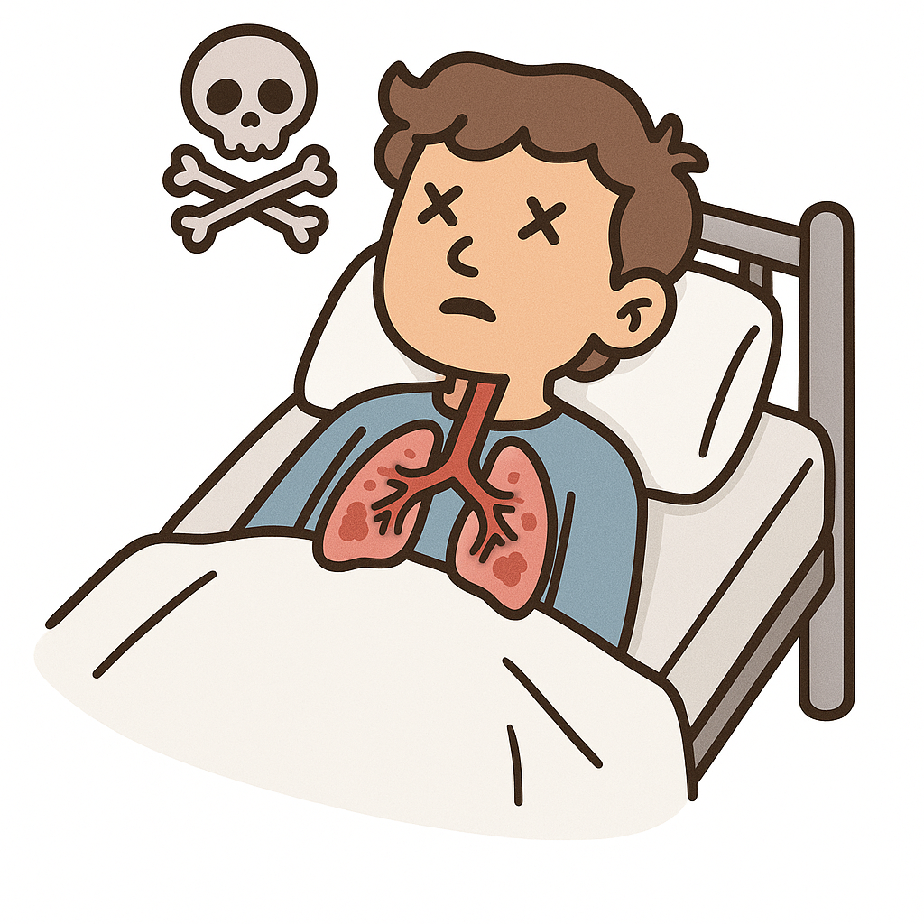
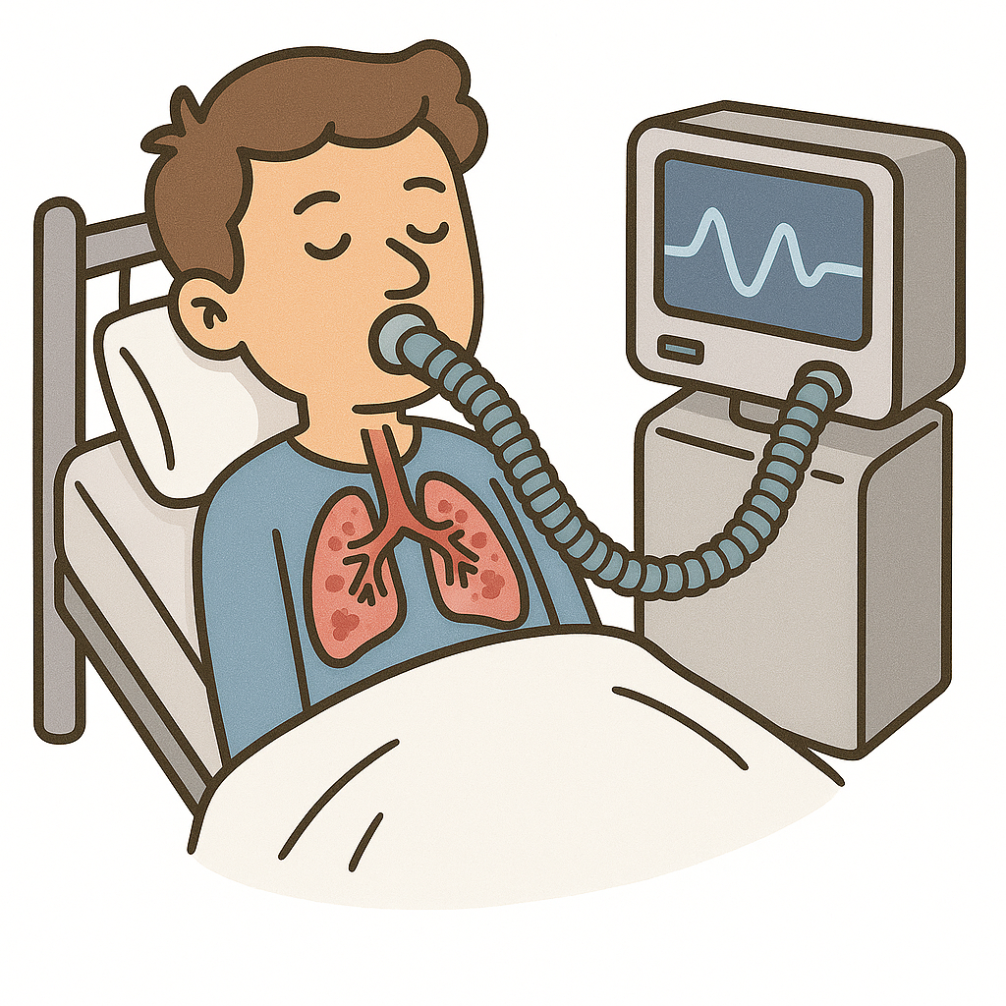
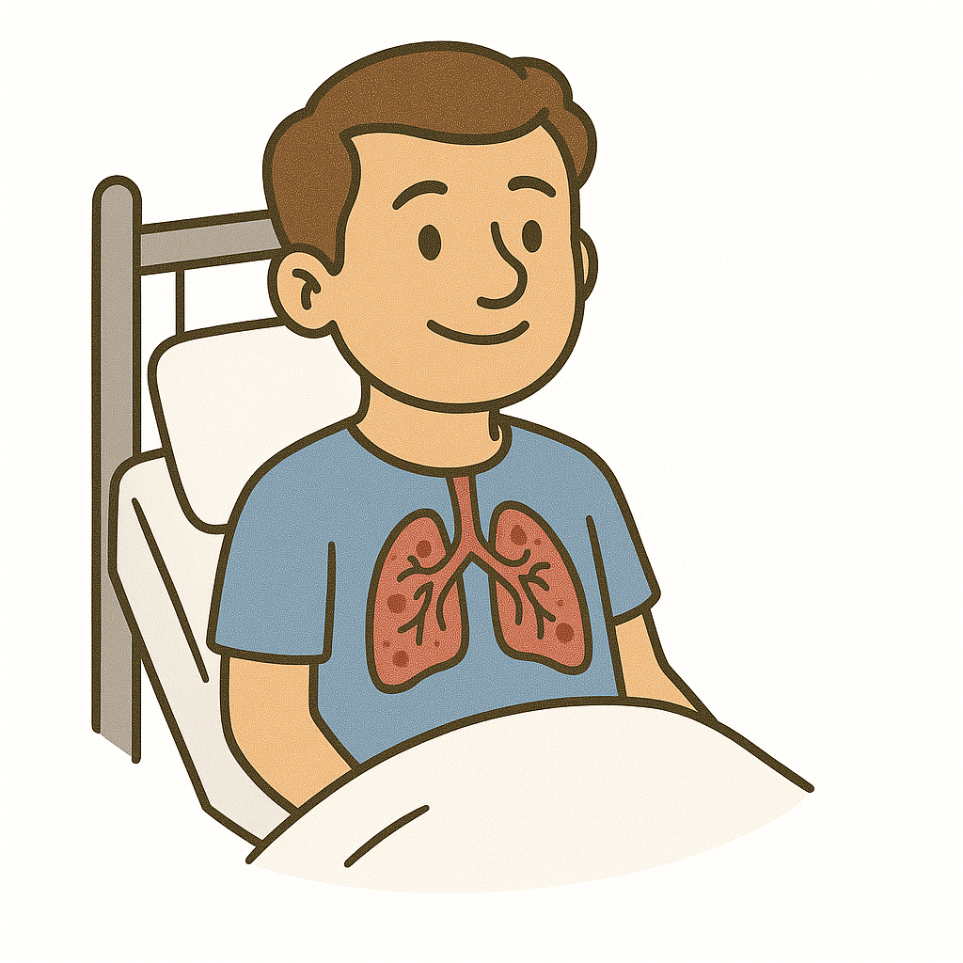
Death
(Max 28 days)
“With which one will I be less likely to die?”
Win
Tie
Loss
Stop
Dead: Dead
Ventilator Days
(Max 28 days)
“If I don’t die, but get intubated, with which one will I get off the ventilator faster?”
Win
Tie
Loss
“Is one more iatrogenically injurious than the other?”
Stop
VD >1 (i.e., intubated)
NIRS hours
(Max 24 hours)
“If I don’t die or get intubated, with which one will I get better faster?”
Win
Tie
Loss

Slide 29
Secondary Outcomes
New Pneumonia
New or worsening ARDS
Shock

Slide 30
Sample Size
450 + 50 = 500 total
Based on Win Ratio analysis of:
  Death (to 28 days)
  Ventilator days (to 28 days)
  NIRS hours (to 24 hours)
One interim analysis for superiority

Slide 31

Site Things to Know

Slide 32

Expected Site Team Structure
Site PI
  Emergency Medicine
Critical Care Co-Is
  Medical ICU
  CCU
  Other ICUs
Hospital medicine (if admitted to floor)
Respiratory Therapy Champion
Research Coordinator

Slide 33
Overview of Responsibilities
Site Preparation
  Contract
  EFIC CCPD
  Recruitment strategy
  Interface with stakeholders
  Training
Screening
  Screening log (Included/excluded)
Enrollment
  EFIC notification
4. Facilitate protocol
  Maintain assigned NIRS for 24 h
  Titrate up/down by guidelines
5. Data collection, entry and queries
  28 days main collection

Slide 34
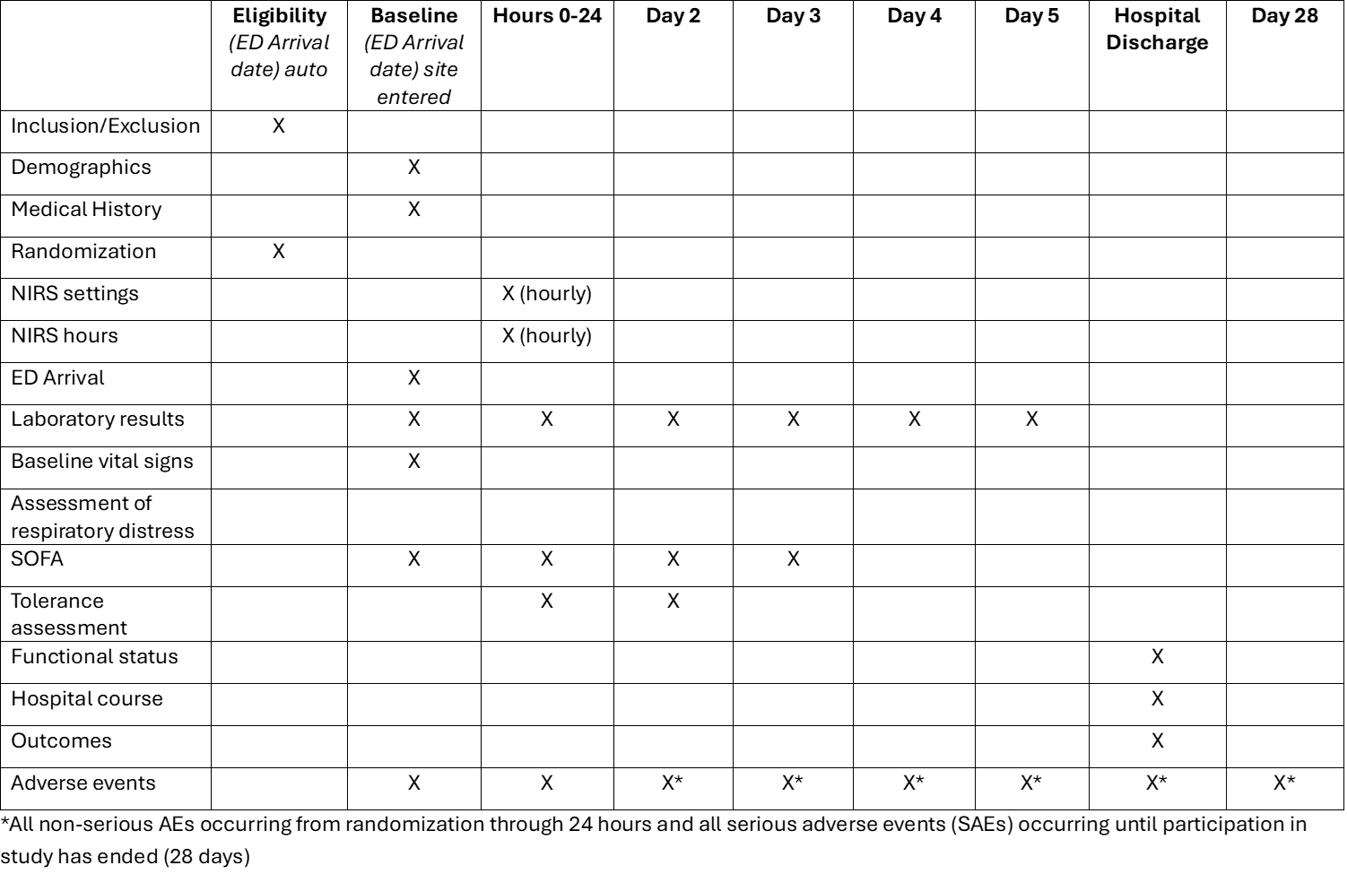
Schedule of Events
DRAFT

Slide 35

CTMS and Data Collection
WebDCUv2
  eDOA
  Regulatory document upload
  EFIC
  Central IRB forms
  Payment tracking
  Randomization
  Electronic CRFs
  AE Reporting

Slide 36

Exception from Informed Consent
Life-threatening emergency condition
Therapeutic window = zero minutes
Pilot:
  >50% AHRF lack capacity to consent
  Of those, >50% lacked proxies for consent
Centralized EFIC model (UAB) – Digital engagement tools
  Similar to KESETT model
  Social media
  Marketing surveys
  Virtual meetings and interviews

Slide 37
EFIC CCPD
Centralized deployment by UAB
Similar to KESETT
Site responsibilities:
  Develop CCPD plan with UAB
  Arrange for 6 individual interviews
    UAB will run interview, site investigator must be present
  Conduct other local activities as appropriate

Slide 38
Schedule of Payments
Schedule sent by Michigan
Payments for:
  Start-up ($10,000 one time)
  Enrollment and protocol completion ($3400/patient)
  Data completion ($2000/patient)
  Inclusive of F&A

Slide 39
Respiratory Therapy Advisory Group
National advisory group for WINDSURFER
Meeting once per month during study development

Slide 40
Next Steps
Site contract with Michigan
Regular reports on monthly SIREN SC meeting and site communications
EFIC CCPD plan
  Meeting in Late 2025
Site initiation meeting
  3 - 4 hours
  Spring 2026
Vanguard Sites (4) – Summer 2026
Remaining Core Sites – Summer/Fall 2026
Reserve Sites as needed – 2027

Slide 41
Ancillary Study Ideas?
Contact Henry, Jarrod or Mark

Slide 42
windsurfer-pi@umich.edu

