Slide 1


Intro to EFIC for KESETT

Slide 2
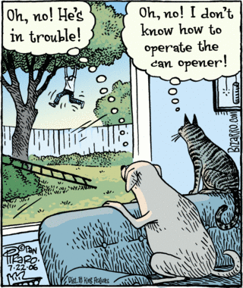
Notes:
When we conduct research in the emergency setting, it is possible to have competing ways of perceiving the situation. I think it is important that we remain focused on the patient (aka the would-be subject) first. So, in the context of this cartoon… we must strive to “be the dog”.
Rabbi Hillel the Elder from the Talmud, where he is said to have summarized the Torah by saying "What is hateful to you, do not do to your fellow man. This is the whole Torah; the rest is commentary.".

Slide 3

Exception from informed consent (EFIC)
Very special circumstances
When autonomy is silent
Consistent with Helsinki and Belmont
Brief history in the US

Slide 4
EFIC - What kinds of trials?
Life threatening?
Available therapy inadequate or unproven?
Informed consent not feasible?
Prospect of direct benefit?
Trial couldn’t be carried out with EFIC?

Slide 5
EFIC - Additional requirements
Community consultation
Public disclosure
Obligatory data monitoring
Family opt outs if practical
IRB disapprovals reported to all IRB
Generally requires IND or IDE approval or OHRP oversight

Slide 6

EFIC - Community consultation is two way communications
Town hall meetings
Visits to existing community meetings or sites
Focus groups and interactive social media
Random digit dialing interviews
Community fairs or events
Geographic and special interest communities

Slide 7

EFIC - Public disclosure is one way communications
Websites and social media
Advertising
Press releases
Newsletters
Before and after study

Slide 8

Why?
If we know why we are doing something…
We can do it better
We can judge how well we’ve done it
So, why are these the requirements for EFIC?

Slide 9
A possible answer….
These are the ways that good doctors and researchers act.
In fact, that is why we do informed consent when it is possible.

Slide 10
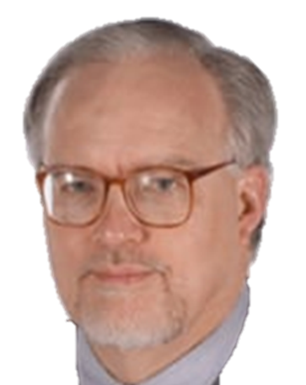
Carl Schneider
The practice of autonomy: Patients, doctors and medical decisions. Carl E. Schneider (Oxford University Press, New York, New York, 1998)
People like to be asked more than they like to decide.

Slide 11
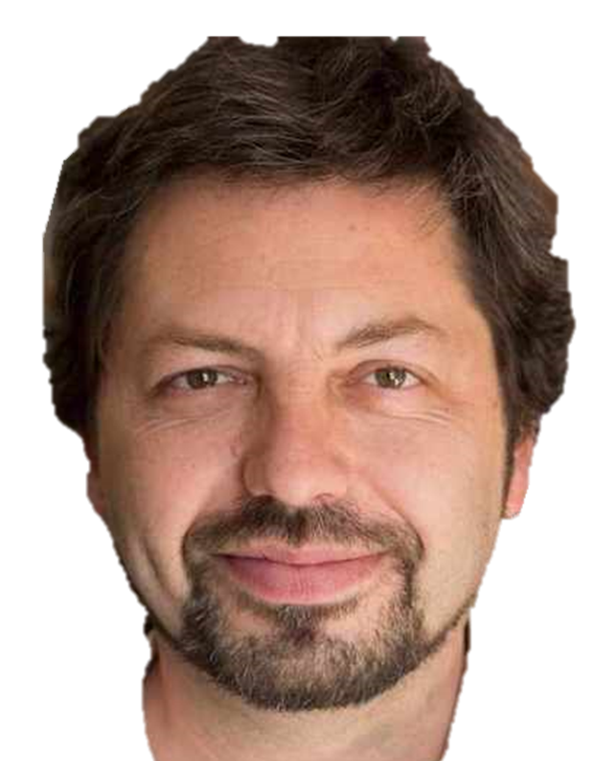
Eyal N. Using informed consent to save trust. J Med Ethics. 2014 Jul;40(7):437-44. doi: 10.1136/medethics-2012-100490. PMID: 25180355.
Nir Eyal
Even more, they want their doctor/researcher to be the kind of person who would ask.

Slide 12
If this is our philosophical basis, then…
How do we remain “that sort of doctor” when the emergency situation prevents us from asking?
What core values and acts are embodied in the proper moral agent? I’ll suggest 4

Slide 13
Four core values…
We need to be…
Heedful
Respectful
Humble
Transparent

Slide 14

Four core values… and they map to EFIC requirements
We need to be…
Heedful
Respectful Community Consultation
Humble
Transparent Public Disclosure

Slide 15
Four core values… and to EFIC behaviors and activities
We need to be…
Heedful ➔ Listen and consider
Respectful ➔ Go to the people
Humble ➔ Do it yourself
Transparent ➔ Keep nothing concealed

Slide 16
Useful practical implications
“Enough” depends on what the investigator does, not on the response
The community’s impact on the investigator matters more than the investigator’s impact on the community
It is more important to be transparent then it is to be seen

Slide 17
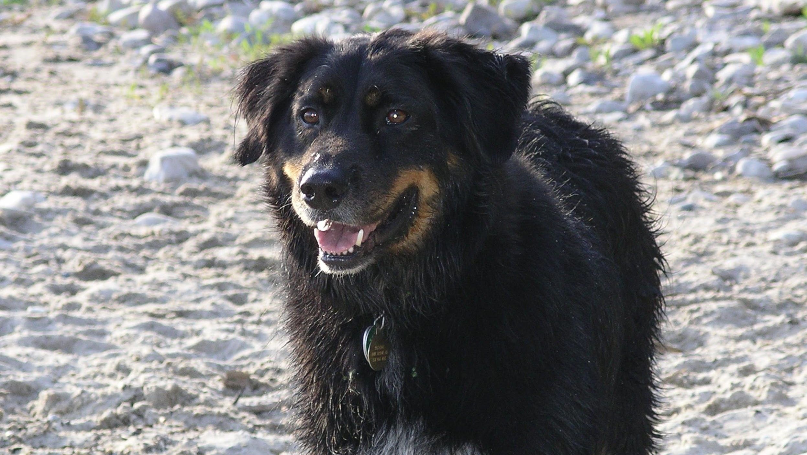
Notes:
Remember! Be the dog.

Slide 18
EFIC in KESETT - How to “be the dog”
Goals and mindset remain value-added, investigator engaged
Regulations have not changed
Community Consultation
Public Disclosure
Single IRB - EM-CIRB at Advarra
EFIC Core at the University of Alabama

Slide 19

Two Focus Groups
Sites recruit 8 stakeholders for each
Stakeholders should have various backgrounds
Study team will also attend the focus groups
EFIC Core at UAB will organize and facilitate
Pay the stakeholder participants
Summarize the responses and report
Notes:
Explain BRIEFLY,
Listen a lot.
We tell people about the research
We ask them about themselves.
Yes we want their reactions to the research, but the public aren’t experts in your research, we already know a lot about our research, the public are experts on themselves.
What are their past experiences with seizures, with research, with emergency care?
What are their concerns? Their questions? Their fears?
What are their values with regard to emergency research, but also just what do they value?
The facilitator will start by prompting the investigators to explain briefly,
Then will go around the group, with a series of prompts, making sure everyone tells the group something.
The facilitator will prepare the report summarizing what is heard.

Slide 20
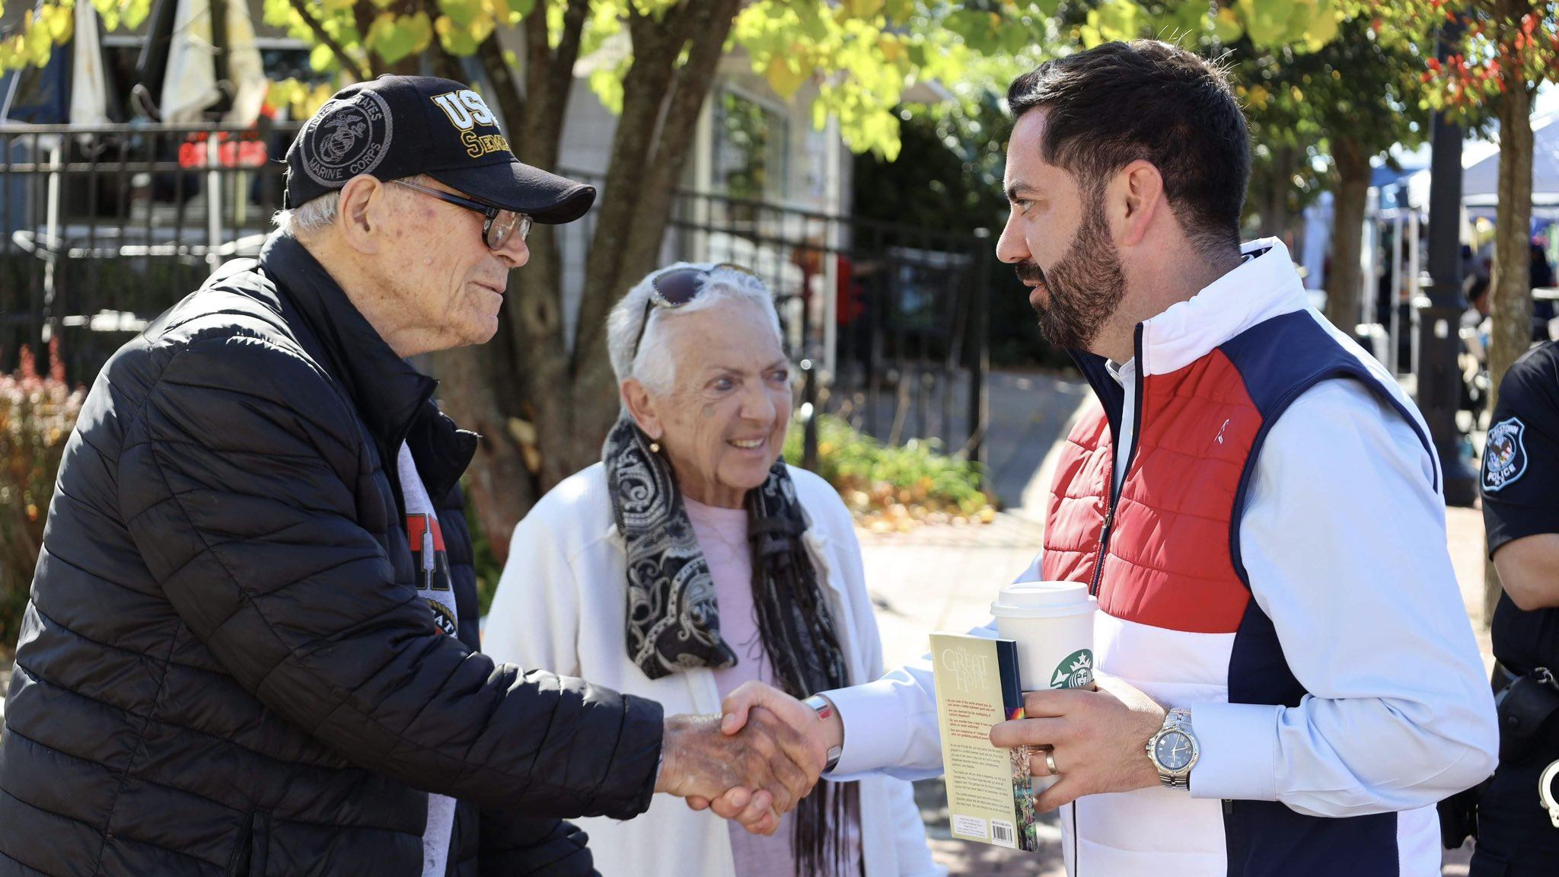
Two In-Person Events
Get out into the community
Consider fairs, markets, festivals, epilepsy strolls
Consider special populations, retirement communities, day cares
Sites provide report in WebDCU
Provide findings and summaries to the EFIC core
Notes:
Your chance to get out of the institutional walls
Going to meet people where they are is a practice of respect.
Are you Shakespeare fans? This is akin to Coriolanus going to the market to show his wounds.
Yes, this is understandably outside of a lot of people’s comfort zones. A lot of us would rather be behind a lectern and behind a deck of slides..But most people overthink this. It doesn’t have to be a big deal. Just go out and introduce yourself. Some people don’t want to talk but a lot of people really do. Again, you should tell people enough so they know what you’re talking to them about, but you don’t have to say a lot. Mostly ask them questions and listen.
We went to the epilepsy stroll with a big team including investigators and research coordinators from three area sites with 1-3 staff from each site. Over a couple of hours each of us talked to about 8-10 folks for an average of about 10 minutes,
Really, it is easy, and it quickly goes from discomfort to being rewarding.
For these you’ll need to write up your own short narrative descriptions of the event. These should be short. Describe the event, who from the team went, what kind of people did you meet and about how many, describe the interaction, how long you talked. Then a brief description or synthesis of the kinds of things you heard, both the expected and perhaps the unexpected. But really broad strokes are fine.

Slide 21

Contracted Surveys
Sites provide catchment zip codes
EFIC core will purchase surveys from Qualtrics pool
Centrally summarized and reported

Slide 22

Public Disclosure
EFIC core customizes for each site
Web site
Social Media campaign
Sites can supplement as needed

Slide 23
EFIC Site Startup Flow
Contract
Local IRB Ceding Letter
Local Context Form
Plans for in-person events
Attend site intake mtg
Recruits FG stakeholders
Study team attends FG
Conduct in-person events
Report in-person events
Complete Site Readiness
Site Activation Call
Sites
Schedules site intake mtg
Web site
Social media campaign
Purchased surveys
Schedules Facilitates FGs
Pays FG stakeholders
Receives in-person data
Prepare site report for IRB
UAB EFIC core
Startup payment #1
Submit CIRB site application
Confirm Readiness
Site Activation Call
Released to enroll
Startup payment #2
SIREN CCC

Slide 24
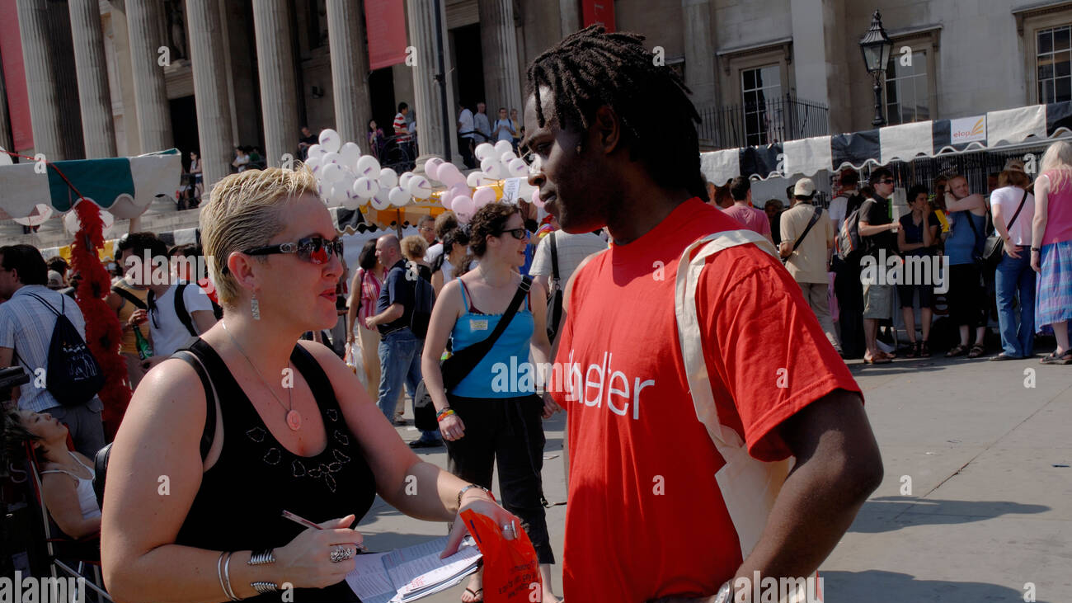
Take away
Attitude matters - look for rewarding experiences not chores
Keep it as simple as you can
Central support is designed to help
Don’t hesitate - get started, get done

