Slide 1
P-ICECAP: Cooling Basics, Clinical Issues and Cooling Protocol
Frank W. Moler, MD, MS
Professor of Pediatrics
Division Pediatric Critical Care Medicine
University of Michigan Medical School
Ann Arbor, MI
Supported by UH3 HL159134, U24 HL159132

Slide 2
Overview
This talk reviews basic temperature (temp) related information needed for RCs and site PIs.
This will assist research teams in optimal temp control in our P-ICECAP patients. Periodic review should be done during the trial.
‘Just in time’ reviews with your clinical teams will be optimal, especially for the Induction and the Rewarming phases in P-ICECAP.
You need to be your site’s TTM experts!
Multiple Kahoot Questions

Slide 3
Outline
Definitions
Thermoregulation - basics
Physiologic and other clinical effects of hypothermia/cooling
Central temperature measurement
Factors impacting target temperature
Cooling protocol through 120 hours
Case Examples (Temperature Curves)

Slide 4
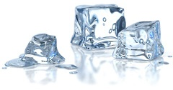
Definitions

Slide 5
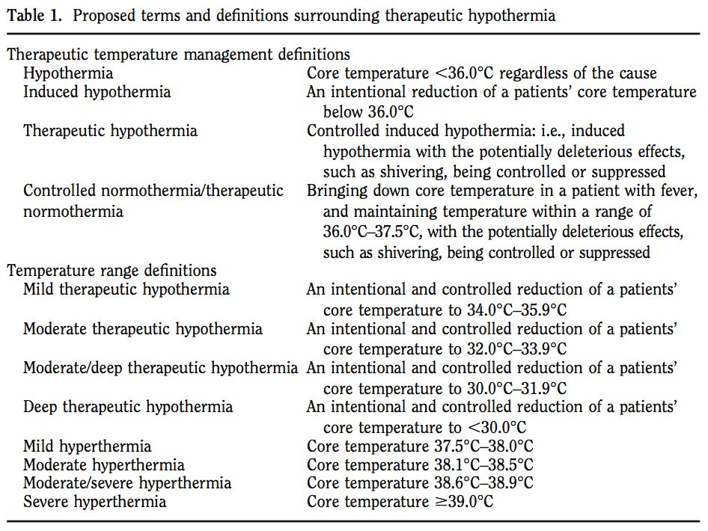
Polderman
CCM 2009

Slide 6
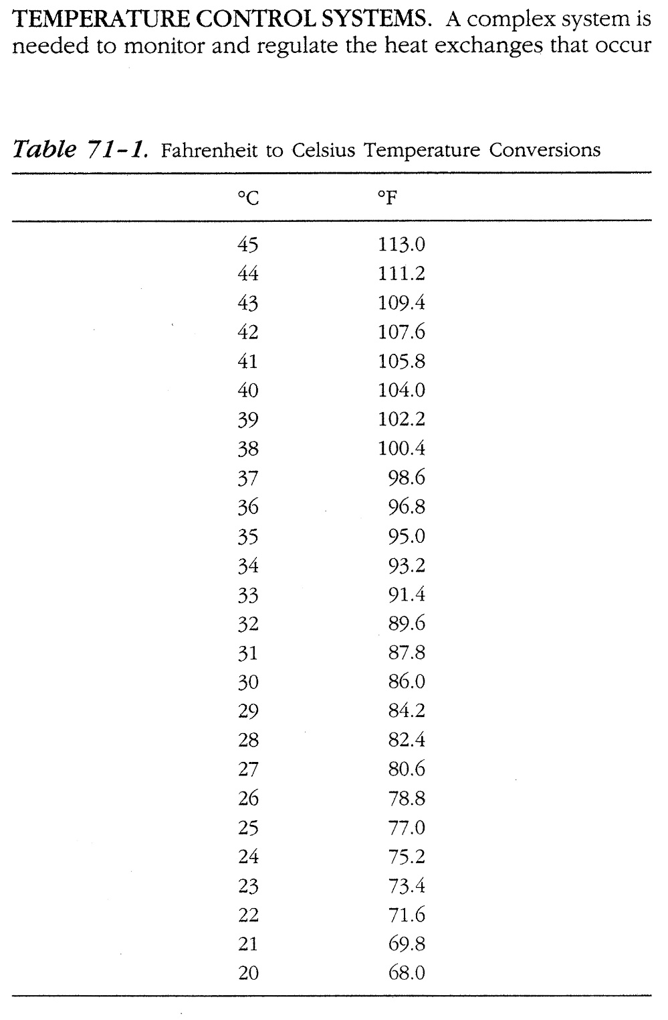
Therapeutic Normothermia
= Normothermia
TTM 36.0-37.5°C (36.8)
Therapeutic Hypothermia
= Cooling
TTM 32.0-34.0°C (33.0)
*Concern for arrhythmias at temp < 30°C. Rewarm STAT to goal
**Greatly increased risk of VF and other arrhythmias < 28°C. STAT rewarming required.
Irwin and Rippe. Intensive Care Medicine, 4th ed, 1999

Slide 7
Thermoregulation
Basics 101

Slide 8
Normal thermoregulation
Heat production
  Normal heat production from metabolic processes in liver, viscera, and muscle
  During exercise or shivering, muscle primary source of heat generation, may be very large
Heat elimination
  Radiation = heat from skin to object without contact (NA)
  Convection = airflow across skin (minor P-ICECAP)
  Conduction = skin to object in contact (#1 in P-ICECAP)
  Evaporation = sweating (NA in P-ICECAP)

Slide 9
Normal thermoregulation
Hypothalamus regulates body Tº
  Afferent inputs to hypothalamus
    Skin*, abdomen, thorax, spinal cord, brain
  Hypothalamus processes based on its temp setpoint
  Central temp below hypothalamic setpoint results in efferent responses
    Cutaneous vasoconstriction
      impedes heat transfer through skin
    Shivering
      generates heat (muscles)

Slide 10
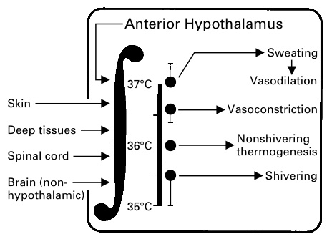
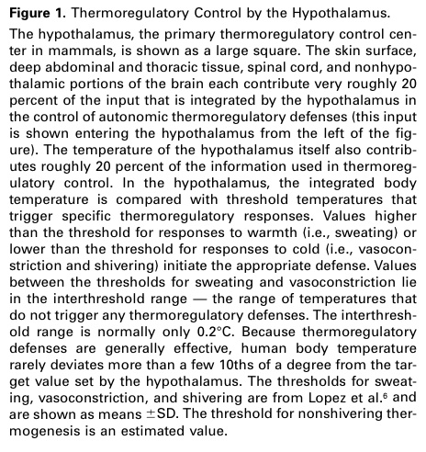
Red bar = hypothalamic set point
Sessler DI. NEJM 1997:336;1730-7

Slide 11
Thermoregulation
Pediatrics
  Smaller infants / children
    Larger SA/volume compared to adults
    Reduced shivering response < 1 yr
    Easier/shorter time to induce hypothermia (cooling) and temp control in very young
Shivering decreases at approximately 33.5ºC
  P-ICECAP goal 33.0ºC in hypothermia (cooled) groups

Slide 12
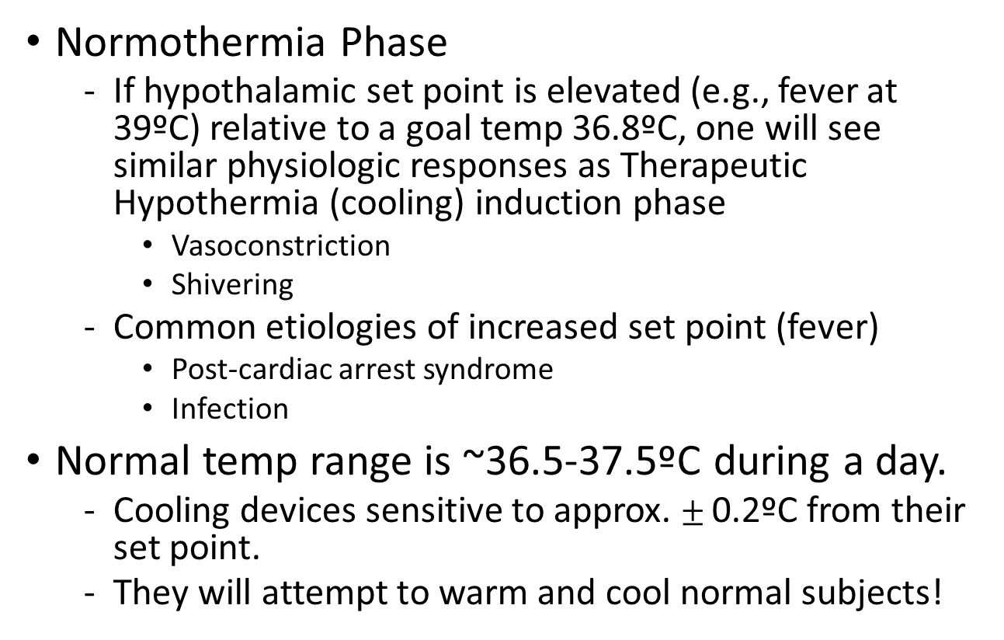
Normal thermoregulation
Normothermia Phase
  If hypothalamic set point is elevated (e.g., fever at 39ºC) relative to a goal temp 36.8ºC, one will see similar physiologic responses as Therapeutic Hypothermia (cooling) induction phase
    Vasoconstriction
    Shivering
  Common etiologies of increased set point (fever)
    Post-cardiac arrest syndrome
    Infection
Normal temp range is ~36.5-37.5ºC during a day.
  Cooling devices sensitive to approx. $±$ 0.2ºC from their set point.
  They will attempt to warm and cool normal subjects!

Slide 13
Physiologic and other effects of cooling in P-ICECAP

Slide 14
List of Physiologic Effects
Shivering
Hypovolemia (during cooling and rewarming)
CV including bradycardia
Potassium
Glucose
Other chemistries (Mg, PO4, etc.)
LFTs, amylase/lipase, lactate
Plts/Coags
WBC/Inflammation/Infection
Drug metabolism
Metabolic rate
Blood gases
Skin
Modified from:
- Polderman, CCM 2009
- ILCOR, Circulation, 2008

Slide 15
1. Shivering
Causes large amount of heat generation/rewarming
May or may not be visible
#1 cause of poor TTM control in P-ICECAP
Cooling devices may not overcome shivering (examples)
Tx is REQUIRED. Not optional.
Suggested agents
  Opioids (e.g., fentanyl)
  Benzodiazepines (e.g., midazolam), dexmedetomidine and others
  NMB (e.g., vecuronium)
Shivering response decreases at ~ 33.5ºC
Shivering response less in young (< 1 yr)
Will see shivering in both hypothermia (cooled) and normothermia phases, if hypothalamic set point is greater than goal temperature

Slide 16
1. Shivering – drugs to inhibit
Benzodiazepines* (midazolam - example)
  Sedative
  Vasodilation (+/-)
  Antiepileptic effects
  Decrease shivering
Opiods* (fentanyl - example)
  Analgesia, sedation
  Vasodilation (+/-)
  Decrease shivering
NMB* (vecuronium, rocuronium and others). Recall Cis-Atracurium has temperature dependent metabolism, prolonged with cooling (Hofmann Reaction). Twitch monitoring with NMB infusions recommended.
  Inhibits shivering, greatly facilitates cooling and temp control
  Masks sedation level and seizures
*ILCOR, Circulation 2008 – drug classes recommended

Slide 17
Induction of Hypothermia without sedation
Polderman
CCM 2009
If hypothalamic set point normal at 37.0ºC
- Vasoconstriction - 36.5ºC
- Shivering - 35.5ºC
-↑HR
-↑Metabolic rate (40-100%)
-↑Stress response
Undesirable in patients with neurologic and/or CV injury post arrest

Slide 18
Induction of Hypothermia with sedation/analgesia
Polderman
CCM 2009
↓Shivering
↓HR
↓ Metabolic rate
↓ Stress response
Improved neurologic outcome compared to no sedation/analgesia.
Less CV stress in post arrest patient

Slide 19
2. CV: Hypovolemia
Hypovolemia – common during the cooling Induction Phase
  Often due to cold diuresis (renal);
  Results in tachycardia and hypotension;
  Requires tx
  Note: if patient cooled and HR not reduced, may be sign of hypovolemia
Hypovolemia – also common during Rewarming Phase
  Vasodilation; may result in tachycardia and hypotension; requires tx

Slide 20
3. CV effects
Cardiovascular (assuming pt deeply sedated and euvolemic)
  ⬆BP (MAP), ⬆CVP, ⬆M_{V}02
  ⬇HR
  ⬇CO (due to HR), but improved O₂ supply/demand ratio
    Case series – cooling used for low cardiac output states (LCOS)
    Used for JET post op ped cardiac patients

Slide 21
3. CV effects
ECG changes –
  Bradycardia (⬇HR) common (⬆PR, ⬆ QRS,⬆QT intervals)
  No specific tx usually required for ⬇HR, if temp >30ºC and otherwise stable
    Atropine ineffective
    If hypothermic without ⬇HR, consider hypovolemia or inadequate sedation as cause
  Other arrhythmias uncommon if temp > 30ºC!
  Arrhythmias at temps < 30ºC
    28-30 ºC - ⬆ (AF & VF)
    < 28 ºC - ⬆⬆VF.
    STAT and prompt rewarming to 33ºC required if ever <30ºC (MANUAL Mode required for Blanketrol-III)

Slide 22
4. Electrolytes (Potassium = K⁺)
Close monitoring of K⁺ required post arrest due to AKI risk
Electrolytes q 6 hr during cooling and rewarming phases and q 12 hr during other phases.
  Induction Phase - serum K⁺ decreases
    Careful replacement as needed
  Rewarming Phase - serum K⁺ increases
    Slow rewarming results in less elevation in K+
    If patient received insulin for hyperglycemia and extra K⁺ replacement given, this may result in greater ⬆ K⁺ on rewarming - - - be careful!
    Consider removing K⁺ from IV fluids during rewarming; supplement prn if needed

Slide 23
5. Hyperglycemia (GLU)
Common post arrest due to stress response
Relative insulin resistance with cooling
Significance & optimal range for GLU unknown
Neonatal, adult and THAPCA RCTs did not use tight control
Often improves without tx in first 24 hr
Important: if insulin for hyperglycemia used during cooling, will need more K⁺ replacement. This may lead to HYPERkalemia and HYPOglycemia on rewarming as insulin resistance resolves.
Protocol suggests <200 mg/dl (range 80-200) acceptable
  consider reducing glucose in IV solutions, insulin only as needed for GLU > 200.
Monitor q 6-12 hr. More often if insulin used.

Slide 24
6. Chemistries (other)
  ⬇ Phosphate, Magnesium, Calcium
    Each may decrease during cooling
    Monitored at least daily
    Replace if indicated
7. LFTs, Amylase/Lipase, Lactate
  ⬆ Amylase, lipase, liver enzymes
  ⬆ Lactate (up to 6 mmol/L)
    Monitor at least daily
    No tx generally required
    Elevations also commonly associated with cardiac arrest

Slide 25
8. Hematology/Coagulation
Platelets
  Mildly reduced numbers common
  May require tx [platelet transfusion] if level too low for clinical setting (e.g., chest tube bleeding).
Mild abnormalities coagulation studies ~ 33ºC
  NOT seen when measured in lab (37ºC)
  Usually requires no tx [FFP transfusion]
Clinical trials including THAPCA-IH did not describe increased bleeding with cooling.
Monitor at least daily

Slide 26
9. Hematologic (Neutropenia)/Infection
⬇ WBC (neutropenia) may occur
Impaired inflammatory response with cooling
Potentially higher risk of infection
Out of hospital cardiac arrests commonly associated with VAP and/or BSI in adults
THAPCA overall positive cultures 39-46% (lung, blood and urine). Drowning subgroup 43-67%
IMPORTANT:
Consider antibiotic prophylaxis in BOTH cooled & normothermia groups as fever will be masked by TTM in both.

Slide 27
10. Drug Metabolism
Drug clearance often dependent on enzyme reactions
Hypothermia is expected to be associated with slower drug clearance and potentially higher drug levels (opiates, benzos, NMBs, etc.).
  Follow levels if available (i.e. phenobarb)
  Titrate sedation drugs to effect
  Consider cautious use of drugs that cause bradycardia (i.e., dexmedetomidine?)

Slide 28
11. Metabolic Rate
Reduced with cooling (32-34ºC)
  ~8-10% per degree C
Caloric requirements decrease during cooling
  ~30-40%
Do not over feed

Slide 29
12. Blood Gases
P_{a}O₂ and P_{a}CO₂ solubility differs by temp
A rough estimate of temp correction to 33ºC
~ P_{a}CO₂ = ↓2 torr/ºC = ~ 8 torr
~ P_{a}O₂ = ↓5 torr/ºC = ~20 torr
Controversial if correction should be done
P-ICECAP, like THAPCA, will not temp correct ABGs
Report at standard body temp 37.0ºC

Slide 30
13. Skin
  Closely observe skin and provide good nursing care during 120 hrs. of temperature management.
    Cooling not associated with skin break down in Neonatal cooling trials up to 72 hr. or THAPCA 48 hr.
  Larger, malnourished, immobile patients may be at greater risk

Slide 31
Central Temperature
Measurement

Slide 32
Temperature Measurement
Central temperature measurement required to estimate blood temp (Gold Standard)
Delay in a central site to reflect blood temp in real time is associated with overshoot of cooling
  - Ideal site = accurate, short time lag
Dual central temp measurements required for all patients (Primary to cooling device; Secondary to bedside monitor or cooling device).
Exception - ECMO cases – 1 central temp (or venous circuit blood) only required

Slide 33
Esophageal (Preferred primary site – attached to the cooling devise (Arctic Sun, Blanketrol, other). Used as sole temp site in NICHD neonatal trials
  Accuracy: High level
  Time lag: Shortest = 5 min (2-10 min)
  Insertion: easy, but MUST verify position by CxR
  IMPORTANT: Correct placement in lower 1/3 of esophagus is critical
    If in stomach, temp may measure low by 1-3ºC
    If tube feeds (gastric) and reflux, may make measurement inaccurate
    Vented G-tube accuracy?
    Position of ET tube in tracheal relative to probe location in esophagus
    May move with neck extension/flexion

Slide 34
Rectal (secondary probe– to monitor)
  Accuracy: Moderate level
  Time lag: Moderate = 15 min (10-40 min)
  Insertion: Easy
  Dislocation: Common. Monitor for it.
Bladder (secondary probe – to monitor)
  Accuracy: Moderate level
  Time lag: Moderate = 20 min (10-60 min)
  Insertion: Easy
  Dislocation: Uncommon. Low urine output may result in less accurate measurements
  Not available for smallest infants
*If Esophageal probe is not used as primary probe, then Rectal or Bladder will need to be selected.

Slide 35
Skin sites (skin, axillary, etc)
  Accuracy: Inaccurate – not a central temperature. Do not use.
  Time lag: Moderate = 20 min (10-60 min)
  Insertion: Easy
  Dislocation: Uncommon
Tympanic membrane (better than Skin)
  Accuracy: Moderate, may be inaccurate
  Time lag: Moderate = 10 min (10-20 min)
  Insertion: Easy; quick
  Dislocation: NA
  Other: not continuously measured

Slide 36
Central Temp Differences
Two central temps for safety
If within ± 1ºC - acceptable
If consistently > 1ºC, escalating action required
  Notify the site PI
  Verify probe placement (esophageal, rectal)
  Verify YSI 400 compatible probes used
  Stomach feeds/GE reflux (esophageal probe)
  Low urine output (temp sensing Foley)
  Determine which probe is most accurate to be Primary connected to the cooling device.
  May need to check 3rd central temp site

Slide 37
Factors influencing ability to maintain goal temperature

Slide 38
1. Patient factors
Patient factors impeding cooling
  Size (larger, obesity)
  Shivering (commonly subclinical)
    Sedation/analgesia/NMB (Inadequate)
    Sepsis/Infection
  Seizures
  Extremely reduced CO/poor skin perfusion
    e.g. abdominal compartment syndrome.

Slide 39
2. Skin surface area for cooling
Surface area (SA) for contact (Conduction)
  2 vs. 1 blankets (i.e., anterior/posterior vs. posterior)
  Positioning of patient (i.e., side vs. back)
  With Arctic Sun too few pads (surface area) may result in difficulty rewarming
Extraneous materials between patient and blankets/pads (Maxi-Therm Lite blankets or Arctic Sun pads)
  Minimize, none required, no sheets

Slide 40
3. Cooling Devices
Know how to use your site’s cooling device/modes per the manufacturer's recommendations!
Also, know important limitations of your device
Most common devices used in P-ICECAP are:
  Blanketrol-III: Gentherm (formerly CSZ) has improved educational materials and videos on website.
  https://www.gentherm.com/en/medical/hyper-hypothermia/blanketrol-3
  https://gentherm.com/en/medical/resources-manuals/?section=blanketrol
  https://vimeo.com/403437211
  Arctic Sun: BD outstanding hands-on customer service
  Other (Criticool, etc.)
Unlike THAPCA, we are not instructing on the use of any device. Examples used are for discussion purposes only. Call vendor for issues with temperature control.

Slide 41
3. Cooling Equipment: Example of modes – Blanketrol-III
AUTO CONTROL Mode
  Warms or cools water to max range of 4 - 42ºC when patient’s central temp +/- 0.2ºC from Blanketrol Set Point temp.
  For large patients.
GRADIENT VARIABLE MODE (Plus SMART MODE)
  Cools water to narrower range; dampens temp fluctuation compared to AUTO CONTROL Mode.
  For smaller patient sizes.
  Example (assume patient 34ºC and set point 33ºC )
    AUTO CONTROL: 4 - 42ºC For large patients
    Gradient Variable 20ºC: 14 - 42ºC
    Gradient Variable 10ºC: 24 - 42ºC. For smallest patients
Defer to manufacturer/vendor for optimal set up and use

Slide 42

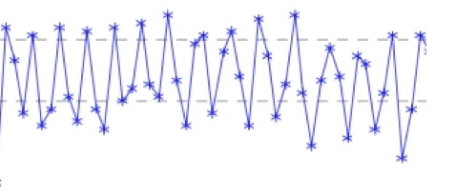

Temperature Tracings (from Primary Probe)
Not in range
AUTO Mode
NMB, Sedation
In range
GRADIENT VARIABLE Mode 10º C
NMB, sedation

Slide 43
3. Blanketrol and SMART MODE
GRADIENT VARIABLE with SMART MODE – Blanketrol-III
A modification to the GRADIENT VARIABLE MODE.
SMART MODE will decrease the water temperature set in GRADIENT VARIABLE MODE by 5ºC if the goal temperature is not achieved within 30 minutes.
It reverts to the GRADIENT VARIABLE MODE once the target temperature goal is achieved.
This mode is suggested to be used by the manufacturer (Gentherm).
See User Guide and Inservice videos updated since THAPCA.
https://gentherm.com/wp-content/uploads/blanketrol-III-userguide-99217.pdf

Slide 44
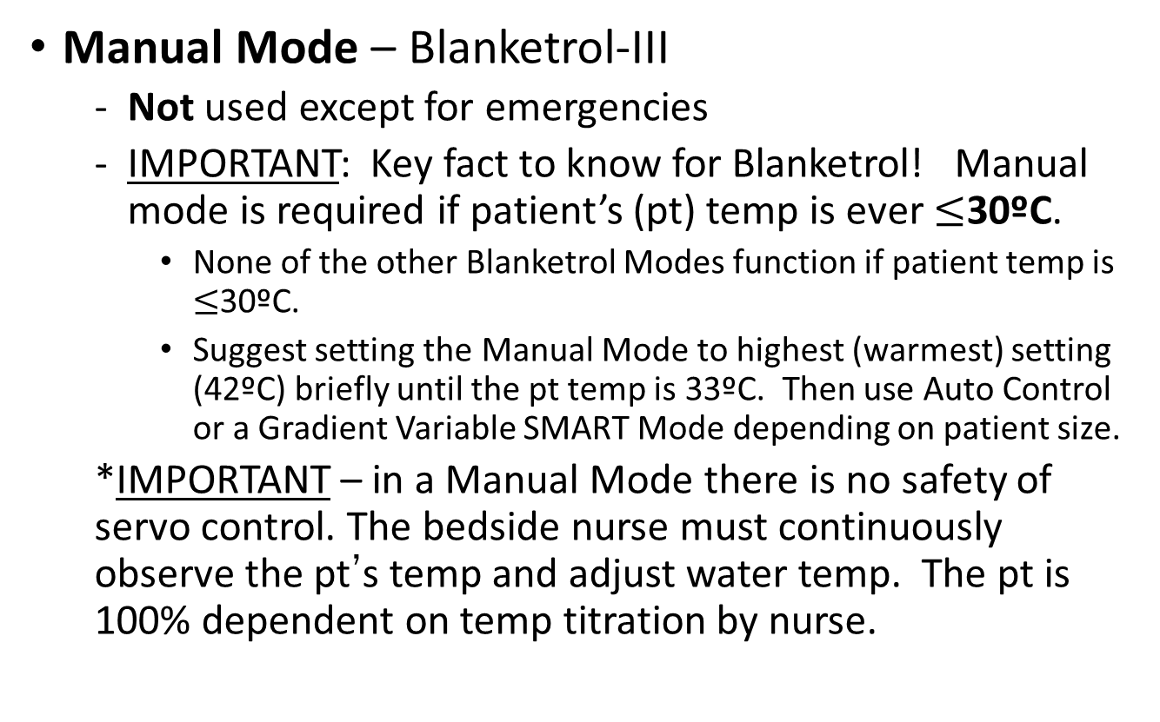
3. Blanketrol-III
Manual Mode – Blanketrol-III
  Not used except for emergencies
  IMPORTANT: Key fact to know for Blanketrol! Manual mode is required if patient’s (pt) temp is ever $≤$30ºC.
    None of the other Blanketrol Modes function if patient temp is $≤$30ºC.
    Suggest setting the Manual Mode to highest (warmest) setting (42ºC) briefly until the pt temp is 33ºC. Then use Auto Control or a Gradient Variable SMART Mode depending on patient size.
  *IMPORTANT – in a Manual Mode there is no safety of servo control. The bedside nurse must continuously observe the pt’s temp and adjust water temp. The pt is 100% dependent on temp titration by nurse.

Slide 45
Temperature Monitoring and Management

Slide 46
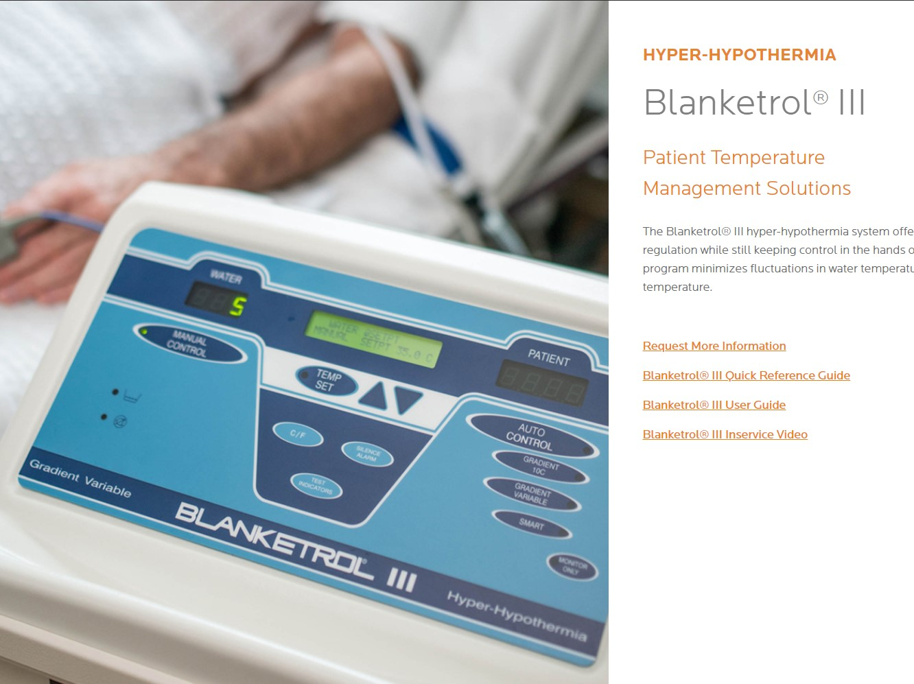
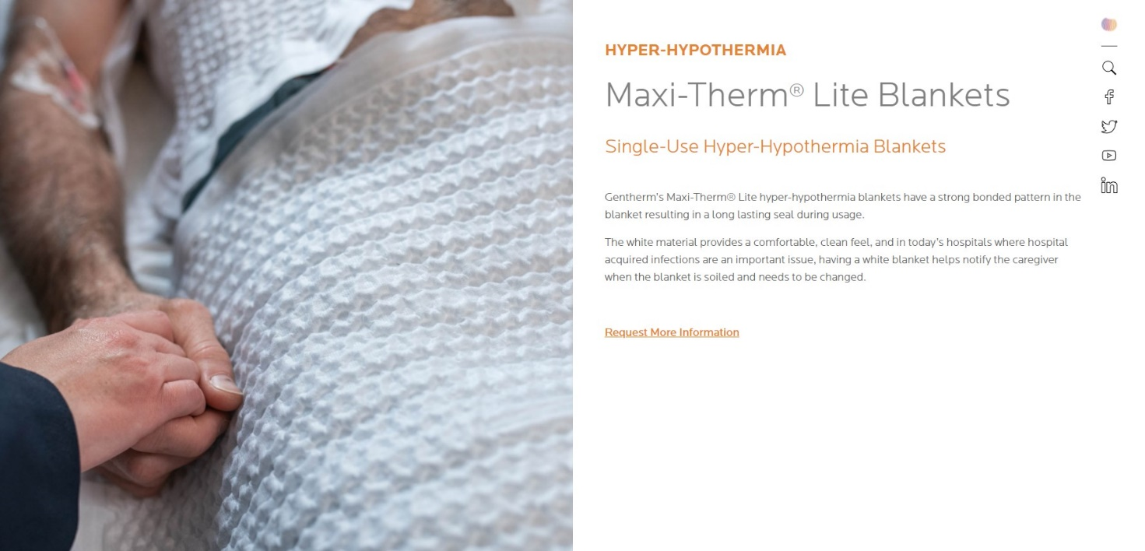

Slide 47
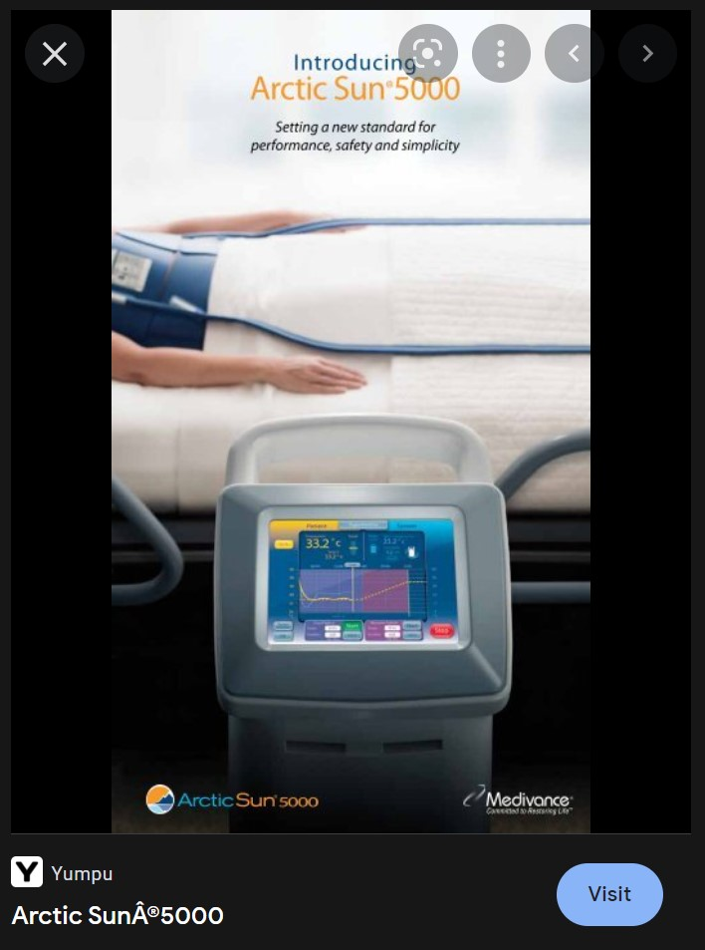
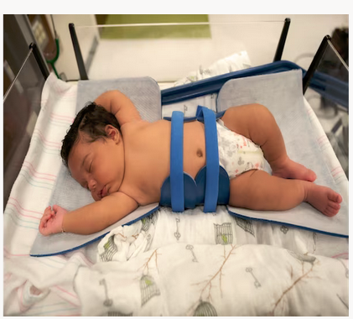
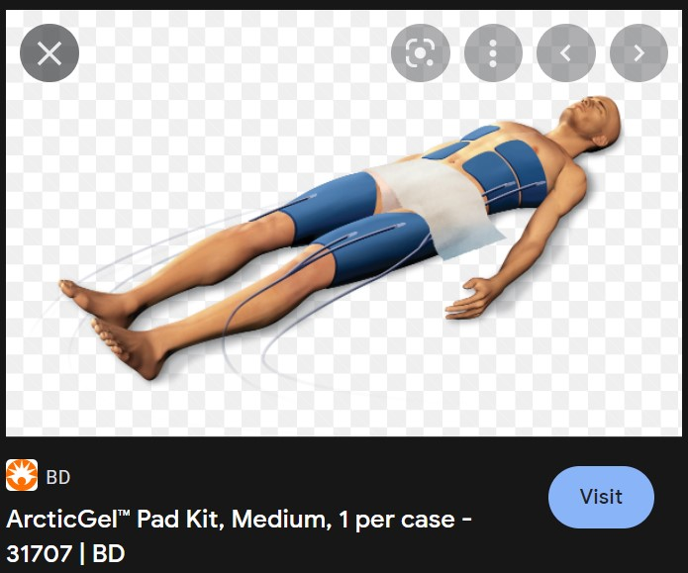

Slide 48
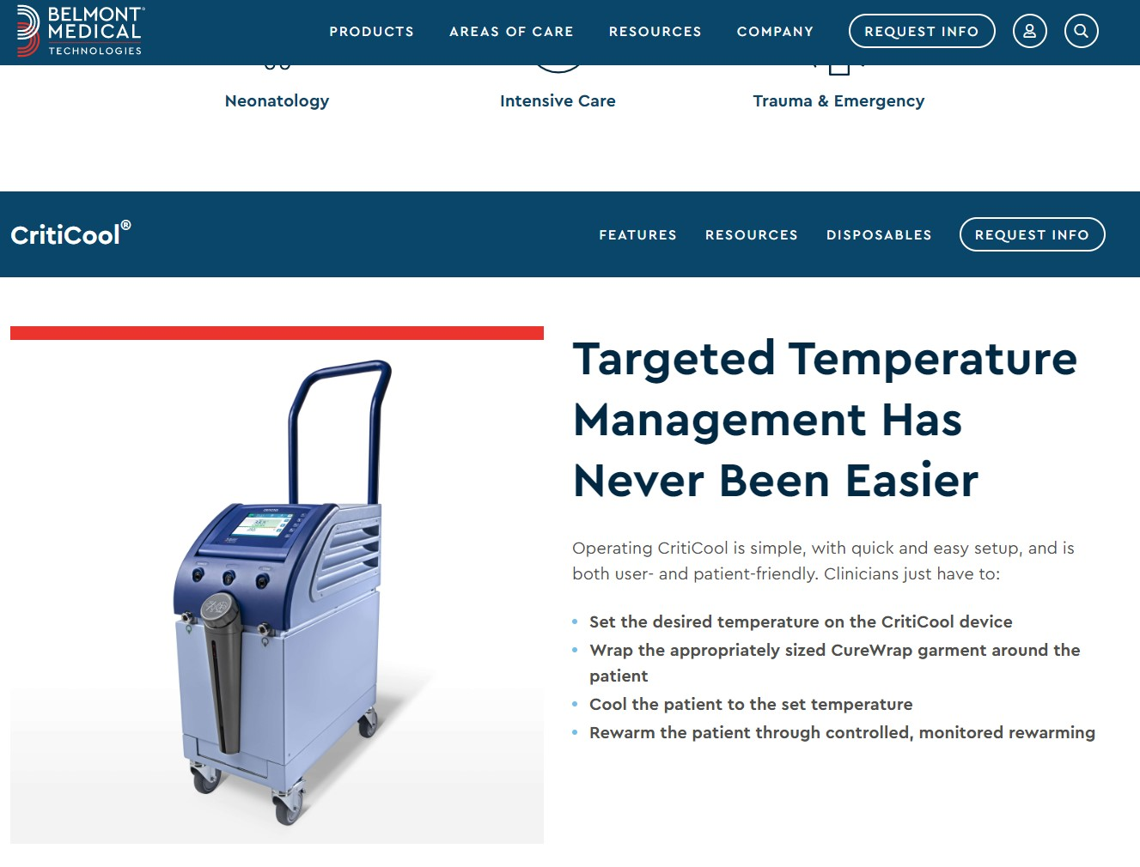
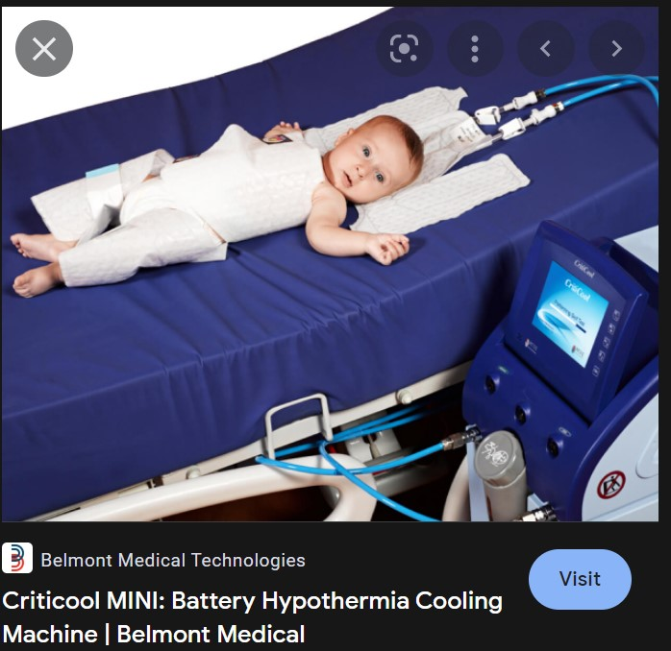

Slide 49
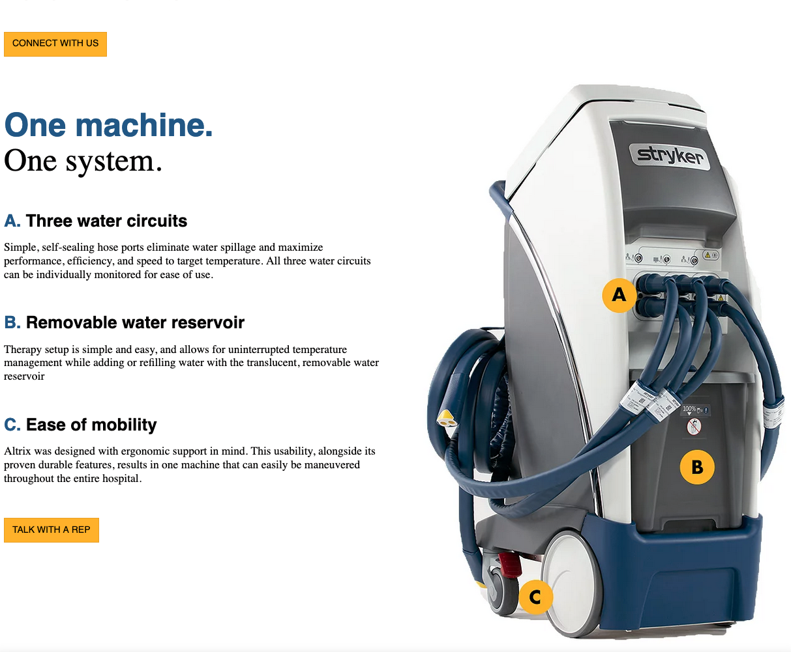

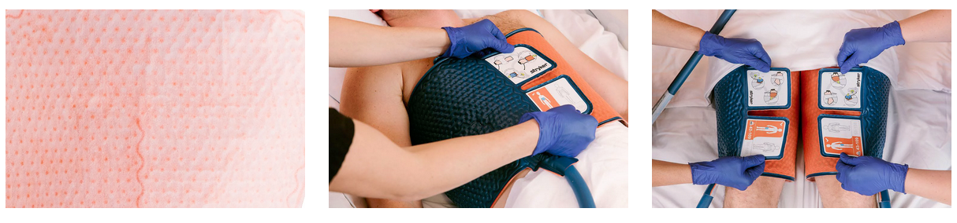

Slide 50
Monitoring: TTM 33°C (32-34°C)
Two central temperature probes.
  Primary to cooling device (Blanketrol-III, Arctic Sun, other).
    *This temperature is entered into the case report form (CRF).
  Secondary to bedside monitor or device (safety).

Slide 51
Monitoring: TTM 33°C (32-34°C)
Initial cooling device’s target temp is 33°C (range 32-34°C) until rewarming. (Exception 0 hr cooling/ normothermia group).
Different devices have different settings/modes for small to large sized patients.
  If temp is not staying in the 32-34°C range, you need to adjust cooling device per manufacture (e.g., next slide).
    Arctic Sun (excellent hands-on support)
    Blanketrol-III (good online instructions & videos)
    Both have 24/7 hotline numbers for support.
  The on-call P-ICECAP team has 24/7 hotline that is available for other study questions.

Slide 52
Temperature tracings from small child (primary probe)
Not in 32-34ºC range:
Overshooting
B-3, AUTO Mode
NMB, Sedation
Water temp ~4 to 42ºC
In range
B-3, Changed to GRADIENT VARIABLE 10ºC Mode
NMB, sedation
Water temp ~23 to 42ºC

Slide 53
Temperature Management
A major goal in P-ICECAP is to achieve the desired phase target temperatures for the 120-hour intervention while preventing shivering.
Sedation and analgesia are generally used throughout the120 hours while a patient remains intubated.
Use NMB for Induction and Rewarming phases. Other times PRN. MUST avoid shivering. (examples)
Subclinical shivering is common. In patients with difficult to maintain temperature, consider additional sedation with NMB trial.

Slide 54
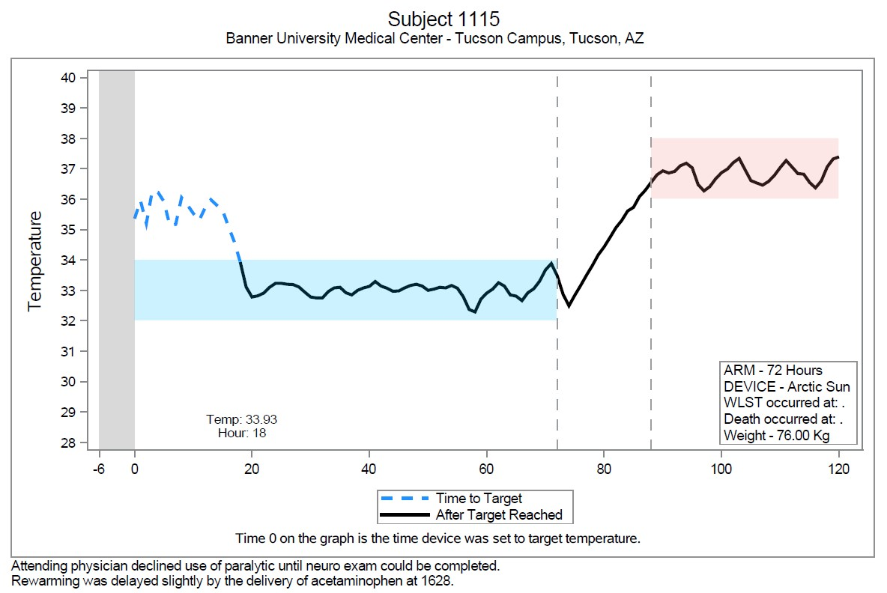

Clinical Attending
No NMB
AS can not overcome shivering w/o Sedation/ NMB

Slide 55
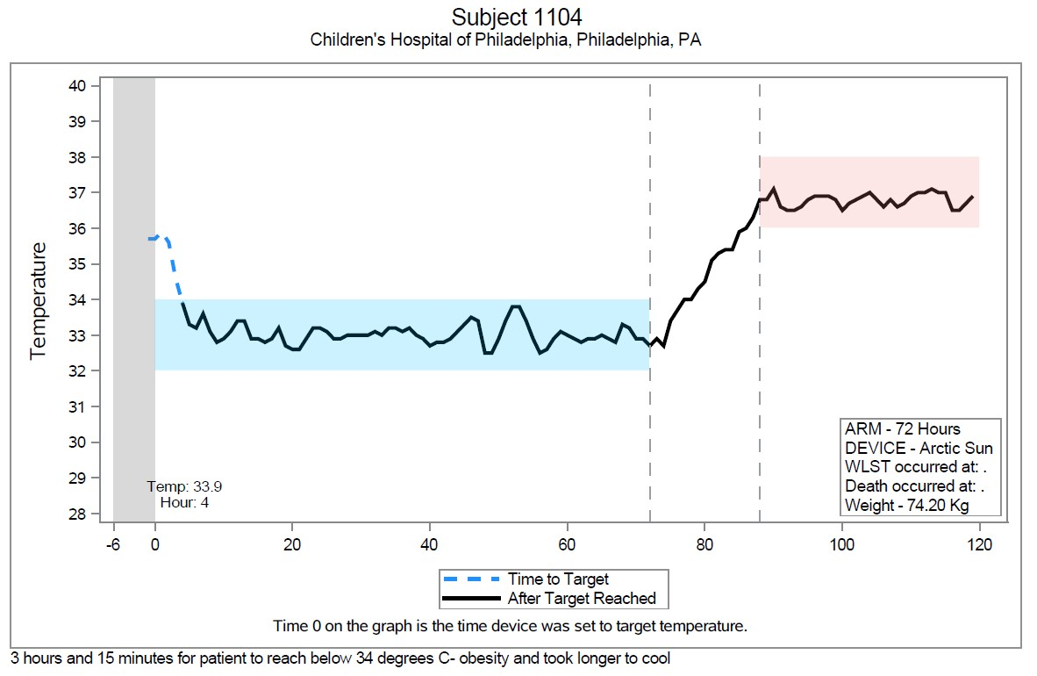
+ Sedation/ NMB much improved TTM

Slide 56
Protocol Overview Through 120 Hours

Slide 57
Overview – from 37,000 feet
Example – University of Michigan
PICU fellow is contacted re: an OHCA from outside ED or our UM ED.
The research team on call is immediately notified of a pending OHCA admit.
Research team discusses with clinical team the case summary, arrival time, and approach for consent
Order for nursing to get cooling equipment to bedside:
  Blanketrol-III, two Maxi-Therm Lite cooling blankets (Ped or Adult), 2 hoses, 2 temperature probes and temp sensing Foley of correct size
On pt arrival, clinical team stabilizes, places CVC, art line.
Cooling device started as soon as it is safe to set up.
Clinical team initiates their usual TTM target between 33-37ºC before consent.

Slide 58
Overview – from 37,000 feet
Research team introduced by clinical team to family. Then gets informed consent and randomizes to one of 10 cooling durations from 0 to 96 hours.
Subject enrollment = time randomized to a study cooling duration.
TTM 33°C (or 36.8°C for 0 cooling normothermia group) will be set as target temp no later than 15 min after randomization.
  If it was started prior to randomization, then the start time for cooling groups 12-96 hr will be when a target 32-34°C set.
  For normothermia 0 hr cool group, start time is when site begins toward a target of 36-37.5°C.
Protocol goal is to achieve a temp range no later than 2 hr. after randomization.
  Sedation and NMB for induction phase results in fastest time to goal
  *Ideally, research team supervises until temp stable

Slide 59
Overview – from 37,000 feet
Cooling duration is equal to the combined time of the Induction plus Maintenance phases.
For nine cooling groups (12-96 hr), after the assigned cooling duration is completed, slow rewarming over at least 16 hrs.
Then normothermia 36.8°C for rest of 120 hr.
Exception is the 0 hour controlled normothermia group. The pt brought to 36.8 °C ASAP, then normothermia for remaining 120 hr.

Slide 60
P-ICECAP Trial: Cooling, Rewarming and Normothermia Phases

Slide 61
Cooling Groups: 12, 18, 24, 36, 48, 60, 72, 84, 96 hours

Slide 62
Cooling Groups: 12, 18, 24, 36, 48, 60, 72, 84, 96 hours
Induction Phase (I)
  Time from start of TTM 33ºC (or 32-34ºC if pre randomization) until the goal range (32-34ºC) is reached.
  Use the recommended cooling modes described by manufactures for the patient’s size.
    Blanketrol III - AUTO CONTROL or GRADIENT VARIABLE SMART MODE – per manufacturer.
    Arctic Sun – per manufacturer.
  Induction will require sedation + analgesia and NMB
    MUST PREVENT SHIVERING!
  Likely time of maximum BP instability following OHCA since closest to event
  Hypovolemia, Hypokalemia and Hyperglycemia may occur during this period
  ‘Just in time’ review with clinical team optimal

Slide 63
Cooling Groups: 12, 18, 24, 36, 48, 60, 72, 84, 96 hours
Maintenance Phase (II)
  Steady state period with target temperature 33ºC (32-34ºC) until assigned study cooling duration is completed and planned rewarming starts.
  Adjust the cooling device mode as needed per manufacturer to keep in the goal 32-34ºC range.
  Titrate sedation/analgesia to achieve/maintain “sluggish or no response to noxious stimulus.”
  NMB prn after stable 32-34ºC temp range is achieved.
  Similar clinical issues as Induction Phase possible (Hypovolemia, Hypokalemia and Hyperglycemia).

Slide 64
Cooling Groups: 12, 18, 24, 36, 48, 60, 72, 84, 96 hours
Rewarming Phase (III)
  This is a critical time – it needs to be done slowly.
  Begins with the initiation of planned increase of device target temp toward 36.8ºC (normothermia) goal.
  Should be done over ≥ 16 hrs
  For Blanketrol-III: AUTO CONTROL or GRADIENT VARIABLE SMART MODE
    Manually Increase temp set goal 0.7 ºC every 4 hrs.
      33ºC (0 hr); 33.7ºC (0-4hr); 34.4ºC (4-8hr); 35.1ºC (8-12hr); 35.8ºC (12-16hr); then 36.8ºC (16+hr)
    Goal temp of 36.8ºC (36-37.5ºC range) after 16 hrs
  For Arctic Sun – the rate of rewarming is programed to achieve the goal of 36.8ºC (from 33ºC) over 16-18 hr.

Slide 65
Cooling Groups: 12, 18, 24, 36, 48, 60, 72, 84, 96 hours
Rewarming Phase (III)
  BP, Potassium, and Glucose need to be monitored carefully during rewarming.
  Electrolytes and glucose at least every 6 hrs. and more frequently if indicated.
  Increased sedation and NMB is usually required as the shivering response increases with rewarming
  Fluid bolus often needed.
  Rapid rewarming must be avoided to minimize risks of cerebral edema, hypotension, hyperkalemia and hypoglycemia.
  Review issues of the Rewarming Phase with the clinical team prior to its start.
  Call the 247 on-call number if any questions.

Slide 66
Cooling Groups: 12, 18, 24, 36, 48, 60, 72, 84, 96 hours
Normothermia Phase (IV)
  Goal temp is 36.8°C, range 36-37.5°C for remaining time to 120 hrs
  If clinical team determines they must check fever status, put in MONITOR ONLY Mode
  Return to the device’s appropriate cooling mode if temp > 37.5°C, but only if the patient remains intubated. Sedation/analgesia and possibly NMB may be required to prevent shivering

Slide 67
Cooling Groups: 12, 18, 24, 36, 48, 60, 72, 84, 96 hours
Normothermia Phase (IV)
  Clinical team may elect to extubate patient if clinically awake and otherwise stable
    Management of fever following extubation is limited to antipyretic agents (Tylenol). Will NOT be able to use the cooling device with deep sedate or NMB to prevent shivering.
    Can use temp MONITOR Only Mode
  *IMPORTANT: Do NOT extubate a patient until rewarmed! Cerebral edema, hypoglycemia, hyperkalemia, and hypotension are risks of rapid rewarming.

Slide 68
Controlled Normothermia = Zero (0) Hours of Additional Cooling Group

Slide 69
Controlled Normothermia = Zero (0) Hours of Additional Cooling Group
This arm is effectively TTM 36.8°C for 120 hrs
Temp will be maintained through 120 hrs from when the cooling device is set with the intent to establish normothermia
  either to a set temp > 36°C OR
  otherwise beginning active rewarming with the intent to establish normothermia in children who are hypothermic
Set temp to 36.8°C within 15 minutes of randomization if appropriate

Slide 70
Controlled Normothermia = Zero (0) Hours of Additional Cooling Group
Pts will be rewarmed promptly per routine clinical practice, and will not be rewarmed using the 16 hr procedure for the arms that receive therapeutic hypothermia for 12 to 96 hours.
Reasonable ranges of rewarming can range from 0.5- 1°C per hr or more.
Pts should be rewarmed as fast as tolerated to achieve normothermia. (In THAPCA trials, the normothermia group was set to achieve 36.8°C ASAP).
If the pt’s temp is < 32°C, the pt should be rewarmed ASAP to 33°C for safety to minimize the risk of arrhythmia.

Slide 71
Controlled Normothermia = Zero (0) Hours of Additional Cooling Group
If a pt is hyperthermic (>37.5°C) at randomization?
  The device should be set at 36.8°C to cool to normothermia range (36-37.5°C) ASAP

Slide 72
Initial Site Enrollments
For the first 2 patients enrolled at each site, we recommend you contact the on-call 247 P-ICECAP hotline 844-742-3227 (844-PICECAP) to review the Induction Phase soon after device is set to 33°C. Call again just prior to start of the Rewarming Phase.
The other time to call is for a site’s 1st randomization to normothermia (0 hr cooling) group
Since sites are using their own cooling devices, we are relying on sites and manufacturers to use their cooling equipment safely. Contact your vendor for an in-service if you believe it would benefit your PICU/PCCM team.
Arctic Sun may have already contacted you.
Contact Gentherm (Blanketrol) and other manufactures as needed for in-services.

Slide 73
Questions?

