Slide 1
P-ICECAP Investigator Meeting
4.29.25 and 4.30.25
11AM – 3 PM
Frank W. Moler, MD, MS
Professor, Pediatric Critical Care Medicine
University of Michigan Medical School
Ann Arbor, MI
Supported by UH3 HL159134, U24 HL159132

Slide 2
Welcome!

Slide 3
Agenda
Best practices for enrollment and early intervention (30 min) Topjian/Moler
Active listening & other consenting tools you might not know (15 min) Miller
KUDOs (20 min) Weber
Stories from the Trenches (30 min) Adam Schwarz, Stuart Friess, Supreeth Sharaschandra
Break (15 min)
AE and SAE reporting reminders (30 Min) Silbergleit/Daniels
Kahoot! (30 min) Weber/Meurer
Follow-up Procedures for Sites (45 min) Slomine
Questions and Open Discussion (20 min) Group
Adjourn (3PM)

Slide 4
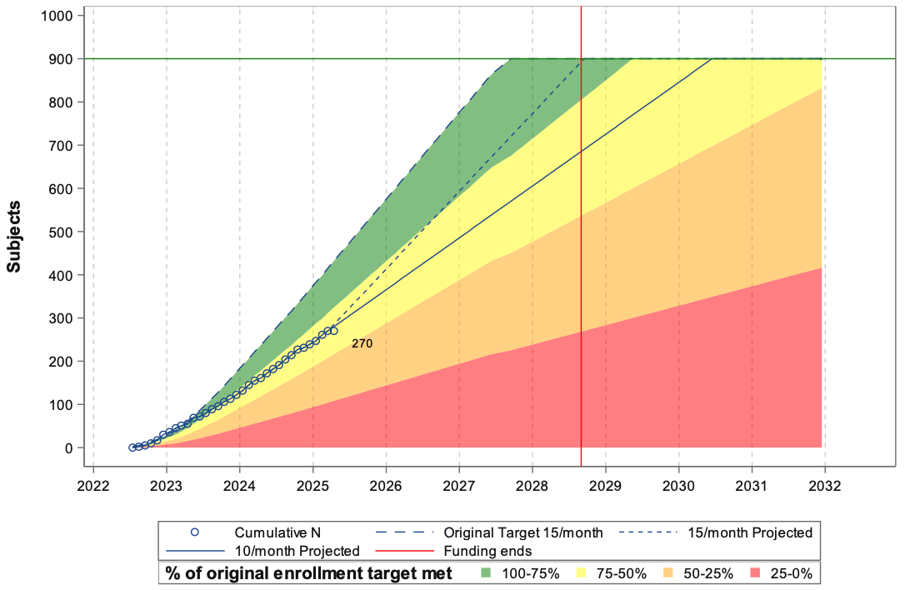
P-ICECAP Enrollment Projections
4/1/2025
100% goal = 416
75% goal = 312
65% actual = 270
15
10

Slide 5
Questions?

