Slide 1

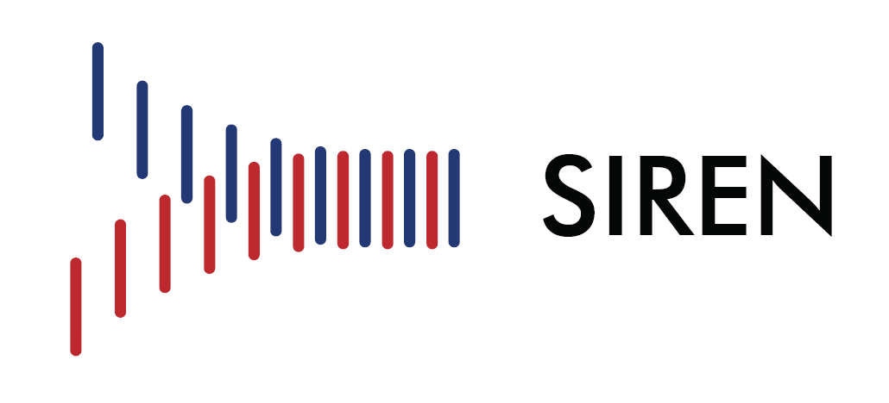
Best Practices for Enrollment and Early Intervention

Slide 2
Objectives
Review opportunities and pearls for optimization of:
  Screening
  Enrollment
  Randomization
  Initiation Intervention

Slide 3


Slide 4
Robust Screening & Notification
Rapid screening is critical for enrollment within 6 hours
Approaches:
  Centrally page through the ICU fellow
  Transport team notifies study team prior to hospital arrival
  Epic study team chat notification
  EMR automatic notification

Slide 5
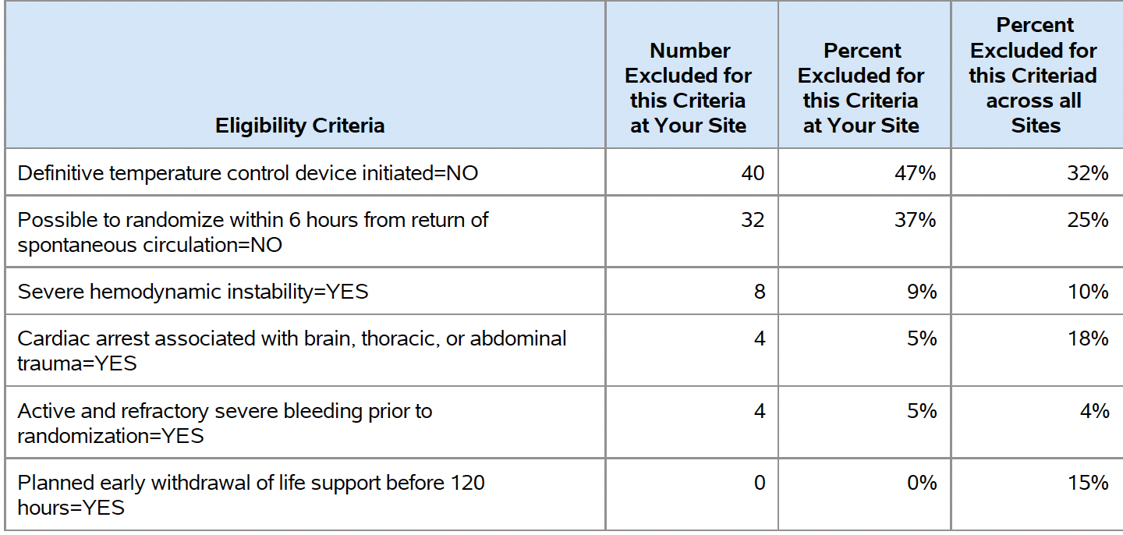
Exclusion Criteria We May Be Able To Impact
Start Blanket
Notificiation
Review Doses
Call Hotline
Call Hotline
Partner with
Clinical Team

Slide 6
Enrollment Order Of Operations
Screening
Consent
TTM Initiation
Randomization
Screening
TTM Initiation
Consent
Randomization
Case
ROSC: 4 AM Deadline: 10 AM
Hospital Arrival: 9:15 AM Consent starts: 9:25 AM
Consent Signed: 9:55 AM TTM start: 9:57 AM
Randomization: 9:58 AM

Slide 7
Temperature Management
Set to goal temp within 15 minutes of randomization
Achieve < 34 C within 2 hours of randomization

Slide 8
Goal: Set to temp within 33 C
Time of initiation of cooling (start of intervention -TTM 33C)
The time the device is set to 33 C
  After randomization, should be within 15 minutes of randomization
  If prior to randomization, time of button push to 33C
87% of sites

Slide 9
Notes:
Completing the top of the day 1 temp log will let you confirm your rewarm start time – RCs know how to do this.

Slide 10
Notes:
Completing the top of the day 1 temp log will let you confirm your rewarm start time – RCs know how to do this.

Slide 11
Nomenclature
Day 1 visit is from initiation of temperature control device through the end of the calendar day (23:59).
Day 2 visit is the next day 00:00 through 23:59.
NOTE: randomization may happen on Day 1 or Day 2, depending on the timing of events.

Slide 12
Goal: Cooling to target within 2 hours
Average time from Randomization to < 34C:
99 minutes
62% achieved <34C within 120 minutes

Slide 13
Optimization of Achieving 33 C
Blanketrol (two blankets) for more effective coverage
  Two hoses to one machine
Arctic Sun
- Use additional pads to maximize coverage
Sedation AND Paralytic
  Shivering can be unobserved
  Makes the device work more
  Increased metabolic demand may increase secondary brain injury

Slide 14
Sedation and Analgesia During Study
Goal: Sedation scores are per your ICU with a target of “sluggish or no response to noxious stimulus.” (e.g. SBS -2, RASS -4)
Decisions regarding agents are at the jurisdiction of the clinical team with the following guidance

Slide 15
Sedation and Analgesia
Should be initiated as a continuous infusion with intermittent boluses to achieve goal sedation score.
Titrate to achieve sedation score
After rewarming is complete sedation goals are at the jurisdiction of the clinical team

Slide 16
Sedation and Analgesia
Common sedatives: dexmedtomidine and midazolam
Common analgesics: narcotics
If after the first 4 hours of intervention the patient has no clinical response to noxious stimulus sedative and analgesics can be weaned
May wean off after 24 h if no response to noxious stimulus.

Slide 17
Shivering
Goal: prevent and treat shivering during induction and rewarming
May be subclinical and difficult to detect
May be difficult to differentiate from seizures or myoclonus
Sites that have shivering scores and protocols can use them
Treatments: Neuromuscular blockade, Dexmedtomidine

Slide 18
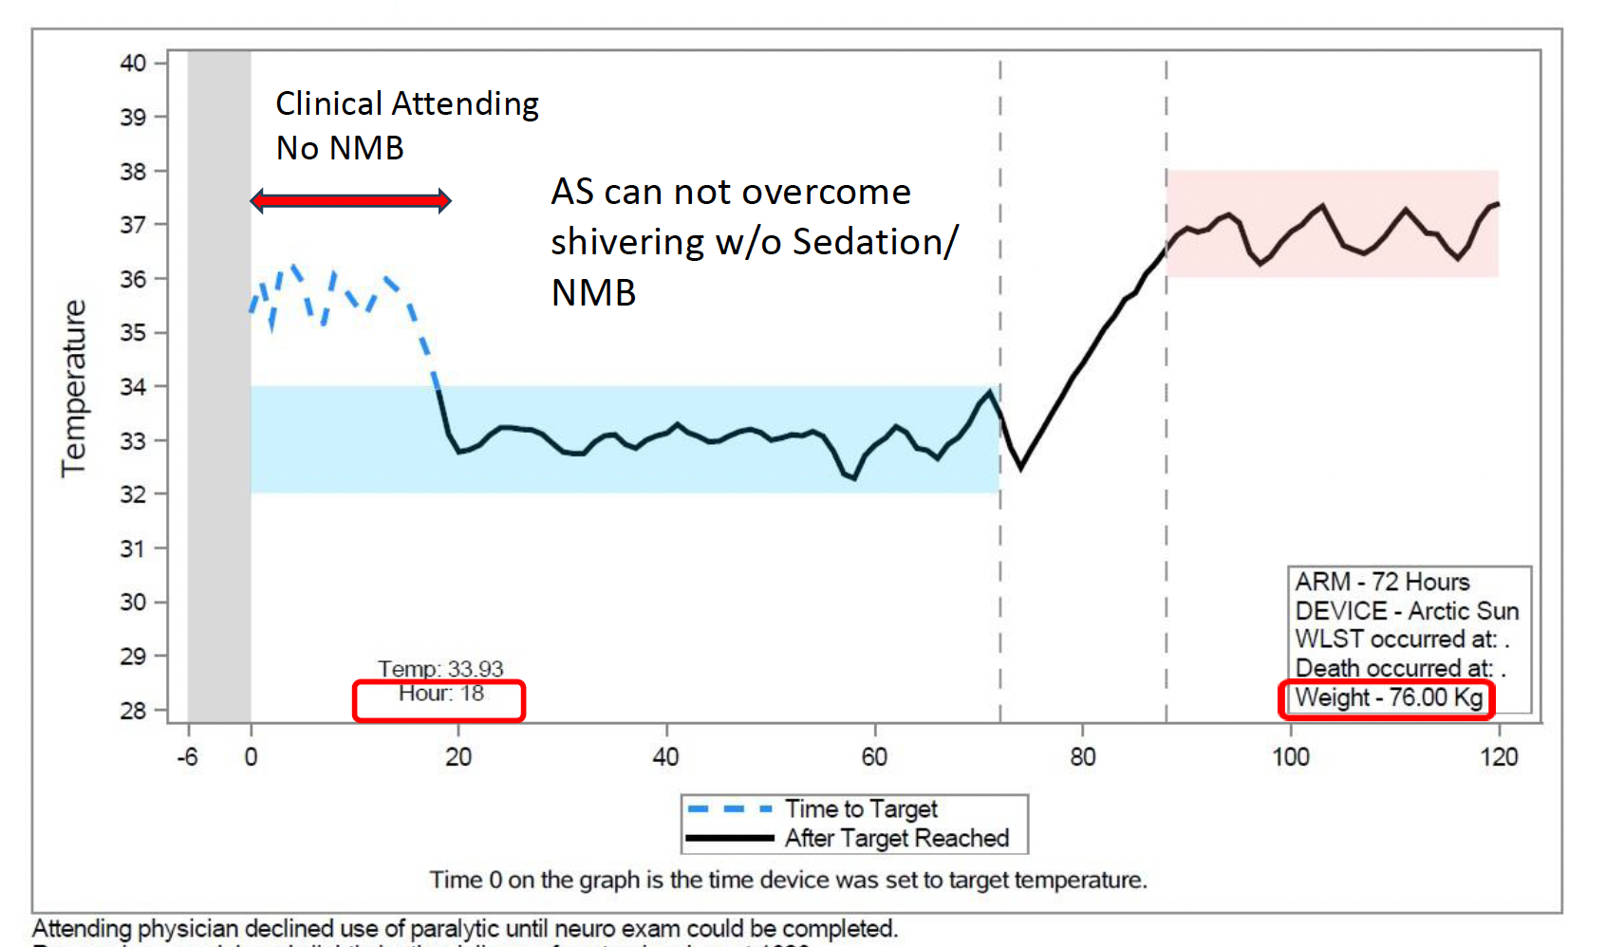
No Neuromuscular Blockade Used

Slide 19
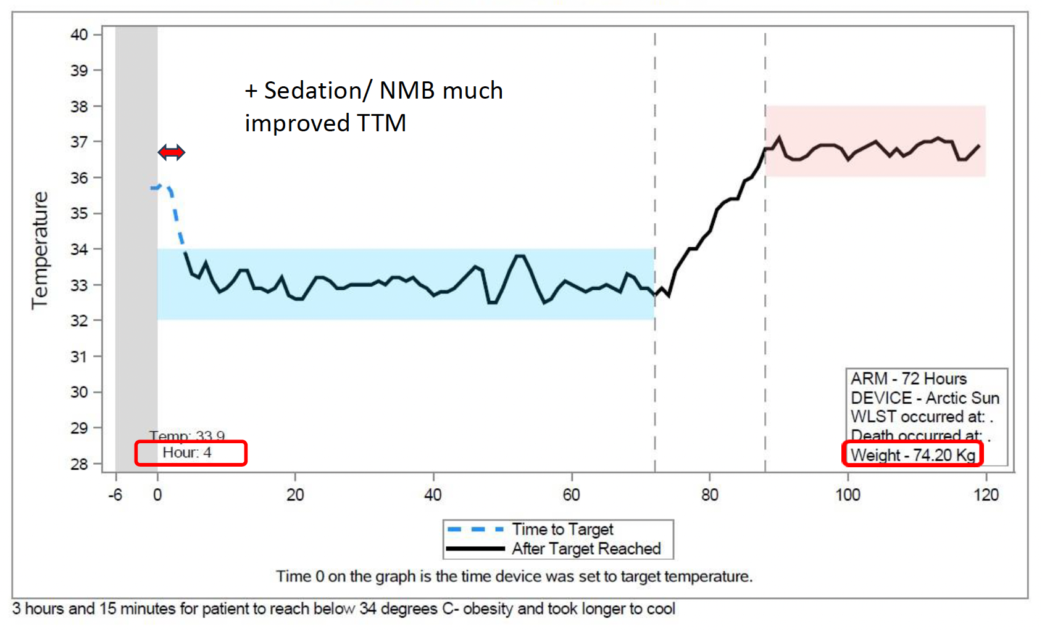
Neuromuscular Blockade Used

Slide 20
Rewarming
Make sure you do the math correctly!
  Have your RC enter the top of the Day 1 temp log to confirm rewarm start
“Anticipated time rewarming starts” on the F503 Daily Temperature Log at the Day 1 visit.
Paralyze during rewarming
Notes:
Completing the top of the day 1 temp log will let you confirm your rewarm start time – RCs know how to do this.

Slide 21
Interfacing with the Clinical Care
Adapt your local procedures where appropriate
  Opportunity to strengthen clinical TTM protocols
Site presentations about local study updates and procedures
Review clinical standardization guidelines with clinical teams
  https://siren.network/trial/p-icecap/clinical-standardization-guidelines/

Slide 22
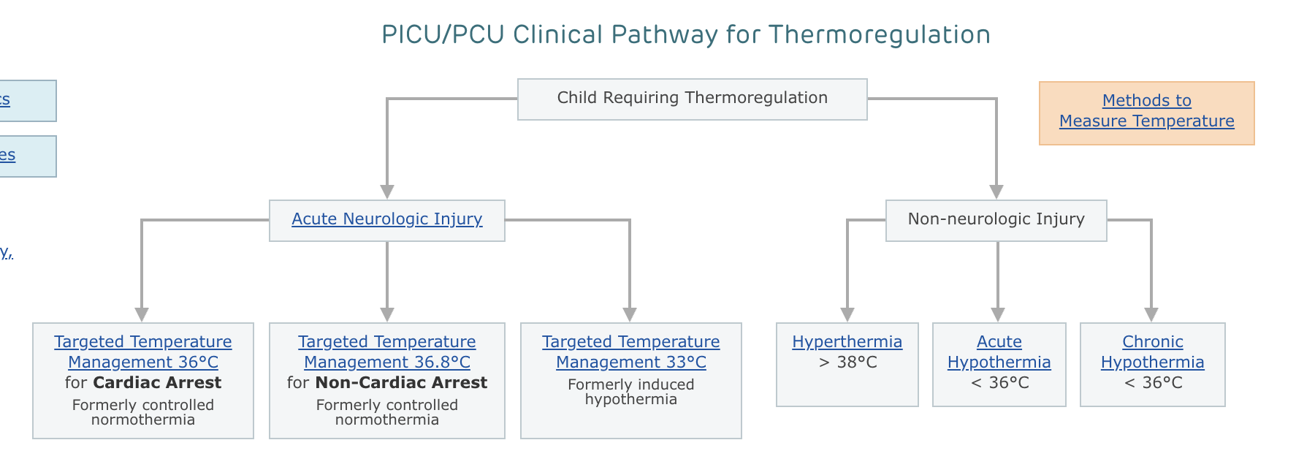
Pathways
https://pathways.chop.edu/clinical-pathway/thermoregulation-picu-pcu-clinical-pathway

Slide 23
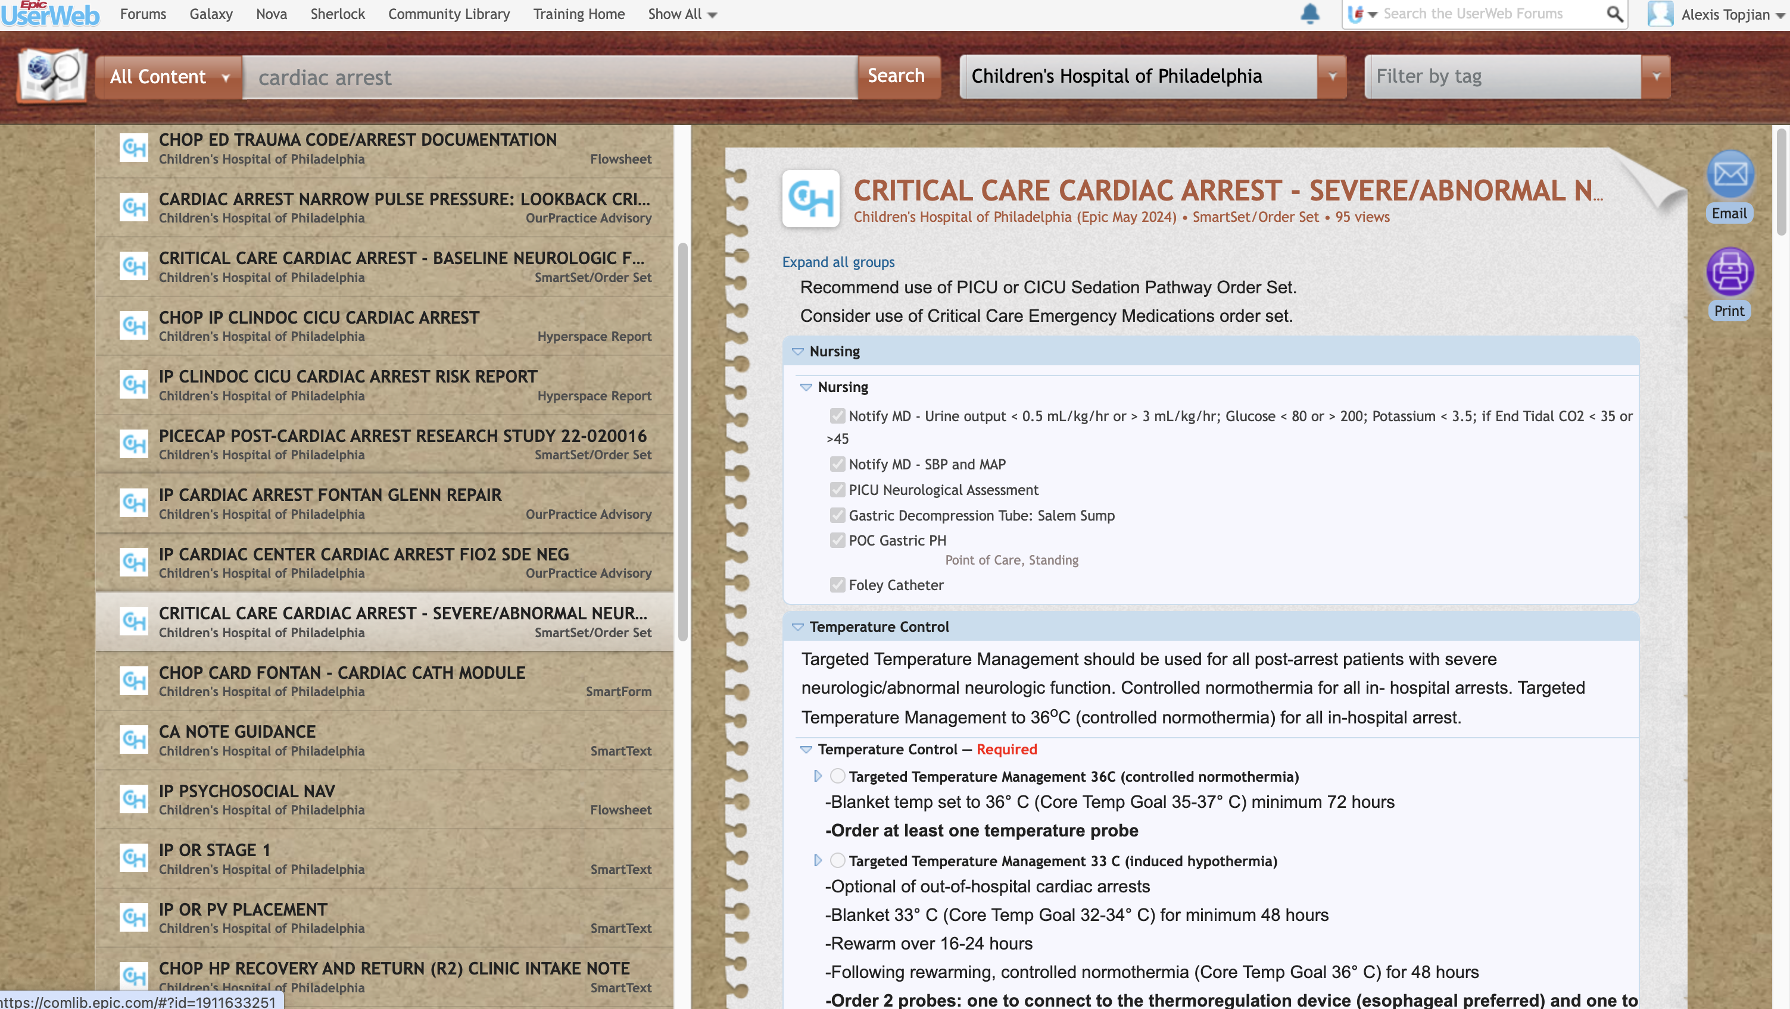
Order Set: Epic UserWeb
https://comlib.epic.com/#?query=cardiac%20arrest&customers=410,&tags=&type=All&pagesize=100&pageindex=0&id=1911785267

Slide 24
Call the Hotline – We Want to Hear From You!
BEFORE
  Eligibility
DURING
  If clinical picture changes
  Clinician deviation from protocol
  Brain death suspected
  Cooling or rewarming difficulties
Notes:
I see lots of comments in WebDCU where I think “wish they would have called the hotline…”

Slide 25
Questions/Discussion

Slide 26
Extra slides

Slide 27
Definitions
Time of cardiac arrest:
  When the child’s arrest starts (Often now known)
  NOT when they are found
Time of initiation of TTM
  When the button on the closed loop cooling device is pushed

Slide 28
Return of Spontaneous Circulation
ROSC is operationally defined as the restoration of a palpable pulse or a measurable blood pressure. If cardiac monitoring is available, ROSC requires an organized cardiac rhythm.
Sustained ROSC is when the patient has achieved ROSC with signs of circulation persisting for at least 20 consecutive minutes.

Slide 29
Sustained ROSC example
CPR from 2:00 to 2:10 pm
ROSC is at 2:10 pm
No additional CPR is provided for next 20 minutes
Time of sustained ROSC is 2:10pm, but you don’t know that until 2:30pm

Slide 30
Temperature Monitoring
Continuous from time of clinical initiation through end of intervention
Core body temperature should be monitored at two core sites
  Esophageal, bladder, rectal
The esophageal probe is the preferred primary probe which will be connected to the surface cooling unit.

Slide 33
Temperature Management
Clinically Used Servo Regulated Device
Rarely ECMO
No intravascular cooling, gastric cooling etc
Can use acetaminophen as an adjunct

Slide 34
Induction of Hypothermia
Decrease in temperature to 33C

Slide 35

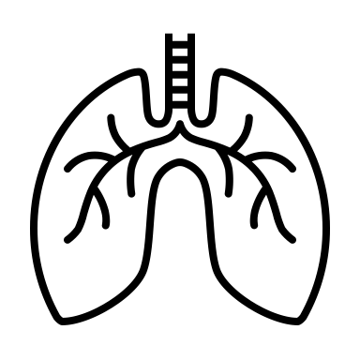



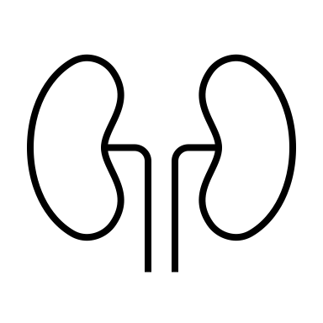

Induction Phase
Cardiac:
↓ Heart Rate
↑ Systemic vascular resistance
↓ Cardiac output
EKG: mildly prolonged PR, wide QRS, increased QT
Endocrine/Metabolic
Hyperglycemia → diuresis
↑ insulin resistance
Target Euglycemia
Insulin infusion
Expect bradycardia
Expect cool extremities
and poor cap refill
Renal:
“Cold diuresis”
↑ venous return, ↑ ANP,
↓ ADH, tubular dysfunction
Electrolyte abnormalities
↓ K
↓ Phos
↓ Mg
Neuromuscular:
Shivering
↑ metabolic demand
Resolves < 34C
Sedate/paralyze
Monitor and replete electrolytes
Replete Fluids
Coagulation:
Mild coagulopathy
Mild ↓ platelet count and function
Other:
Altered drug metabolism
Altered blood gas analysis
Mild increase in amylase, AST/ALT
↑ fat metabolism → ↑ ketones and lactate → ↓ pH
Notes:
Mitigate some of the risks by rapid induction of hypothermia and getting to the maintenance phase quickly
Shivering – increases metabolic demand – can treat with sedatives, resolves under 34C
Decreas insulin sensitivity and decrease insulin amount secreted by pancreas
Hypothermia induced intracellular shift and tubular dysfunction (increased renal excretion of electrolytes) – depletion of magnesium, potassium, and phosphate during cooling --> risk of arrythmias
Cardiac output
Mild hypothermia in euvolemic patient will decrease HR and increase myocardial contractility – systolic function improves but mild degree of diastolic dysfunction may occur. BP usually stable or increases slightly. CO decreases (with HR) but so does metabolic demand (usually meets or exceeds decrease)
DEEP hypothermia: decreases myocardial contractility, risk of arrhythmia and less likely to have successful treatment of arrhythmia (hypothermic myocardium less responsive to antiarrhytjmics and more difficult to defibrillate)
Does her underlying HOCM play into your management at all? If so, how?
Likes to be full…
Hypovolemia (cold diuresis) – increased venous return (peripheral vasoconstriction), activation of atrial natriuretic peptide, decreased ADH and renal ADH receptor levels, and tubular dysfunction
EKG changes: initially sinus tachycardia followed by sinus bradycardia – can also see prolonged PR, increased QT interval, some widening of the QRS
Coagulopathy:
Metabolic rate decreases 50-65% -- decreased O2 consumption and CO2 production
Decreased O2 consumption means theoretical risk during reperfusion because high O2 may increase reperfusion injury
Decreased CO2 production may result in hyperventilation if vent not changed (and therefore cerebral vasoconstriction)
Decreased calorie needs; increased fat metabolism leading to increased glycerol, free fatty acids, ketonic acids, and lactate – can cause mild metabolic acidosis
Decreased insulin secretion (and many patients a moderate and sometimes severe insulin resistance) – important to remember during rewarming
Decreases coagulation activation and formation of microthrombi
Improves tolerance for ischemia
Suppress epileptic activity
At what point do you care about HR?

Slide 36
Induction Phase
Severe Complications
Usually T < 30 °C
Cardiac:
Arrhythmia (VT)
Coagulation:
Bleeding
Other:
Infection

Slide 37
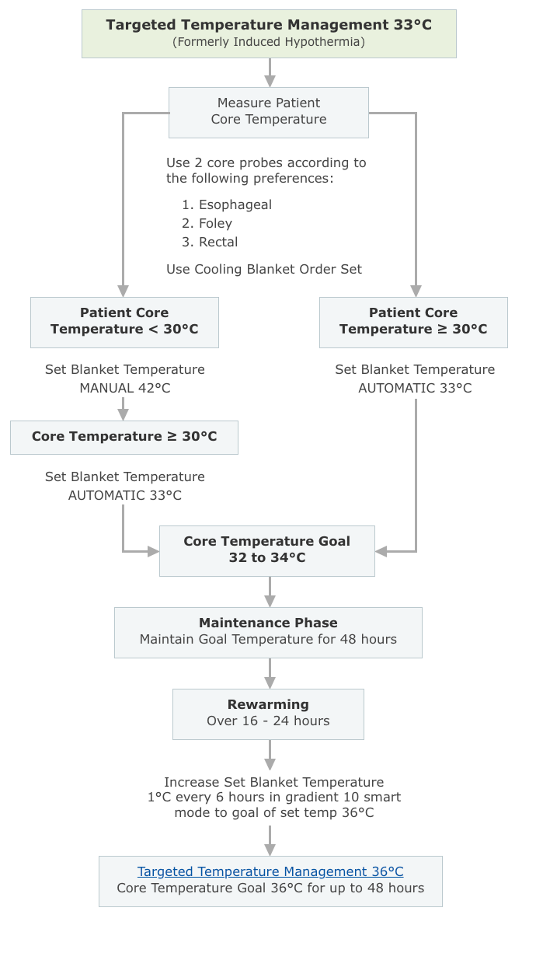
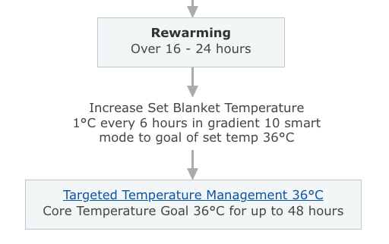
Blanketroll: Targeted Temperature Management
for Hypothermia or Normothermia
Notes:
What is the gradient 10 smart mode? Measure’s patient’s temperature and will create a maximum of 10C difference between the patient’s temperature and the current water temperature
Of note, never use gradient 10 WITHOUT using smart mode

Slide 38
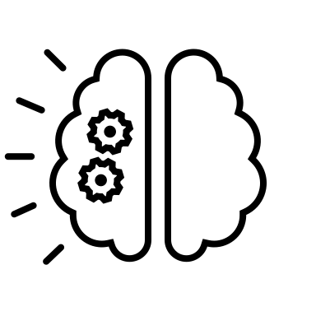
Rewarming Phase
Does her underlying hypertrophic cardiomyopathy change how you would manage her in this phase?
Rewarm 0.1-0.5/1°C every 6 hours
Cardiac:
Vasodilation
Hypotension
Tachycardia
Neuro:
Seizures
Give volume
Endocrine:
Increased insulin sensitivity
Renal:
Electrolyte abnormalities
↑ K
Risk of hypoglycemia
Hyperkalemia worse with
rapid rewarming

