Slide 1

Key Strategies and Lessons Learned for Maximizing Follow-Up
Beth Slomine, PhD, ABPP

Slide 2

Agenda
Review of outcome measures
  Baseline (pre-CA)
  Hospital discharge
  3- and 12-month interviews
  Neurological Examination
Key strategies for sites to maximize outcomes success
Questions and lessons learned

Slide 3
Baseline (pre-CA) and Acute Measures of Functioning
Baseline (BEFORE CA)
PedsQL
Family and Household Information
PCPC/POPC
Hospital Discharge or 30 days (whichever comes first)
PCPC/POPC

Slide 4

Key Strategies and Lessons Learned
This is not a comprehensive overview of baseline/early outcomes measures
These slides focus on your role in obtaining outcomes AFTER discharge
Some things not reviewed today:
  Identifying and supporting respondents
  Family and Household Information Form
  Baseline and 30-day PCPC/POPC
For greater detail see MoP and past Investigator Meeting Recordings/Slides

Slide 5


Obtaining Outcomes is Critical for Trial Success
To determine optimal cooling duration in survivors, caregiver-interviews conducted by phone must be obtained at 3 and 12 months after OHCA
VABS-3 at 3-months is used for adaptive allocation
VABS-3 Mortality Composite at 12 months is the primary outcome
Without 3- AND 12-month telephone interview, we will not be able to determine efficacy of intervention.

Slide 6





VABS-3 – What it is and why we use it
Adaptive Behavior Composite
  Communication
  Daily Living Skills
  Socialization
  Motor Skills
Must be conducted by TELEPHONE interview
The VABS-3 usually takes 30 to 60 minutes

Slide 7
THAPCA-OH cohort 1-year post-arrest
Slomine et al., Pediatrics, 2016
Level of Adaptive Functioning (VABS-II) | % | Brief example of functional skills
No Disability >85, n =32 | 37% | Age-appropriate functioning, attending school without supports
Mild to Moderate Disability <84 – 50, n=25 | 30% | Daily activities below peers in one or more areas, requires assistance at school and possibly around the home
Severe Disability <50, n-28 | 33% | Daily activities well below peers across areas, requires significant assistance and home and school
85 survivors with broadly average pre-CA functioning

Slide 8

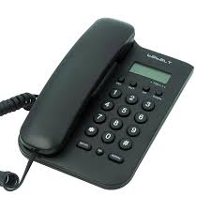
Kennedy Krieger Outcomes Center
Centralized, telephone outcomes from Baltimore, Maryland (except for AU/NZ)
Our goal is to make telephone outcomes collection as easy as possible for caregivers and sites
What we need from you:
  Connect us with caregivers of surviving participants
  Help us when we have trouble connecting
  Respond PROMPTLY to our emails and calls
  PICECAP@kennedykrieger.org

Slide 9
Onsite Neurological Examination
If you have not already done so, NOW is the time to identify at least one neurologist at your site
Make sure you understand the process for scheduling at your hospital and how early you need to reach out for an appointment with your study neurologist
Make sure your neurologist knows what is needed during the visit (Age-appropriate PRCA form, <3 or >3 years)
Neurological examination must be completed AFTER the 12-Month telephone interview

Slide 10
How are we doing so far?
3-month follow-up ~90%
12-month follow-up ~85%
Onsite neurological examination ~67%
  These numbers do not include known deaths or participants who withdrawal before follow-up

Slide 11

Advantages of Interview and Neurological Examination
VABS-3 (Telephone Caregiver-Interview)
Primary outcome
Collected centrally
Low caregiver and site burden
PRCA (Neurological examination)
Direct measure of child functioning
Obtained by trained clinician
Needed to validate interview data

Slide 12
Around Enrollment
Complete Baseline (pre-CA) PedsQL
  <72 hours of enrollment
  Read questions to caregiver or sit with caregiver
  Review PedsQL before uploading to secure Dropbox for KKI
      Every question is answered
      Only one response is circled for each question
Build rapport
Building rapport with family improves communication around follow-up
Collect MULTIPLE contacts on the Participant Contact Information Form

Slide 13
Before Hospital Discharge or Prior to 2-month Post CA
RC/PI check-in - Remind them about the study and thank caregiver for participating
Remind caregiver of follow-up timepoints
~ 2 mo post CA to set up 3-month interview with KKI
~ 6-9 mo post CA to schedule onsite neurological exam (end of 12-month window)
~ 11 mo post CA to coordinate 12-month interview with KKI
Confirm contact information on the Participant Contact Information Form
Obtain/Confirm MULTIPLE Contacts
Provide KKI Contact information –
Phone calls will come from 443-923-2999
Text from 443-961-5332
May want to program contact into caregiver’s phone
Different numbers for Spanish speaking families and those from AU/NZ

Slide 14

At 2 months after CA
Reach out to family to confirm child’s vital status and arrange time/date or best times to reach caregiver for 3-mo KKI call
Use the contact tracking log from the beginning
If having difficulty, reach out to KKI early at picecap@kennedykrieger.org
When you connect, remind caregiver that 12-month interview and onsite neuro exam are the next steps following the 3-month interview
Update contact form and upload to secure Dropbox for KKI - Include any information about the caregiver’s availability and notable social information/stressors

Slide 15

At 6-9 months after CA
12-month neurological examination is the last study point and the only onsite follow up
Coordinate with caregiver and your study neurologist to schedule an appointment 3-6 weeks AFTER the 12-month post-CA date
If your neurologist’s appointments fill quickly, reach out on the sooner end
Remind caregiver that you will reach out at the 11 month point prior to the 12-month interview

Slide 16

At 11 months after CA
Reach out to family to confirm child’s vital status and arrange time/date or best times to reach caregiver for 12-mo KKI call.
Use the contact tracking log
Reach out to KKI early at picecap@kennedykrieger.org
When you connect, remind caregiver of the date for the onsite neuro exam which is the last step of the study following the 12-month interview
Update contact form and upload to secure Dropbox for KKI - Include any information about the caregiver’s availability and notable social information/stressors

Slide 17
Best Practices and Tips for Connecting with Caregivers
Connect with the family before discharge
Remember most caregivers want to participate in the follow-up assessments
Remember most caregivers are busy
Just because a family is difficult to reach, or child has an unfavorable outcome does NOT mean they are not interested in participating in the follow-up assessments
Expect to need to try caregivers at different days/times using various modes of communication
Text whenever possible, may need to call nights/weekends
Remember KKI can help - Connect with KKI early for helpful suggestions

Slide 18
When you reach the caregiver
Identify best time/date for interview
Identify anything that might interfere with call (e.g., vacation, surgery)
Provide reminders about remaining follow up time points
Re-share KKI contact information

Slide 19

Reminders about the Timing
We have a window of one month to complete each interview
3-month interview (+/- 2 weeks)
12-month interview (+/- 2 weeks)
Use the window calculator (SIREN > Workbench > Resources > 3 and 12 month Post CA Window Calculator) if you are not sure when to start reaching out to the caregiver - https://siren.network/wp-content/uploads/2025/02/3_and_12_month_post_ca_window_calculator_mw_edits.xlsx
Schedule the neuro exam for after 12-month window (3 to 6 weeks after 12-month date which is 1 to 4 weeks after the 12-month time point)

Slide 20
What do I do if I can’t reach a caregiver?
Check medical records for updated contact information
Check social work notes for context about the child’s living situation
Check for upcoming appointments and meet family at appointment
Have the PI or Sub-I reach out
Try different days of the week/times/methods
Reach out to all contacts on contact form
Reach out to KKI early for suggestions
Send contact log for KKI analysis
Attend Moni’s office hours

Slide 21
What if KKI can’t reach the family?
Respond to KKI’s request for assistance
KKI may ask you to:
Check the medical record for updated contact information
Check social work notes for updated context about the child’s living situation
Check for upcoming appointments and meet family at appointment
Have the PI or Sub-I reach out
Consider offering compensation for time spent

Slide 22
Compensation for Interview Time is Permissible
Compensation is not budgeted into 12-month interview, but sites can choose to use some funds received for completed interviews to provide compensation for time spent if barrier to participation is time spent
Appropriate reimbursement amounts may vary by trial, type of visit, participant factors, and location of enrollment site.
Payments will be capped at the US General Services Administration standard Per Diem Rates for current year/city in which the study visit takes place https://www.gsa.gov/travel/plan-book/per-diem-rates
Timing of reimbursement for clinical trial visits should be proximate to clinical trial visit.
Used successfully for some interviews

Slide 23
What do we do if a child lives in a facility and the family is not very involved?
May complete the interview with caregiver who knows the child well (e.g., nurse)
Connect KKI with contact at the facility
Will need buy-in from facility director/nursing leadership
May need PI support (PI call the facility and explain the study)
The neurological examination may need to coordinated with a hospital visit

Slide 24
What if I know a participant is neurologically devastated?
Don’t assume that the outcome assessment will be uncomfortable or that the caregiver won’t be interested
Most caregivers want to talk about their child
The interview will be short (15-30 minutes)
Questions are modified to focus on what the child does without focusing on the child’s limitations
Every effort should be made to try to schedule the neurological examination

Slide 25
What if a participant and family move to another state?
Update contact information. Interviews can be completed in any state/country
Check in with Moni about the onsite neurological examination
  Child may be able to participate in the neuro exam at another P-ICECAP site

Slide 26
What if I have a participant who moves into foster care?
Let KKI and Moni know early
Determine who is the LAR and who has rights to make decisions for research
If in state custody, check state laws
P-ICECAP leadership can help provide guidance
We have had at least three children in foster care during follow-up

Slide 27
What if a higher functioning participant turns 18 during the follow up period?
Caregiver can still participate in interview
There is no self-report interview for adult participants
Consent would need to be obtained from the participant prior to the onsite neurological exam

Slide 28
What if a participant is hospitalized in a psych ward or incarerated during the follow up window?
It depends – reach out to KKI for guidance
VABS-3 items are based on what an individual can do freely in their environment
If able to complete daily activities, but restricted from age-appropriate activities, VABS-3 may not be valid

Slide 29



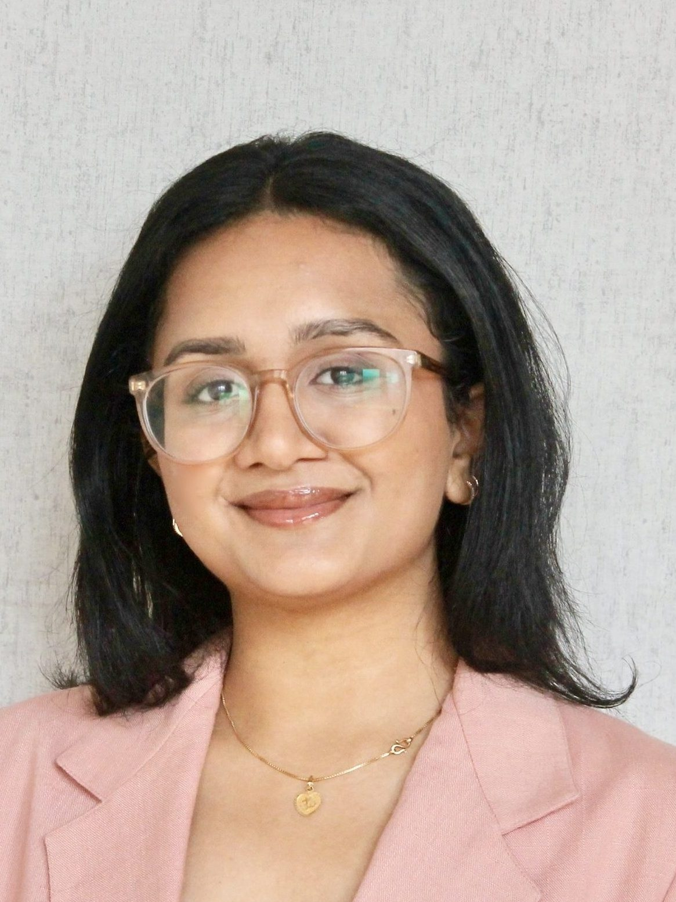
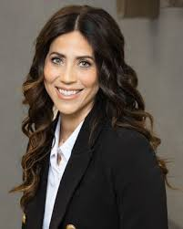
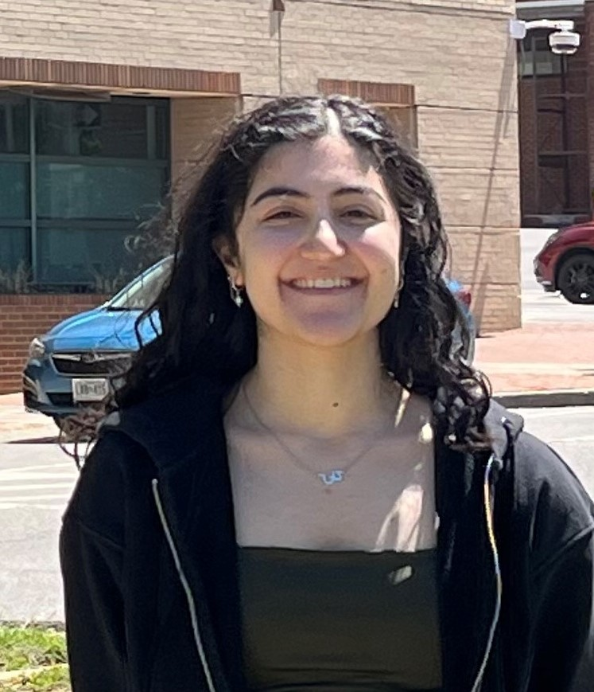
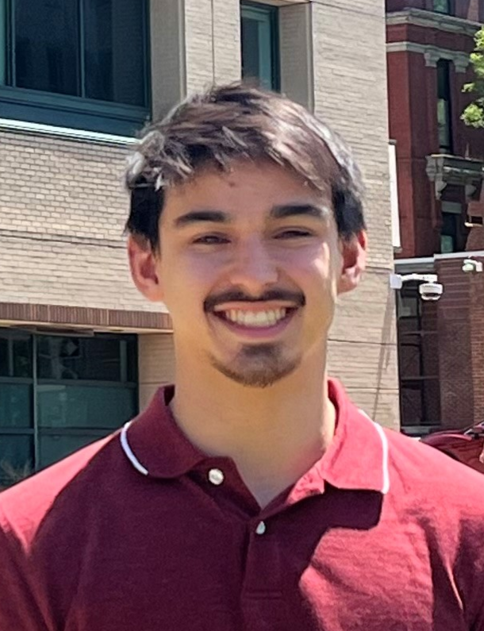
Thank you for your attention!
Questions??

Slide 30
Thank you to the amazing site coordinators, sub-Is, and PIs!

