Slide 1
Educational Spotlight:
Adverse Event Reporting

Slide 2
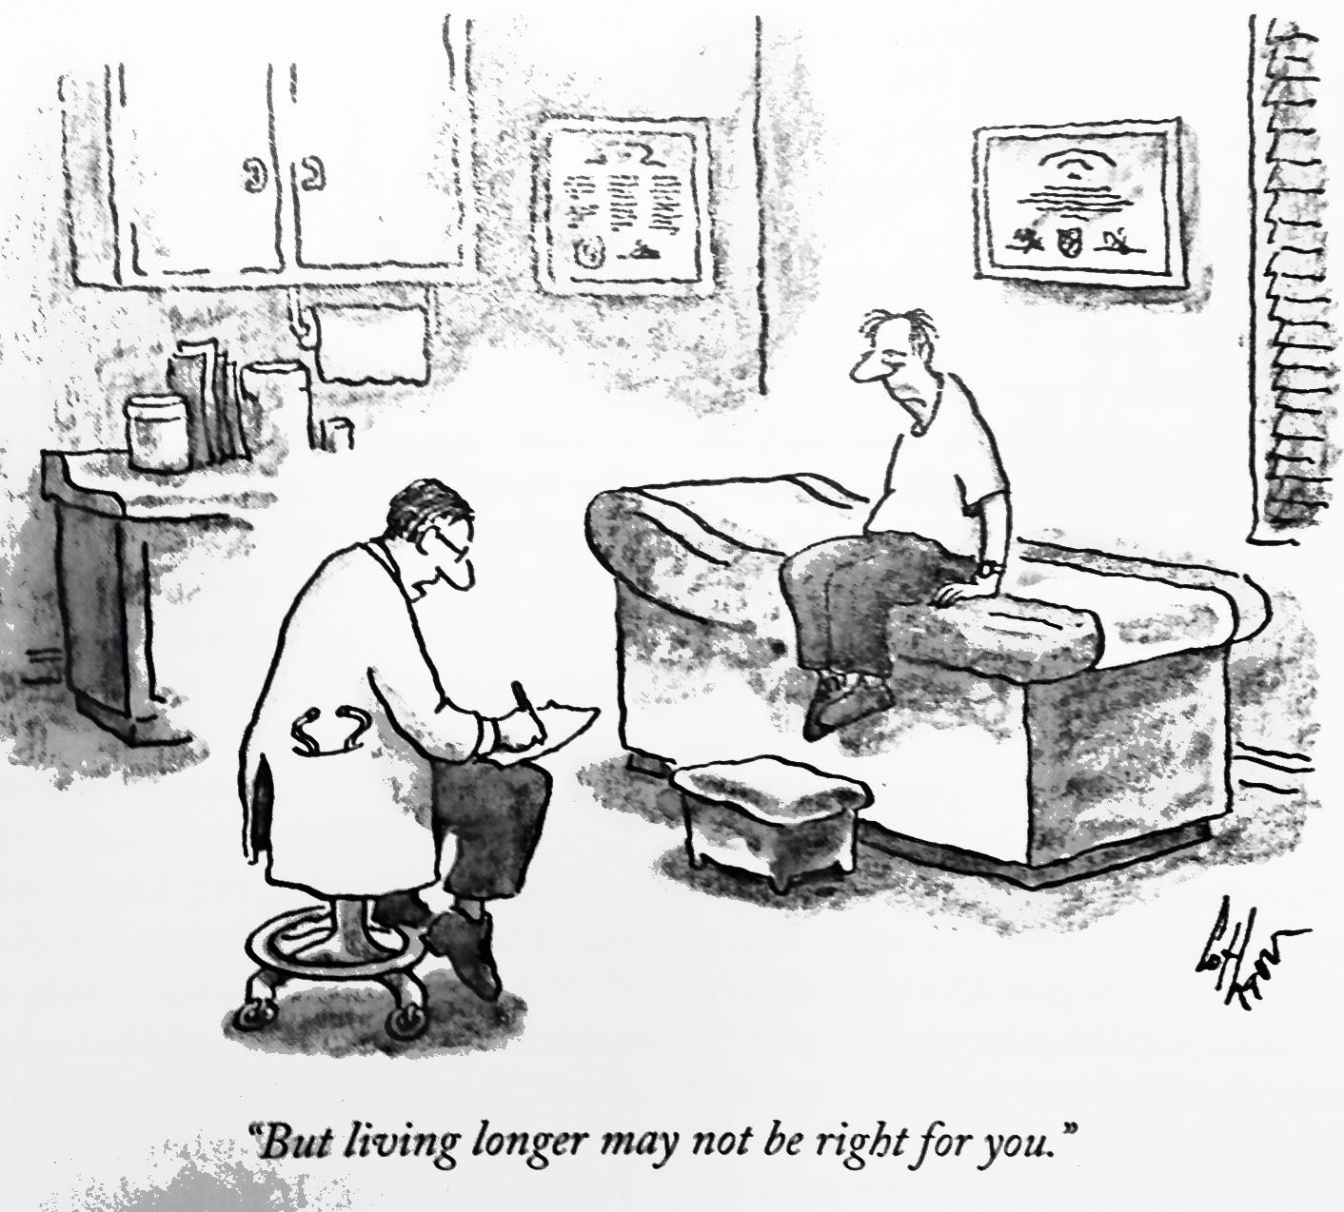

Slide 3
Adverse Events – key points
Do not report events EXISTING PRIOR to randomization
(unless there is a change in severity)
Report the DIAGNOSIS, not the symptoms:
Fever, cough, chest pain, crackles = pneumonia
Report the PATHOLOGY, not the outcome or treatment
Not ‘death’ but the event that caused death
CD
Notes:
3

Slide 4
Relatedness Relatedness algorithm
Not Related
The timing is wrong and there was clearly another cause
Unlikely (both of the following, but timing doesn’t matter)
Another cause is possible
Not something the intervention is known to cause
Reasonable Possibly (2 of 3)
Timing is suggestive.
Not readily caused by something else
This is something the intervention is known to cause.
Definitely (must have all 3)
Timing suggests intervention caused the problem.
No other possible cause.
This is something the intervention is known to cause.
RS

Slide 5
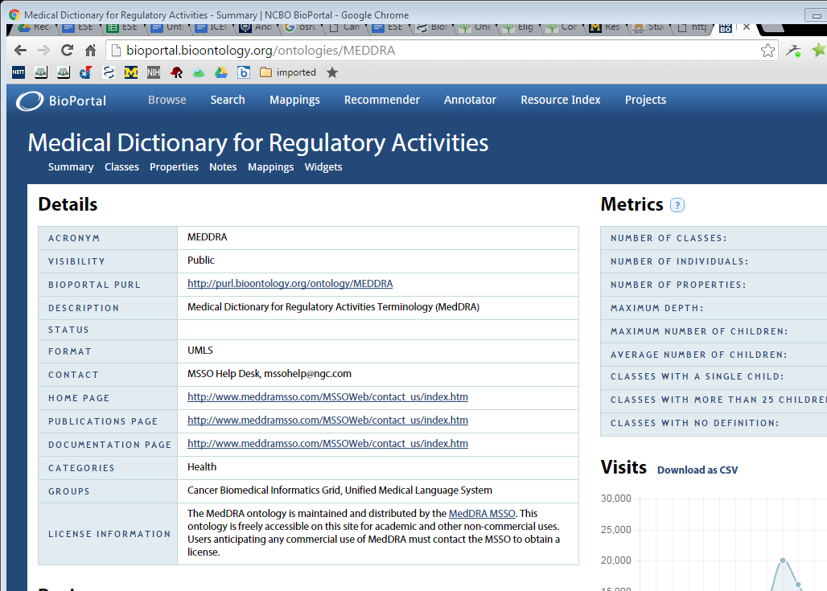
http://bioportal.bioontology.org/ontologies/MEDDRA

Slide 6
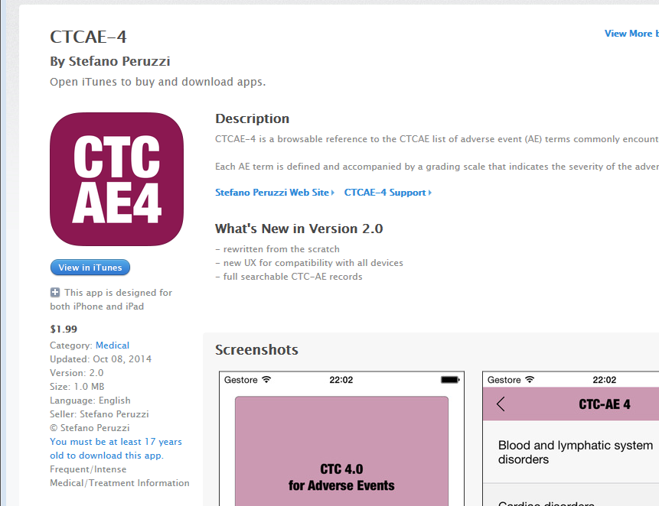
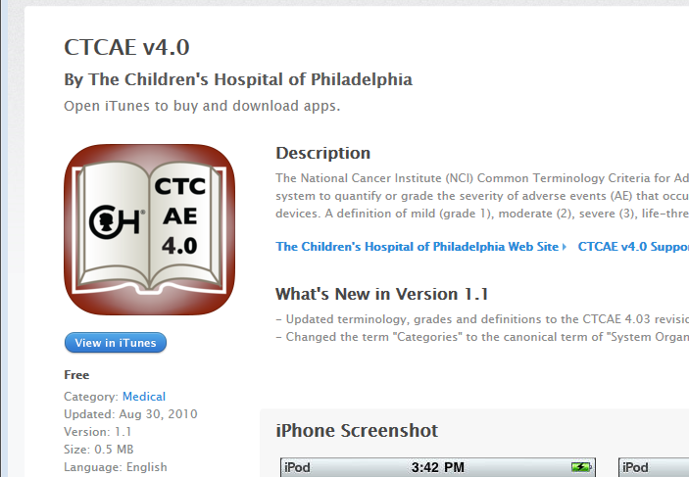

Slide 7
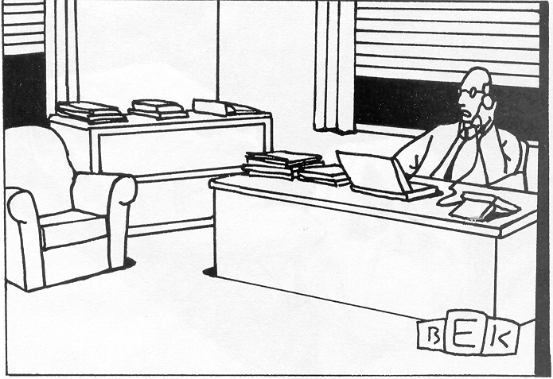
“I just have to create a few loose ends for other people
to clear up, and then I can out of here.”
Notes:
Why you have to turn in SAE’s early. A lot of other people need to look at them and the clock is running

Slide 8
Write good SAE narratives
Be concise but complete (not comprehensive)
Include only the pertinent PMH and HPI
Describe the event
Describe the response
Describe the outcome
And say when each of those happened
Look for and respond to queries promptly
Notes:
It is important for us here at the CCC and for all your site co-investigators.

Slide 9
Sample narrative
A 83 year old female with a history of epilepsy was found seizing and was appropriately enrolled at 18:05 on 3/10/09. In the ED at 20:22 she was awake and conversant. At 21:10 she had another generalized seizure and was treated with lorazepam 2 mg IV with termination of her seizure at 21:14. Her phenytoin level subsequently was reported to be 5 . At 21:25 she was given phenytoin 1 g IV. At admission at 22:50 she was again awake and conversant.

Slide 10
Sample narrative
A 83 year old female with a history of epilepsy was found seizing and was appropriately enrolled at 18:05 on 3/10/09. No respiratory distress or hypoxia was noted in the ED. Pulse ox 97% at 22:00 before admission. On 3/11/09 at 16:00, she was noted to be short of breath with a pulse ox of 88% on room air. At 16:15 supplemental oxygen was administered at 4 LPM and pulse ox was 93%. Chest x-ray at 17:11 showed RLL infiltrate suggestive of aspiration. Respiratory distress increased and at 23:20 she was transferred to the ICU and endotracheally intubated.

Slide 11
Narrative template respiratory depression
A [age] year old [male/female] was found seizing on [date] at [time] and was enrolled in ESETT. The patient [stopped/did not stop] seizing after study drug administration. The patient subsequently underwent endotracheal intubation for respiratory depression [in the ED/on the ward/in the ICU] at [time]. The patient [was/was not] still thought to be seizing at the time of intubation.
[The patient was subsequently extubated on [date].]
[The patient remained intubated as of [date] because of [suspected etiology].]
RS

Slide 12
Narrative template completed
Respiratory Depression
A 38 year old male with a history of seizures, was found seizing and was enrolled in ESETT at approximately 20:45 on 9/1/2009. The patient did stop convulsing after study drug administration. He subsequently underwent endotracheal intubation for respiratory depression in the ED at 21:20. The patient was not thought to be seizing at the time of intubation, but was felt to have respiratory depression from the combination of alcohol intoxication, and benzodiazepines. The patient was treated with propofol and admitted to the ICU. The patient was subsequently extubated on 9/2/2009.
RS

