Slide 1
ESETT Investigators meeting

Slide 2
Flow Diagram
400 patients were randomized
16 excluded from the intention-to-treat population for repeat enrollment
5 received levetiracetam
7 received fosphenytoin
4 received valproate
384 unique subjects
145 levetiracetam
118 fosphenytoin
121 valproate
36 excluded from the per protocol analysis
34 had eligibility violations
2 received <80% of infusion
39 excluded from the per protocol analysis
39 had eligibility violations
2 received <80% of infusion (and had eligibility violations)
30 excluded from the per protocol analysis
29 had eligibility violations
2 received <80% of infusion (1 had eligibility violations)
145 included in ITT analysis
109 included in the per protocol analysis
150 included in safety analysis
118 included in ITT analysis
79 included in the per protocol analysis
125 included in safety analysis
121 included in ITT analysis
91 included in the per protocol analysis
125 included in safety analysis
Notes:
The intention-to-treat (ITT) analysis includes all unique participants but does not include repeat enrollments of the same participant. The per-protocol analysis excludes repeat enrollments, enrollments with eligibility deviations, and enrollments in which participants did not receive the assigned drug dose. The safety analysis includes all enrollments.

Slide 3
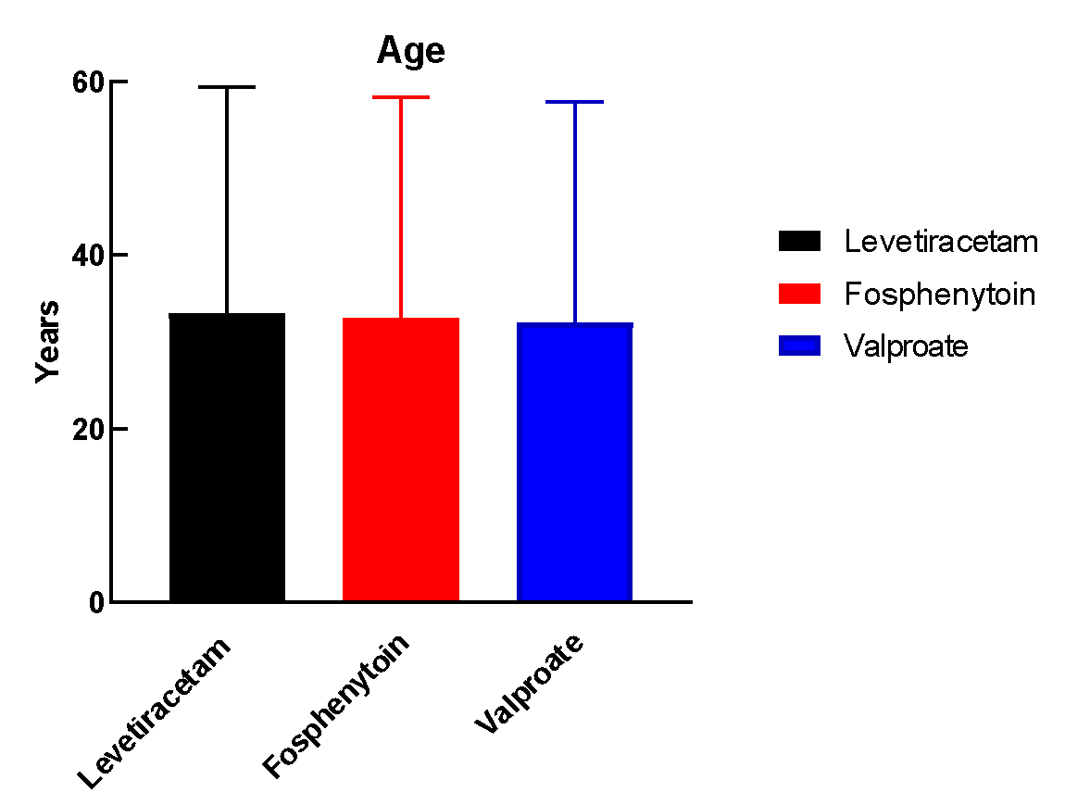
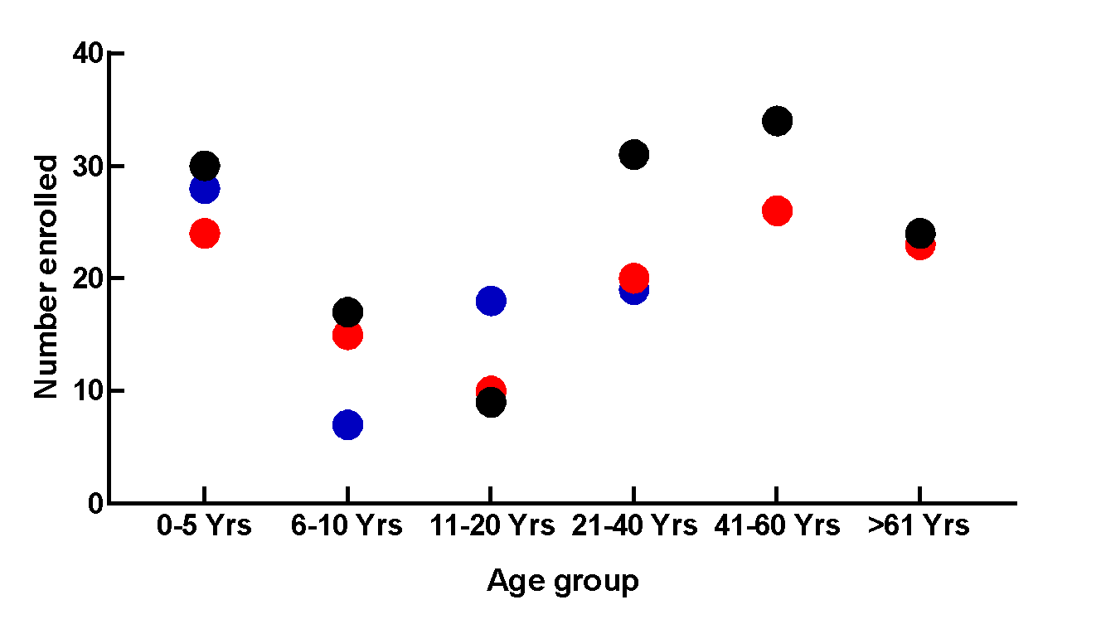

Slide 4
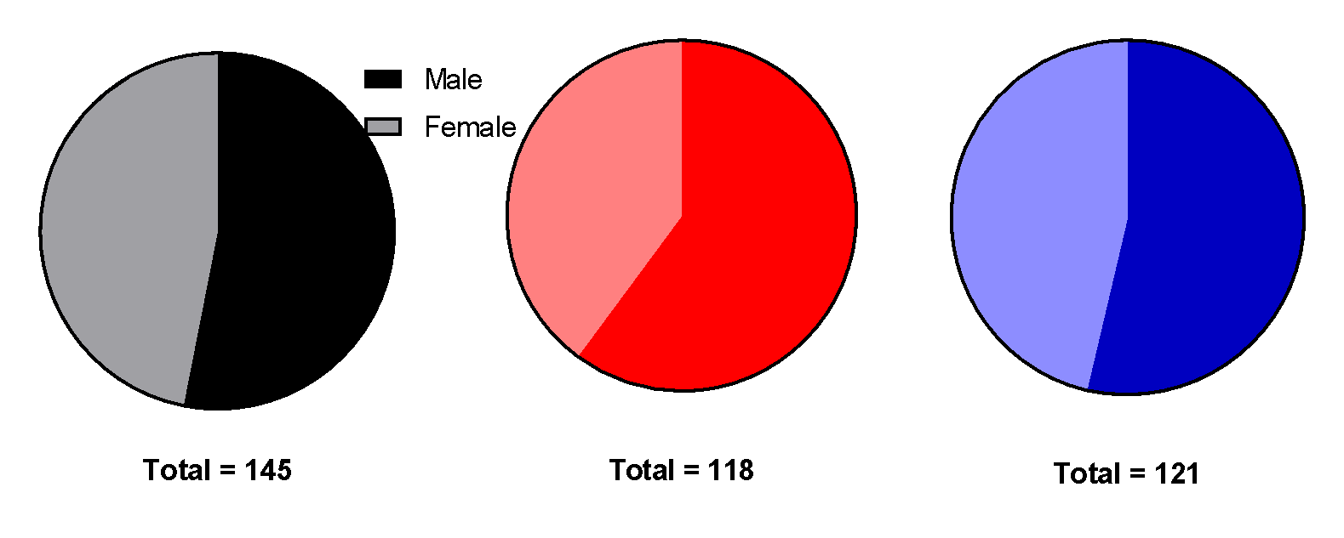
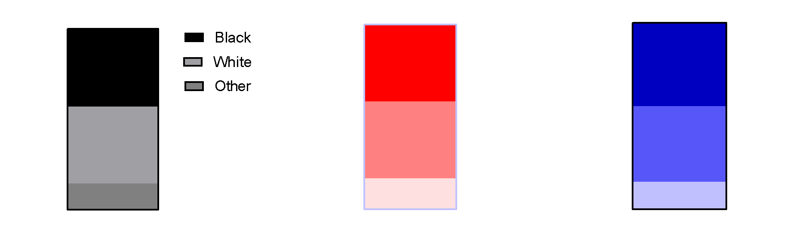
Levetiracetam
Fosphenytoin
Valproate

Slide 5
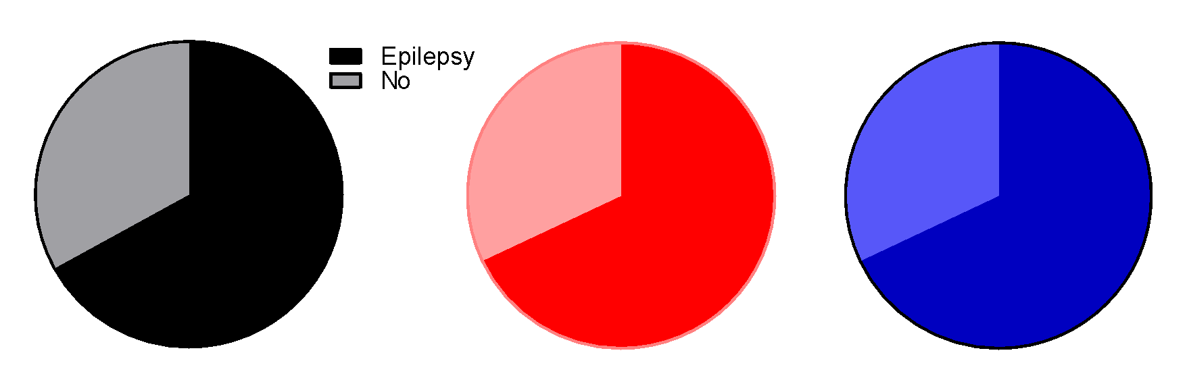
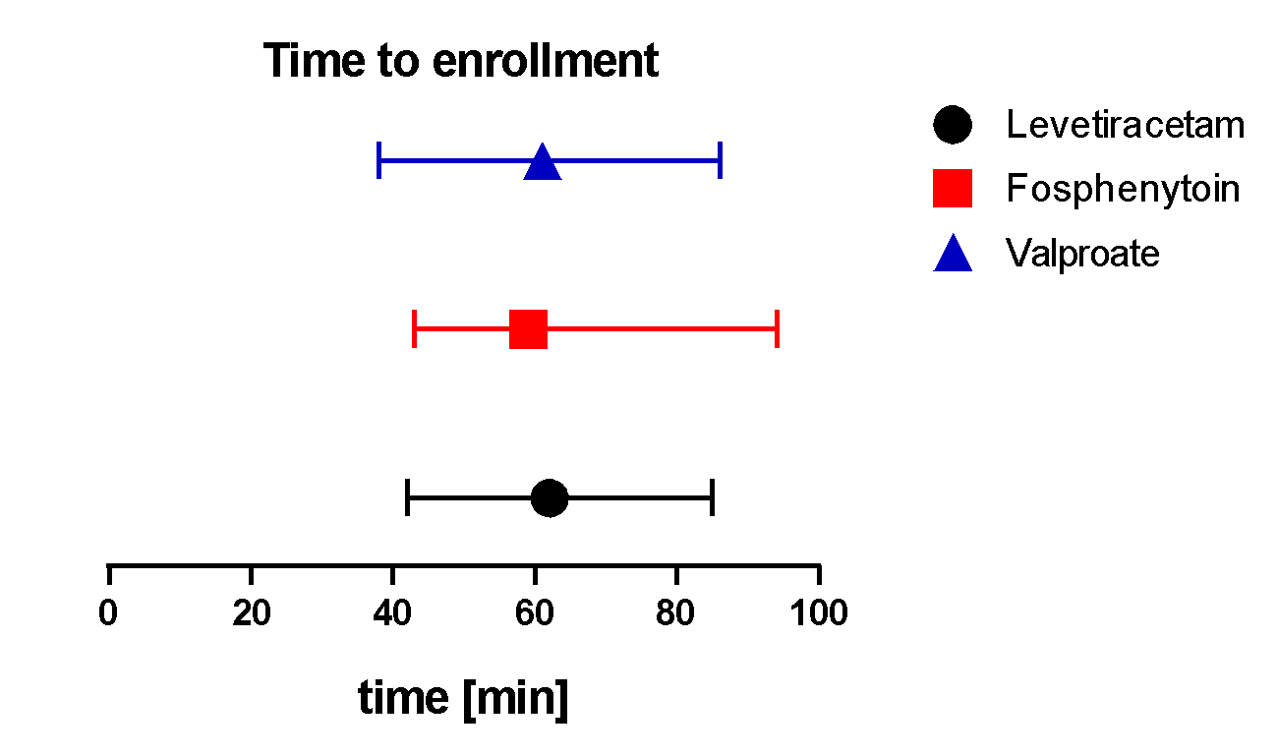

Slide 6
Primary Objective:
Which treatment is best?
Or, if there is no single best treatment, is there a worst treatment?
A Bayesian approach was used to estimate the probability that each treatment is the best or worst.
Prior to observing study data all three treatments were considered to be equally likely to be the most effective or least effective treatment.
Notes:
The prior used in ESETT was equivalent to 2 subject’s worth of data, 1 a treatment success and the other a treatment failure.

Slide 7
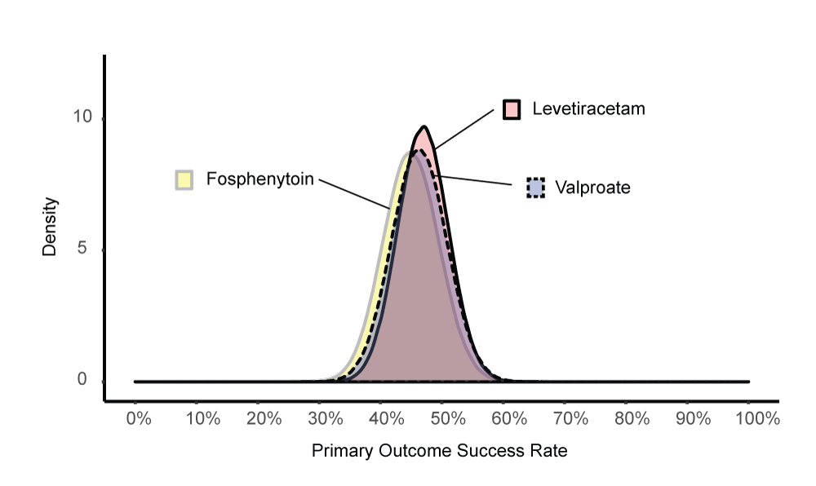
 | LEV | FOS | VPA
Success Rate [95% credible intervals] | 47% [39%, 55%] | 45% [36%, 54%] | 46% [38%, 55%]
Probability treatment is the best/ worst | 0.41 / 0.24 | 0.24 / 0.45 | 0.35 / 0.31
Notes:
Posterior Probabilities of Success by Treatment Group for the Primary Outcome of Cessation of Status Epilepticus at 1 hour This figure illustrates the relative posterior probabilities of treatment success on the primary outcome for each treatment assignment and reinforces the similarity of outcomes for all three drugs.
While the probability of being the best treatment can be interpreted directly, no claim should be made about a treatment being the best unless the probability exceeds 0.975, in order to avoid making a type I error.
All treatments had probabilities less than 0.975, and so the conclusion was that neither a best, nor a worst, treatment could be identified.

Slide 8
Decision Rule was that the probability 0.975 to make a claim that one drug was the best or worst.
All treatments had probabilities less than 0.975, and so the conclusion was that neither a best, nor a worst, treatment could be identified.
The rates of cessation of seizures at one hour was not different between levetiracetam, fosphenytoin, and valproate, each of which stopped seizures in approximately half of patients.

Slide 9
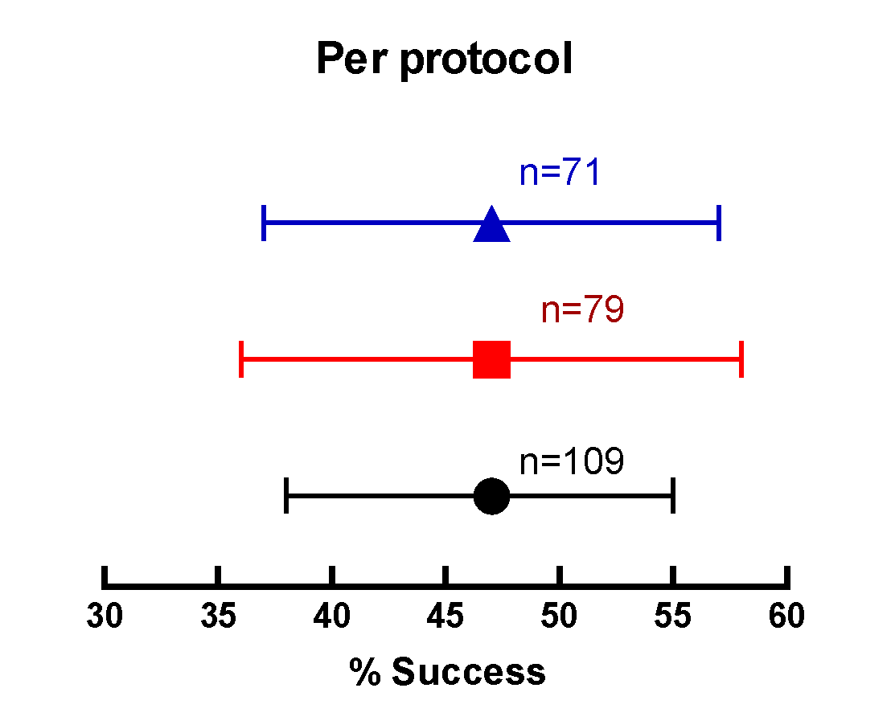
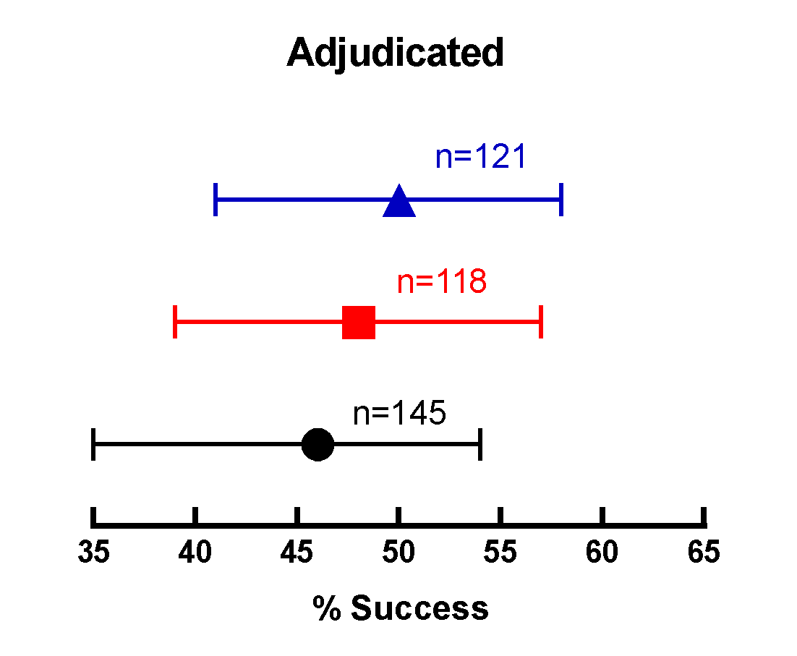
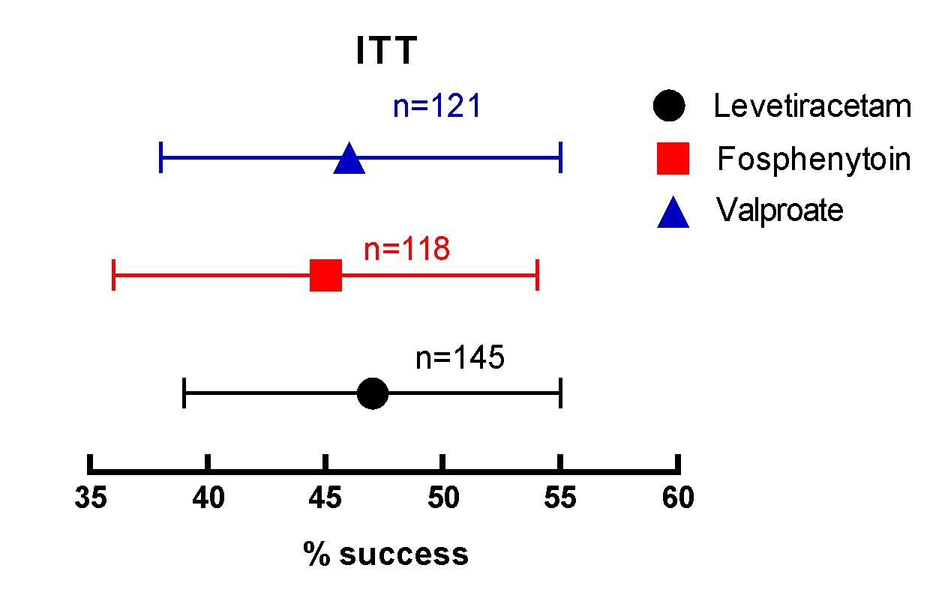

Slide 10
No statistically significant differences detected for secondary efficacy outcomes
 | Levetiracetam N=145 | Fosphenytoin N=118 | Valproate N=121
Admission to intensive care unit | 60% | 60% | 59%
Length of ICU stay, days, median (IQR) | 1 (0 - 3) | 1 (0 - 3) | 1 (0 - 3)
Length of hospital stay, days, median (IQR) | 3 (1 - 7) | 3 (1 - 6) | 3 (2 - 6)
Time to seizure cessation
Patients with success on primary outcome | N=68 | N=53 | N=55
Minutes, median (IQR) n = number with audio recording | 11 (6 - 16) n = 14 | 12 (8 - 21) n = 15 | 7 (5 - 15) n = 10
Seizure cessation within 20 minutes | 78% | 81% | 78%

Slide 11
No statistically significant differences detected for safety
Safety | Levetiracetam N=150 | Fosphenytoin N=125 | Valproate N=125
Life-threatening hypotension within 60 min of start of study drug infusion | <1% | 3% | 2%
Life-threatening cardiac arrhythmia within 60 min | <1% | 0% | 0%
Endotracheal intubation within 60 min | 20% | 26% | 17%
Acute seizure recurrence 1 - 12 hrs | 11% | 11% | 11%
Acute anaphylaxis | 0% | 0% | 0%
Acute respiratory depression | 8% | 13% | 8%
Hepatic transaminase or ammonia elevations | <1% | 0% | <1%
Purple glove syndrome | 0% | 0% | 0%
Death | 5% | 2% | 2%

