Slide 1

Established Status Epilepticus Treatment Trial (ESETT)
A multicenter, randomized, blinded, comparative effectiveness study of fosphenytoin, valproic acid, or levetiracetam in the emergency department treatment of patients with benzodiazepine-refractory status epilepticus.
ESETT Virtual Investigator Meetings
November 26, 10:00 a.m. – 12:00 p.m.
November 27, 2:00 – 4:00 p.m.
866-842-5779 / Code: 395 061 7438

Slide 2
ESETT Virtual Investigator Meeting
Agenda November 26 and 27
Start | End | Item | Presenter
 |  | Monday, November 26, 10:00-12:00
10:00 AM | 10:05 AM | Welcome
10:05 AM | 11:05 AM | Protocol Adherence | Dr. Kapur, Dr. Chamberlain, Dr. Silbergleit
11:05 AM | 11:25 AM | PK/PD Training | Lisa Coles
11:25 AM | 11:40 AM | Screening Best Practices | Ima Samba (CHOP), Maha Khalil (Texas Children's)
11:40 AM | 12:00 PM | Ongoing Training of Clinical Staff and Study Team | Joy Black, Lindsey Harris
 |  | Tuesday November 27, 2:00-4:00
2:00 PM | 2:05 PM | Welcome
2:05 PM | 3:05 PM | Protocol Adherence | Dr. Kapur, Dr. Chamberlain, Dr. Silbergleit
3:05 PM | 3:25 PM | PK/PD Training | Lisa Coles
3:25 PM | 3:40 PM | Screening Best Practices | Ima Samba (CHOP), Maha Khalil (Texas Children's)
3:40 PM | 4:00 PM | Ongoing Training of Clinical Staff and Study Team | Joy Black, Lindsey Harris

Slide 3
Synopsis
150,000 Episodes of Status Epilepticus
30% continue to seizure after benzodiazepines
Best second line agents unknown
Three agents are commonly used
  Fosphenytoin (FOS) 20 mg/Kg
  Levetiracetam (LEV) 40 mg/Kg
  Valproic acid (VPA) 60 mg/Kg
Notes:
ESETT is designed to address this problem. What is the best treatment for the 30% of patients with out-of-hospital status epilepticus with benzodiazepine refractory status, which we term established status.
Three agents are commonly used clinically to treat established status, fosphenytoin, valproate, and levetiracetam, and worldwide these are each used about a third of the time. Of these, only fosphenytoin is labeled by FDA for this indication and even that is only labeled for adults. There are no high quality data to inform which drug works best, or really if any of them work at all to terminate status.
We are enrolling adults and children greater than 2 years of age. Patients need to have failed adequate doses of benzodiazepines with a last dose at least 5 and no more than 30 minutes prior to enrollment.

Slide 4
Goal
To determine the most effective or the least effective agent among three most commonly used drugs.
Determine rate of safety events: life-threatening hypotension or cardiac arrhythmia.
Other secondary outcomes

Slide 5
Inclusion Criteria
Inclusion criteria | Measure
Patient witnessed to have a seizure in the past 5-30 minutes. | Time of first seizure is when EMS personnel were called if eyewitness account available or first seizure witnessed by EMS personnel.
Patient received adequate dose of benzodiazepines in the past 5-30 minutes. The doses may be divided. Time is counted from the last dose. | EMS or ED record of treatment: For those > 40 kg--diazepam 10 mg IV or rectal, lorazepam 4 mg, IV, or midazolam 10 mg IM or IV. For those 10-40 Kg adequate doses are: diazepam 0.3 mg/kg IV or rectal, lorazepam 0.1 mg/kg IV or midazolam 0.3 mg/kg IM or 0.2 mg/Kg IV
Continueded seizure in the Emergency Department | Clinical observation
Age more than 2 years | Caretakers report the age or clinical observation

Slide 6
Exception From Informed Consent
Justification:
  Convulsive status epilepticus is a life threatening disease
  Best available treatment is unproven
  Clinical trials are needed
  Obtaining prospective informed consent is not feasible
    Subject altered (actively seizing and unconscious)
    An acute seizing patient cannot be identified prospectively
    LAR is often not available in the short time frame required. Even when an LAR is available, meaningful informed consent is impossible to obtain because of the time constraints and the emotional distress caused by witnessing convulsive SE.
  Subjects may benefit from the research
  Research could not be carried out without EFIC
  Therapeutic window too short

Slide 7
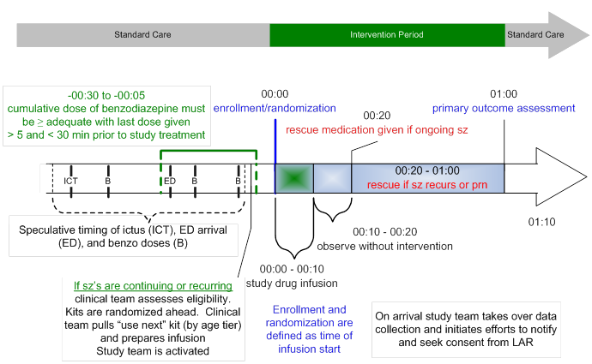

Slide 8
Primary Outcome
Clinical cessation of status epilepticus, determined by the absence of clinically apparent seizures and improving responsiveness, at 60 minutes after the start of study drug infusion, without the use of additional anti-seizure medication.
(*Note if patient is intubated within 60 minutes of enrollment, it is failure to meet primary outcome, because sedatives are used)

Slide 9
Other Outcomes
Safety outcomes
Secondary
Life-threatening hypotension:
Life-threatening cardiac arrhythmia:
Richmond agitation and sedation score at primary outcome determination
Time to termination of seizures
Intubation,
Admission to ICU
Seizure recurrence
Length of stay in the ICU and hospital,
Mortality

Slide 10
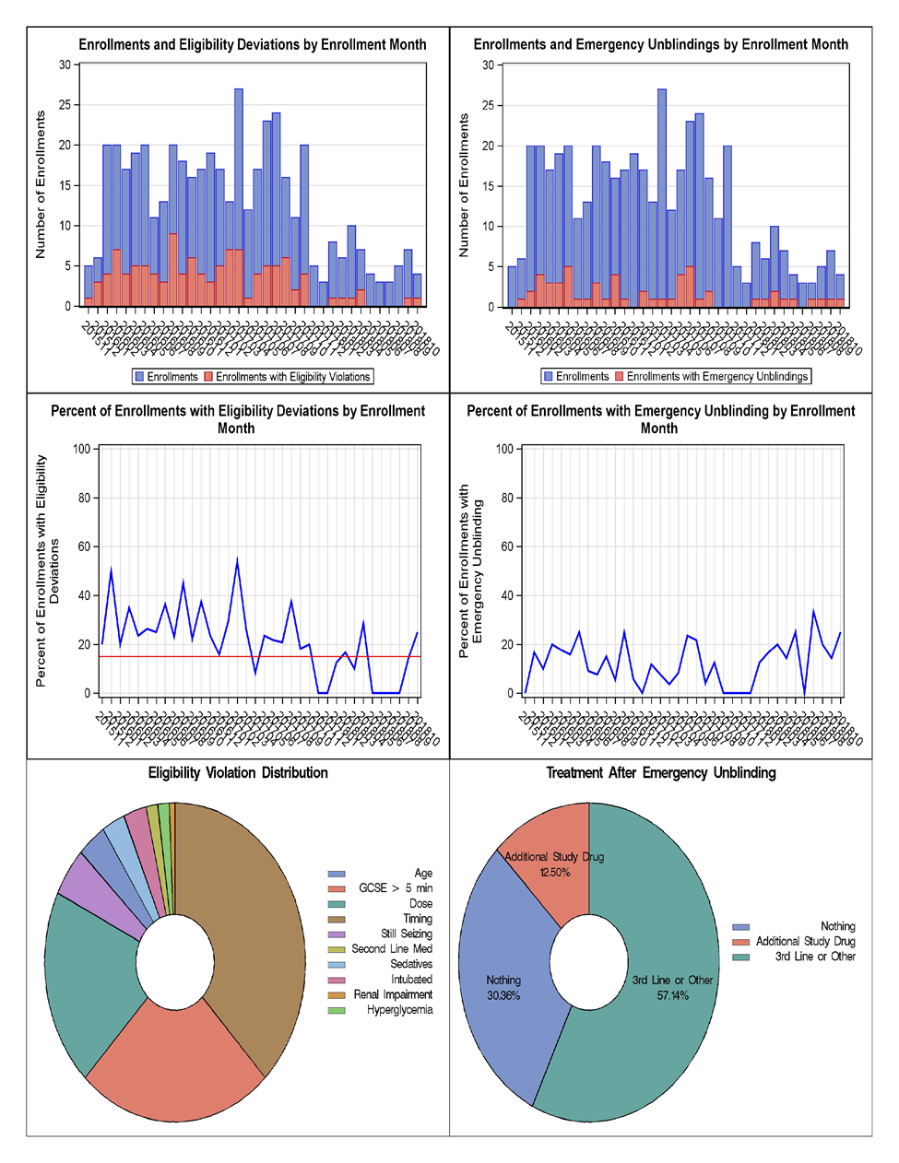

Slide 11
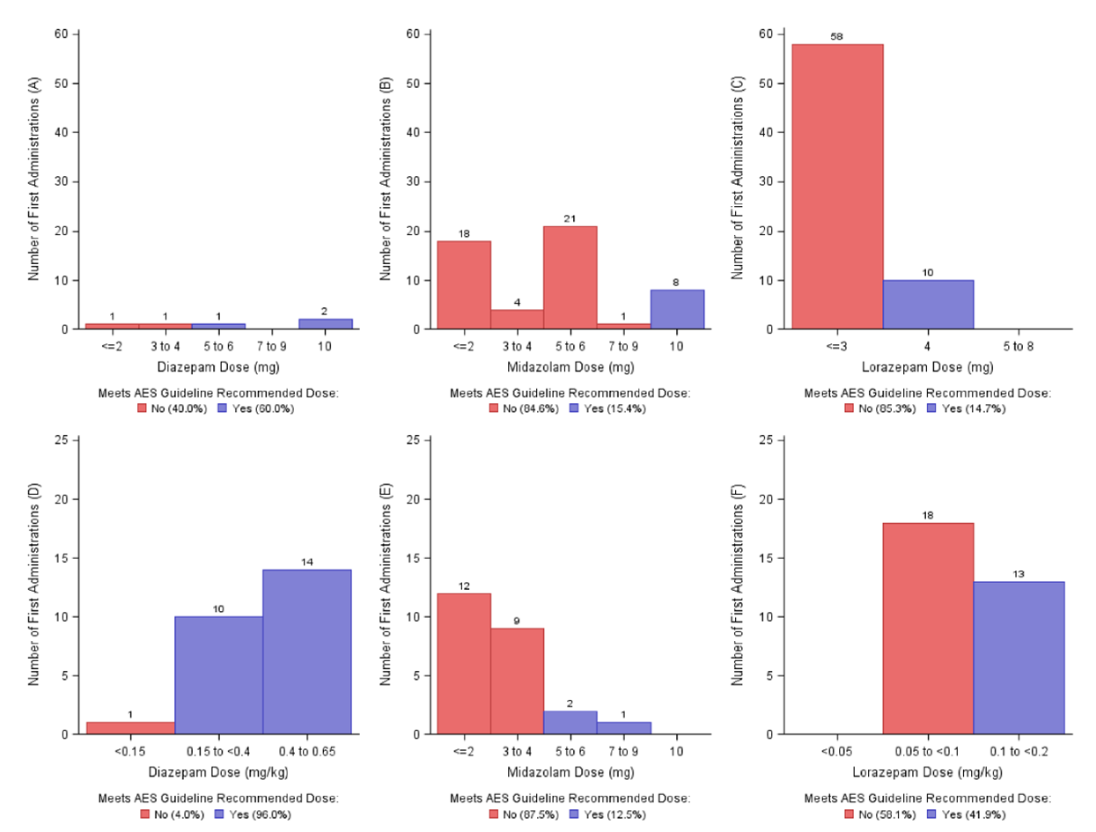
Under-dosing of benzodiazepines

Slide 12
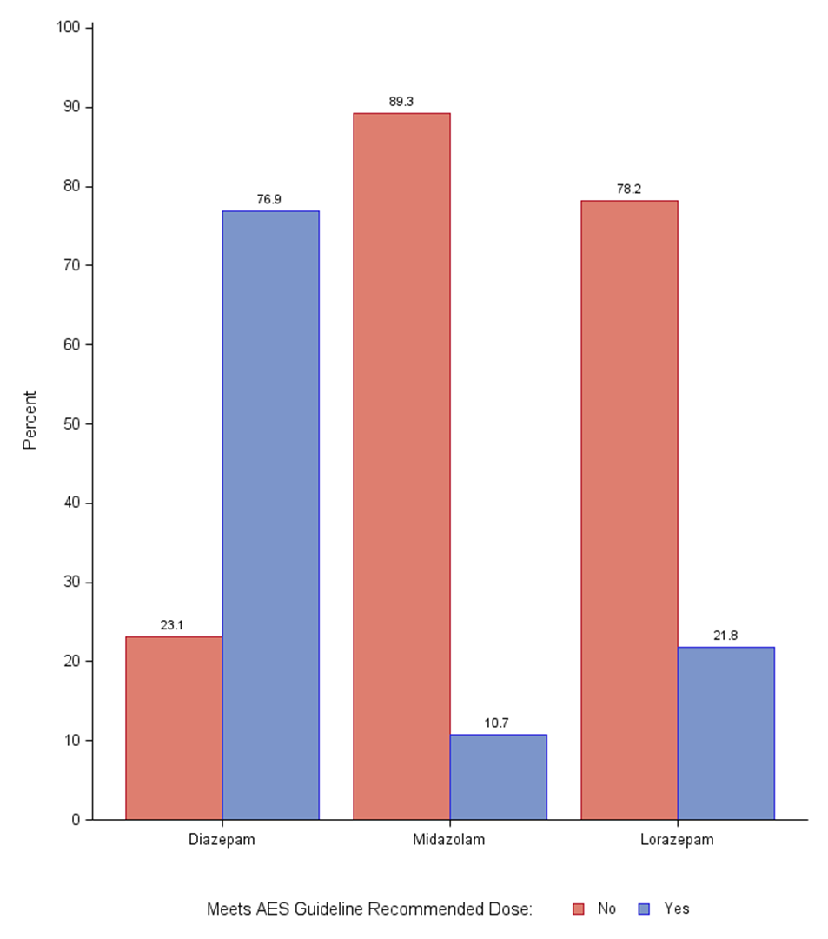
Benzodiazepines : dose vs AES guidelines

Slide 13
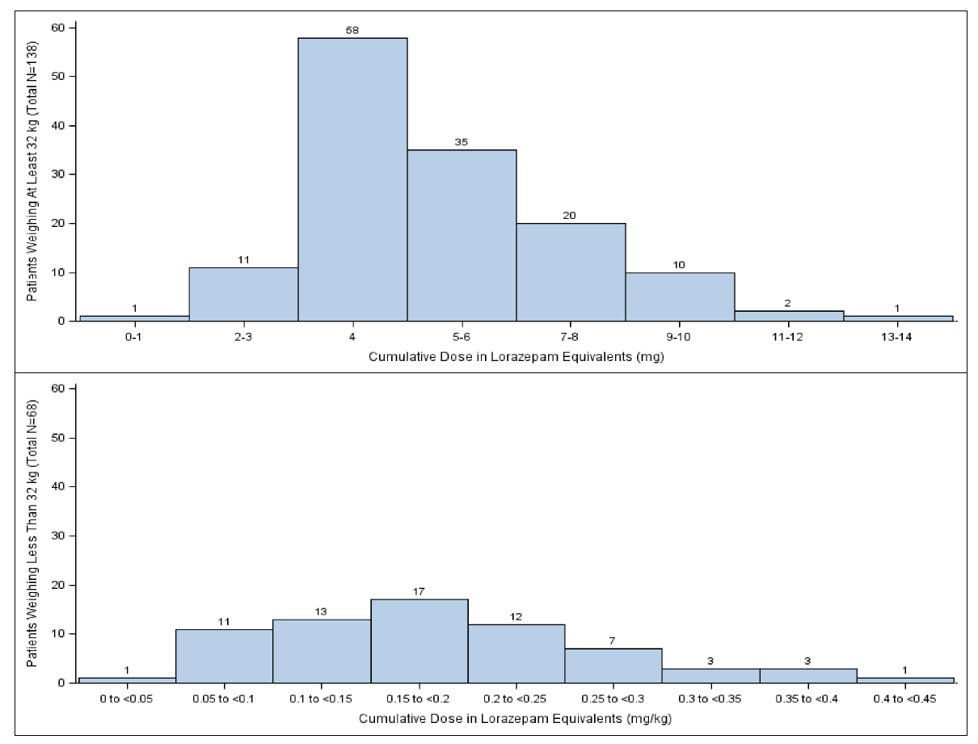
Cumulative dose in Lorazepam equivalents

Slide 14
Small dose safer or more dangerous?
Do benzos cause cardio respiratory compromise?
However PHTSE trial data suggest that under-treatment is more dangerous.
N Engl J Med. 2001 Aug 30;345(9):631-7.

Slide 15
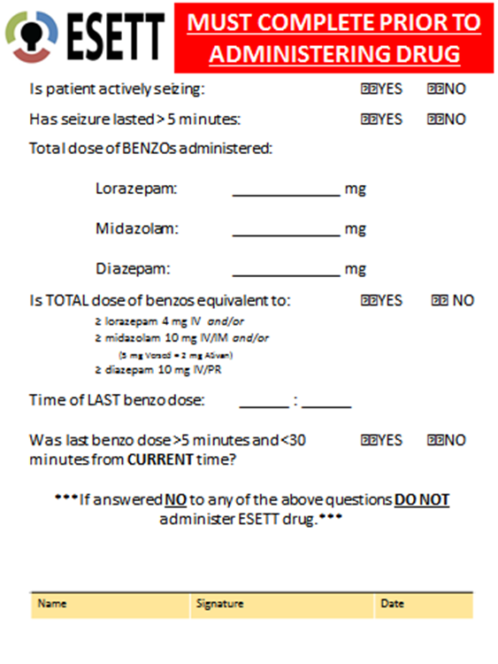
Preventing near misses
Modified ESETT app on Protocol assist device.
Cards available to fix on top study box.
Increased awareness of the protocol

Slide 16
GTCS > 5 minutes
Psychogenic non epileptic seizures: if the chart has this diagnosis/ you know that they have PNES.
Focal seizures.

Slide 18
Emergency Unblinding
Ongoing or recurrent status
Plan to use one of the study drugs as next agent
We will ask to speak to treating physician
Preferred options:
  Aggressive use of third line agent
    General anesthesia
    Phenobarbital
    Midazolam drip
    Others

Slide 19
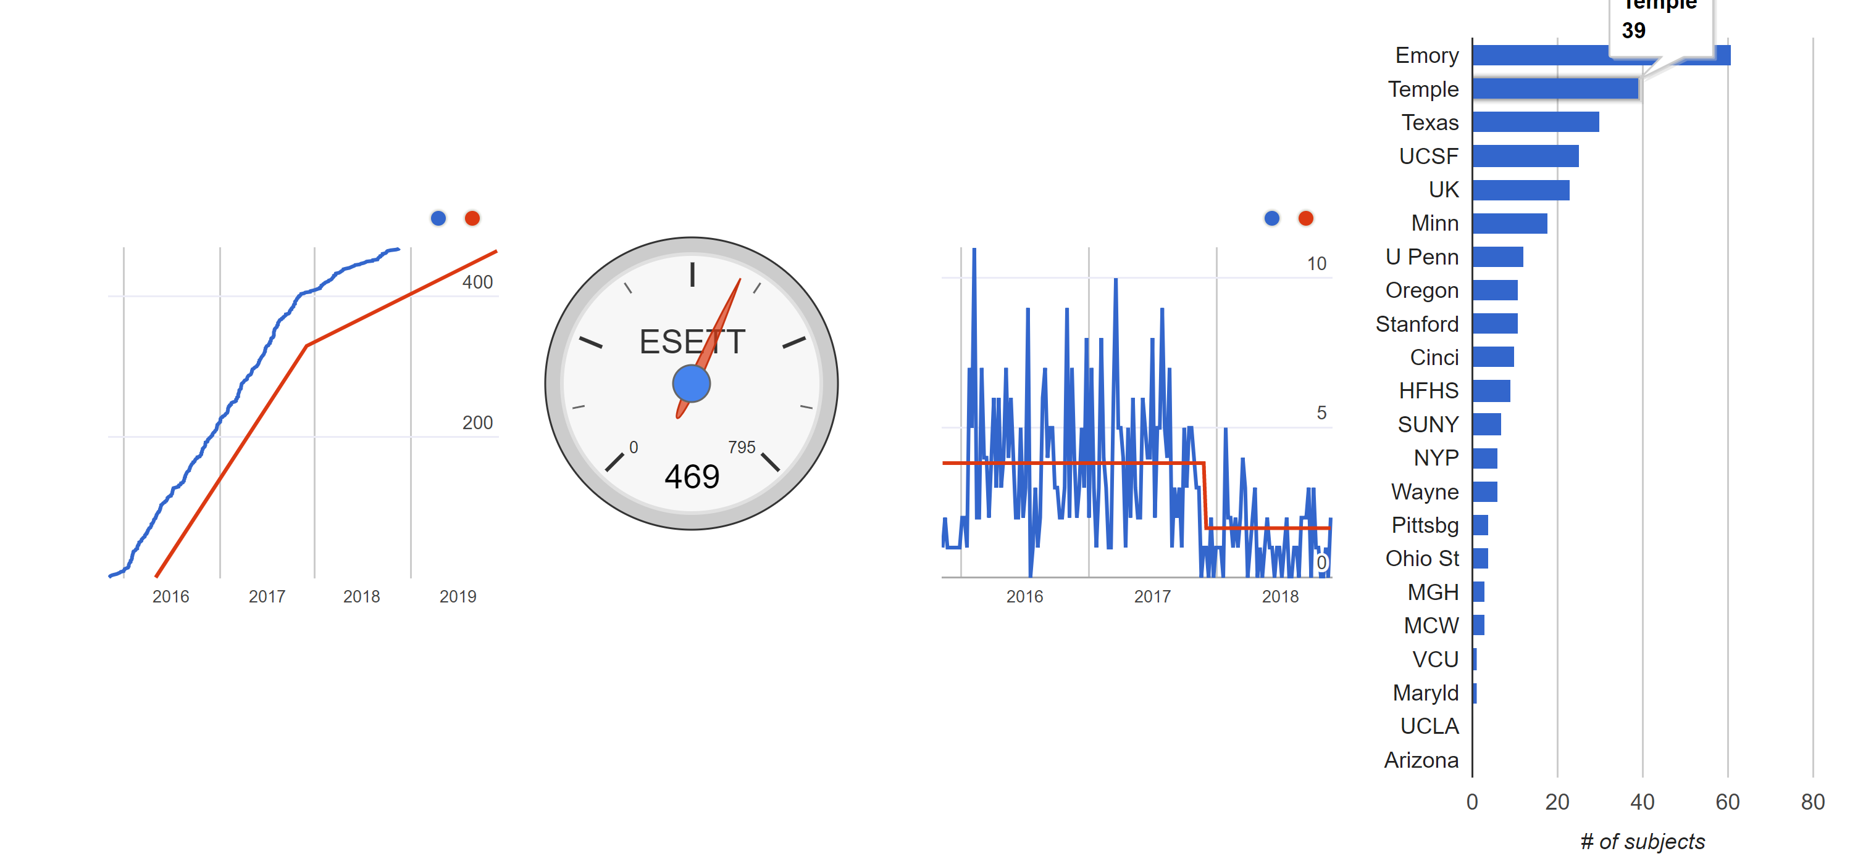
Accrual – tracking
You can always see up to the minute accrual data at:
nett.umich.edu/nett-resources/dashboard
or go to nett.umich.edu and click on “enrollment dashboard”

Slide 20
Acknowledgments
ESETT collaborators:
Gerhard Bauer, Lea Becker, Tom Bleck, Erin Bengelik, John Betjemann, Joy Black, Hannah Cock, Cassidy Connor, Jason Connor , Jim Chamberlain, Jim Cloyd, Lisa Coles, Catherine Dillon, Jordan Elm, Amy Fansler, Nathan Fountain, Brandy Fureman, Emily Gray, Deneil Harney, Christina Hill, Steve Huff, Karen Johnston, Elizabeth Jones, Brian Kelley, Brian Litt, Dan Lowenstein, Arthi Ramakrishnan, Shlomo Shinnar, Kate Shreve, Robert Silbergleit, Valerie Stevenson, David Treiman, Eugen Trinka.
Lab Colleagues
Doug Borris, John Williamson, Jianli Sun, Zakaria Mtchedlishvilli Chengsan Sun, Karthik Rajasekaran, Suchitra Joshi, Howard Goodkin, Edward Bertram, Brandon Martin, Marko Todorovic, Jianli Sun, Natalia Dabrowska, Ashley Renick,
Catherine Swanwick, Mmatt Rannals
Funding: NINDS, Counter-Act program (NIH), Congressionally- Directed Medical Research Program (CDMRP) of the Department of Defense, Epilepsy Foundation, CURE Epilepsy Foundation.

Slide 21
Essential Knowledge Game!
East of the Mississippi vs
West of the Mississippi

Slide 22
SAE Reporting
Consider the following 3 versions of an SAE narrative. After all 3 are shown, choose the version that is most consistent with ESETT training on preferred reporting of SAE narratives….

Slide 23
Version A – Respiratory Depression
A 35 yo with complex psychiatric history and prior alcohol related seizures had stuttering status epilepticus, received midazolam 10 mg and lorazepam 2 mg in divided doses over 2 hours, and enrolled on 2/8/17 at 23:01, followed by an aspiration event and transient hypoxia. He stopped seizing but remained poorly responsive. He was endotracheally intubated at 23:25 for airway protective and decreased level of consciousness and risk of further aspiration. He was sedated with propofol and admitted to ICU. Normal CXR and no sequelae of aspiration on 2/9/17. Extubated on 2/10/17.

Slide 24
Version B – Respiratory Depression
35 y.o. male with a history of anxiety, bipolar affective disorder, schizophrenia, and previous seizure event thought to be EtOH related presented to enrolling center ED via EMS 2/8/17 at 20:47 with seizures. Seizure in route abated with 4mg midazolam IM EMS administered. On initial assessment patient was sedated, but responded to noxious stimuli. Sedation thought to be due to EtOH, versed, and post-ictal state. Labs and CT head ordered. In CT patient had repeat seizure. He was given midazolam 3 mg IM and was brought back to ER. He appeared to continue to be having seizure so additional midazolam 3 mg IV was given. Seizure appeared to resolve. Neurology consulted to ER. Patient return of seizures occurred at approximately 2240. He was given an additional lorazepam 2 mg IV. Seizure continued for 5 minutes so ESETT drug was given. Study drug infusion started at 23:01. During infusion, pt appeared to have aspiration event. Infusion completed and patient stopped seizing and withdrew from nailbed pressure. At 20 minute assessment he was still responding to noxious stimulation. He was intubated for airway protection due to apparent aspiration event. He was sedated with propofol post intubation. Pt was admitted to the ICU for further diagnosis and management. 60 minute assessment at 00:15 revealed pt was sedated but withdrew from nailbed pressure. On 2/10/17 about 13:15 he was electively extubated. 2/10/17 1900 many verbally aggressive outbursts noted. 2/11/17 09:03 patient left AMA, after psychiatric evaluation

Slide 25
Version C – Respiratory Depression
A patient stopped seizing but remained poorly responsive and so got intubated. He went to the ICU and ultimately did ok. He had respiratory depression.

Slide 26
Consider the following 3 versions of an SAE narrative. After all 3 are shown, choose the version that is most consistent with ESETT training on preferred reporting of SAE narratives….
Version A – Respiratory Depression
A 35 yo with complex psychiatric history and prior alcohol related seizures had stuttering status epilepticus, received midazolam 10 mg and lorazepam 2 mg in divided doses over 2 hours, and enrolled on 2/8/17 at 23:01, followed by an aspiration event and transient hypoxia. He stopped seizing but remained poorly responsive. He was endotracheally intubated at 23:25 for airway protective and decreased level of consciousness and risk of further aspiration. He was sedated with propofol and admitted to ICU. Normal CXR and no sequelae of aspiration on 2/9/17. Extubated on 2/10/17.
Version B – Respiratory Depression
35 y.o. male with a history of anxiety, bipolar affective disorder, schizophrenia, and previous seizure event thought to be EtOH related presented to enrolling center ED via EMS 2/8/17 at 20:47 with seizures. Seizure in route abated with 4mg midazolam IM EMS administered. On initial assessment patient was sedated, but responded to noxious stimuli. Sedation thought to be due to EtOH, versed, and post-ictal state. Labs and CT head ordered. In CT patient had repeat seizure. He was given midazolam 3 mg IM and was brought back to ER. He appeared to continue to be having seizure so additional midazolam 3 mg IV was given. Seizure appeared to resolve. Neurology consulted to ER. Patient return of seizures occurred at approximately 2240. He was given an additional lorazepam 2 mg IV. Seizure continued for 5 minutes so ESETT drug was given. Study drug infusion started at 23:01. During infusion, pt appeared to have aspiration event. Infusion completed and patient stopped seizing and withdrew from nailbed pressure. At 20 minute assessment he was still responding to noxious stimulation. He was intubated for airway protection due to apparent aspiration event. He was sedated with propofol post intubation. Pt was admitted to the ICU for further diagnosis and management. 60 minute assessment at 00:15 revealed pt was sedated but withdrew from nailbed pressure. On 2/10/17 about 13:15 he was electively extubated. 2/10/17 1900 many verbally aggressive outbursts noted. 2/11/17 09:03 patient left AMA, after psychiatric evaluation
Version C – Respiratory Depression
A patient stopped seizing but remained poorly responsive and so got intubated. He went to the ICU and ultimately did ok. He had respiratory depression.

Slide 27
ESETT Pharmacokinetic-Pharmacodynamic (PK/PD) Study
ESETT Investigators Meeting
November 26th and 27th, 2018

Slide 28
ESETT PK/PD Study
Determine whether drug concentrations help explain responses (seizure cessation/AEs).
Aim: Relate drug exposure with seizure cessation and the key secondary outcomes.
Outcomes:
  Better understand the results from ESETT.
  Provide guidance on how best to use FOS, LEV, and VPA for treatment of SE in children.

Slide 29
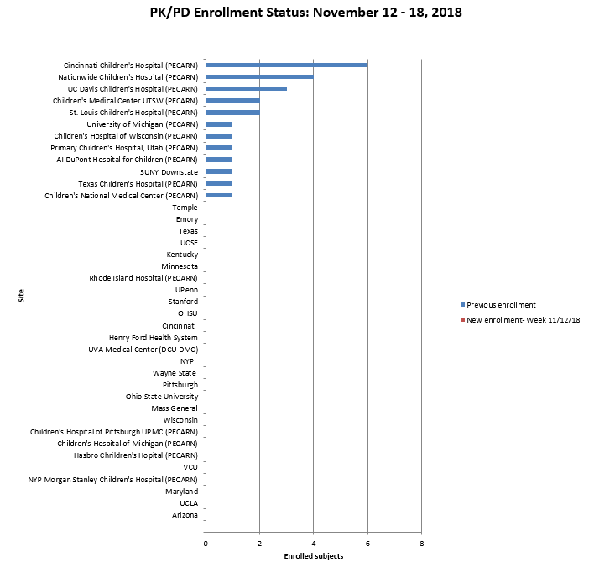
Study Progress
26 subjects enrolled
15/20 ESETT enrollments
THANK YOU!

Slide 30
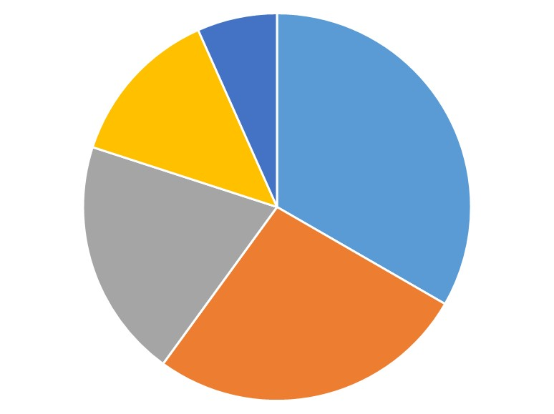
Reasons for Missed Enrollments
Communication
(8%)
Laboratory
(17%)
Consenting
(40%)
Site Participation
(25%)
Blood
Collection
(33%)

Slide 31
Overview of Study Procedures
Measure the patient’s height
Collect two blood samples (2.5-3 mL/sample)
  One sample between 20-50 min and a second sample between 60-120 min from the start of drug infusion
    Record exact blood collection time
    If unable to collect sample within window, draw sample when possible.
enrollment/
randomization
00:00
00:10
00:20
00:50
00:60
02:00
1 blood
collection
1 blood
collection
study
drug
infusion
observe

Slide 32
Consenting Considerations
A few instances where LAR declined the first or second blood collection.
pediatric patient
unconscious/seizing*
conscious
2nd IV*
no 2nd IV
obtain approval*
* collect sample

Slide 33
A Few Reminders
If the first blood sampling window is missed, please take 2 samples in the second window. If you can only obtain 1 sample, please collect it.
Fill out ESETT PK/PD eCRF for every ESETT subject.
Ship samples to CODR when convenient
  should be shipped following the completion of up to 4 subjects or every 6 months, whichever comes first.

Slide 34
Frequently Asked Questions
Can blood drawn from a site used to deliver fluids or other study medication be used?
  Answer: Yes. Blood can be drawn from any site NOT used for study drug infusion.
What should I do if we obtain the blood sample outside of the sampling time window?
  Answer: The data from this sample can still be used. Record the actual time that the sample was collected on the PK blood collection eCRF and process and ship that sample as specified.

Slide 35
Frequently Asked Questions (Cont.)
What should I do if the volume of blood collected is less than 2.5 mL?
  Answer: The sample will still be used. Process and ship the sample as specified.
What should I do if the blood sample is centrifuged greater than 2 hrs after sample collection?
  Answer: Record the procedural deviation under Question 8 of the PK/PD eCRF.

Slide 36
Contacts
ESETT PK/PD study team at esett-pkpd@umich.edu
Lisa Coles at 612-624-1861 (office) or durh0016@umn.edu
James Cloyd at 612-624-4609 (office)
References
Manual of Procedures
1 page quick guide

Slide 37
Thanks Again and Questions

Slide 38
CHOP | ESETT Screening
RCs/RAs stagger work day schedules to maximize ESETT coverage from 8:00 am to 8:00 pm on weekdays.
Enrollment only occurs when RCs/RAs are present. Early RC/RA ‘turns on’ ESETT. Late RC/RA ‘turns off’ ESETT.
Academic associates screen patients who present to the ED with seizures from 7:00 am to 12:00 am on weekdays and weekends, as an extension of ESETT EFIC consultation activities.
Academic associates alert RCs/RAs of actively seizing patients in the ED.

Slide 39
CHOP | ESETT Missed Eligible Tracking
Missed eligibles are tracked via Business Object Reports in the EMR, allowing us to review all patients who present to the ED with chief complaints indictive of seizure or status epilepticus.
NCT03754114

Slide 40

ESETT screening – Texas Children’s Hospital
Helps identify trends in exclusion criteria and reasons not enrolled
Missed eligible
Inadequate benzos
Education/awareness initiatives
(RCs & clinicians)

Slide 41
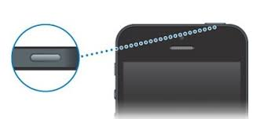
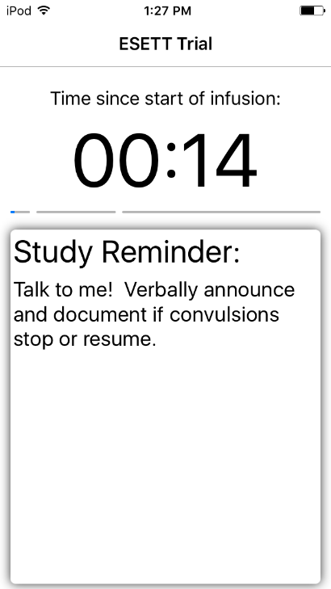



Protocol Assist Device Reminders
Do not turn off device in the middle of an enrollment!
  The recording stops while the screen is turned off even though the timer does not.

Slide 42
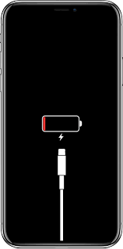
Protocol Assist Device Reminders
Regularly check device for charge level!
Make sure the device is charged and ready after each enrollment. Check the battery level every 2-4 weeks.
Note: Colder temperatures may give a false battery reading when the device is first turned on. Allow it to warm up before assessing its need for charge.

Slide 43
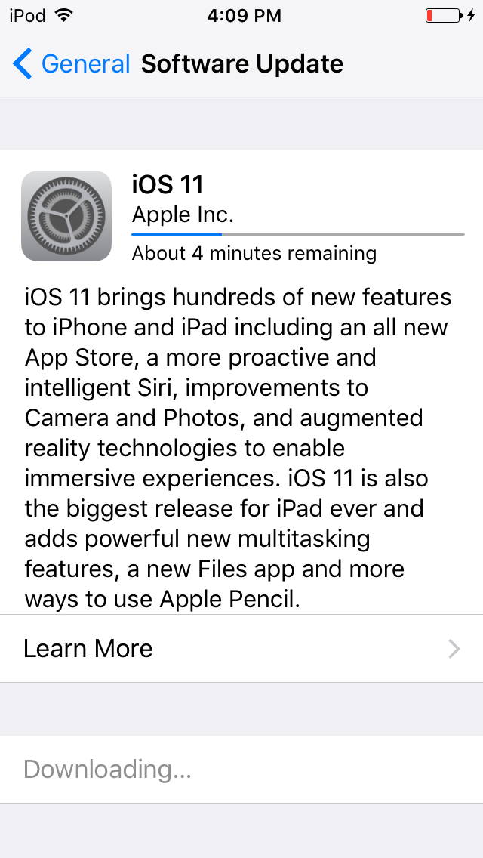
Protocol Assist Device Reminders
Update iOS software when available!
  Be sure your software is up to date by installing updates when they are available. For assistance with iOS updates, please contact Lindsey (liha@umich.edu).
Software updates can be found under Settings > General > Software Update.

Slide 44
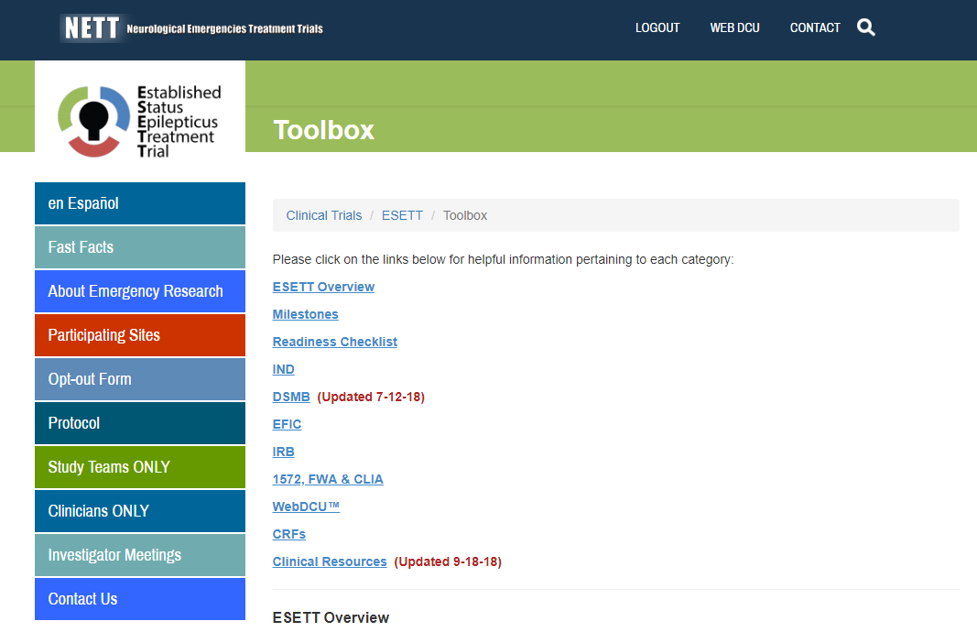
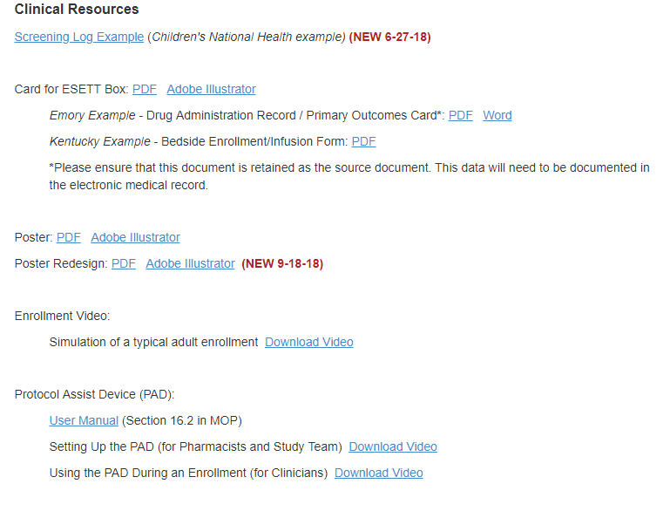

Protocol Assist Device Reminders
Further information about the Protocol Assist Device can be found in the User Manual, link in the ESETT website toolbox.

Slide 45

Clinical Summary Packet Reminders
The Clinical Summary Packets should include the following documents:
  Summary Packet cover page
  Ambulance run sheet
  Complete ED chart (including ED chart from referring hospital if patient was transferred)
  Admission note/H&P
  Initial neurology consult note (if different from admission note)
  Reports of any brain CT, brain MRI and all EEG if obtained.
  Full Discharge summary – not just patient discharge instructions

Slide 46
Clinical Summary Packet Reminders
  All electronic health records should be printed directly to pdf.
  If possible, do not print paper copies and scan them back into an electronic record.

Slide 47
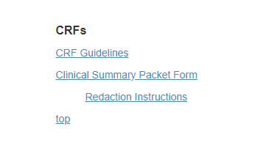
Clinical Summary Packet Reminders
  All references to study drug assignment/dosing and patient PHI must be electronically redacted.
    Redaction instructions and CRF completion guidelines can be found in the ESETT website toolbox.

Slide 48
ESETT Clinical Team Training Materials
Available at ESETT.org under Clinicians Only (no login required!)
  ESETT Minutes
    Enrollment
    Dosing
    SE in the ED
  Videos
  Feel free to share all materials under Study Team Section (login required)

