Slide 1
Why this trial?
Translational science
Clinical importance
Meaningful answers
Notes:
This trial uses an adaptive “smart” design to provide meaningful answers to the right questions.
The right question, for example, is “what is the optimal duration of cooling?”. The answer to that question is inherently more useful and meaningful than, say, “is 48 hours of cooling better than 24 hours of cooling?” A traditional trial design comparing two durations of treatment can’t adequately describe a duration response curve that is almost certainly not linear.

Slide 2
Design overview
Initially randomization to 12, 24, or 48 hours
Randomization adapts independently for each rhythm type:
  Allocation is to more successful original and interposed durations
  If curve is flat, randomization opens to 6 hr duration
  If curve is positive, randomization opens to 60 and 72 hr durations
Ends early if duration-response is flat or negative
Notes:
ICECAP is a duration-seeking design that will reveal the shape of the duration-response curve. It starts out by putting the first 150 subjects in each rhythm type on 12, 24, or 48 hours of cooling, and then looks at the shape of the response curve from those subjects. If any trend is emerging toward longer doses of cooling being more effective, then the next 50 patients are randomized to the original arms and some longer duration arms. If the trend continues, longer duration arms are added every 50 patients. If the emerging trend is a flat duration response, then future subjects are placed on a shorter duration arm and more interspersed durations. Subjects are allocated to find the “knee” of the duration response curve, the duration of cooling where the response plateaus. The start of that plateau is the optimal duration of cooling, a meaningful answer.
The shape of the duration response also answers our other question, does hypothermia work at all? Any positive dose response curve indicates that there is efficacy, even without a placebo group. A completely flat dose response curve, in which no duration of cooling is any more effective than the shortest possible duration, strongly implies that the therapy is ineffective. The trial ends early if a flat response is detected.
This trial designs learns, in an entirely pre-planned and programed, from accumulating data in the trial, and then adapts the randomization to put more subjects into the arms that are most informative. This prevents wasting a bunch of subjects on arms that end up being entirely uninformative. The design means that we learn more from each patient.

Slide 3
Study Outline
Eligibility
Intervention
Enrollment / Patient Flow
Outcomes
Sites

Slide 4
Inclusion
Coma after resuscitation from OHCA
Cooled to <34 deg C within 240 min of arrest
Definitive temperature control applied
Age ≥ 18 years
Informed consent from LAR including intent to maintain life support for 96 hours
Enrollment within 6 hours of initiation of cooling

Slide 5
Exclusion
Hemodynamic instability
Pre-existing condition confounding outcome
Pre-existing terminal illness, unlikely to survive
Planned early withdrawal of life support
Presumed sepsis as etiology of arrest
Prisoner

Slide 6
Intervention
Duration
Measured from definitive cooling initiation
Any definitive cooling device*
Clinical standardization

Slide 7
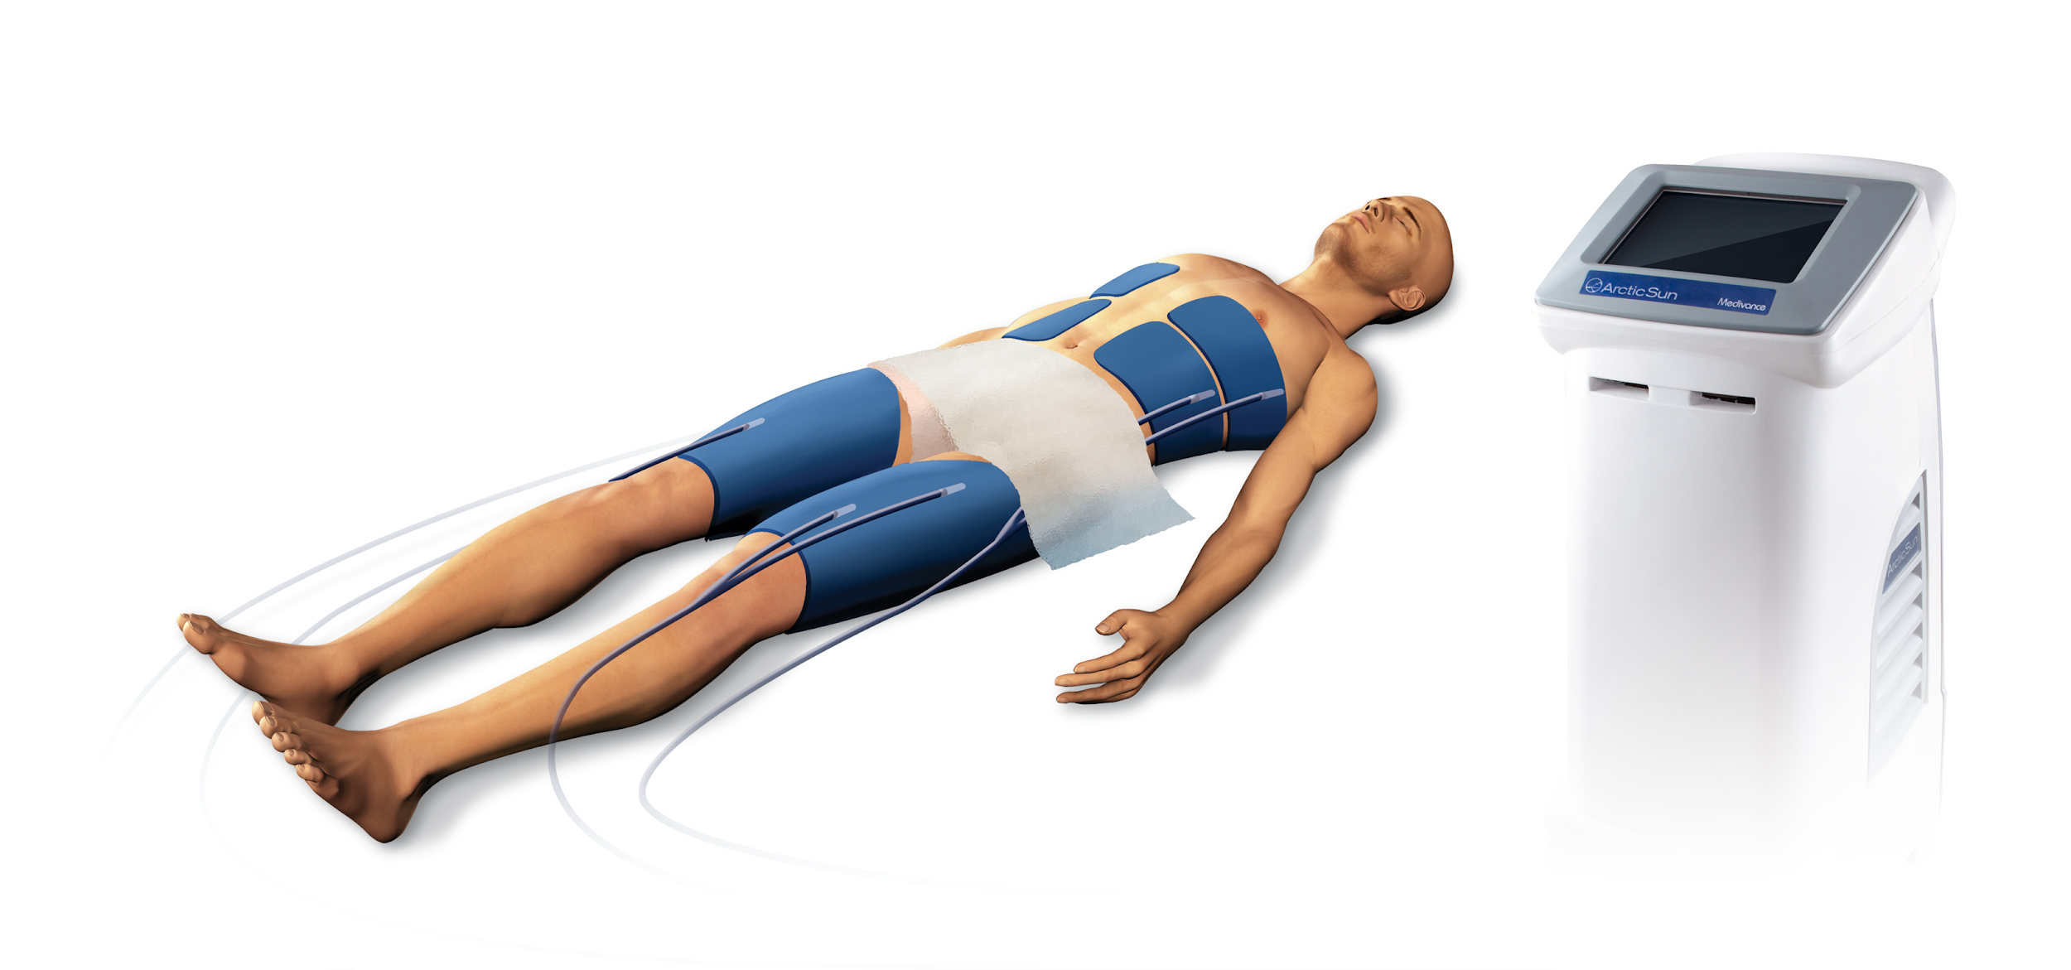
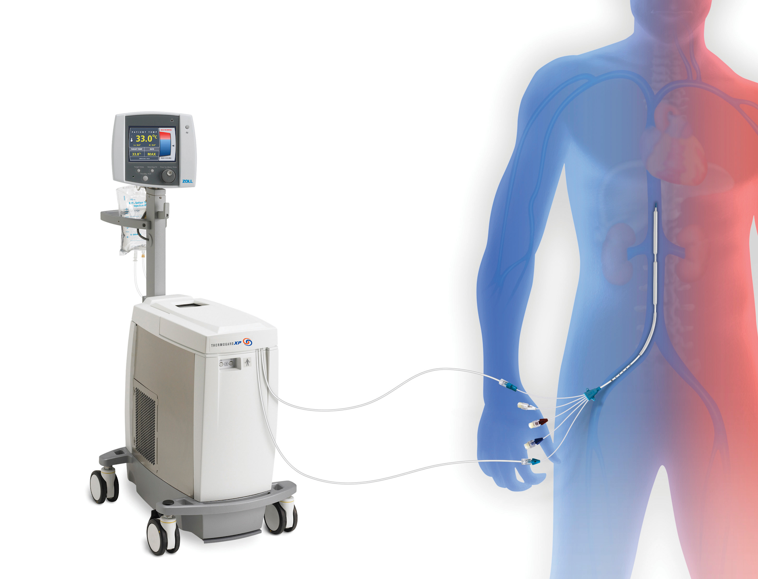
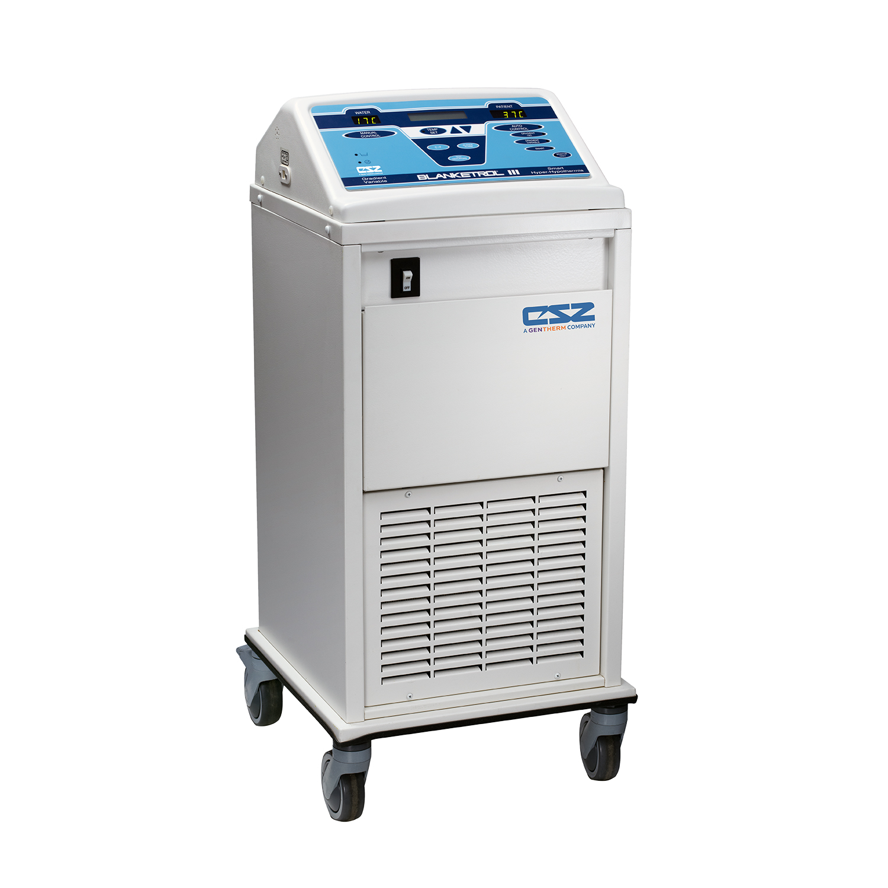
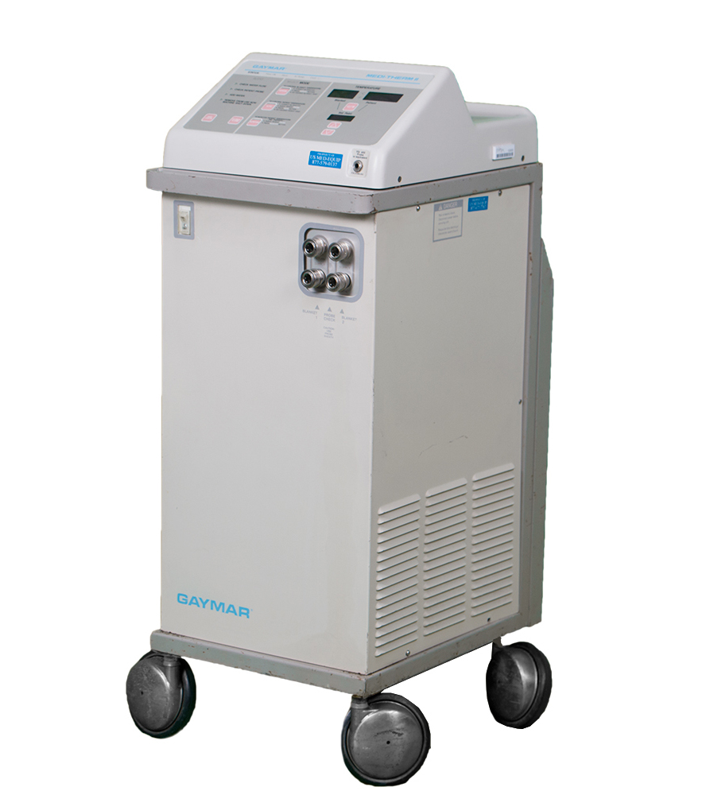
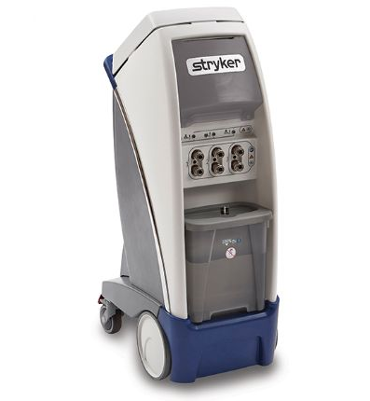

Slide 8
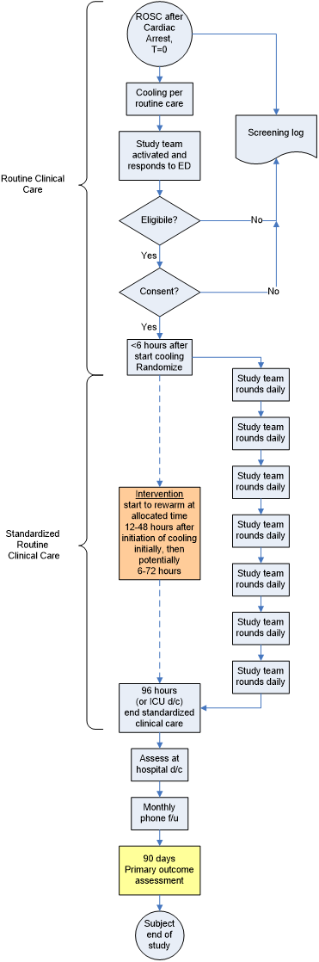
Enrollment and
Patient Flow

Slide 9
Enrollment and
Patient Flow

Slide 10
Enrollment and
Patient Flow

Slide 11
Primary Outcome
Modified Rankin scale at 90 days after ROSC
Functional outcome incorporating mortality
  Analyzed non-parametrically to explore both the proportion achieving a good neurological outcome and deficit among those with good outcomes
Blinded assessment
Primary Outcome for Resuscitation Science Studies Consensus Conference
May 5-6, 2008

Slide 12
Modified Rankin Scale “simple interview”
Dead from any cause
6
Stroke. 2010;41:1048
Could you live alone without any help from another person?
This means being able to bathe, use the toilet, shop, prepare or get meals, and manage finances.
Are you able to walk without help from another person?
Yes=3
Bedridden or needing constant supervision,
5
No
No
Not bedridden, intermittent supervision,
4
Are you able to do everything that you were doing right before your event, even if slower and not as much?
No=2
Not completely back to the way you were before your event,
1
Yes
Yes
Completely back to the way you were before your event,
0
Notes:
Online training module
>500 trained examiners in NETT
Average 85% agreement training cases
Re-certification every 24 months

Slide 13
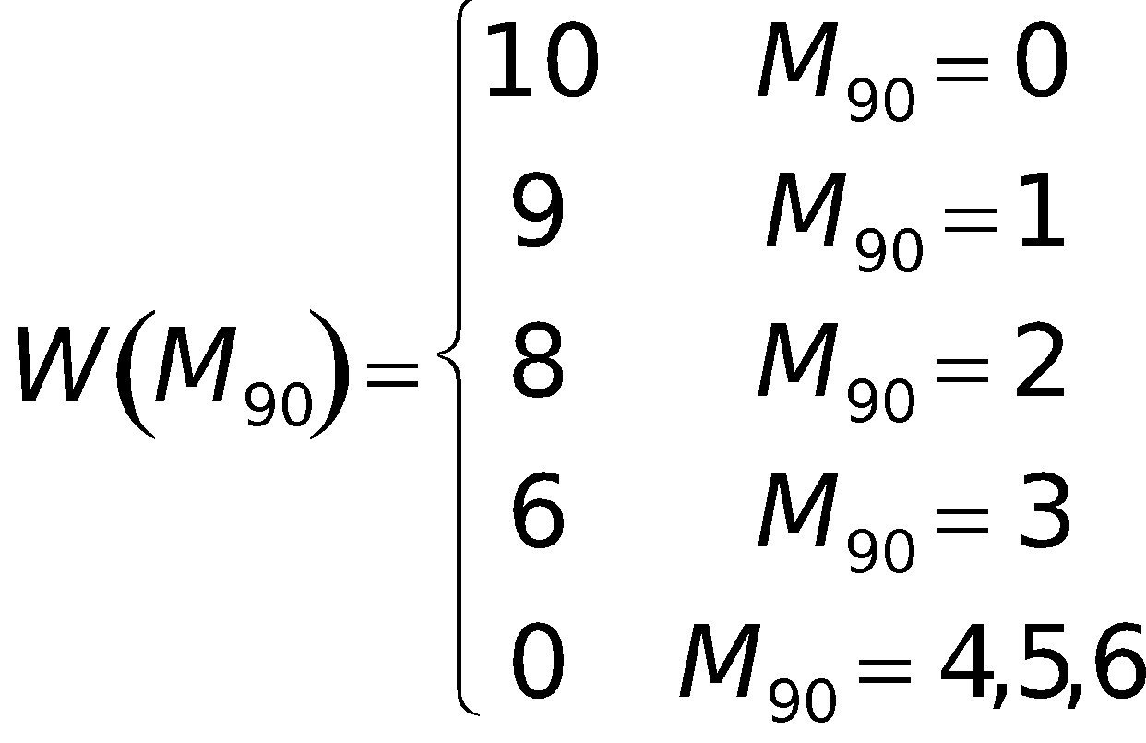
Mean weighted modified Rankin Score

Slide 14

Other Outcomes
Safety
  Well defined safety outcomes
  On-going assessment of SAE balance
NIH toolbox plus
  Standard cognitive and functional testing
  Patient Reported Outcomes – NeuroQoL
Ancillary studies for other questions
NIH HHS-N-260-2006-00007-C

Slide 15

Questions and discussion

