Slide 1
Protocol Introduction-Rationale
Will Meurer

Slide 2
Cardiac Arrest is a Cardiac Emergency and a Neurological Emergency
Notes:
This meeting, with folks from both NHBLI and NINDS is particularly exciting to us in the SIREN leadership because it represents the synergy upon which this new network is built. Cardiac Arrest is emblematic of that synergy because it truly and profoundly is both a cardiac emergency and neurological emergency. I’ve heard Dr. Koroshetz describe cardiac arrest as the biggest stroke you can have. We are excited to have our first NHLBI sponsored trial starting.

Slide 3
ICECAP
A randomized, response-adaptive, duration-finding, comparative effectiveness clinical trial with blinded outcome assessment.
Notes:
ICECAP is a clinical trial in comatose survivors of cardiac arrest to find out if longer durations of cooling can make more people better. It will also confirm whether or not therapeutic cooling works at all in patients with shockable rhythms, and separately in patients with initially non-shockable rhythms. The trial will use adaptive dose-finding methods to learn the shape of the curve that relates duration of induced hypothermia to the rate of good clinical outcome.
In terms of hypothermia, “dose” is mostly driven by how long you cool and how cold. Depth of cooling has a very limited tolerable range and seems to be less clinically important, but duration can be varied quite a bit and appears mechanistically significant. This study looks at only duration.

Slide 4
Why this trial?
Translational science
Clinical importance
Meaningful answers
Notes:
I want to start with why? Why this trial? The answer has three parts.
First, because this is where the science leads us. This is a truly translational investigation building on what has been learned about mechanisms of injury and therapy,
Second because it answers multiple questions of clinical and regulatory importance. This results of this will immediately affect clinical practice.
Finally, three, because of the innovative trial design, the results will provide meaningful answers. Answers that are relatively insensitive to prior assumptions. This is the last and only trial you’ll need to do to answer questions of duration.
Let’s take each of these one at a time.

Slide 5
Why this trial?
Translational science
Clinical importance
Meaningful answers
Notes:
This trial is where the science leads us. We believe in research based on rational therapeutic development that progresses from understandings of mechanism developed in basic science labs, to preclinical testing in multiple labs and in multiple species, small and large. Then translation into humans with evidence that the mechanisms seen in animals are implicated in the human condition to be studied. We reject the notion of just guessing at and testing tweaks of clinical parameters based on hunches, and just because they are easy to test.
The volume of basic science and preclinical data on hypothermia in ischemia is vast and our time is limited, so I’m going to just skim the surface, and then relate it to human translation.

Slide 6
Ann Neurol 2006;59:467–477
3,500 papers
7,554 results
116 interventions
995 scorable “trials”
Hypothermia
Most studied 92 studies
Highest Quality
Level of effectiveness 46%
Notes:
To start, hypothermia clearly protects against ischemic injury in animal models. I love this now teenaged, or 13 year old paper from a hardy Australian group of researchers who attempted to summarize, in one article, all prior comparative experiments of neuroprotective interventions in brain ischemia models. They read and analyzed 3500 papers and 7,500 experimental results. They ended up finding about a thousand preclinical “trials” that they could score on quality and effectiveness of therapy, involving 116 interventions.
Hypothermia turned out to be the most frequent and best studied intervention, representing almost 10% of the trials, and having the highest quality scores using STAIR criteria. Hypothermia showed an aggregate 46% level of effectiveness over control, putting it in the top echelon of interventions.

Slide 7
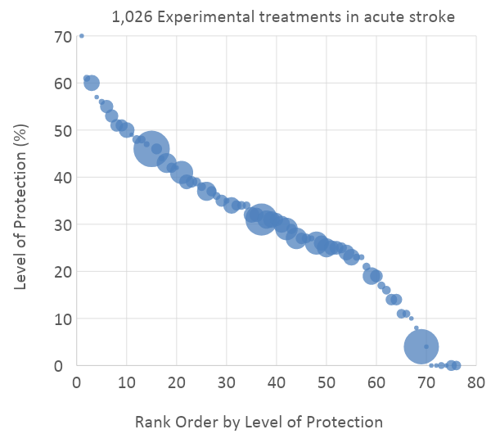
Ann Neurol 2006;59:467–477
 | Experimental Contrasts (n)
Focal Ischemia Models | 94 | favors treatment
 | 28 | neutral
 | 0 | favors control
Global Ischemia Models | 77 | favors treatment
 | 28 | neutral
 | 0 | favors control
Culture Models | 13 | favors treatment
 | 3 | neutral
 | 1 | favors control
Notes:
Graphically, their data looks like this. The interventions are ranked on effectiveness and the size of the bubble shows the number of trials analyzed. The large green dot represents hypothermia, with a high level of efficacy, only beaten by a few other interventions that were never ultimately reproduced.
The table on the right shows that efficacy was in both focal and global cerebral ischemia animal models in most experiments, and in few cell culture models.
The papers they didn’t report on were basic science papers exploring mechanism rather than outcome. So what do those show?

Slide 8
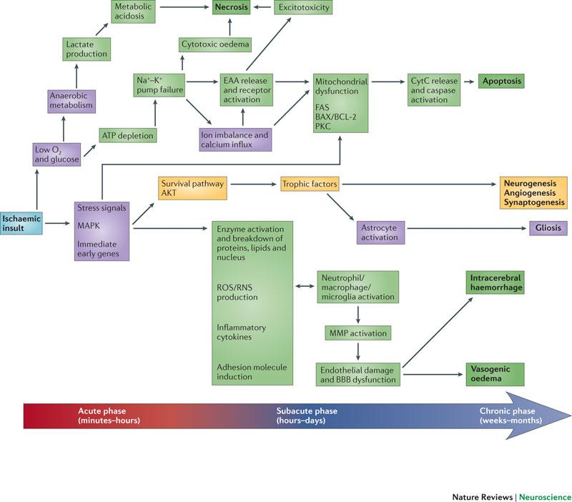
Neuroprotective mechanisms of hypothermia in brain ischaemia,
2012;13:267
Notes:
Basic science has elucidated many mechanisms by which hypothermia appears to act. These were reviewed by Yenari and Han who put together this mechanistic map of the ischemic cascade. This map t is laid out with increasing time from ictus going from left to right. Green and yellow boxes are mechanisms down or up regulated by hypothermia. It’s a busy graphic, but Yenari created it to show that many of the putative protective mechanisms, peak days after ictus, especially those involving apoptosis and inflammation. And some mechanisms like neuro-, angio- and gliogenesis are only seen with prolonged experimental durations of cooling.

Slide 9
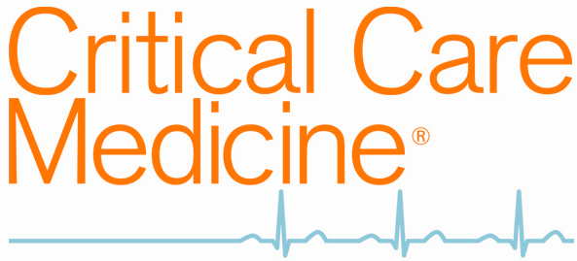
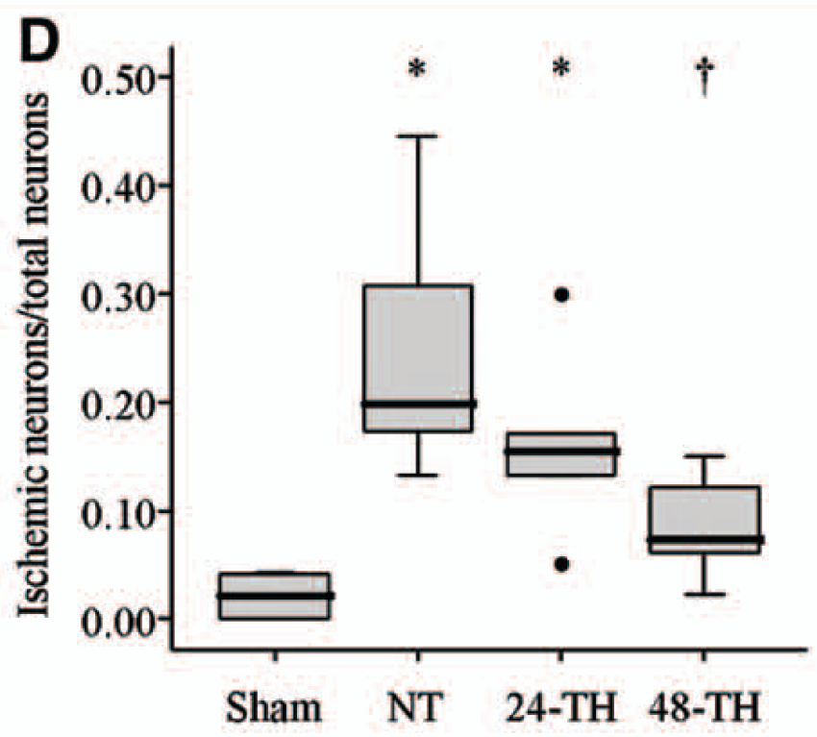
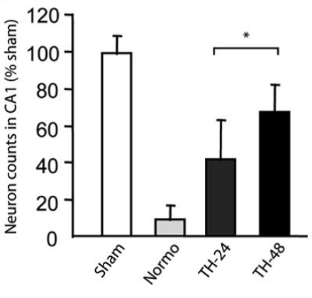
Impact of therapeutic hypothermia onset and duration on survival, neurologic function, and neurodegeneration after cardiac arrest. Crit Care Med. 2011;39:1423-30
Prolonged therapeutic hypothermia is more effective in attenuating brain apoptosis in a Swine cardiac arrest model. Crit Care Med. 2014;42:e132-42.
ROK A090395
Notes:
These mechanistic rationales for longer duration cooling have been subsequently tested and borne out in multiple labs and species. Here are two representative, clinically-relevant cardiac arrest models. One is in the rat from Bob Neumar’s lab, and another in swine from Korea. In both there is profound neuronal preservation in the hippocampus with 48 hours of cooling versus 24 hours.
Duration dependent markers of apoptotic mechanisms were also consistent across models and species. In particular, these studies measured cleaved and cytosolic protein-kinase-C-ratios and cleaved caspase 3 ratios.

Slide 10
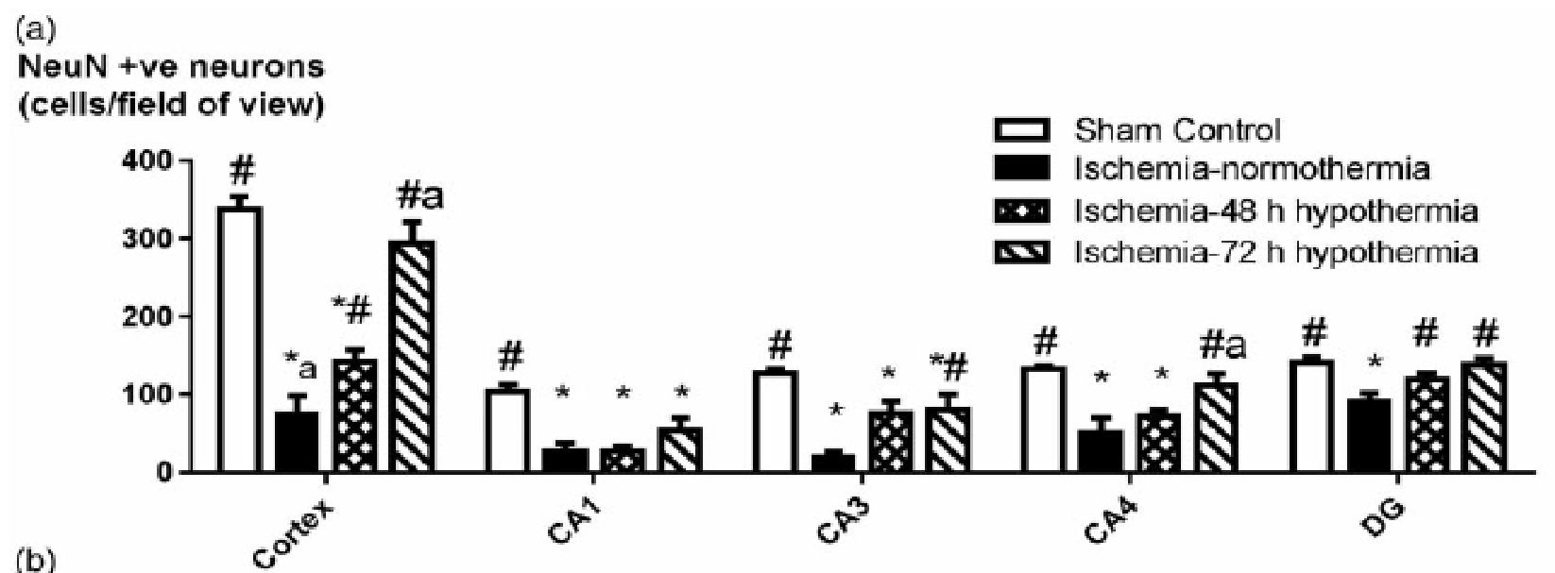
Notes:
Another group from New Zealand published this global cerebral ischemia model in fetal sheep. Here more neurons are preserved with 72 versus 48 hours of cooling. Duration dependent protection in this model is robust and shown in multiple different brain regions, cortex, hippocampus, and dentate gyrus. Preserved neuron counts correlated with suppression of inflammatory cells on immunohistochemistry as well. In another study, this same group compared 72 to 120 hours and did not find any further evidence of benefit, (albeit with different methodos).

Slide 11
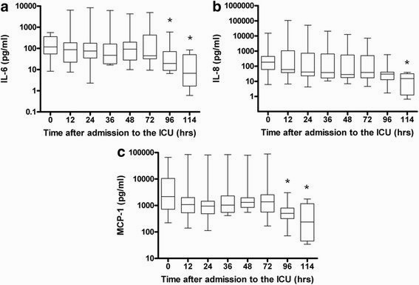
From: Seventy-two hours of mild hypothermia after cardiac arrest is associated with a lowered inflammatory response during rewarming in a prospective observational study. Critical Care 2014;18:546
Cytokine and chemokine profiles of the patients during hypothermia and after rewarming. Graphs show data for ten patients after cardiac arrest with respect to the proinflammatory cytokine interleukin 6 (IL-6) (a) and the chemokines IL-8 (b) and monocyte chemotactic protein 1 (MCP-1) (c) during hypothermia (0 to 72 hours) and after rewarming (72 to 114 hours). Values presented are medians (black lines in boxes), 25th to 75th interquartile ranges (boxes) and minimums and maximums (whiskers). *Statistically significant compared to time 0.
Notes:
Ok, but does it translate? Here is evidence that markers of inflammation are also suppressed in humans by longer durations of cooling after cardiac arrest. A Dutch group cooled 10 comatose survivors of cardiac arrest for 72 hours and serially tested inflammatory responses during cooling and rewarming. In a previous study, they had observed a spike in inflammatory markers during rewarming after 24 hours of cooling, but in those cooled for 72 hours, cytokines and chemokines (including IL6, IL10, IL-8, MCP 1, and ICAM1) remained stable during hypothermia and rewarming. The investigators concluded that prolonged hypothermia blunts the inflammatory response after rewarming in patients after cardiac arrest.

Slide 12
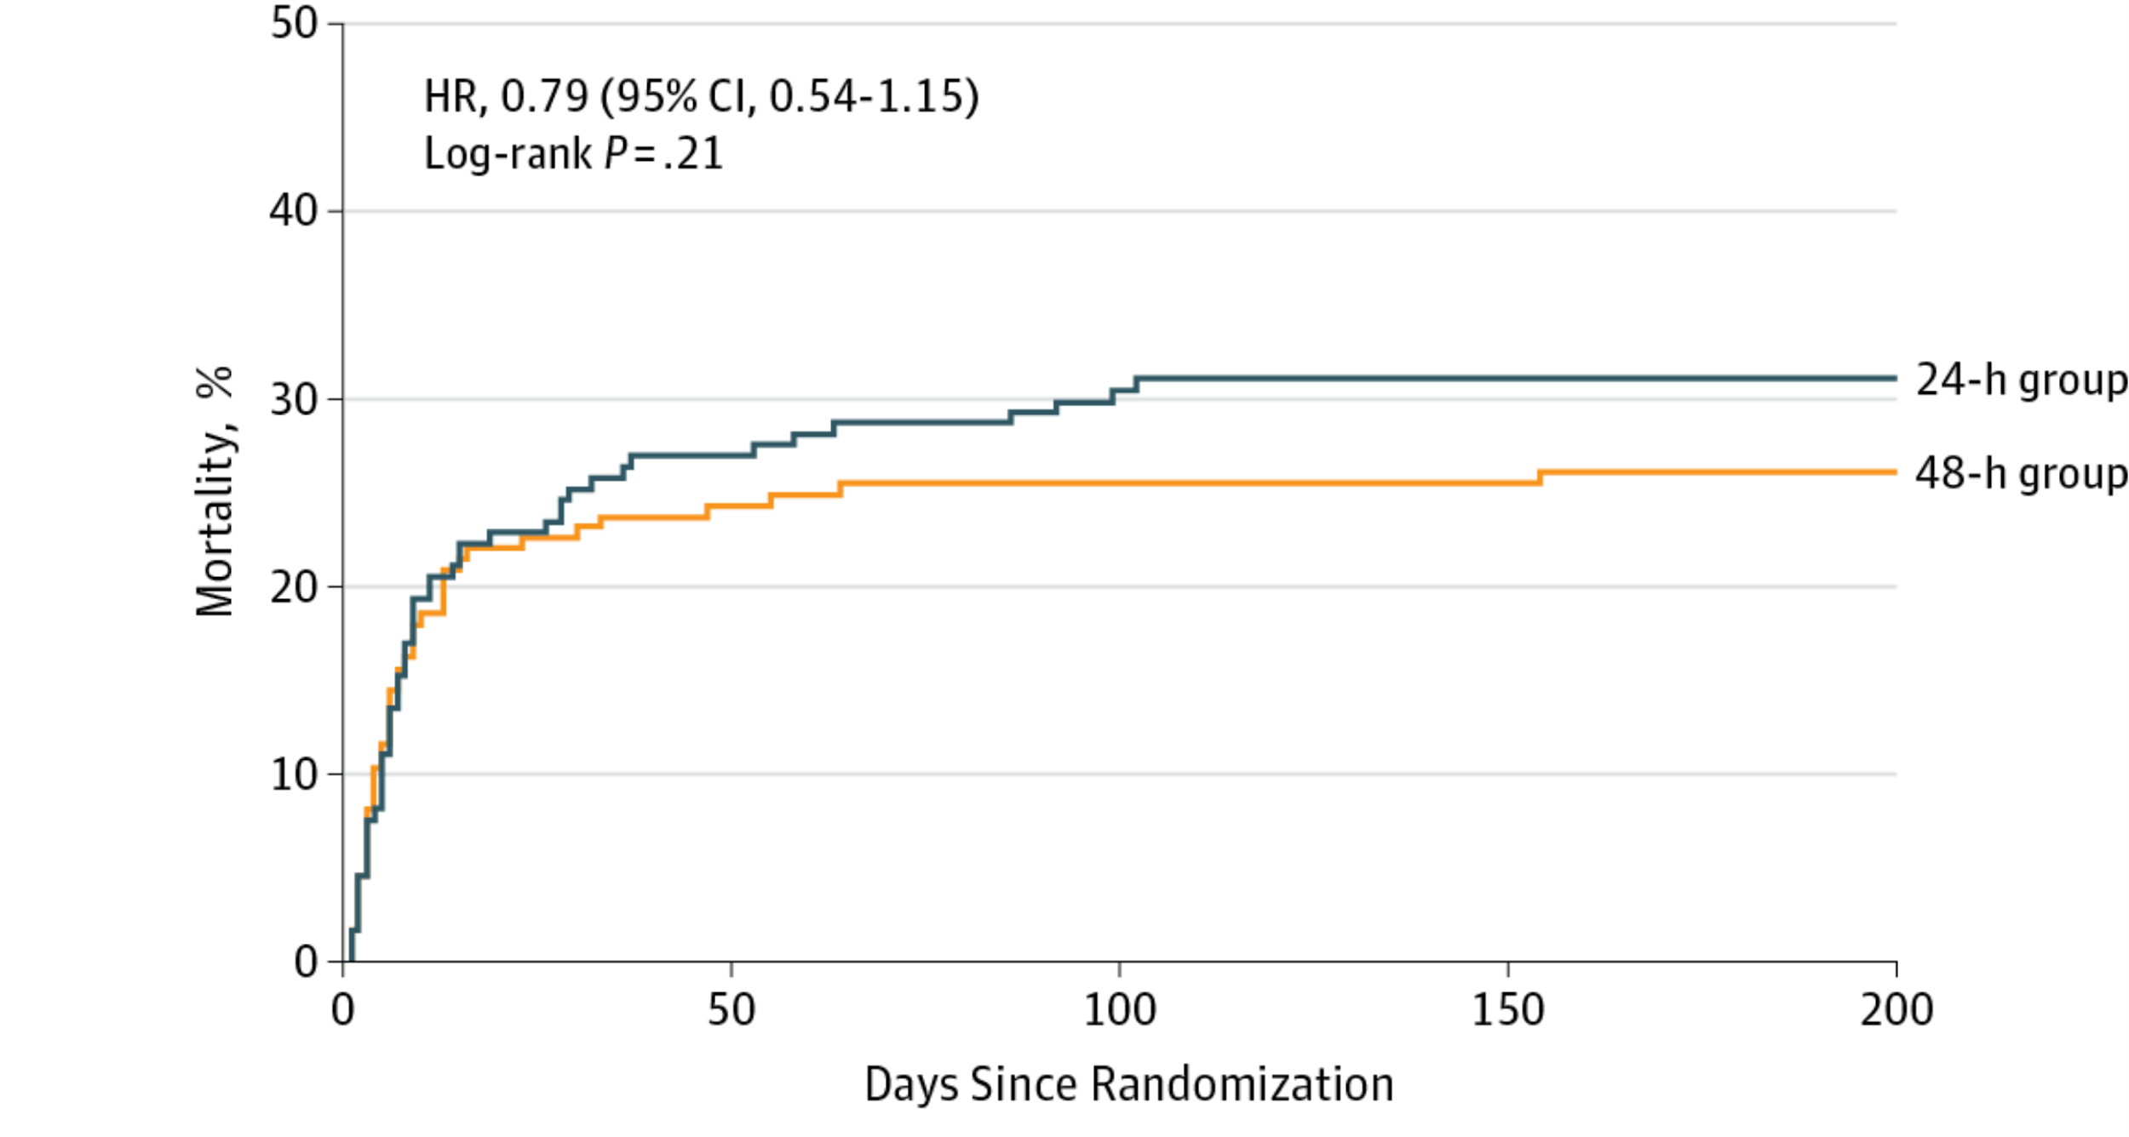
From: Targeted Temperature Management for 48 vs 24 Hours and Neurologic Outcome After Out-of-Hospital Cardiac Arrest A Randomized Clinical Trial
JAMA. 2017;318(4):341-350. doi:10.1001/jama.2017.8978
Figure Legend:
Probability of Death With Standard and Prolonged Targeted Temperature Management.Kaplan-Meier probability of death from randomization to 6 months (200 days) in the study groups. Median follow-up time was 184 days (IQR, 33-196 days) in the 48-hour group and 181 days (IQR, 15-193 days) in the 24-hour group.
Copyright 2017 American Medical Association. All Rights Reserved.
Notes:
What about human efficacy data? A European trial published in 2017 randomized 355 comatose survivors of cardiac arrest to 24 or 48 hours of cooling. The study was powered to detect a 15% absolute difference in survival with good neurological outcome, but observed a 5% improvement in good outcome and a 7% improvement in survival. These were not statistically significant but would have been clinically important if real and not random.
It is unclear what can be learned from this underpowered neutral study. It is consistent with (but not indicative of) an effect of duration of cooling on outcome in humans. Clearly it illustrates the need to properly power trials to detect clinically important effects.

Slide 13
Systemic Hypothermia After Neonatal Encephalopathy: Outcomes of neo.nEURO.network RCT
Simbruner G, Mittal RA, Rohlmann F, Muche R and neo.nEURO.network Trial Participants
Volume 126, Number 4, October 2010
Notes:
Experience with duration of cooling in patients with neonatal brain ischemia is less direct, but may also be informative. Following several multicenter clinical trials of cooling, all for 72 hours, this is standard care for these patients in most NICU. Of note, all of these 72 hour neonatal trials are also more strongly positive and more reproducible than the 12 and 24 hours cardiac arrest trials to date.

Slide 14
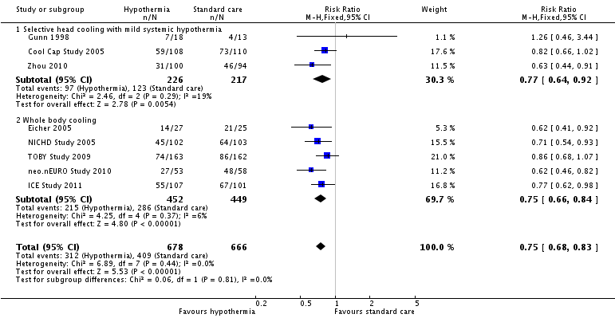
72 Hours of cooling for newborns with hypoxic ischaemic encephalopathy
Cochrane Database of Systematic Reviews 31 JAN 2013 DOI: 10.1002/14651858.CD003311.pub3
Notes:
This is a Forest plot from a Cochrane meta-analysis of neonatal hypothermia trials demonstrating a consistent pattern of efficacy of 72 hours of cooling to 33 deg C for this other population of patients with global brain ischemia. The cumulative risk ratio on death and disability for 72 hours of hypothermia versus standard care is 0.75 with narrow confidence intervals.

Slide 15
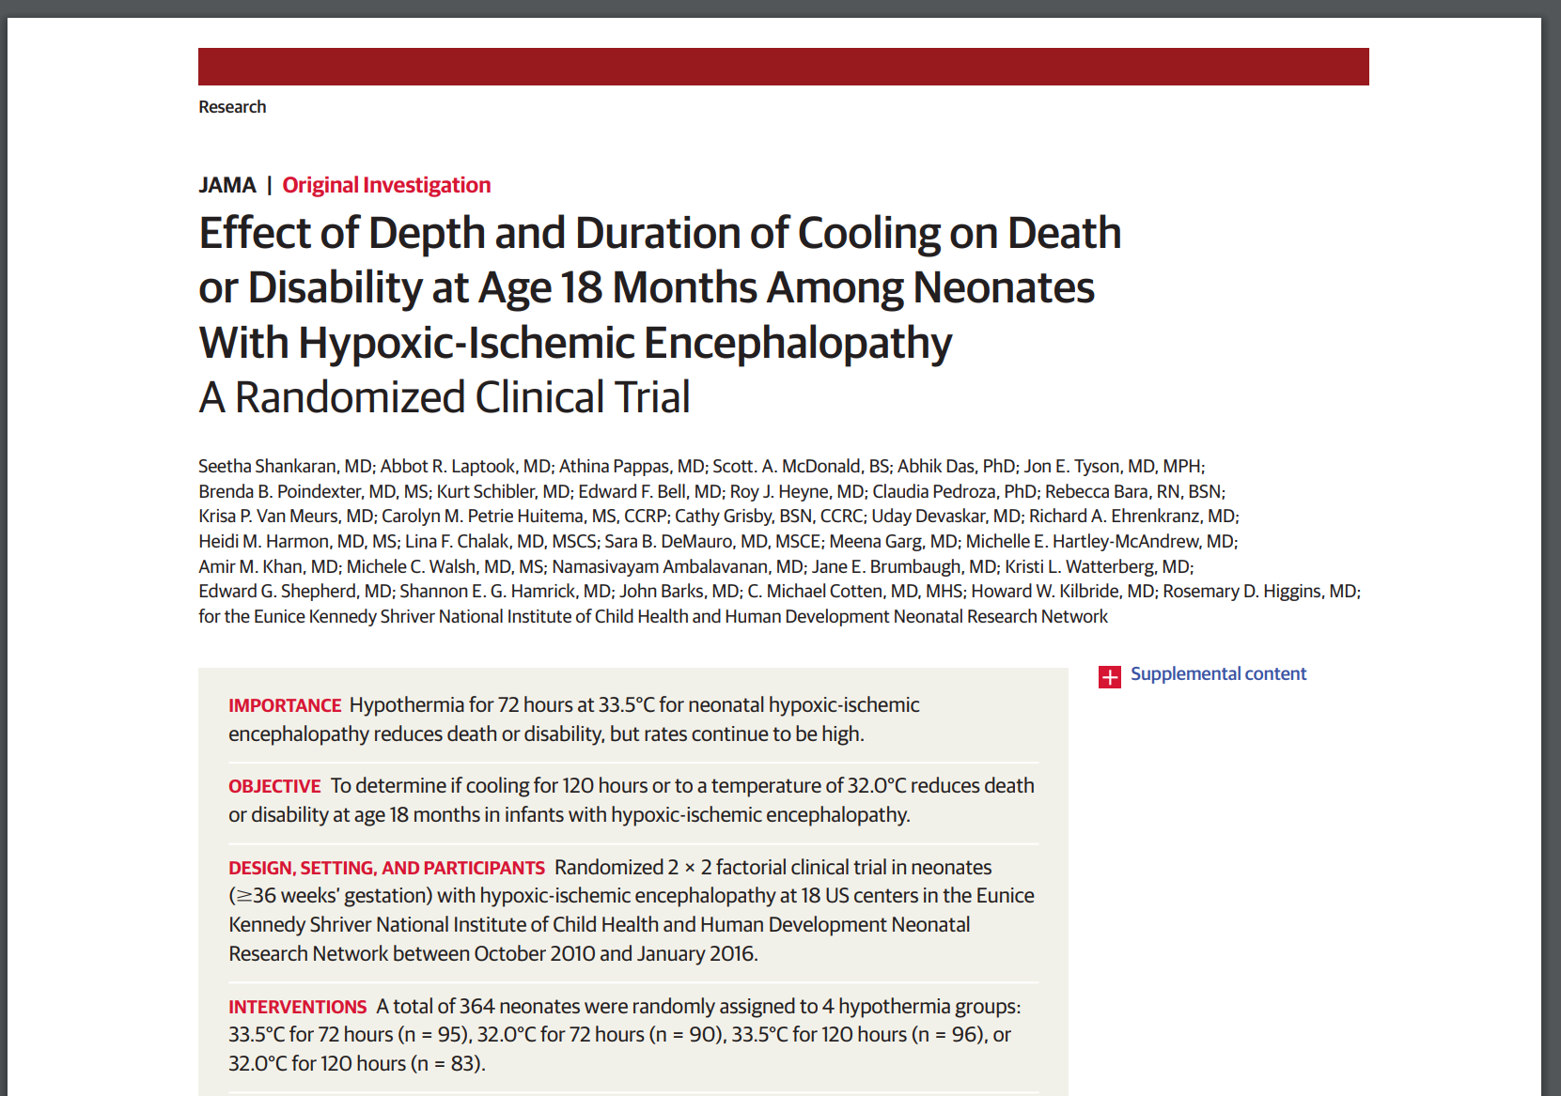
Effect of Depth and Duration of Cooling on Death or Disability at Age 18 Months Among Neonates With Hypoxic-Ischemic Encephalopathy: A Randomized Clinical Trial
JAMA. 2017;318(1):57-67
Factorial Design
72 versus 120 hours
33.5°C versus 32°C
Stopped for futility
Death and disability 31.8% v. 31.6%
Death 13% v 19%
Mod-Severe disability 22% v 15%
Notes:
Duration of hypothermia is a research priority in neonatal brain ischemia as well, and has been studied by the NICHD. A multicenter factorial trial of cooling for 72 versus 120 hours, and of 32 versus 33.5 deg C was recently published. There was no difference between the two durations in the composite endpoint of death and disability which were 31.8 and 31.6% respectively. This may represent the plateau of a duration response curve.
Of uncertain significance is that the longer duration of cooling was associated with lower rates of moderate and severe disability, and less cerebral palsy in survivors, but this was offset by more frequent deaths.
This trial also illustrates the difficulty of figuring out the best duration based on comparing only two durations. Is 72 hours the best duration? Are we on plateau and cooling too long even at 72 hours, or was there a peak between 72 and 120 where disability was reduced without the increase in mortality? Comparing only two durations doesn’t reveal the shape of the duration response curve. We’ll come back to that too.

Slide 16
Why this trial?
Translational science
Clinical importance
Meaningful answers
Notes:
It isn’t enough to be scientifically promising, the trial has to be clinically important. This trial is clinically important. It is designed to answer clinicians’ questions critical to caring for patients, and it addresses questions of regulatory science important to FDA.
It addresses the knowledge gaps identified in the 2017 AAN clinical guideline, and in the most recent 2015 ILCOR advisory statement.

Slide 17
Real? Optimized?
Non-responders
200,000 patients shockable cardiac arrest
200,000 patients non-shockable cardiac arrest
Notes:
Why are these the important questions? There are close to 400,000 victims of out of hospital cardiac arrest. This is a common, devastating emergency.
Consider first, only the half of these patient that present with v-fib or v-tach, the shockable forms of cardiac arrest. Perhaps a quarter of these patients will survive to hospital discharge with a favorable neurological outcome without hypothermia. (click) The early clinical trials of TTM suggested that induced hypothermia, as tested, might double that. If true, that still leaves us with a 50% rate of non-responders. (click) So a first critical question is how do we optimize our treatment to improve outcomes in this large group of non-responders. Both AAN and ILCOR identify whether longer duration of cooling can optimize dose as a key opportunity.
But then, we also have the other half of these out of hospital cardiac arrest patients, those with initially un-shockable cardiac arrests. (click) Their resuscitation rates and survival rates to hospital discharge are substantially lower. Targeted temperature management has been extrapolated and used in these patients based on clinical judgement and observational data, but we have only one recent small randomized clinical trial published last month to support what has become a standard practice. So, another question, maybe two. Can hypothermia really improve the outcomes of these patients? And if initial rhythm is a marker of severity, might the optimal duration be different in these patients? Again, these questions of what patient populations benefit from TTM and whether different populations need different durations are the questions identified in the ILCOR statement.
(click) But we also need to go back to these people whom I said we think have better outcomes based on the early clinical trials, because maybe they don’t. FDA has always had concerns about the methodology of those early trials, and the European TTM trial has added to that uncertainty. Can we confirm or reject the current guideline based standard use of TTM? Does cooling help at all in these patients? And if it does, then the advisory statements identify another important knowledge gap related to this population discharged with good neurological outcomes. Just how good are these outcomes? Survivors with good outcomes still have distressing residual problems on patient reported outcomes and neuropsych testing. Can patient outcomes be optimized if we measure these morbidities too?
This trial is important today, because it will inform on all of these questions that matter to patients and clinicians, and that are of regulatory importance.
http://www.heart.org/HEARTORG/General/Cardiac-Arrest-Statistics_UCM_448311_Article.jsp

Slide 18
Specific Aims
In each of two populations of adult comatose survivors of cardiac arrest (those with initial shockable rhythms and those with PEA/asystole)
Can longer durations of hypothermia improve patient outcomes?
Can the efficacy of hypothermia be confirmed by evaluating duration response?
Does duration have a differential effect on safety and quality of recovery?
Notes:
From those questions we have developed these specific aims and study objectives.
In each of two populations of adult comatose survivors of cardiac arrest (those with initial shockable rhythms and those with PEA/asystole):
Can longer durations of hypothermia improve patient outcomes?
Can the efficacy of hypothermia be confirmed by evaluating duration response?
Does duration have a differential effect on safety and quality of recovery?

Slide 19
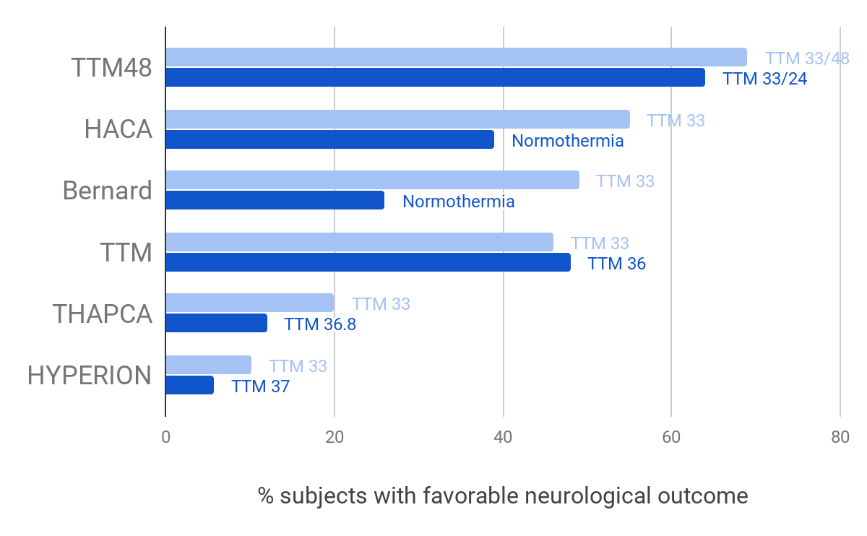
Notes:
A couple of trials of hypothermia in recent years make ICECAP more important than ever. Current clinical guidelines and practice are largely based on the 2002 Bernard and HACA trials, published together in the NEJM showing concordant and substantial improvements in survival with good neurological outcomes in patients with cooling as compared to normothermia. These were small trials with methodological limitations, but they changed practice.
The European TTM trial was meant to address limitations of the earlier trials and was reported in 2013. It used the same devices in both groups to actively manage temperature, but compared target temperatures of 33 versus 36 degrees. It was larger and had relatively stronger methodology than the earlier trials, and it showed no difference between the groups. Interestingly outcomes in both groups were similar to the cooling arms of the previous trials. Varied interpretations have created clinical confusion. Although the authors disagree, some say the TTM trial means that cooling devices don’t work, and have abandoned the practice altogether. Others say that it was just a trial of TTM versus TTM in which TTM won, with no preference for one target temperature over another in efficacy or safety. As such, it offers no reason to change practice, and does not seem to have changed practice much in the US. In a survey of our planned sites, and in a straw poll of hands at a plenary session of the Neurocritical Care Society a couple of years ago, cooling to 33 remained consistent with most current practice. Criticisms of the trial, including a very long delay to cooling and too rapid rewarming have resulted in the same group tweaking some of these parameters and repeating the trial, which is now ongoing.
The recent HYPERION trial used 33 versus 37 degree targets for targeted temperature management in patients with non-shockable rhythms. It demonstrated improved outcomes in the 33 degree group and was a positive study based on the prespecified primary hypothesis.
The other study I want to mention here is the NHLBI THAPCA trial of TTM in children with out of hospital cardiac arrest which was led by my colleague at the University of Michigan Frank Moler and Mike Dean at Utah. This was an important trial that compared cooling to normothermia. The trial was powered to detect a 15 to 20% absolute benefit. What they observed was a much lower than expected event rate in the control group, and an absolute increase of 8% in good outcomes in the hypothermia group (from 12 to 20%). Even though this was the same relative improvement they had planned for (and about the same OR as the original adult trials), they were unfortunately underpowered to detect this difference. So, the trial was neutral, but I challenge anyone to say that they wouldn’t care which treatment their child would get based on these data.
These trials have created confusion, but not nihilism about this treatment. The results of recent years make the questions that ICECAP is designed to answer ever more important and necessary. The use of duration-response to determine efficacy is appealing because it is acceptable to those with or without clinical equipoise. We have even talked to Frank Moler and Mike Dean about this, and they have interest in a proposing an ancillary pediatric ICECAP cohort if we move forward.
This trial is clinically important now more than ever.

