Slide 1
Hyperbaric Oxygen Brain Injury Treatment Trial: A Multicenter Phase II Adaptive Clinical Trial
June 11, 11:00 a.m. – 12:30 pm ET
June 13, 3:00 – 4:30 pm ET
Virtual Investigator Meeting
June 13, 2019

Slide 2
Welcome
Blue Jean Etiquette
To avoid an echo, please make sure you only have audio playing out of one device (either computer or phone)
Please make sure you are on mute if you are not speaking or presenting
Please do not put the line on hold, if you need to take another call, please hang up and dial back in afterwards
Access to Protocol Refresher Quiz
Go to pollev.com/nataliefishe198
Virtual Investigator Meeting
June 13, 2019

Slide 3
Agenda
Tuesday, June 11, 2019; 11:00am – 12:30pm ET
Start | End | Item | Presenter
11:00am | 11:05am | Welcome | Gaylan Rockswold, MD, PhD
11:05am | 11:10am | Study Enrollment Update | Bill Barsan, MD
11:10am | 11:55am | Protocol Refresher
11:10am | 11:35am | Overview and Quiz | Fred Korley, MD, PhD
11:35am | 11:40am | Can a potential subject with a pneumothorax be enrolled? | Chris Logue, MD (Hennepin)
11:40am | 11:45am | When does pulmonary dysfunction disqualify a potential subject from enrollment? | Gaylan Rockswold, MD, PhD (Hennepin)
11:45am | 11:50am | Can an potential subject intoxicated with drugs and alcohol be enrolled? | Luke James, MD (Duke)
11:50am | 11:55am | Remote Consent is Awesome! | Cathy Fairfield (Iowa)
11:55am | 12:05pm | Screening Best Practices (peer to peer) | Abbey Staugaitis (HCMC) Eric Jaton (HCMC) Cathy Fairfield (Iowa)
12:05pm | 12:15pm | Adverse Event Reporting | Sarah Rockswold, MD
12:15pm | 12:25pm | Ongoing Training of Clinical Staff Best Practices (peer‐to‐peer) | Abbey Staugaitis (HCMC) Eric Jaton (HCMC) Cathy Fairfield (Iowa)
12:25pm | 12:30pm | Closing Remarks | Gaylan Rockswold, MD, PhD
Virtual Investigator Meeting
June 11, 2019

Slide 4
Agenda & Welcome
Thursday, June 13, 2019; 3:00pm – 4:30pm ET
Start | End | Item | Presenter
3:00pm | 3:05pm | Welcome | Gaylan Rockswold, MD, PhD
3:05pm | 3:10pm | Study Enrollment Update | Bill Barsan, MD
3:10pm | 3:55pm | Protocol Refresher
3:10pm | 3:35pm | Overview and Quiz | Fred Korley, MD, PhD
3:35pm | 3:40pm | Can a potential subject with a pneumothorax be enrolled? | Chris Logue, MD (Hennepin)
3:40pm | 3:45pm | When does pulmonary dysfunction disqualify a potential subject from enrollment? | Gaylan Rockswold, MD, PhD (Hennepin)
3:45pm | 3:50pm | Can an potential subject intoxicated with drugs and alcohol be enrolled? | Luke James, MD (Duke)
3:50pm | 3:55pm | Remote Consent is Awesome! | Cathy Fairfield (Iowa)
3:55pm | 4:05pm | Screening Best Practices (peer to peer) | Cathy Fairfield (Iowa) Rachael Woodburn (Duke)
4:05pm | 4:15pm | Adverse Event Reporting | Sarah Rockswold, MD
4:15pm | 4:30pm | Ongoing Training of Clinical Staff Best Practices (peer‐to‐peer) | Abbey Staugaitis (HCMC) Eric Jaton (HCMC) Bill Gossett (HCMC)
4:30pm |  | Closing Remarks | Gaylan Rockswold, MD, PhD
Virtual Investigator Meeting
June 13, 2019

Slide 5
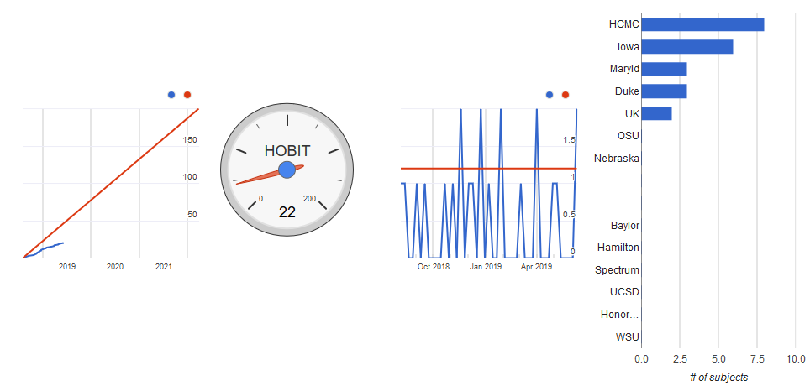
Study Enrollment Update
7 sites open
Virtual Investigator Meeting
June 13, 2019

Slide 6
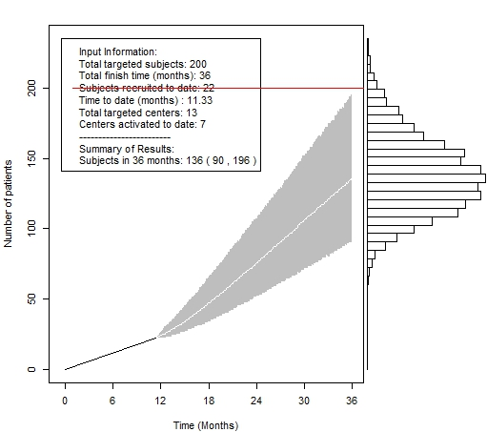
Study Enrollment Update
Virtual Investigator Meeting
June 13, 2019

Slide 7
Protocol Refresher
Overview and Quiz
Access to Protocol Refresher Quiz
Go to pollev.com/nataliefishe198
Respond to question within 10 seconds after it is read
Virtual Investigator Meeting
June 13, 2019

Slide 8
Notes:
Poll Title: Can I report an unanticipated problem or adverse event or protocol deviation directly to the IRB? https://www.polleverywhere.com/multiple_choice_polls/tehNUjdg4Kgpt6Cbhn9Ah

Slide 9
Notes:
Poll Title: Can a subject who has a seizure post-enrollment still receive HBO treatment? https://www.polleverywhere.com/multiple_choice_polls/qyiarbCyd2oFRHDOSjto7

Slide 10
Notes:
Poll Title: What should I be doing to ensure that my site does not miss any potential subjects? https://www.polleverywhere.com/multiple_choice_polls/rDiDAtn9XpGGY7dPf9SV7

Slide 11
Notes:
Poll Title: Do all GOSE assessment sessions have to be audio/video recorded? https://www.polleverywhere.com/multiple_choice_polls/WZSV1Duq400uxpcCvvyco

Slide 12
Notes:
Poll Title: All patients with spinal fractures should be excluded from the HOBIT study https://www.polleverywhere.com/multiple_choice_polls/gTkUhBdyjRB9EgJgggUiy

Slide 13
Notes:
Poll Title: When replacing the air in the endotracheal tube cuff with water prior to initiating HBO treatment, which of the following should not be done https://www.polleverywhere.com/multiple_choice_polls/bArxyokpBV4EBkx3OvsnV

Slide 14
Notes:
Poll Title: The HBO chamber logs need to be completed for every dive https://www.polleverywhere.com/multiple_choice_polls/h7GoiU3OTT6IE2zWJCrO9

Slide 15
Notes:
Poll Title: Should hyperbaric treatments continue if the subject starts following commands? https://www.polleverywhere.com/multiple_choice_polls/N2y8SFUCa6WVd7iVhacIr

Slide 16
Notes:
Poll Title: Which of the following is a recommended approach for helping LARs and families understand what HBO treatment entails? https://www.polleverywhere.com/multiple_choice_polls/chwZsI7HvUQm6EavyeZRJ

Slide 17
Notes:
Poll Title: Which GCS should be used to determine eligibility for HOBIT https://www.polleverywhere.com/multiple_choice_polls/W15OJ41zAEN1GoG2J2sgd

Slide 18
Can a Potential Subject with a
Pneumothorax be Enrolled?
Chris Logue MD, HCMC

Slide 19
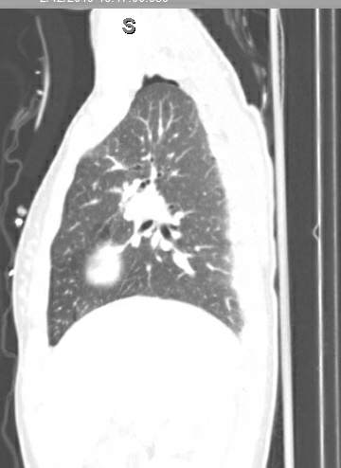
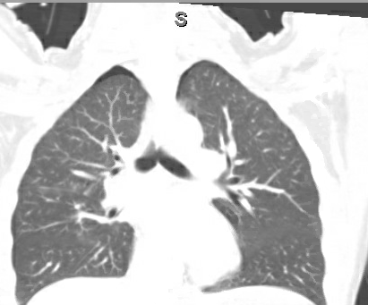
12 Feb 2019 Screen Fail - 17 YOF MVC
Initial Presentation
R lung
Virtual Investigator Meeting
June 13, 2019

Slide 20
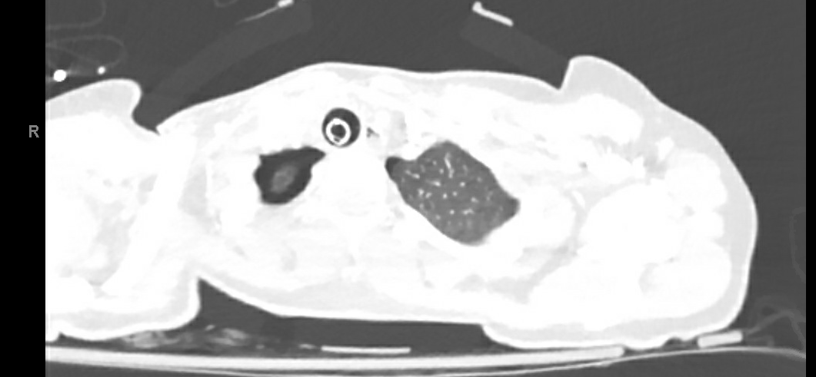
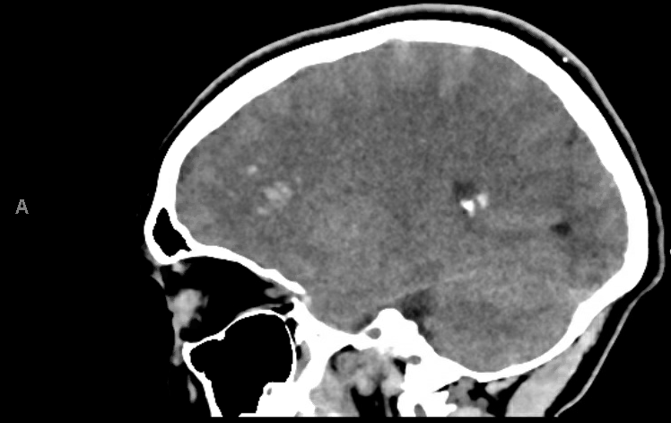
CT Images
12 Feb 2019 Screen Fail - 17 YOF MVC
Virtual Investigator Meeting
June 13, 2019

Slide 21
Hospital Course
Pt arrives at 1600 via HEMS following high speed MVC, unrestrained passenger
Intubated, pan scan, admitted to PICU with NSG consult. GCS 6
CT Chest shows “trace bilateral pneumothorax”, contusion, possible aspiration
HCT shows IPH, no midline shift
EVD/Licox/ART/Central Line placed
HBO advised of potential. Concern for the bilat ptx if randomized to HBO
Virtual Investigator Meeting
June 13, 2019

Slide 22
Hospital Course Continued
Due to pulmonary injuries, NSG pulls ABG to assess gas exchange
PaO2 = 332, FiO2 = 0.60, P/F ratio = 553. OK
Coordinators in discussion with SICU/PICU about ICU RN staffing if randomized to dive, Dr. Rockswold discusses with Peds Intensivist. Plan made
HBO reviews Chest CT imaging, ok without bilat chest tubes for ptx if diving. Requests CXR to reassess
Trauma advised of plan, decline to enroll (4 hours post page)
PICU/HBO/NSG/SICU advised no-go
Virtual Investigator Meeting
June 13, 2019

Slide 23
Recommendations
No-go for Monoplace
At the discretion of the HBO team-Multiplace
Chest imaging immediately before each dive, vigilance on lung assessment (as usual)
Staff at chamberside that can perform a needle decompression
Have equipment, meds, at bedside for a chest tube insertion
Chest imaging immediately after each dive, vigilance on lung assessment (as usual)
Virtual Investigator Meeting
June 13, 2019

Slide 24
When Does Pulmonary Dysfunction Disqualify a Potential Subject from Enrollment?
Gaylan Rockswold, MD, PhD; HCMC

Slide 25
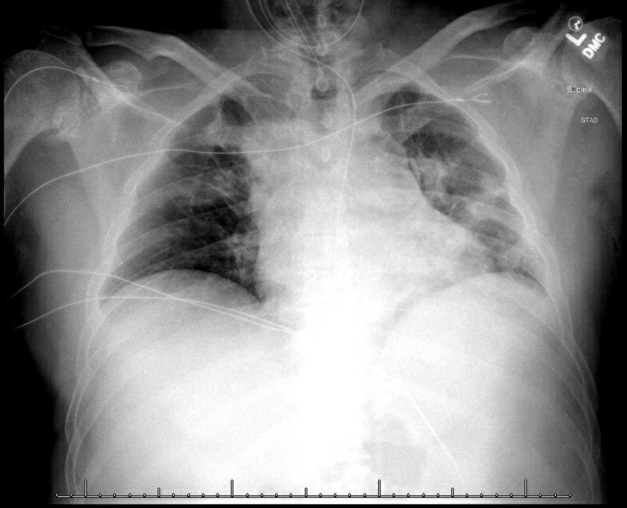
Initial Presentation
1163 - 59 YOM Highway MVC Enrolled 1/1/2019
Virtual Investigator Meeting
June 13, 2019

Slide 26
Hospital Course
1163 – 59 YOM Highway MVC, enrolled 1/1/2019
Scattered SAH, R IPH
Probable aspiration event prehospital
GCS 6, baseline FiO2 of 50%
Screened for HOBIT 12/31 22:00, enrolled at 0031 2.5 ATA + 3 hr NBH.
No P/F ratio done until pt in HBO suite
Upon arrival to HBO for dive #1 - ABG drawn
ABG resulted with PaO2 84. PaO2/FiO2 = 168
P/F ratio below 200. All subsequent dives aborted for pulmonary function
Virtual Investigator Meeting
June 13, 2019

Slide 27
Recommendation
If pt Fi02 requirement is equal or greater than 40%, and/or there is chest injury/aspiration, a P/F ratio and pulmonary status has to be evaluated prior to randomization
Virtual Investigator Meeting
June 13, 2019

Slide 28
Can a Potential Subject Intoxicated with Drugs and Alcohol be Enrolled?
Luke James, MD; Duke

Slide 29
Hospital Course
20:00: 65 yo female fell down a flight of stairs, +LOC
Initial GCS per EMS: 8 → 3 during transport
20:30: ED arrival
Multiple face and head lacerations, orbital wall fracture, and acute hypoxic respiratory failure
Sedated, paralyzed and intubated
Blood alcohol level = 300 mg/dl
Head CT: bilateral SAH
Pre-randomization GCS off sedatives and paralytics: 6T (E1V1M4)
23:00: EVD placed by neurosurgery
Virtual Investigator Meeting
June 13, 2019

Slide 30
Hospital Course
Two long conversations with subject’s husband to verify history
Neurosurgeon and study PI discussions re: keeping subject in trial after consent was signed.
Evidence supporting TBI
SAH on head CT; clear mechanism of TBI; normal neuro exam at baseline and comatose immediately after injury; only improved to GCS 7 during the following 5 hours.
Virtual Investigator Meeting
June 13, 2019

Slide 31
Outcome
9 hours after first HBO treatment: GCS=11T; Extubated.
Day 2: EVD removed
Day 5: discharged
Virtual Investigator Meeting
June 13, 2019

Slide 32
Remote Consent is Awesome!
Cathy Fairfield; Iowa

Slide 33
Screening Best Practices
Cathy Fairfield; Iowa
Using the screener form with key points to capture
Team receives Trauma pages prior to the subject arrival to ED
Research team has 24/7 coverage between being in the ED & On Call
Research team member goes to the trauma room to gather info before it is placed in Epic
Research team member talking with clinical staff- neurosurgery, nursing, ED team
Virtual Investigator Meeting
June 13, 2019

Slide 34
Screening Best Practices Eric Jaton & Abbey Staugaitis; HCMC
The NSG service is our eyes and ears for enrollments
We keep it as simple as possible, and within their normal clinical decision making. Are you thinking of placing an ICP monitor in this patient? Yes? A HOBIT coordinator should be paged.
Virtual Investigator Meeting
June 11, 2019

Slide 35
Screening Best Practices
Rachael Woodburn, Duke
Utilizing the ED team and the anesthesia CRU to screen for potential patients
Paging the neurosurgeons about once a week to remind them to page our designated HOBIT pager with anyone they think maybe even a slight potential. Study team will then do a “deeper dive” into the chart ASAP
Informing the hyperbaric team immediately when we think we have a potential patient to give them as much time as possible to prepare their staff and the chamber
Communication is key!
Virtual Investigator Meeting
June 13, 2019

Slide 36
Adverse Event Reporting
Sarah B. Rockswold, MD; HCMC

Slide 37
Adverse Event Reporting - Objectives
What are the expected HOBIT SAEs
Currently what are the most common HOBIT SAEs
Become familiar with combining related SAEs into one event
Realize the importance of reporting the temporal relationship between the adverse event and treatment
Virtual Investigator Meeting
June 13, 2019

Slide 38
Adverse Event Reporting – Expected SAEs
Signs of Pulmonary Dysfunction
PaO2/FiO2 ≤ 200 or requiring PEEP > 10 cm of water to maintain a PaO2/FiO2 ratio of > 200
Pneumothorax induced by HBO therapy
Pneumonia
Virtual Investigator Meeting
June 13, 2019

Slide 39
Adverse Event Reporting – Expected SAEs
Critically decreased Cerebral Perfusion Pressure (CPP)
CPP < 60 mmHg on at least 2 consecutive measurements obtained at least 30 minutes apart
Hypercarbia during transportation
PaCO2 > 45 mmHg on arterial blood gas obtained post-transport to HBO chamber and before HBO treatment
Seizures during HBO treatment
Virtual Investigator Meeting
June 13, 2019

Slide 40
Adverse Event Reporting – Expected SAEs
Critical hypotension
-Mean arterial pressure (MAP) < 70 mmHg on at least 2 consecutive measurements obtained at least 30 minutes apart
For both critically decreased CPP and MAP
-During the first 5 days of treatment, all episodes of either should be recorded as one SAE. The start time is the time of the first occurrence of critical decrease in CPP/MAP and the end time is when the decrease in CPP/MAP finally resolved
Virtual Investigator Meeting
June 13, 2019

Slide 41
Adverse Event Reporting
Summary of all Serious Adverse Events by medDRA organ system and preferred term (4/23/2019)
SAEs by MedDRA SOC & PT Names |  | Total N (%)
Total Subjects with at least one SAE |  | 13 | (72.2)
All SAEs |  | 28 | (100.0)
SOCName | PTName
Infections and infestations | Pneumonia | 7 | (25.0)
Vascular disorders | Hypotension | 2 | (7.1)
Nervous system disorders | Cerebral hypoperfusion | 4 | (14.3)
 | Haemorrhage intracranial | 1 | (3.6)
 | Seizure | 1 | (3.6)
 | Intracranial pressure increased | 1 | (3.6)
 | External hydrocephalus | 2 | (7.1)
 | Cerebrovascular accident | 1 | (3.6)
Surgical and medical procedures | Withdrawal of life support | 1 | (3.6)
 | Gastrointestinal tube insertion | 1 | (3.6)
Investigations | Pulmonary function test abnormal | 1 | (3.6)
 | Haemoglobin decreased | 1 | (3.6)
Blood and lymphatic system disorders | Anaemia | 1 | (3.6)
Renal and urinary disorders | Acute kidney injury | 1 | (3.6)
Respiratory, thoracic and mediastinal disorders | Lung disorder | 2 | (7.1)
 | Respiratory failure | 1 | (3.6)
Virtual Investigator Meeting
June 13, 2019

Slide 42
Adverse Event Reporting
The most common SAEs were expected
Pneumonia
Critically decreased CPP
Critical hypotension
These are all frequently seen in severe TBI patients, so will need to analyze treatment arms v. control subjects
Virtual Investigator Meeting
June 13, 2019

Slide 43
Adverse Event Reporting – Reporting Tips
The CCC is required to submit any SAEs that are determined to be unexpected and probably, possibly, or definitely related to the research procedures.
This notification to the IRB must occur promptly and no later than 10 business days from the time the investigator learns of the event
Virtual Investigator Meeting
June 13, 2019

Slide 44
Adverse Event Reporting – Reporting Tips
Combining groups of events reflecting identical underlying pathophysiology:
For example, if a subject has an elevated ICP and a decreased MAP/CPP all due to cerebral edema, report the cerebral edema SAE and put the ICP, MAP, CPP in the narrative
There is a SAE template that combines CPP,ICP, & MAP in the in the MOP within the HOBIT Safety Monitoring Plan
Virtual Investigator Meeting
June 13, 2019

Slide 45
Adverse Event Reporting – Reporting Tips
Report diagnoses not the symptoms or signs separately
Pneumonia (diagnosis) instead of cough, chest pain, fever, infiltrates on chest x-ray, and/or hypoxia
Virtual Investigator Meeting
June 13, 2019

Slide 46
Adverse Event Reporting – Reporting Tips
Death is an outcome and never a SAE
The adverse event name should be what caused the subject’s death (pathology)
Virtual Investigator Meeting
June 13, 2019

Slide 47
Adverse Event Reporting – Reporting Tips
Temporal relationship to enrollment and treatment
Prior to enrollment would not matter (unless severity worsens)
Need to have study arm, enrollment date/time, number of treatments, and end of treatment period to be in narrative
Important to note when SAEs such as CPP, hypotension, seizure occurs related to treatment (during or after)
Virtual Investigator Meeting
June 13, 2019

Slide 48
Adverse Event Reporting – Reporting Tips
The independent medical safety monitor (IMSM) does not have access to subject’s medical records. They need enough information to be able to determine the (1) severity of the event; (2) relatedness to the intervention; (3) expectedness
Virtual Investigator Meeting
June 13, 2019

Slide 49
Adverse Event Reporting – Conclusion
The most common SAEs currently are pneumonia, critically decreased CPP, and hypotension which were expected
It is important to group related SAEs together
Reporting temporal relationship to enrollment and treatment is critical
Virtual Investigator Meeting
June 13, 2019

Slide 50
Ongoing Training of Clinical Staff
Eric Jaton & Abbey Staugaitis; HCMC
Our NSG service has a Friday AM conference, which we present at every 3 months (at minimum). This captures all the senior residents multiple times, and catches the rotating/juniors residents at least once during their rotation. We also make ourselves available to do 1:1 training if a clinician expresses interest but needs help to get on-boarded as an investigator
We (the research team) also have multiple debriefs after each HBO randomization - one with HBO, one with NSG, and if possible, one with everybody (NSG, HBO, SICU, RT, Dr. R/PI, Research)
We have SICU cross train a few RNs that could cover a dive and follow the patient down to HBO, instead of HBO staff covering them all. This staffing flexibility is extremely important to have us ready to go 24/7
Biweekly email blast with our local notes to the entire NSG team. I usually attach this as a forward to Natalie's newsletter
Virtual Investigator Meeting
June 13, 2019

Slide 51
Ongoing Training of Clinical Staff Cathy Fairfield; Iowa
Use of the HOBIT checklist
Monthly meeting with HOBIT leadership team at UIHC
When a new SNICU nurse is with the subject at HBO- research team member share with him/her:
the HBO unit, the procedure of being there, what the team needs from him/her for charting in Epic
Virtual Investigator Meeting
June 11, 2019

Slide 52
Maintaining Competency with the Magellan Ventilator And Supporting Systems Bill Gossett (HCMC)
* Monoplace Sites Only

Slide 53
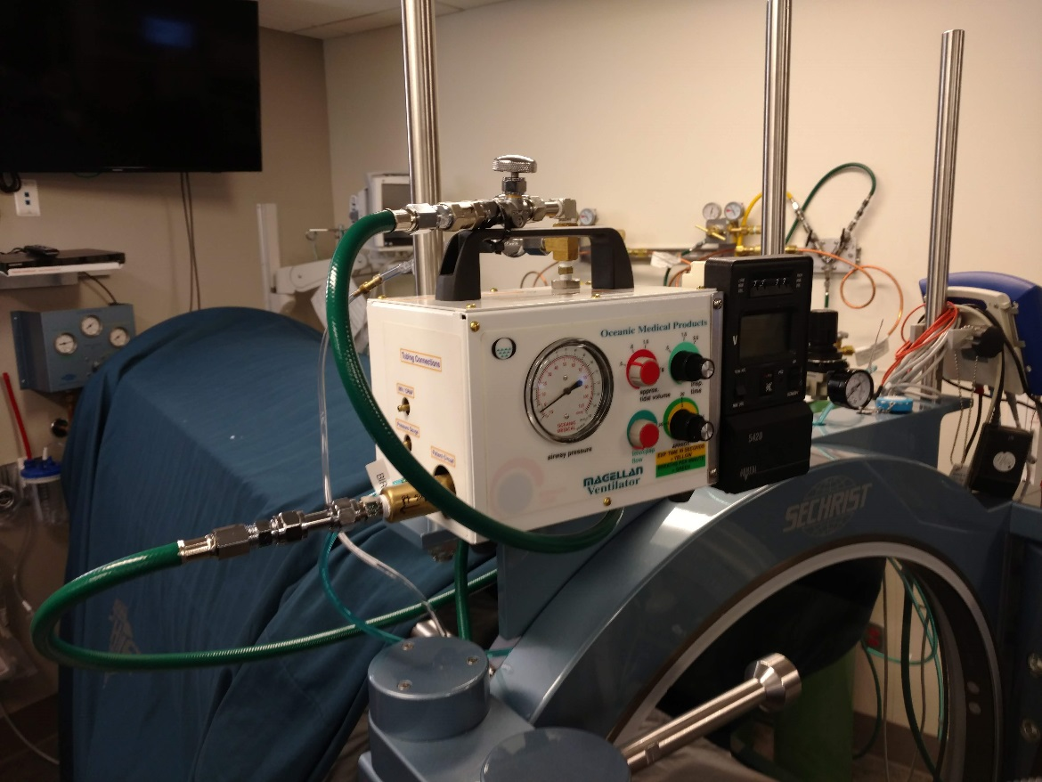
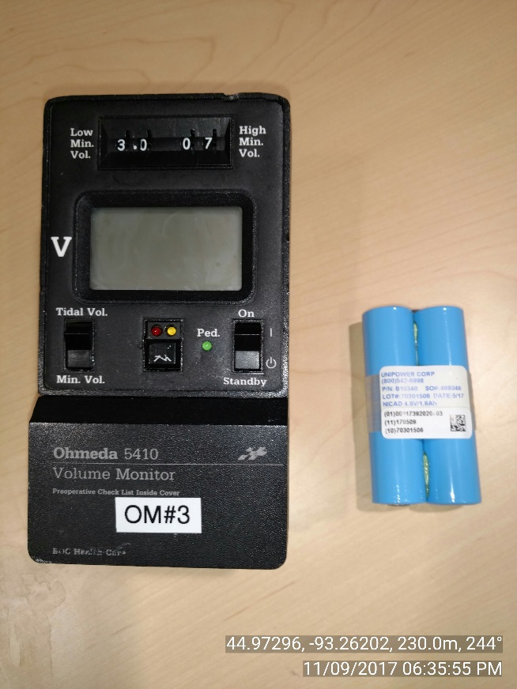
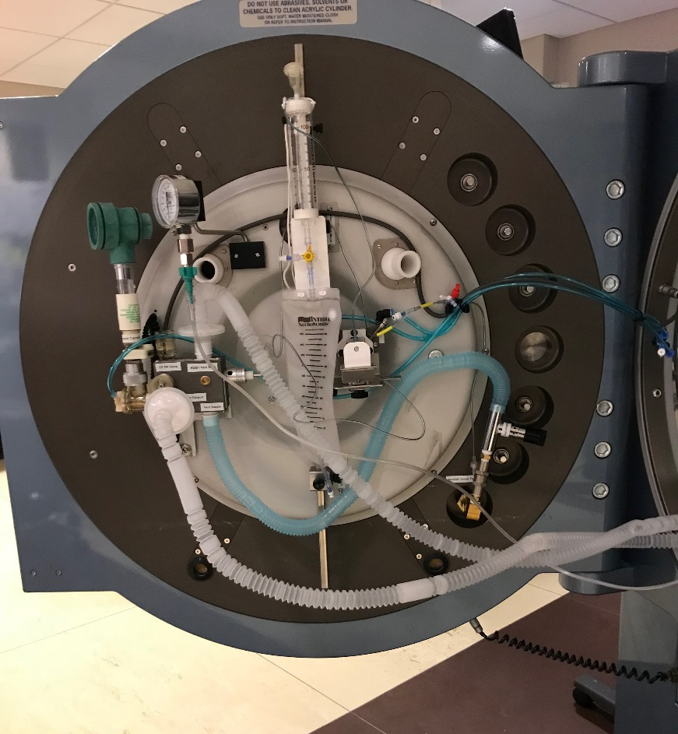
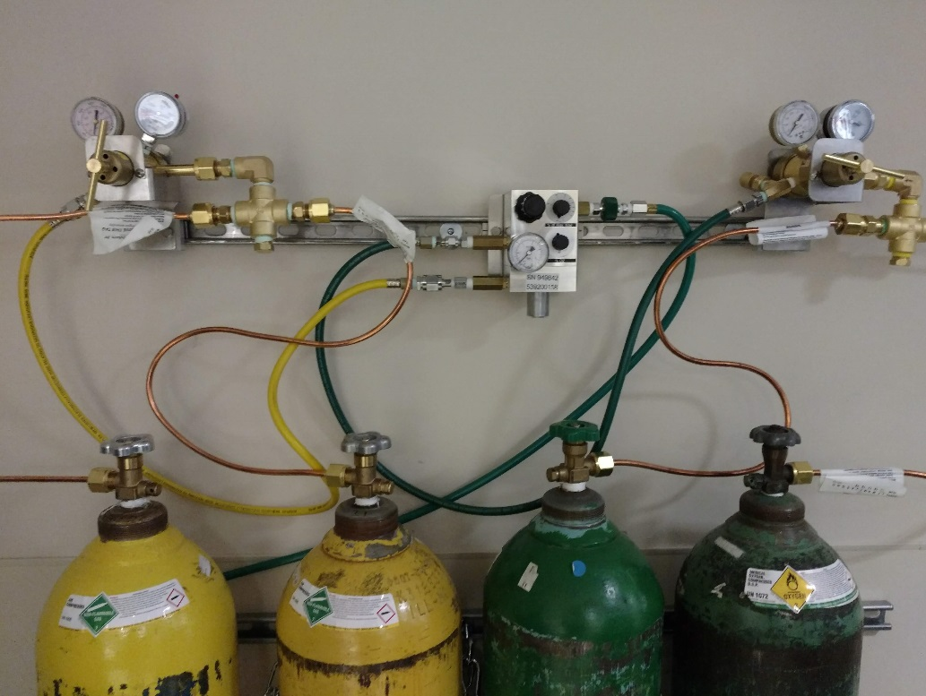
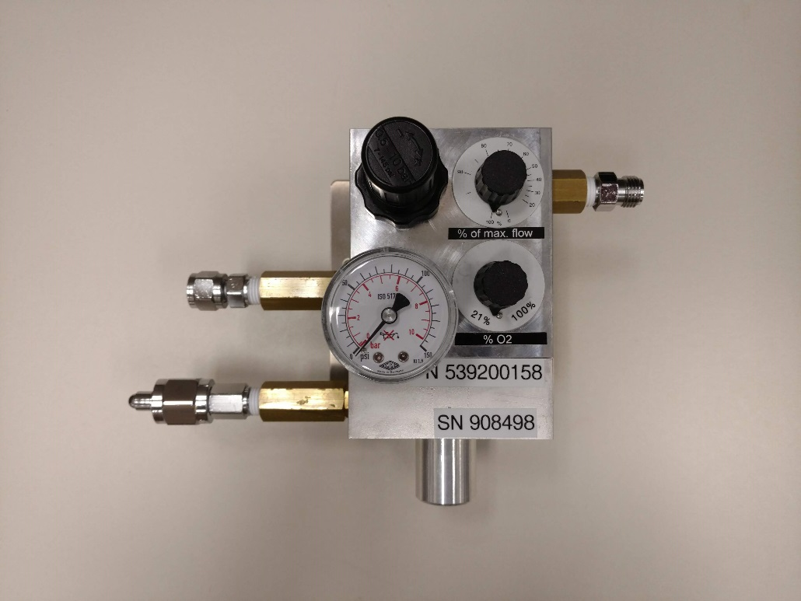
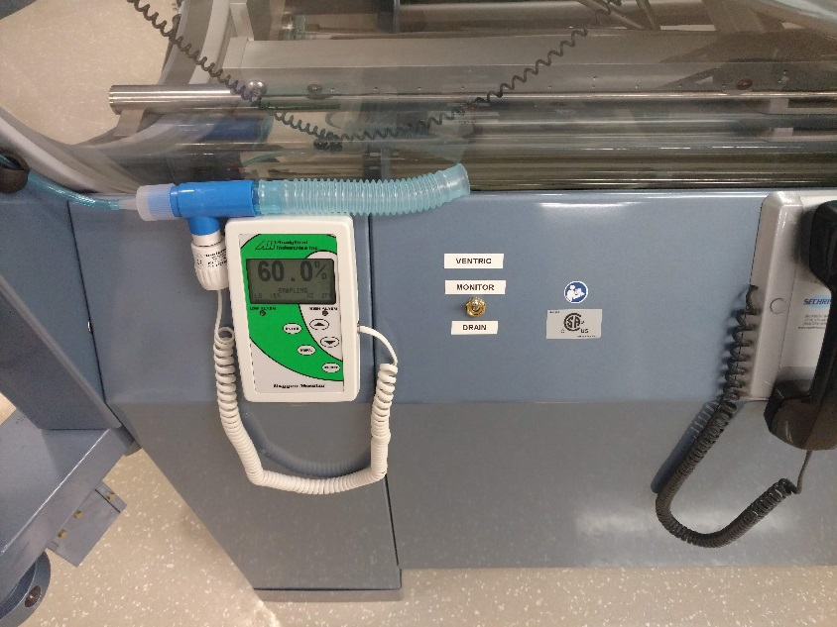
Virtual Investigator Meeting
June 13, 2019

Slide 54
Challenges of Maintaining Competency
DSMB expressed concern with how sites would maintain skill sets to safely ventilate subjects during a hyperbaric treatment
Challenges:
New and unfamiliar equipment
Vt, PIP and I:E ratios are constantly changing during compression and decompression
There can be long gaps of time between HOBIT subjects resulting in diminished skill sets and safety
Keeping multiple individuals trained and competent to safely operate the Magellan ventilator
Virtual Investigator Meeting
June 13, 2019

Slide 55
Refresher Training
An abbreviated training video for the Magellan and supporting system is coming soon, hopefully available by next month (July)
The training video will review equipment, system set up, operation of the ventilator during a hyperbaric treatment, and simple troubleshooting
Anyone who may potentially operate the Magellan needs to watch the training video at least every three (3) months
Please keep a record of your training
Virtual Investigator Meeting
June 13, 2019

Slide 56
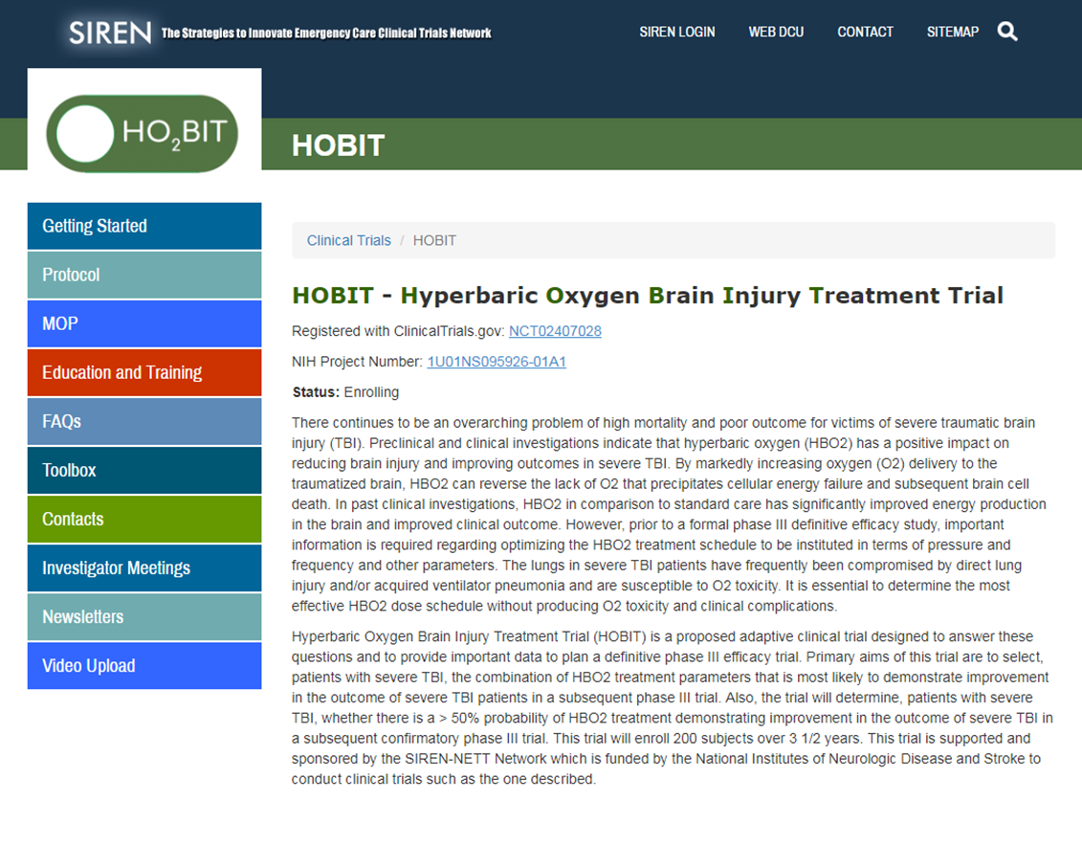
Training Videos in HOBIT Website “Toolbox”
www.hobittrial.org
FYI: The HYCEP training video is also available in the same HOBIT Toolbox. Important to review for prevention of VAP
Virtual Investigator Meeting
June 13, 2019

Slide 57
Closing Remarks
Virtual Investigator Meeting
June 13, 2019

