Slide 1


Hyperbaric Oxygen Brain Injury Treatment Trial: A Multicenter Phase II Adaptive Clinical Trial
November 22, 10:00 am – 12:00 pm ET
November 22, 2:00 pm – 4:00 pm ET
Virtual Investigator Meeting
November 22, 2019

Slide 2
Blue Jean Etiquette
To avoid an echo, please make sure you only have audio playing out of one device (either computer or phone)
Please make sure you are on mute if you are not speaking or presenting
Please do not put the line on hold, if you need to take another call, please hang up and dial back in afterwards
MUTE
Chat Box
Virtual Investigator Meeting
November 22, 2019

Slide 3
Agenda & Welcome
Friday, November 22, 2019; 2:00pm – 4:00pm ET
Start | End | Item | Presenter
2:00pm | 2:05pm | Welcome | Gaylan Rockswold, MD, PhD
2:05pm | 2:25pm | Protocol Update | Fred Korley, MD, PhD
2:25pm | 2:30pm | Regulatory Requirements & Milestone Document | Natalie Fisher
2:30pm | 2:35pm | EFIC Financial Considerations | Valerie Stevenson
2:35pm | 3:05pm | EFIC History & Regulations | Robert Silbergleit, MD
3:05pm | 3:45pm | EFIC Process & Documentation | Deneil Harney
3:45pm | 4:00pm | Discussion/Questions
Virtual Investigator Meeting
November 22, 2019

Slide 4
HOBIT Protocol Update
Frederick Korley, M.D., Ph.D.
University of Michigan

Slide 5
Rationale
37 subjects enrolled, 45 potential subjects missed due to inability to obtain informed consent from an LAR
Current median time for obtaining informed consent:
    5.8 (IQR: 4.7 - 6.3) hours after ED arrival for those not requiring surgery
    8.4 (IQR: 6.5 - 9.3) hours after ED arrival for those requiring surgery
Bias towards enrolling subjects requiring emergency surgery (60% of enrolled subjects)
Virtual Investigator Meeting
November 22, 2019

Slide 6
What’s unchanged
Obtaining informed consent during the first 6 hours following arrival to the ED
Efforts to identify an LAR
Inclusion and exclusion criteria
Study interventions
Outcome ascertainment
Virtual Investigator Meeting
November 22, 2019

Slide 7
What has changed
Document steps undertaken to identify the subject and find the LAR.
If no LAR is found 6 hours after presentation to the ED enroll subject under EFIC
Continue to look for LAR even after subject has been enrolled.
  LAR may withdraw subject from study at any time
  Continue attempts at identifying LAR until 6 month visit if needed.
  Can’t enroll subject if non-LAR family member declines
Consider starting preparatory work for HBO treatment before 6 hour mark
Conduct community consultation and public disclosure events
Virtual Investigator Meeting
November 22, 2019
Notes:
Realize that it is possible subject will not be randomized to HBO

Slide 8
Biospecimen Ancillary (BioHOBIT)
Objectives
Aim 1: Validate the accuracy of candidate monitoring biomarkers for predicting clinical outcome
Aim 2: Determine the treatment effect of different doses of HBOT on candidate monitoring biomarkers
Aim 3: Determine whether there is a biomarker-defined subset of severe TBI that responds favorably to HBOT
Virtual Investigator Meeting
November 22, 2019

Slide 9
Sample collection
15 ml of blood collected every 8 hours, during the first 24 hours following randomization and once day on days 2, 3, 5, 7, 14 and 6 months
One additional 15 ml sample will be obtained 4 hours after a morning dive
5 ml CSF will be collected at these time points as well
Store samples in -70/-80 degree C
Samples will be shipped in batches to Bio-SEND (Indiana University)
Virtual Investigator Meeting
November 22, 2019

Slide 10
Questions
Virtual Investigator Meeting
November 22, 2019

Slide 11
Regulatory Requirements & Milestone Document
Natalie Fisher

Slide 12
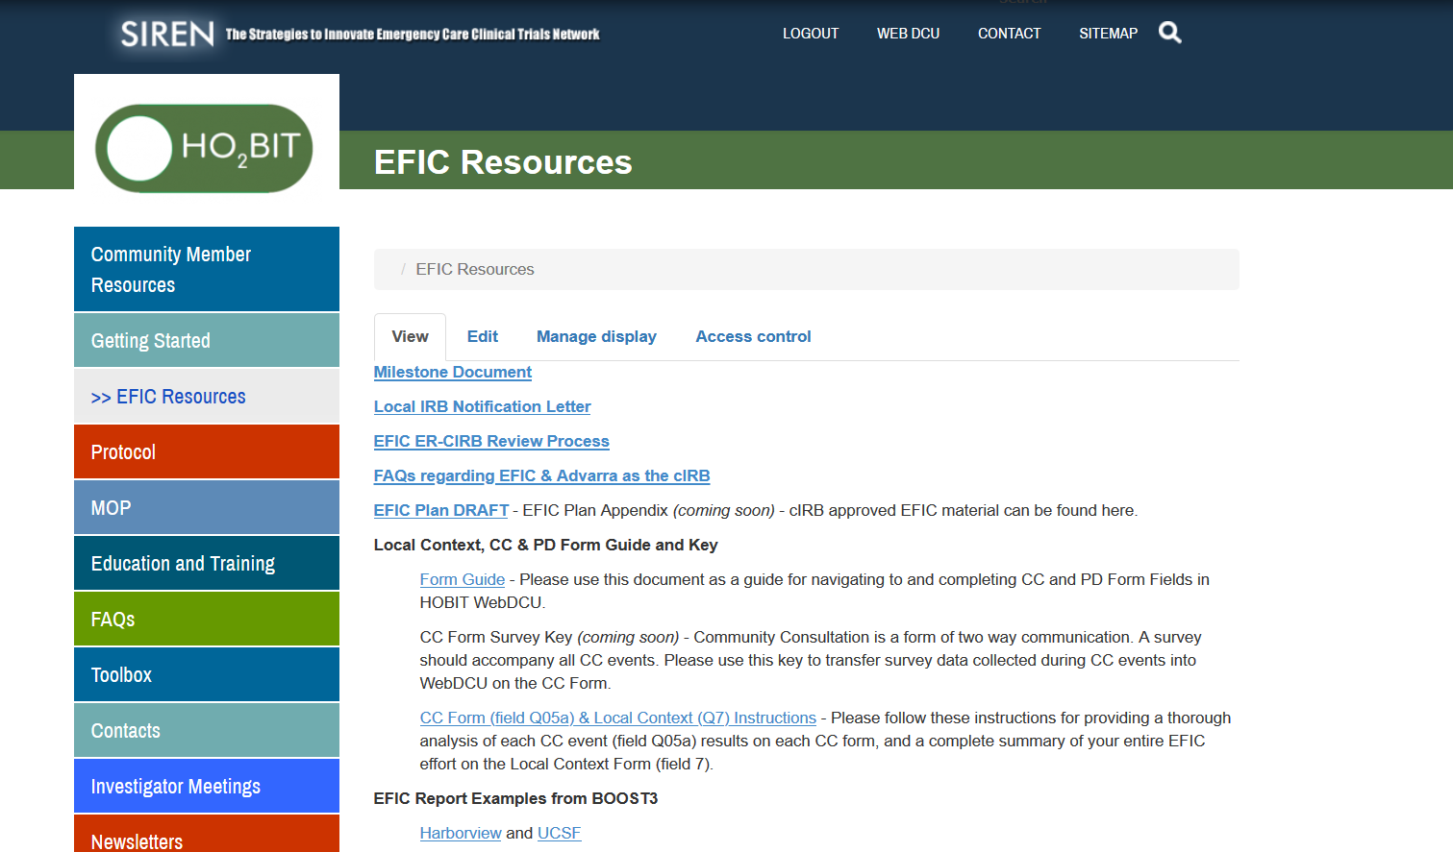
Milestone Document
Hobittrial.org
Virtual Investigator Meeting
November 22, 2019

Slide 13
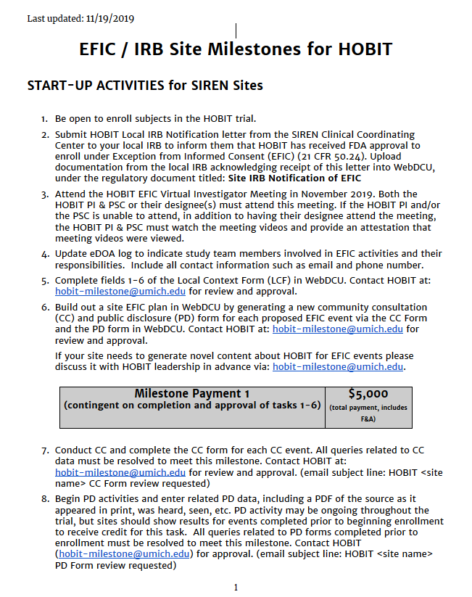
Milestone Document
Task 1: Be open to enroll
Complete all start up activities:
cIRB approval
Simulation complete
Chamber is ready
Study team and clinical teams are trained
Regulatory Compliant
Readiness call
Virtual Investigator Meeting
November 22, 2019

Slide 14
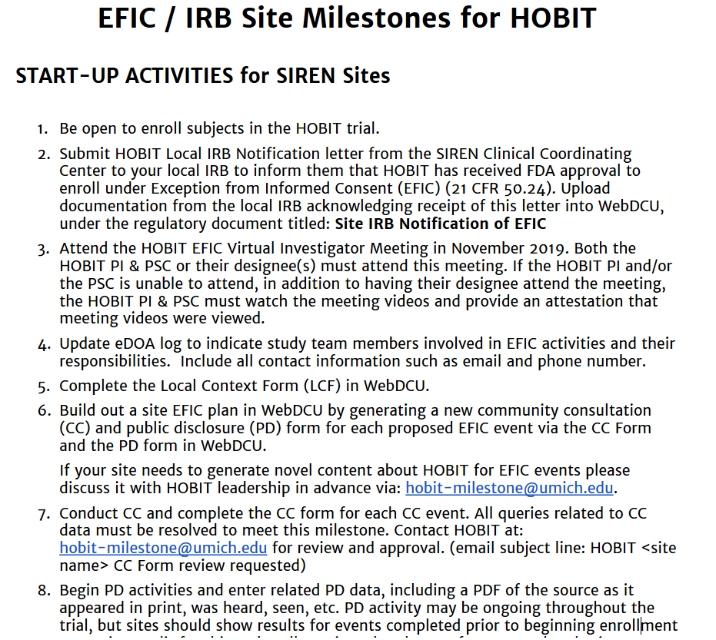
Milestone Document
Task 2: Notify Local IRB
Submit template letter to local IRB (available on EFIC Resources page: hobittrial.org)
Upload receipt of submission in WebDCU
Virtual Investigator Meeting
November 22, 2019

Slide 15
Milestone Document
Task 3: Attend EFIC VIM
PI & PSC must attend the meeting
If unable to attend, meeting video must be watched and attestation provided
Virtual Investigator Meeting
November 22, 2019

Slide 16
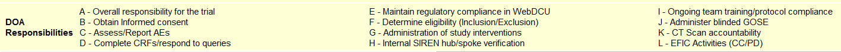
Milestone Document
Task 4: Update eDOA
Update the eDOA to include:
“L” EFIC Activities (CC/PD)
Virtual Investigator Meeting
November 22, 2019

Slide 17
EFIC Financial Considerations
Valerie Stevenson

Slide 18
EFIC Financial Considerations for HOBIT
Budget submitted to NIH for approval
Reimbursement amounts
  $1,500 reimbursement for submitting and receiving approval for simulation video remains unchanged
  $5,000 for completing milestones 1-6
  $25,000 for completing EFIC activities and receiving approval to enroll under EFIC
  Per-subject tiers unchanged
Site agreements to be revised after receiving approval
Virtual Investigator Meeting
November 22, 2019

Slide 19
EFIC History & Regulations
Robert Silbergleit, MD

Slide 20
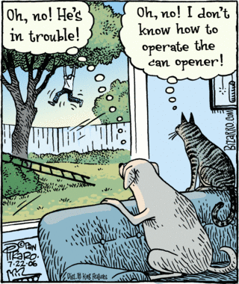
Notes:
When we conduct research in the emergency setting, it is possible to have competing ways of perceiving the situation. I think it is important that we remain focused on the patient (aka the would-be subject) first. So, in the context of this cartoon… we must strive to “be the dog”.

Slide 21
Exception from Informed Consent
Very special circumstances
When autonomy is silent
Consistent with Helsinki and Belmont
Brief history in the US
Virtual Investigator Meeting
November 22, 2019

Slide 22
EFIC – Special circumstances
Life threatening?
Available therapy inadequate or unproven?
Informed consent not feasible?
Prospect of direct benefit?
Trial couldn’t be carried out without EFIC?
Virtual Investigator Meeting
November 22, 2019

Slide 23
EFIC – Special requirements
Community consultation
Public disclosure
Obligatory data monitoring
IRB disapprovals reported to all IRB
Generally requires IND or OHRP approval
Virtual Investigator Meeting
November 22, 2019

Slide 24
EFIC – Community consultation
Town hall meetings
Visits to existing community meetings
Focus groups
Random digit dialing interviews
Geographic and special interest communities
Virtual Investigator Meeting
November 22, 2019

Slide 25
EFIC – Public disclosure
Advertising
Press releases
Newletters
Before, during, and after study
Virtual Investigator Meeting
November 22, 2019

Slide 26
EFIC – Teleological Pitch
If we know why we are doing something…
  We can do it better
  We can judge how well we’ve done it
So, why are these the requirements for EFIC?
Virtual Investigator Meeting
November 22, 2019

Slide 27
Possible answer…
These are the ways that good doctors and researchers act.
In fact, that is why we do informed consent when it is possible.
Virtual Investigator Meeting
November 22, 2019

Slide 28
Philosophical basis for consent?
People like to be asked more than they like to decide.
Even more, they want their doctor/researcher to be the kind of person who would ask.
Virtual Investigator Meeting
November 22, 2019

Slide 29
Philosophical basis for EFIC?
How do we remain “that sort of doctor” when the emergency situation prevents us from asking?
What core values and acts are embodied in the proper moral agent? I’ll suggest 4
Virtual Investigator Meeting
November 22, 2019

Slide 30
Core values
We need to be…
    Heedful
    Respectful
    Transparent
    Humble
Virtual Investigator Meeting
November 22, 2019

Slide 31
Core values and the EFIC rules
We need to be…
    Heedful ⇨ Comm. Consult.
    Respectful ⇨ Comm. Consult.
    Transparent ⇨ Public Disclosure
    Humble ⇨ Comm. Consult.
Virtual Investigator Meeting
November 22, 2019

Slide 32
Core values and their manifestations
We need to be…
    Heedful ⇨ Listen and consider
    Respectful ⇨ Go to the people
    Transparent ⇨ Keep nothing concealed
    Humble ⇨ Do it yourself
Virtual Investigator Meeting
November 22, 2019

Slide 33
Implications for EFIC
These underlying ethical purposes mean that….
    Focus is on due diligence of the investigator
    The investigator’s behavior is the metric
Virtual Investigator Meeting
November 22, 2019

Slide 34
Implications for EFIC
The community’s impact on the investigator matters more than the investigator’s impact on the community
It is more important to be transparent then it is to be seen
Virtual Investigator Meeting
November 22, 2019

Slide 35
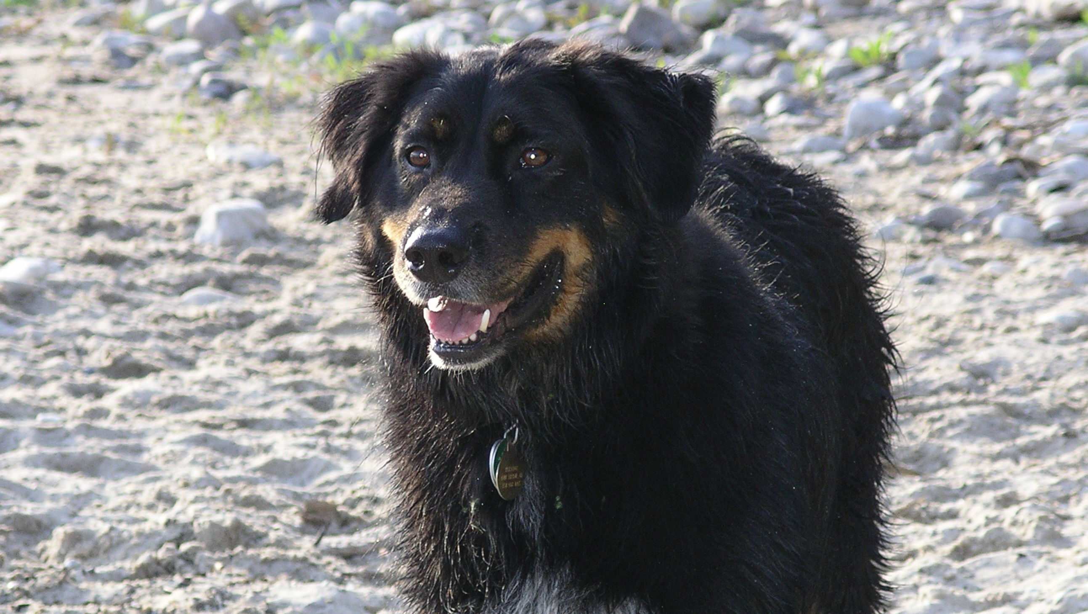
Notes:
Remember! Be the dog.

Slide 36
EFIC Process & Documentation
Deneil Harney

Slide 37
Objectives
HOBIT EFIC Plan
  Who is your community?
  Your site specific EFIC Plan & documentation
EFIC Results Reports
Virtual Investigator Meeting
November 22, 2019
Notes:
37

Slide 38
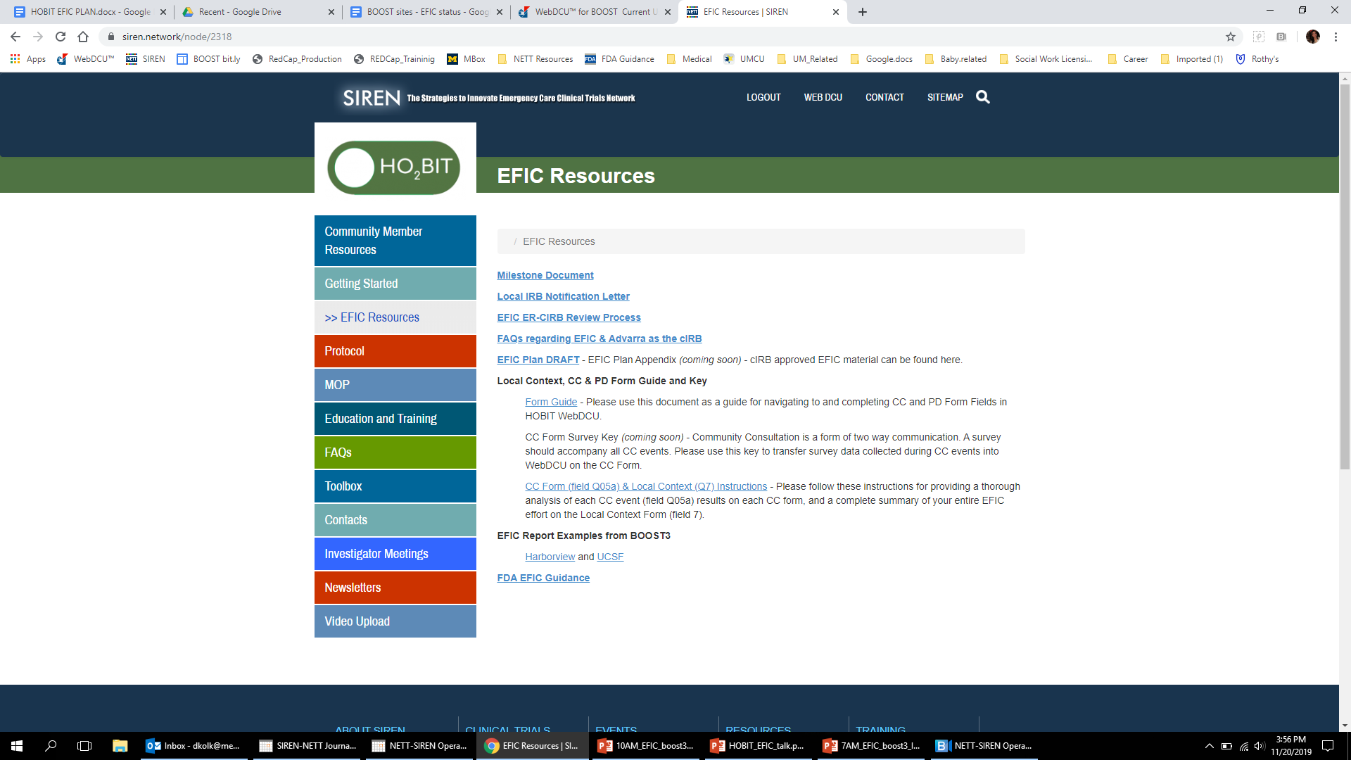

www.hobittrial.org
Virtual Investigator Meeting
November 22, 2019
Notes:
38

Slide 39
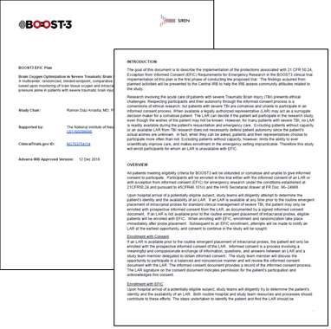

EFIC Plan
INTRO / Overview
Virtual Investigator Meeting
November 22, 2019
Notes:
39

Slide 40
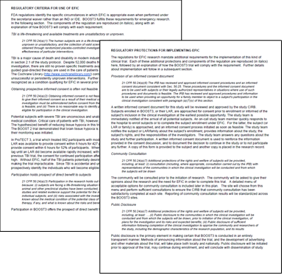
EFIC Plan
Regulations
Virtual Investigator Meeting
November 22, 2019
Notes:
40

Slide 41
EFIC Plan
CC Principles
Virtual Investigator Meeting
November 22, 2019
Notes:
41

Slide 42
EFIC Plan
Translating the goals into action:
  Showing respect for persons
  1.) Going out into the community where the community gathers, versus asking them to come to us.
  2.) Investigator engagement, versus only allowing consultations that can be outsourced or delegated.
  Providing opportunities for the affected communities to provide meaning input
  1.) The plan promotes event formats that ensure that study teams listen as much as they talk.
  2.) brief presentations followed by longer discussions should be the goal.
  Reaching representatives of the community
  Religious leaders, community organizers, patient and disease advocates, local political leaders, or others best equipped to identify group level concerns.
  Respecting the autonomy of a group of individuals who may have or be at risk for the condition
  Motorcycle, ATV, Snowmobile Clubs, etc.,
  The seizure community (“at risk”),but also: existing TBI patients and/or their caregivers
Virtual Investigator Meeting
November 22, 2019
Notes:
42

Slide 43
CC Methods
COMMUNITY CONSULTATION MENU – EFIC Plan (pg. 14)
A ( Interactive - Direct ) | B ( Asynchronous - Delegated)
A presentation and discussion by an investigator visiting a meeting of an existing group (visits to existing meetings) | Telephone survey* (random digit dialing)
Focus group (moderated small group session) | Web-based survey*
In-person individual interviews or meetings | Social media messaging*
Meetings convened by the investigators inviting the targeted audience (preferably with RSVP) | In person solicited survey* e.g., waiting room booth, etc.,
A booth or table at community events involving interactive discussions (not just surveys)
DRAFT
* Note that to be considered a CC activity, all surveys must come after the study team provides sufficient information about the study, and must include the opportunity for community members to get answers to questions and to interact with the investigator or study team.
Sites must complete 6 total CC events or activities
At least four must come from column A
And at least one event must come from Column B
Virtual Investigator Meeting
November 22, 2019
Notes:
43

Slide 44
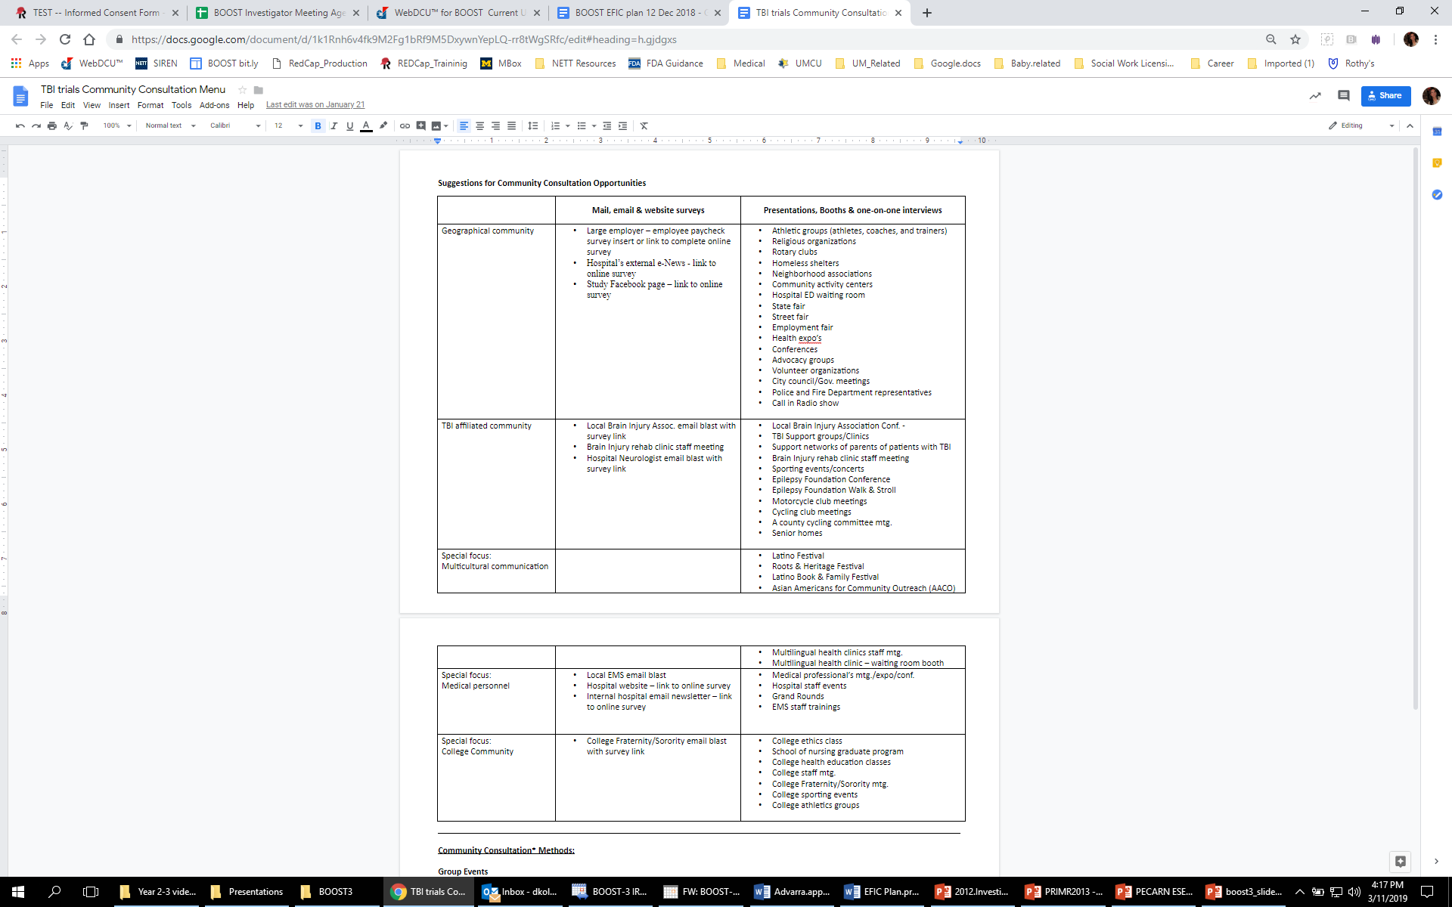

CC Suggestions
EFIC Plan appendix:
Notes:
44

Slide 45
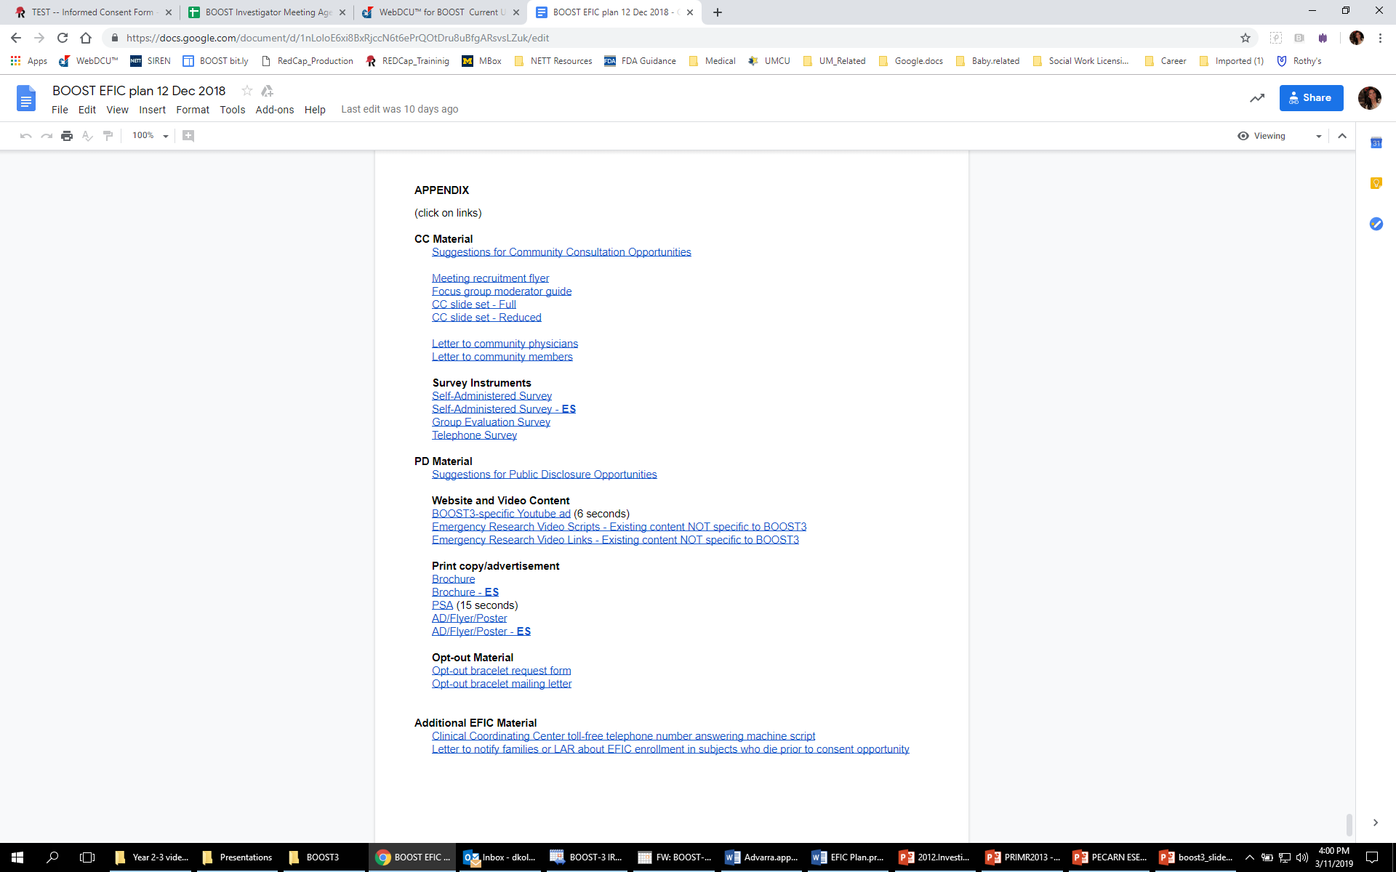
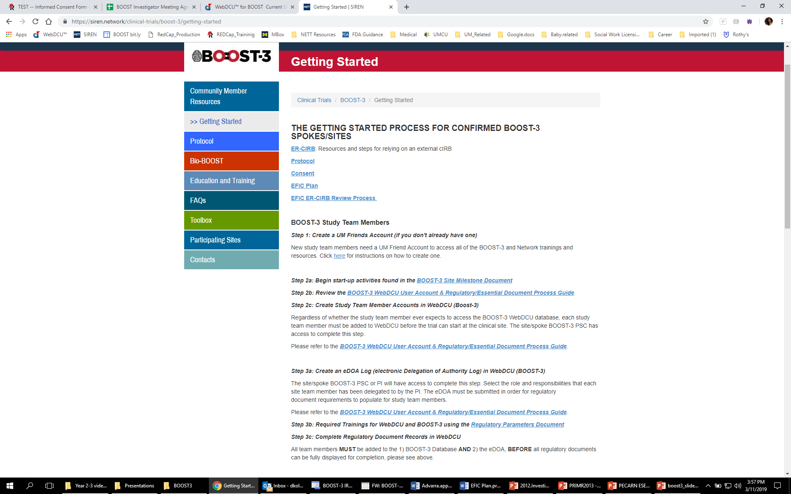
www.HOBIT3trial.org
Notes:
In the EFIC Plan Appendix!
The list I just showed is the first link under CC Material.
This is where, a list of all EFIC material that has been cIRB approved for you to use to conduct your CC and PD events can be found. You’ll need to come here to pull down material that has been approved for use with the community by the cIRB.
There is some flexibility to generate new material, based on existing approved content, either from resources on this list, the protocol or the consent form. However, any “new” material will need to be sent for sponsor review before it can be used and may also need to be cIRB approved as well. Such requests can be sent to the hobit-milestone group email.
I can’t stress this enough, each CC event should include
1.) One of the survey instruments – to collect written feedback from the community you engage.
2.) copies of the brochure – for participants to take home and includes your contact information if a participant would like to reach you later with questions., and
3.) an Opt-out bracelet request form (which you can make available as needed)
Any Opt-out bracelet requests that are completed, you’ll want to hang onto, to mail a bracelet to, closer to when your site is released to enroll.
45

Slide 46
EFIC Plan
PD Principles
The regulatory intent and specific goals of public disclosure are not explicit in the regulations either, but this plan is based on the presumption that the primary goal of public disclosure is transparency.
Virtual Investigator Meeting
November 22, 2019
Notes:
46

Slide 47
PD Methods
PUBLIC DISCLOSURE MENU (PRE-TRIAL) – EFIC Plan (pg. 20)
A (networking) | B (paid advertising) | C (conventional outlets)
National or local study website | Newspaper advertisement (and similar print advertising) | Press release
Social media postings | Television and radio ads (broadcast advertising) | News stories, interviews (print, radio, or TV)
Mailings (including email circulars/bursts and direct paper mailings) | Outdoor advertising (placards, bus ads, billboards, etc.) | Newsletters (articles or informational ads, print or electronic)
Booth/Table Community event | Paid online advertisements (banner, block, or video ads purchased from Google, Facebook, Youtube, etc.) | Brochures, flyers, handouts, bulletin boards
 |  | Radio or TV PSA (public service announcements)
DRAFT
Sites must complete 6 total PD events or activities
At least two must come from column A
And at least 1 event from Column B or C.
Virtual Investigator Meeting
November 22, 2019
Notes:
47

Slide 48
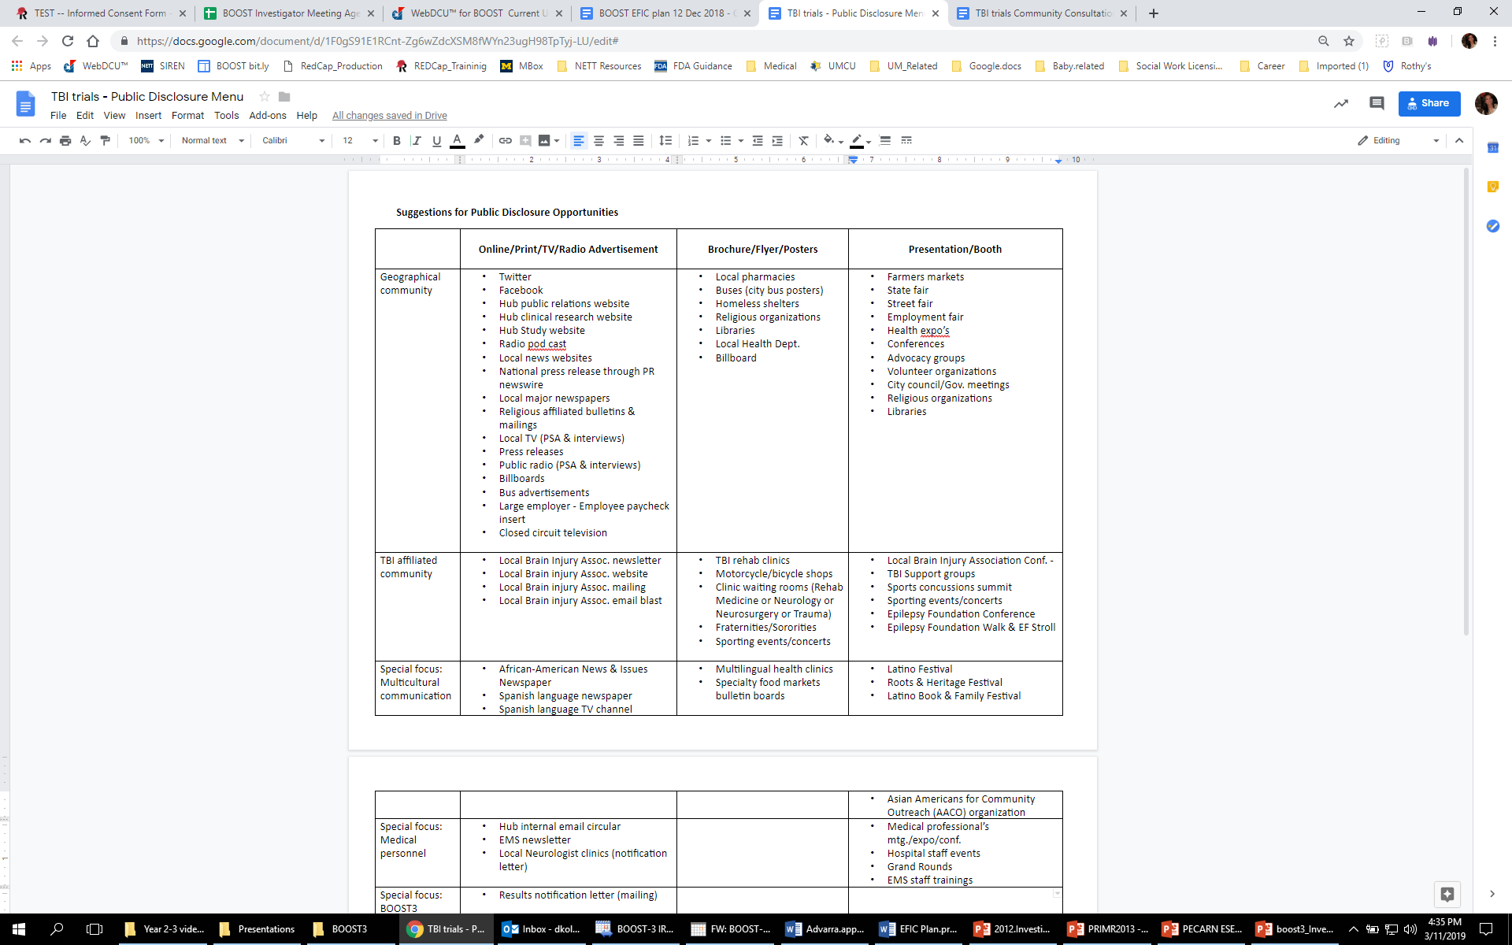
Notes:
48

Slide 49
www.HOBIT3trial.org
Notes:
circled resource – shown on prior slide.
49

Slide 50
www.hobittrial.org
Virtual Investigator Meeting
November 22, 2019
Notes:
50

Slide 51
Objectives
HOBIT EFIC Plan
  Who is your community?
  Your site specific EFIC Plan & documentation
EFIC Results Reports
Virtual Investigator Meeting
November 22, 2019
Notes:
51

Slide 52
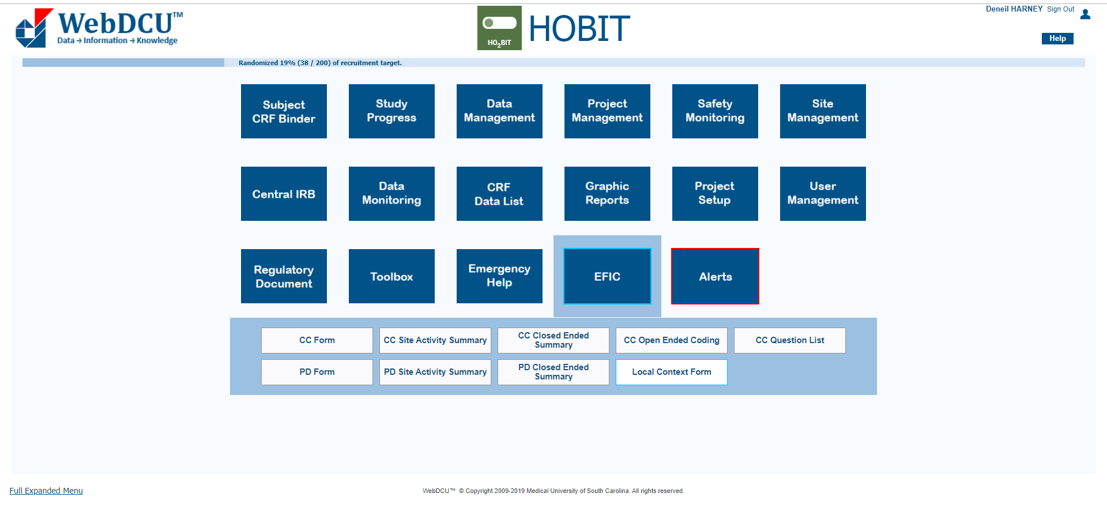
Virtual Investigator Meeting
November 22, 2019
Notes:
Under the EFIC tile is where you will find the three essential EFIC data management forms for HOBIT, circled.
1.) Local Context Form
2.) CC Form and
3) PD Form
We’ve talked about the EFIC plan, the methods that can be used to conduct CC and PD specific events and the resources to carry them out,
But “who” is your community?
Before you build out your list of CC & PD events it’s important you know “who” you need to reach.
Upon reading the EFIC plan, the next thing you want to do is complete the local context form (Task 5 of the Milestone document). Which is the sub-tile circled in red below the EFIC tile.

Slide 53
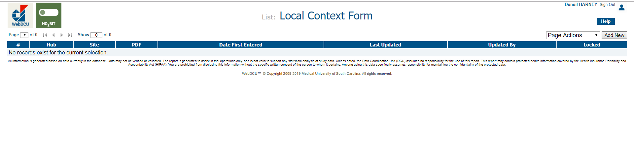
Instert screen shot of lsit view of Local Context Form
Virtual Investigator Meeting
November 22, 2019

Slide 54
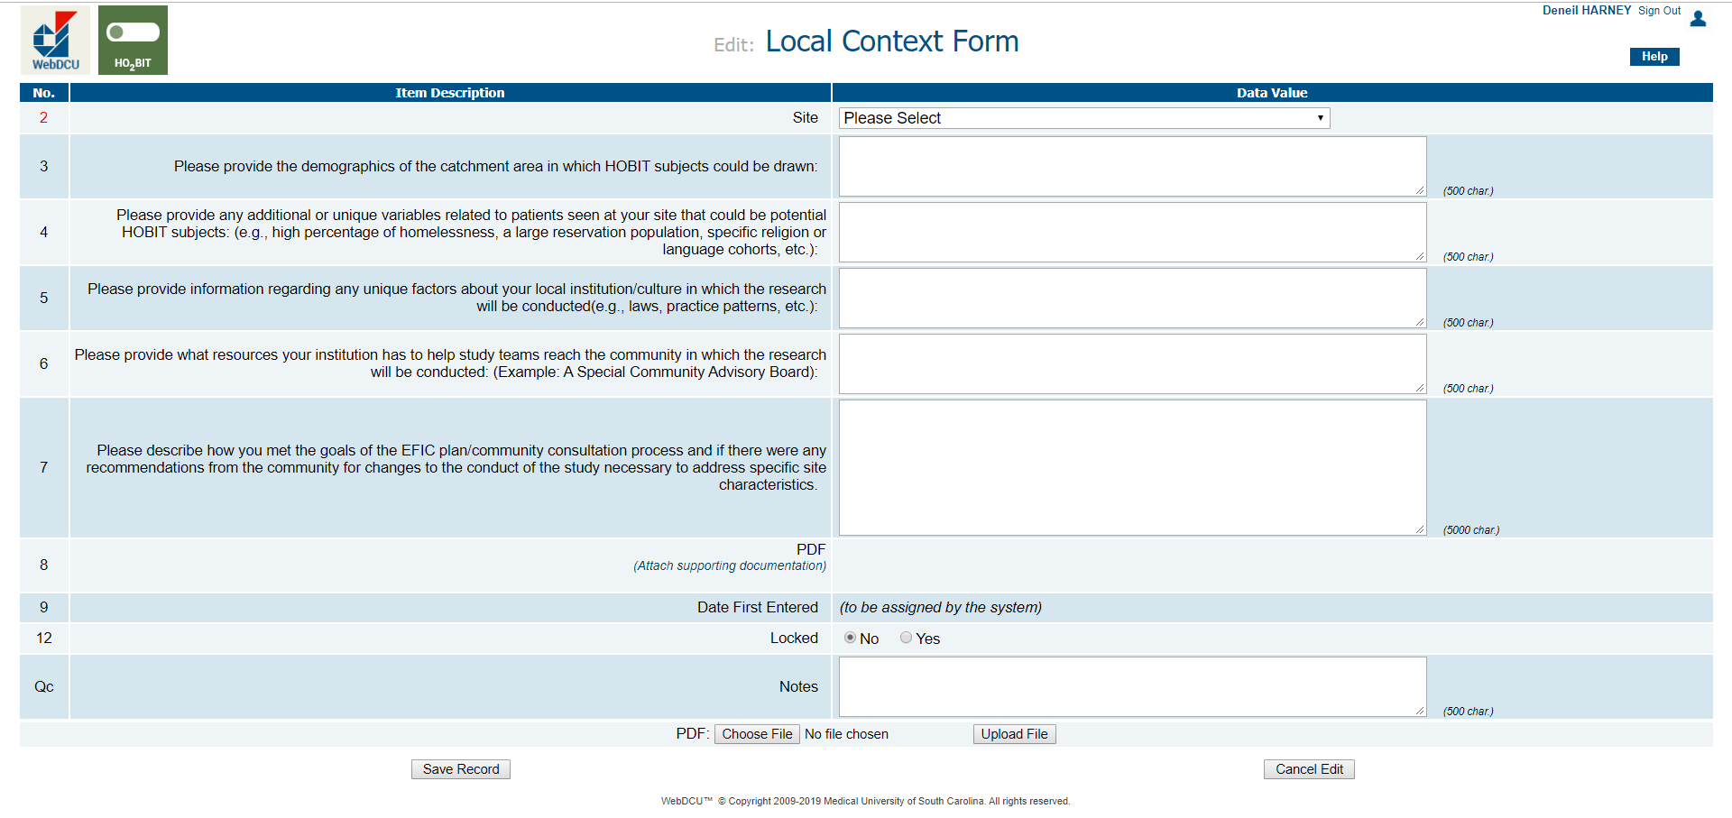
Virtual Investigator Meeting
November 22, 2019
Notes:
The form consists of five questions.
Come here and answer the first 5. fields 2-6, before you build out your plan. Field 7 is a field you will fill out after you complete your events.
The data in 3-6 will help you to know “who” you should make a point to hear from and advertise to, in addition to the TBI related community, during CC and PD effort.
The answer to all of these questions on this form will be relayed to the cIRB when your EFIC results are submitted for their review, and they will be critically looking to make sure the people you told them about here, are represented in your CC and PD effort.
54

Slide 55
Talk Objectives
HOBIT EFIC Plan
  Who is your community?
  Your site specific EFIC Plan & documentation
EFIC Results Reports
Virtual Investigator Meeting
November 22, 2019
Notes:
55

Slide 56

Virtual Investigator Meeting
November 22, 2019
Notes:
56

Slide 57
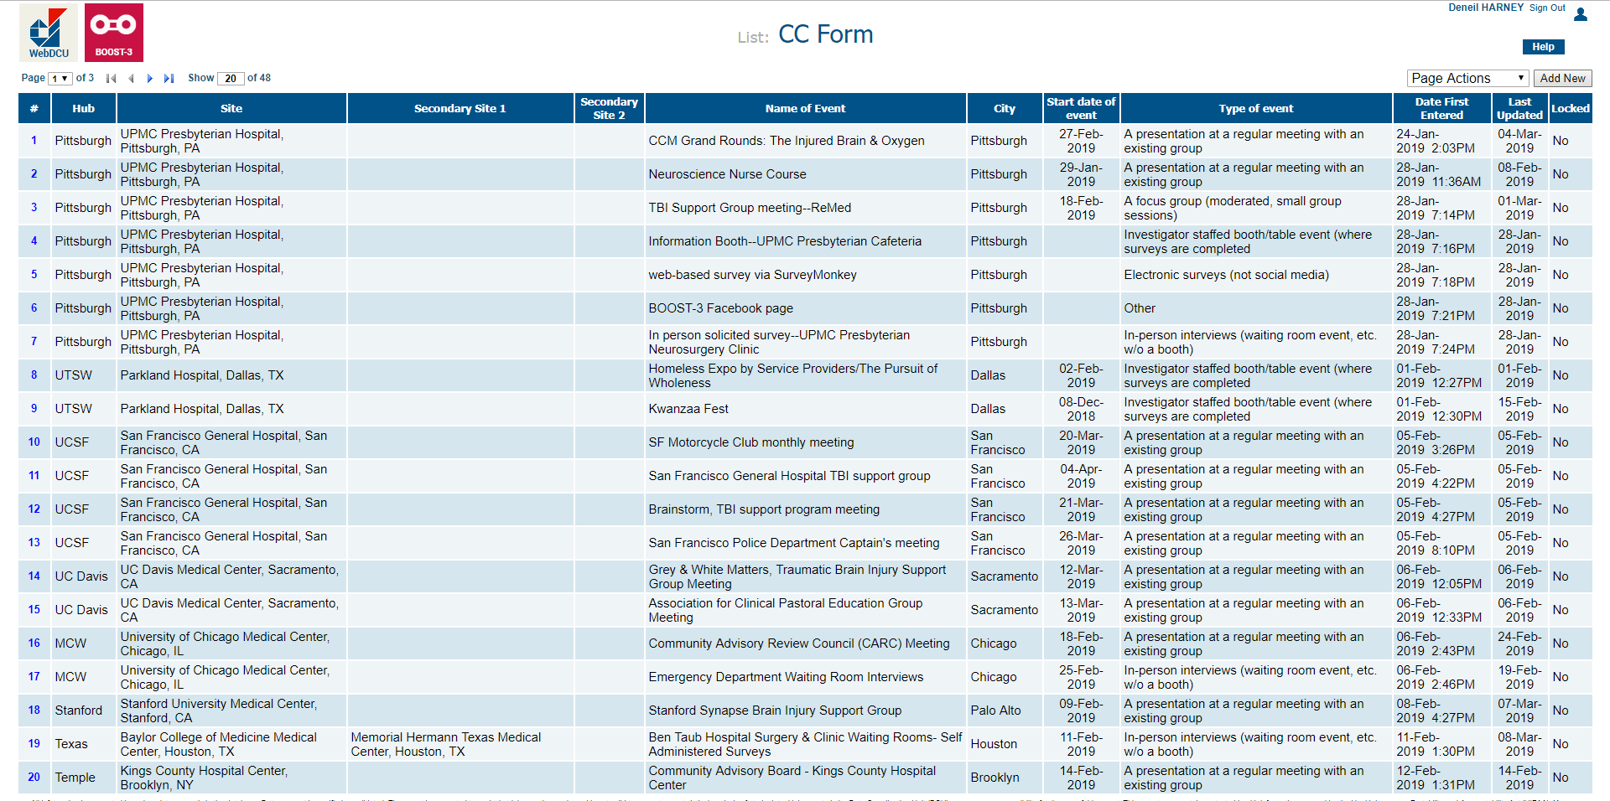
Notes:
This view is fully visible across sites. It is a great way for you to see what other sites are doing for EFIC and may help give you ideas about groups to reach locally, that maybe you hadn’t thought of.
Sites click on the “Add New” button in the top right corner to be taken to a blank data entry form.
57

Slide 58
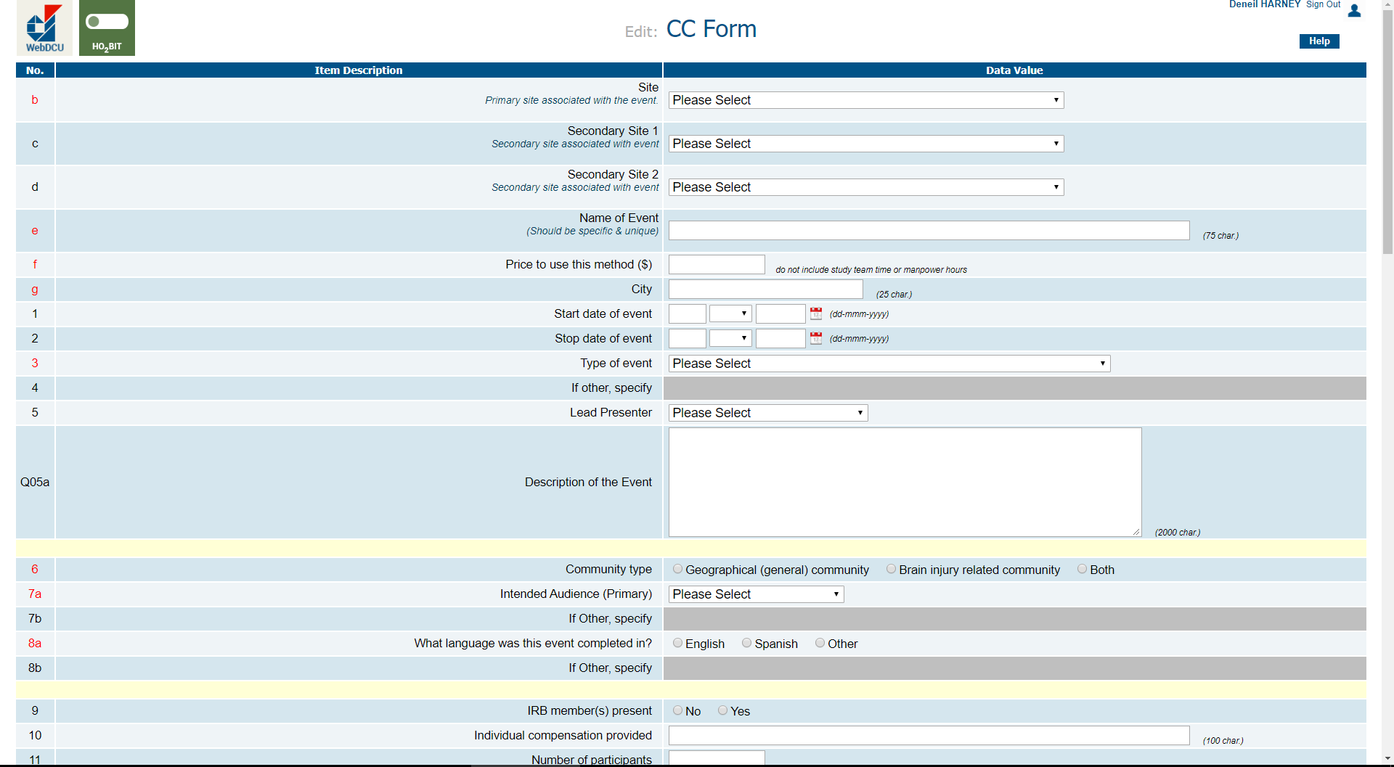
Notes:
While the method used can vary, all of our sites use our centrally developed survey instruments to capture feedback from the community, which I highlighted previously as a required document for all CC event.
All of those survey data points have been represented on this form. The CC Form also allows for some tailoring and makes some fields “optional.”
Fields to Point out:
1.) Name of Event --- make unique (no two CC events for a given site should be identical), please do not use acronyms
2.) field Q05a – Description of event (see resource on the HOBIT EFIC resources page.)
3.) field 11 - Number of participants (see CC form guide on the HOBIT EFIC resources page.)
Start a CC form for every event you are planning to conduct. This form can be edited as you go.
58

Slide 59
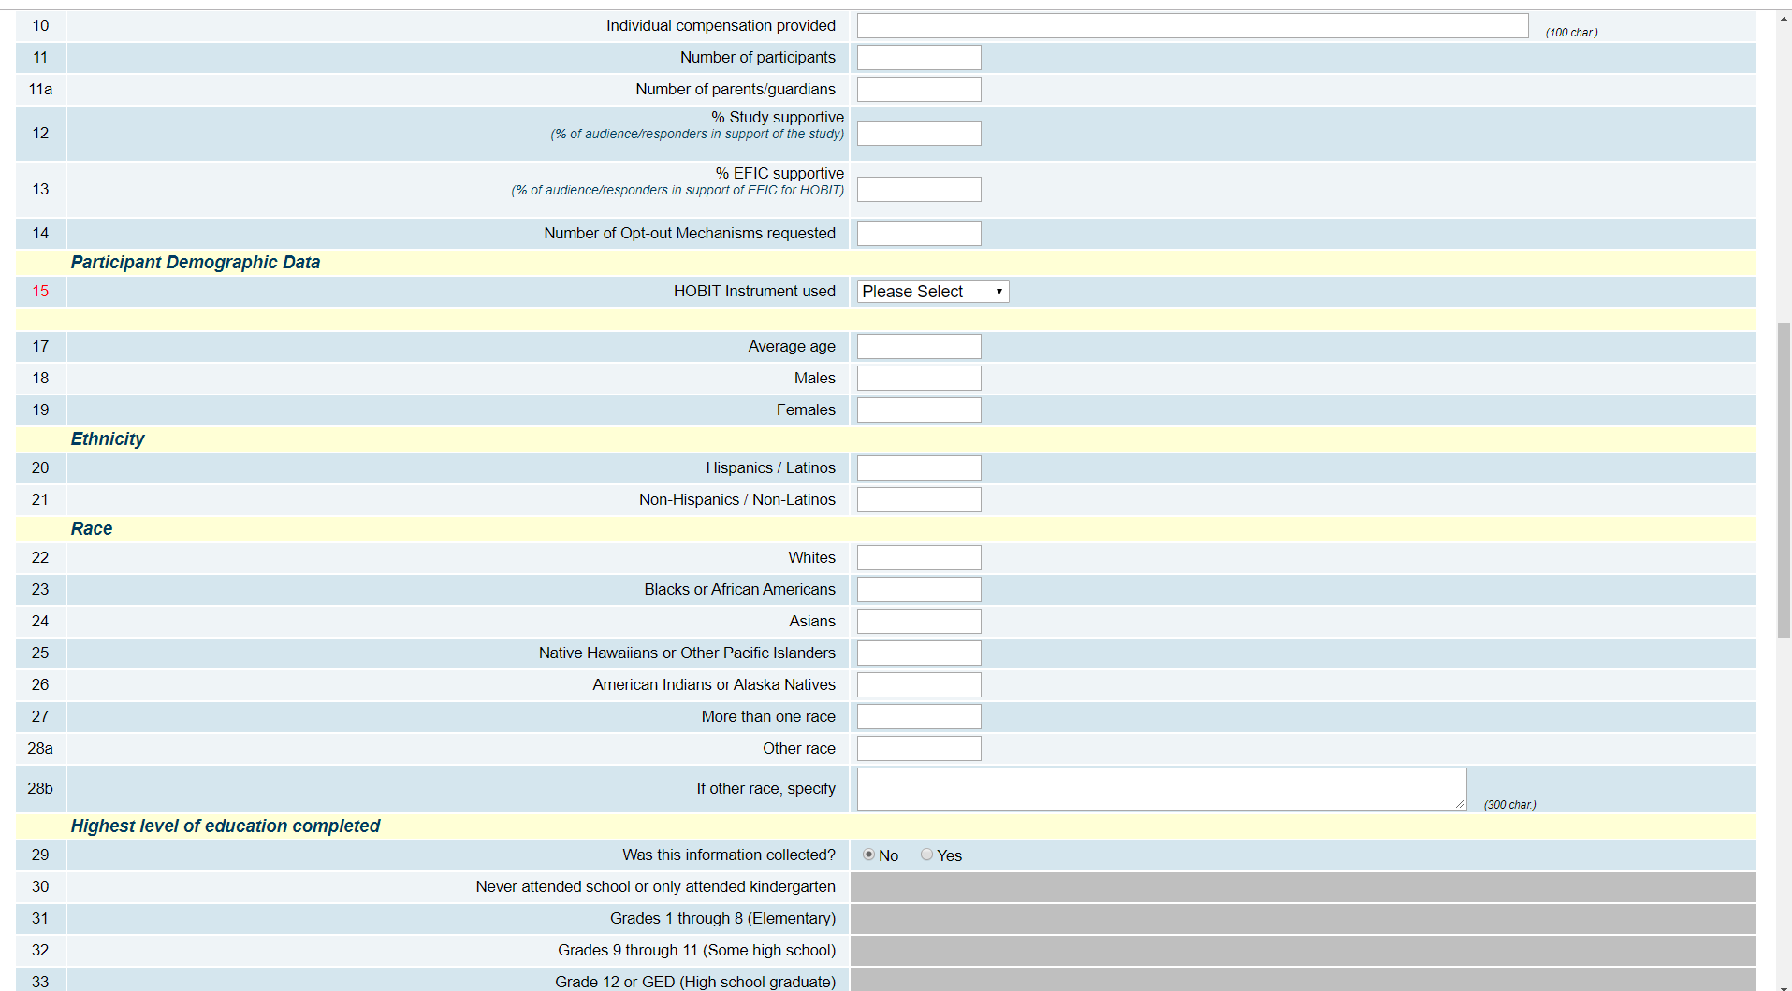
CC Form – Cont.
Notes:
READ
CC Form continues.
These are questions reflected on the survey instruments required for each CC event conducted.
Use the CC Form Key – on the HOBIT website EFIC Resources page.
59

Slide 60
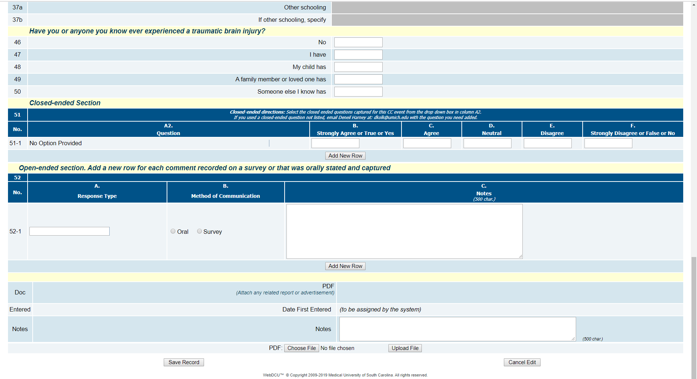
CC Form – Cont.
Notes:
Section 51 toward the middle of this screen shot is used to capture closed-ended responses, which is the where the bulk of the survey data is entered.
The CC form key will help you fill this section out completely.
Section 52 is our open-ended section. This is where sites data enter each open comment left on the survey or else that was raised during a CC event.
Someone at each CC event should be responsible for logging open-ended comments raised through two-way dialog so that they can be captured here.
POINT OUT
1.) use complete sentences or add context. Please do not include half thoughts or statements no one else not present at the event could make sense of. I feel like this should be obvious, but it happens.
2.) Additionally, there is not any need to capture community comments about your presentation style.
Please review and use the Form Guide & Key to complete this form, it offers step by step instructions to help ensure your form is completed successfully the first time.
Once you have all of your events completed you’ll need to reach out to have your CC event forms reviewed for completeness and lock (Milestone task 7)
60

Slide 61
Notes:
You’ll select PD form ….
61

Slide 62
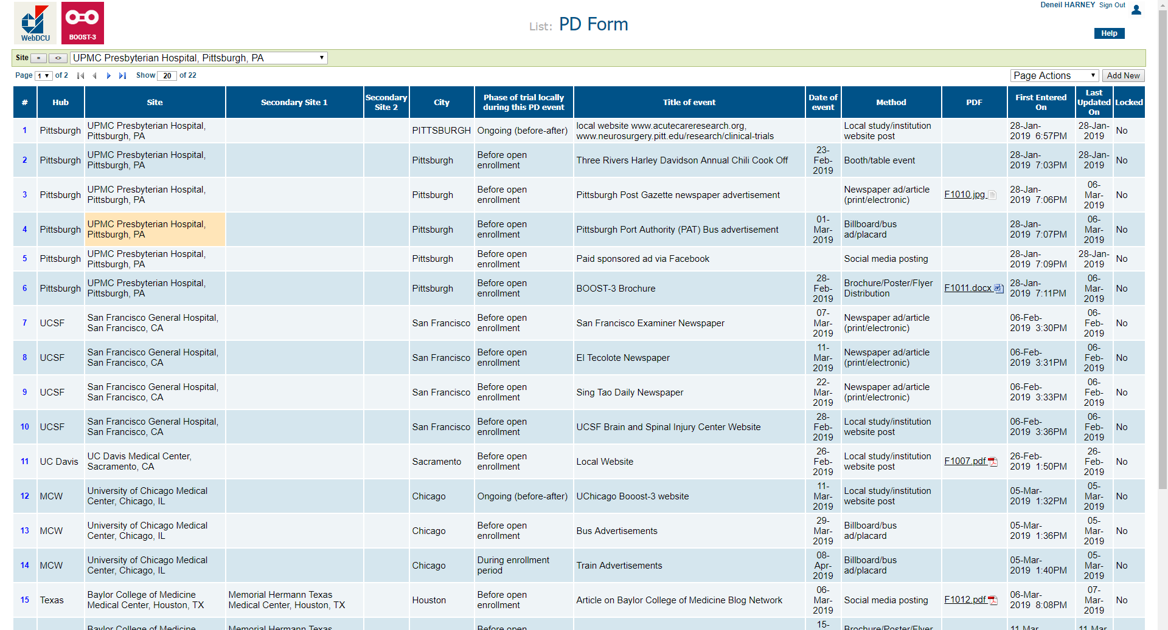
PD Form
Notes:
62

Slide 63
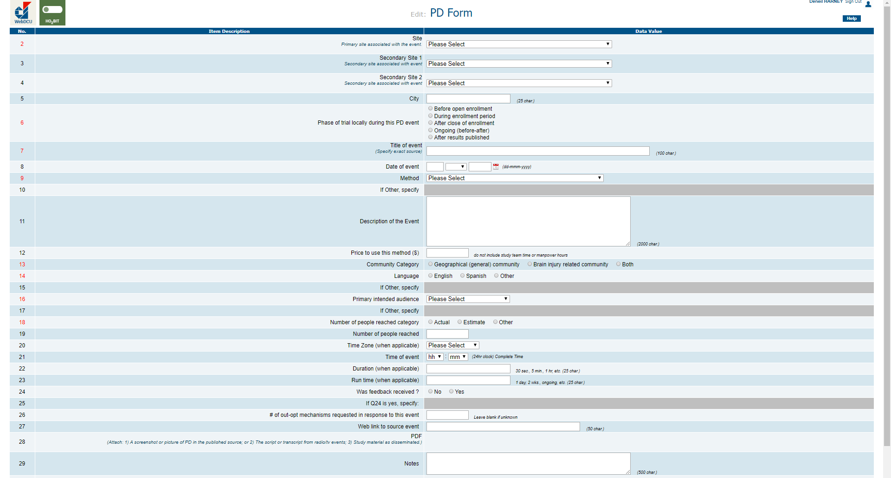
Notes:
Here is a snapshot of the Public Disclosure data entry Form.
The PD form is a much smaller form as the data points available are much fewer.
The PD FORM includes information about: the strategy used, location, method, cost, and date, the intended audience, community response, and whether or not an opt-out mechanism was requested.
If I could highlight one very significant field is would be the last one, which allows for a PDF of the source document from Public Disclosure to be uploaded.
As part of the PD report that is generated all source files published will be included. We will not be able to lock any PD event form as complete if this source file is missing.
We collect at minimum the actual: newspaper clipping, the page of a newsletter or newspaper that includes any mention of HOBIT, the screen-shot of a website or webpage created for HOBIT as well as Tweets, Facebook posts, etc.,
If you have a PD event you aren’t sure how to capture in a PDF or you aren’t sure what type of file to capture for a specific event, please reach out. There is also a Guide to help you complete the PD Form fields successfully on the HOBIT website.
A PD form must be completed for each PD event conducted.
63

Slide 64
www.hobittrial.org
Notes:
This slide just represents where you can go to find the WebDCU form related resources I’ve mentioned for successfully filling out the local context form, and the CC and PD Form.
64

Slide 65
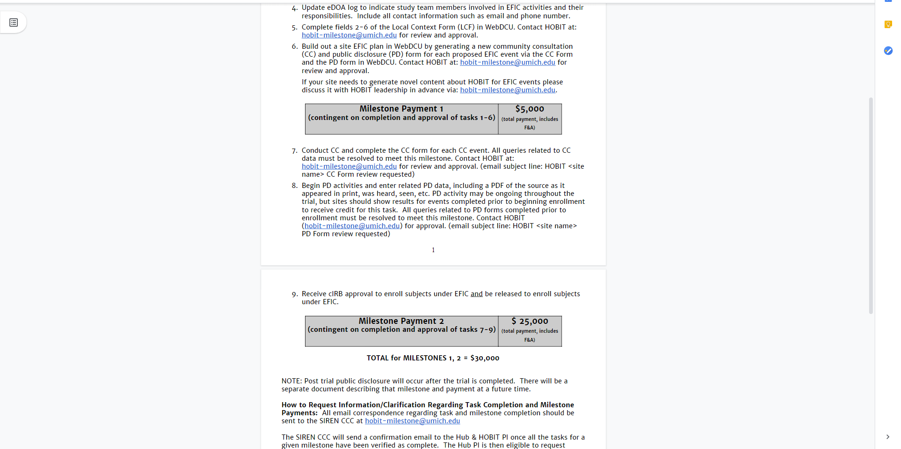

Slide 66
Talk Objectives
HOBIT EFIC Plan
  Who is your community?
  Your site specific EFIC Plan & documentation
EFIC Results Reports
Virtual Investigator Meeting
November 22, 2019
Notes:
66

Slide 67
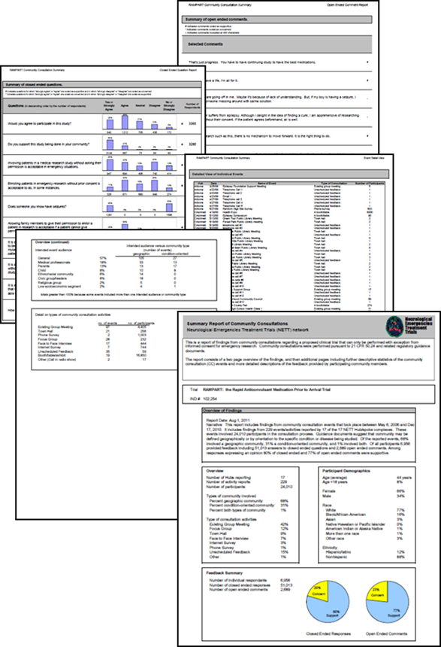

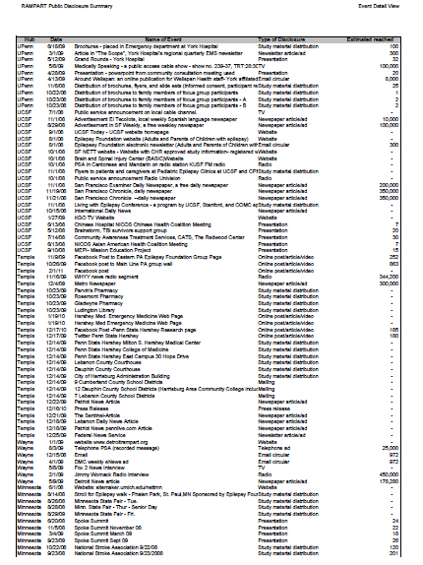
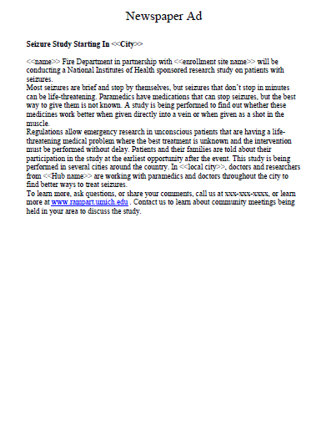
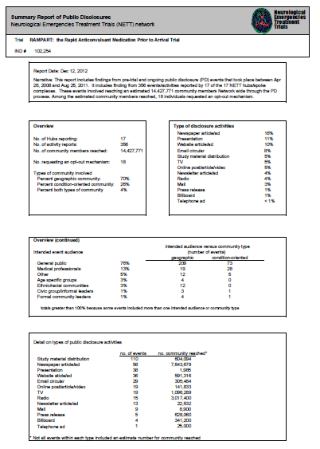
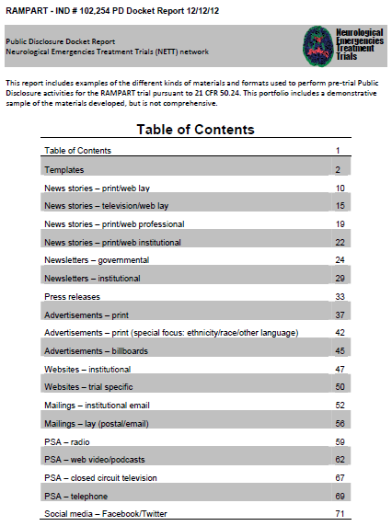
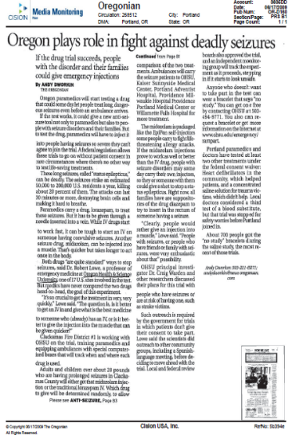


EFIC Results - Reports
Public Disclosure Report
Community Consultation Report
Virtual Investigator Meeting
November 22, 2019
Notes:
This slide just demonstrates an example of the EFIC packet that is pulled together by the coordinating center.
A site level specific report is generated for your site application to the cIRB and study wide reports are generated annually for the cIRB, the DSMB, etc.
And I’ll stop there.
NEXT
67

Slide 68
www.hobittrial.org
Notes:
Site specific EFIC packets – circled.
68

Slide 69
HOBIT-milestone@umich.edu
Virtual Investigator Meeting
November 22, 2019
Notes:
69

Slide 70
Questions?
EFIC Virtual Investigator Meeting
November 22, 2019

