Slide 1


Hyperbaric Oxygen Brain Injury Treatment Trial: A Multicenter Phase II Adaptive Clinical Trial
November 9, 10:00 am – 12:00 pm ET
November 12, 3:00 pm – 5:00 pm ET
HOBIT / BioHOBIT Virtual Investigator Meeting
November 9th & 12th, 2020

Slide 2
Zoom Reminders
To avoid an echo, please make sure you only have audio playing out of one device (either computer or phone)
Please make sure you are on mute if you are not speaking or presenting
Please do not put the line on hold, if you need to take another call, please hang up and dial back in afterwards
Questions can be asked via the Chat box
Mute / Unmute
Chat Box
HOBIT / BioHOBIT Virtual Investigator Meeting
November 9th & 12th, 2020

Slide 3
Agenda & Welcome
Item | Presenter
Welcome | Natalie Fisher Gaylan Rockswold, MD, PhD
Study Enrollment Update (COVID effect) | Bill Barsan, MD
Important Study Reminders | Gaylan Rockswold, MD, PhD
EFIC Updates | Natalie Fisher
Chamber Reminders | Bill Gossett
Questions and Answers | Bill Barsan, MD
BioHOBIT scientific rationale | Frederick Korley, MD, PhD
BioSEND Introduction & Training Site Equipment Review of Biospecimen Collection Protocol BioSend Kits Processing Guidelines Shipping Instructions General BioSend Info | Carolyn Dunifon
Data Coordinating Center Show and Tell | Kyle Hatcher
Contracts and Payments | Valerie Stevenson
HOBIT Clinical Quality Improvement Group (CQIG) | Nick Mohr, MD
Educational Video | Carol VanHuysen
Questions and Closing Remarks | Gaylan Rockswold, MD, PhD
HOBIT / BioHOBIT Virtual Investigator Meeting
November 9th & 12th, 2020

Slide 4
Study Enrollment Update (COVID Effect)
Bill Barsan, MD

Slide 5
COVID-19 Impact
March 2020: Non-COVID research placed on hold at all sites.
Currently: 8 sites open to enrollment
  April: Duke
  May: Iowa and Ohio State
  July: Hennepin County, UCSD
  August: Detroit Receiving
  September: Maryland
  October: Kentucky
Sites still on hold: Honor Health, Hamilton, Spectrum, Nebraska
HOBIT / BioHOBIT Virtual Investigator Meeting
November 9th & 12th, 2020

Slide 6
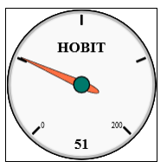
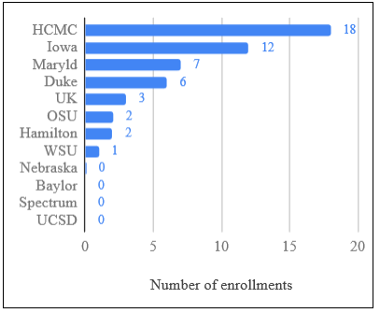
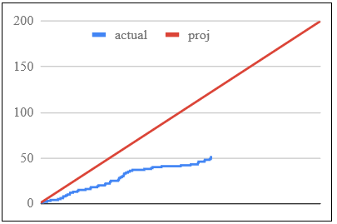
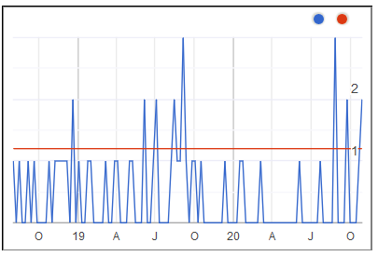
Enrollment Update
HOBIT / BioHOBIT Virtual Investigator Meeting
November 9th & 12th, 2020

Slide 7
Important Study Reminders
Gaylan Rockswold, MD, PhD

Slide 8
Important Study Reminders
Getting every possible patient enrolled
  Have a system of communication from the ED to research personnel.
  Periodic reminders (meetings, electronic notifications, etc.) to neurosurgery, trauma, and ED faculty and residents about the study.
  Daily review of trauma/neuro ICU patient list to see if patients have been missed.
HOBIT / BioHOBIT Virtual Investigator Meeting
November 9th & 12th, 2020

Slide 9
Important Study Reminders
Initial evaluation of the patient
  The iGCS should be done just prior to enrollment after stabilization/off sedatives and paralytics.
  Severe TBI patients have the greatest potential to improve or deteriorate in the first hours after injury.
  Be sure mental status depression is due to TBI primarily and not due to EtOH/drugs.
  Head CT abnormal secondary to TBI when GCS 7-8 or when EtOH > 0.2.
  Evaluate early for lung injury, aspiration, history of COPD, etc. If present, treat lungs and get a p/f ratio before enrollment.
HOBIT / BioHOBIT Virtual Investigator Meeting
November 9th & 12th, 2020

Slide 10
Important Study Reminders
Making the 8-hour time window
  Requires early leadership from the site PI or his/her designee.
  Requires a team including ED, trauma surgery, neurosurgery, intensivists, ICU nursing staff, HBO staff, and research personnel working together.
  This requires “buy in”. The more patients enrolled, the more likely this is to occur.
  The team needs to communicate, anticipate, and manage the timeline. Particular issues include neurosurgery placing an ICP monitor and the possibility of a required second head CT.
  HBO chambers have to be able to do both EVD and intraparynchamal ICP monitoring.
HOBIT / BioHOBIT Virtual Investigator Meeting
November 9th & 12th, 2020

Slide 11
EFIC Update
Natalie Fisher, MS, CCRP

Slide 12
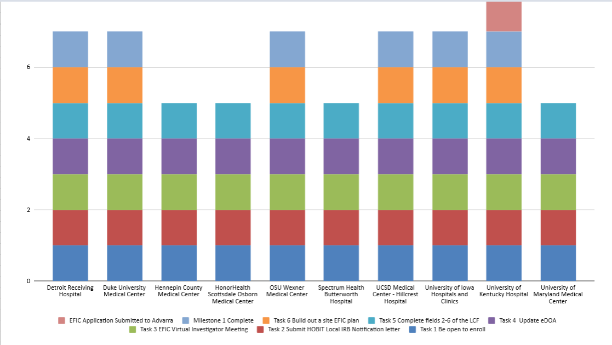
EFIC Site Status
Not included Baylor
St. Mary’s Hamilton
HOBIT / BioHOBIT Virtual Investigator Meeting
November 9th & 12th, 2020
Notes:
I know many of you have seen this EFIC readiness graph before, showing where our sites stand in completing EFIC Milestone 1. So far we have 6 sites that have completed Milestone 1. In order to receive that 1st milestone payment of $20,000, sites must build out the EFIC plan, meeting the requirements for CC and PD events. We hope we can get all sites complete with Milestone 1 before the end of the year and we are happy to work one on one with any site that needs help reaching that goal. We want to give a shout out to the University of Kentucky who’s EFIC application is being reviewed by Advarra today. There are a hand full on sites that are on track to be done with CC & PD events in the next few weeks so we are very encouraged that a few sites will be enrolling under EFIC by end of the year.

Slide 13
EFIC Requirements
CC Events
At least 6 At least 4 column A At least 1 column B
Geographic community listed in the Local Context Form must be reached (African American, low income, rural, etc.)
TBI community must be reached (TBI support group, etc.)
100 surveys
HOBIT / BioHOBIT Virtual Investigator Meeting
November 9th & 12th, 2020
Notes:
Now, I just wanted to quickly review the EFIC requirements. For community consultant – at least 6 events minimum are required and of these, At least 4 events must be of a type in column A, and at least 1 event must be of a type in column B. While conducting these CC events, keep in mind the community you’ve told us about in your Local Context Form. Events should include participants representing a sufficient breadth of the diversity of both the geographic community primarily served by your site, and the community either at-risk for, or familiar with, TBI. This could be anyone who has personally experienced a TBI, caregivers or persons who personally know someone with a TBI. And lastely, Advarra would like to all sites to collect 100 survey or more.

Slide 14
EFIC Requirements
PD Events
At least 6 At least 2 column A, At least 1 column B or column C
Broad event (Major newspaper, radio station, public transportation, etc.)
Event intended to reach TBI and/or at risk community (TBI support group, Equestrian, ATV, motorcycle club, etc.)
Event intended to reach unique demographic community listed in the Local Context Form (African American, Hispanic, etc.)
HOBIT / BioHOBIT Virtual Investigator Meeting
November 9th & 12th, 2020
Notes:
And in Terms of PD requirements, we are also looking for at least 6 events minimum, At least 2 events must be of a type in column A, and at least 1 event must be of a type in column B or column C. Distribution of activities should be cognizant of the anticipated audiences, and should include audiences representing a sufficient breadth of the diversity of both the geographic community primarily served by your site mentioned in the local context form, and the community either at-risk for, or familiar with, TBI. In additioan, sites must conduct An event that will broadly reach your geographical community, such as a newspaper or radio ad.

Slide 15
CC EFIC Ideas (COVID)
Type A ( Interactive - Direct )
Virtual focus groups or in person small focus group
A presentation with an existing group meeting that has gone virtual (grand rounds, support groups)
One-on-one telephone interviews conducted by study PI, Coordinator, etc.
Type B ( Asynchronous – Delegated )
Social media event (Facebook live)
Electronic surveys (large employer email blast)
In-person surveys (waiting room event)
Online surveys (NextDoor, hospital website, social media)
Mailed paper surveys
Random digit dialing by a third party
HOBIT / BioHOBIT Virtual Investigator Meeting
November 9th & 12th, 2020
Notes:
We wanted to highlight a few ideas and examples of CC events that sites have been doing during COVID restrictions.
Type A events have been a little bit more challenging for our sites I would say, espepcially in the spring/summer months. But there are a lot of groups that are still meeting, they are just meeting virtually. Reaching out to try to get on meeting agendas of support groups, and local community groups.
And for type B – a lot of sites are doing pretty well overall executing these types of events. We’ve seen sites conduct Facebook live events (this could be done with your insitutions or a specific groups that has a platform on facebook. Finding a large employers in your area and sending surveys in an email blast. Condcting in person surveys on your campus, waiting room, or other public places. Posting the survey link using social media or on your instututions website. Doing paper mailing of surveys and random digit dialing.
If you are struggling to execute any CC event, please reach out to us. We are happy to discuss with you one on one to come up with a plan and brainstorm ideas.
If you’ve received milestone payments start executing plan… if you need help prioritizing call with us.

Slide 16
Next Steps: Once CC & PD Events Complete
EFIC application to cIRB
Approval from cIRB & CCC to enroll under EFIC
  EFIC Informed Consent Form
  Protocol V6
  F211 Informed Consent Log*
HOBIT / BioHOBIT Virtual Investigator Meeting
November 9th & 12th, 2020
Notes:
So what are the next steps? Once a site has completed all their EFIC activities? The 1st thing we’ll do here at the CCC, is we’ll assemble your EFIC report, a PDF of all your EFIC information, which is then submitted to the cIRB for review.
On approval of the EFIC application by both Advarra and the CCC, you will receive a new consent form, will beginning using protocol V6. as well as begining to use CRF form 211 the Informed consent log and I’ll go into a little bit more about this form later on.

Slide 17
EFIC Process:
Begins Upon Arrival of Potentially Eligible Subject
Start preparing for treatment early
If LAR is available within 6 hours – eligible subject may be enrolled with prospective informed consent (signed consent)
Determine availability of LAR
*Document efforts on the informed consent log case report form*
If LAR is not available after 6 hours – eligible subject may be enrolled with EFIC
Efforts to contact an LAR will continue*
LAR will be notified of an EFIC enrollment and consent to continue/withdrawal be sought at the earliest opportunity
HOBIT / BioHOBIT Virtual Investigator Meeting
November 9th & 12th, 2020
Notes:
Alright, so now let’s talk about the EFIC Process and how this looks for HOBIT. Upon hospital arrival of a potentially eligible subject, study teams will diligently try to determine the availability of an LAR. Both routine hospital and study team resources and processes should contribute to the determination of the availability of an LAR. The steps undertaken to seek the LAR should be documented and included on the informed consent log case report form. So there are 2 ways to enroll a HOBIT subject. If an LAR is available within 6 hours – the eligible subject may be enrolled with a signed informed consent from the LAR. Or If an LAR is not available after 6 hours, eligible subjects can be enrolled with EFIC. Subsequent to an EFIC enrollment, efforts to contact an LAR will continue. An LAR will be notified of an EFIC enrollment and consent to continue in the study will be sought at the earliest opportunity.
Start preparing for treatment early, call HBO team.
17

Slide 18
EFIC Process
Once the LAR is notified of an EFIC enrollment:
      Continue = Obtain Informed Consent
LAR can withdraw at anytime
HOBIT / BioHOBIT Virtual Investigator Meeting
November 9th & 12th, 2020
Notes:
Once located, the LAR will be informed of the subject’s enrollment in the study and of the details and risks of the study. At that time, the LAR will be given the option of allowing the subject to continue in the study, or withdrawing the subject’s participation then or at anytime throughout the course of the study. If the LAR wants to continue the subject’s participation, an informed consent form signed by the LAR for continuation of participation will be obtained at that time.
18

Slide 19
Enrolling under EFIC
Randomization
before 6 hours
Randomization
before 6 hours
Randomization
before 6 hours
Randomization
before 6 hours
Randomization
before 6 hours
HOBIT / BioHOBIT Virtual Investigator Meeting
November 9th & 12th, 2020
Notes:
And here, we just want to emphasize a very important point – no subject can be enrolled/randomized before 6 hours when enrolling with EFIC

Slide 20
Informed Consent Log
The Informed Consent Log CRF is completed documenting the effort to find the LAR, including the search types, number and time of attempts
  Start ASAP
  Update on rolling basis
  Ideally consent determination within 24 hours
Rare: no consent determination (no LAR identified, LAR not available, patient identification is unknown, patient expires prior to consent, etc.
  Final outcome will be discussed with study team and approved by HOBIT leadership on the SIREN Operations Committee
*Use this form once approved to enroll with EFIC
HOBIT / BioHOBIT Virtual Investigator Meeting
November 9th & 12th, 2020
Notes:
The informed consent log case report form is also used to document continuing efforts to locate an LAR until notification and a consent process can occur, and the final results of that process is documented. The log will include the types of attempts made, and the number and times of those attempts.
It should be started as soon as possible and no later than 24hr. after time of enrollment.
The informed consent log is a living CRF that should be updated on a rolling basis as soon as new information is available until a final outcome has been reached. The tracking process should continue until written consent (or withdrawal) is obtained.
It is expected that a thourough effort will be made to identify and locate an LAR/guardian and obtain a consent decision in the first 24hrs. of enrollment, except in rare circumstances (no LAR identified, LAR not available, patient identification is unknown, patient expires prior to consent being obtained, etc.).
In the rare case where no LAR consent is obtained and the participant remains incapable of consent at 6 months, documentation of the attempt process and condition of the participant will be recorded on the Informed Consent Log.
Final outcome will be discussed and approved by HOBIT leadership on the SIREN Operations Committee.

Slide 21
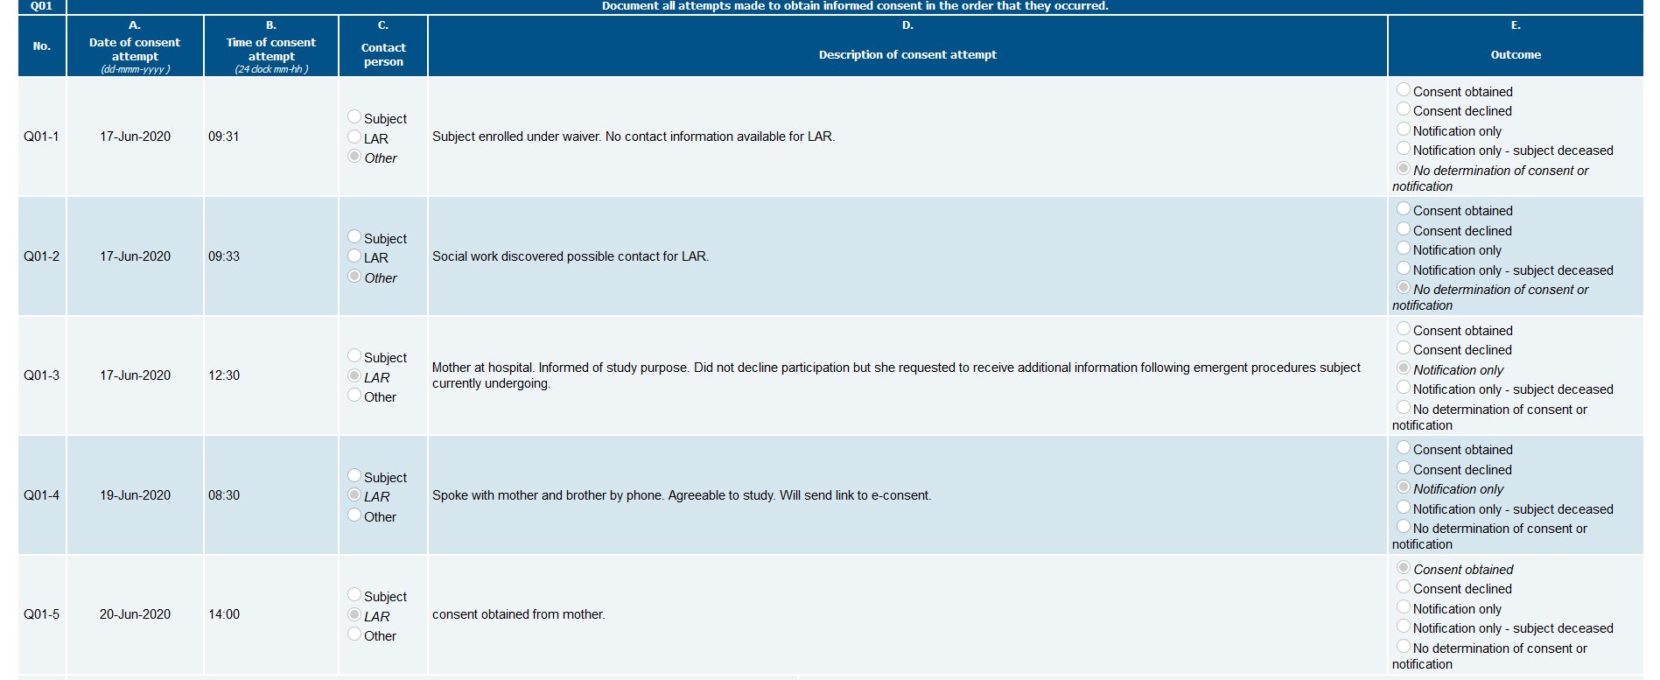
Informed Consent Log
HOBIT / BioHOBIT Virtual Investigator Meeting
November 9th & 12th, 2020

Slide 22
EFIC & Informed Consent Log
Questions?
HOBIT / BioHOBIT Virtual Investigator Meeting
November 9th & 12th, 2020

Slide 23
Chamber Reminders
Bill Gossett

Slide 24
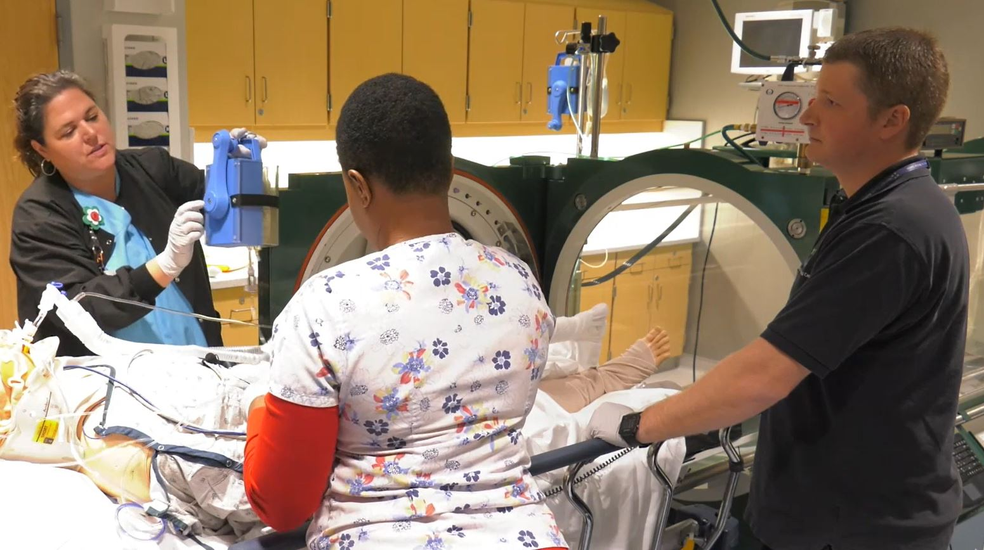
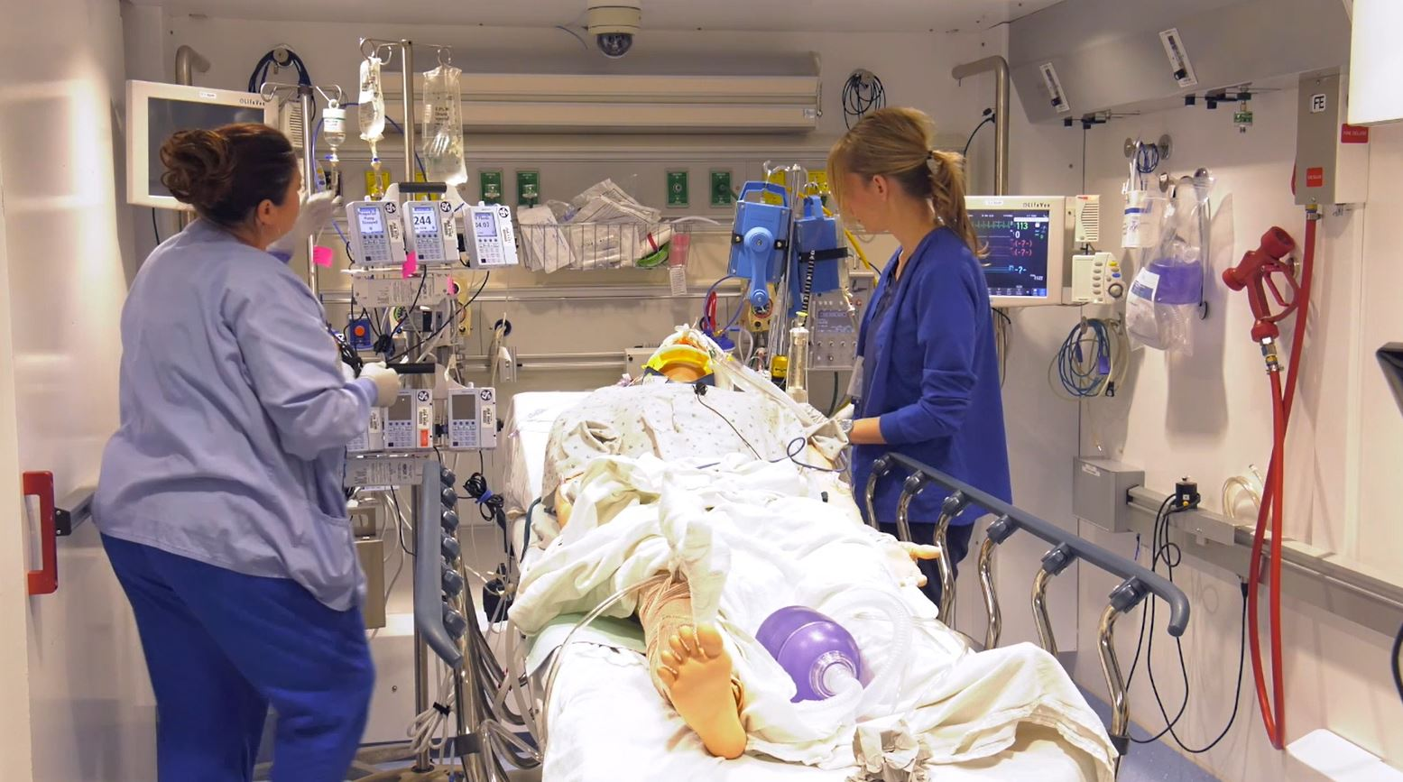
Chamber Reminders
Monoplace Chamber
Multiplace Chamber
HOBIT / BioHOBIT Virtual Investigator Meeting
November 9th & 12th, 2020

Slide 25
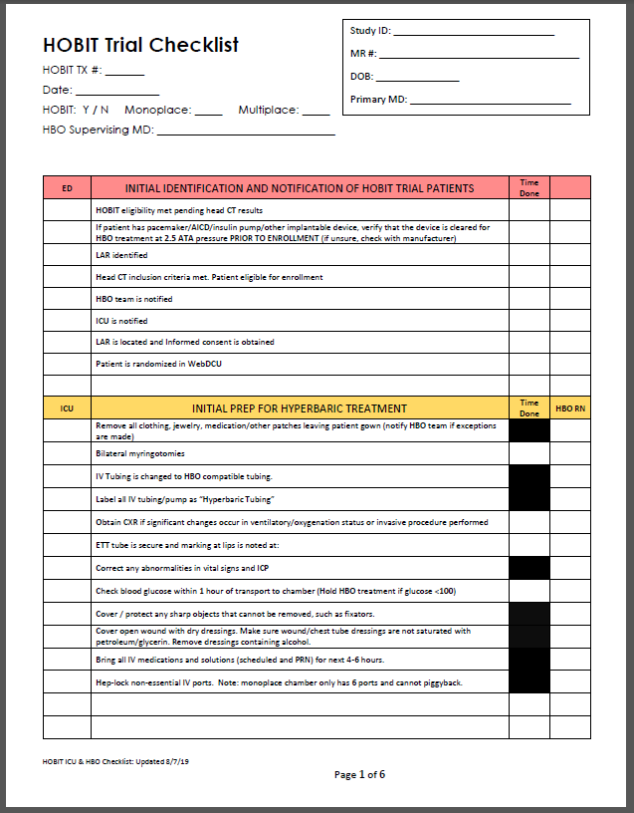
Refresher Training
Simulation training to identify gaps and problems.
  Time gaps: unnecessary delays, prioritizing, after hours call-in’s
  Knowledge gaps: protocol and equipment
  Communication gaps: individuals and departments
  Equipment gaps: missing or not available
HOBIT Checklist - guide for simulation training (Toolbox)
Practice in ED, ICU, RT’s, and HBO
First treatment TIME WINDOW

Slide 26
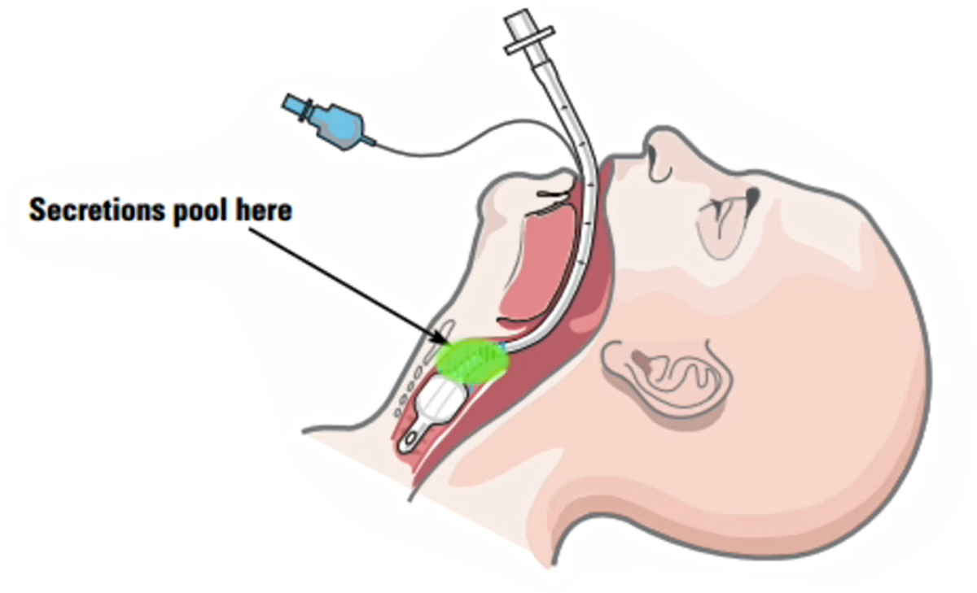
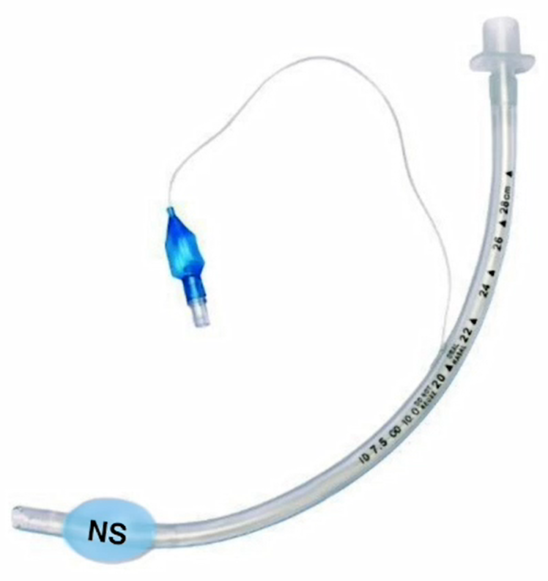
Importance of Reviewing
HYCEP Maneuver
Extremely important to use a safe procedure when changing the ET tube cuff from air to water or NS.
HYCEP is an acronym for “Hyperbaric Cuff Exchange Procedure”.
Videos and training guides are in the HOBIT Toolbox
HOBIT / BioHOBIT Virtual Investigator Meeting
November 9th & 12th, 2020

Slide 27
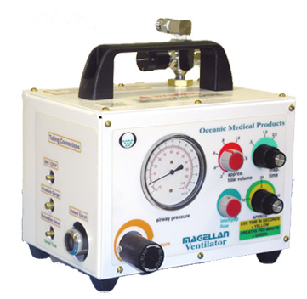
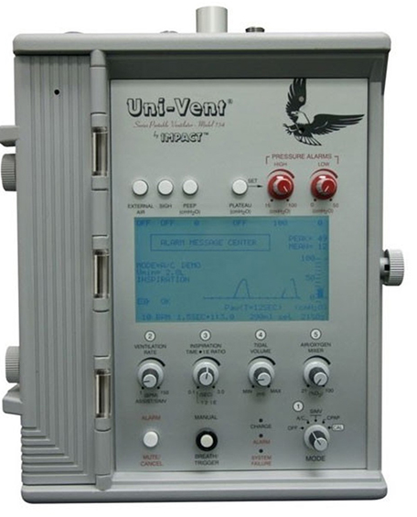
In the Hyperbaric Unit
Hyperbaric Ventilator
+
Baseline
FiO2
+
Before HBO
Treatment
ABG
HOBIT / BioHOBIT Virtual Investigator Meeting
November 9th & 12th, 2020

Slide 28
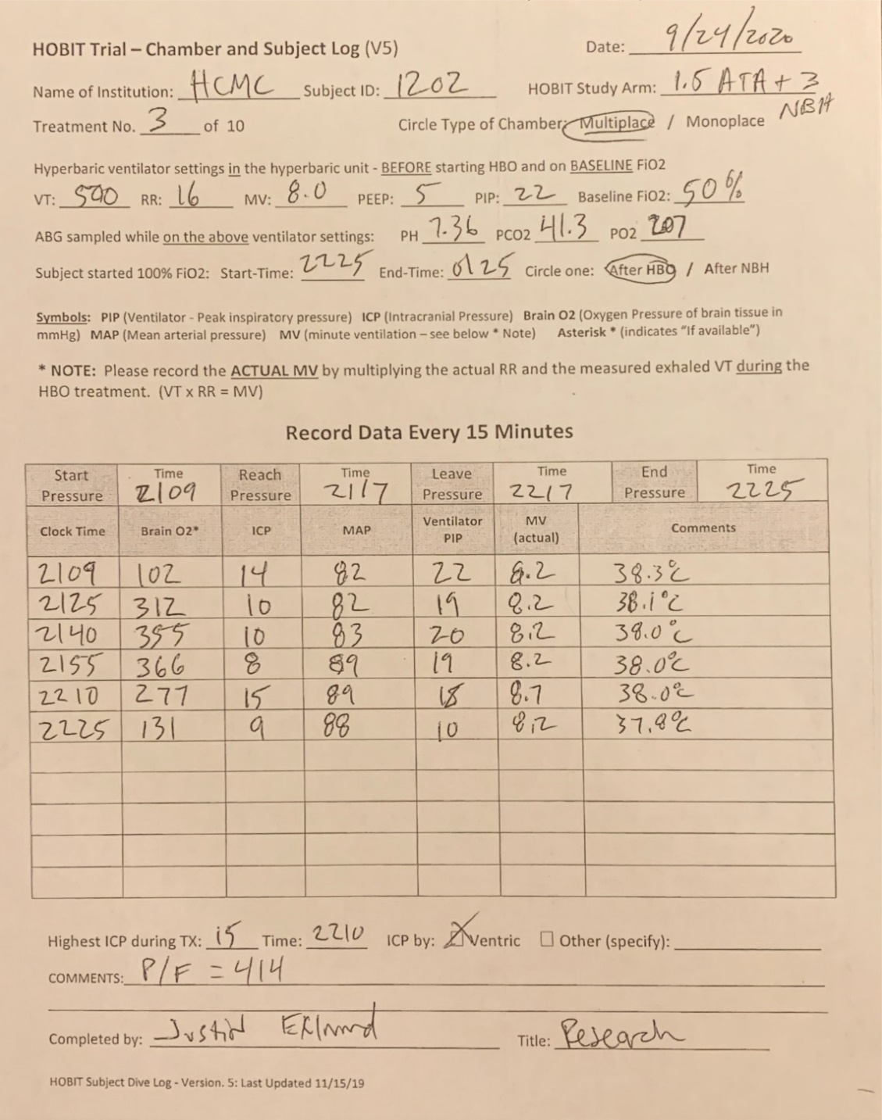

Chamber and Subject Log
Logs are uploaded to WebDCU and reviewed.
Subject on Hyperbaric ventilator during prep time
ABG’s on baseline FiO2 after 15 min.
Measuring minute ventilation (MV)
Peak Inspiratory Pressures (PIP)
Chamber dive times
HOBIT / BioHOBIT Virtual Investigator Meeting
November 9th & 12th, 2020

Slide 29
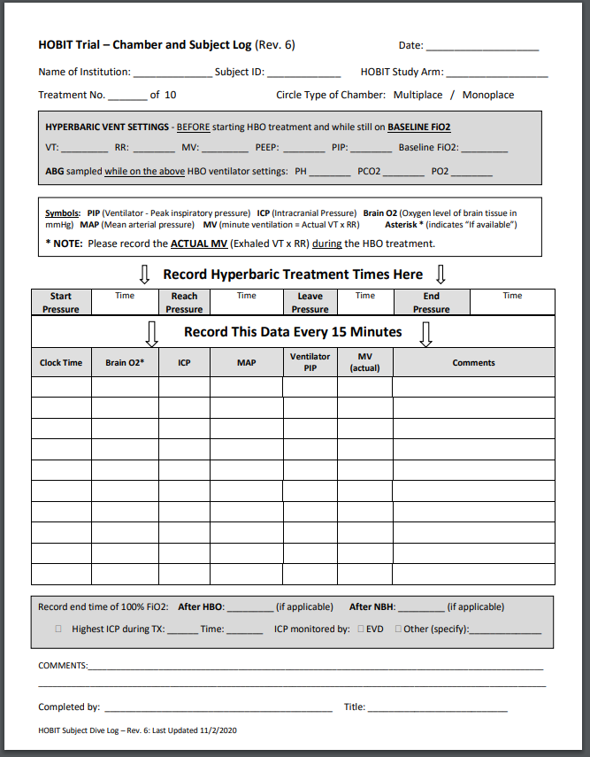
Most Recent Chamber and Subject Log
HOBIT Toolbox (Chamber Resources)
Subject section
Ventilator and ABG section
Chamber “dive” section
Data section
Recording when on 100% FiO2
Highest ICP
Signature
HOBIT / BioHOBIT Virtual Investigator Meeting
November 9th & 12th, 2020

Slide 30

BioHOBIT
The Scientific Premise
Frederick Korley, M.D., Ph.D.

Slide 31
Funding
NINDS R01NS114251

Slide 32
Overall Objectives
  Validate candidate monitoring biomarkers for monitoring patient response to neuroprotective therapy in severe TBI.
  Validate candidate predictive biomarkers for identifying patients most likely to respond favorably to HBO treatment

Slide 33
Study Overview
Aim 1:
Quantify NfL’s stroke risk prediction ability in a population-based cohort.
Aim 2:
Investigate the determinants and prognostic accuracy of temporal changes in NfL levels
Validate the accuracy of candidate monitoring biomarkers for predicting a clinical outcome in severe TBI
Determine the treatment effect of different doses of HBOT on monitoring biomarkers and clinical outcome.
Aim 3:
Determine the extent to which NfL levels can be modified by targeted CVD risk factor control.
Determine whether there is a biomarker defined subset of severe TBI that responds favorably to HBOT.
Impact
Inform a go/no-go decision regarding phase III trial for HBOT
Validate the first severe TBI candidate monitoring biomarkers
Identify the severe TBI subgroup most likely to benefit from HBOT

Slide 34
Monitoring Biomarkers
Assessed serially over time to measure presence, status, or extent of a disease or to provide evidence of an intervention effect. Examples: HIV viral load, lactic acid
Intervention
Disease
Monitoring Biomarker
Clinical Outcome

Slide 35
Predictive Biomarkers
Identifies individuals who are more likely to respond to exposure to a therapeutic agent.
Enrichment Phase
Randomized control trial phase
Predictive
Biomarker
positive
Randomize
Intervention
All
Eligible
patients
Screening
Placebo
Predictive
Biomarker
negative
Excluded
The role of predictive biomarker in a future enrichment design trial

Slide 36
Candidate Biomarkers
Glial Cells
Glial fibrillary acidic protein (GFAP)
Neurons
Neurofilament light chain (NF-L)
Inflammatory
High Sensitivity CRP

Slide 37
Time course of biomarker levels

Slide 38
Effect of ongoing brain injury

Slide 39
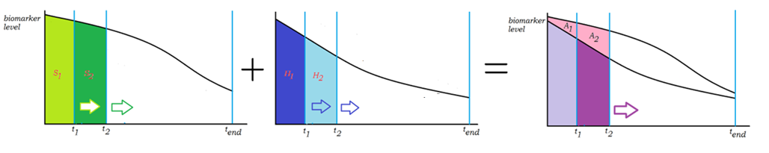
Hypothesized effect of HBO Treatment
Control
Control
Control
HBO dose 1
HBO dose 1

Slide 40
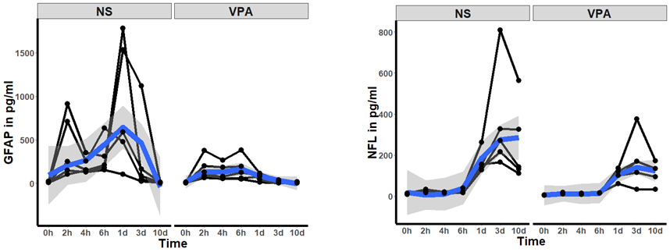
Preliminary evidence – Animal Model Study
Korley et al. J Neurotrauma. 2018 May 15;35(10):1185-1191

Slide 41
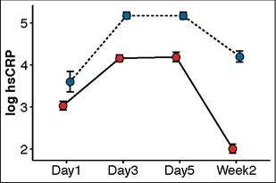
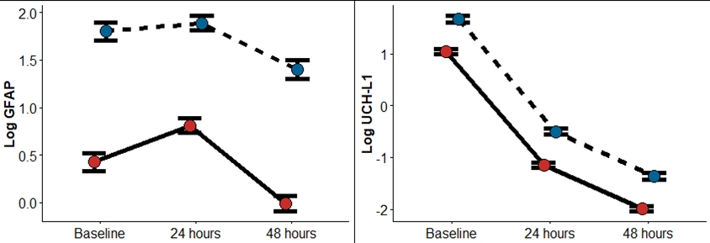
Prognostic ability of biomarkers
Favorable Outcome
Unfavorable Outcome

Slide 42
Sample Collection Schedule
Visit | 0hr | 8hr | 24hr | Post-HBO (once @ D2-D5) | D3 | D5 | D7 | D14 | D180
Plasma
Serum
Buffy Coat
CSF

Slide 43
Consent
Consent for HOBIT = Consent for BioHOBIT

Slide 44

The Biomarkers in the Hyperbaric Oxygen Brain Injury Treatment Trial (BioHOBIT)
Biospecimen collection & processing

Slide 45
Overview
  Specimen uniformity and quality
  Site Equipment
  Procedures
    Kit Contents
    Sample Labelling
    Sample Collection and Processing
    Shipping Samples
    Non-Conformance
  Contact Information

Slide 46
Specimen Uniformity and Quality
General Reminders

Slide 47
Specimen Uniformity and Quality
Most biomarkers are sensitive to time and temperature
  Standardization of processing across sites is key
  Specimens must be processed within 2 hours of collection
  Reference the BioSEND Specimen Collection, Processing, and Shipment Manual as needed
  Do not replace or supplement any kit components without first receiving approval from BioSEND/NINDS
  Questions? Email biosend@iu.edu

Slide 48
Site Equipment
Sites will need to supply the following items:
Gloves
Alcohol wipes
Butterfly needles
Tourniquet
Gauze pads
Bandages
Microcentrifuge tube rack
Sharps bin and lid
Crushed ice
Pipettes and pipette tips
Centrifuge capable of maintaining 4°C
-80°C Freezer
Dry ice

Slide 49
Procedures
Maintaining specimen uniformity and quality

Slide 50
Collection Protocol
Visit & Sample Type | 0hr/BL | 8hr | 24hr/D1 | Post-HBO (one time between D2-D5) | D3 | D5 | D7 | D14 | D180
Plasma aliquots, 1500ul | 4 | 4 | 4 | 4 | 4 | 4 | 4 | 4 | 4
Serum aliquots, 1500ul | 4 | 4 | 4 | 4 | 4 | 4 | 4 | 4 | 4
Buffy Coat | 1 | 1 | 1 | 1 | 1 | 1 | 1 | 1 | 1
CSF aliquots, 1500ul | 4 | 4 | 4 | 4 | 4 | 4 | 0 | 0 | 0

Slide 51
Kit Contents and Ordering
Kit and supply ordering will be through WebDCU
Sites will be sent an initial shipment of 24 visit kits

Slide 52
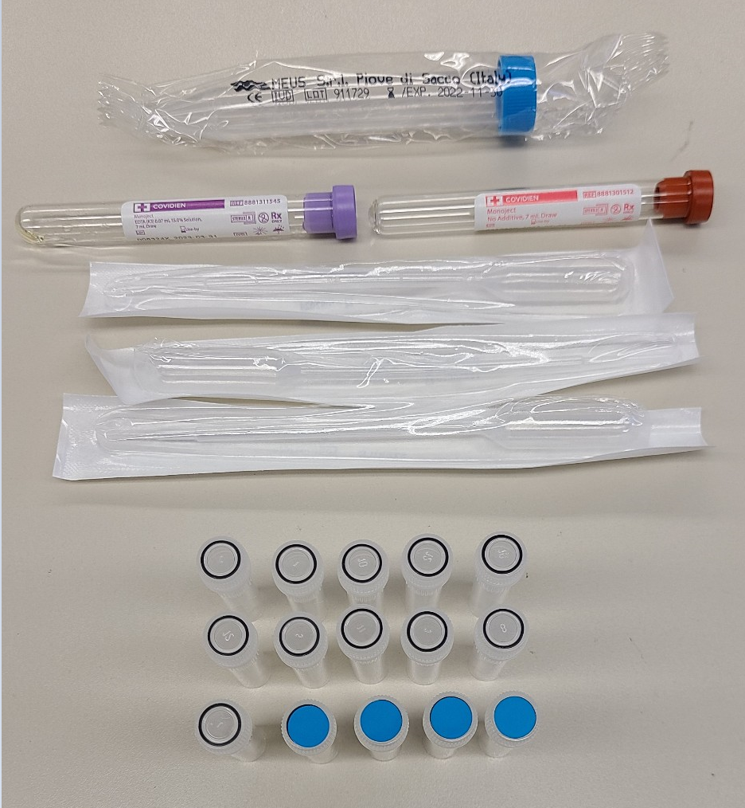
Kit Contents and Ordering
  Standard Kit:
  Contains supplies for blood and CSF
  Can be used for any time point

Slide 53
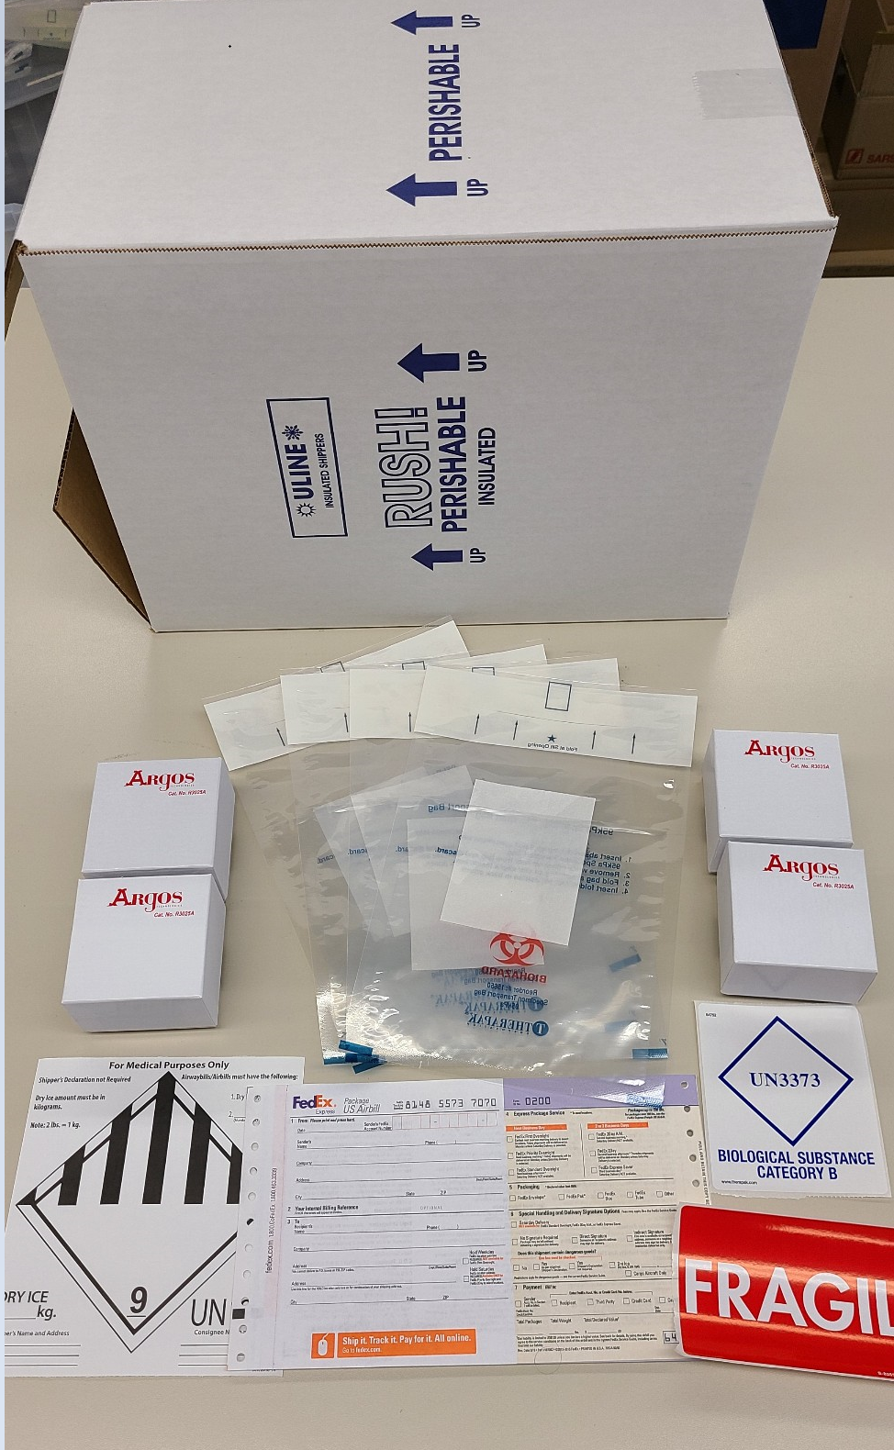
Kit Contents and Ordering
Shipping Kit:

Slide 54
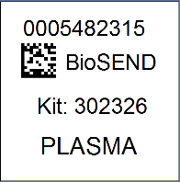

Sample Labelling
  Labels are provided by Indiana University
  Please check that all samples are properly labelled to ensure correct identification by IU
  If do not have enough labels to complete a visit, please contact IU immediately
  Labelling the tubes during processing prevents sample mix-ups
Kit ID
987654
Kit ID
987654
Notes:
It can be difficult to stick the label on a cold or wet tube.

Slide 55
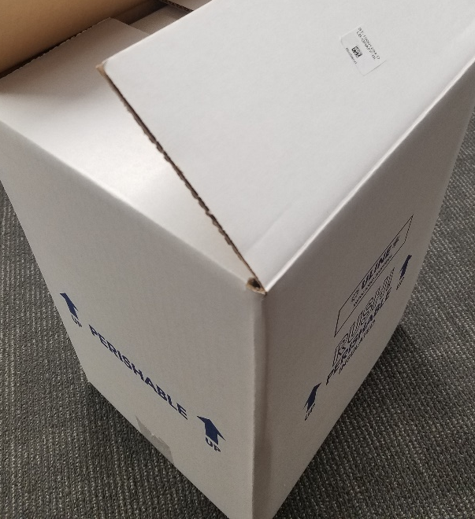
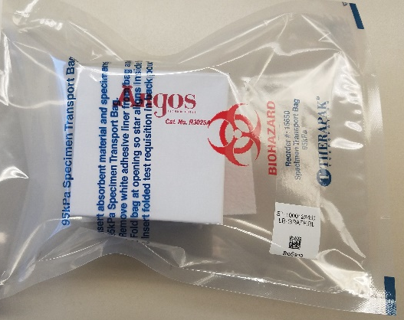
Sample Labelling
  Kit labels are placed on packaging material
Notes:
It can be difficult to stick the label on a cold or wet tube.

Slide 56

Sample Labelling
Please...
Label all collection and aliquot tubes before cooling, collecting, processing, or freezing samples
Label only 1 visits’s tubes at a time to avoid mix-ups
Wrap the label around the tube horizontally - label position is important for all tube types
Make sure the label is completely adhered by rolling between your fingers
0001234567
BioSEND
987654
PLASMA
0001234567
BioSEND
987654
PLASMA
YES
NO

Slide 57

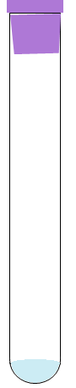
Sample Collection and Processing
7ml Serum
7ml EDTA
Blood Tube Draw Order
1
2

Slide 58





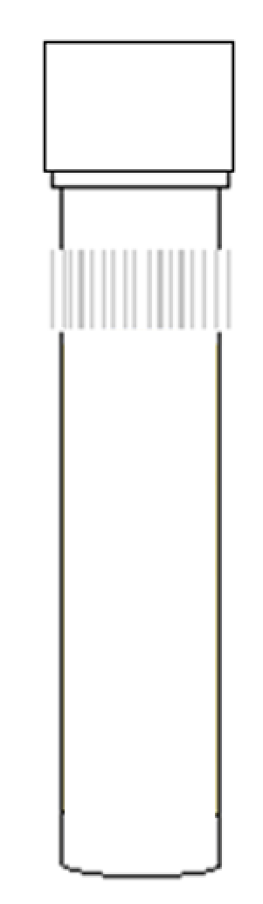
Sample Collection and Processing: Serum
Step One
Step Two
Step Three
Step Four
Step Five
Step Six
Serum
Serum
Serum tube
X 4
Using a clean transfer pipet, aliquot 1.5 ml serum into each clear-capped cryotube.
If a residual aliquot (<1.5 ml) is created, place a blue cap on this aliquot.
Samples must be processed and stored within 2 hours of collection.
Store serum aliquots upright at -80°C until shipment.
Pre-chill cryotubes on wet ice for at least 5 minutes.
Store tubes at room temperature.
Label collection tubes and cryotubes with serum labels prior to blood draw. Prepare 4 cryotubes for serum.
Collect blood in serum tube, allowing blood to flow for 10 seconds and ensuring blood flow has stopped.
Immediately after blood draw, invert tube
8-10 times to
mix samples.
Allow blood to clot at room temperature for 30 minutes.
After incubation, centrifuge sample at 1500 x g at 4°C for 15 minutes.
Notes:
Be sure to give the tube enough time to clot to avoid hemolysis.

Slide 59




Sample Collection and Processing: Plasma & Buffy Coat
Step One
Step Two
Step Three
Step Four
Step Five
Step Six
Plasma
Plasma
EDTA tube
X 5
Using a clean transfer pipet, aliquot 1.5 ml plasma into each clear-capped cryotube.
If a residual aliquot (<1.5 ml) is created, place a blue cap on this aliquot.
Samples must be processed and stored within 2 hours of collection.
Store plasma aliquots upright at -80°C until shipment.
Pre-chill cryotubes on wet ice for at least 5 minutes.
Store tubes at room temperature.
Label collection tubes and cryotubes with prior to blood draw. Prepare 4 cryotubes for plasma and 1 for buffy coat.
Collect blood in
EDTA tube, allowing blood to flow for 10 seconds and ensuring blood flow has stopped.
Immediately after blood draw, invert tube 8-10 times to
mix samples.
Centrifuge sample at 1500 x g at 4°C for 15 minutes.
Step Seven
Using a clean transfer pipet, collect the buffy coat (will include residual plasma and some red blood cells).
Transfer the buffy coat to clear-capped cryotube.
Store plasma and buffy coat aliquots upright at -80°C until shipment.
Notes:
Collect some serum and RBCs with buffy (if it’s not red, you didn’t get it all).

Slide 60

Sample Processing: CSF
Step One
Step Two
Step Three
Step Four
Step Five
X 4
Using a clean transfer pipet, aliquot 1.5 ml CSF into each cryotube.
If a residual aliquot (<1.5 ml) is created, place a blue cap on this aliquot.
Samples must be processed and stored within 2 hours of collection.
Store CSF aliquots upright at -80°C until shipment.
Prepare four cryotubes with CSF labels.
Do NOT pre-chill cryotubes for CSF.
Collect CSF into 15 ml conical tube.
Immediately after collection, gently invert the 15 ml conical tube 3-4 times to mix the sample.
Centrifuge samples at room temperature at 2000 x g for 10 minutes.

Slide 61
Sample Collection and Processing: Aliquots
Filling biomarker serum, plasma, and CSF aliquots:
Ensure that you are using the correct vials
  Clear cap = CSF and buffy coat
  Blue cap = residuals
Fill as many cryovials as possible to 1.5 ml
Over-filled vials may burst in freezer!
Ship ALL material to IU, even if final vial is less than standard volume
YES
NO

Slide 62
Sample Collection and Processing
  Troubleshooting Blood Collection
  Issue #1: Tube with little/no vacuum
  Always check expiration date on the tube before beginning blood draw and discard expired tubes
  Store tubes at “room temperature” – extreme temperature can affect vacuum
  Keep extra collection tubes from supplemental kit nearby during blood draw to replace “bad” tubes
  If this is a frequent occurrence, report tube type and lot number to IU.

Slide 63
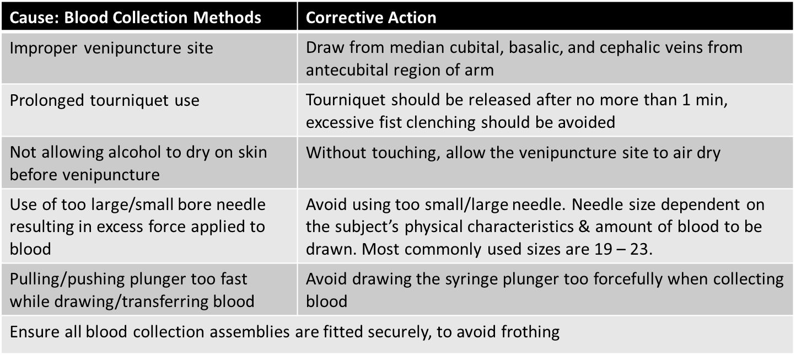
Sample Collection and Processing
  Troubleshooting Blood Collection
  Issue #2: Hemolyzed serum and/or plasma caused by incorrect collection
For more information, visit: http://www.bd.com/vacutainer/pdfs/techtalk/TechTalk_Jan2004_VS7167.pdf
Notes:
Don’t move needle around in the vein

Slide 64
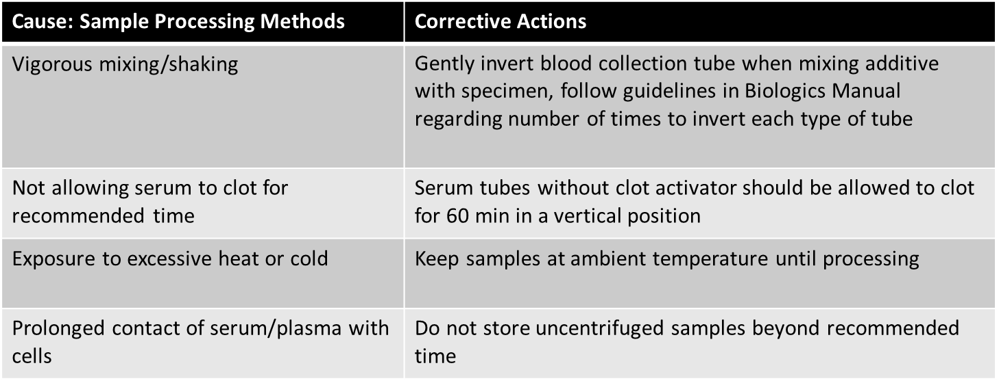
Sample Collection and Processing
  Troubleshooting Blood Collection
  Issue #2: Hemolyzed serum and/or plasma caused by incorrect processing
For more information, visit: http://www.bd.com/vacutainer/pdfs/techtalk/TechTalk_Jan2004_VS7167.pdf
Notes:
Let the serum clot!

Slide 65
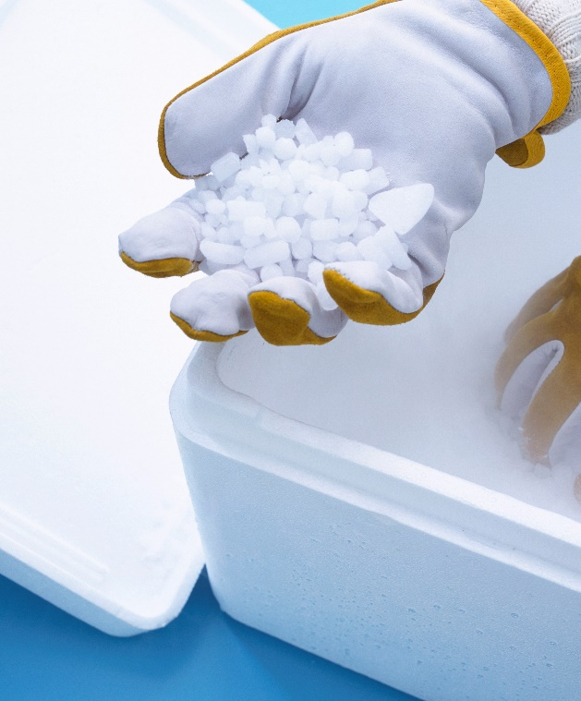
Shipping Samples: Frozen
  Packing and Shipping Frozen Samples
  All BioHOBIT samples ship frozen
  Ship frozen samples on dry ice
  Frozen samples should be shipped only Monday through Wednesday
  Always fill carton to top with dry ice
  Do not pack shipment until the day of pickup

Slide 66
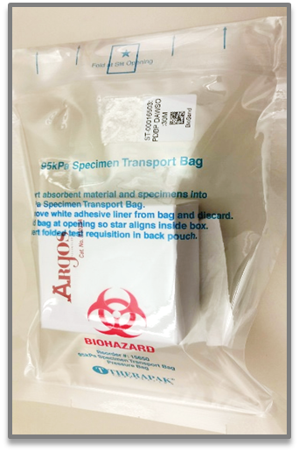
Shipping Samples: Frozen
  Packing and Shipping Frozen Samples
  Shippers use approx. 10lbs of dry ice
  Place layer of dry ice in between cryoboxes

Slide 67
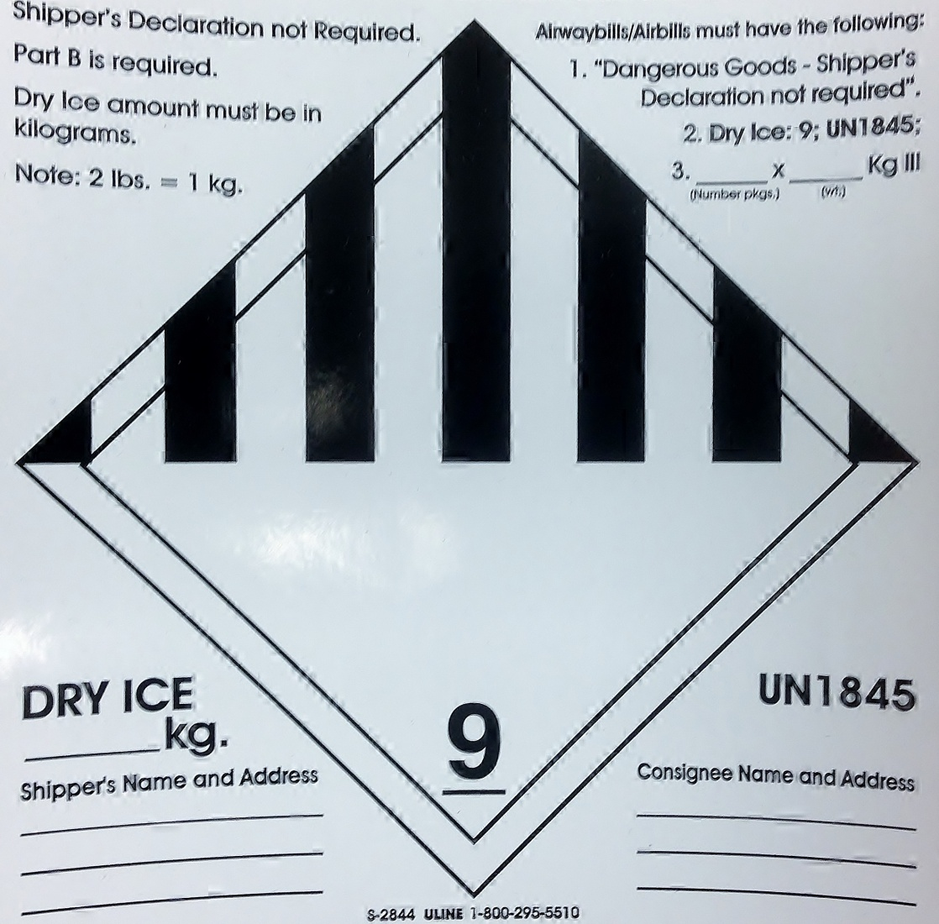
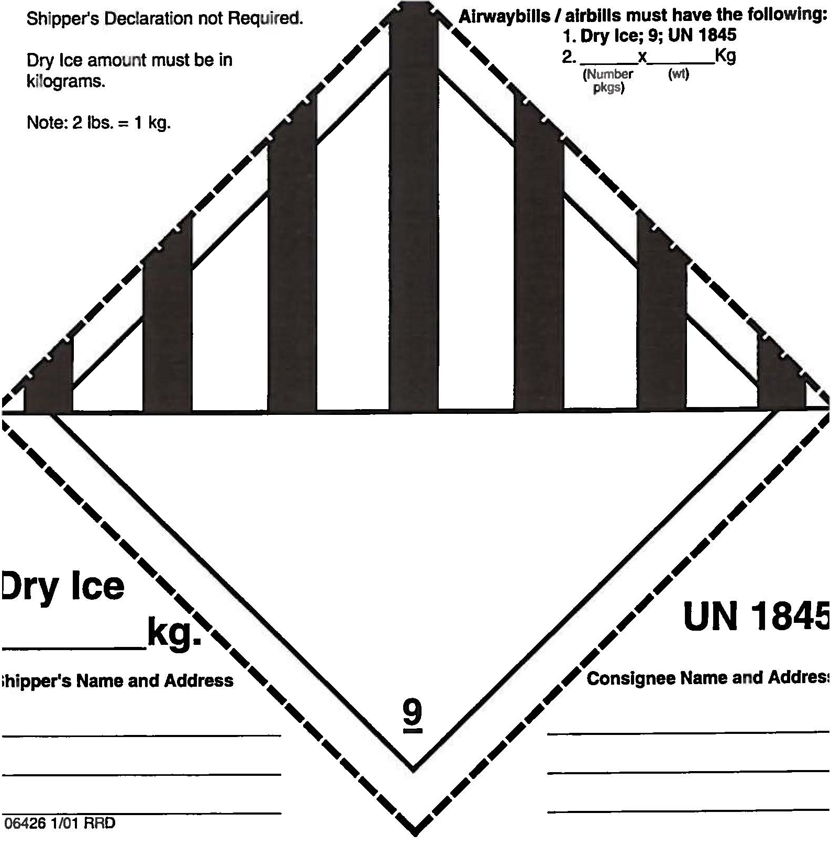
Shipping Samples
  Class 9 Dry Ice Label should not be covered with other stickers and must be completed, or FedEx will reject/return your package!
Packing and Shipping Frozen Samples
Net weight of dry ice in kg
IU information and address
Your name & address

Slide 68
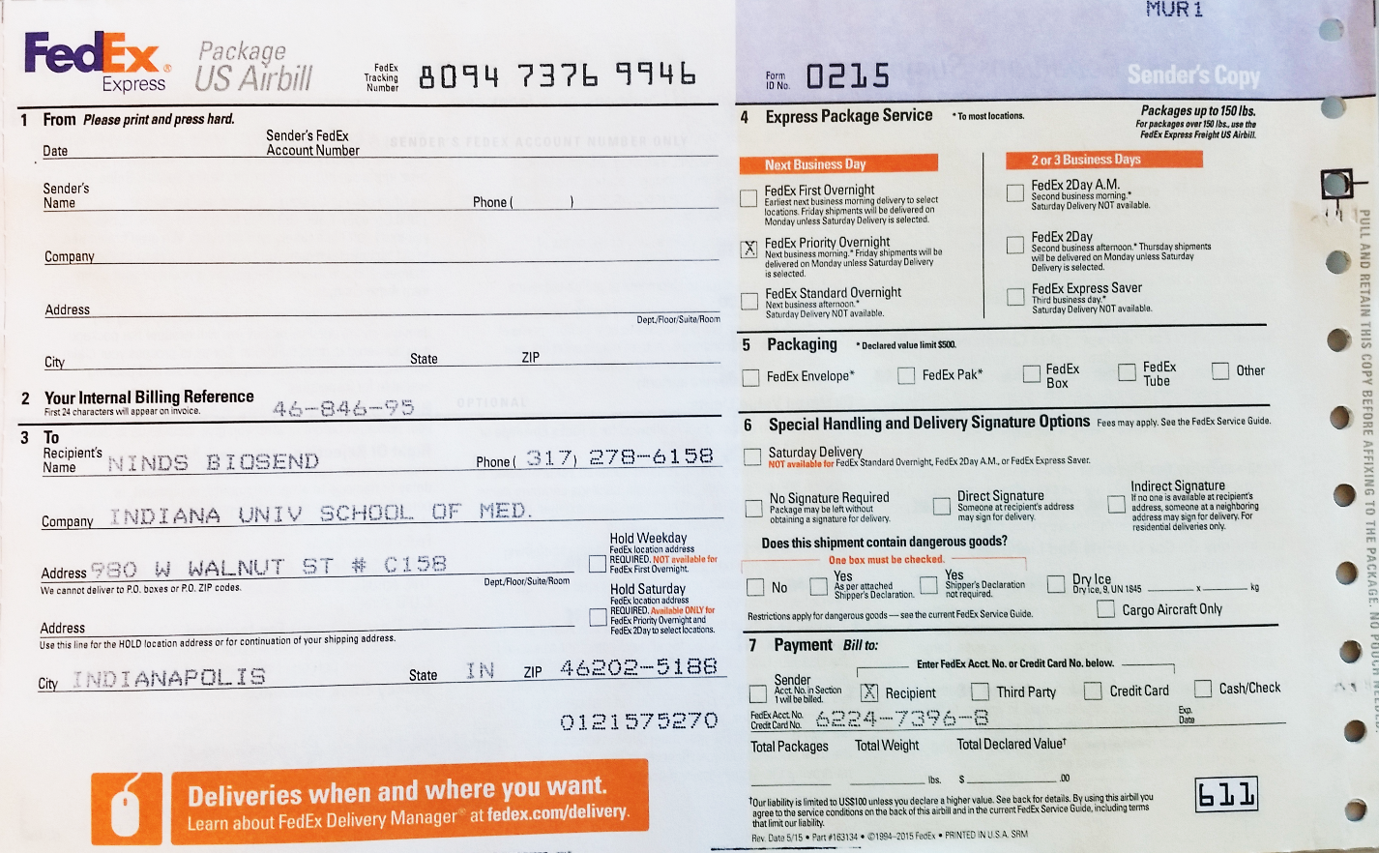
Shipping Samples
Complete “From” portion of FedEx airbill
FedEx

Slide 69
Shipping Samples: Closures
Date | Holiday
January 1 | New Year's Day
3rd Monday in January | Martin Luther King, Jr Day
4th Monday in May | Memorial Day
July 4 | Independence Day (observed)
1st Monday in September | Labor Day
4th Thursday in November | Thanksgiving
4th Friday in November | Friday after Thanksgiving
December 25 | Christmas
  IU will be closed for shipments the week of Thanksgiving (11/23-11/27)

Slide 70
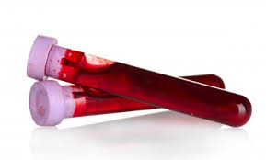
Non-Conformance
  Non-conformance to standard procedures may reduce the utility of the biospecimens:
  Not processing serum/plasma within 2 hours of collection allows for breakdown of certain proteins and small molecules
  Over/under centrifuging changes plasma, serum, CSF composition

Slide 71
Non-Conformance Reporting
  Most common non-conformance issues:
  Samples shipped for weekend/holiday delivery
  Sample form incomplete/inaccurate
  Unlabeled or mislabeled tube(s)
  Sample hemolysis

Slide 72
Contacts
  Indiana University
  General Questions:
  biosend@iu.edu
  Biorepository Project Manager:
  Claire Wegel
  cwegel@iu.edu
  Tel: 317.278.6158
Biorepository Clinical Research Coordinator:
Carolyn Dunifon
cdunifon@iu.edu
Tel: 317.274.5751

Slide 73
DCC Show and Tell
Kyle Hatcher

Slide 74
Contracts and Payments
Valerie Stevenson

Slide 75
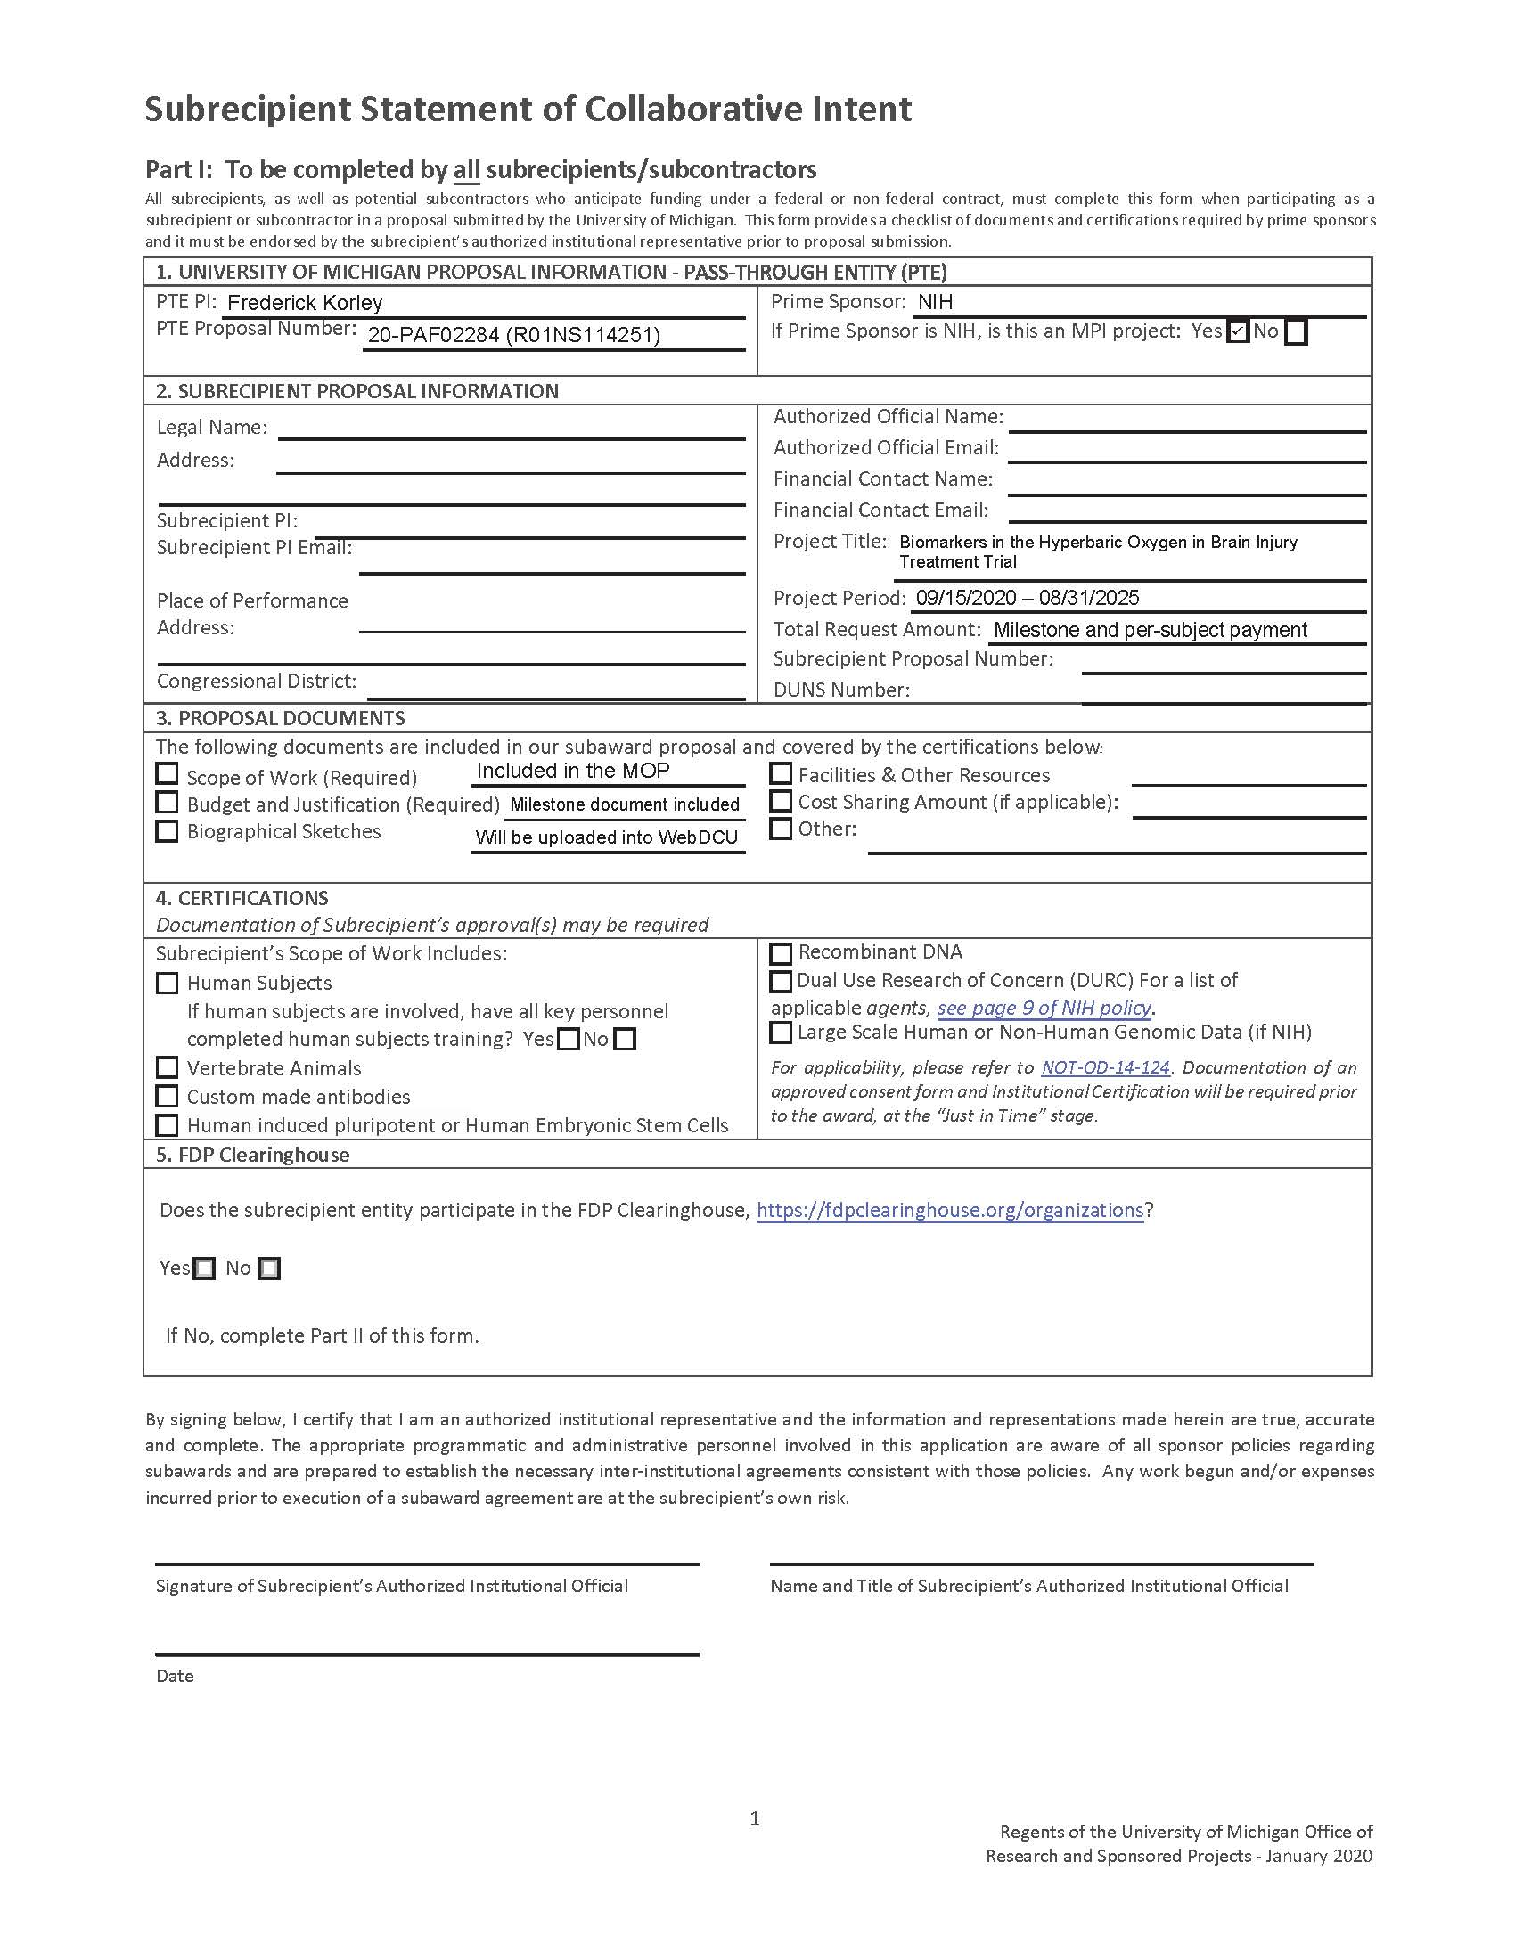
Contracts
Complete subrecipient form
Execute study-specific trial rider

Slide 76
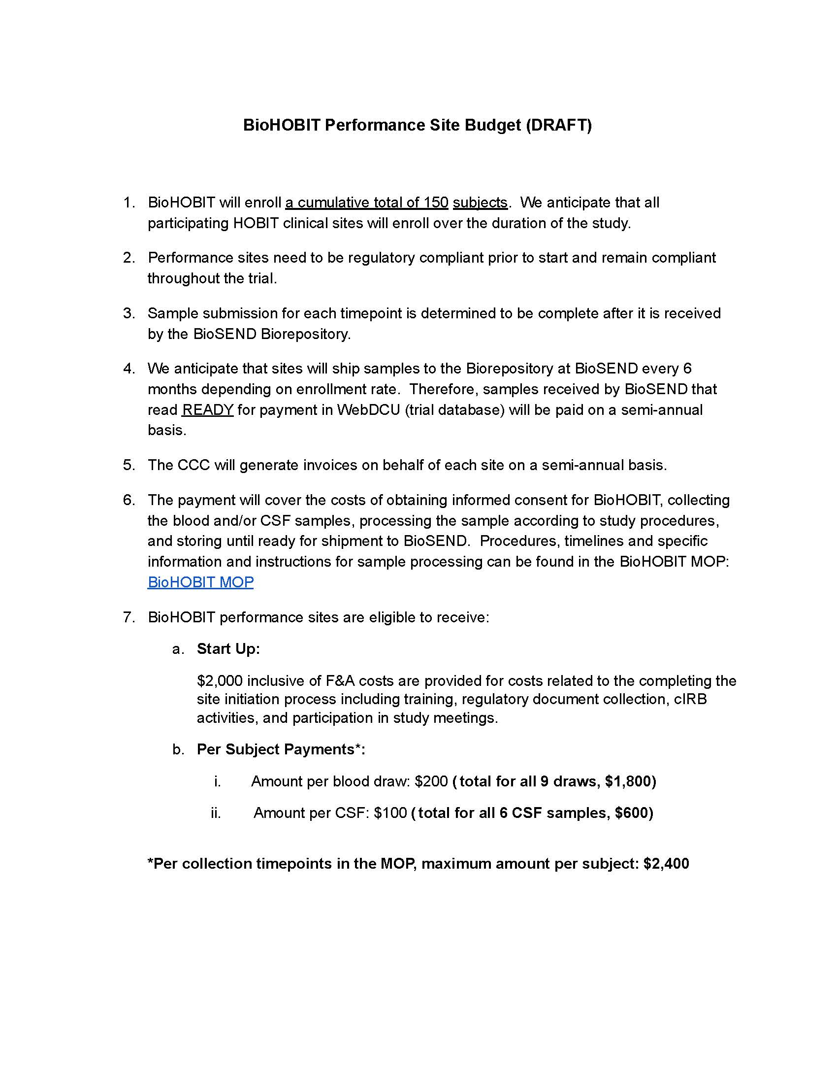
BioHOBIT Payments
Complete activities listed
within Milestone Document

Slide 77
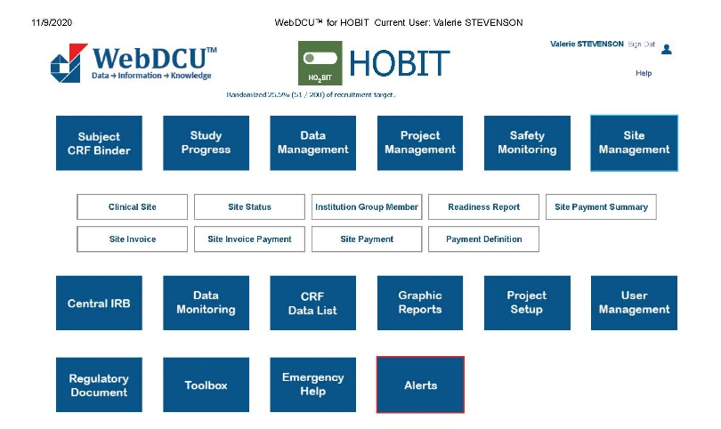
BioHOBIT Payments

Slide 78
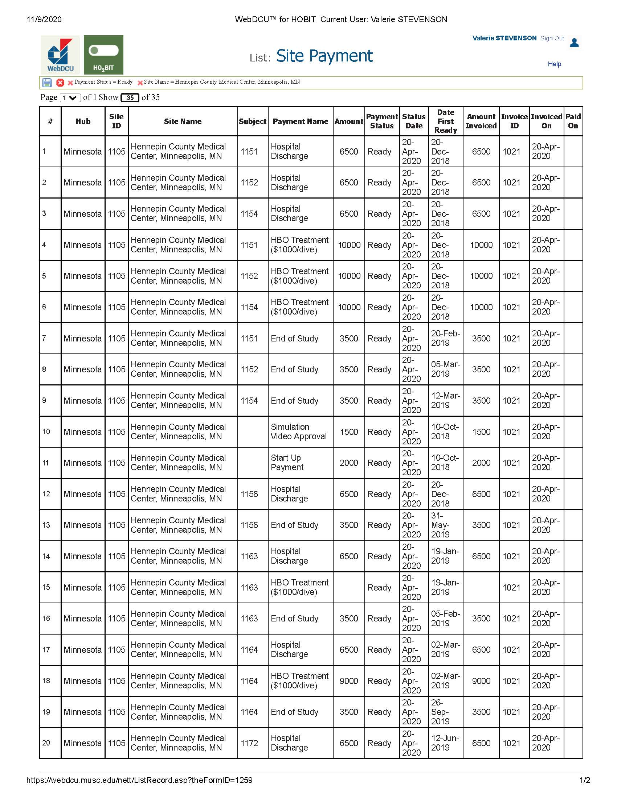
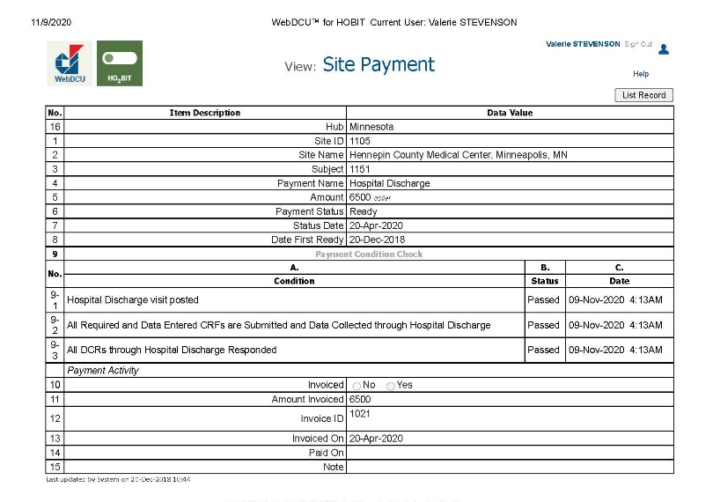
BioHOBIT Payments

Slide 79
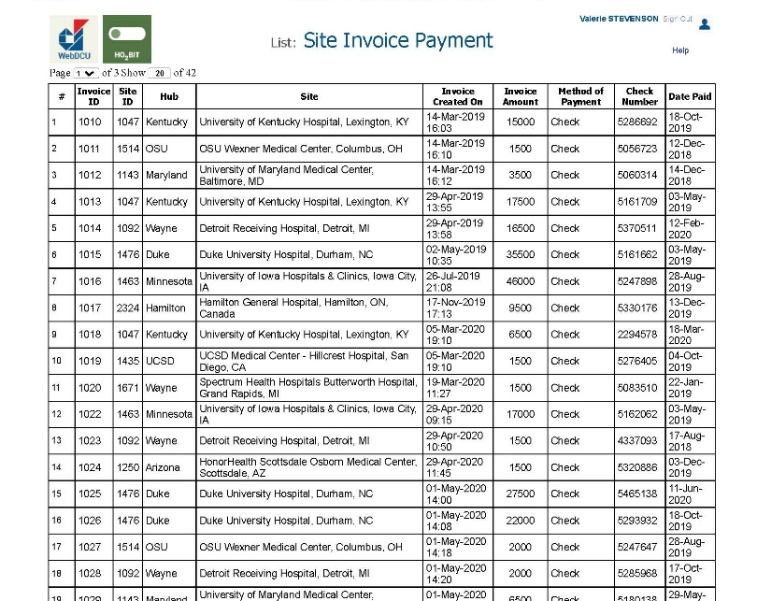
BioHOBIT Payments

Slide 80
Questions?

Slide 81
HOBIT Clinical Quality Improvement Group (CQIG)
Nicholas Mohr, MD, MS
Professor of Emergency Medicine, Anesthesia Critical Care and Epidemiology
University of Iowa Carver College of Medicine and College of Public Health
nicholas-mohr@uiowa.edu

Slide 82
Objectives
To discuss the goals of the HOBIT Clinical Quality Improvement Program
To identify problems highlighted by HOBIT sites
To review some draft HOBIT “best practices”
Notes:
No conflicts of interest.

Slide 83
Clinical Quality Improvement Group
Goal: To improve efficiency, standardization, and conduct of HOBIT trial
Composition: All HOBIT site PIs
Meetings: Monthly teleconferences (Nov 9, noon CST)
Notes:
No conflicts of interest.

Slide 84
Site PI Survey
How is the HOBIT trial going at your site?
Notes:
No conflicts of interest.

Slide 85
Site PI Survey
How many of the eligible patients do you capture at your site?
Notes:
No conflicts of interest.

Slide 86
Focus Areas
Early study subject recognition and timely enrollment
Coordination of care between multiple clinical teams
Delays in ICP monitor placement
Notes:
No conflicts of interest.

Slide 87
“Best Practices”
ED-based research assistants
Standard screening worksheet
Involvement of site PI within 1 hour
Group communication tool (group text)
Ongoing involvement from neurosurgery
Formal timeline with thresholds for notification
Ongoing clinical trial education (stakeholders)
Notes:
No conflicts of interest.

Slide 88
HOBIT Clinical Quality Improvement Group (CQIG)
Nicholas Mohr, MD, MS
Professor of Emergency Medicine, Anesthesia Critical Care and Epidemiology
University of Iowa Carver College of Medicine and College of Public Health
nicholas-mohr@uiowa.edu

Slide 89
Educational Video
Carol VanHuysen

Slide 90
Questions and Closing Remarks
Gaylan Rockswold, MD, PhD

