Slide 1
Common Data Pitfalls

Slide 2
Housekeeping
Check your alerts for outstanding data/DCRs/Rule Violations
Some sites have only minimal corrections to make before subjects are eligible for payment!
Keep an eye on your financial information under SITE MANAGEMENT and reach out if you think you should have been paid but have not.
If you miss a subject because you were not notified in time, make sure to retrain stake holders. Make sure your PI is aware.
If you have remaining DCRs after a monitoring visit, please address those.
If you receive an email from Kennedy Krieger, please always respond!
Notes:
RC Zoom from … about study finances if you need a refresher
KKI has lots of suggestions about making contacts. Please always treat as time-sensitive and urgent. This is related to our primary outcome.

Slide 3
PICECAP Trial 12-month Neurology Appt
Reach out to your study neurologist EARLY.
Clinics fill up way in advance.
Schedule the on-site neurology exam at the END of the 12 -month window or even AFTER the window.
This gives KKI the entire window to reach the family for the phone call.
If you cannot schedule the neurology exam at end or after window, reach out to KKI! picecap@kennedykrieger.org
Notes:
You will receive an automated reminder from WEBDCU

Slide 4
Screen Failures
Enter a screen failure for all OH surviving pediatric cardiac arrests, that are not enrolled.
Make sure you are capturing them all.
Remind frequently
Review ICD10 codes to make sure you have not missed any.
3. Include those not approached because of non-availability of team members
Be sure to note inclusion criteria met or exclusion criteria not met, if any!
Select A (Site Operation Issues) ONLY if the subject was otherwise eligible
Notes:
This includes subjects that have <2 mins compressions and are not even admitted to PICU. Include those not approached because of non-availability of needed team members
2
Tempting to just say no to all exclusion criteria, since you already said no one was available… It will look like you are missing eligible subjects. I will reach out to you if I see a SF like that. I am just trying to make you all look good!
If you DO miss an eligible subject for a site operation issue (like you weren’t notified, or no study staff available) then select A! I know this is ‘new’ information and if I see you have selected A for a screen failure, I may reach out to make sure it was an eligible subject.

Slide 5
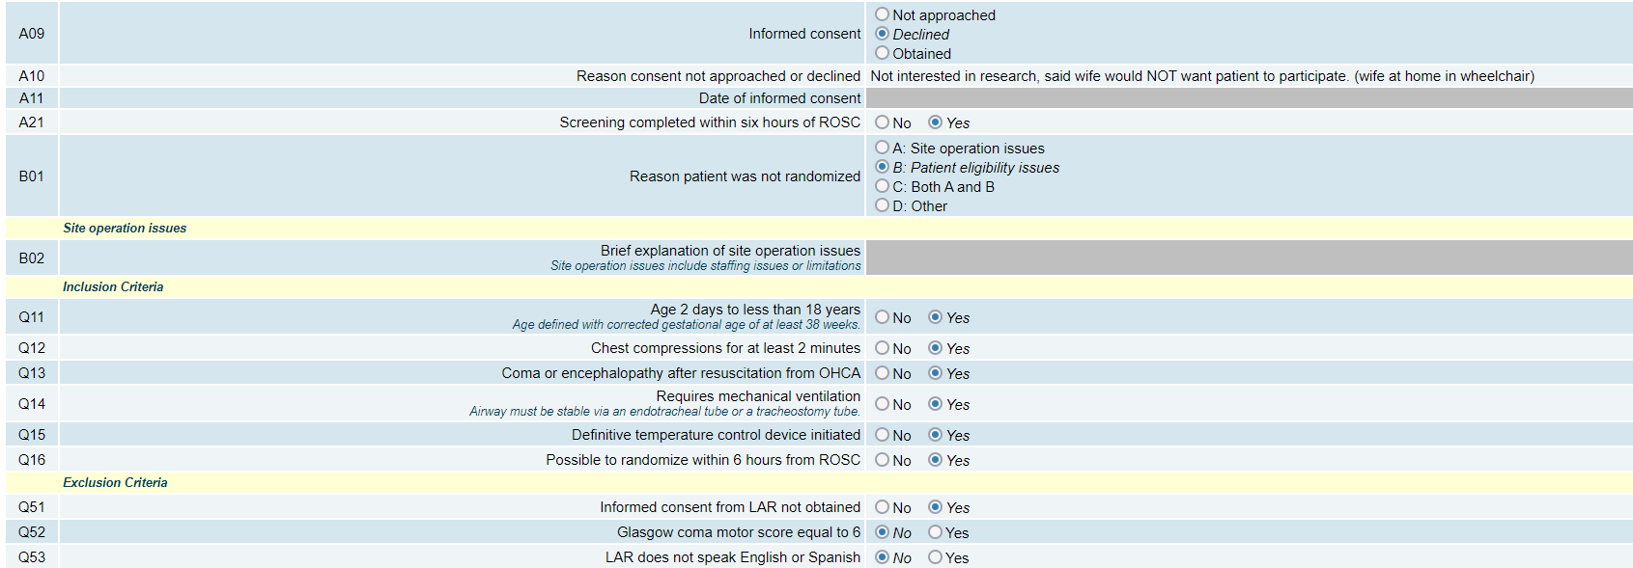
DECLINES
Notes:
Declines: If you select D for B01, you will not be paid. Declines are eligible for $100 payment (Meet inclusion criteria and screened within 6 hours)
If the CA did not show up within the window/time is too short to enroll, - you will answer NO to Q16 “possible to randomize within 6 hrs from ROSC”). You should select C if you were not notified in time, and you will still complete the inclusion/exclusion criteria.

Slide 6
Modified Pediatric GCS Form
The information on this CRF is part of the exclusion criteria (Motor Score =6)
The time of this assessment must be BEFORE randomization.
“This is a big one!”
Notes:
This is a DCR that the DCC posts frequently. Quoting Liz “This is a big one”

Slide 7
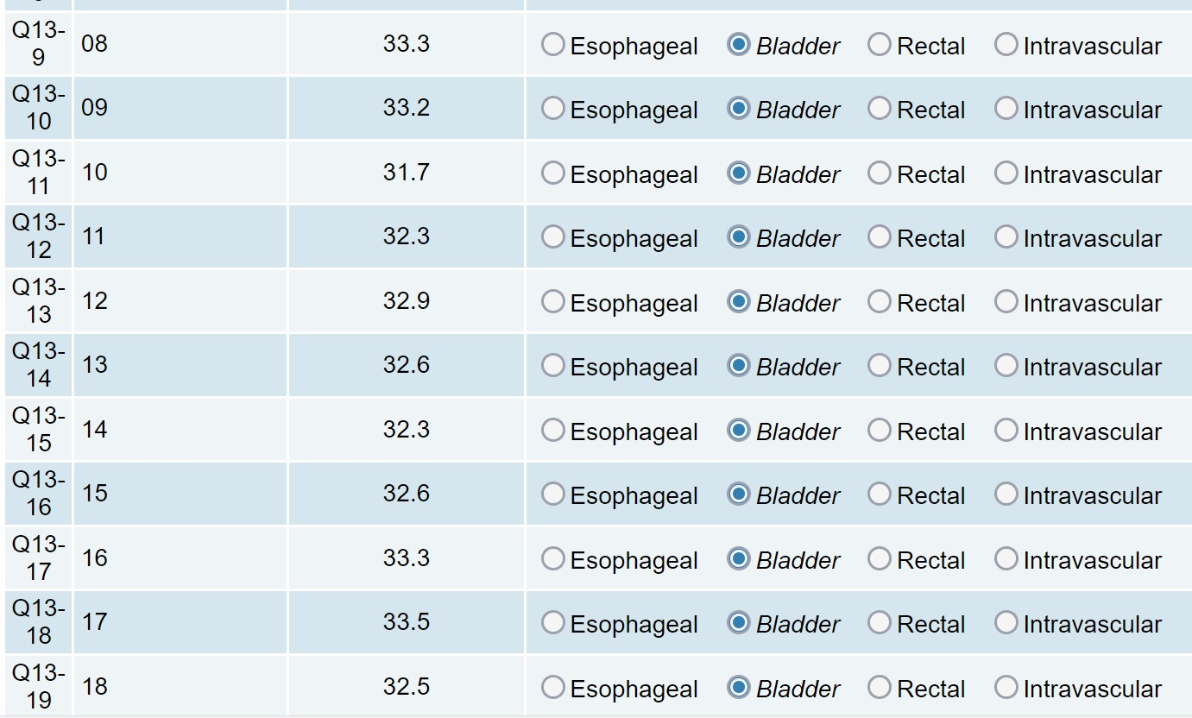
Temp Log Tidbits
Notes:
After you enter all temps for a day, review Q11 and make sure there are no temps out of range.
Clinically significant only refers to the temperature required by the study. A temp of 31.7 in a cooled patient isn’t clinically significant in the traditional sense.
If your subject is randomized to hypothermia, you must answer the “Clinically significant temperature excursions” question as YES if you have a temp outside the 32.0-34.0 range.
If your subject is randomized to normothermia, you must answer the “Clinically significant temperature excursions” question as YES if you have a temp outside the 35.8-37.8 range.
If you know why the temp was out of range, enter an explanation. If, after EMR review you cannot explain the excursion, note that in Q12.

Slide 8
Temp Log Date/Times
Notes:
If the initial target temperature is set to 33 and maintained, then Q01 and Q02 AND Q04 and Q05 should be the same date/times. If the temperature was not maintained then make a note in the general comments to avoid a DCR ☺
Per CRF completion guidelines - IMPORTANT: ***For Q04 and Q05, if the device is set to a target temperature between 32 and 34 before randomization and maintained, please enter the device initiation in Q04 and Q05.

Slide 9
Definition of an SAE (MOP section 7.1)
fatal or life-threatening,
permanently or substantially disabling,
requires or prolongs hospitalization,
results in a congenital anomaly,
requires intervention to prevent permanent impairment or damage, or
any event that the treating clinician or internal medical monitor judges to be a significant hazard, contraindication, side effect, or precaution.
Report SAEs until end of study (365 days or death)
Definition of an AE
any unfavorable and unintended sign (including a clinically significant abnormal laboratory finding), symptom, or disease temporally associated with the use of a medical treatment or procedure regardless of whether it is considered related to the medical treatment or procedure (attribution of unrelated, unlikely, reasonable possibility, or definitely)
Report up to 120 hrs (end of intervention) or death if death is before 120 hrs.
Notes:
No AE’s prior to device initiation unless the event worsenned

Slide 10
SAE Nuggets
CRF Completion guidelines:
Serious adverse events (SAEs) occurring at any time between randomization and subject’s end of study are to be reported.
This includes re-hospitalizations before day 365 for any reason. (admitted for norovirus, needing IV hydration and observation? - SAE!)
If a subject dies before day 365, you must report the terminal SAE. (hint: “death” is not an SAE, it is a result of the SAE)
When completing your first SAE, read through the CRF Completion Guidelines about Form 104 Adverse Event and the MOP section 7.1. Have your PI do this as well – it will save you time and DCRs!
Notes:
This means ALL SAEs until 1 year or death, whichever comes first must be reported.
This means you must keep an eye out for readmissions for your study patients who survive to discharge.

Slide 11
More SAE Nuggets
Q04 Relatedness to Study Intervention
Remember, the intervention is DURATION (not cooling)
(CRF completion guidelines pg 15)
Algorithm to Determine Relatedness of Adverse Event to Study Intervention
Unrelated | The temporal relationship between treatment exposure and the adverse event is unreasonable or incompatible and/or adverse event is clearly due to extraneous causes (e.g., underlying disease, environment)
Unlikely | Must have both of the following 2 conditions, but may have reasonable or only tenuous temporal relationship to intervention.
 | 1. Could readily have been produced by the subject’s clinical state, or environmental or other interventions. 2. Does not follow a known pattern of response to intervention.
Reasonable Possibility | Must have at least 2 of the following 3 conditions
 | 1. Has a reasonable temporal relationship to intervention. 2. Could not readily have been produced by the subject’s clinical state or environmental or other interventions. 3. Follows a known pattern of response to intervention.
Definitely | Must have all 3 of the following conditions
 | 1. Has a reasonable temporal relationship to intervention. 2. Could not possibly have been produced by the subject’s clinical state or have been due to environmental or other interventions. 3. Follows a known pattern of response to intervention.
Notes:
PI (or SubI) must make this determination. They sometimes like to eyeball relatedness, but please give them this table to review.

Slide 12
Yet more SAE nuggets
Q12
This is a subset of events that PICECAP is interested in.
To complete Q12, you must consult section 7.7 of the MOP for definitions.
“All definitions in this section already presuppose an event that meets the criteria for AE reporting in this trial.”
Notes:
3 –this means we do not want you to look for adverse events based on this list.
For example – your PI would have to have told you that they wanted to report Hypokalemia as an adverse event to begin with. (ie, don’t go through the EMR looking for low potassium values)
For example – your PI tells you to record pneumonia as an adverse event. You get to question 12 and look at the definition in the MOP and this pneumonia does not meet the definition – then you select ‘other adverse event’ for Q 12.

Slide 13
Event Description of your SAE (so many nuggets!)
An outside medical monitor reviews all SAEs so the event description must be comprehensive but concise:
Provide age, gender, most pertinent history and time/date of randomization.
Include dates and times for the enrolling event and relevant procedures/clinical assessments.
Include a description of what happened. Include only relevant clinical information (medical status prior to the event, signs and/or symptoms).
Summarize only relevant portions of the subsequent clinical course (including outcomes of treatment and relevant test/laboratory results: both positive and negative).
Investigators may elaborate on their assessment of event relatedness to study intervention if desired to further explain their determination. Include a clear statement from the investigator stating whether the event was related to the study intervention.

Slide 14
Sample SAE Narrative for “Neurological Decompensation”
___-year-old male resuscitated following arrest DATE. Cooled with Blanketrol-III from
DATE-DATE and remained in the normothermia phase until DATE/TIME. MRI performed on DATE showed significant anoxic brain injury involving bilateral basal ganglia, thalami, cerebral peduncles, and occipital region suggestive of catastrophic brain injury per neurology consultants. Due to poor neurologic prognosis, participant was transported to the operating room for compassionate extubation and organ donation. Participant was compassionately extubated on DATE at TIME. Cessation of circulatory function with PEA was noted at TIME. EKG rhythm noted to be asystole and time of death declared at TIME on DATE.
CRF Completion Guidelines Page 18

Slide 15
F510 Neurological Assessment
Use this CRF for any neurological assessment done days 1-7
The FORM is REQUIRED on days 5, 6, and 7
- If no neurological exam done on those days, answer the first question (Neurological Assessment Performed?) on the form as NO.
The exam should be a focused neurological examination performed by a neurologist, a clinical team provider or a P-ICECAP Investigator.
The information for this form should NOT be obtained from nursing neuro-checks or chart review.
It is a good idea to print out the CRF for the examiner to complete. Be sure to have the examiner sign and date the form at the bottom to denote it as source document.

Slide 16
F514 POPC PCPC
There are multiple timepoints where this CRF must be completed.
Baseline: should reflect how the child was before the arrest
Day 30 OR hospital discharge (whichever comes first)
If still in hospital at day 30, complete the CRF (DCC may remind you)
If discharges from hospital, complete at discharge (no day 30 POPC PCPC needed)
If subject dies, answer the first question “Data collected?” as NO.
Notes:
1. Use the medical record or medical history to complete this baseline assessment

Slide 17
PRCA at month 12
Pediatric Resuscitation after Cardiac Arrest (the 12 month, on site, neurologic exam form)
Once you have the completed form back from your Neurologist:
Review it for completeness. Follow up ASAP if something seems to be missing.
Upload the CRF to your drop box for review by Lead Study Neurologists
Enter the PRCA into WebDCU
If you hear back from Dr. Faye Silverstein or Dr. Rebecca Ichord about your PRCA, please respond promptly!

Slide 18
Questions? Confused about anything data-related?

