Slide 1
Central IRB and E-Consent
Robert Silbergleit, MD

Slide 2
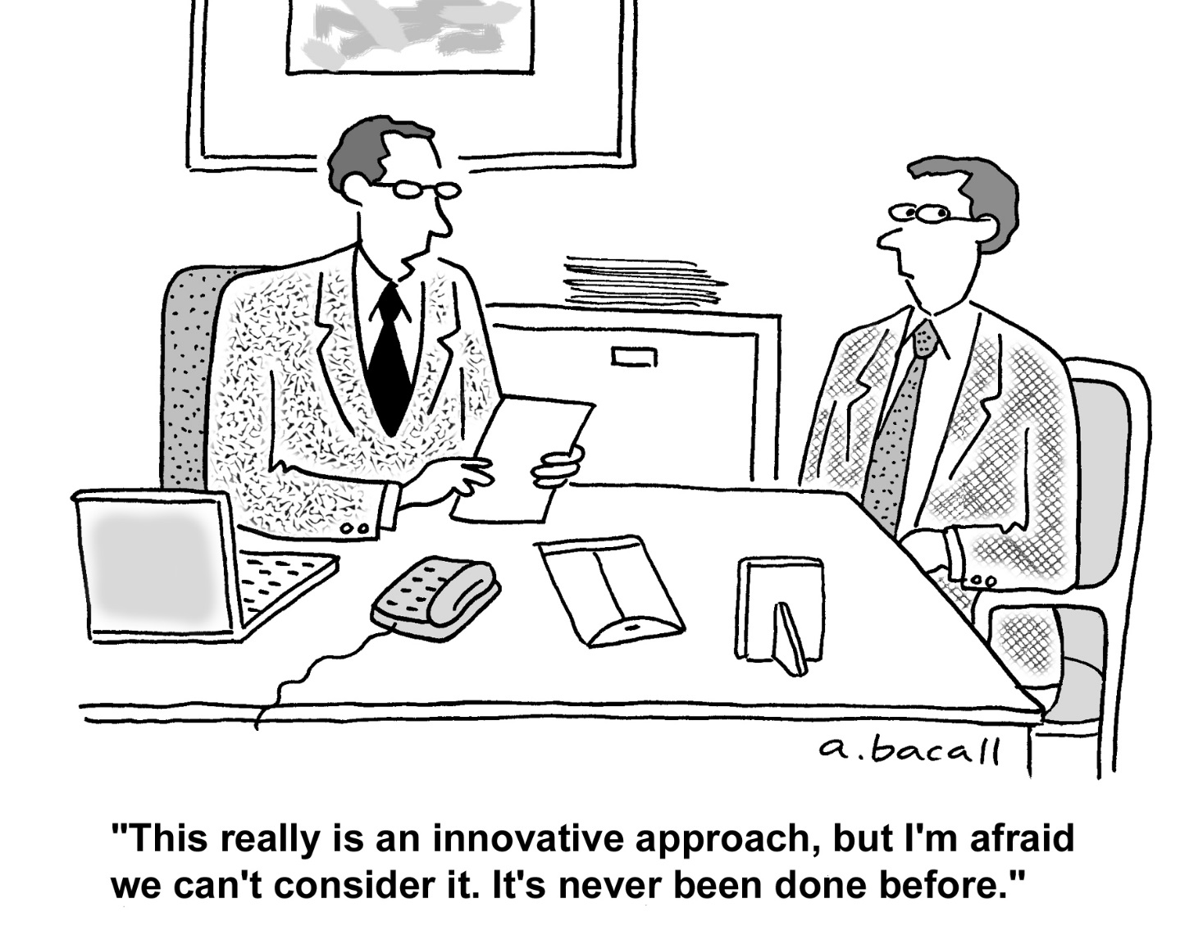
Notes:
Adverse events – seriousness is all relative

Slide 3
Objectives
Why a central IRB?
What a CIRB is and is not.
How it works.
The e-consent platform
CD
Notes:
3

Slide 4
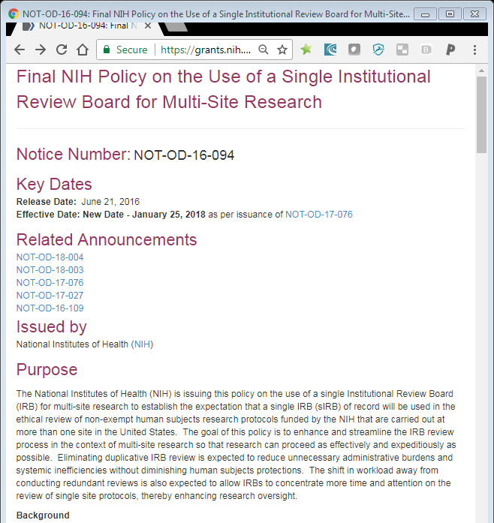
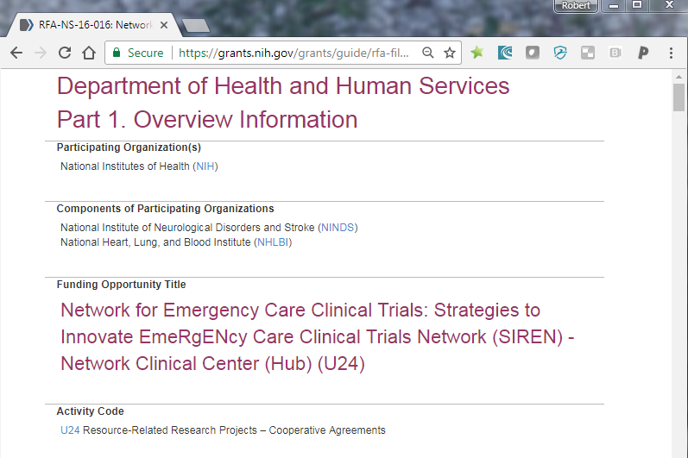
Why a central IRB?

Slide 5

Why a central IRB?
Empowerment
Equity
Efficiency
Expertise

Slide 6
What a CIRB is and is not
It IS a replacement for your local IRB panel
  Protocol review, consent review, site applications, AE’s, ORIO’s, SCR’s
It IS NOT a replacement for everything your local IRB office does
  Contracts, staff training, certification, billing, COI, radiation comm, etc.

Slide 7
How it works
Sponsor
Reliance agreements
Local processes
Ceding documents
Site applications
Approvals
AE and ORIO reporting
SCR

Slide 8
How it works
ER-CIRB
CIRB
Communication
Data flow
Avoid triplicative data entry
Avoid download/upload
IRB-IT
CTMS WebDCU
CCC
Site
Site
Site
Site

Slide 9

E-consent document
Consent remains a human process
Adjustable text size
Error reduction
Compliant remote consent documentation
Completes the web based study binder
Facilitate remote monitoring

Slide 10
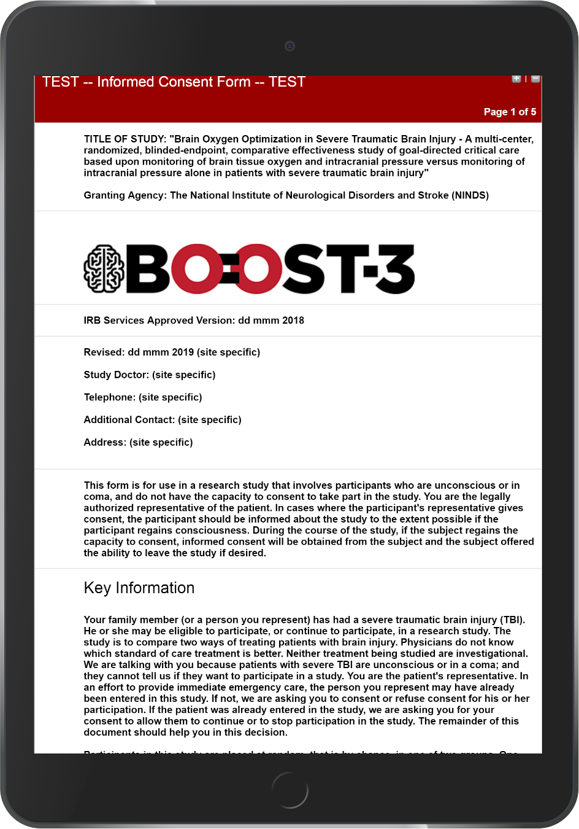
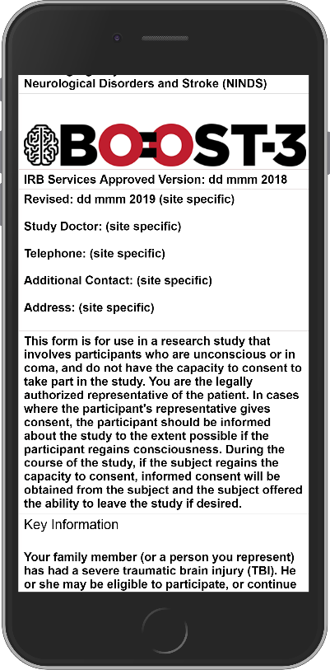
Link to test form
Link to simulator
RedCap
Compliant
Web based

Slide 11
Questions?

Slide 12
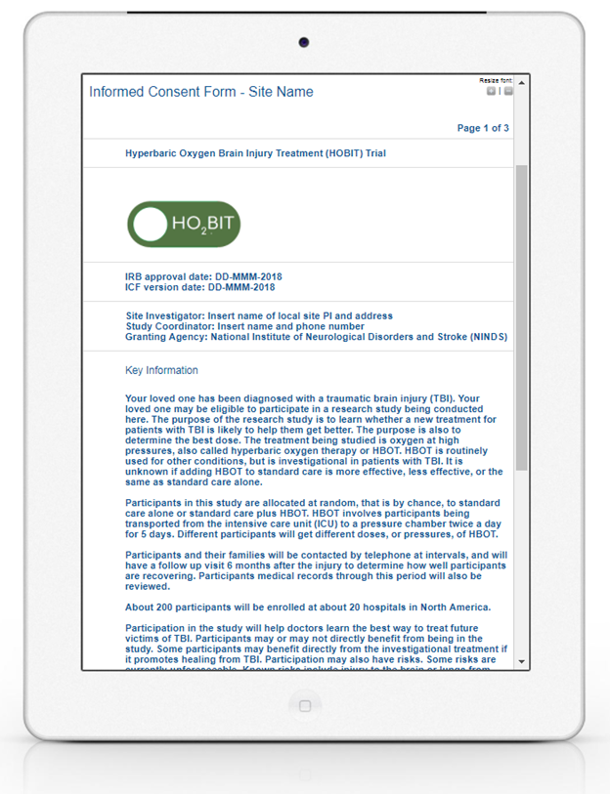
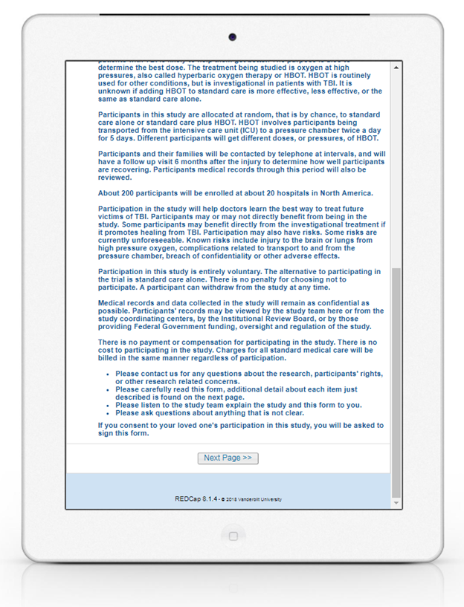


Slide 13
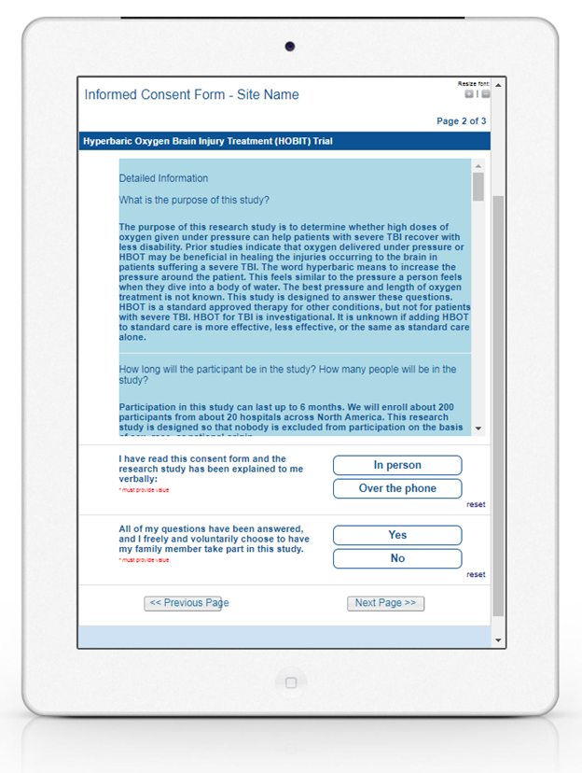
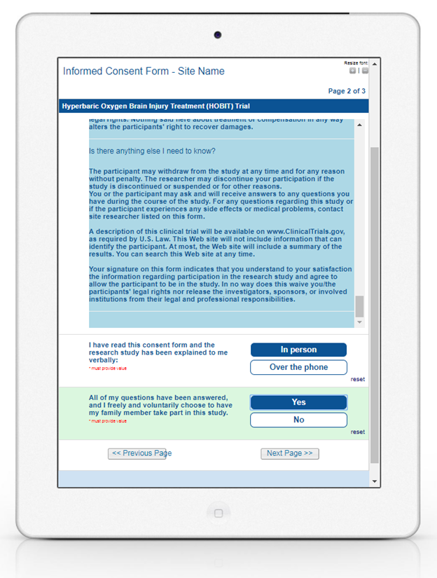

Slide 14
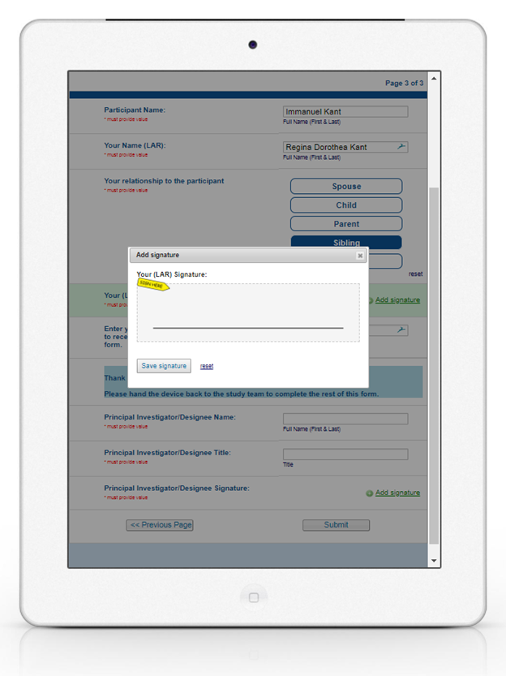


Slide 15
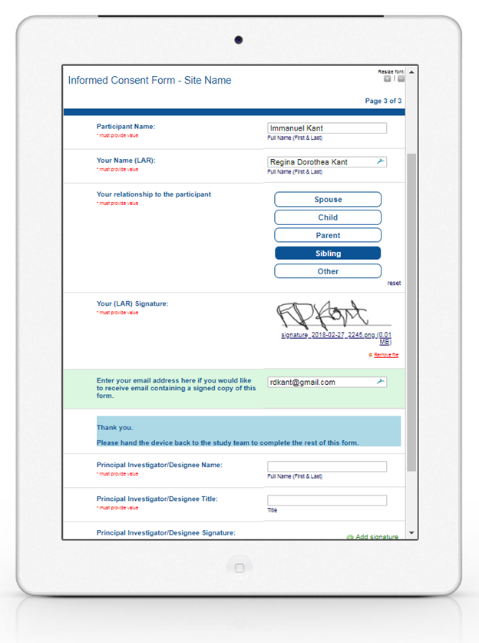
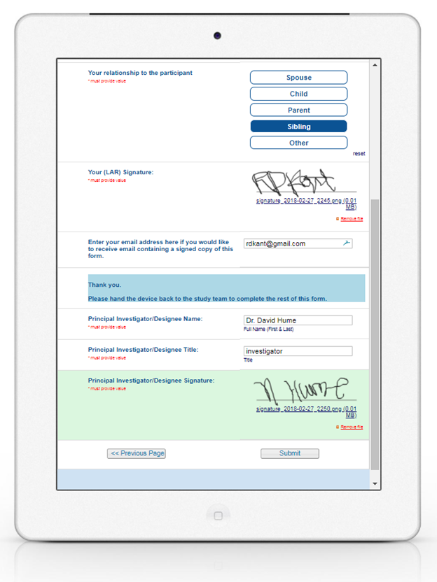

Slide 16
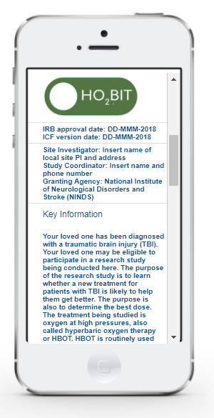
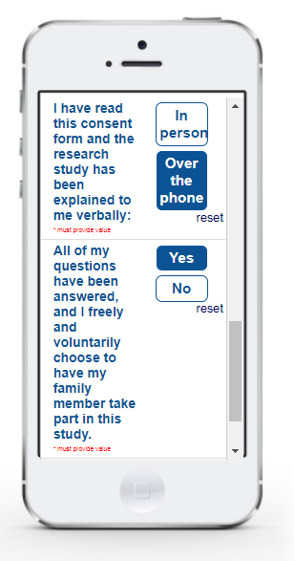
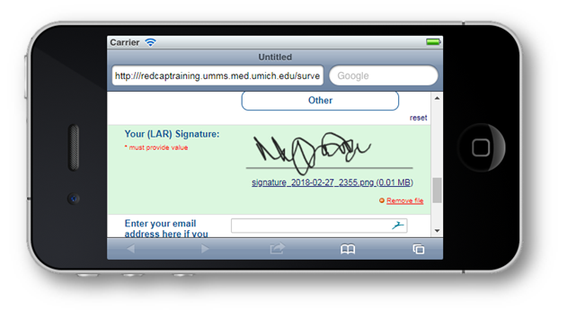

Slide 17
Questions?

