Slide 1
BOOST-3 Site Progress
Congratulations to the following sites!
Released to Enroll: UPMC Presbyterian Hospital, Memorial Hermann Texas Medical Center, and Ben Taub General Hospital
IRB Approved: San Francisco General Hospital

Slide 2
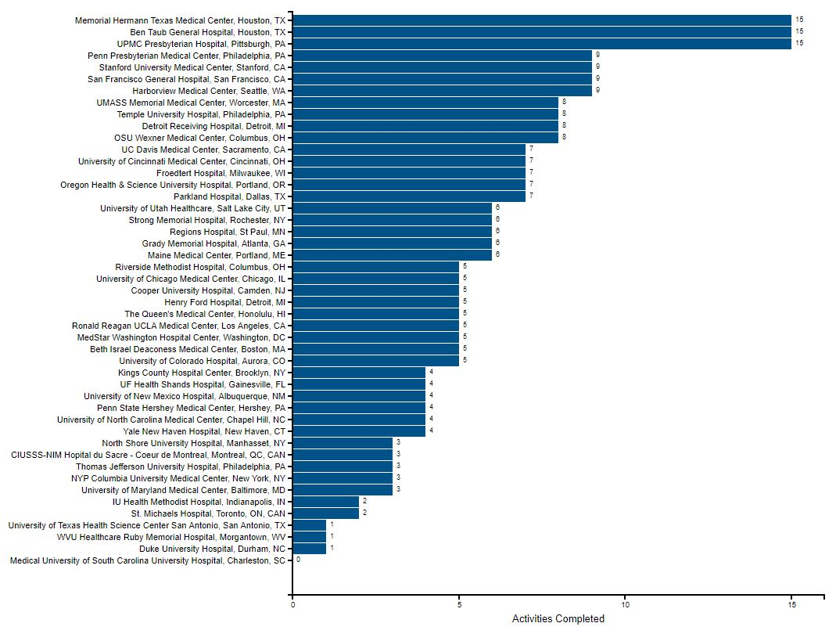
BOOST-3 Site Progress

Slide 3
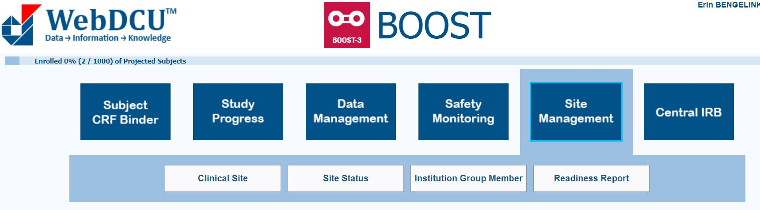
BOOST-3 Site Readiness Report

Slide 4
BOOST-3 Readiness Report

Slide 5
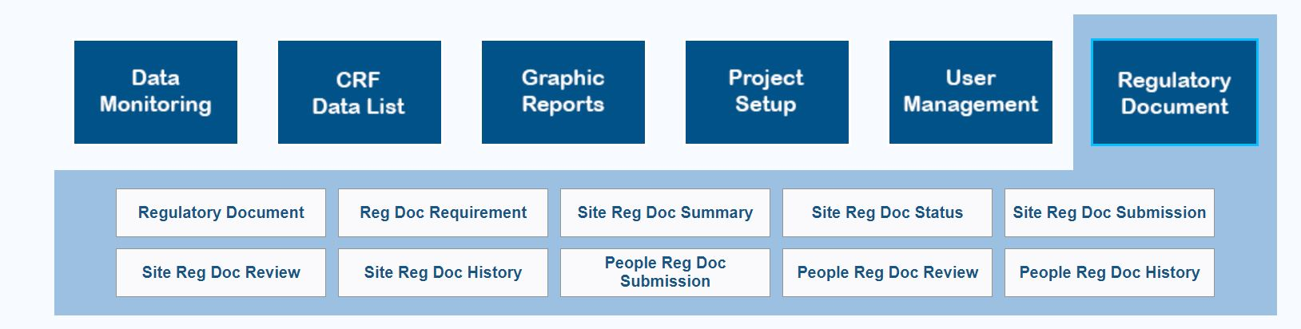
BOOST-3 Site Regulatory Status

Slide 6
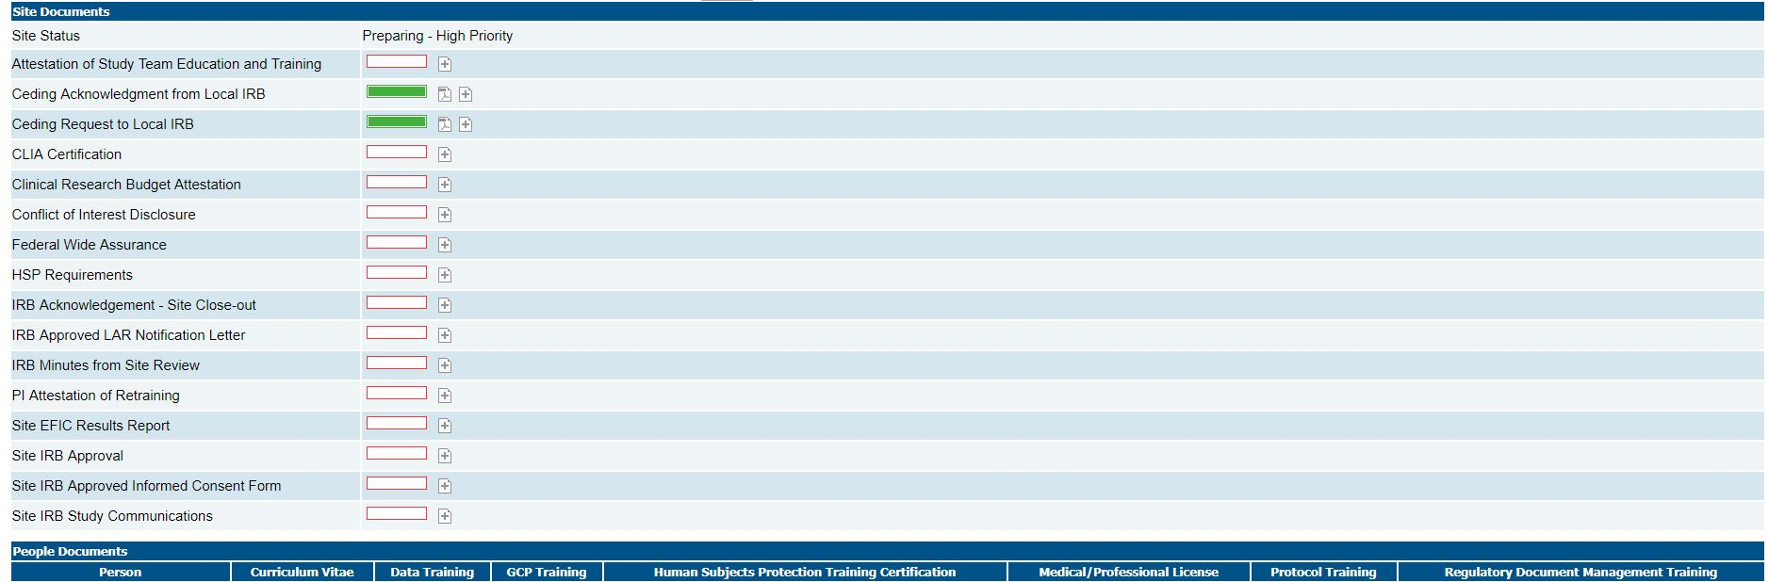
BOOST-3 Site Regulatory Status

Slide 7
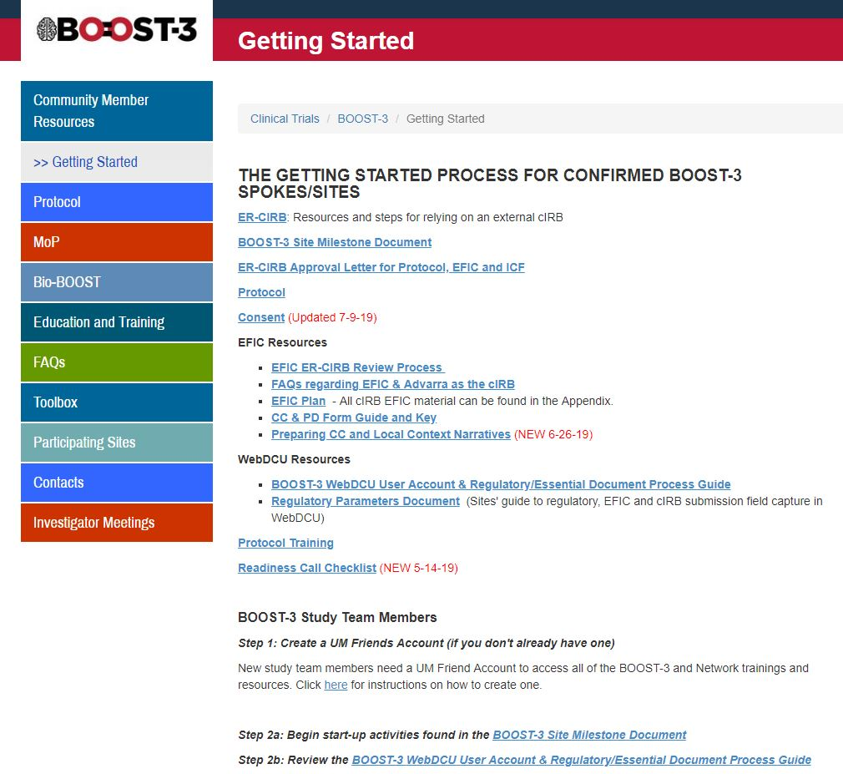
BOOST-3 Getting Started Page

Slide 8
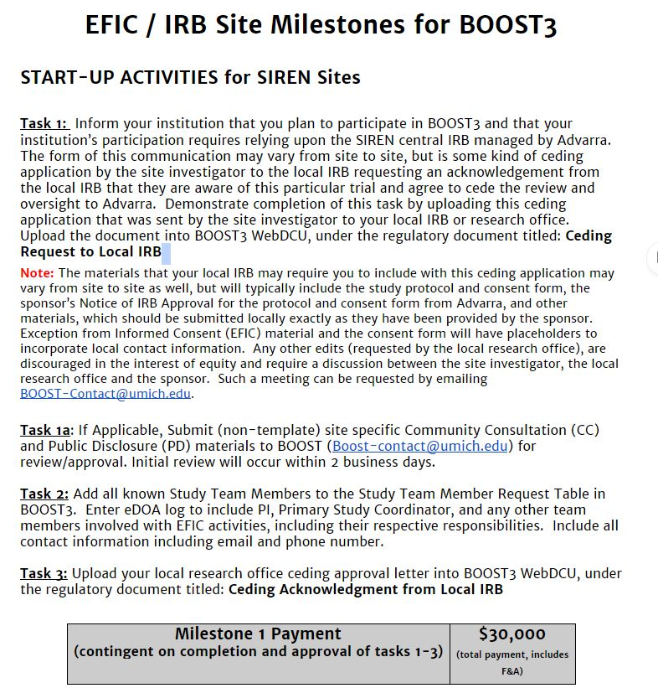
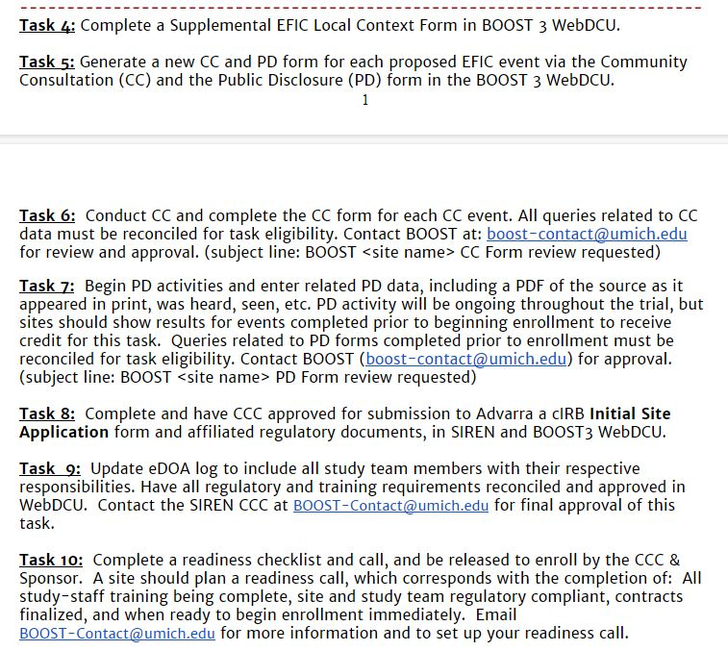
BOOST-3 Milestone Document

Slide 9
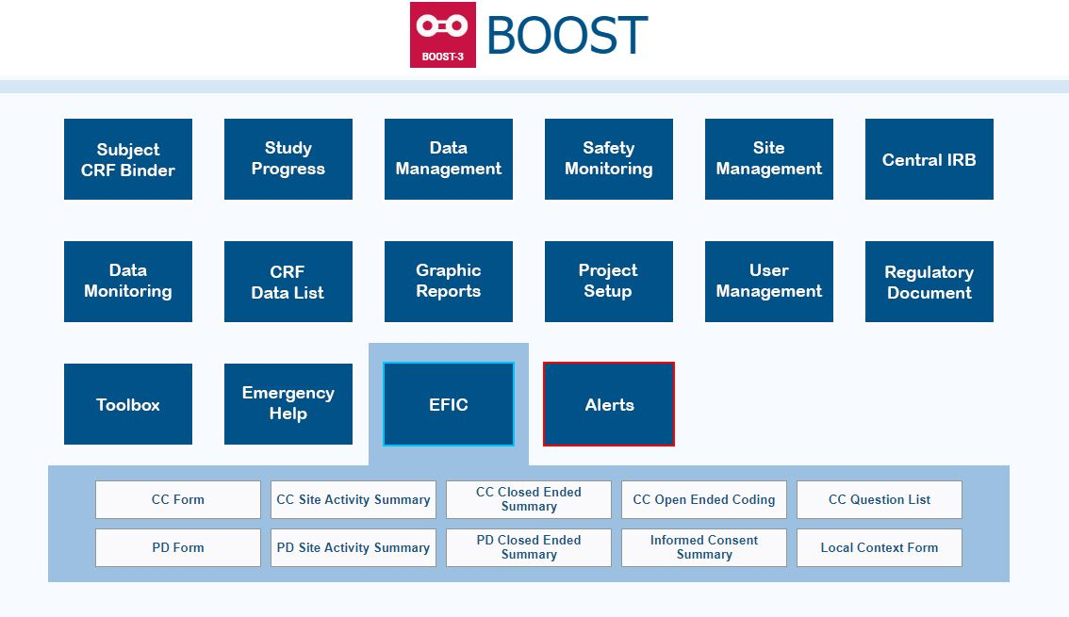
BOOST-3 EFIC Activity Reporting

Slide 10
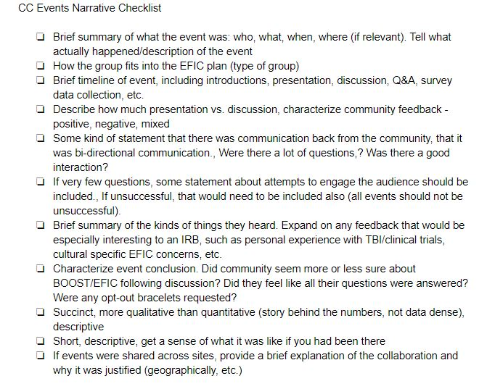
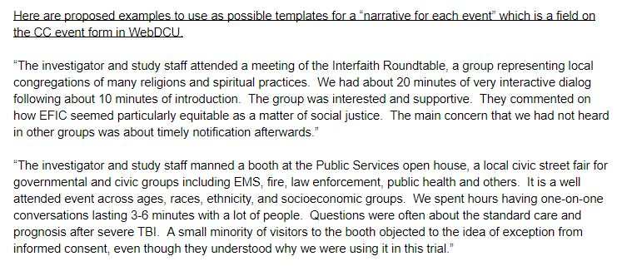
BOOST-3 CC Form Narratives

Slide 11
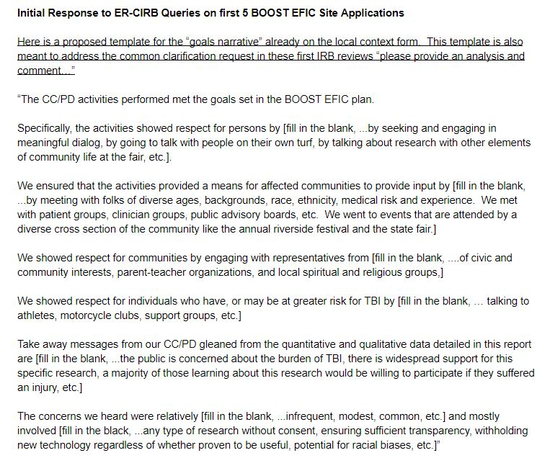
BOOST-3 CC Local Context Form Narratives
(Question 7)

Slide 12
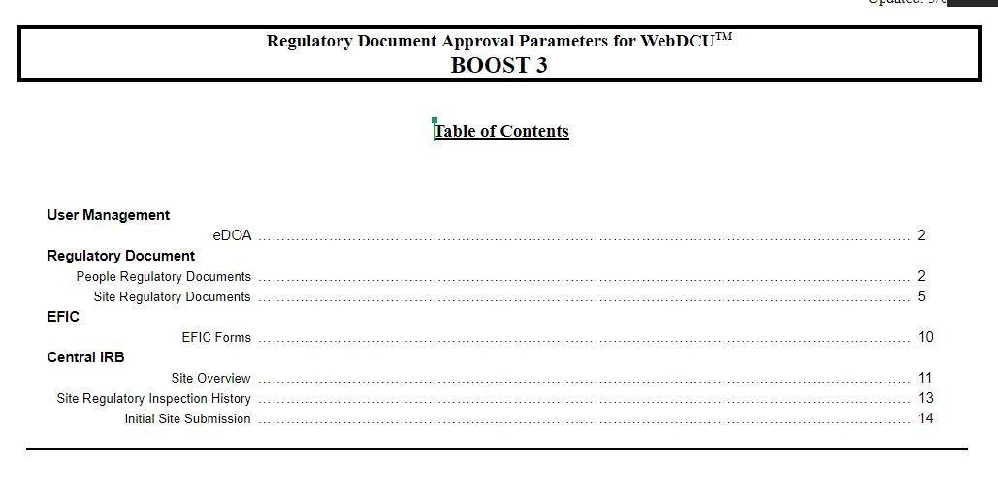
BOOST-3 Parameters Document

Slide 13
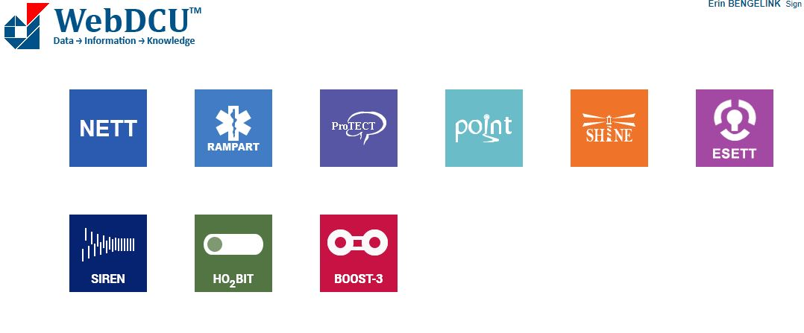
cIRB Forms

Slide 14
SIREN cIRB Forms

Slide 15
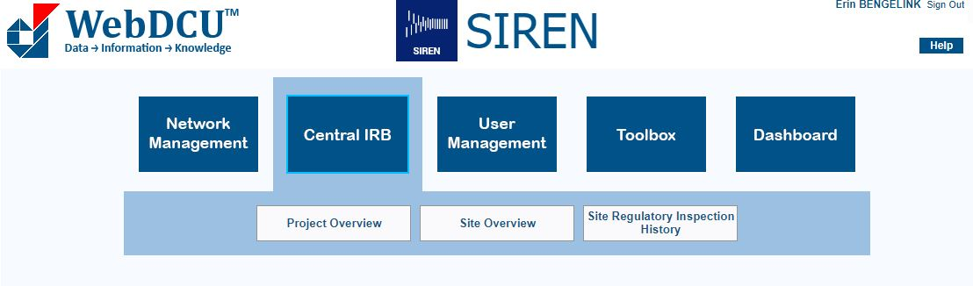
SIREN cIRB Forms

Slide 16
BOOST-3 cIRB Forms

Slide 17
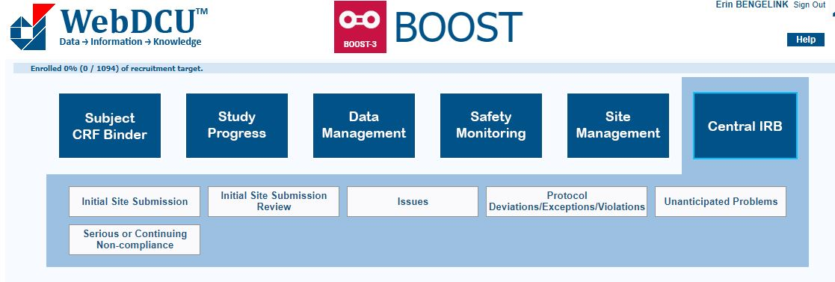
BOOST-3 cIRB Forms

