Slide 1
Brain Oxygen Optimization in Severe TBI Phase 3 Protocol Training--Lessons Learned updated January 2021
Ava Puccio, RN, PhD; Anita Fetzick, RN, MSN; Carol Moore, MA boost-trainers@umich.edu

Slide 2
Screening and Enrollment: Lessons Learned
For urgent questions related to a potentially eligible patient or a study participant, call the Emergency BOOST-3 PI Hotline at:
855-4-BOOST3
(855-426-6783)
Notes:
Carrying a trauma alert pager can assist the on call coordinator in screening for potential patients. Descriptions that use terms such as closed head injury, skull fracture, posturing, raccoon eyes, etc suggest that a potential patient is en route and may help in allowing more time to gather information during screening. Conversely, the trauma pager may offer clues about patients that would otherwise exclude a patient from BOOST-3, with terms such as gunshot wound to the head, patient is following commands, major chest trauma with hypoxia at the scene, etc.
The trauma alert can allow for a coordinator to be present when the patient arrives (if patient arrival happens to be normal working hours); it is beneficial for the coordinator to be present in the ER/Trauma Bay upon patient arrival (if possible). The coordinator can easily obtain a brief report from the patient transport team that could include time of injury, stability of vital signs at the scene and during transport, and neurologic exam at the scene, especially the patient’s exam before intubation, if this was done en route.
If available, the ER social workers or case managers can be a valuable source of information, especially with patient identification and obtaining contact information on the LAR or next-of-kin. The social work or case management team can also alert a coordinator when the LAR or next-of-kin has arrived at the hospital.
Effective communication with the trauma or neurosurgery physicians is essential for successful screening and enrollment. Prior to enrollment and randomization, the coordinator will need verification from the neurosurgeon that the patient has a TBI that requires intracranial pressure monitoring, and that an accurate GCS has been obtained that meets inclusion criteria.
2

Slide 3
Inclusion and Exclusion Criteria Questions
Q: Is an ABG required during screening, to determine if a potential subject meets exclusion criteria:
PaO₂/FiO2 ratio < 150?
A: No.
If there is a clinical indication to obtain an ABG, such as major chest trauma, decreased SPO₂ saturations, etc., an ABG is recommended.

Slide 4
Inclusion and Exclusion Criteria Questions
Q: If a potential subject presents with hypotension (SBP < 90mmHg) or hypoxia (SPO₂ <90), should they immediately be excluded?
A: Not necessarily.
The hypoxia and hypotension needs to be persisted for 5 mins sustained to be excluded. If patient is resuscitated and vital signs stabilize prior to the 6 hour from admission/12h from injury window closes, it may be possible to proceed with enrollment; if there is uncertainty regarding patient eligibility, contact the PI Emergency Hotline to confirm.

Slide 5
Inclusion and Exclusion Criteria Questions
Q: Can a potential subject be enrolled if pupil assessment is not able to be evaluated?
A: Bilateral unreactive pupils and GCS 3T, is indicative of brain death.
However, if both pupils are unable to be assessed, potential for enrollment, weighing in GCS score. Should be reviewed with a lead PI prior to enrollment.
If there is uncertainty regarding patient eligibility, contact the PI Emergency Hotline to confirm. should be reviewed with a lead PI prior to enrollment.

Slide 6
Inclusion and Exclusion Criteria Questions
Q: For patients who require immediate surgical evacuation of a hematoma or other emergent surgeries? Do monitors still have to be inserted within 6 hours?
A: Yes. Only if feasible to place monitors and randomize within 6 hours of arrival to enrolling hospital (and within 12 hours from injury).
Monitors can be placed in the OR and randomization should take place during this time, provided it’s within 6 hours of arrival.
If the patient is to be randomized after placement of probes, do not hook up the cable to the PbtO₂ monitor until after randomization. Treatment can start when it is practical and feasible to do so.

Slide 7
Screening Log
A screening log should be maintained by each site. Patients with all of the following should be included:
Admission to ICU
Positive TBI (verified by CT)
Placement of intracranial monitoring (GCS < 8)
Notes:
A screening log should be
maintained by each site
•
• Admission to ICU
• Positive TBI (CT scan)
•
All patients with the
following should be
included:
Placement of
intracranial monitoring

Slide 8
EFIC Process: Begins Upon Arrival of Potentially Eligible Subject
Determine availability of LAR
*Document efforts on the informed consent log case report form*
If an LAR is not available prior to the placement of intracranial monitors, eligible subjects will be enrolled with EFIC after intracranial monitors are placed.
When a subject is enrolled under EFIC, efforts to contact an LAR will continue.
LAR will be notified of an EFIC enrollment and consent to continue in the study will be sought at the earliest opportunity.
Note: Timing of probe placement MUST be prior to randomization for EFIC enrolled subjects
Notes:
(need to include link to opt out registry, link for toolbox)
Upon hospital arrival of a potentially eligible subject, study teams will diligently try to determine the availability of an LAR. Both routine hospital and study team resources and processes should contribute to the determination of the availability of an LAR. The steps undertaken to seek the LAR should be documented and included on the informed consent log case report form. If an LAR is not available prior to the routine emergent placement of intracranial monitors, eligible subjects will be enrolled with EFIC after placement of intracranial monitors. Subsequent to an EFIC enrollment, efforts to contact an LAR will continue. An LAR will be notified of an EFIC enrollment and consent to continue in the study will be sought at the earliest opportunity.
Once located, the LAR will be informed of the subject’s enrollment in the study and of the details and risks of the study. At that time, the LAR will be given the option of allowing the subject to continue in the study, or withdrawing the subject’s participation then or at anytime throughout the course of the study. If the LAR wants to continue the subject’s participation, an informed consent form signed by the LAR for continuation of participation will be obtained at that time. The informed consent log case report form is also used to document continuing efforts to locate an LAR until notification and a consent process can occur, and the final results of that process. The log will include the types of attempts made, and the number and times of those attempts. If an LAR is never found, then the subject must be notified and approached for consent to continue in the study if and when the subject regains consciousness and decision-making capacity. For subjects who expire prior to identification of an LAR, consent is not obtained. If an LAR is eventually located, they should be notified of the subject’s participation. In the rare case where an LAR can not be found and the subject remains incapable of consent at 6 months, attempts to find an LAR will be discontinued, but documentation of the LAR search process until that time, and the subject’s decisional capacity will be documented.
8

Slide 9
Considerations Related to Neuromonitoring
Neuromonitoring devices that are NOT acceptable include:
NIRS
BIS (except in the OR)
Jugular bulb saturation monitors
Cerebral blood flow monitors
Routine transcranial doppler
These devices can provide indirect information regarding brain tissue oxygenation.
Acceptable devices:
EEG
Microdialysis
ECoG
Brain temperature
Cerebral autoregulation
NOTE: The occasional use of TCDs to assess for vasospasm is allowed. If performed, this information should be collected
Notes:
Other acceptable neuro-monitoring devices include: EEG, ECog, microdialysis, brain temperature, cerebral autoregulation. Neuro-monitoring devices that are not acceptable include: NIRS, BIS (except in the OR), Jugular bulb saturation monitors, cerebral blood flow monitors, or routine transcranial doppler (TCD) monitoring as these can provide indirect information regarding brain tissue oxygenation. The occasional use of TCDs to confirm suspected vasospasm is allowed and if performed the report should be collected. If vasospasm is present, this information must be documented in the Adverse Event CRF.
9

Slide 10
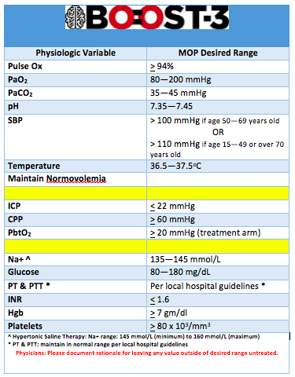
CST Physiologic Ranges
The CST Reference Ranges document should be printed out and provided to clinical team upon subject enrollment.
If values are outside of these ranges and the clinical team chooses not to treat, then the treating physician must document rationale for leaving value outside of range.

Slide 11
Procedures To Check Reliability of PbtO2 Measurements
Calibration of device will be checked according to manufacturer’s instructions
Prior to Insertion
Each participant will have an FiO2 challenge within 2 hours after catheter placement
Recorded measurements will be initiated 60 minutes after placement of monitor
Treatment staff will be blinded to results in control arm
FIO2 Challenge
FiO2 Challenge will be repeated daily until probe is removed.
Study staff may request a challenge at any time if they suspect the PbtO2 probe is not working.
Repeated Challenges
Notes:
Function and reliability of the PbtO2 probe will be assessed as described on this slide. In the event of a non-functioning or mal-positioned PbtO2 probe or expansion of a contusion that results in the inability to obtain PbtO2 values, a new PbtO2 probe should be placed in the ICP+PbtO2 intervention group within 2 hours if at all possible. This is not necessary in the ICP alone (control) group.
Prior to insertion, calibration of the device will be checked according to the manufacturer’s instructions.
Each participant will have a FiO2 challenge done within 2 hours after placement of the catheter, and then daily thereafter until the probe is removed. Treatment staff will be blinded to the results of the FiO2 challenge in the control arm. The expected response to a FiO2 challenge would be a PbtO2 increase of at least 5 mm Hg. If the initial challenge does not demonstrate the expected response, a repeat challenge should be done within 1 hour.
If the second FiO2 challenge again fails to show the appropriate response of a PbtO2 increase of at least 5 mm Hg, further management will be determined by patient group.
In the ICP+PbtO2 (intervention) group, a head CT should be obtained to assess for PbtO2 probe malpositioning, contusion expansion, or other potential causes for inaccurate PbtO2 measurements. In the event of a non-functioning or mal-positioned PbtO2 probe or expansion of a contusion that results in the inability to obtain PbtO2 values, a new PbtO2 probe should be placed within 2 hours if at all possible.
In the ICP only (control) group, the study team will document that the PbtO2 probe is unreliable. The PbtO2 probe will not be replaced but it should be checked daily by the study team in the event that it begins to record data again. It should remain in place until removal criteria have been met (see below).
The study staff may request a FiO2 challenge at any time if they suspect the PbtO2 probe is not working. The results of any challenges in the ICP only (control) group should not be shared with the clinical team in order to maintain blinding.
In addition, for participants in the ICP+PbtO2 (intervention) group, the clinical team may perform a FiO2 challenge at any time they feel it is indicated based on the clinical situation and local protocol. The clinical team will not be blinded to the results of these challenges.
The information from any FiO2 challenge performed should be captured in the daily CRF.
The study or clinical team may also perform MAP or CO2 challenges based on local protocols. The results of any challenges in the ICP only (control) group should not be shared with the clinical team in order to maintain blinding. Information from MAP or CO2 challenges should be maintained per local protocols and recorded on the CRF.
11

Slide 12
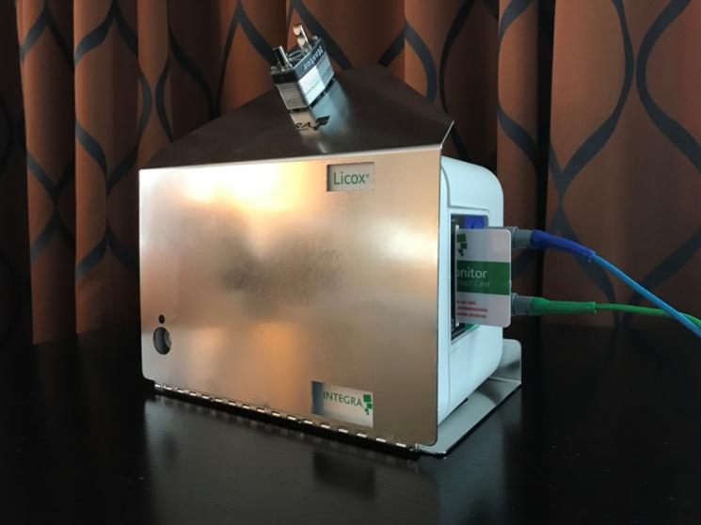
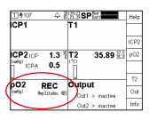
Handling of Study Interventions: Blinding
PbtO2 Monitors will be masked for subjects randomized into the Control Group
6 Month Outcomes Assessors must be blinded to randomization assignment
Video: Licox Blinding Cover Application
BOOST-3 Quick Guide Reference for Raumedic Device
Notes:
Blinding The PbtO2 monitors will be masked for this study in the control group, so that hospital staff will not be able to read the PbtO2 information. Hospital staff are not blinded as to who is in the control or active treatment groups. The 6 Month outcomes will be collected by an assessor blinded to randomization assignment.
12

Slide 13
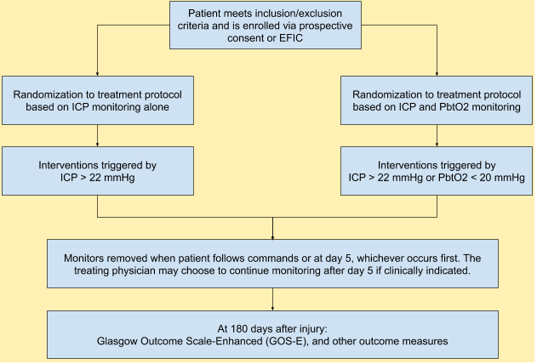
Duration of Monitoring: Minimum 120 hours (5 days) from time of randomization
Day 1 begins at time of randomization and ends at 23:59 that same calendar day. Days 2--6 begin at midnight and end at 23:59 each calendar day.
Notes:
Patients with severe TBI who meet eligibility criteria and are appropriate for ICP monitoring according to Brain Trauma Foundation (BTF) guidelines will be implanted with ICP monitors and PbtO₂ monitors. ICP and PbtO2 monitors will be placed following local standard practice patterns. In general, these monitors are placed through a single burr hole using a multi-lumen bolt system, so an additional burr hole or prolonged procedure times are not necessary. Participants will be randomized to a treatment protocol based on ICP values alone (control group) or a treatment protocol based on ICP and PbtO₂ values (intervention group). A maximum of 1094 participants will be randomized in the study. All participants will be treated according to a standard protocol which will be triggered when the ICU / ED staff identify a rise in ICP > 22 mm Hg or and/or a fall in PbtO₂ < 20 mm Hg.
The treatment protocol is a set of physiologic interventions which vary depending on whether the problem is isolated intracranial hypertension, isolated cerebral hypoxia, or the simultaneous occurrence of elevated ICP and low PbtO₂. The treatment protocol is tiered in a hierarchical fashion, with less aggressive interventions attempted before more aggressive maneuvers. Monitoring with PbtO₂ will continue until the participant awakens from coma or until it is no longer indicated, according to standardized treatment protocol. Functional outcome will be assessed 6 months after injury using the Glasgow Outcome Scale-Extended (GOS-E). Additionally, a battery of psychometric tests and structured questionnaires will be administered to assess functional, cognitive, and behavioral function at 6 months after injury. If the participant is unable to come to the clinic for in-person follow-up, appropriate questionnaires may be administered by telephone.
In this study, the control group will receive standard care based on ICP monitoring alone, while the treatment group will receive standard care using information from the ICP monitors as well as from the PbtO₂ monitors. . Participants randomized to the control group will have a PbtO₂ monitor implanted in a similar fashion as participants in the active treatment group, but after calibration of the device the display of PbtO₂ values will be masked, making the display accessible only to study staff who will check the accuracy of the device function. The oxygen data will be continuously saved by digital data recorders for both groups.
The control group will receive standard therapy targeted at ICP control, as compared with the active treatment group who will receive therapies aimed at both ICP and PbtO₂ regulation. Variables collected will include when the episode of intracranial hypertension or tissue hypoxia was recognized, when each of the therapies were initiated for each episode, and the treatment utilized. Additionally, data regarding efficacy of each intervention will be collected, as well as the timing of subsequent tiers of therapies, when less invasive treatments are ineffective. Physiologic and laboratory data will be collected and reviewed within the context of the clinical standardization guideline and physiological intervention protocol with compliance feedback provided directly to each site from the Clinical Standardization Team to reduce clinical management variability across sites. Up to the first five days after randomization, measured physiological data will include: cerebral perfusion pressure (CPP), ICP, PbtO₂ (in the treatment arm), systemic and brain temperature, systolic blood pressure (SBP), mean arterial pressure (MAP), paO₂, paCO₂, INR, platelet count, and hematocrit.
13

Slide 14
Removal or Replacement of Probes
In general, ICP and PbtO2 probes will be removed by Day 5 (minimum 120 hours of monitoring—may carry over to a Day 6 visit)
Continued monitoring is allowed if clinically indicated.
Treatment arms MUST be maintained
Replacement of a PbtO2 probe will only be considered in the ICP + PbtO2 group.
Probes may be removed before 5 days (120 hours) in the following situations:
The participant awakens from coma (motor GCS score = 6).
There is a medical indication for removal (ie, infection; associated bleeding).
No abnormalities of ICP for 72 hours after injury in the ICP only arm
No abnormalities of ICP or PbtO2 are noted for 72 hours after injury in the ICP + PbtO2 arm
Withdrawal of care
***NOTE: if a participant undergoes withdrawal of life sustaining treatments during the first 5 days/120 hours of monitoring, the site PI must call the study hotline to notify study leadership about withdrawal of life sustaining treatments for the participant.
If a probe is removed, the reason will be documented in the CRF
An ‘intent to treat analysis’ will be used.
Notes:
Removal or replacement of probes will be completed at the discretion of the attending physician at each site.
The reason for removal or replacement will be documented in the daily CRF.

Slide 15
Notes:
Treatment is tier based and triggered by abnormalities in either ICP (> 22 mmHg) or PbtO2 (< 20 mmHg). Elevations in ICP above 22 mm Hg, or a decline in PbtO2 below 20 mm Hg, which are sustained for more than 5 minutes will trigger intervention. Although 5 minutes of abnormal values are required to confirm a sustained abnormality requiring a treatment intervention, the actual start of an Episode is defined as the time when the value first exceeded the target value. Treatments must be initiated within 15 minutes of the start of the episode, as detected by the continuous ICP and PbtO2 recordings. The Moberg monitor will be programmed to signal the treating team in real time, when an intervention is recommended. It is expected that a treatment intervention will be initiated as soon as possible after the start of the episode.
An Episode ends when an abnormality is treated and has resolved with normal values occurring for a duration of 30 minutes.
If another abnormality begins after 30 minutes of normality, a new Episode begins and the treatment team should again begin in Tier 1.
Participants may start in one type of episode and move to another. Therapy will depend on which type of episode they are in at any given time. For the participants randomized to ICP treatment alone, only Type A and Type B episodes are relevant. Participants randomized to ICP + PbtO2 treatment may fall into any of the 4 scenarios (A, B, C, or D).

Slide 16
Documentation of Interventions
Treatment interventions triggered by elevations in ICP and/or decreases in PbtO2 will be recorded by the ICU nurses in bedside flow sheets, the EMR, and/or in CarePath
The time the abnormality was noted by nursing staff and the time the intervention started should also be recorded in the medical record, with the goal of an intervention initiation within 15 minutes of onset of the event.
Study coordinators will transfer information about those interventions into WebDCUTM.
Data to be collected includes information regarding the efficacy of the intervention in reversing the abnormal physiologic parameter.
Pertinent information from the ICU flow chart, nurses’ notes, as well as the continuous record of ICP and PbtO2, will be collected daily by the study coordinators.

Slide 17
Tier Treatments: Lessons Learned
Q: What if a treatment that is listed in the Tiers is already being done prior to the beginning of an abnormality that signals the beginning of a Scenario?
Is there an exception in which you may begin in Tier 2 treatments?
A: Only treatments initiated AFTER an abnormality has begun which begins an episode or Scenario should be entered on the case report form (CRF) as treatments included in the study protocol. The CRF will document the time of the new episode, and any new treatment initiated. If the treatment was already being actively used before the episode started, it should NOT be entered on the CRF as a new treatment.
Examples:
If the head of bed is already elevated when the ICP increases to begin a new episode, the raising head of bed is not a new treatment unless the head of the bed is raised further.
If a patient has an emergent cranial surgery, then the procedure cannot be considered as a Tier (3) Treatment if any episodes occur AFTER surgery has occurred.
If you are doing a treatment that says “ensure temperature” or “maintain a temp”, you must note WHICH treatment was INITIATED in order to “ensure” or “maintain
Exception: If the treatment team is already working in Tier 2 when a new Episode begins, and the clinicians deem it unreasonable or inadvisable to re-visit Tier 1 treatments (e.g., HOB is already elevated, CSF drainage utilized, and others), then it is acceptable NOT to begin treatment of the new Episode with Tier 1 choices.

Slide 18
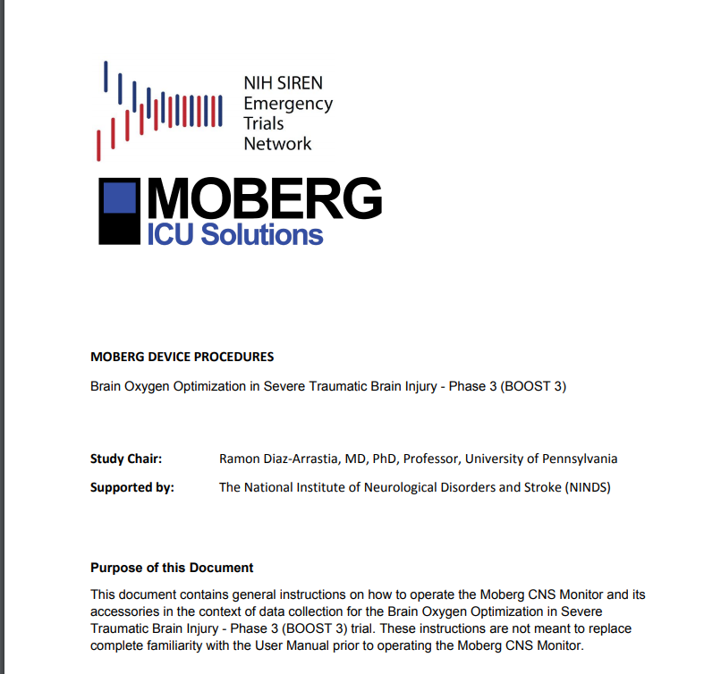
Data Capture is Essential to Study Success!
Use of a Daily Checklist completed by the study coordinator at the bedside may contribute to fewer protocol deviations from delayed/missed tier interventions or missing data
The Moberg Device Setup and Procedures Manual should be at the bedside upon each enrollment to assist with setup/discontinuation of monitoring, troubleshooting
Notes:
18

Slide 19
Withdrawal From Participation
Reason for wishing to withdraw must be determined
Study interventions and further data collection may be discontinued
After withdrawal, the participant’s care should revert to standard care at the enrolling site.
Participant data collected prior to withdrawal from the study is maintained in the study database, but no additional participant data will be collected from the participant or medical record following study withdrawal. Exception could be obtained from LAR to continue to collect data—must be documented in research record.
Notes:
(may need to re-phrase)
Regardless of whether a subject was initially enrolled with informed consent or EFIC, an LAR may withdraw the subject from further participation at any time and for any reason. After regaining consciousness and decision making capacity, subjects may also withdraw themselves from further participation. Whenever possible, the reason for wishing to withdraw should be determined. Those wishing to withdraw the study intervention should be aware that the intervention can be discontinued (i.e. request that the PbtO2 monitors be removed, or that ICU staff be unblinded to PbtO2 values) without withdrawing from the trial and further data collection. Discontinuation of the study intervention itself does not constitute withdrawal from further participation in the study. After withdrawing from either the intervention or any further participation in the study, the participant’s care should revert to standard care at the enrolling site. Consistent with OHRP and FDA guidance, participant data collected prior to withdrawal from the study is maintained in the study database, but no additional participant data will be collected from the participant or their medical record subsequent to withdrawal from the study.
19

Slide 20
For additional references and resources, please review the FAQ and Toolbox pages on the BOOST-3 SIREN website.
For non-urgent questions:
boost-trainers@umich.edu
For urgent questions related to a potentially eligible patient or a study participant, call the Emergency BOOST-3 PI Hotline at:
855-4-BOOST3 (855-426-6783)

