Slide 1


Brain Oxygen Optimization in Severe TBI-Phase 3
BOOST3 PIs:
Ramon Diaz-Arrastia
Lori Shutter
Bill Barsan
Sharon Yeatts

Slide 2
Review of Agenda
SIREN Overview
Introductions
Timelines
Regulatory and WebDCU training
EFIC overview
Protocol Training
Moberg training
Outcomes overview and training
Clinical Standardization
Central IRB; SAE and protocol deviation reporting
Hands on training
Ancillary studies

Slide 3





ALIAS 2
RAMPART
ATACH 2
ProTECT
POINT
SHINE
ESETT
Evolution not creation

Slide 4
Multiple PIs—CCC and DCC
CCC PIs
Bill Barsan
Clif Callaway
Rob Silbergleit
DCC PIs
Yuko Palesch
Valerie Durkalski

Slide 5
Design principles and organizational values
Focus on early treatment.
Focus on meaningful outcomes for patients.
Focus on efficiency.
Focus on collaboration.
Focus on transforming the clinical trials enterprise.

Slide 6
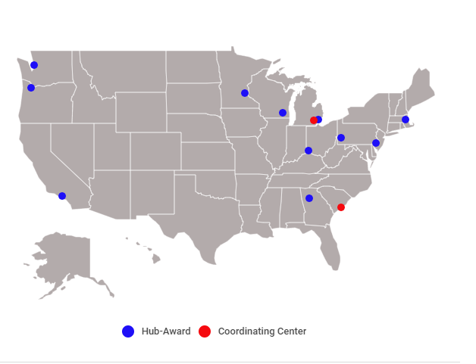
SIREN Grant Awards
Massachusetts General Hospital
Temple University
University of Pittsburgh
Wayne State University
University of Cincinnati
Emory University
Medical College of Wisconsin
University of Minnesota
University of Washington
Oregon Health Sciences University
University of California Los Angeles
Coordinating Centers
University of Michigan
Medical University of South Carolina

Slide 7
Scope of Portfolio
Late learning phase or confirmatory phase trials
Patient oriented outcomes
Controlled efficacy to registry based RCT
Appropriately sized for our scalable network
Primary focus on neurological, cardiac, lung and blood (NINDS/NHLBI)
Secondary focus on other IC portfolios, and health services

Slide 8
Current Trials
HOBIT—Hyperbaric Oxygen in severe TBI
  Late phase 2 trial with 200 patients at 13 sites
  7 enrolling sites currently
  First patient enrolled July 30, 2018
  16 enrollments to date
  6 more sites to open by July 2019
BOOST3—Outcomes of severe TBI patients comparing use of brain tissue oxygen with ICP monitoring vs ICP monitoring alone
Other studies in the pipeline

Slide 9
Introductions:
NINDS Program Directors
BOOST3 Principal Investigators
BOOST3 Initial Sites
Baylor Medical College | Thomas Jefferson University Hospital
Beth Israel Deaconess Medical Center- Harvard Medical School | UC Davis Medical Center
Columbia University Medical Center | University of California, Los Angeles
Cooper University Hospital | University of California, San Francisco
Duke University Medical Center | University of Chicago
Emory University | University of Cincinnati
Henry Ford Health System | University of Colorado School of Medicine
Indiana University (IU Health Methodist Hospital) | University of Florida
Kings County | University of Massachusetts Medical School (UMASS)
Maine Medical Center | University of Montreal
Medical College of Wisconsin | University of New Mexico Hospital
Medical University of South Carolina | University of North Carolina School of Medicine
North Shore University Hospital | University of Pennsylvania
Ohio State University Wexner Medical Center | University of Pittsburgh
Oregon Health & Science University | University of Rochester Medical Center (Strong Memorial Hospital)
Parkland Hospital | University of Texas Health Science Center at San Antonio
Penn State Hershey Milton S. Hershey Medical Center | University of Texas Health Sciences Center at Houston- Memorial Hermann
Queen's Medical Center, HI | University of Utah
R Adams Cowely Shock Trauma Center, University of Maryland | University of Washington - Harborview Medical Center
Regions Hospital | University of West Virginia
Riverside Methodist Hospital - OhioHealth | Washington Hospital Center/Georgetown University Hospital
St. Michaels- University of Toronto | Wayne State University
Stanford Medical | Yale University
Temple University
Additional Phase
Massachusetts General Hospital- Harvard Medical School
Denver Health Medical Center
Johns Hopkins School of Medicine
Sunnybrook University of Toronto
Cedars-Sinai Medical Center

Slide 10
Site Milestone Task Progress
Ceding App Submitted (19) | Milestone 1 Completed (9) | Started CC Activities (8)
Baylor College of Medicine | Baylor College of Medicine | Baylor College of Medicine
Beth Israel Deaconess Medical Center | Harborview Medical Center | Kings County
Emory/Grady Memorial | Parkland Hospital | Parkland Hospital
Harborview/University of Washington | Stanford University | Upenn/Penn Presbyterian
Maine Medical Center | UMASS | Stanford University
MCW/Froedtert | University of Chicago | University of Chicago
OHSU | University of Pittsburgh | University of Pittsburgh
Parkland Hopsital | University of Rochester/Strong Memorial | University of Rochester/Strong Memorial
Stanford University | UT Houston/Memorial Hermann
UC Davis
UCSF
UMASS
University of Chicago
Upenn/Penn Presbyterian
University of Pittsburgh
University of Rochester/Strong Memorial
University of Utah
UNM
UT Houston/Memorial Hermann

Slide 11
Study Timelines
Complete CC activities
Approval of CC by Central IRB
Protocol training and certification of site personnel
Readiness call to be released to enroll
Expect first patient in trial by end of April 2019

Slide 12
Breaks
Moberg monitor training
  Sign up sheet at the Moberg desk for training
Integra monitoring
Raumedic monitoring
PLEASE USE THE BREAK TIME TO STOP BY THE DIFFERENT STATIONS

Slide 13
QUESTIONS?

