Slide 1
Site Regulatory Readiness
Mickie Speers

Slide 2

ICECAP
Influence of Cooling duration on Efficacy in Cardiac Arrest Patients
Site Regulatory Readiness
Mickie Speers
ICECAP Site Manager/Monitor
SIREN CCC, University of Michigan
Notes:
‹#›

Slide 3
Agenda
Important Websites
Documents & Tools
Being Released to Enroll
Ongoing Activities

Slide 4
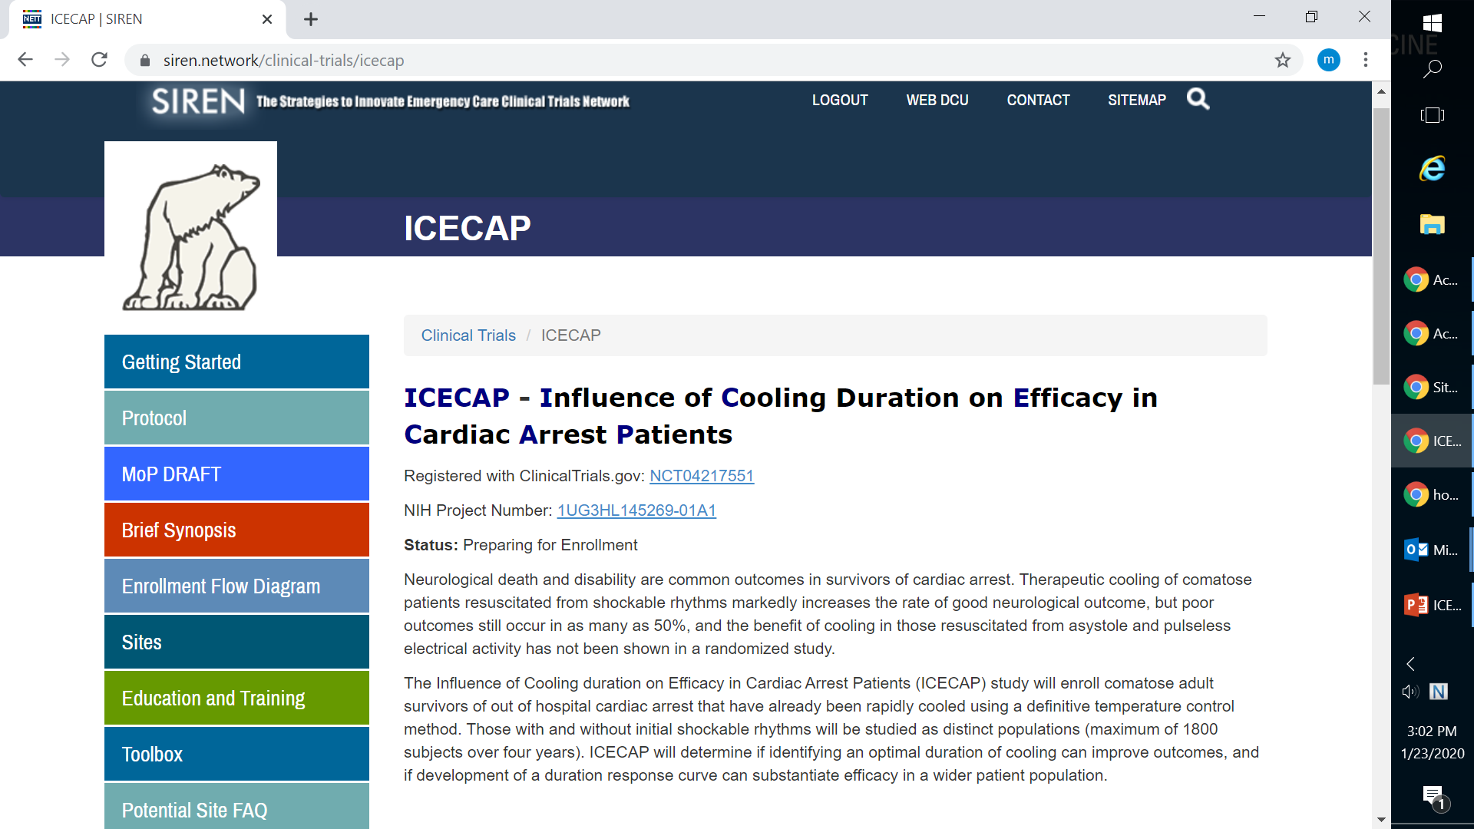

ICECAPtrial.org
  Locate study materials: protocol, cIRB approved ICF, milestones, regulatory parameters document, MOP
  Access training materials and FAQs
Notes:
‹#›

Slide 5
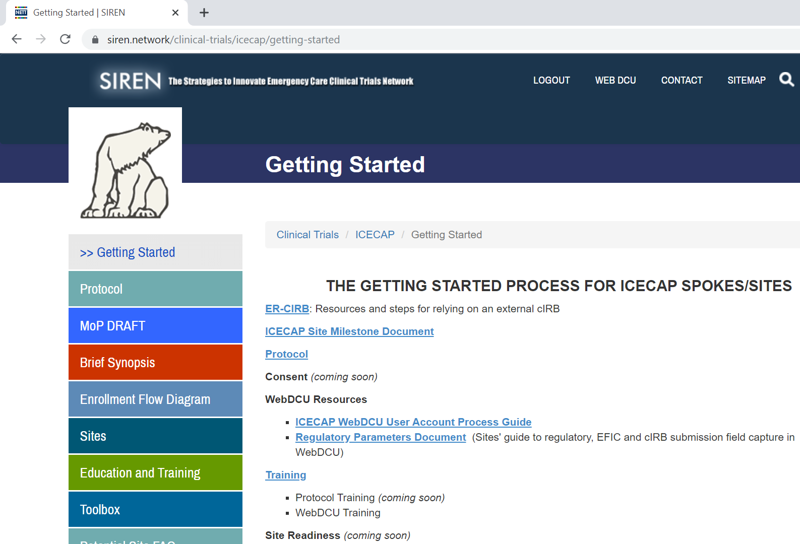

Getting Started
  Important information and materials for preparing for ICECAP
  Useful links to trial resources
Notes:
‹#›

Slide 6
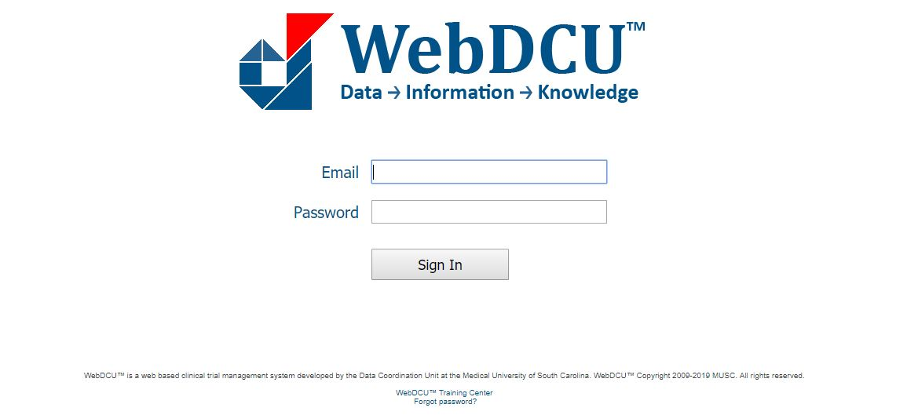

ICECAP Regulatory Database: WebDCUTM
Notes:
‹#›

Slide 7

ICECAP Regulatory Database: WebDCUTM
  ICECAP regulatory database will serve as the central repository for all regulatory documents
  IRB Approvals and other essential documents will be available via the database
  Automated emails will be sent for expired, expiring, and missing documents
Notes:
‹#›

Slide 8

Regulatory Parameters Document
  Outlines all regulatory and training requirements
  People Document: Specific to an individual study team member

Slide 9
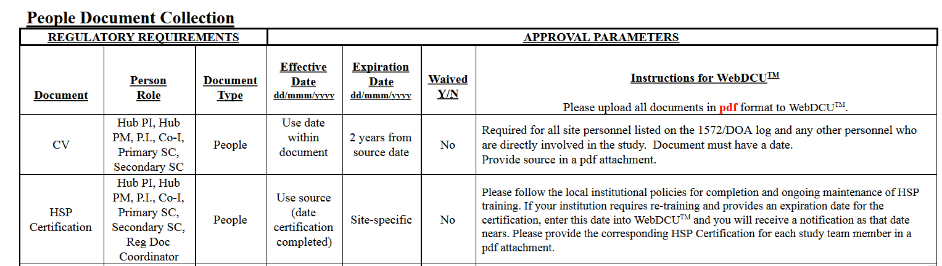

Slide 10
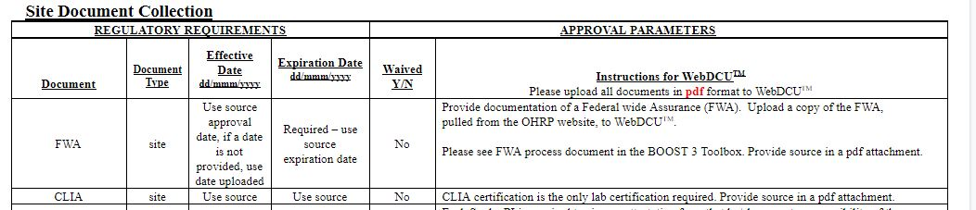

Regulatory Parameters Document
  Outlines all regulatory and training requirements
  Site Document: Applies to a site/Spoke

Slide 11
Regulatory Site Documents Needed for Startup
  IRB Approved Informed Consent (Advarra)
  cIRB Tables
    Site Overview (SIREN)
    Site Regulatory Inspection (SIREN)
    Initial Site Submission (ICECAP)
  FWA for your Institution
  CLIA Certification
  Attestation of Study Team Education and Training
  Ceding Request to Local IRB
  Ceding Acknowledgment from Local IRB
  HSP Requirements
  IRB Approval (Advarra)
  Reminder: Please upload all documents as pdfs in WebDCU

Slide 12
Regulatory People Documents Needed for Startup
  Applicable Team Members
  Medical License
  BOOST Data Training
  Regulatory Document Training
  Blinded Outcomes Assessment Training
  All Team Members
  CV
  HSP
  GCP
  Protocol Training
  Reminder: Please upload all documents as pdfs in WebDCU

Slide 13
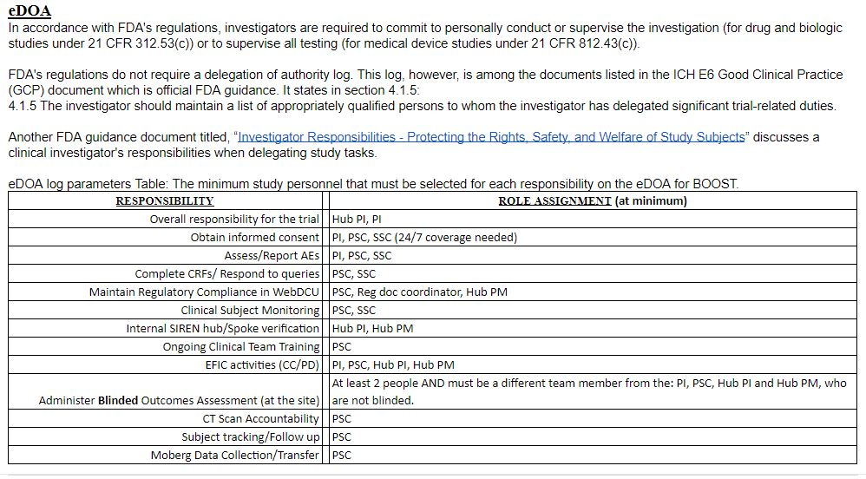
  .

Slide 14
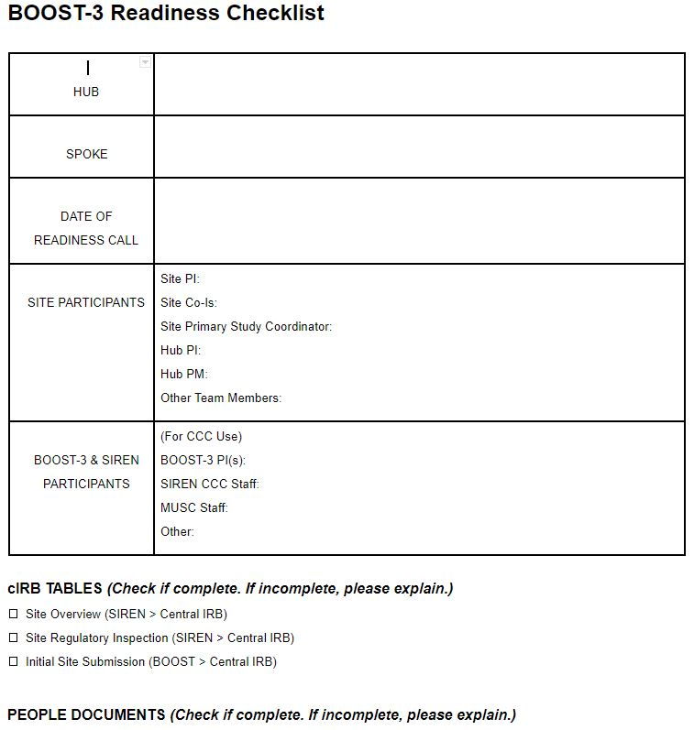
Readiness Checklist
  Sites will complete to confirm regulatory and logistical readiness
  List names of site participants who will be in attendance
  Respond to all questions in logistics section
  Email completed checklist prior to the call (ICECAP-contact @umich.edu)

Slide 15
Final Checks to be Released to Enroll in ICECAP
  eDOA Complete
  All documents in WebDCU
  Complete Readiness Checklist
  Send completed readiness checklist to ICECAP-contact@umich.edu and request a readiness call

Slide 16
Readiness Call
  A readiness call is the study initiation meeting
    Site Personnel: Hub PI and PM, Trial PI, Primary SC. Other team members are welcome to attend!
    ICECAP PI, Site Manager, MUSC personnel and other team members
  Conducted via phone conference
  Q&A with trial leadership and CCC
  Evaluate and confirm site readiness for study activation

Slide 17
Post Call – Site Activation
  If action items remain after the readiness call, site personnel will resolve prior to activation
  If no action items, site will be activated and released to enroll (assuming site has been approved by Advarra)
  ICECAP study team will be notified via email

Slide 18
Ongoing Site Management
  It is the responsibility of each Hub/Site to maintain regulatory compliance, inclusive of site documents and people documents, throughout the duration of the trial
  Documents approaching expiration should be reconciled prior to the expiration date
  Study team personnel who are out of regulatory compliance should not participate in any trial related activities

Slide 19
Study Team Changes
  Documented in ICECAP Database
  Update eDOA
  Upload all team personnel documents, trainings and certifications (eg., CV, medical license)
  Study team members cannot begin research related activities until all of the above have been reconciled.

Slide 20

Who to Contact?
For immediate emergency assistance (enrollment, clinical, protocol, adverse events, etc.), please use the 24/7 ICECAP Principal Investigator Hotline: 1-833-442-3227 (833-4ICECAP)
Clinical questions for ICECAP trial PIs: ICECAP-PIs@umich.edu
For non-urgent data entry/WebDCU questions call: 1-866-450-2016
For all other non-urgent questions: ICECAP-contact@umich.edu
For all email communications, please include ICECAP at the beginning of the subject line. Or #ICECAP

Slide 21
Questions?
Mickie Speers
734-232-3474
lraes@med.umich.edu

