Slide 1
Adverse Events and Serious Adverse Events
Robert Silbergleit, MD

Slide 2
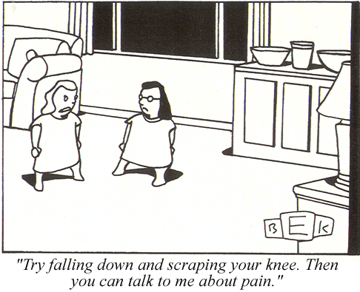
Notes:
Adverse events – seriousness is all relative

Slide 3
Adverse Events – key points
Do not report events EXISTING PRIOR to randomization
(unless there is a change in severity)
Report the DIAGNOSIS, not the symptoms:
Fever, cough, chest pain, crackles = pneumonia
Report the PATHOLOGY, not the outcome or treatment
Not ‘death’ but the event that caused death
CD
Notes:
3

Slide 4
Relatedness Relatedness algorithm
Not Related
The timing is wrong and there was clearly another cause
Unlikely (both of the following, but timing doesn’t matter)
Another cause is possible
Not something the intervention is known to cause
Reasonable Possibly (2 of 3)
Timing is suggestive.
Not readily caused by something else
This is something the intervention is known to cause.
Definitely (must have all 3)
Timing suggests intervention caused the problem.
No other possible cause.
This is something the intervention is known to cause.

Slide 5
While being screened for enrollment in BOOST, a 52 yo with TBI from a MVC has a prolonged seizure requiring treatment which resolves after several rounds of anticonvulsants. She is subsequently appropriately enrolled. Anticonvulsant medications are continued after enrollment as is continuous EEG monitoring.
Adverse event? Yes / No
Serious? Yes / No
Expected? Yes / No
Related? A. Not related
B. Unlikely
C. Reasonable Possibly
D. Definitely

Slide 6
While being screened for enrollment in BOOST, a 52 yo with TBI from a MVC has a prolonged seizure requiring treatment which resolves after several rounds of anticonvulsants. She is subsequently appropriately enrolled. Anticonvulsant medications are continued after enrollment as is continuous EEG monitoring. Brief electrographic seizures are seen. No AED are added or changed.
Adverse event? Yes / No
Serious? Yes / No
Expected? Yes / No
Related? A. Not related
B. Unlikely
C. Reasonable Possibly
D. Definitely

Slide 7
While being screened for enrollment in BOOST, a 52 yo with TBI from a MVC has a prolonged seizure requiring treatment which resolves after several rounds of anticonvulsants. She is subsequently appropriately enrolled. Despite continued anticonvulsants she develops more seizures in the ICU, and her propofol is titrated up from mild sedation to burst suppression.
Adverse event? Yes / No
Serious? Yes / No
Expected? Yes / No
Related? A. Not related
B. Unlikely
C. Reasonable Possibly
D. Definitely

Slide 8
A 32 yo with TBI from a fall aspirates while being endotracheally intubated, and is subsequently appropriately enrolled in BOOST. On hospital day 2, he develops pneumonitis, and his PEEP is increased to improve recruitment. Three hours later he decompensates, is found to have a pneumothorax. A chest tube is placed without complications.
Adverse event? Yes / No
Serious? Yes / No
Expected? Yes / No
Related? A. Not related
B. Unlikely
C. Reasonable Possibly
D. Definitely

Slide 9
A 32 yo with TBI from a fall aspirates while being endotracheally intubated, and is subsequently appropriately enrolled in BOOST. On hospital day 2, his pBTO2 is low. Among other interventions to improve cerebral oxygenation, his PEEP is increased. Three hours later he decompensates, a pneumothorax is found. A chest tube is placed without complications.
Adverse event? Yes / No
Serious? Yes / No
Expected? Yes / No
Related? A. Not related
B. Unlikely
C. Reasonable Possibly
D. Definitely

Slide 10
An 18 yo with TBI after falling from a skateboard is appropriately enrolled. On ICU day 3 his routine metabolic panel shows a potassium of 3.2 and an AST of 99 for which he receives no specific intervention.
Adverse event(s)? Yes / No
Serious? Yes / No
Expected? Yes / No
Related? A. Not related
B. Unlikely
C. Reasonable Possibly
D. Definitely

Slide 11
An 18 yo with TBI after falling from a skateboard is appropriately enrolled. On ICU day 3, while intensity of care for intracranial hypertension is rapidly increasing, his routine metabolic panel shows a potassium of 3.2 and an AST of 99 for which he receives, by an electrolyte replacement protocol, 40 mEq of potassium by orogastric tube.
Adverse event(s)? Yes / No
Serious? Yes / No
Expected? Yes / No
Related? A. Not related
B. Unlikely
C. Reasonable Possibly
D. Definitely

Slide 12
An 18 yo with TBI after falling from a skateboard is appropriately enrolled. On ICU day 2 an MRI of the cervical spine is obtained that reveals a subtle fracture and unstable appearing ligamentous injury at C2/C3, not seen or previous CT scan, for which he subsequently gets operative fixation.
Adverse event(s)? Yes / No
Serious? Yes / No
Expected? Yes / No
Related? A. Not related
B. Unlikely
C. Reasonable Possibly
D. Definitely

Slide 13
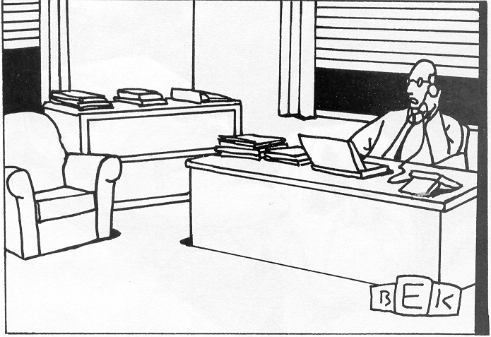
“I just have to create a few loose ends for other people
to clear up, and then I can out of here.”
Notes:
Why you have to turn in SAE’s early. A lot of other people need to look at them and the clock is running

Slide 14
Write good SAE narratives
Be concise but complete (not comprehensive)
Include only the pertinent PMH and HPI
Describe the event
Describe the response
Describe the outcome
And say when each of those happened
Look for and respond to queries promptly
Notes:
It is important for us here at the CCC and for all your site co-investigators.

Slide 15
How are SAE narratives used?
Medical safety monitor
DSMB
Study Leadership
Notes:
It is important for us here at the CCC and for all your site co-investigators.

Slide 16
Example narrative
A 40 year old female bicyclist suffered a TBI with SAH and was appropriately enrolled at 7/10/19. On 7/12/19, she returned to the ICU from radiology for a follow up head CT. At 23:15 she became hypotensive to 85/45, tachycardic to 122, and had an increased FiO2 requirement. A chest x-ray at 23:35 was unremarkable, but a PE protocol chest CT at 00:45 on 7/13/19 demonstrated saddle pulmonary emboli and evidence of right heart strain. Interventional radiology performed suction thrombectomy and IVC filter placement later that day. On 7/14/19 she was hemodynamically stable, and there were no further thromboembolic complications.

Slide 17
Too much
35 y.o. male with a history of anxiety, bipolar affective disorder, schizophrenia, and previous seizure event thought to be EtOH related presented to enrolling center ED via EMS 2/8/17 at 20:47 with seizures. Seizure in route abated with 4mg midazolam IM EMS administered. On initial assessment patient was sedated, but responded to noxious stimuli. Sedation thought to be due to EtOH, versed, and post-ictal state. Labs and CT head ordered. In CT patient had repeat seizure. He was given midazolam 3 mg IM and was brought back to ER. He appeared to continue to be having seizure so additional midazolam 3 mg IV was given. Seizure appeared to resolve. Neurology consulted to ER. Patient return of seizures occurred at approximately 2240. He was given an additional lorazepam 2 mg IV. Seizure continued for 5 minutes so ESETT drug was given. Study drug infusion started at 23:01. During infusion, pt appeared to have aspiration event. Infusion completed and patient stopped seizing and withdrew from nailbed pressure. At 20 minute assessment he was still responding to noxious stimulation. He was intubated for airway protection due to apparent aspiration event. He was sedated with propofol post intubation. Pt was admitted to the ICU for further diagnosis and management. 60 minute assessment at 00:15 revealed pt was sedated but withdrew from nailbed pressure. On 2/10/17 about 13:15 he was electively extubated. 2/10/17 1900 many verbally aggressive outbursts noted. 2/11/17 09:03 patient left AMA, after psychiatric evaluation

Slide 18
Too much - continued
35 y.o. male with a history of anxiety, bipolar affective disorder, schizophrenia, complex psychiatric history and previous seizure event thought to be EtOH related and prior alcohol related seizures…
presented to enrolling center ED via EMS 2/8/17 at 20:47 with seizures. Seizure in route abated with 4mg midazolam IM EMS administered. On initial assessment patient was sedated, but responded to noxious stimuli. Sedation thought to be due to EtOH, versed, and post-ictal state. Labs and CT head ordered. In CT patient had repeat seizure. He was given midazolam 3 mg IM and was brought back to ER. He appeared to continue to be having seizure so additional midazolam 3 mg IV was given. Seizure appeared to resolve. Neurology consulted to ER. Patient return of seizures occurred at approximately 2240. He was given an additional lorazepam 2 mg IV. Seizure continued for 5 minutes so ESETT drug was given. Study drug infusion started at 23:01. During infusion, pt appeared to have aspiration event.
…had stuttering status epilepticus, received midazolam 10 mg and lorazepam 2 mg in divided doses over 2 hours, and enrolled on 2/8/17 at 23:01, followed by an aspiration event and transient hypoxia. ….

Slide 19
Too much - continued
Infusion completed and patient stopped seizing and withdrew from nailbed pressure. At 20 minute assessment he was still responding to noxious stimulation. He was intubated for airway protection due to apparent aspiration event.
He stopped seizing but remained poorly responsive. He was endotracheally intubated at 23:25 for airway protective and decreased level of consciousness and risk of further aspiration.
He was sedated with propofol post intubation. Pt was admitted to the ICU for further diagnosis and management. 60 minute assessment at 00:15 revealed pt was sedated but withdrew from nailbed pressure.
He was sedated with propofol and admitted to ICU. Normal CXR and no sequelae of aspiration on 2/9/17.
On 2/10/17 about 13:15 he was electively extubated. 2/10/17 1900 many verbally aggressive outbursts noted. 2/11/17 09:03 patient left AMA, after psychiatric evaluation
Extubated on 2/10/17.

Slide 20
Too much - resolution
35 y.o. male with a history of anxiety, bipolar affective disorder, schizophrenia, and previous seizure event thought to be EtOH related presented to enrolling center ED via EMS 2/8/17 at 20:47 with seizures. Seizure in route abated with 4mg midazolam IM EMS administered. On initial assessment patient was sedated, but responded to noxious stimuli. Sedation thought to be due to EtOH, versed, and post-ictal state. Labs and CT head ordered. In CT patient had repeat seizure. He was given midazolam 3 mg IM and was brought back to ER. He appeared to continue to be having seizure so additional midazolam 3 mg IV was given. Seizure appeared to resolve. Neurology consulted to ER. Patient return of seizures occurred at approximately 2240. He was given an additional lorazepam 2 mg IV. Seizure continued for 5 minutes so ESETT drug was given. Study drug infusion started at 23:01. During infusion, pt appeared to have aspiration event. Infusion completed and patient stopped seizing and withdrew from nailbed pressure. At 20 minute assessment he was still responding to noxious stimulation. He was intubated for airway protection due to apparent aspiration event. He was sedated with propofol post intubation. Pt was admitted to the ICU for further diagnosis and management. 60 minute assessment at 00:15 revealed pt was sedated but withdrew from nailbed pressure. On 2/10/17 about 13:15 he was electively extubated. 2/10/17 1900 many verbally aggressive outbursts noted. 2/11/17 09:03 patient left AMA, after psychiatric evaluation
A 35 yo with complex psychiatric history and prior alcohol related seizures had stuttering status epilepticus, received midazolam 10 mg and lorazepam 2 mg in divided doses over 2 hours, and enrolled on 2/8/17 at 23:01, followed by an aspiration event and transient hypoxia. He stopped seizing but remained poorly responsive. He was endotracheally intubated at 23:25 for airway protective and decreased level of consciousness and risk of further aspiration. He was sedated with propofol and admitted to ICU. Normal CXR and no sequelae of aspiration on 2/9/17. Extubated on 2/10/17.

Slide 21
Not enough
Blood culture positive for beta hemolytic strep, left peripheral line. Patient started Levaquin 750 mg oral tablet qd x 10 days

Slide 22
Not enough
Blood culture positive for beta hemolytic strep, left peripheral line. Patient started Levaquin 750 mg oral tablet qd x 10 days
A 42 yo with epilepsy and prior TBI was enrolled on 3/15/17 at 9:02PM. On [date?] she had fever, leukocytosis, and underwent a workup for an infectious source. Blood culture grew strep agalactiae sensitive to ceftriaxone and levofloxacin, but no other source was found. She was treated with ceftriaxone IV x 4 days, and levofloxacin PO x 10 days, and had no further fevers.

Slide 23
Style points
Use generic drug names
Use a spell checker
Have the site PI read critically

Slide 24
Questions?

