Slide 1
Brain Oxygen Optimization in Severe TBI Phase 3
Erin Bengelink
BOOST-3 Site Manager
SIREN CCC, University of Michigan
Notes:
1

Slide 2
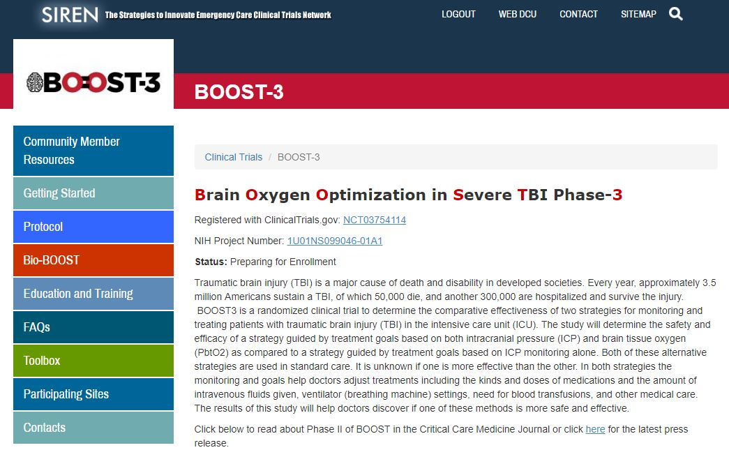
BOOST3trial.org
Locate study materials: protocol, EFIC materials, cIRB approved ICF, milestones, regulatory parameters document, MOP
Access training materials and FAQs
Notes:
2

Slide 3
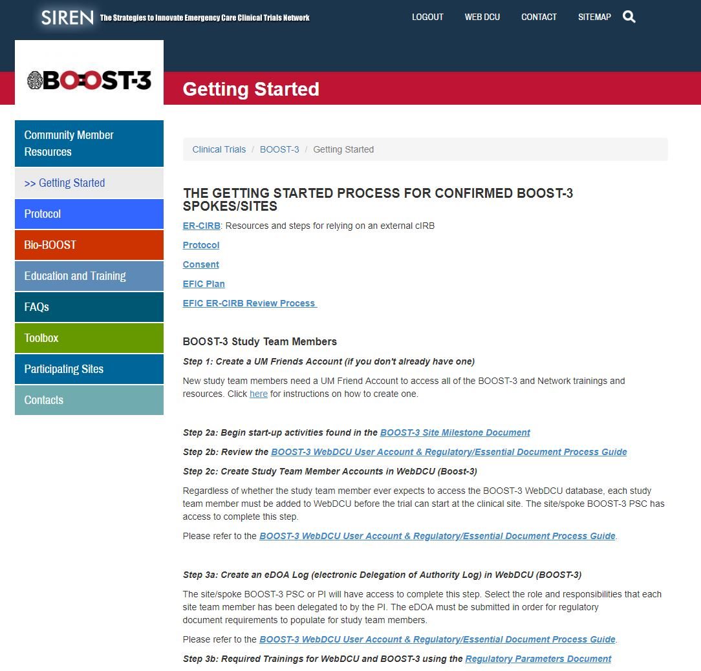
Getting Started
Important information and materials for preparing for BOOST-3
Useful links to trial resources
Notes:
3

Slide 4
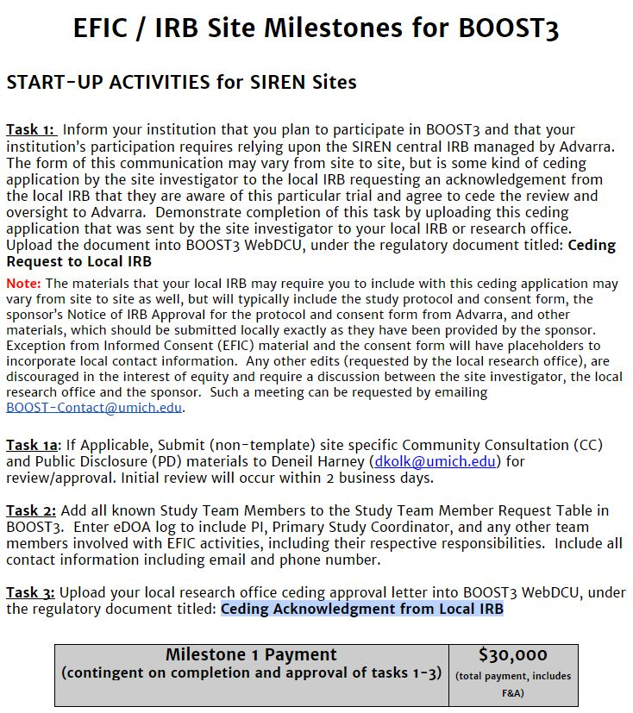
BOOST-3 Milestones
Milestone 1
Task 1: Ceding Request to Local IRB
Task 2: Electronic Delegation of Authority (eDOA) Log
Task 3: Ceding Acknowledgment from Local IRB
Notes:
4

Slide 5
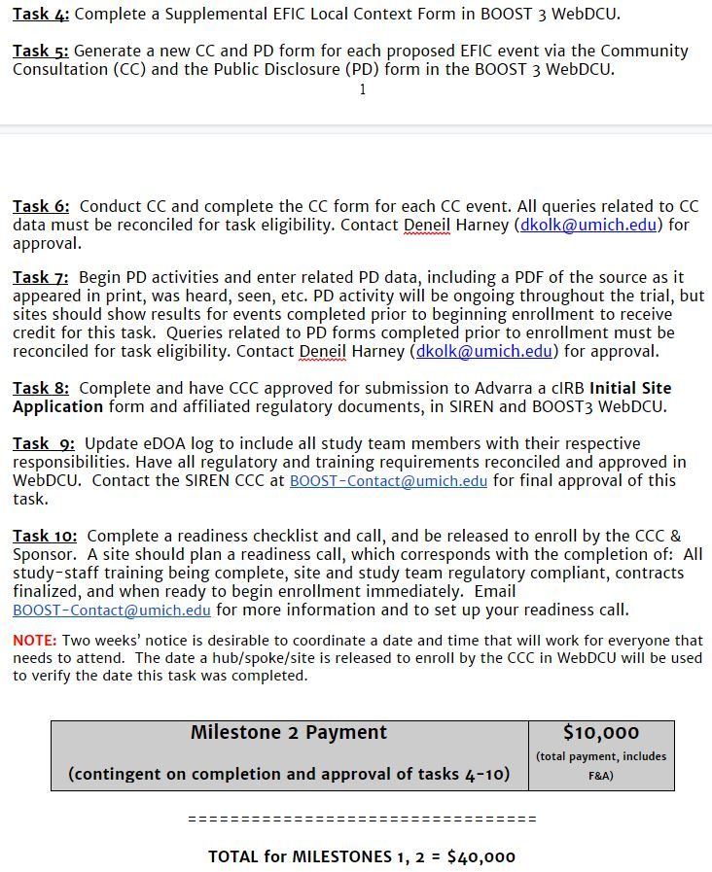
BOOST-3 Milestones
Milestone 2
Task 4: EFIC Local Context Form
Task 5: Log CC/PD Events
Task 6/7: CC/PD Activities
Task 8: cIRB Site Application
Task 9: eDOA log
Task 10 Readiness checklist/call
Notes:
5

Slide 6
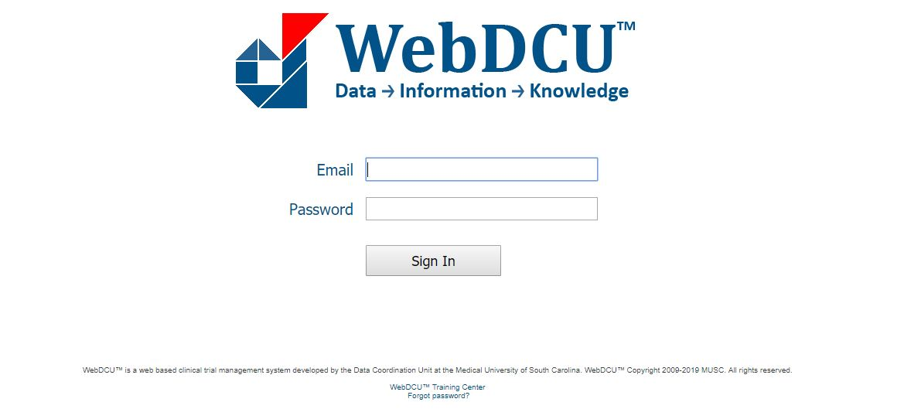
BOOST-3 Regulatory Database: WebDCUTM
Notes:
6

Slide 7
BOOST-3 Regulatory Database: WebDCUTM
BOOST-3 regulatory database will serve as the central repository for all regulatory documents
IRB Approvals and other essential documents will be available via the database
Automated emails will be sent for expired, expiring, and missing documents
Notes:
7

Slide 8
Regulatory Parameters Document
Outlines all regulatory and training requirements
People Document: Specific to an individual study team member

Slide 9
Regulatory Parameters Document
Outlines all regulatory and training requirements
Site Document: Applies to a site/Spoke

Slide 10
Regulatory Documents for Site Startup – Site Documents and Forms
FWA for your Institution
CLIA Certification
Attestation of Study Team Education and Training
Ceding Request to Local IRB
Ceding Acknowledgment from Local IRB
HSP Requirements
EFIC Results Report
IRB Approval (Advarra)
IRB Approved Informed Consent (Advarra)
cIRB Tables
Site Overview (SIREN)
Site Regulatory Inspection (SIREN)
Initial Site Submission (BOOST-3)
Reminder: Please upload all documents as pdfs in WebDCU

Slide 11
Regulatory Documents for Site Startup – People Documents
All Team Members
CV
HSP
GCP
Protocol Training
Applicable Team Members
Medical License
BOOST Data Training
Regulatory Document Training
Blinded Outcomes Assessment Training
Reminder: Please upload all documents as pdfs in WebDCU

Slide 12
Regulatory Documents for Site Startup
Electronic Delegation of Authority (eDOA) Log
Completed Readiness Checklist
Send completed readiness checklist to boost-contact@umich.edu

Slide 13
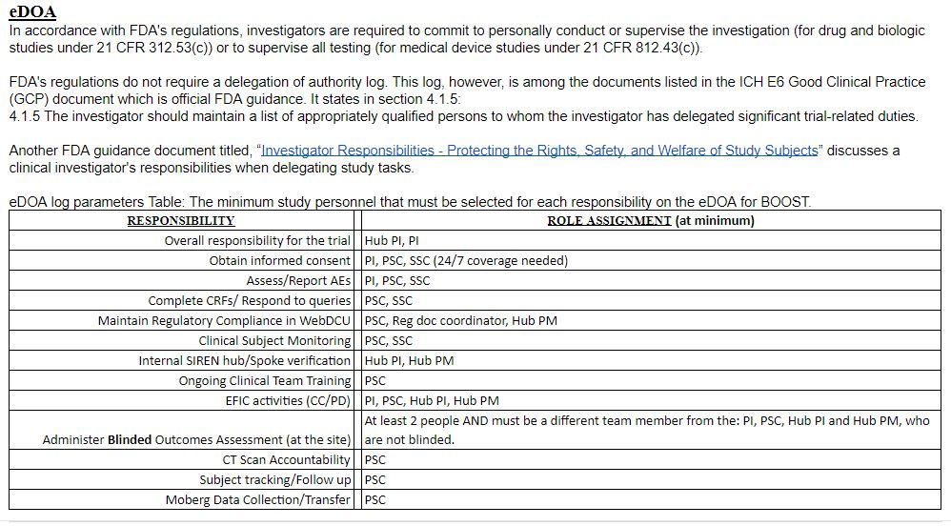
Electronic Delegation of Authority (eDOA) Log

Slide 14
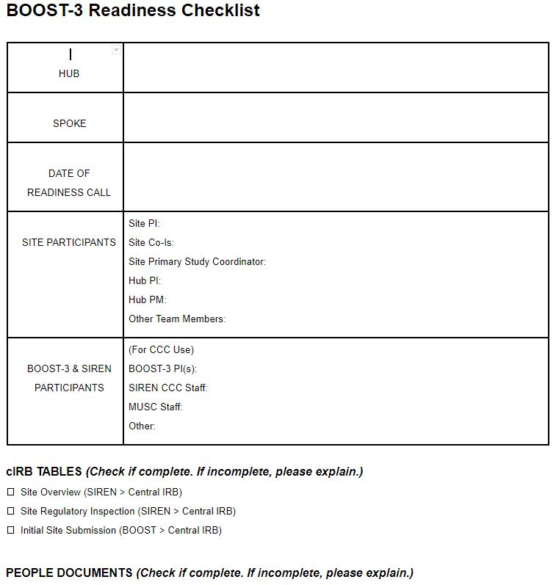
Readiness Checklist
Sites will complete to confirm regulatory and logistical readiness
List names of site participants who will be in attendance
Respond to all questions in logistics section
Email completed checklist prior to the call (boost-contact @umich.edu)

Slide 15
Readiness Call
A readiness call is the study initiation meeting
Conducted via phone conference
Evaluate and confirm site readiness for study activation
Q&A with trial leadership and CCC

Slide 16
Readiness Call
Site Personnel: Hub PI and PM, Trial PI, Primary SC. Other team members are welcome to attend!
BOOST-3 PI, Site Manager, MUSC personnel and other team members
All participants will receive an appointment request sent to their calendars with conference line information

Slide 17
Post Call – Site Activation
If action items remain after the readiness call, site personnel will resolve prior to activation
If no action items, site will be activated and released to enroll
BOOST-3 study team will be notified via email

Slide 18
Ongoing Site Management
It is the responsibility of each Hub/Site to maintain regulatory compliance, inclusive of site documents and people documents, throughout the duration of the trial
Documents approaching expiration should be reconciled prior to the expiration date
Study team personnel who are out of regulatory compliance should not participate in any trial related activities

Slide 19
Study Team Changes
Add to BOOST-3 Database
Update eDOA
Upload all team personnel documents, trainings and certifications (eg., CV, medical license)
Study team members cannot begin research related activities until all of the above have been reconciled.

Slide 20
Who to Contact?
For immediate emergency assistance (enrollment, clinical, protocol, adverse events, etc.), please use the 24/7 BOOST-3 Principal Investigator Hotline: 855-4-BOOST3 (855-426-6783)
Clinical questions for BOOST3 trial PIs: boost-PIs@umich.edu
For non-urgent data entry/WebDCU questions call: 1-866-450-2016
For all other non-urgent questions: boost-contact@umich.edu
For all email communications, please include BOOST-3 at the beginning of the subject line.

Slide 21
Questions?

