Slide 1


Brain Oxygen Optimization in Severe TBI Phase 3
Protocol Training
Ava Puccio, RN, PhD; Anita Fetzick, RN, MSN; Lori Shutter, MD
University of Pittsburgh / UPMC

Slide 2
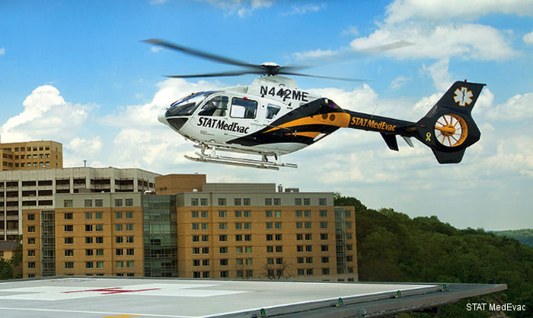
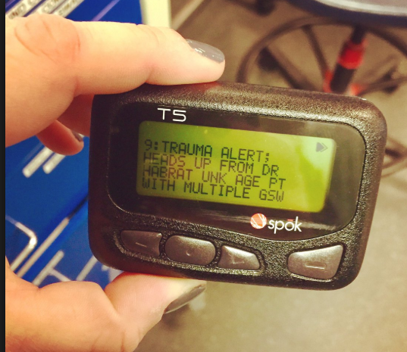

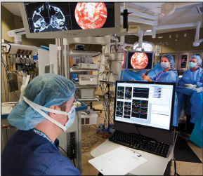



Subject Identification: Helpful Hints for Screening
Notes:
Carrying a trauma alert pager can assist the on call coordinator in screening for potential patients. Descriptions that use terms such as closed head injury, skull fracture, posturing, raccoon eyes, etc suggest that a potential patient is en route and may help in allowing more time to gather information during screening. Conversely, the trauma pager may offer clues about patients that would otherwise exclude a patient from BOOST-3, with terms such as gunshot wound to the head, patient is following commands, major chest trauma with hypoxia at the scene, etc.
The trauma alert can allow for a coordinator to be present when the patient arrives (if patient arrival happens to be normal working hours); it is beneficial for the coordinator to be present in the ER/Trauma Bay upon patient arrival (if possible). The coordinator can easily obtain a brief report from the patient transport team that could include time of injury, stability of vital signs at the scene and during transport, and neurologic exam at the scene, especially the patient’s exam before intubation, if this was done en route.
If available, the ER social workers or case managers can be a valuable source of information, especially with patient identification and obtaining contact information on the LAR or next-of-kin. The social work or case management team can also alert a coordinator when the LAR or next-of-kin has arrived at the hospital.
Effective communication with the trauma or neurosurgery physicians is essential for successful screening and enrollment. Prior to enrollment and randomization, the coordinator will need verification from the neurosurgeon that the patient has a TBI that requires intracranial pressure monitoring, and that an accurate GCS has been obtained that meets inclusion criteria.
2

Slide 3
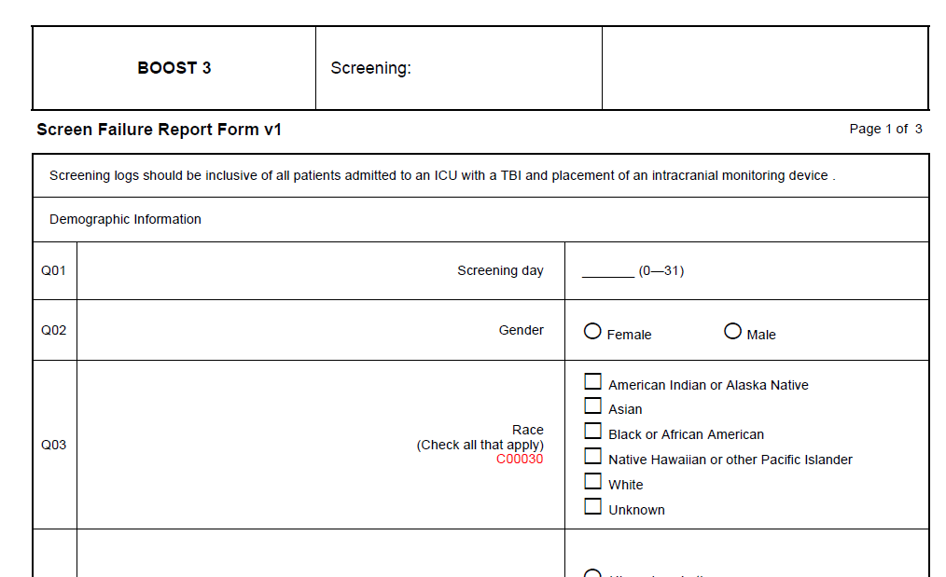

Screening for Enrollment
A screening log should be maintained by each site
All patients with the following should be included:
  Admission to ICU
  Positive TBI (CT scan)
  Placement of intracranial monitoring
Notes:
When more than one family member is present, the individual on top of the hierarchy is the LAR and responsible for signing the consent. Unless otherwise stated in local or state regulations, any of the above individuals are acceptable for LAR consent if other members higher in the hierarchy are not promptly available. A non-LAR family member (some state regulations may identify family members that don’t meet LAR criteria) may object to enrollment, but cannot provide consent. If an LAR consents to the subject’s continued participation in the study and a concerned family member who is not an LAR voices objections, thoughtful discussions with all concerned parties will be initiated. Often families are able to come to a mutually agreeable decision.
Ancillary staff such as social work, case managers, staff nurses can assist in providing appropriate location to discuss the trial and review the consent form. Ideally, these should be quiet, private areas such as a family meeting room, private conference room, or an area of the waiting room that is quiet and not overcrowded.
Priority should be taken so that the LAR/next-of-kin should be updated on the patient’s condition and plan of care—ideally the LAR should have an opportunity to speak with a treating physician or the nursing staff. This can lead into the discussion of study participation and ultimately, review of informed consent. A coordinator may help to facilitate this discussion between the treatment team and the LAR/Next of Kin, which can also help build a relationship between the coordinator and family when the coordinator acts as a patient/family advocate.
3

Slide 4

The Informed Consent Process
Establish line of sanguinity for next-of-kin:
Spouse
Adult child (age >18 years)
Parent
Adult sibling (age >18 years)
Grandparent
Adult grandchild (age >18 years)
Find an appropriate environment
Ensure that LAR is updated on subjects condition and plan of care
Explain purpose of trial
Review consent form in detail
Make sure all questions are addressed
Notes:
When more than one family member is present, the individual on top of the hierarchy is the LAR and responsible for signing the consent. Unless otherwise stated in local or state regulations, any of the above individuals are acceptable for LAR consent if other members higher in the hierarchy are not promptly available. A non-LAR family member (some state regulations may identify family members that don’t meet LAR criteria) may object to enrollment, but cannot provide consent. If an LAR consents to the subject’s continued participation in the study and a concerned family member who is not an LAR voices objections, thoughtful discussions with all concerned parties will be initiated. Often families are able to come to a mutually agreeable decision.
Ancillary staff such as social work, case managers, staff nurses can assist in providing appropriate location to discuss the trial and review the consent form. Ideally, these should be quiet, private areas such as a family meeting room, private conference room, or an area of the waiting room that is quiet and not overcrowded.
Priority should be taken so that the LAR/next-of-kin should be updated on the patient’s condition and plan of care—ideally the LAR should have an opportunity to speak with a treating physician or the nursing staff. This can lead into the discussion of study participation and ultimately, review of informed consent. A coordinator may help to facilitate this discussion between the treatment team and the LAR/Next of Kin, which can also help build a relationship between the coordinator and family when the coordinator acts as a patient/family advocate.
4

Slide 5
EFIC Process:
Begins Upon Arrival of Potentially Eligible Subject
Determine availability of LAR
*Document efforts on the informed consent log case report form*
If an LAR is not available prior to the placement of intracranial monitors, eligible subjects will be enrolled with EFIC after intracranial monitors are placed.
When a subject is enrolled under EFIC, efforts to contact an LAR will continue.
LAR will be notified of an EFIC enrollment and consent to continue in the study will be sought at the earliest opportunity.
Notes:
(need to include link to opt out registry, link for toolbox)
Upon hospital arrival of a potentially eligible subject, study teams will diligently try to determine the availability of an LAR. Both routine hospital and study team resources and processes should contribute to the determination of the availability of an LAR. The steps undertaken to seek the LAR should be documented and included on the informed consent log case report form. If an LAR is not available prior to the routine emergent placement of intracranial monitors, eligible subjects will be enrolled with EFIC after placement of intracranial monitors. Subsequent to an EFIC enrollment, efforts to contact an LAR will continue. An LAR will be notified of an EFIC enrollment and consent to continue in the study will be sought at the earliest opportunity.
Once located, the LAR will be informed of the subject’s enrollment in the study and of the details and risks of the study. At that time, the LAR will be given the option of allowing the subject to continue in the study, or withdrawing the subject’s participation then or at anytime throughout the course of the study. If the LAR wants to continue the subject’s participation, an informed consent form signed by the LAR for continuation of participation will be obtained at that time.
The informed consent log case report form is also used to document continuing efforts to locate an LAR until notification and a consent process can occur, and the final results of that process. The log will include the types of attempts made, and the number and times of those attempts. If an LAR is never found, then the subject must be notified and approached for consent to continue in the study if and when the subject regains consciousness and decision-making capacity. For subjects who expire prior to identification of an LAR, consent is not obtained. If an LAR is eventually located, they should be notified of the subject’s participation. In the rare case where an LAR can not be found and the subject remains incapable of consent at 6 months, attempts to find an LAR will be discontinued, but documentation of the LAR search process until that time, and the subject’s decisional capacity will be documented.
5

Slide 6
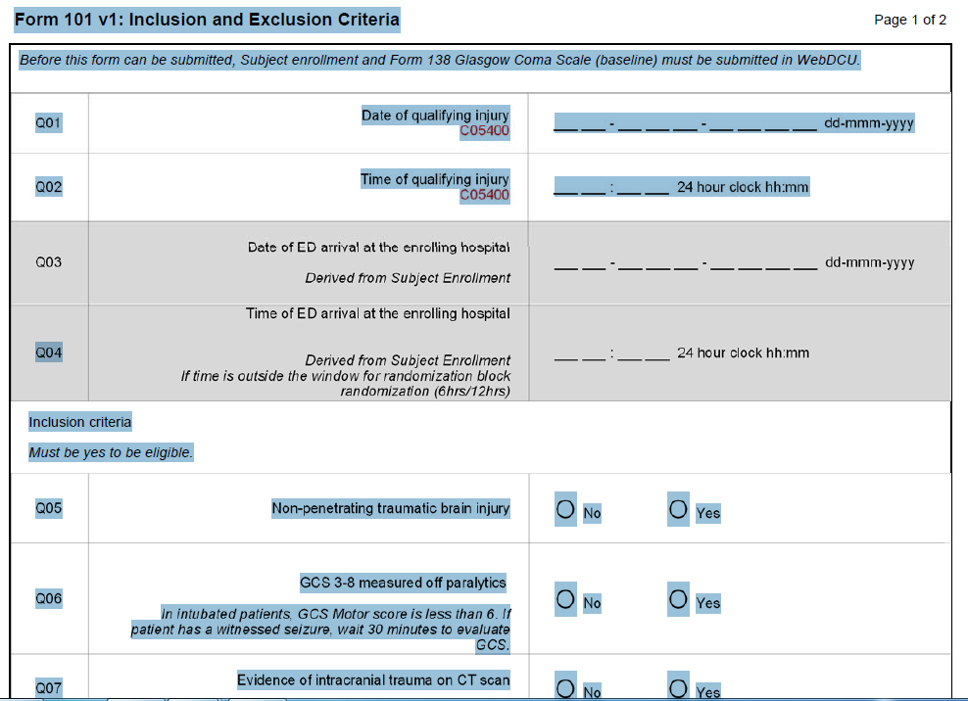
Randomization Procedure: CRFs to complete
CRFs to be completed prior to randomization:
  Inclusion/Exclusion Criteria checklist
  Randomization form
    use GCS (in the absence of sedation/paralytics) that was performed closest to randomization
Check Opt-out registry and document
Notes:
(perhaps include screenshots of randomization screens)
Form 138 (Baseline GCS Form)
Form 101 (I/E Criteria Form)
6

Slide 7
Randomization Procedure
To receive a treatment assignment, site personnel will enter participant and covariate information into WebDCUTM, the electronic Clinical Trial Management System run by the SIREN Data Coordinating Center (DCC) at the Medical University of South Carolina.
https://webdcu.musc.edu/login.asp
Notes:
(perhaps include screenshots of randomization screens)
Form 138 (Baseline GCS Form)
Form 101 (I/E Criteria Form)
7

Slide 8
Case Study: 17 yo male s/p ATV accident on 6/27/19 at approximately 21:00. GCS 3 at the scene, pupils 2mm and reactive. Seizure activity noted en route to OSH. Initial CT scan performed at OSH revealed a right EDH with midline shift; pupil exam changed from 2mm and reactive bilaterally to right pupil 7mm and nonreactive. Taken emergently to OR for right decompressive craniectomy. He arrives at study hospital on 6/28/19 at 8:45am, GCS 7T, pupils 4mm and reactive bilaterally. ICP and PbtO₂ monitors were placed at 10:00.

Slide 9
Does this patient meet criteria for enrollment in BOOST-3?
Yes
No
Notes:
Answer: B (see next slide)

Slide 10
Why does this patient NOT meet eligibility criteria?
Age less than 18
Monitors were not placed within eligible time frame
Patient exhibited seizure activity at the scene
Patient underwent a right decompressive craniectomy, and the PbtO2 monitor must be placed in the right frontal lobe.
Notes:
Answer: B The monitors should be placed as soon as possible after injury, and should be placed within 12 hours after injury and within 6 hours of arrival at the enrolling hospital. The patient was injured at 9pm on 2/27, so intracranial monitoring and randomization must take place before 9am on 2/28. Placement occurred at 10am, so the patient is not eligible as placement occurred at 10am.
A is incorrect as the age range is 14 and older
C is incorrect as seizure activity is not an exclusion, although it should be noted that an exam should be performed AT LEAST 30 minutes after a patient has had a witnessed seizure
D is incorrect as this is not an exclusion; per protocol, the PbtO2 probe will be inserted into the right frontal lobe, unless there is a contraindication such as a craniotomy flap, compound depressed skull fracture, or an underlying focal parenchymal injury such as a contusion or intracerebral hematoma. In these cases the probe will be inserted into the left frontal area.

Slide 11
Case Study: 31 yo female s/p unhelmeted MCC on 5/31/19 at approximately 22:00. Arrived to study hospital at 23:36 on 5/31.
Injuries: Diffuse SAH, IPH, left occipital bone fx, left post 9th rib fx, lung contusion, retroperitoneal hematoma.
Per chart review, the patient has no significant PMH, takes daily multivitamin, and has no known allergies. A loading dose of Phenytoin is started in the Trauma bay and an order for routine dosing for the next 7 days is placed.
Vitals: Stable en route. In Trauma Bay, BP 130/96, HR 102, RR 14, SPO2 95%
Neuro exam: Patient localizes RUE/withdraws LUE to painful stimuli, no eye opening, intubated—GCS 7T; right pupil 3mm and sluggish, left pupil 5mm and reactive.
The patient is transported to the ICU on 6/1/19, with the plan to place ICP and PbtO2 monitors. At this time, the patient’s LAR (mother) has not been able to be notified of the patient’s condition. No other emergency contacts have been identified.

Slide 12
Based solely on the information provided, does this patient meet criteria for enrollment and randomization into BOOST3?
Yes
No
Need more information
Notes:
Answer: C at this point patient does meet eligibility criteria, however a few more assessments need to be performed to rule out any exclusion criteria.

Slide 13
What further tests need to be performed before enrollment to confirm eligibility?
Repeat CT scan to confirm that intracranial monitors to confirm correct placement
Calculate PaO2/FiO2 ratio
Urine or serum pregnancy test
Check EFIC opt out registry
B, C, D
C, D
All of the above
Notes:
Answer: E—the patient’s PaO2/FiO2 ratio must be > 200 to rule out exclusion criteria; this can be calculated by confirming the PaO2/FiO2 ratio using PaO2 levels obtained from an ABG or SPO2 level, with known FIO2 at time of ABG or SPO2 measurement. For example, if this patient had an ABG drawn in the Trauma Bay that has a PaO2 value of 385 while on 100% FiO2, the PaO2/FiO2 ratio would be 385 and appropriate for enrollment. Additionally, a urine or serum pregnancy test must be performed on a female patient to rule out pregnancy prior to randomization. The EFIC opt out registry must be checked prior to randomization to confirm that the patient is not listed in the registry. If the patient’s name is on the Opt out registry, they cannot be enrolled into BOOST3.
Answer A is incorrect; per protocol, a single head CT will be obtained within 24 hours, per local standard of care, and after placement of the monitors to confirm location / assess for placement associated adverse events. This does not need to be done prior to randomization.

Slide 14
Withdrawal From Participation
Reason for wishing to withdraw must be determined
Study interventions and further data collection may be discontinued
After withdrawal, the participant’s care should revert to standard care at the enrolling site.
Participant data collected prior to withdrawal from the study is maintained in the study database, but no additional participant data will be collected from the participant or medical record following study withdrawal.
Notes:
(may need to re-phrase)
Regardless of whether a subject was initially enrolled with informed consent or EFIC, an LAR may withdraw the subject from further participation at any time and for any reason. After regaining consciousness and decision making capacity, subjects may also withdraw themselves from further participation. Whenever possible, the reason for wishing to withdraw should be determined. Those wishing to withdraw the study intervention should be aware that the intervention can be discontinued (i.e. request that the PbtO2 monitors be removed, or that ICU staff be unblinded to PbtO2 values) without withdrawing from the trial and further data collection. Discontinuation of the study intervention itself does not constitute withdrawal from further participation in the study. After withdrawing from either the intervention or any further participation in the study, the participant’s care should revert to standard care at the enrolling site. Consistent with OHRP and FDA guidance, participant data collected prior to withdrawal from the study is maintained in the study database, but no additional participant data will be collected from the participant or their medical record subsequent to withdrawal from the study.
14

Slide 15
Intracranial Monitors
The type of monitors used at each site will be documented at time of site initiation.
  Changes in equipment used will require notification to the monitoring team.
An ICP and PbtO₂ monitor are required for every participant.
Information from any neuro-monitoring device used must be collected as part of the study protocol.
Notes:
The occasional use of TCDs to confirm suspected vasospasm is allowed and if performed the report should be collected. If vasospasm is present, this information must be documented in the Adverse Event CRF.

Slide 16
Considerations Related to Neuromonitoring
Neuromonitoring devices that are NOT acceptable include:
  NIRS
  BIS (except in the OR)
  Jugular bulb saturation monitors
  Cerebral blood flow monitors
  Routine transcranial doppler
These devices can provide indirect information regarding brain tissue oxygenation.
Acceptable devices:
  EEG
  Microdialysis
  ECoG
  Brain temperature
  Cerebral autoregulation
NOTE: The occasional use of TCDs to assess for vasospasm is allowed. If performed, this information should be collected
Notes:
Other acceptable neuro-monitoring devices include: EEG, ECog, microdialysis, brain temperature, cerebral autoregulation. Neuro-monitoring devices that are not acceptable include: NIRS, BIS (except in the OR), Jugular bulb saturation monitors, cerebral blood flow monitors, or routine transcranial doppler (TCD) monitoring as these can provide indirect information regarding brain tissue oxygenation. The occasional use of TCDs to confirm suspected vasospasm is allowed and if performed the report should be collected. If vasospasm is present, this information must be documented in the Adverse Event CRF.
16

Slide 17
Intracranial Monitors: Placement and Timing
ICP and PbtO₂ monitors will be placed at the same time per local placement practices.
The monitors should be placed as soon as possible after injury, and need to be placed within 12 hours after injury and within 6 hours of arrival at the enrolling hospital.
A non contrast head CT will be done on all patients as part of their initial evaluation. Another non contrast head CT should be obtained within 24 hours after placement of the ICP and PbtO₂ monitors to confirm location/assess for monitor placement.

Slide 18
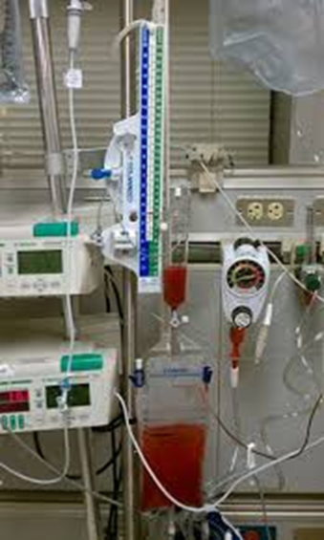
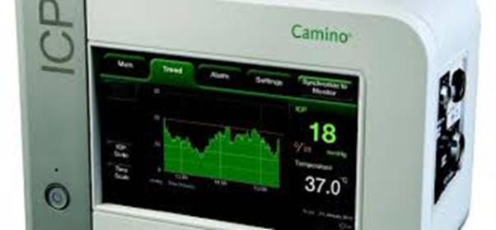
Intracranial Monitors
Continuous ICP monitoring is required. This can be done by either a parenchymal monitor or external ventricular drain (EVD).
  If an EVD is placed, it is to be zeroed at the tragus.
  An EVD may be used as the ICP monitor as long as continuous ICP measurements can be recorded. Whenever the EVD is open to drain, a method must be available to allow for continuous ICP measurements.
  CSF drainage via the EVD can be either continuous or intermittent.
Notes:
Any interruption in ICP monitoring needs to be very short (<5 minutes?)

Slide 19
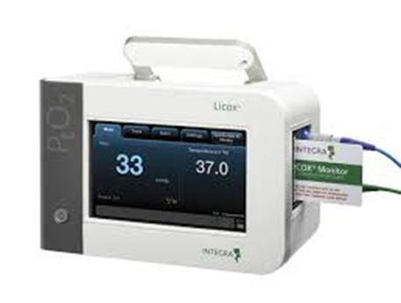
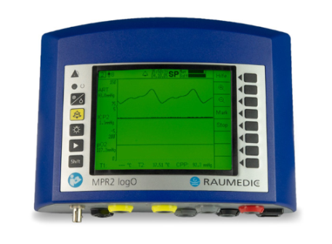
Intracranial Monitors: PbtO₂ placement
The PbtO₂ probe will be introduced through either a burr hole in the skull via a bolt or via tunneling under the scalp using equipment per local institutional practices.
  The goal is to place the PbtO₂ probe in a position remote from any known or visible contusion.
    The PbtO₂ probe will generally be inserted into the right frontal lobe, unless there is a contraindication (ie craniotomy flap, compound depressed skull fracture, underlying contusion or intracerebral hematoma). In these cases, the probe will be inserted into the left frontal area.
Function and reliability of the PbtO₂ probe will be assessed.

Slide 20
Procedures To Check Reliability of PbtO₂ Measurements
  Calibration of device will be checked according to manufacturer’s instructions
Prior to Insertion
  Each participant will have an FiO₂ challenge within 2 hours after catheter placement
    Recorded measurements will be initiated 60 minutes after placement of monitor
    Treatment staff will be blinded to results in control arm
FIO2 Challenge
  FiO₂ Challenge will be repeated daily until probe is removed.
  Study staff may request a challenge at any time if they suspect the PbtO₂ probe is not working.
Repeated Challenges
Notes:
Function and reliability of the PbtO2 probe will be assessed as described on this slide. In the event of a non-functioning or mal-positioned PbtO2 probe or expansion of a contusion that results in the inability to obtain PbtO2 values, a new PbtO2 probe should be placed in the ICP+PbtO2 intervention group within 2 hours if at all possible. This is not necessary in the ICP alone (control) group.
Prior to insertion, calibration of the device will be checked according to the manufacturer’s instructions.
Each participant will have a FiO2 challenge done within 2 hours after placement of the catheter, and then daily thereafter until the probe is removed. Treatment staff will be blinded to the results of the FiO2 challenge in the control arm. The expected response to a FiO2 challenge would be a PbtO2 increase of at least 5 mm Hg. If the initial challenge does not demonstrate the expected response, a repeat challenge should be done within 1 hour.
If the second FiO2 challenge again fails to show the appropriate response of a PbtO2 increase of at least 5 mm Hg, further management will be determined by patient group.
In the ICP+PbtO2 (intervention) group, a head CT should be obtained to assess for PbtO2 probe malpositioning, contusion expansion, or other potential causes for inaccurate PbtO2 measurements. In the event of a non-functioning or mal-positioned PbtO2 probe or expansion of a contusion that results in the inability to obtain PbtO2 values, a new PbtO2 probe should be placed within 2 hours if at all possible.
In the ICP only (control) group, the study team will document that the PbtO2 probe is unreliable. The PbtO2 probe will not be replaced but it should be checked daily by the study team in the event that it begins to record data again. It should remain in place until removal criteria have been met (see below).
The study staff may request a FiO2 challenge at any time if they suspect the PbtO2 probe is not working. The results of any challenges in the ICP only (control) group should not be shared with the clinical team in order to maintain blinding.
In addition, for participants in the ICP+PbtO2 (intervention) group, the clinical team may perform a FiO2 challenge at any time they feel it is indicated based on the clinical situation and local protocol. The clinical team will not be blinded to the results of these challenges.
The information from any FiO2 challenge performed should be captured in the daily CRF.
The study or clinical team may also perform MAP or CO2 challenges based on local protocols. The results of any challenges in the ICP only (control) group should not be shared with the clinical team in order to maintain blinding. Information from MAP or CO2 challenges should be maintained per local protocols and recorded on the CRF.
20

Slide 21
Checking Reliability of PbtO₂ Data: FiO₂ Challenge
Only the research team will be able to see the results of the challenge in the blinded ICP-only group.
How to perform the challenge
Increase FiO₂ to 100% for 20 minutes or until PbtO₂ increases by 5 mm Hg, whichever occurs first.
  If the PbtO₂ increases, you have confirmed accuracy of the PbtO₂ readings.
  If the FiO₂ challenge fails, repeat the challenge in about 1 hour.
  If the challenge fails again, further management will be determined by patient group.
Document time and results of the challenge

Slide 22
Checking Reliability of PbtO₂ Data: FiO₂ Challenge
If the FiO₂ challenge fails a second time, management is based on patient group:
  In the ICP + PbtO₂ treatment group, the PI is notified and a head CT should be obtained to assess position of PbtO₂ probe, contusion expansion, or other potential causes for inaccurate PbtO₂ measurements.
    In the event of a non-functioning or mal-positioned probe, or contusion expansion that results in the inability to obtain PbtO₂ values, a new PbtO₂ probe should be placed within 2 hours if at all possible.
  In the ICP only group, the study team will document that the PbtO₂ probe is unreliable.
    The medical staff and PI will not be notified that the probe is not functioning.
    The PbtO₂ probe will not be replaced but it should be checked daily by the study team in the event that it begins to record data again. It should remain in place until the removal criteria has been met.

Slide 23
Checking Reliability of PbtO₂ Data: FiO₂ Challenge
Documentation
Measurements to be obtained at both the start and completion of the required daily FiO₂ challenge include:
  Time of the challenge, whether the PbtO₂ showed an appropriate response, the ICP, FiO₂, SaO₂, and an ABG for PaO₂ and pH.
  This information will be recorded in the CRF.
In the event of additional FiO₂ challenges performed by the clinical team, measurements to be recorded at both the start and completion of the challenge include:
  Time of the challenge, whether the PbtO₂ showed an appropriate response, the ICP, FiO₂, and SaO₂. ABG data is optional for FiO₂ challenges performed by the treating physician.

Slide 24
Checking Reliability of PbtO₂ Data: FiO₂ Challenge
Notes:
No other active changes in care should be done during the challenge, including but not limited to adjustments in sedation, analgesia, EVD drainage or other physiological parameters in order to avoid confounding the response to the FiO₂ challenge.
At completion of any FiO₂ challenge the FiO₂ should be weaned back to the baseline level.
Study staff may request FiO₂ challenge at any time if they suspect the PbtO₂ probe is not working.
For participants in the ICP + PbtO₂ treatment group, the clinical team may perform a FiO₂ challenge at any time they feel it is indicated based on the clinical situation and local protocol.

Slide 25
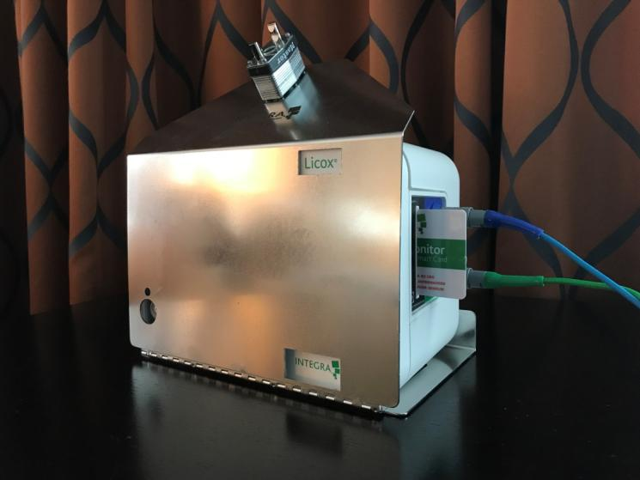
Handling of Study Interventions: Blinding
PbtO₂ Monitors will be masked for subjects randomized into the Control Group
6 Month Outcomes Assessor must be blinded to randomization assignment
Notes:
Blinding The PbtO2 monitors will be masked for this study in the control group, so that hospital staff will not be able to read the PbtO2 information. Hospital staff are not blinded as to who is in the control or active treatment groups. The 6 Month outcomes will be collected by an assessor blinded to randomization assignment.
25

Slide 26
After confirming that the patient meets eligibility criteria, the study coordinator has been notified that the neurosurgeon has just completed placement of a ventriculostomy drain (EVD) and is currently placing a PbtO2 monitor. What should the study coordinator remind the clinical team regarding placement of intracranial monitors or neuromonitoring?
If the treating physician plans to leave the EVD open continuously, an intraparenchymal ICP monitor must be placed to allow for continuous ICP measurement.
Brain tissue oxygen values must not be treated prior to randomization.
Other neuromonitoring devices, such as a cerebral blood flow monitor, Jugular bulb saturation, NIRS, BIS or routine TCD cannot be used in a patient enrolled into BOOST3.
All of the above.
Notes:
Answer: D All of the above. Continuous ICP monitoring, either by parenchymal monitor or external ventricular drain (EVD), is required. An EVD can be used as the ICP monitor, particularly if CSF drainage for treatment of elevated ICP is required. CSF drainage via the EVD can be either continuous or intermittent. The ICP readings may be from the EVD monitor only if continuous readings can be recorded. If CSF drainage from the EVD is continuous, ICP readings must come from a parenchymal ICP monitor in order to obtain continuous ICP readings. Treatment of brain tissue oxygen values prior to randomization or planned use of devices that would allow unblinding of medical care team to the treatment group are items that would exclude an otherwise eligible BOOST3 participant; PbtO2 values should not be visible to the treatment team prior to randomization or in the blinded arm. Neuro-monitoring devices that are not acceptable include: NIRS, BIS (except in the OR), Jugular bulb saturation monitors, cerebral blood flow monitors, or routine transcranial doppler (TCD) monitoring as these can provide indirect information regarding brain tissue oxygenation. The occasional use of TCDs to confirm suspected vasospasm is allowed and if performed the report should be collected. If vasospasm is present, this information must be documented in the Adverse Event CRF. Other acceptable neuro-monitoring devices include: EEG, ECog, microdialysis, brain temperature, cerebral autoregulation.
26

Slide 27
The patient is randomized to the ICP + PbtO2 treatment group. An FiO2 challenge is performed to check functionality of the PbtO2 probe. The patient’s inhaled oxygen is placed at 100% FiO2 via ventilator.
Initial PbtO2 value: 11mmHg
PbtO2 value after 20 minutes: 15mmHg
Does this suggest that the PbtO2 probe is properly functioning?
Yes
No
Notes:
Answer: B No—The expected response to a FiO2 challenge would be a PbtO2 increase of at least 5 mm Hg.
27

Slide 28
The patient is randomized to the ICP + PbtO2 treatment group. An FiO2 challenge is performed to check functionality of the PbtO2 probe. The patient’s inhaled oxygen is placed at 100% FiO2 via ventilator.
Initial PbtO2 value: 11mmHg
PbtO2 value after 20 minutes: 15mmHg
What is the next step in confirming functionality of the PbtO2 probe?
The PbtO2 probe should be replaced immediately in order to prevent delay of treatment of potentially low PbtO2 values
A head CT should be obtained to assess for the PbtO2 probe malpositioning, contusion expansion, or other potential causes for innacurate PbtO2 measurements.
The study or clinical team is required to immediately perform a MAP or CO2 challenge.
A repeat FiO2 challenge should be done within 1 hour of initial FiO2 challenge.
Notes:
Answer: D If the initial challenge does not demonstrate the expected response, a repeat FiO2 challenge should be done within 1 hour of initial FiO2 challenge.
A is incorrect; If the second FiO2 challenge again fails to show the appropriate response of a PbtO2 increase of at least 5 mm Hg, further management will be determined by patient group:
In the ICP+PbtO2 (intervention) group, a head CT should be obtained to assess for PbtO2 probe malpositioning, contusion expansion, or other potential causes for inaccurate PbtO2 measurements. In the event of a non-functioning or malpositioned PbtO2 probe or expansion of a contusion that results in the inability to obtain PbtO2 values, a new PbtO2 probe should be placed within 2 hours if at all possible. In the ICP only (control) group, the study team will document that the PbtO2 probe is unreliable. The PbtO2 probe will not be replaced but it should be checked daily by the study team in the event that it begins to record data again. It should remain in place until removal criteria have been met.
B is incorrect, as a repeat FiO2 challenge should be done prior to obtaining head CT
C is incorrect, as the study/clinical team is not required to perform a MAP or CO2 challenge, these are optional and based on local protocols; a repeat FiO2 challenge should be done first. If performed, information from MAP or CO2 challenges should be maintained per local protocols and recorded in WebDCU.
28

Slide 29
Recording of ICP and PbtO₂
Continuous tracings of both ICP and PbtO₂ values will be recorded at the bedside using the Moberg CNS Monitor
  This device will be calibrated and checked for proper functioning by both nursing and research staff.
  These recordings have real time resolution.
  The precise equipment and software used for the continuous recordings will be developed for each Clinical Site according to local needs and available equipment.
These continuous records will become a source document for this study.
The monitors and Moberg CNS system will both be outfitted with alarms that advise the ICU nursing staff whenever ICP rises above 22 mmHg or PbtO₂ falls below 20 mmHg.
  The PbtO₂ alarms will be silenced for the ICP only group.

Slide 30
Removal or Replacement of Probes
In general, ICP and PbtO₂ probes will be removed by Day 5
  Continued monitoring is allowed if clinically indicated.
  Replacement of a PbtO₂ probe will only be considered in the ICP + PbtO₂ group.
Probes may be removed before 5 days in the following situations:
  The participant awakens from coma (motor GCS score = 6).
  There is a medical indication for removal (ie, infection; associated bleeding).
  No abnormalities of ICP for 72 hours after injury in the ICP only arm
  No abnormalities of ICP or PbtO₂ are noted for 72 hours after injury in the ICP + PbtO₂ arm
  Withdrawal of care
If a probe is removed, the reason will be documented in the CRF
  An ‘intent to treat analysis’ will be used.
Notes:
Removal or replacement of probes will be completed at the discretion of the attending physician at each site.
The reason for removal or replacement will be documented in the daily CRF.

Slide 31


Clinical Standardization Guidelines
Goal directed management of physiologic parameters will be in accordance with recommended treatment guidelines published by the Brain Trauma Foundation and the American College of Surgeons
Clinical management of these parameters
  Should be based on local protocols
  Will be tracked on the daily CRFs

Slide 32
Clinical Standardization Guidelines
We purposely have limited “rules” regarding clinical management. Topics for which we provide guidance are:
  Hemodynamic Issues
  Temperature management
  Respiratory issues
  Hematologic issues
  Seizure prevention / Management
  Withdrawal of care / Brain Death
These will be presented tomorrow

Slide 33
Clinical Standardization Guidelines
Hemodynamic Issues
  Arterial Blood Pressure monitoring for CPP purposes will be standardized to the level of the heart
Temperature Management
  Initial goal is normothermia (36.5 – 37.5°C).
  Hyperthermia (temperature > 38.3° C) must be managed aggressively per local protocol.
  Prophylactic hypothermia is not allowed. It is a Tier 3 treatment option.

Slide 34
Clinical Standardization Guidelines: Respiratory Issues
PaO₂, PaCO₂, and pH levels will be monitored at least daily
  This information will be collected immediately after any FiO₂ challenge and whenever an ABG is drawn for clinical management
Target PaO₂ is 80 to 200 mm Hg
  In some clinical settings a lower PaO2 is needed. In that situation, a PaO2 < 80 mm Hg will be acceptable if PbtO2 is at target (20 mm Hg). Documentation is required regarding why the lower PaO2 is needed
  Elevated PaO2 may also be harmful, and further FiO2 increases are not allowed if PaO2 is above 200 mm Hg unless PbtO2 is persistently less than 20 mm Hg when other variables contributing to low PbtO2 have been addressed and controlled
  A PaO2 below 60 mm Hg will be a protocol violation

Slide 35
Clinical Standardization Guidelines: Respiratory Issues
Initial Target PaCO2 should be normocapnia (i.e., 35 - 45 mm Hg)
  PaCO2 adjustments should be in small increments (maximum of 5).
  Further adjustments should be guided by the clinical status (ie, history of CO2 retention, acute uncompensated hypercarbic respiratory failure, pulmonary contusions, etc).
Target pH is 7.35 – 7.45.
  When adjusting PaCO2, the pH must also be considered. Further lowering of PaCO2 should not be done if pH > 7.45, and PaCO2 should not be increased if pH is < 7.35.

Slide 36
Clinical Standardization Guidelines: Hematologic Issues
Hemoglobin levels should be maintained above 7.0 g/dL.
Goal INR at time of insertion/removal of intracranial probes is < 1.6.
  Correction should be initiated rapidly and will be done per local protocol.
  The measures used for correction and resolution of the coagulopathy will be documented on the CRF.
Goal platelets for insertion/removal of intracranial probes is > 80,000 /ml.
  Correction should be initiated rapidly and will be done per local protocol.
  The measures used for correction and resolution will be documented on the CRF.

Slide 37
Clinical Standardization Guidelines: Seizure Prevention / Management
Use of prophylactic anti-seizure medications (AEDs) is optional
If prophylactic AEDs are initiated, they should be used for 7 days only unless there is evidence of seizure development.
  Phenytoin, levetiracetam, or other AEDs may be used for prophylaxis based on local protocol
  If phenytoin is chosen, a loading dose of 20 mg/kg should be given followed by a maintenance dose of 3 - 5 mg/kg/day in divided doses
  AED levels should be monitored per site protocol
Clinical or subclinical seizures (as identified by EEG) should be managed according to site protocol.
  An AE form should be submitted to reflect onset, duration, and treatment of any seizure

Slide 38
Withdrawal of Care / Brain Death
The intent of the study is to optimize therapy for 5 days after randomization. Withdrawal of care during the first 5 days may be considered in dire circumstances or if requested by the patient’s family.
  The site PI will call the study hotline to update the study leadership team about withdrawal of care for a subject.
Withdrawal of care will be documented on the End of Study form, and at the bedside on the Moberg monitoring device.
Should the patient progress to brain death, determination is per local protocol. Participation in the clinical trial will not preclude a patient from consideration as an organ donor.

Slide 39
Assessing Patient Physiology: MAP Challenge
A MAP challenge is done at the discretion of the treating physician to assist in assessment of cerebral autoregulation. This can guide both MAP and CPP goals in individual patients.
How to perform the challenge
  Initiate or titrate a vasopressor to increase MAP by 10 mm Hg for approximately 20 mins or until the PbtO2 has increased by 5 mm Hg, whichever occurs first.
  Measurements to be obtained at both the start and completion of any MAP challenge include:
    Time of the challenge, whether the PbtO2 showed an appropriate response, the ICP, MAP and CPP.
    This information will be recorded in WebDCU

Slide 40
Assessing Patient Physiology: MAP Challenge
Notes:
No other active changes in care should be done during the MAP challenge, including but not limited to adjustments in sedation, analgesia, EVD drainage or other physiological parameters in order to avoid confounding the response to the MAP challenge.
At completion of the MAP challenge the vasopressor should be either returned to the baseline infusion rate or discontinued if it had been initiated specifically for the challenge.

Slide 41
Assessing Patient Physiology: CO₂ Challenge
A CO2 challenge may be done by the treating physician to assist in assessment of cerebral CO2 vasoreactivity to guide ventilator adjustments and may indirectly provide input regarding potential hyperemia. This challenge can use either hyperventilation or hypoventilation based on the patient’s individual clinical situation.
How to perform the challenge
  Adjust the respiratory rate by 25% and then in increments of 2 breaths/min with the goal of changing PaCO2 by up to 10 mm Hg (either increase or decrease).
  The duration of this challenge is approximately 20 mins or until the PbtO2 has increased or decreased by 5 mm Hg, whichever occurs first.
  End-tidal CO2 and PbtO2 are monitored continuously to follow the response to ventilatory changes and the effect on PbtO2, and the challenge should be terminated if PbtO2 approaches 15 mm Hg or decreases by greater than 50% of the value attained during a FiO2 challenge.

Slide 42
Assessing Patient Physiology: CO₂ Challenge
Documentation
Measurements to be obtained at both the start and completion of any CO2 challenge include:
  Time of the challenge, whether the PbtO2 showed an appropriate response, the ICP, end tidal CO2, and an ABG for PaCO2, and pH.
  This information will be recorded in the WebDCU.
Notes:
No other active changes in care should be done during the challenge, including but not limited to adjustments in sedation, analgesia, EVD drainage or other physiological parameters in order to avoid confounding the response to the CO2 change.
At completion of the CO2 challenge the respiratory rate should be returned to the baseline rate.

Slide 43


Management of elevated ICP and/or low PbtO2
Types of events |  | ICP < 22 mm Hg | ICP > 22 mm Hg
PbtO₂ > 20 |  | Type A No interventions directed at PbtO₂ or ICP needed | Type B Interventions directed at lowering ICP
PbtO₂ < 20 |  | Type C Interventions directed at increasing PbtO₂ | Type D Interventions directed at lowering ICP and increasing PbtO₂

Slide 44
Managing ICP and PbtO₂
Tiered algorithm based approach similar to BOOST II
  Tiers are hierarchical, with increased aggressiveness of interventions
Guided provider determined management
  Aimed at minimizing treatment variability across study centers while respecting local protocols and expertise
  Decisions regarding which intervention to use within any tier should be based on and aimed at addressing the presumed underlying pathophysiology contributing to that individual episode
Notes:
Interventions may vary based on the patient’s clinical scenario at the time of the episode

Slide 45
Scenario Based Patient Management
Elevations in ICP > 22 mm Hg, or a decline in PbtO₂ < 20 mm Hg, which are sustained for more than 5 minutes will trigger an intervention.
Treatments must be initiated within 15 minutes of the start of the episode, as detected by the continuous ICP and PbtO₂ recordings.
  The Moberg monitor will signal the treating team in real time, when an intervention is recommended. It is expected that a treatment intervention will be initiated as soon as possible after the start of the episode.
Participants may start in one type of episode and move to another.
  Therapy will depend on which type of episode they are in at any given time.
  For ICP only group, only Type A and Type B episodes are relevant.
  For ICP + PbtO₂ group, any of the 4 scenarios (Type A, B, C, or D).

Slide 46
Scenario Based Patient Management
Therapeutic strategies are divided into tiers that are organized in a hierarchical fashion
  Less aggressive interventions are in the lower tiers and more aggressive maneuvers in the higher tiers.
Treatment interventions within any one tier can be attempted in any order or combination.
  At least one treatment in Tier 1 must be tried before moving on to Tier 2.
  It is not necessary to use all treatments in the tier, but it is expected that at least one intervention from each tier will be used before proceeding to the next tier.
  Tier 3 treatments are optional.

Slide 47
Scenario Based Patient Management
The initial choice of a treatment option from any tier should be determined based on what may be the most effective for the current clinical situation, participant characteristics and local protocols.
  Any intervention chosen should be aimed at addressing the underlying pathophysiology that is contributing to each individual episode.
For any treatment chosen, a rapid response to that treatment is expected.
  Should a treatment not be effective in a timely fashion, additional interventions within the same tier may be attempted, or a decision may be made to quickly move to the next tier.

Slide 48

Scenario Based Patient Management
While there is no maximum number of treatment options that can be attempted from any one tier, no more than 60 minutes should be spent trying interventions within any single tier prior to moving on to the next tier.
The bedside treatment team has the option to progress to higher tiers as rapidly as they feel is clinically indicated.

Slide 49
Documentation of Interventions
Treatment interventions triggered by elevations in ICP and/or decreases in PbtO₂ will be recorded by the ICU nurses on the Moberg or in bedside flow sheets
  The time the abnormality was noted by nursing staff and the time the intervention started should also be recorded in the medical record, with the goal of an intervention initiation within 15 minutes of onset of the event.
Study coordinators will transfer information about those interventions into WebDCUTM.
  Data to be collected includes information regarding the efficacy of the intervention in reversing the abnormal physiologic parameter.
  Pertinent information from the ICU flow chart, nurses’ notes, as well as the continuous record of ICP and PbtO₂, will be collected daily by the study coordinators.

Slide 50
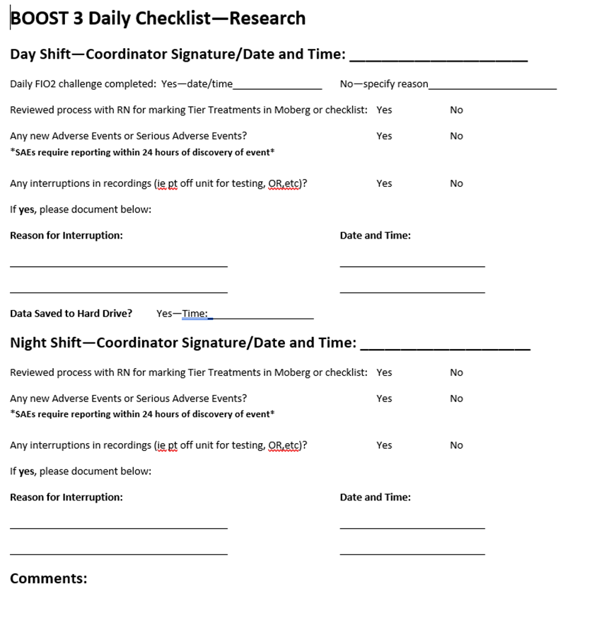
Data Capture is Essential to Study Success!
Use of a daily checklist completed by the study coordinator at the bedside may contribute to fewer protocol deviations from delayed/missed tier interventions or missing data
Notes:
50

Slide 51
General Caveats
Targets of osmolality therapy with mannitol or saline:
  Most centers use osmolality targets for mannitol treatment and Na⁺ target for saline, with values checked every 6- 12 hours.
  Target serum osmolality (Sosm) is < 320 mOsm, osmolar gap (Ogap) < 20, and serum sodium (sNa) < 160 mEq/L.
Active weaning of any changes made to address an acute episode should be initiated once the patient is back at scenario A levels (ie, ICP and PbtO₂ within goal range) and the bedside provider feels the patient has stabilized.

Slide 52
Scenario Based Patient Management
Type A (ICP < 22 mm Hg; PbtO₂ > 20 mm Hg)
  This is the target range and no additional therapy is needed.

Slide 53
Isolated ICP increase | Isolated PbtO₂ drop | ICP increase + PbtO₂ drop
TIER 1 Adjust head of the bed to lower ICP Ensure Temperature < 38°C. Titrate pharmacologic analgesia or sedation Titrate pharmacologic sedation CSF drainage (if EVD available) Low dose Mannitol (0.25 – 0.5 g/kg), to be administered as bolus infusion. Hypertonic saline. Titrate to ICP control and avoid serum Na+ above 160. Initiate or titrate anti-seizure medications (AEDs) Adjust ventilator for a target PaCO2 of 35 - 40 mm Hg and target pH of 7.35 - 7.45 | TIER 1 Adjust head of the bed to improve Pbt)2 Ensure Temperature < 38°C. Optimize CPP to a max of 70 mm Hg with fluid bolus or pressors. Optimize hemodynamics by: 1) Treating hypovolemia; 2) Avoid hypervolemia Adjust PaO2 by: 1) increasing FiO2 up to 60%; 2) adjusting PEEP; 3) Pulmonary toileting (suctioning) Adjust ventilator for a target PaCO2 of 38-42 mm Hg and target pH of 7.35 - 7.45 Initiate or titrate anti-seizure medications (AEDs) | TIER 1 Adjust head of the bed to lower ICP Ensure Temperature < 38°C. Pharmacologic analgesia and sedation CSF drainage (if EVD available). Increase CPP to a maximum >70 mm Hg with fluid bolus. Low dose Mannitol, (0.25 – 0.5 mg/kg) or Hypertonic saline Optimize hemodynamics by: 1) Treating hypovolemia; 2) Avoid hypervolemia; Increase PaO2 by: 1) increasing FiO2 up to 60%; 2) adjusting PEEP; 3) Pulmonary toileting (suctioning) Adjust ventilator for a target PaCO2 of 38-42 mm Hg and target pH of 7.35 - 7.45 Initiate or titrate anti-seizure medications (AEDs).
TIER 2 Adjust ventilatory rate for target PaCO2 of 33 – 38 mm Hg and target pH of 7.30-7.45 High dose Mannitol 1-1.5 g/kg or higher frequency of standard dose mannitol Hypertonic saline bolus (i.e., 30 ml of 23.4%). Treat surgically remediable lesions according to guidelines Adjust temperature to 35 – 36°C, using active cooling measures. Neuromuscular blockade with short acting agents, use a bolus dose to determine effect | TIER 2 Adjust ventilatory rate to increase PaCO2 to 40 – 45 mm Hg and target pH of 7.35-7.45 Increase PaO2 by: 1) increasing FiO2 up to 100%; 2) adjusting PEEP; 3) bronchoscopy Increase CPP above 70 mmHg with fluids or vasopressors. Neuromuscular blockade with short acting agents, use a bolus dose to determine effect Transfuse pRBCs. Decrease ICP to < 15 mm Hg. CSF drainage. Increased sedation | TIER 2. High dose Mannitol 1-1.5 g/kg, or frequent boluses standard dose Mannitol Hypertonic saline bolus (i.e., 30 ml of 23.4%) Increase CPP above 70 mm Hg with vasopressors. Increase PaO2 by: 1) increasing FiO2 to 100%; 2) adjusting PEEP; 3) bronchoscopy Transfuse pRBCs Treat surgically remediable lesions according to guidelines Adjust temperature to 35 - 36°C, using active cooling measures. Neuromuscular paralysis blockade with short acting agents, use a bolus dose to determine effect
TIER 3 (Tier 3 therapies are optional). Pentobarbital coma, according to local protocol. Decompressive craniectomy. Adjust temperature to 32-35°C, using active cooling measures. Adjust ventilatory rate for target PaCO2 of 30 – 35 mm Hg and target pH of less than 7.50 Other salvage therapy per local protocol and practice patterns | TIER 3 (Tier 3 therapies are optional). Adjust ventilatory rate to increase PaCO2 to > 45 mm Hg if ICP is < 22 mm Hg and maintain a target ph of 7.30 – 7.45 Increase cardiac output with inotropes (milrinone, dobutamine) Assess for vasospasm, if present augment CPP Consider hyperventilation for reverse Robin-Hood syndrome Other salvage therapy per local protocol and practice patterns Consider other causes: PE, CSDs, CST | TIER 3. (Tier 3 therapies are optional). Pentobarbital coma: Decompressive craniectomy. Induced hypothermia. hypothermia to 32-35° C. Increase cardiac output with inotropes (milrinone, dobutamine) Assess for vasospasm, if present augment CPP Consider hyperventilation for reverse Robin-Hood syndrome Other salvage therapy per local protocol and practice patterns Consider other causes: PE, CSDs, CST
Notes:
This is too busy a slide which I do not expect you to read, but it illustrates that the treatment protocol used was a distillation of evidence-based but PRIMARILY expert opinion representing what neurointensivists do on a daily basis when managing severely ill patients with TBI.
The protocol targets the abnormality detected at any epoch in the ICU—isolated intracranial hypertension, isolated brain tissue hypoxia, or the combination of both, since each require different (and in some cases opposite) interventions.
The protocol is pragmatic, and recognizes that the practice in the Neuro ICU is complex, and the study protocol should not seek to replicate a textbook of Neurocritical Care Medicine. The protocol was arranged in hierarchical tiers, with less intense and less dangerous interventions in Tier 1, with more intense and risky interventions in Tiers 2 and 3. Within each tier there were several options, and it was up to the staff in each ICU to choose which options to apply, baed on the clinical details of each patient.
What was tested was the protocol informed by PbtO2 and ICP data, compared to the protocol informed by only ICP data. PbtO2 was recorded in both groups, but in the ICP only group the number was masked and treating physicians were blinded to it.

Slide 54
Scenario B: ICP>22; PbtO₂>20
Adjust head of bed to lower ICP
Initiate or titrate anti-seizure medications; consider EEG
Adjust analgesia OR sedation: Titrate to effect.
Tier 1 Interventions:
Treatment must begin within 15 minutes of ICP abnormality that is sustained for 5 minutes
CSF drainage if EVD is available; titrate to effect.
Adjust ventilator for target PaCO₂ 35-40mmHg, and target pH 7.35—7.45
Ensure temperature is < 38ºC; treat hyperthermia
Hyperosmolar therapy: Low dose Mannitol (0.25 – 0.5 g/kg) or Hypertonic Saline
Notes:
Notes re: CSF drainage
--Either continuous or intermittent CSF drainage is allowed per site protocol
Notes re Hyperosmolar therapy
--Low dose mannitol—titrate to ICP control and maintain Sosm < 320 mOsm or Ogap <20
--Hypertonic saline—concentration based on local protocol; titrate to ICP control; maintain serum Na < 160mEq/L
Notes re: seizures
Seizure activity may be cause of ICP elevation; if not already on AEDs, consider adding AED prophylactically for 1 week only; if on an AED, check level if appropriate to titrate dose and consider an EEG.

Slide 55
Scenario B: ICP>22; PbtO₂>20
Hyperosmolar Therapy Notes
Mannitol: may also use more frequent lower dose mannitol (0.25—0.5 g/kg); keep serum osm < 320 mOsm
HTS: may repeat, keep serum Na levels <160 mEq/L.
Hyperosmolar Therapy
  High dose mannitol (1.0—1.5 g/kg)
  Hypertonic Saline bolus (30 ml of 23.4%).
Neuromuscular Blockade with short acting agents
Adjust temperature to 35—36ºC using active cooling measures
Tier 2 Interventions: Treatment must begin within 60 minutes if ICP is still >22
Treat surgically remediable lesions according to guidelines
Hyperventilation to PCO₂ goal 33—38 mmHg and target 7.35—7.45
Notes:
Providers may move to Tier 2 interventions at any point if ICP is > 22mmHg and at least one intervention from Tier 1 has been used. These interventions are listed in no particular order and should be chosen based on individual patient characteristics and local protocols.
Notes re: neuromuscular blockade
--initial bolus should be used to determine effectiveness; if the bolus dose is effective, a continuous infusion may be used.
--NMB should be rapidly weaned upon clinical stablization
55

Slide 56
Scenario B: ICP>22; PbtO₂>20
Tier 3 Interventions (optional)
Pentobarbital coma, per local protocol. Notes: Use an initial bolus of 5 mg/kg to determine if effective. If the bolus is effect, a continuous infusion may be used. Pentobarbital should be rapidly weaned upon clinical stabilization | Decompressive craniectomy | Adjust temperature to 32-35° C, using active cooling measures. | Adjust ventilatory rate: target PaCO₂ of 30 - 35 mm Hg while maintaining a pH less than 7.5 | Other salvage therapy per local protocol & practice patterns.

Slide 57
Scenario C: ICP<22 PbtO₂<20
Initiate or titrate anti-seizure medications
Adjust head of the bed to improve brain oxygen level
Ensure Temperature < 38ºC; Treat fever
Adjust ventilator rate to a PaCO2 38-42 mmHg while maintaining target pH 7.35—7.45
Optimize CPP up to 70 mm Hg with fluid bolus or vasopressors
Tier 1 Interventions: Treatment must begin within 15 minutes of PbtO₂ abnormality that is sustained for 5 minutes
PaO₂ adjustments: (obtain ABG before treating with PaO2 adjustments)
Optimize hemodynamics
Increase FiO₂ up to 60%.
Resuscitation - address hypovolemia to achieve euvolemia with volume per local protocol
Diuresis - avoid hypervolemia, consider furosemide or diuretic
Pulmonary toilet including suctioning of secretions
Adjust PEEP by a max of 5 cm H20 over baseline; monitor ICP response
Notes:
•Notes: May assess autoregulation per local protocol to optimize MAP/CPP.
•Note that increasing PaO2 above 150 mmHg might imply overtreatment by PaO2 and prevents detection of another potential cause of low PbtO2 (eg, low CPP)
◦Pulmonary toilet: Bronchoscopy is not included in this tier as an option.
•Notes: In general, any single adjustment in the ventilatory rate to adjust PaCO2 must be in small increments (maximum of 5). Further lowering of PaCO2 should not be done if pH > 7.45, and PaCO2 should not be increased if pH is < 7.35.
Notes: Seizure activity may be a cause of decreased PbtO2. If not already on AEDs, consider adding an AED prophylactically for 1 week only. If on an AED, check level if appropriate to titrate dose and consider an EEG.
57

Slide 58
Scenario C: ICP<22 PbtO₂<20
PaO₂ adjustment: (obtain ABG )
  Increase FIO₂ up to 100%
  Adjust PEEP in increments of 3—5 cm H₂O; monitor ICP response
  Perform bronchoscopy
Adjust ventilator rate: target PaCO₂ of 40—45mmHg while maintaining pH 7.35—7.45
Neuromuscular blockade with short acting agents
Tier 2 Interventions: Treatment must begin within 60 minutes if PbtO₂ is still < 20
Increase CPP above 70 mm Hg with fluids or vasopressors.
Transfuse PRBC; document post-transfusion Hgb and PaO₂ on CRF
Decrease ICP to <15mmHg
  Increase sedation
  CSF drainage
Notes:
Providers may move to Tier 2 interventions at any point if PbtO2 is less than 20mmHg and at least one intervention from Tier 1 has been used. These are listed in no particular order and should be chosen based on individual characteristics and local protocols.
Notes re: PaO2 adjustments
-increasing PaO2 above 150mmHg might imply overtreatment by PaO2 and prevents detection of another potential true cause of low PbtO2, such as low CPP.
--when increasing FiO2: this option should only be used when PaO2 is < 200 mmHg if PbtO2 is persistently less than 20 mmHg and other variables contributing to low PbtO2 have been addressed and controlled. If this step is taken, it is important for FiO2 to be weaned as rapidly as possible once the patient has stabilized (decrease FiO2 by 5% every 30 minutes as long as PbtO2 remains above 20mmHg)
Notes re: CCP increase
--there is a potential for harm related to augmentation of CPP above 70mmHg with vasopressors
Notes re: NMB
--an initial bolus should be used to determine effectiveness; if the bolus dose is effective, a continuous infusion may be used; NMB should be rapidly weaned upon clinical stablization
58

Slide 59
Scenario C: ICP<22; PbtO₂<20
Tier 3 Interventions (optional)
Increase cardiac output with inotropes (milrinone, dobutamine) Notes: Consider use of CO/CI monitoring per local protocol if starting inotropes. | Assess for vasospasm with TCDs, CTA, or DSA. Notes: If present, treat with augmentation of CPP. | Hyperventilation (per CO₂ challenge) to address possible ‘reverse Robin-Hood syndrome’ | Adjust ventilatory rate: target PaCO₂ to > 45 mm Hg, maintain a target pH of 7.30 – 7.45 Notes: only if ICP under control | Other salvage therapy per local protocol & practice patterns. Notes: Consider other causes of low PbtO₂, ie CSDs, PE, CST
Notes:
•Adjust ventilatory rate to increase PaCO2 to > 45 mm Hg while maintaining a target pH of 7.30 – 7.45.
◦Notes: In general, any single adjustment in the ventilatory rate to adjust PaCO2 must be in small increments (maximum of 5). PaCO2 should not be increased is pH is < 7.30.
◦Notes: A PbtO2 probe located in an area already maximally vasodilated might measure a drop of flow (low PbtO2) if other areas of the brain vasodilate (potentially because of hypoventilation), creating a “steal” by diverting flow from the area measured. Treatment requires vasoconstricting the normal brain to redirect the flow towards the area measured using hyperventilation. Use the hyperventilation CO2 challenge to test this hypothesis.

Slide 60
Scenario D: ICP>22, PbtO₂<20
Treatment for this group is primarily aimed at lowering ICP with a secondary focus on raising PbtO2
Hyperosmolar therapy: Low dose Mannitol (0.25 – 0.5 g/kg) or Hypertonic Saline
Adjust head of the bed to lower ICP
Ensure Temperature < 38°C Treat fever
Adjust analgesia OR sedation; titrate to effect
Adjust ventilator rate to a PaCO₂ 38-42 mmHg while maintaining target pH 7.35—7.45
Tier 1 Interventions: Treatment must begin within 15 minutes of abnormality that is sustained for 5 minutes
CSF drainage if EVD available
PaO2 adjustments: (obtain ABG before treating with PaO2 adjustments)
Initiate or titrate anti-seizure medications
Optimize CPP up to 70 mm Hg with fluid bolus or pressors
Optimize hemodynamics using either:
Increase FiO₂ up to 60%.
Pulmonary toilet
Adjust PEEP
Resuscitation
Diuresis
Notes:
•Notes: May assess autoregulation per local protocol to optimize MAP/CPP.
Mannitol - Titrate to ICP control and maintain Sosm < 320 mOsm or Ogap <20.
Hypertonic saline. - Concentration of hypertonic saline should be based on local protocol. Titrate to ICP control. Titrate to effect and maintain sNa < 160 mEq/L.
•PaO2 Adjustments Obtain arterial blood gas to confirm that oxygenation is in desired range before treating with PaO2 adjustments. Note that increasing PaO2 above 150 mmHg might imply overtreatment by PaO2 and prevents detection of another potential the true cause of low PbtO2 (eg, low CPP)
Increase PEEP by a maximum of 5 cm H20 over baseline. Monitor for any ICP response to this change.
Pulmonary toileting including suctioning if secretions are problematic. Bronchoscopy is not included in this tier as an option.
Notes: In general, any single adjustment in the ventilatory rate to adjust PaCO2 must be in small increments (maximum of 5). Further lowering of PaCO2 should not be done if pH > 7.45, and PaCO2 should not be increased if pH is < 7.35.
◦Notes: Hyperventilation to PaCO2 below 35 mm Hg is not recommended for Type D events.
•Initiate or titrate anti-seizure medications (AEDs).
◦Notes: Seizure activity may be a cause of ICP elevation or decreased PbtO2. If not already on AEDs, consider adding an AED prophylactically for 1 week only. If on an AED, check level if appropriate to titrate dose and consider an EEG.
60

Slide 61
Scenario D: ICP>22; PbtO₂<20
Hyperosmolar Therapy Notes
Mannitol: may also use more frequent lower dose mannitol (0.25—0.5 g/kg); keep serum osm < 320 mOsm
HTS: may repeat, keep serum Na levels <160 mEq/L.
Hyperosmolar Therapy
  High dose mannitol (1.0—1.5 g/kg)
  Hypertonic Saline bolus (30 ml of 23.4%).
Neuromuscular blockade with short acting agents
Transfuse PRBC; document post-transfusion Hgb and PaO₂ on CRF
Tier 2 treatment must begin within 60 minutes if PbtO₂ and ICP remain abnormal
Adjust temperature to 35—36ºC using active cooling measures
PaO₂ adjustment: (obtain ABG )
  Increase FIO₂ up to 100%
  Adjust PEEP in increments of 3—5 cm H₂O; monitor ICP response
  Perform bronchoscopy
Increase CPP above 70 mmHg with fluid boluses or vasopressors.
Treat surgically remediable lesions according to guidelines
Notes:
Providers must move to Tier 2 interventions if ICP remains above 22 and PbtO2 remains less than 20 within 60 minutes of start of abnormality; they may move to Tier 2 interventions at any point if values remain abnormal and at least one intervention from Tier 1 has been used.
Notes re: CPP
-there is potential for harm related to CPP augmentation above 70mmHg with vasopressors
Notes re: PaO2 adjustments
-increasing FIO2 to 100% should only be used when PaO2 is > 200 mmHg if brain oxygenation is persistently less than 20 and other variables contributing to low PbtO2 have been addressed and controlled. If this step is taken, it is important for the FIO2 to be weaned as rapidly as possible once the patient has stablized—decrease FiO2 by 5% every 30 minutes as long as PbtO2 remains above 20mmHg
Notes re: NMB
-an initial bolus should be used to determine effectiveness; if bolus is effective, a continuous infusion may be used; NMB should be rapidly weaned upon clinical stablization
61

Slide 62
Scenario D: ICP>22; PbtO₂<20
Tier 3 Interventions (optional)
Pentobarbital coma, per local protocol. Notes: Determine effectiveness Rapidly wean upon stabilization | Decompressive craniectomy | Adjust temperature to 32-35° C, using active cooling measures. | Increase cardiac output with inotropes (milrinone, dobutamine) Notes: Consider use of CO/CI monitoring per local protocol if starting inotropes. | Assess for vasospasm with TCDs, CTA, or DSA. Notes: If present, treat with augmentation of CPP. | Hyper-ventilation (per CO₂ challenge) to address possible ‘reverse Robin-Hood syndrome’ | Other salvage therapy per local protocol & practice patterns. Notes: Consider other causes of low PbtO₂, ie CSDs, PE, CST
Notes:
•Notes: A PbtO2 probe located in an area already maximally vasodilated might measure a drop of flow (low PbtO2) if other areas of the brain vasodilate (potentially because of hypoventilation), creating a “steal” by diverting flow from the area measured. Treatment requires vasoconstricting the normal brain to redirect the flow towards the area measured using hyperventilation. Use the hyperventilation challenge to test this hypothesis.

Slide 63
Reminder: Contact Information
For immediate emergency assistance (enrollment, clinical, protocol, adverse events, etc.), please use the 24/7 BOOST-3 Principal Investigator Hotline:
855-4-BOOST3 (855-426-6783)
Clinical questions for BOOST3 trial PIs: boost-PIs@umich.edu
For non-urgent data entry/WebDCU questions call: 1-866-450-2016
For all other non-urgent questions: boost-contact@umich.edu
For all email communications, please include BOOST-3 at the beginning of the subject line.

Slide 64
The patient is randomized to the ICP + PbtO₂ treatment group. A second FiO₂ challenge is performed which confirms that the probe is functional—Initial PbtO₂ values increase from 14mmHg to 25mmHg after repeating the FiO₂ challenge.
The patient remains sedated on 15mcg/kg/min propofol and fentanyl at 100mcg. EVD is open continuously to allow for CSF drainage. She is afebrile at 37°C.
At 8:05am, the patient alarm notifies the bedside nurse of he following values
ICP: 26 mmHg
PbtO₂: 22 mmHg
Based on this information, the appropriate intervention should be selected from which type scenario:
Type A
Type B
Type C
Type D
Notes:
Answer: B ICP> 22, PbtO2 > 20
64

Slide 65
The patient remains sedated on 15mcg/kg/min propofol and 100mcg fentanyl. EVD is open continuously to allow for CSF drainage. She is afebrile at 37°C.
Vent settings: AC 12/500/40%/5 PEEP
At 8:05am, the patient alarm notifies the bedside nurse of he following values:
ICP: 26 mmHg
PbtO₂: 22 mmHg
Based on this information, the appropriate intervention should first be:
Ensure Temperature is < 38ºC: place the patient on a cooling blanket
High dose Mannitol: give the patient 1g/kg Mannitol IV
Adjust sedation: increase Propofol to 20mcg/kg/min
Optimize CPP: increase CPP (max 70mmHg) using a fluid bolus
Notes:
Answer: C—Adjust sedation: increase Propofol to 20 mcg/kg/min
Answer A is incorrect as the patient is currently afebrile. While this is listed as a Scenario B intervention, this would not be appropriate at this point in time for this patient.
Answer B is incorrect as this is a Tier 2 intervention. Providers may move to Tier 2 interventions at any point if ICP remains > 22mmHg and at least one intervention from Tier 1 has been used.
Answer D is incorrect as this is an intervention under a Type C scenario (PbtO2 < 20, ICP <22mmHg)
65

Slide 66
Following the increase in sedation performed at 8:06am, the patient remains sedated on 20mcg/kg/min propofol and 100mcg fentanyl. EVD is open continuously to allow for CSF drainage. She is afebrile at 37°C.
An 8:10am ABG has the following results: pH 7.38/PaCO₂ 39/PaO₂ 197/HCO3 22
Vent settings: AC 12/500/40%/5 PEEP
Based on this information, which interventions should be documented on the CRF for this episode?
CSF Drainage
Adjust sedation
Adjust ventilator for target PaCO₂ 35—40mmHg/target pH 7.35—7.45
All of the above
Notes:
Answer: B—Adjust sedation
Answer A is incorrect as the EVD was already open continuously to allow for CSF drainage prior to the ICP elevation/start of episode. While this is listed as a Scenario B intervention, this would not be appropriate to document in the CRF as this was not done in response to an abnormal ICP.
Answer C is incorrect; while an ABG was obtained, there was no ventilator rate adjustment done in response to an ICP elevation/start of episode. While a target PaCO2 value of 35—40 is listed as a Scenario B intervention target, the intervention is to adjust the ventilator rate; therefore, this would not be an appropriate documentation item in the CRF for this episode.
Answer D is incorrect as the only correct answer listed is B.
66

Slide 67
Following the increase in sedation performed at 8:06am, the patient remains sedated on 20mcg/kg/min propofol and 100mcg fentanyl. EVD is open continuously to allow for CSF drainage. She is afebrile at 37°C.
An 8:10am ABG has the following results: pH 7.38/PaCO2 39/PaO2 197/HCO3 22
Vent settings: AC 12/500/40%/5 PEEP
ICP at 8:15 am: 28mmHg
PbtO₂ at 8:15am: 20 mmHg
Based on this information, which interventions may be performed at this time (8:15am)?
Adjust temperature to 32—35ºC: start intravascular cooling
Assess for surgical remediable lesion
Adjust ventilator for target PaCO₂ 33—38mmHg; pH 7.35-7.45
A, B, C
B, C
None—ICP must remain elevated for > 60 minutes in order to perform another intervention.
Notes:
Answer: E B-Assess for surgical remediable lesion, and C-Adjust ventilator rate for target PaCO2 30—35 mmHg. More than 1 option may be selected. These are both listed under Tier 2, Scenario B and may be started at any point (must be within 60 minutes from start of episode).
Answer A is incorrect as this is a Tier 3 intervention; an appropriate option for temp management could be to lower temp to 35—36C, using active cooling measures, but aiming for a target of 32—35 is a tier 3 option. Tier 3 therapies are optional and may be used at any point after at least one option from both Tier 1 and Tier 2 have been attempted and are ineffective. Theoretically, this could be an option if B and C are tried and ICP does not return to a normal level.
Answer F is incorrect; Providers may move to Tier 2 interventions at any point if ICP is > 22 mm Hg and at least one intervention from Tier 1 has been used. Clinicians do not have to wait 60 minutes to use a Tier 2 intervention.
67

Slide 68
Following the change in AC rate, the patient is taken to CT scan at 8:45am which shows an enlarged left frontal contusion with left to right midline shift. Patient remains sedated on 20mcg/kg/min propofol and fentanyl at 100mcg. EVD is open continuously to allow for CSF drainage. She is afebrile at 36.5ºC.
An 8:55 am ABG has the following results: pH 7.44/PaCO₂ 33/PaO₂ 195/HCO3 23
Vent settings: AC 14/500/40%/5 PEEP
ICP at 8:55 am: 30mmHg
PbtO₂ at 8:55am: 18 mmHg, sustained for >5minutes
Based on this information, which interventions are ideally required to be performed at this time?
Mannitol (low dose)
Optimize CPP: Increase CPP up to a maximum of 70mmHg with fluid bolus or vasopressors
PaO₂ adjustment: Increase FiO₂ to 60%
A, B
A, B, and C
Notes:
This is a really tricky scenario.
Answer: D multiple interventions could be performed a this time.
Answer A and B are choices to be performed Administer mannitol (low dose) and/or Optimize CPP—Increase CPP to a max 70mmHg with fluid bolus or vasopressor
Answer C is incorrect; while this is a Type C/D Tier 1 therapy for low PbtO2, note that increasing PaO2 above 150 mmHg might imply overtreatment by PaO2 and prevents detection of another potential the true cause of low PbtO2 (eg, low CPP). Since the current ABG reveals a PaO2 value above 150mmHg, simply increasing FiO2 is not an ideal option for this subject.
Clinically, with the options provided, the best course for this patient would likely be to increase CPP, then operate at the discretion of NSGY.
68

Slide 69
The patient ultimately is started on norepinephrine to achieve a target CPP of 70mmHg and emergently brought to the OR for a left DHC. Following surgery, the patient returns to the ICU and is sedated on propofol at 20mcg/kg/min and fentanyl at 150mcg/hr. EVD remains open for CSF drainage. Temperature is maintained at 36.5°C with intravascular cooling. It is now PTD 3 (6/3/19), with PbtO₂ and ICP values within normal range since surgery.
Vent settings: AC 16/500/60%/5PEEP
ABG from 12pm, 6/3/19: 7.43, PCO₂ 33, PaO₂ 105, HCO₃ 22
The bedside nurse responds to an alarm from the patient monitor:
ICP at 12:15 pm: 12 mmHg
PbtO₂ at 12:15pm: 14 mmHg
Based on this information, which interventions are ideally required to be performed at this time?
Type A
Type B
Type C
Type D
Notes:
Answer: Type C (ICP < 22mmHg, PbtO2 <20 mmHg)
69

Slide 70
The patient ultimately is started on norepinephrine to achieve a target CPP of 70mmHg and emergently brought to the OR for a left DHC. Following surgery, the patient returns to the ICU and is sedated on propofol at 20mcg/kg/min and fentanyl at 150mcg/hr. EVD remains open for CSF drainage. Temperature is maintained at 36.5°C with intravascular cooling. It is now PTD 3 (6/3/19), with PbtO2 and ICP values within normal range since surgery.
Vent settings: AC 16/500/60%/5PEEP
ABG from 12:10pm, 6/3/19: 7.43, PCO₂ 33, PaO₂ 105, HCO₃ 22
ICP at 12:15 pm: 12 mmHg
PbtO₂ at 12:15pm: 14 mmHg
Based on this information, the appropriate intervention that should be done within 15 minutes is:
PaO₂ adjustment: Increase FiO₂ to 100%
PaO₂ adjustment: Increase PEEP to 10
Lower head of bed to improve brain oxygenation
B and C
Notes:
Answer: D (B and C).
Answer A is incorrect—this is a Tier 2 intervention. . Providers may move to Tier 2 interventions at any point if PbtO2 remains < 20 mmHg and at least one intervention from Tier 1 has been used
B and C are appropriate interventions as they are listed under Type C, Tier 1; Based from the current ABG, the PaO2 level has fallen to 105, therefore PaO2 adjustments are appropriate. This can be done by increasing FiO2 to 60%, or adjusting PEEP, both Tier 1 interventions. Increasing PEEP is also appropriate at this time since the ICP is within normal limits at 9mmHg; ICP response to a change in PEEP should be monitored.
Lowering the head of the bed may also increase CPP, and this can be done safely as long as ICP is low.
Other Tier 1 interventions include
Adjust ventilatory rate to achieve a PaCO2 of 38 - 42 mm Hg while maintaining a target pH of 7.35 - 7.45.
Initiate or titrate anti-seizure medications (AEDs).
70

Slide 71
The patient ultimately is started on norepinephrine to achieve a target CPP of 70mmHg and emergently brought to the OR for a left DHC. Following surgery, the patient returns to the ICU and is sedated on propofol at 20mcg/kg/min and fentanyl at 150mcg/hr. EVD remains open for CSF drainage. Temperature is maintained at 36.5°C with intravascular cooling. It is now PTD 3 (6/3/19), with PbtO2 and ICP values within normal range since surgery.
Vent settings: AC 16/500/60%/10PEEP
ABG from 1:15 pm, 6/3/19: 7.39, PCO₂ 35, PaO₂ 241, HCO₃ 21
ICP at 1:15 pm: 17 mmHg
PbtO₂ at 1:15pm: 20 mmHg
Based on this information, the appropriate intervention at this time is:
PaO₂ adjustment: Increase FiO₂ to 100%
Decrease ICP to < 15mmHg
A and B
None of the above
Notes:
Answer: D (none of the above). Both ICP and PbtO2 are within the desired range, so no further Tier treatments are required.
The FiO2 at 60% has resulted in a PaO2 above 150, but the PbtO2 is on the margin of normal. This suggests a widening A-a O2 gradient, and should consider a pulmonary problem. Pulmonary toilet (Tier 1 intervention) or bronchoscopy (Tier 2 intervention) are possible Type C interventions at this stage.
71

Slide 72
It is now PTD 4. Both ICP and PbtO₂ values have been well controlled and have remained within the desired range for at least 24 hours. The patient is now opening her eyes and localizes both upper extremities to painful stimuli (GCS 9T). A neurosurgery resident places an order for a routine Brain MRI and informs the bedside nurse that the PbtO₂/ICP monitor that was placed through a bolt will be removed later in the day, prior to MRI.
Based on this information, per protocol, can the ICP and PbtO₂ probes be removed on PTD 4? :
Yes, values have been normal for at least 24 hours
Yes, in order to do the MRI, the bolt must be removed
Yes, GCS is now > 8T
No
Notes:
Answer: D (No). Ideally, the attending physician should discuss the matter with the site PI to determine if the brain MRI needs to be done immediately.
Answer A is incorrect as no abnormalities of ICP or PbtO2 are noted for 72 hours after injury in the ICP + PbtO2 arm.
Answer B is incorrect as this is a routine MRI. If this is a routine MRI, this could be delayed until after 5 days when ICP/PbtO2 monitoring is completed.
Answer C is incorrect as the patient’s motor GCS score must be at least 6; localization indicates that the patient’s motor score is 5.
Removal or replacement of probes will be completed at the discretion of the attending physician at each clinical site. The reason for removal or replacement will be documented and recorded in the daily case report form. ICP and PbtO2 probes will be removed by Day 5 unless clinically indicated to continue monitoring. Replacement of a PbtO2 probe after 5 days, or in the case of device failure will only be considered in the ICP + PbtO2 group.
Probes may be removed before 5 days when any of the following conditions are met:
The participant awakens from coma (motor GCS score = 6).
There is a medical indication for removal of the probes (such as infection or bleeding associated with the catheter).
No abnormalities of ICP for 72 hours after injury in the ICP only arm
No abnormalities of ICP or PbtO2 are noted for 72 hours after injury in the ICP + PbtO2 arm
Withdrawal of car
72

Slide 73
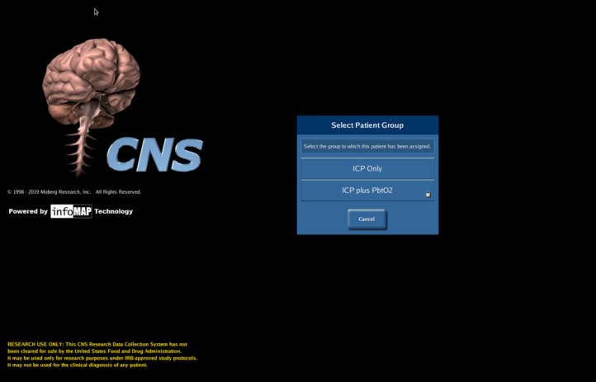
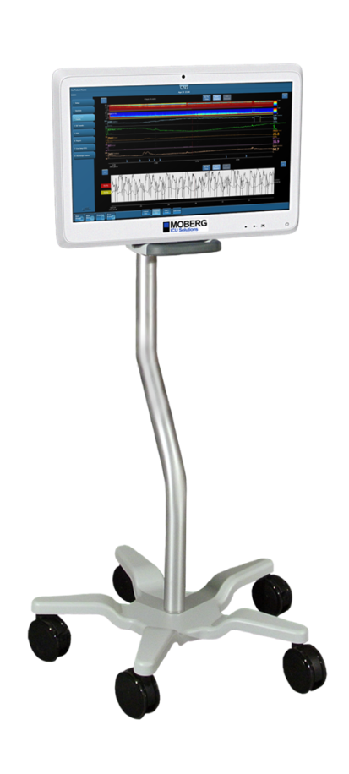
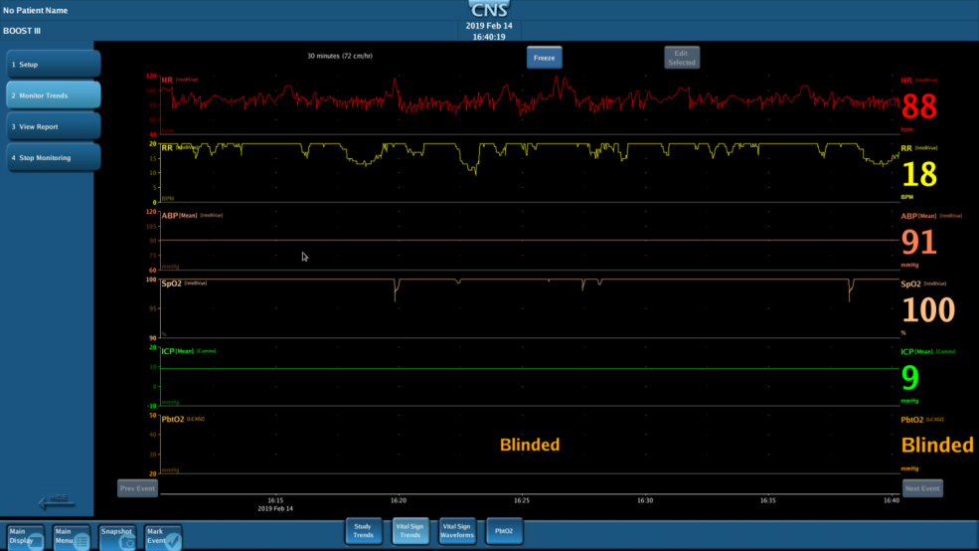
Data Capture

Slide 74
Breaks
Moberg monitor training
  Sign up sheet at the Moberg desk for training
Integra monitoring
Raumedic monitoring
PLEASE USE THE BREAK TIME TO STOP BY THE DIFFERENT STATIONS

Slide 75
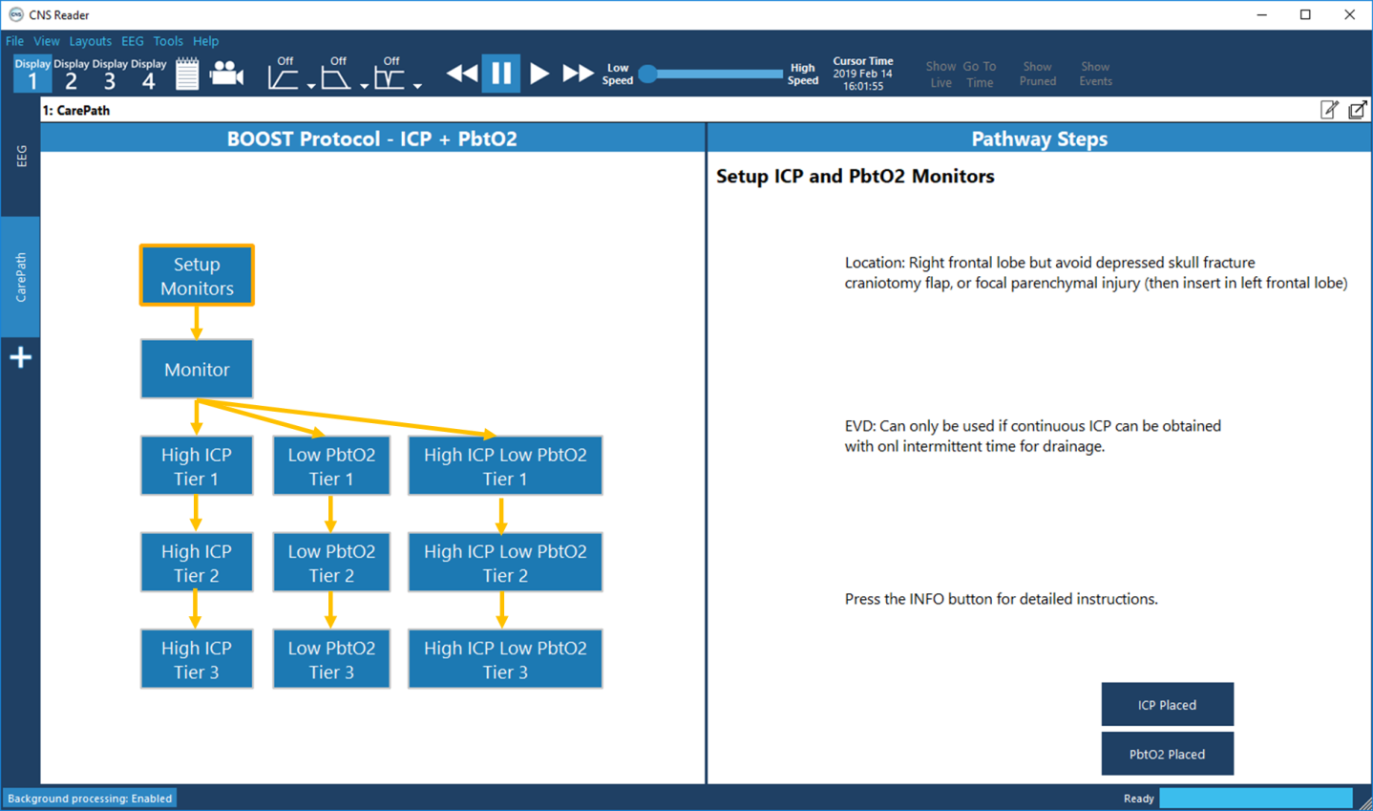
Data Capture

Slide 76
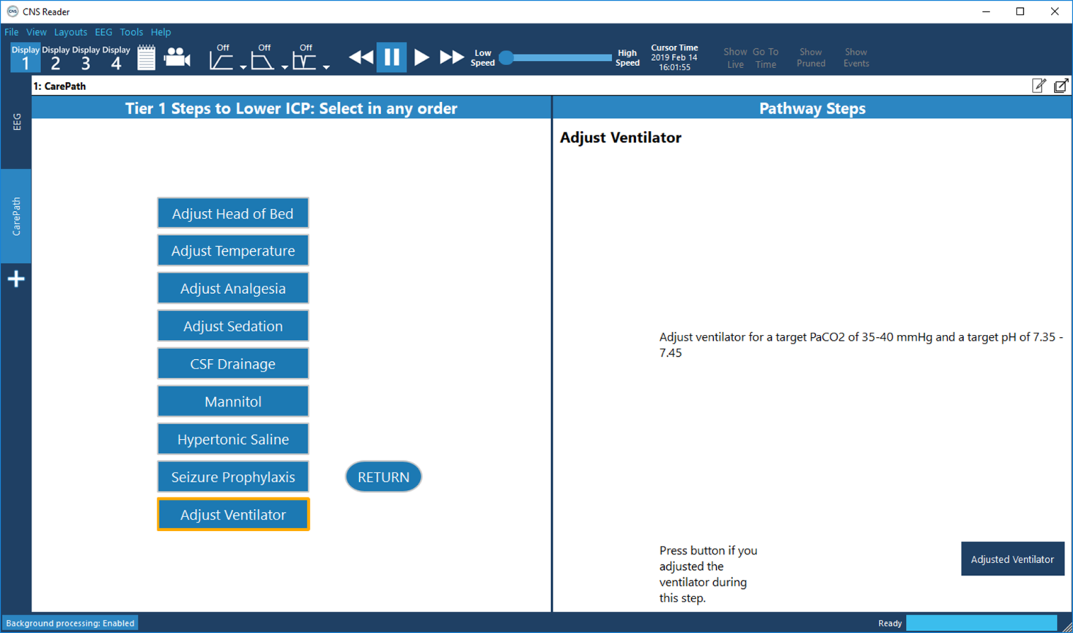
Data Capture

Slide 77
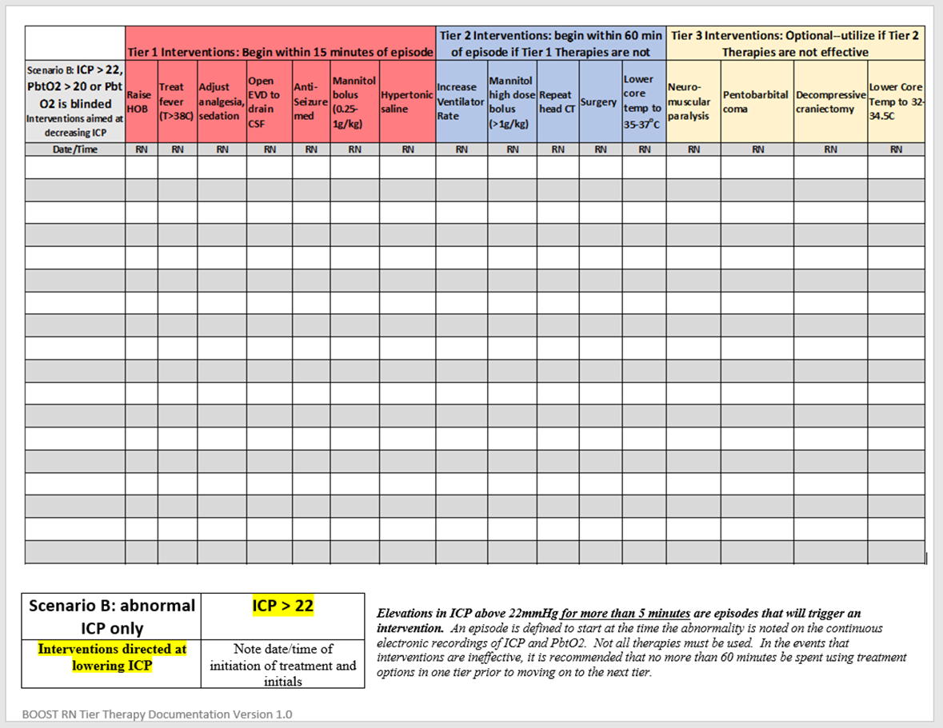
Documentation of Tier Treatments
Notes:
Treatment interventions triggered by elevations in ICP and/or decreases in PbtO2 will be recorded by the ICU nurses in bedside flow sheets, and study coordinators will transfer information about those interventions into WebDCU. Furthermore, the time the abnormality was noted by nursing staff and the time the intervention started will also be recorded in the medical record, with the goal of an intervention initiation within 15 minutes of onset of the event. Data to be collected includes information regarding the efficacy of the intervention in reversing the abnormal physiologic parameter. Pertinent information from the ICU flow chart, as well as the continuous record of ICP and PbtO2, will be collected daily by the study coordinators and will become a source document for the study.
77

Slide 78
Clinical Site Responsibilities for Data Review & Annotations
Analysis of continuous ICP and PbtO₂ data will be an important secondary analysis of BOOST-3.
Investigators at the clinical sites (or their designees as needed to maintain blinding) should review the continuous ICP and PbtO₂ data at least daily to ensure that it is clean and free of artifacts.
  In order to maintain blinding for those in the ICP-only group, these daily reviews should take place in such a manner that others do not see the PbtO₂ data.
  Periods when such data is artifactual should be annotated using software tools in the Moberg CNS monitor by the research team.
  Research coordinators should review the clinical chart and query bedside nurses to confirm times when the patient was disconnected and identify explanations for periods of artifactual data.
At the end of the monitoring period, after the continuous physiologic data is fully cleaned and annotated, it should be uploaded to the secure web server.
Notes:
Data may be artifactual as a consequence of the patient being disconnected from the monitors for transport to an imaging study or other procedure or noisy due to equipment malfunction or other technical issue

Slide 79
EEG Monitoring
EEG monitoring is not required for research purposes.
Sites may use continuous video EEG (cvEEG) monitoring to manage severe TBI patients, or may use EEG monitoring on an as needed basis (i.e monitoring 30 - 60+ minutes at a time, when clinically indicated).
  In both settings, treatment of seizures will be according to clinical protocols at each site, and information about anti-epileptic treatments will be recorded in CRFs.

Slide 80
Who to Contact?
For immediate emergency assistance (enrollment, clinical, protocol, adverse events, etc.), please use the 24/7 BOOST-3 Principal Investigator Hotline:
855-4-BOOST3 (855-426-6783)
Clinical questions for BOOST3 trial PIs: boost-PIs@umich.edu
For non-urgent data entry/WebDCU questions call: 1-866-450-2016
For all other non-urgent questions: boost-contact@umich.edu
For all email communications, please include BOOST-3 at the beginning of the subject line.

Slide 81

QUESTIONS?

