Slide 1


Brain Oxygen Optimization in Severe TBI--Phase 3
Protocol Introduction and Scientific Rationale
Ramon Diaz-Arrastia, MD, PhD
Professor of Neurology, University of Pennsylvania
BOOST-3 Study Chair

Slide 2
Does BOOSTing Cerebral Oxygenation Boost TBI Outcomes?
We don’t know
The question belies the complexity of the answer
  It is likely that increasing cerebral oxygenation is helpful in some cases but not in others
  In some cases, increasing cerebral oxygenation may be harmful
  Cerebral blood flow and cerebral oxygen utilization is highly dynamic in critically ill patients
  It is critical to understand the endophenotypes of brain tissue hypoxia

Slide 3
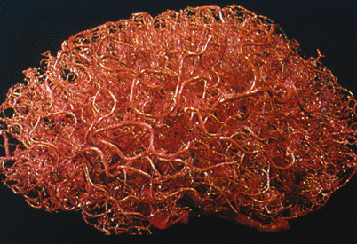
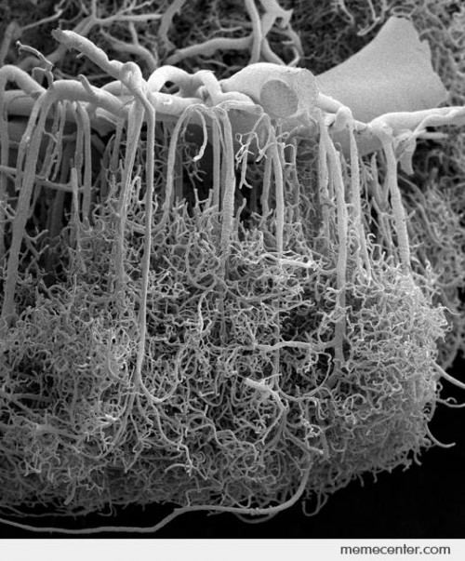
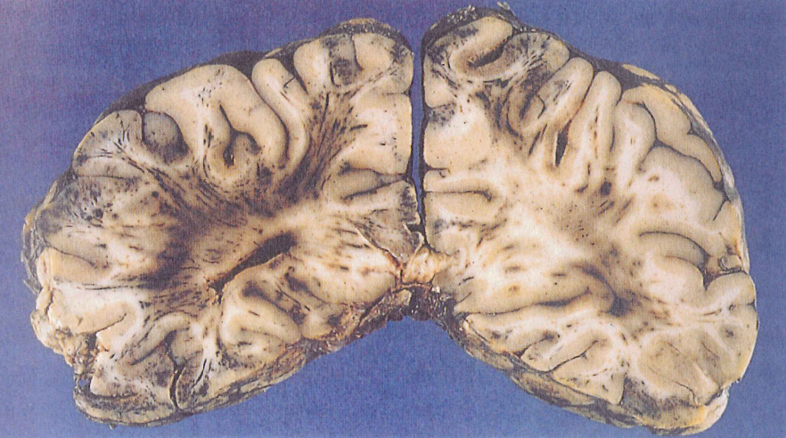
Anatomy of Cerebral Microvasculature
Zlokovic et al, Neurosurgery 43(4):877-878, 1998.
Reina de la Torre, et al Anat Record 1998;251:87-96
PC Blumbergs, in Reilly & Bullock, Head Injury, 2nd Ed, 2005
Notes:
I do not have to remind this audience that the brain is the most highly vascular organ in the body. It is said that “every neuron has its own personal capillary”, and exquisite coupling of blood flow to metabolic demand is essential for normal brain functioning.
The anatomy of the blood supply to the brain makes it very susceptible to the shearing and stretching forces that occur during a traumatic brain injury.
[POINT OUT RIGHT SIDED FIGURE]
The capillary bed that supplies the cortex is supplied by arterioles that come off orthogonally from vessels running in the subarachnoid space and pierce the pial membranes to enter the brain, thus traversing environments of different densities.
[POINT OUT LOWER FIGURE] It has been recognized for many decades that traumatic brain injury results in a diffuse microvasculopathy, as shows here in this gross specimen from a lethal case of TBI. Lower degrees of traumatic microvascular injury also occur in milder TBIs, including some cases of concussion.

Slide 4
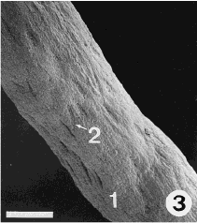
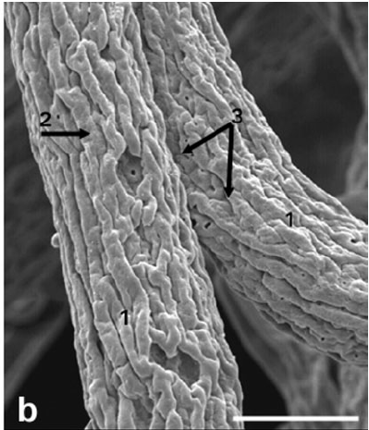
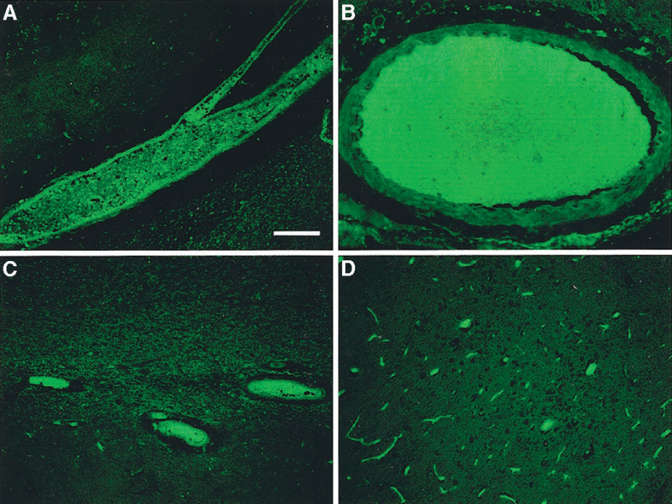
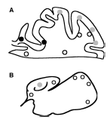
Microscopic Pathology of Diffuse Vascular Injury after TBI
Control
TBI
Rodriguez-Baeza, et al Anat Record 1998;252:176-184
Rodriguez-Baeza, et al Anat Record 2003;273A:583-593
Stein et al, J. Neurosurg 97:1373-1377 (2002)
Stein et al, Neurosurg 54:687-691 (2004)
Notes:
At a microscopic level, there is diffuse and multifocal endothelial injury and microthrombosis.
[POINT OUT UPPER FIGURES] In a normal individual, the endothelial wall of the pre-capillary arterioles is smooth, with small pits representing the tight junctions that are part of the blood brain barrier. In a patient who died several days after a severe TBI, the smooth endothelium is damaged, thickened, with prominent folds, pits, and leaky barrier.
[POINT OUT LOWER FIGURES] Using immunohistochemistry to anti-thrombin III, diffuse microthrombosis are readily demonstrated, in most cases at sites distant from grossly visible contusions.

Slide 5
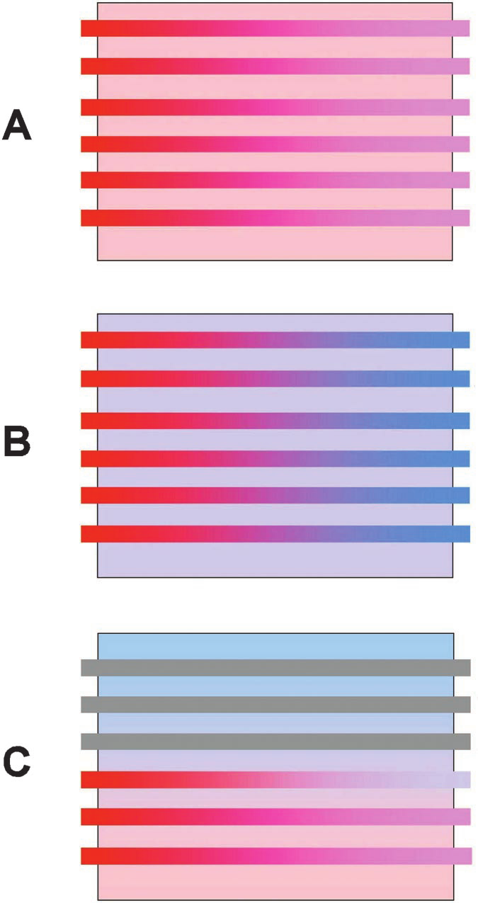
Macrocirculatory vs. Microcirculatory Hypoxia
Normal condition. Oxygenated blood delivers O₂ to tissue. PaO₂ and PtO₂ equilibrated
Macrocirculatory ischemia (classical ischemia). Hypotension of large vessel stenosis reduces blood entering capillaries. Tissue extracts higher fraction of O₂ from blood, but remains ischemic
Microcirculatory ischemia (diffusion hypoxia). Patchy microvascular collapse or occlusion results in increased gradient between blood O₂ and tissue O₂
Menon et al, Crit Care Med 2004;32:1384-1390

Slide 6
Macrocirculatory vs. Microcirculatory Hypoxia
Veenith et al, JAMA Neurol 2016;73(5):542-550

Slide 7
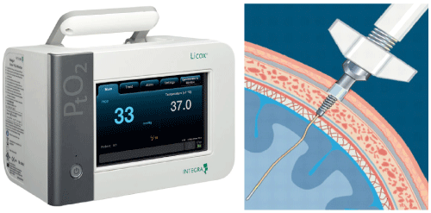
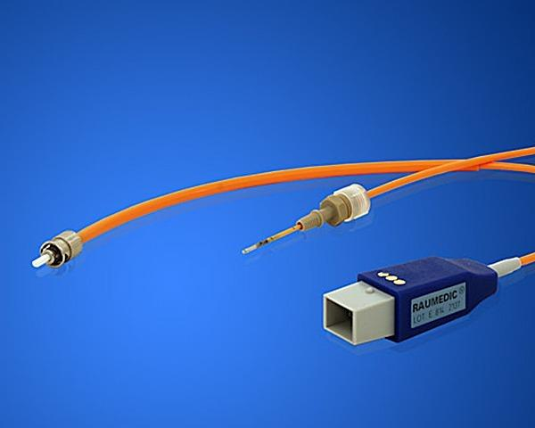
Brain Tissue Oxygen Monitors
FDA-approved November, 2000
Measures PbtO₂ in mm³ region around tip of catheter
No Class I data that it improves outcome
Variable penetrance of utilization in NICU

Slide 8
Rationale for PbtO₂ monitoring
Episodes of low PbtO₂ are common after TBI
  Van den Brink et al¹ (2000)
    101 patients monitored average 86 hours
    57% had values < 15 mm Hg
    42% had values < 10 mm Hg
    22% had values < 5 mm Hg
  Longhi et al² (2007)
    Episodes PbtO2 10 - 19 mm Hg in 23% of time
      Median duration 50 minutes
    Episodes PbtO2 < 10 mm Hg 11% of the time
      Median duration 39 minutes
van den Brink WA, et al, Neurosurgery 2000; 46:868-878.
Longhi L, et al, Intensive Care Med 2007; 33(12):2136-2142.

Slide 9
Rationale for PbtO₂ monitoring
Low PbtO₂ is associated with poor neurological outcome
Study (First Author, # of patients evaluable) | Hypoxia |  | No Hypoxia |  | Odds Ratio (95% C.I.)
 | Unfavorable Outcome (n) | Favorable Outcome (n) | Unfavorable Outcome (n) | Favorable Outcome (n)
Van den Brink 2000 (n = 99) | 29 | 14 | 24 | 32 | 3.8 (1.6 – 8.4)
Bardt et al 1998 (n = 35) | 18 | 5 | 3 | 9 | 10.8 (2.1 – 55.7)
Chang et al 2009 (n = 25) | 6 | 1 | 7 | 11 | 9.43 (1.1 – 95.9)
van den Brink WA, et al Neurosurgery 2000; 46:868-878
Bardt TF, et al, Acta Neurochir 1998; Suppl. 71:153-156
Chang J, et al, Crit Care Med 2009;37:283-290

Slide 10
Association of Brain Tissue Hypoxia with
Poor functional Outcome
Chang et al, Crit Care Med 2009;37:283-290

Slide 11
Association of Brain Tissue Hypoxia with
Poor functional Outcome
Chang et al, Crit Care Med 2009;37:283-290

Slide 12
Rationale for PbtO₂ monitoring
Interventions can rectify low PbtO₂
  Normobaric hyperoxia
    Tolias et al (2004)
      Increases PbtO₂ and decreases microdialysate glutamate and lactate levels
    Nortje et al (2008)
      Increases PbtO₂ and decreases microdialysate L/P ratio, increases CMRO₂ in physiologic region of interest
Tolias, CM, et al, J Neurosurgery 2004; 101:435-444.
Nortje J, et al, Crit Care Med 2008; 36(1):273-280.

Slide 13
Rationale for PbtO₂ monitoring
Interventions can rectify low PbtO₂
  CPP Augmentation
    Johnston et al (2004)
      Norepinepherine increases PbtO₂ and decreases A-V ΔO₂
    Johnston et al (2005)
      Norepinepherine increases PbtO₂ and decreases OEF in ¹⁵O-PET studies
      Linear relationship between PbtO₂ and OEF
  RBC Transfusion
    Zygun et al (2009)
      Increased PbtO2 in 57% of patients
      No change in microdialysate lactate/pyruvate ratio
Johnston AJ, et al, Int. Care Med. 2004; 30:791-797.
Johnston AJ, et al, Crit Care Med 2005; 33(1):189-195.
Zygun DA et al, Crit Care Med 2009;37(3):1074-1078

Slide 14
Published Clinical Trials
No randomized clinical trials available
Four studies have been published
All used historical or concurrent (physician choice) controls
Study | ICP + PbtO2 |  | ICP/CPP |  | Odds Ratio
 | Poor Outcome (n) | Good Outcome (n) | Poor Outcome (n) | Good Outcome (n) | (95% CI)
McCarthy 2009 | 34 | 29 | 32 | 16 | 1.7
Meixenberger 2003 | 18 | 34 | 18 | 21 | 1.6
Narotam 2009 | 44 | 83 | 22 | 17 | 2.4
Spiotta 2010 | 25 | 45 | 32 | 21 | 2.7
Pooled Odds Ratio |  |  |  |  | 2.1 (1.4 – 3.1)
Nangunoori et al NeuroCrit Care 2012 17:131-138

Slide 15
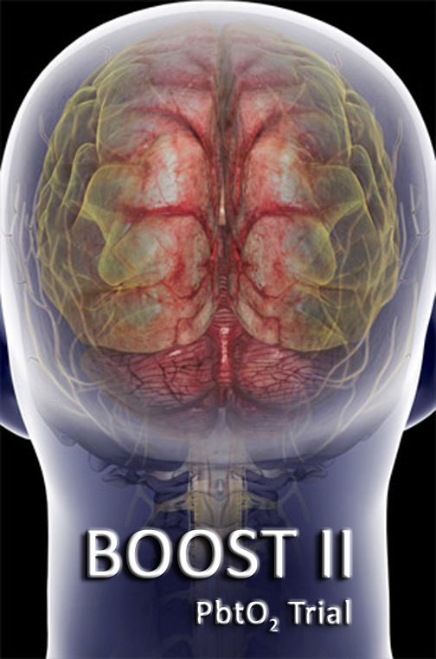
BRAIN OXYGEN AND OUTCOME IN SEVERE TRAUMATIC BRAIN INJURY: PHASE 2
BOOST 2

Slide 16
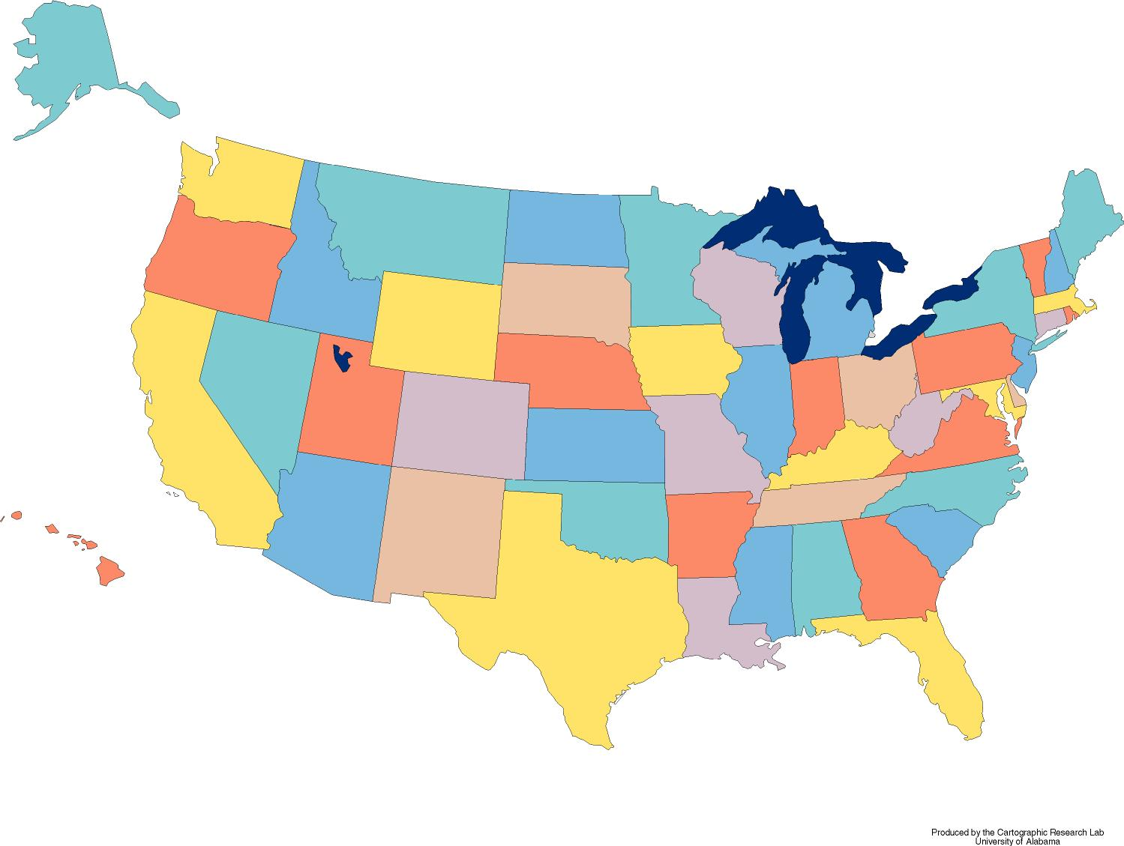
BOOST-2 Study Sites
University of Washington
University of Pittsburgh
Ohio State University
University of Pennsylvania
Thomas Jefferson Univ.
Temple University
University of Cincinnati
Duke University
University of Texas Southwestern
University of Miami

Slide 17
Study Schematic
Patient meets inclusion/exclusion criteria and proxy signs consent
Randomization to treatment protocol based on ICP monitoring alone
Randomization to treatment protocol based on ICP and pBtO₂ monitoring
Interventions triggered by
ICP > 20 mm Hg
If all values normal, remove monitors after 48 hours or randomized monitoring time met
Interventions triggered by
ICP > 20 mm Hg or
pBtO₂< 20 mmHg
Monitors removed when patients awaken from coma, when values (ICP and pBtO₂) are normal for > 48 hours,
or when monitors have been in place for 5 days; patient’s hospital course observed
At 180 days after injury:
Glasgow Outcome Scale-Extended (GOS-E) by telephone

Slide 18
Primary and Secondary Objectives
Primary Objective: Treatment protocol informed by PbtO₂ monitoring results in reduction of brain tissue hypoxia
Secondary Objectives:
  Safety hypotheses: Adverse events associated with PbtO₂ monitoring are rare.
  Feasibility hypotheses: Episodes of decreased PbtO₂ can be identified and treatment protocol instituted comparably across clinical sites, and protocol violations will be low and uniform across different clinical sites.
  Non-futility hypothesis: Relative Risk of good outcome measured by the GOS-E 6 months after injury of 2.0 is consistent with the results of this phase II study.

Slide 19
Demographics
 | Overall | ICP Only | PbtO₂ + ICP | p
Subjects | 119 | 62 | 57
Age Mean (SD) | 37.0 (17.3) | 36.4 (17.5) | 37.7 (17.2) | .560
Sex Male (n, %) | 92 (79%) | 46 (74%) | 46 (84%) | .262
Injury Type
Closed | 118 (99%) | 62 (100%) | 56 (98%) | .479
Penetrating | 0 (0%) | 0 (0%) | 0 (0%)
Blast | 0 (0%) | 0 (0%) | 0 (0%)
Crush | 1 (1%) | 0 (0%) | 1 (2%)
GCS Motor
Mean (SD) | 3.7 (1.5) | 3.7 (1.5) | 3.6 (1.5) | .858
Okonkwo et al, Crit. Care Med 2017 Nov;45(11):1907-1914
Notes:
The study ended up enrolling 119 participants. It was stopped early by the DSMB for early efficacy.
Results were published late last year in Critical Care Medicine.
The two groups were evenly matched, proof that randomization worked.
Patients were in their late 30’s on average, mostly male, and almost exclusively closed head injuries. The mean GCS motor score was near 4, corresponding to non-localizing motor response.

Slide 20
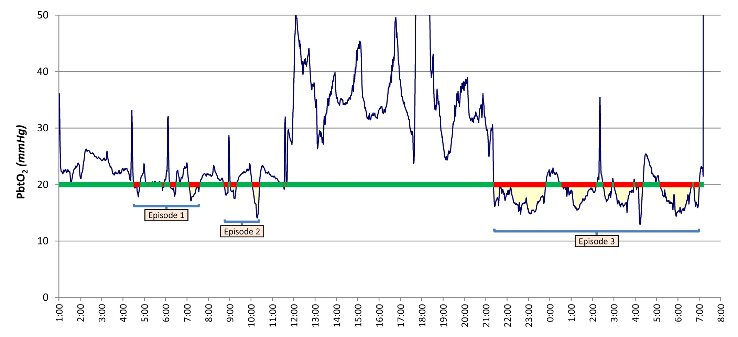
BOOST-2 Primary Outcome
Okonkwo et al, Crit. Care Med 2017 Nov;45(11):1907-1914

Slide 21
BOOST-2 Primary Outcome
PbtO₂ metric | ICP Only (N=57) | PbtO₂ + ICP (N=53) | p
Proportion of time below 20 mm Hg | .45 (.31) Median .44 | .16 (.21) Median .14 | <.00001
Average amount below 20 mm Hg | 4.0 (4.0) Median 2.7 | 1.3 (2.2) Median 0.4 | <.00001
Area [over] the curve (mm Hg*hrs) | 287 (297) Median 196 | 94 (145) Median 28 | <.00001
Okonkwo et al, Crit. Care Med 2017 Nov;45(11):1907-1914

Slide 22
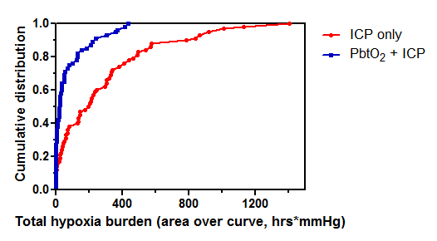
BOOST-2 Primary Outcome
Okonkwo et al, Crit. Care Med 2017 Nov;45(11):1907-1914

Slide 23
BOOST-2 Primary Outcome
ICP metric | ICP Only (N=55) | PbtO₂ + ICP (N=50) | p
Proportion of time above 20 mm Hg | .15 (.19) Median .10 | .13 (.19) Median .04 | .149
Average amount above 20 mm Hg | 1.6 (7.0)* Median 0.4 | 0.7 (1.3)* Median 0.2 | .299
Average amount above 20 mm Hg (excluding the 2 extreme outliers) | 0.6 (0.9) | 0.6 (0.8) | .311
Area under the curve (mm Hg*hrs) | 103 (108) Median 36 | 50 (88) Median 17 | .113
Area under the curve (mm Hg*Hrs) (excluding the 2 extreme outliers) | 50 (56) Median 34 | 41 (59) Median 15 | .115
Okonkwo et al, Crit. Care Med 2017 Nov;45(11):1907-1914

Slide 24
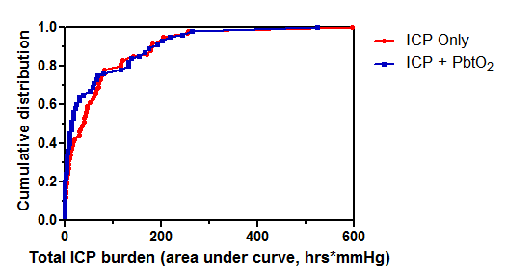
BOOST-2 Primary Outcome
Okonkwo et al, Crit. Care Med 2017 Nov;45(11):1907-1914

Slide 25
BOOST-2 Interventions
Scenario | Tier | Task# | Task | ICP Only | ICP+ PbtO₂
B | 1 | 1 | Adjust head of bed to lower ICP | 61 | 44
 |  | 2 | Ensure temperature < 38 | 72 | 33
 |  | 3 | Adjust sedation and analgesia | 324 | 181
 |  | 4 | Adjust ventilation to obtain PaCO2 between 35‐40 mmHg | 38 | 10
 |  | 5 | CSF drainage | 165 | 59
 |  | 6 | Standard dose mannitol (0.25 – 1.0 g/kg) | 63 | 23
 |  | 7 | Hypertonic saline | 70 | 26
 | 2 | 1 | Adjust ventilation to lower PaCO2 to 32‐35 mmHg. | 9 | 5
 |  | 2 | High dose mannitol (>1g/kg), or higher frequency of standard dose | 6 | 6
 |  | 3 | Repeat CT – look for increased size of intracranial mass lesions | 14 | 7
 |  | 4 | Treat surgically remediable lesions with craniotomy | 0 | 1
 |  | 5 | Adjust temperature to 35 – 37 °C | 4 | 4
 | 3 | 1 | Pentobarbital coma | 1 | 0
 |  | 2 | Decompressive craniectomy | 3 | 0
 |  | 3 | Adjust Temperature to 32 – 34.5 °C | 1 | 0
 |  | 4 | Neuromuscular paralysis | 8 | 2

Slide 26
BOOST-2 Interventions
Scenario | Tier | Task# | Task | ICP Only | ICP+ PbtO₂
C | 1 | 1 | Adjust head of bed to improve brain oxygenation |  | 36
 |  | 2 | Ensure temperature < 38 |  | 41
 |  | 3 | Increase CPP to a maximum of 70mmHg with fluid bolus |  | 27
 |  | 4 | Optimize hemodynamics |  | 25
 |  | 5 | Increase PaO2 by increasing FiO2 to 60% |  | 82
 |  | 6 | Increase PaO2 by adjusting PEEP |  | 35
 |  | 7 | Add EEG monitoring |  | 8
 |  | 8 | Add antiepileptic drug (AED) |  | 7
 | 2 | 1 | Increase PaO2 by increasing FiO2 to 100% |  | 26
 |  | 2 | Increase PaO2 by adjusting PEEP |  | 13
 |  | 3 | Increase CPP to a maximum of 70mmHg with vasopressors |  | 5
 |  | 4 | Adjust ventilation to increase PaCO2 to 45‐50 mmHg |  | 6
 |  | 5 | Transfuse packed RBCs to reach Hgb > 10g/dL |  | 4
 |  | 6 | Decrease ICP to < 10mmHg |  | 11

Slide 27
BOOST-2 Interventions
Scenario | Tier | Task# | Task | ICP Only | ICP+ PbtO₂
D | 1 | 1 | Adjust head of bed to lower ICP |  | 10
 |  | 2 | Ensure temperature < 38 |  | 15
 |  | 3 | Adjust sedation and analgesia |  | 26
 |  | 4 | CSF drainage |  | 7
 |  | 5 | Increase CPP to a maximum of 70mmHg with fluid bolus |  | 8
 |  | 6 | Standard dose mannitol (0.25 – 1.0 g/kg) |  | 1
 |  | 7 | Hypertonic saline |  | 7
 |  | 8 | Increase PaO2 by increasing FiO2 to 60% |  | 19
 |  | 9 | Increase PaO2 by adjusting PEEP |  | 6
 |  | 10 | Add EEG monitoring |  | 0
 |  | 11 | Add antiepileptic drug (AED) |  | 1
 | 2 | 1 | High dose mannitol (>1g/kg), or higher frequency of standard dose |  | 0
 |  | 2 | Increase CPP to a maximum of 70mmHg with vasopressors |  | 1
 |  | 3 | Increase PaO2 by increasing FiO2 to 100% |  | 12
 |  | 4 | Increase PaO2 by adjusting PEEP |  | 3
 |  | 5 | Transfuse packed RBCs to reach Hgb > 10g/dL |  | 1
 |  | 6 | Repeat CT – look for increased size of intracranial mass lesions |  | 2
 |  | 7 | Treat Surgically remediable lesions with Craniotomy |  | 0
 |  | 8 | Adjust Temperature to 35 – 37 °C |  | 2
 | 3 | 1 | Pentobarbital coma |  | 0
 |  | 2 | Decompressive craniectomy |  | 0
 |  | 3 | Adjust Temperature to 32 – 34.5 °C |  | 0
 |  | 4 | Neuromuscular paralysis |  | 1

Slide 28
BOOST-2 Interventions
Tier | Task# | Task | ICP | Total ICP Directed Rx
 |  |  | Only | in ICP/PbtO2 (B+D)
1 | 1 | Adjust head of bed to lower ICP | 61 | 54
 | 2 | Ensure temperature < 38 | 72 | 48
 | 3 | Adjust sedation and analgesia | 324 | 207
 | 4 | Adjust ventilation to obtain PaCO2 between 35‐40 mmHg | 38 | 17
 | 5 | CSF drainage | 165 | 67
 | 6 | Standard dose mannitol (0.25 – 1.0 g/kg) | 63 | 24
 | 7 | Hypertonic saline | 70 | 33
2 | 1 | Adjust ventilation to lower PaCO2 to 32‐35 mmHg. | 9 | 5
 | 2 | High dose mannitol (>1g/kg) | 6 | 6
 | 3 | Repeat CT – look for increased size of mass lesions | 14 | 9
 | 4 | Treat surgically remediable lesions with craniotomy | 0 | 1
 | 5 | Adjust temperature to 35 – 37 °C | 4 | 6
3 | 1 | Pentobarbital coma | 1 | 0
 | 2 | Decompressive craniectomy | 3 | 0
 | 3 | Adjust Temperature to 32 – 34.5 °C | 1 | 0
 | 4 | Neuromuscular paralysis | 8 | 3
Χ² = 26.4 , p = 0.03)

Slide 29
BOOST-2 Secondary Outcome--Safety
Serious Adverse Events by Treatment Groups | Overall | ICP Only | PbtO₂ + ICP | p
Subjects | 119 | 62 | 57
A - Cardio-Vascular | 14 (12%) | 5 (8%) | 9 (16%) | .257
B - Genito-Urinary | 0 (0%) | 0 (0%) | 0 (0%) | ---
C - Gastro-intestinal | 2 (2%) | 1 (2%) | 1 (2%) | 1.000
D - Laboratory abnormalities | 0 (0%) | 0 (0%) | 0 (0%) | ---
E - Metabolic Disorders | 0 (0%) | 0 (0%) | 0 (0%) | ---
F - Musculo-skeletal | 0 (0%) | 0 (0%) | 0 (0%) | ---
G - Neurological | 15 (13%) | 10 (16%) | 5 (9%) | .276
H - Opthamologic | 0 (0%) | 0 (0%) | 0 (0%) | ---
I - Respiratory | 5 (4%) | 1 (2%) | 4 (7%) | .192
J - Skin | 0 (0%) | 0 (0%) | 0 (0%) | ---
K - Other | 25 (21%) | 17 (27%) | 8 (14%) | .114
Death following w/d of medical care | 22 (18%) | 14 (23%) | 8 (14%) | .248
Other* | 3 (3%) | 3 (5%) | 0 (0%) | .245
Okonkwo et al, Crit. Care Med 2017 Nov;45(11):1907-1914

Slide 30
BOOST-2 Secondary Outcome
--Feasibility
 | Overall | ICP Only | PbtO₂ + ICP
Total | 166 | 71 | 95
Deviation: ICP 20-25 for >30 min. | 104 | 57 | 47
Deviation: pBtO2 15-19 for >30 min. | 24 | 0 | 24
Violation: ICP >25 for >30 min. | 21 | 14 | 7
Violation: pBtO2 <15 for >30 min. | 17 | 0 | 17
Okonkwo et al, Crit. Care Med 2017 Nov;45(11):1907-1914

Slide 31
BOOST-2 Secondary Outcome--Non-futility
 | ICP Only (N=62) | PbtO₂ + ICP (N=57) | p
Followed at 6 Months | 52 (84%) | 53 (93%) | 0.159 (Fisher-Exact)
GOS-E Mean (SD) | 3.4 (2.2) | 4.2 (2.5) | 0.111 (Mann-Whitney)
1 - Dead | 18 (35%) | 13 (25%) | OR = 1.8 (95% CI 0.78 – 4.14) p = 0.221 (Fisher-Exact)
2 - Vegetative State | 2 (4%) | 1 (2%)
3 - Lower Severe Disability | 5 (10%) | 7 (13%)
4 - Upper Severity Disability | 12 (23%) | 10 (19%)
5 - Lower Moderate Disability | 4 (8%) | 4 (8%)
6 - Upper Moderate Disability | 5 (10%) | 5 (9%)
7 - Lower Good Recovery | 4 (8%) | 6 (11%)
8 - Upper Good Recovery | 2 (4%) | 7 (13%)
Okonkwo et al, Crit. Care Med 2017 Nov;45(11):1907-1914

Slide 32
BOOST-2 Secondary Outcome
--Non-futility
Okonkwo et al, Crit. Care Med 2017 Nov;45(11):1907-1914

Slide 33
















Slide 34



Brain Oxygen Optimization in Severe TBI-Phase 3 (BOOST-3)
William Barsan, MD, Contact PI, CCC SIREN
Ramon Diaz-Arrastia, MD, PhD, Scientific PI
Lori Shutter, MD, Clinical PI
Sharon Yeatts, PhD, Statistical PI, DCC SIREN

Slide 35
BOOST-Phase 3
Approved by NINDS Council 9/2017
Target enrollment 1094
  Sufficient to detect a 10% absolute improvement in good outcome
  GOS-E Sliding Dichotomy
Planned 45 sites
In collaboration with SIREN Network

Slide 36
Primary Objective
To determine whether the prescribed treatment protocol, informed by PbtO₂ monitoring, results in improved neurologic outcome measured by the Glasgow Outcome Scale-Extended (GOS-E) 6 months after injury compared to treatment based on intracranial pressure (ICP) monitoring only.

Slide 37
Secondary Objectives
To determine whether treatment informed by PbtO2 monitoring improves functional, cognitive, and behavioral outcome at 6 months
Safety objective: To determine whether adverse events and serious adverse events associated with PbtO2 and ICP directed therapy are different from adverse events and serious adverse events for therapy directed only at ICP
To determine whether treatment informed by PbtO2 monitoring improves survival at discharge
To determine whether treatment informed by PbtO2 monitoring reduces total brain hypoxia exposure, measured by the area under the PbtO2 curve below 20 mmHg
To determine whether total brain hypoxia exposure is correlated with worse neurological outcome as measured with the GOS-E
To determine whether total brain hypoxia time is independently correlated with worse neurological outcome as measured by the GOS-E, mortality, and quantified by a composite outcome measure based on functional, cognitive, and behavioral assessments.

Slide 38
Inclusion Criteria
Criteria | Rationale | Metric
1. Non-penetrating traumatic brain injury (TBI) | Primarily focal mechanism of injury; study focuses on diffuse injury | CT scan
2. Requirement for intracranial pressure monitoring, based on BTF / ACS TQIP Guidelines for the Management of Severe TBI, as operationalized below: | Sufficiently severe TBI to warrant invasive intracranial monitoring | GCS / CT scan
A. GCS 3-8 (measured off paralytics) (In intubated patients, GCS Motor score < 6) |  | GCS
B. Evidence of intracranial trauma on CT scan. |  | CT scan. Corresponds to Marshall Score > 1
C. If patient has a witnessed seizure, wait 30 min to evaluate GCS | Post-ictal period may mimic severe TBI but be rapidly reversible | Pre-hospital, ED, and ICU chart
3. Able to place intracranial monitors and randomize within 6 hours of arrival at enrolling hospital, but no later than 12 hours from injury | Treatment of brain tissue hypoxia in first several hours after injury likely influence outcome | Pre-hospital, ED, and ICU chart
4. Males and females ages >14 | Cerebral autoregulation different prior to puberty | Demographic history
5. Fluency in a language by the LAR and patient allowing consent and interview at 6 month follow-up | Ability to obtain informed consent and outcome information | Demographic history

Slide 39
Exclusion Criteria
Criteria | Rationale | Metric
1. Bilaterally absent pupillary response in the absence of paralytic medication | Excessively high risk of unfavorable outcome | Physical exam
2. Contraindication to the placement of parenchymal monitors, such as uncorrectable coagulopathy | Need to safely insert intracranial monitors | INR; Platelet count
3. Treatment via PbtO₂ monitor prior to randomization (monitor can be placed prior to randomization, but readings must be masked to clinical team) | Contamination of group assigned to ICP-only treatment | ICU chart
4. Planned use of devices which may unblind treating physicians as to brain tissue hypoxia (such devices are listed in the Clinical Standardization Guideline or Physiological Intervention Protocol) | High correlation between information from CBF monitors and PbtO₂ monitor | ICU chart; Physical exam
5. Clinical, demographic, or other characteristic that precludes appropriate diagnosis, treatment, or follow-up
A. Systemic sepsis at screening | High risk of infection of intracranial monitors | ICU chart
B. Refractory hypotension (SBP < 90 mmHg for two consecutive readings at least 5 minutes apart any time prior to randomization) | High risk of irreversible hypoxic/ischemic brain injury | Pre-hospital, ED, and ICU chart
C. Refractory systemic hypoxia (SaO₂ < 90% or F_{i}O₂ > 0.5 for two consecutive readings at least 5 minutes apart any time prior to randomization) | High risk of irreversible hypoxic/ischemic brain injury | Pre-hospital, ED, and ICU chart
D. PaO₂/FiO₂ ratio < 200 | Severe pulmonary injury making it difficult to sustain systemic and brain oxygenation | ICU chart, arterial blood gas results

Slide 40
Exclusion Criteria
Criteria | Rationale | Metric
E. Pre-existing neurologic disease (e.g. TBI, stroke, or neurodegenerative disorder) with confounding residual neurologic deficits | Minimize confounding effect of neurologic disability prior to index TBI | Medical history
F. Inability to perform activities of daily living (ADL) without assistance prior to injury | Minimize confounding effect of neurologic disability prior to index TBI | Medical history
G. Known active drug or alcohol dependence that, in the opinion of site investigator, would interfere with physiological response to PbtO₂ treatments | Withdrawal from alcohol or other psychoactive drugs may interfere with treatment interventions | Medical history, physical exam
H. Non-survivable injury (e.g. withdrawal of care prior to randomization, no intention for aggressive intervention, on hospice or DNR order etc.) | Excessively high risk of unfavorable outcome | Physical exam
I. Pregnancy | Unknown effects of PbtO₂ directed interventions on fetus | Medical history; pregnancy test
J. Prisoner or ward of the state | Inability to provide consent | History
4.2.6. Patient listed on EFIC opt-out registry for study | Inability to obtain consent through EFIC procedure | EFIC opt-out registry
Notes:
Point out change in protocol—We will not have an “opt-out” registry. This was left in as an oversight.
Dr. Silbergleit can discuss why an opt-out registry is not appropriate for this study.

Slide 41
Types of events |  | ICP < 22 | ICP > 22
PbtO₂ > 20 |  | Type A No interventions directed at PbtO₂ or ICP needed | Type B Interventions directed at lowering ICP
PbtO₂ < 20 |  | Type C Interventions directed at increasing pBtO₂ | Type D Interventions directed at lowering ICP and increasing pBtO₂

Slide 42
B: Isolated ICP increase | C: Isolated PbtO₂ drop | D: ICP increase + PbtO₂ drop
TIER 1 Adjust head of the bed to lower ICP. Ensure Temperature < 38 ºC. Adjust pharmacological analgesia: Titrate to effect. Adjust pharmacological sedation: Titrate to effect. CSF drainage (if EVD available). Titrate to effect. Either continuous or intermittent CSF drainage is allowed per site protocol. Low dose Mannitol (0.25 – 0.5 g/kg), titrate to ICP control and maintain Sosm < 320 mOsm or Ogap <20. Hypertonic saline. Concentration of hypertonic saline should be based on local protocol. Titrate to ICP control. Titrate to effect and maintain sNa < 160 mEq/L. Initiate or titrate anti-seizure medications (AEDs). Adjust ventilator for a target PaCO2 of 35 - 40 mm Hg and target pH of 7.35 - 7.45 | TIER 1 Adjust head of the bed to improve brain oxygen level. Ensure Temperature < 38º C. Optimize hemodynamics Optimize CPP: May increase CPP up to a maximum of 70 mm Hg with fluid boluses or vasopressors as clinically appropriate. PaO2 Adjustments through any of the following treatment options. Increase FiO2: Increase FiO2 to a maximum of 60%. Adjust PEEP: Pulmonary toilet Adjust ventilatory rate to achieve a PaCO2 of 38 - 42 mm Hg while maintaining a target pH of 7.35 - 7.45. Initiate or titrate anti-seizure medications (AEDs) | TIER 1 Adjust head of the bed to lower ICP (ICP protocol dominant for HOB). Ensure Temperature < 38º C. Adjust pharmacological analgesia: Titrate to effect. Adjust pharmacological sedation: Titrate to effect. CSF drainage (if EVD available). Titrate to effect. Either continuous or intermittent CSF drainage is allowed per site protocol. Optimize hemodynamics Optimize CPP: Increase CPP up to a maximum of 70 mm Hg with fluid boluses or vasopressors Low dose Mannitol (0.25 – 0.5 g/kg), titrate to ICP control and Sosm<320 mOsm or Ogap <20. Hypertonic saline. Concentration of hypertonic saline should be based on local protocol. Titrate to ICP control. Titrate to effect and maintain sNa < 160 mEq/L. PaO2 Adjustments through any of the following options. Increase FiO2 to a maximum of 60%. Increase PEEP by a maximum of 5 cm H20 over baseline Pulmonary toileting Adjust ventilatory rate to achieve a PaCO2 of 38 - 42 , target pH of 7.35 – 7.45. Initiate or titrate anti-seizure medications (AEDs).
TIER 2 High dose Mannitol (1.0 - 1.5 g/kg), or higher frequency of lower dose mannitol (0.25 - 0.5 g/kg). May repeat if Sosm < 320 mOsm. Hypertonic saline bolus (i.e., 30 ml of 23.4%). May repeat if sNa levels are < 160 meq/l. Repeat CT to determine if increased size of intracranial mass lesions and treat surgically remediable lesions according to guidelines. Adjust temperature to 35 – 36º C, using active cooling measures. Adjust ventilator for a target PaCO2 of 33 - 38 mm Hg and target pH of 7.35 - 7.45. Neuromuscular blockade with short acting agents | TIER 2 Adjust ventilatory rate to increase PaCO2 to 40 – 45 mm Hg while maintaining a pH of 7.35 - 7.45. PaO2 Adjustments through any of the following options Increase FiO2: Increase FiO2 to a maximum of 100%. Adjust PEEP: PEEP in increments of 3 - 5 cm H₂0. Perform bronchoscopy Increase CPP above 70 mm Hg with fluid boluses or vasopressors. Neuromuscular blockade (NMB) with short acting agents Transfusion of pRBCs Decrease ICP to < 15 mm Hg. CSF drainage. Increased sedation | TIER 2. High dose Mannitol (1.0 - 1.5 g/kg), or higher frequency of lower dose mannitol (0.25 - 0.5 g/kg). May repeat if Sosm < 320 mOsm. Hypertonic saline bolus (i.e., 30 ml of 23.4%). May repeat if sNa levels are < 160 meq/l. Increase CPP above 70 mm Hg with fluid boluses or vasopressors. PaO2 Adjustments through any of the following options. Obtain arterial blood gas to confirm that oxygenation is in desired range before treating with PaO₂ adjustments. Note that increasing PaO2 above 150 mmHg might imply overtreatment by PaO2 and prevents detection of another potential true cause of low PbtO2 (eg, low CPP) Increase FiO2: Increase PaO2 by increasing FiO₂ to a maximum of 100%. Adjust PEEP: PEEP in increments of 3 - 5 cm H₂0. Monitor for any ICP response Perform bronchoscopy Transfusion of pRBCs Repeat CT and treat surgically remediable lesions according to guidelines. Adjust temperature to 35 - 36º C, using active cooling measures. Neuromuscular blockade (NMB) with short acting agents
TIER 3 (Tier 3 therapies are optional). Pentobarbital coma, according to local protocol. Decompressive craniectomy. Adjust temperature to 32-35º C, using active cooling measures. Adjust ventilatory rate for a target PaCO2 of 30 - 35 mm Hg while maintaining a pH less than 7.5 Other salvage therapy based on local protocol | TIER 3 (Tier 3 therapies are optional). Adjust ventilatory rate to increase PaCO2 to > 45 mm Hg while maintaining a target pH of 7.30 – 7.45. Increase cardiac output with inotropes (milrinone, dobutamine). Consider use of CO/CI monitoring per local protocol if starting inotropes. Assess for vasospasm with transcranial dopplers, CT angiogram, or cerebral angiogram. If present, treat with augmentation of CPP. Hyperventilation (per the CO2 challenge described on page 34) to address possible ‘reverse Robin-Hood syndrome’. Other salvage therapy based on local protocol and practice patterns. Other potential causes / interventionsonsider cortical spreading depolarization via ECog Assess for pulmonary embolism per local protocol Assess for cerebral venous thrombosis per local protocol | TIER 3. (Tier 3 therapies are optional). Pentobarbital coma, according to local protocol. Decompressive craniectomy. Adjust temperature to 32 - 35º C, using active cooling measures. Increase cardiac output with inotropes (milrinone, dobutamine). Assess for vasospasm with transcranial dopplers or cerebral angiogram. If present, treat with augmentation of CPP. Hyperventilation to address possible ‘reverse Robin-Hood syndrome’. Other salvage therapy based on local protocol and practice patterns. Other potential causes / interventions for low PbtO2 should be considered per site protocol. Consider cortical spreading depolarization via ECog Assess for pulmonary embolism per local protocol (i.e., CTA, VQ scan, etc). If present, initiate anticoagulation or obtain IVC filter. Assess for cerebral venous thrombosis per local protocol
Notes:
This is too busy a slide which I do not expect you to read, but it illustrates that the treatment protocol used was a distillation of evidence-based but PRIMARILY expert opinion representing what neurointensivists do on a daily basis when managing severley ill patients with TBI.
The protocol targets the abnormality detected at any epoch in the ICU—isolated intracranial hypertension, isolated brain tissue hypoxia, or the combination of both, since each require different (and in some cases opposite) interventions.
The protocol is pragmatic, and recognizes that the practice in the Neuro ICU is complex, and the study protocol should not seek to replicate a textbook of Neurocritical Care Medicine. The protocol was arranged in hierarchical tiers, with less intense and less dangerous interventions in Tier 1, with more intense and risky interventions in Tiers 2 and 3. Within each tier there were several options, and it was up to the staff in each ICU to choose which options to apply, baed on the clinical details of each patient.
What was tested was the protocol informed by PbtO2 and ICP data, compared to the protocol informed by only ICP data. PbtO2 was recorded in both groups, but in the ICP only group the number was masked and treating physicians were blinded to it.

Slide 43
Clinical Standardization Guidelines
Pragmatic guidelines aimed at minimizing treatment variability across study centers
Recognize the complexity and heterogeneity of TBI, and need to rely on expertise of clinician at the bedside to analyze large amount of complex data
Facilitate monitoring of adherence and assessment of efficacy of interventions

Slide 44
Differences between
BOOST-2 and BOOST-3
Primary outcome
  BOOST-2: Physiologic efficacy
  BOOST-3: Clinical efficacy (GOS-E at 6 months)
Time window for enrollment
  BOOST-2: within 12 hours of injury
  BOOST-3: within 6 hours of arrival AND < 12 hours of injury
  Use of EFIC
ICP threshold
  BOOST-3: 22 mm Hg (rather than 20)
  To reflect new BTF Guidelines
Additional training and monitoring
  Clinical Standardization Guidelines
  Physiologic Interventions

Slide 45
Exception from Informed Consent (EFIC) for Emergency Research
Regulatory Authority
  Secretarial Waiver 45CFR46.101(i)
  Requirements still at 21CFR50.24
Prior Experience
  Community Consultation
  Public Disclosure
Central IRB
Hybrid approach to enrollment
  Prospective LAR consent
  EFIC with LAR consent to continue
Implementation
  Training
  Tracking and accountability
Notes:
45CFR46.101(i) and the HHS Secretarial Waiver at FR Doc. 96–24968 versus 21CFR50.24

Slide 46
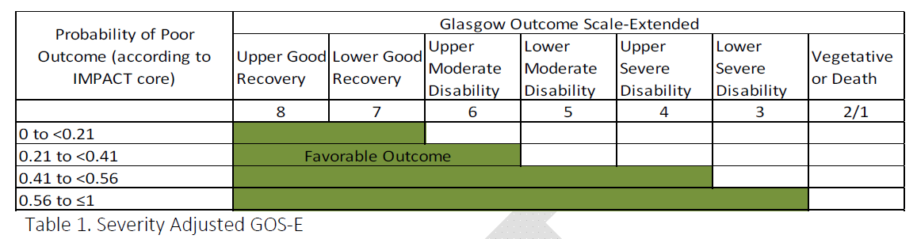
Primary Outcome
Sliding dichotomy of the Glasgow Outcome Scale - Extended

Slide 47
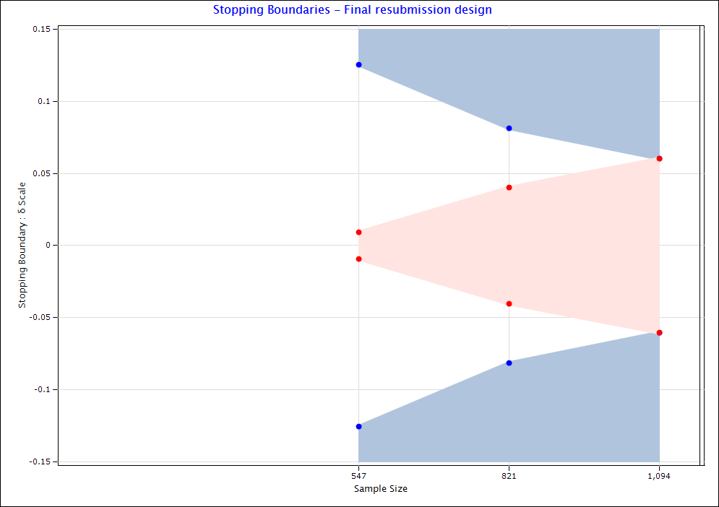
Interim Analysis
Based on error spending functions
2 planned
  1st: after the first 547 complete follow-up period
  2nd: after the first 821 complete follow-up period
12.5%
8.1%
6.0%
0.9%
4.1%

Slide 48
Conclusions
Treatment protocol informed by PbtO₂ and ICP measurements reduces duration of brain tissue hypoxia
Treatment protocol informed by PbtO₂ and ICP measurements is feasible, with modest number of protocol deviations and violations
Treatment protocol informed by PbtO₂ monitoring is consistent with reduction in mortality and increase in good recovery
Definitive Phase 3 trial will establish clinical efficacy

