Slide 1


Secondary Measures: Efficacy Measures and Neuropsychological Outcomes
Noelle E. Carlozzi, Ph.D. and Anna L. Kratz, Ph.D.
Investigator Kick-off Meeting
January 30-31, Clearwater, Florida

Slide 2
Measures
Patient Reported Outcomes (PROs)
  Quality of Life in Neurological Disorders (Neuro-QoL)
Cognitive tests
  NIH Toolbox Cognition Battery
  Traditional Neuropsychological Tests

Slide 3


Neuro-QoL PROs
What is a patient reported outcome (PRO) measure?
Notes:
Neuro-QoL (these measures are administered through Toolbox App)
Mobility (CAT)
Fine Motor/ADL (CAT)
Fatigue (CAT)
Sleep Disturbance (CAT)
Ability to Participate in Social Roles & Activities (CAT)
Satisfaction with Social Roles & Activities (CAT)
Depression (CAT)
Anxiety (CAT)
Stigma (CAT)
Positive Affect & Well-Being (CAT)
Emotional-Behavioral Dyscontrol (CAT)
Cognitive Function (CAT)
Communication (SF –there is NO CAT administration)

Slide 4

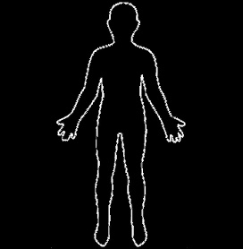

Multidimensional Assessment of Health Related Quality of Life (HRQOL)
  Depression
  Anxiety
  Emotional-Behavioral Dyscontrol
  Cognitive Function
  Positive Affect & Well-being
  Stigma
  Communication
  Mobility
  Fine Motor/ADL
  Fatigue
  Sleep Disturbance
  Ability to Participate in Social Roles and Activities
  Satisfaction with Social Roles and Activities
Mental Health
Physical Health
Social Health

Slide 5

Computer Adaptive Testing (CAT)
Few items + precise score
Notes:
Desired level of precision can be obtained using the minimal possible number of questions.
Reduced burden on the person completing the measure.

Slide 6
Item Bank
Domain = Emotional Functioning
Subdomain = Depression
Item Bank (50 items)
In the past 7 days…
  I felt sad.
  I felt depressed.
  I felt like a failure.
  I felt worthless.
  I felt that nothing could cheer me up.
  [and so on…]
1 = Never
2 = Rarely
3 = Sometimes
4 = Often
5 = Always

Slide 7
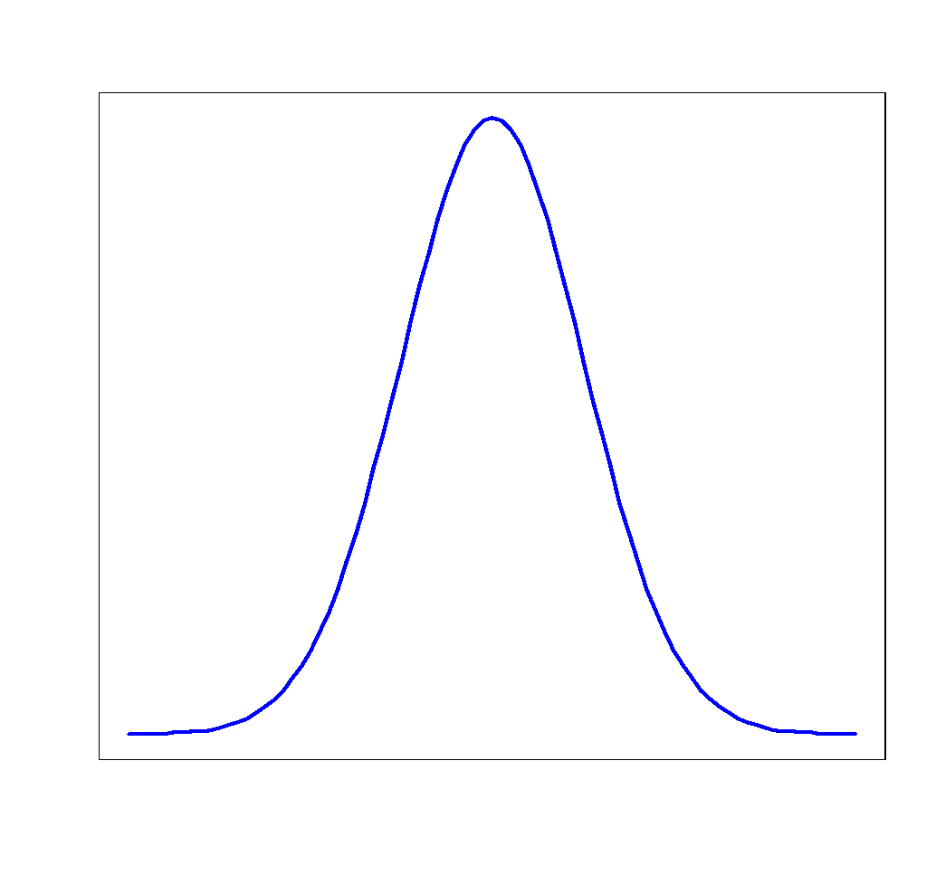
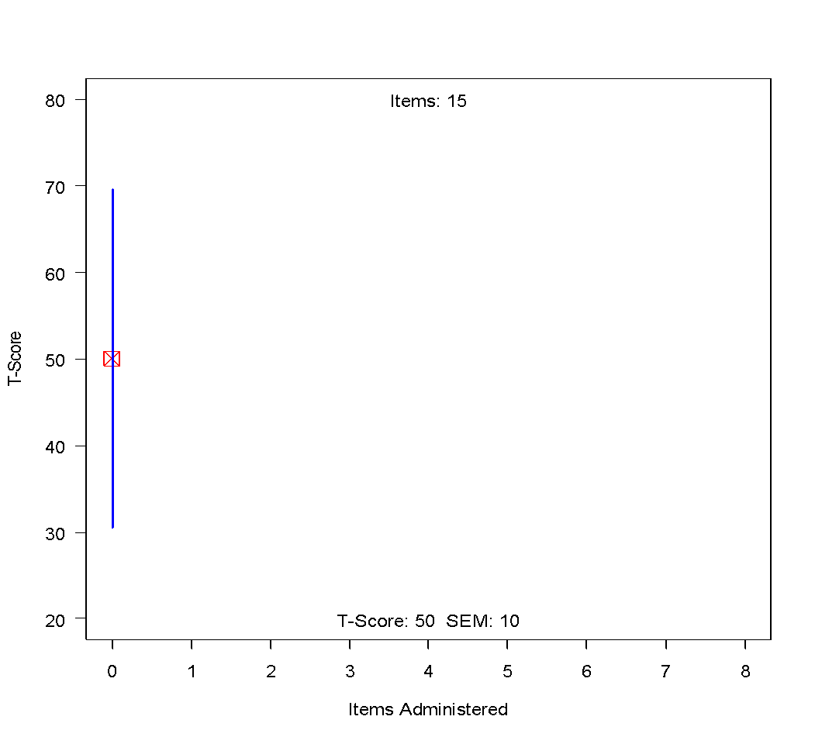
Beginning of CAT
Best 1st item: “I felt depressed”
SE = 10
T-Score = 50

Slide 8
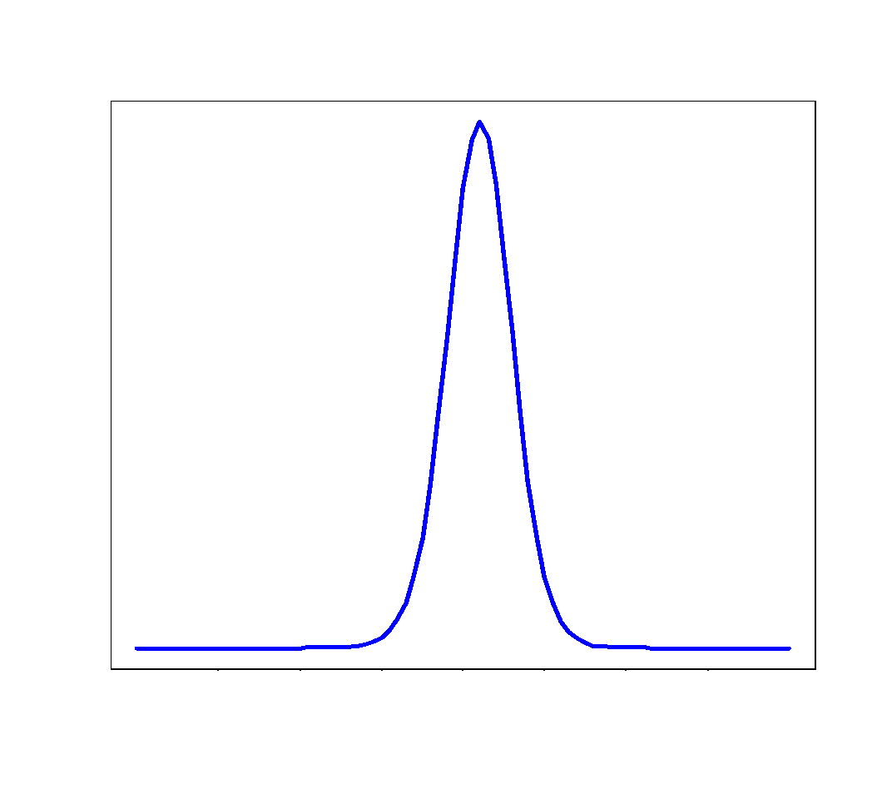
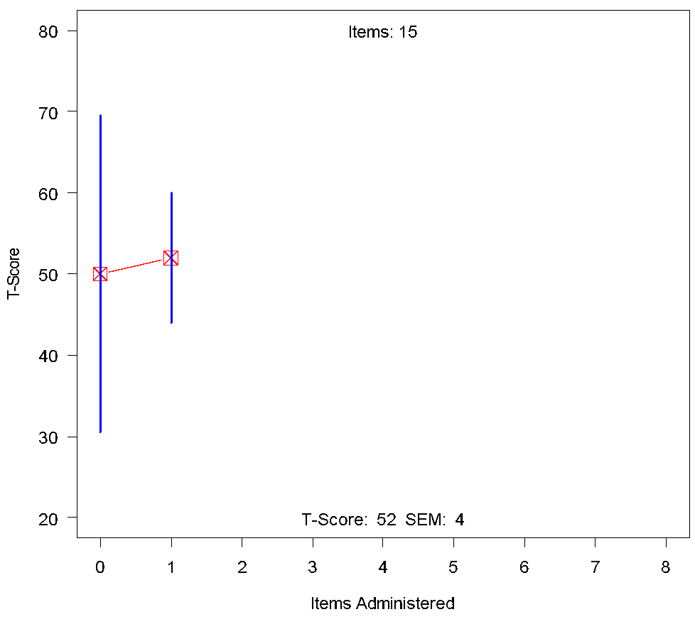
I felt depressed
  Never
  Rarely
  Sometimes
  Often
  Always
Next best item:
“I felt like a failure”
SE = 4
T-Score = 52

Slide 9
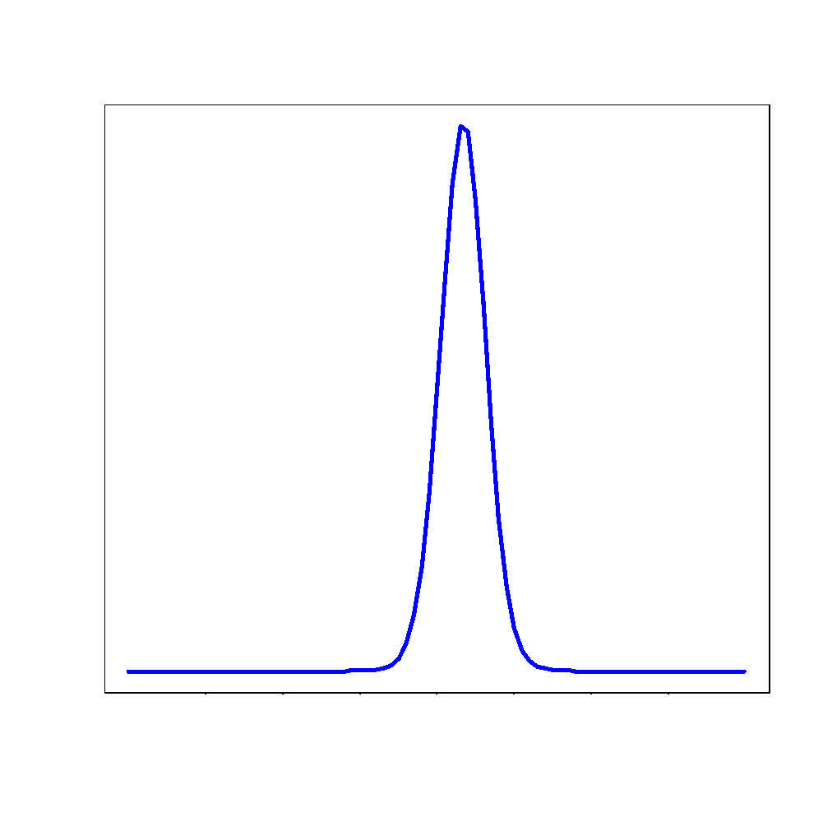
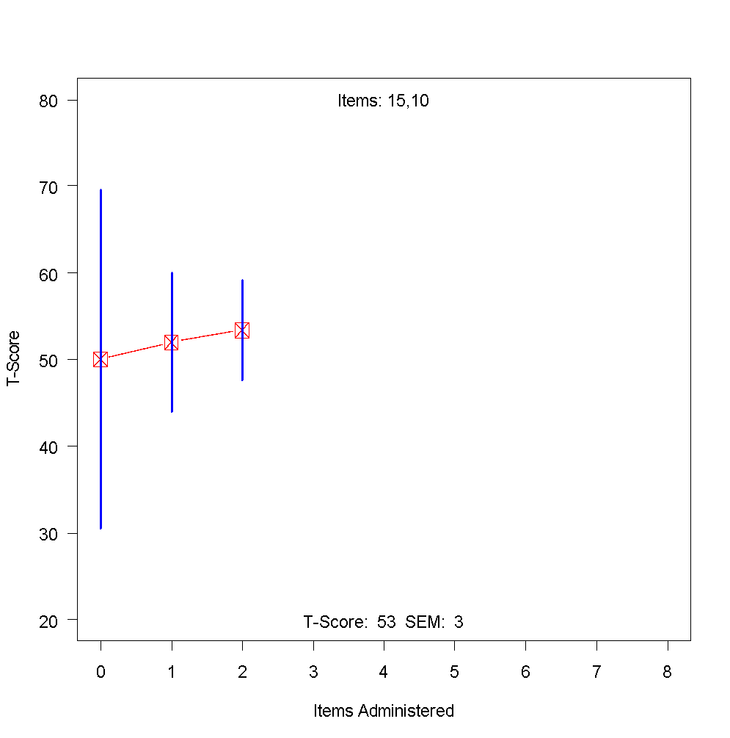
I felt like a failure
  Never
  Rarely
  Sometimes
  Often
  Always
Next best item:
“…”
SE = 3
T-Score = 53

Slide 10
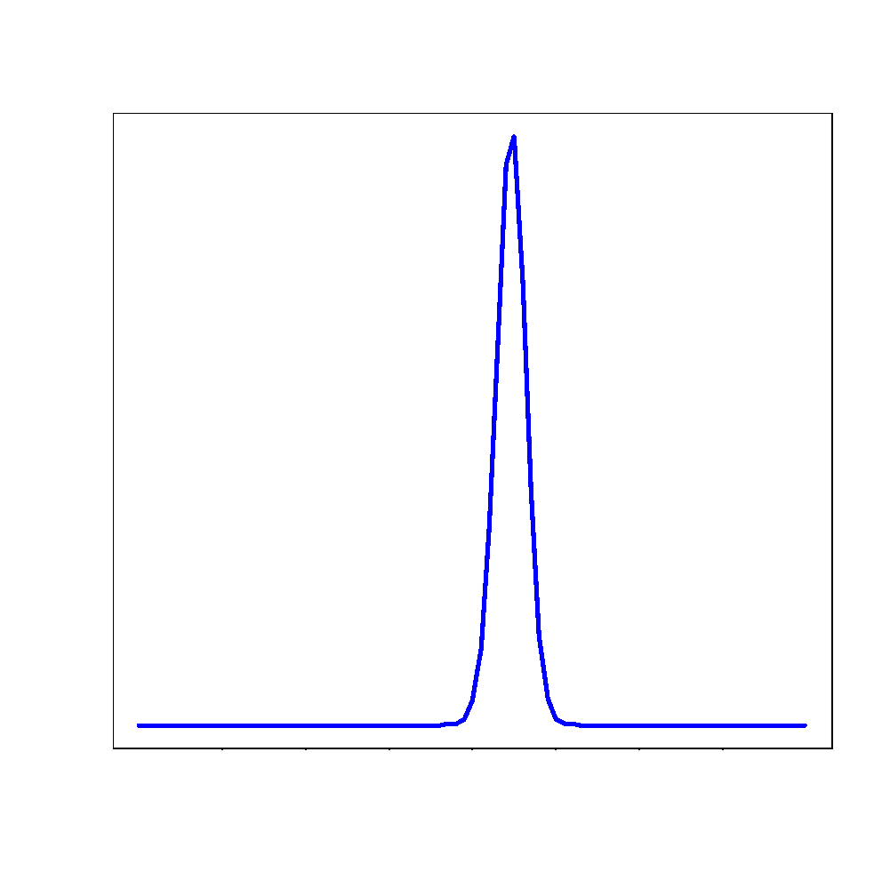
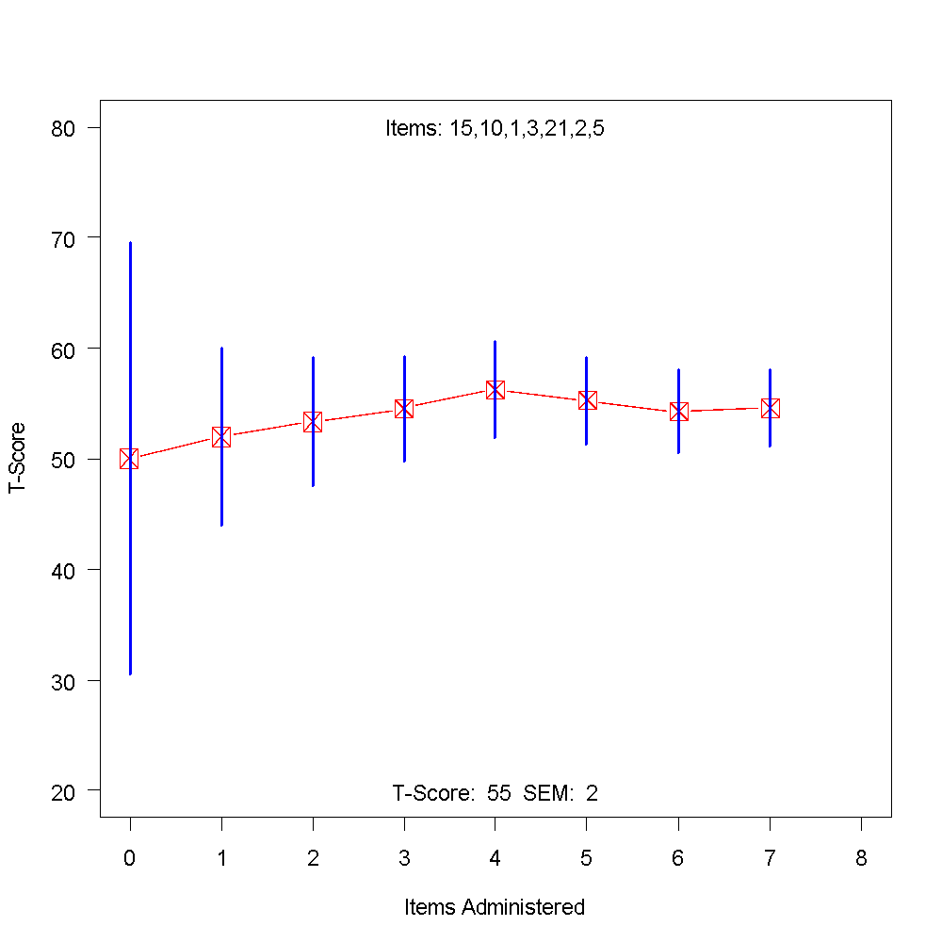
I felt that nothing could cheer me up.
  Never
  Rarely
  Sometimes
  Often
  Always
SE = 2
T-Score = 55

Slide 11

The NIH Toolbox Battery
Four 30-minute domain-level batteries
English and Spanish versions
Fully normed for ages 3-85
108 instruments in total
Cognition
Sensation
Emotion
Motor
Notes:
NIH Toolbox Cognition Battery (these measures are administered through Toolbox App)
Picture Vocabulary
Flanker
List Sorting
DCCS
Pattern Comparison
Picture Sequence Memory
Oral Reading Recognition
Oral Symbol Digit (we decided to use the Toolbox Version instead of the paper version of Digit Symbol to minimize administration burden)

Slide 12
The NIH Toolbox-Cognition Battery
Language
Attention
Working Memory
Processing Speed
Episodic Memory
Executive Function
Notes:
The NIH Toolbox Cognition Battery assesses: The mental processes involved in gaining knowledge and comprehension, such as thinking, knowing, remembering, judging, and problem-solving. These higher-level functions of the brain encompass language, imagination, perceptions, and the planning and execution of complex behaviors.

Slide 13

Picture Vocabulary
(Language)
“BABY”
Ages 3-85

Slide 14
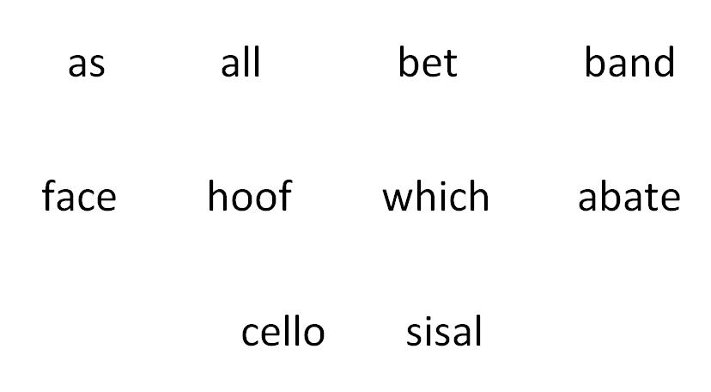
Reading Recognition
(Language)
Ages 7-85
Notes:
Task: The participant is asked to read words (or letters) as accurately as possible.
Total trials: CAT-administered (20-25 items)
Scoring: IRT-based reading level
Total time: 3 minutes
Spanish: Separate but parallel test was developed
Validation Measure:
Wide Range Achievement Test

Slide 15
List Sorting
(Working Memory)
Ages 7-85
Notes:
Task: List sequentially presented test items in order of size
(and within categories); establishes working memory span
Total trials: Test until 2 sequences of the same span size
are failed
Scoring: Total number correct
Total time: 7 minutes

Slide 16

APPLE

Slide 17
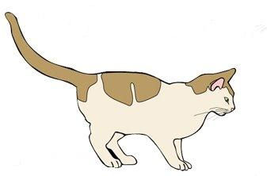
CAT

Slide 18
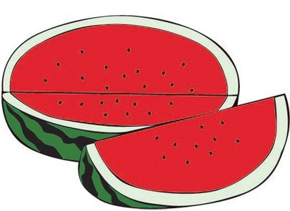
WATERMELON

Slide 19

BEAR

Slide 21
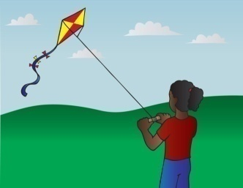

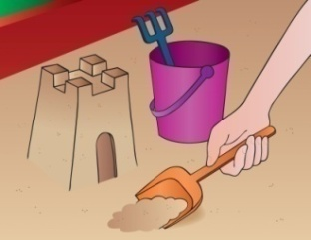
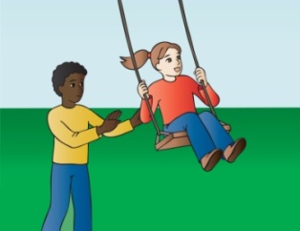
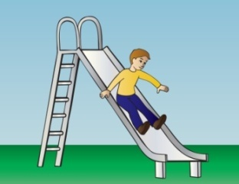
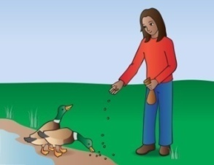
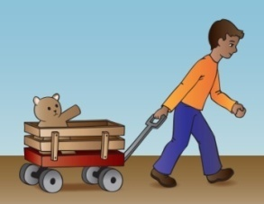
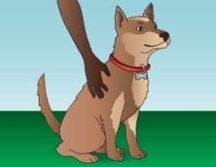
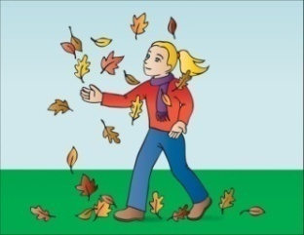
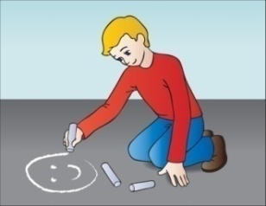
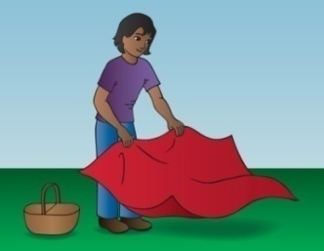


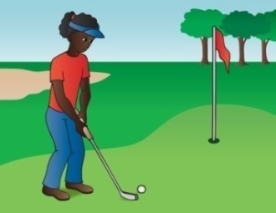
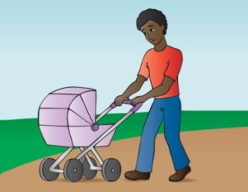
Picture Sequence Memory
(Episodic Memory)
Ages 3-85

Slide 22



Slide 23
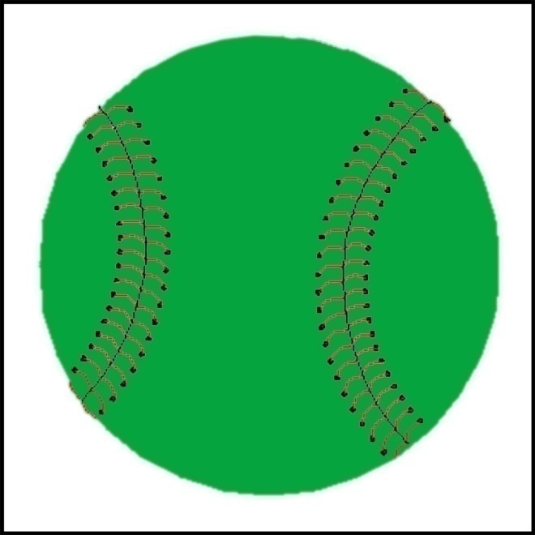
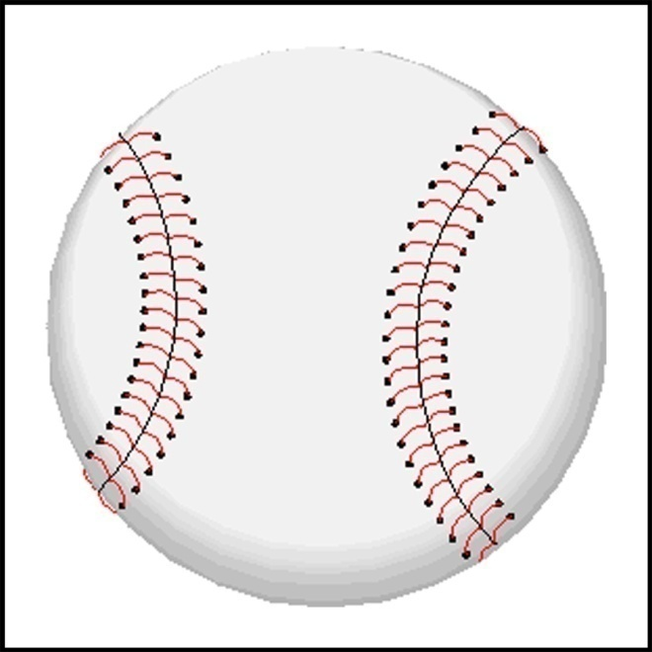
Pattern Comparison
(Processing Speed)
Are the pictures the same?
Ages 7-85
Notes:
Task: Decide as quickly as possible if two items are the
same or not
Total trials: Single
Scoring: Total number of items correctly responded to in 90
seconds
Total time: 90 seconds

Slide 24
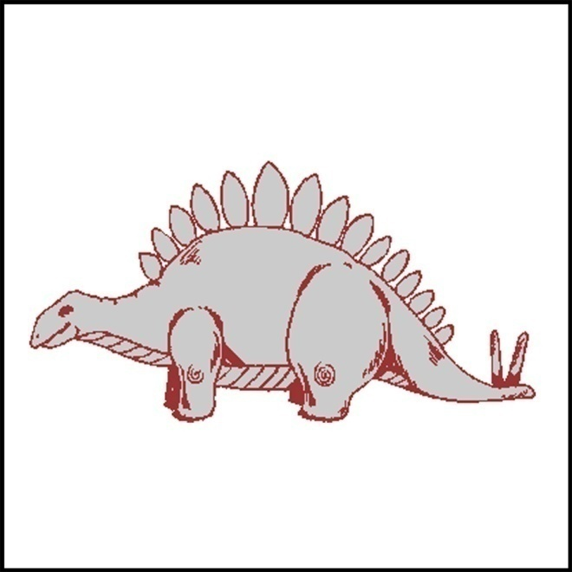
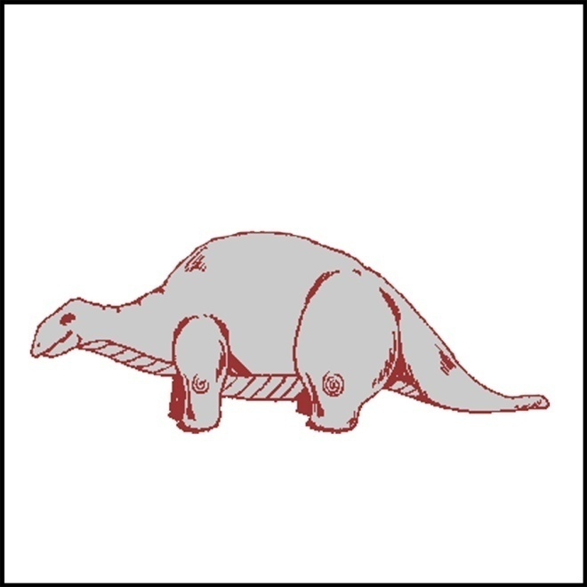
Are the pictures the same?

Slide 25


Are the pictures the same?
Notes:
Need yellow and blue to avoid color blind issues

Slide 26
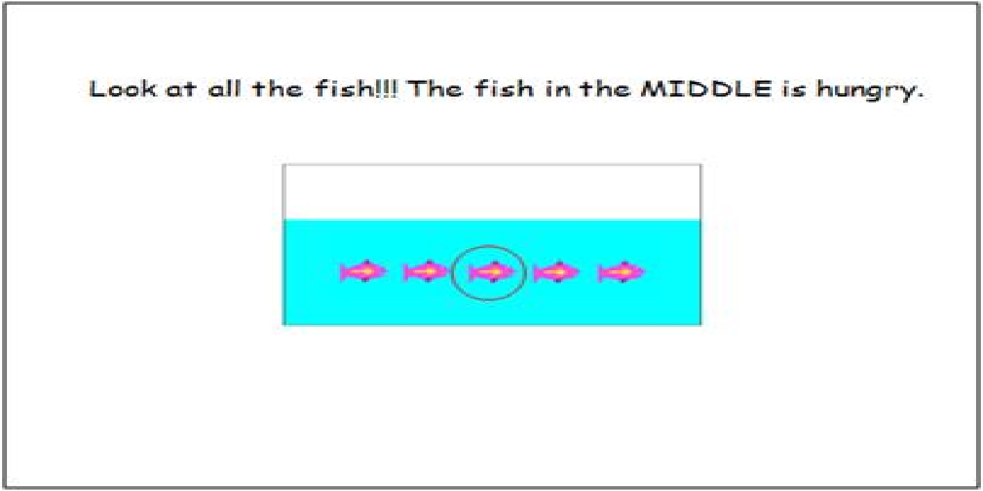
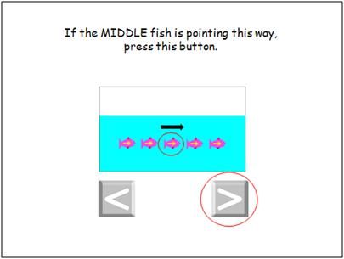
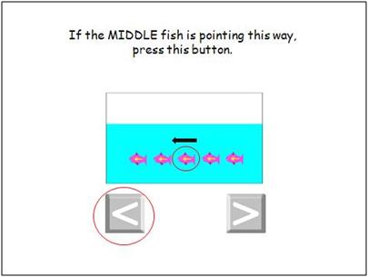
Flanker
(Executive Function and Attention)
Ages 3-85

Slide 27
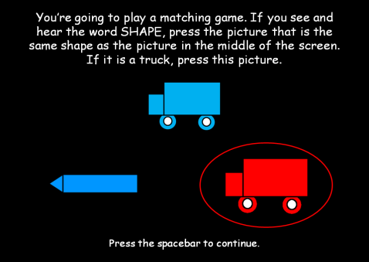
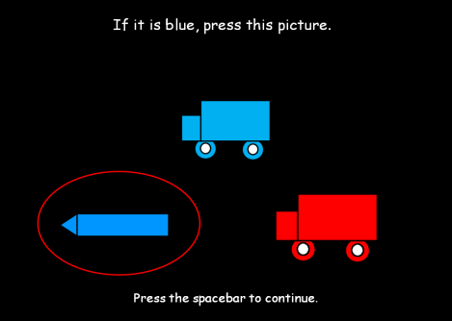
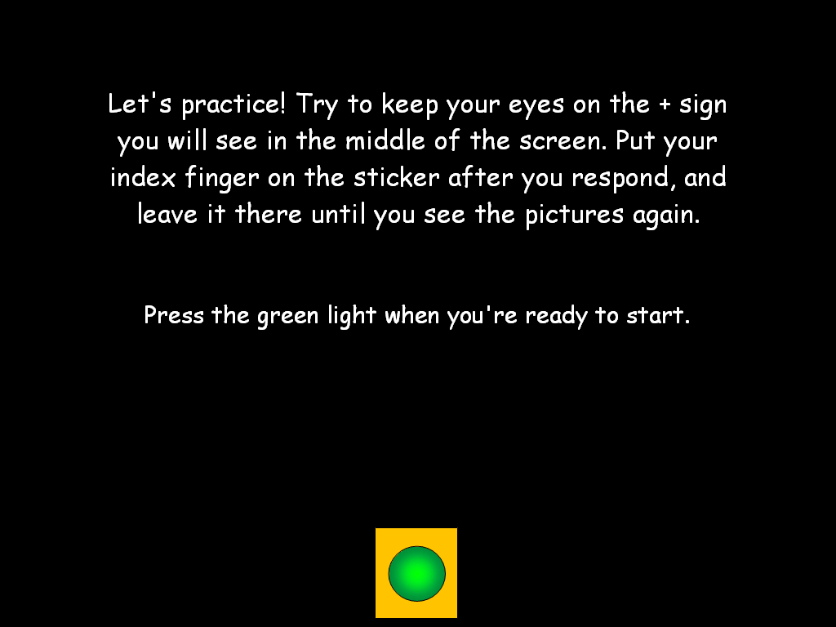
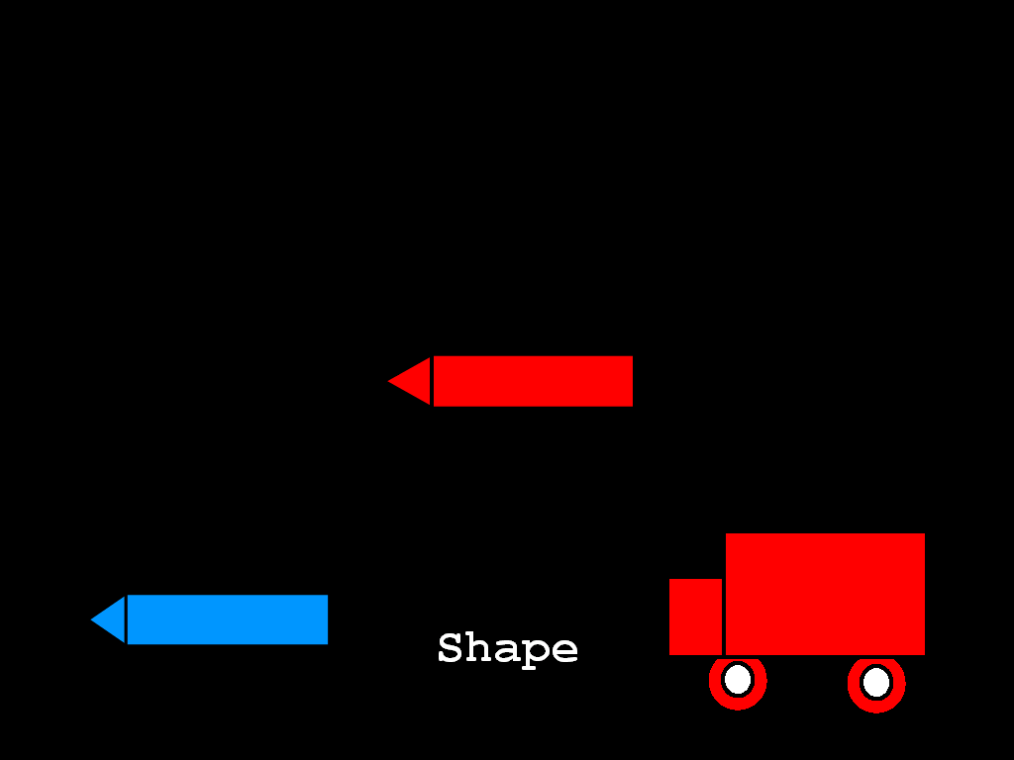
DIMENSIONAL CHANGE CARD SORT
(Executive Function and Attention)
Ages 3-85
Notes:
On some trials, participants are instructed to choose the one that matches the target with respect to shape. On other trials, the instruction is to choose the object that matches the color of the target.
There are 40 trials (5 Pre-Switch, 5 Post-Switch, & 30 Mixed Trials) and the average time to complete the task is 5 minutes.
Total trials: 30
Scoring: Algorithm weighting
accuracy and reaction time
Total time: 4 minutes

Slide 28
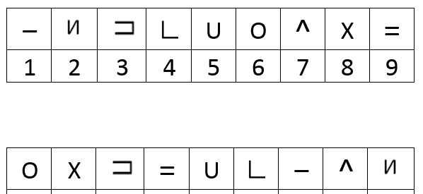
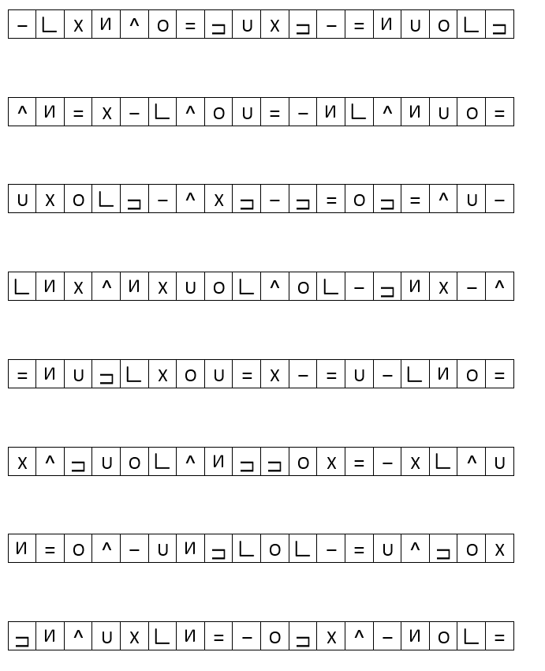
Oral Symbol Digit
Notes:
Oral Symbol Digit (we decided to use the Toolbox Version instead of the paper version of Digit Symbol to minimize administration burden)

Slide 29
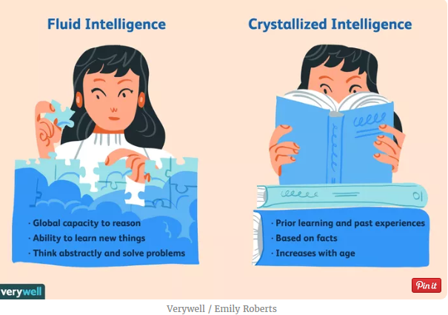
Scoring
Individual Test Scores (raw and scaled scores)
Summary Scores: Crystalized and Fluid Intelligence

Slide 30
Traditional Neuropsychological Tests
Trail Making Test, Parts A & B
  Attention, processing speed, executive functioning (especially B)
Stroop Test
  Executive functioning
Rey Auditory Verbal Learning Test (RAVLT)
  immediate and delayed verbal memory
Controlled Oral Word Association Test (FAS and categories—animals)
  Verbal fluency
Notes:
Traditional Neuropsych measures (these will be paper/pencil; they need to be included on CRF; for ?CRF just raw scores or do we want raw and standard scores??)
Stroop Test (Golden version; https://www.parinc.com/Products/Pkey/435)
Scores: # completed in 45 seconds word reading; # completed in 45 seconds color naming; # completed in 45 seconds interference
Rey Auditory Verbal Learning Test (RAVLT) –public domain (we decided to use this over the Toolbox version as the 30-minute delay is important)
Scores: List A Recall Trial 1, List A Recall Trial 2, List A Recall Trial 3, List A Recall Trial 4, List A Recall Trial 5, List B Recall, Short Term recall List A, 30 minute Recall List A, # Recognition Hits (do we also want False positives and false negatives?)
Controlled Oral Word Association Test (FAS and categories—animals) – public domain
Scores: # words in 60 second F; # words in 60 second A; # words in 60 second S; # animals in 60 seconds (do we want errors and perseverations?—leaning towards no)

Slide 31
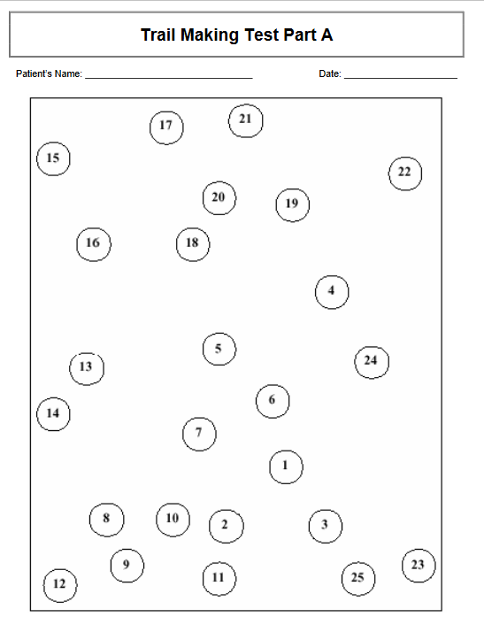
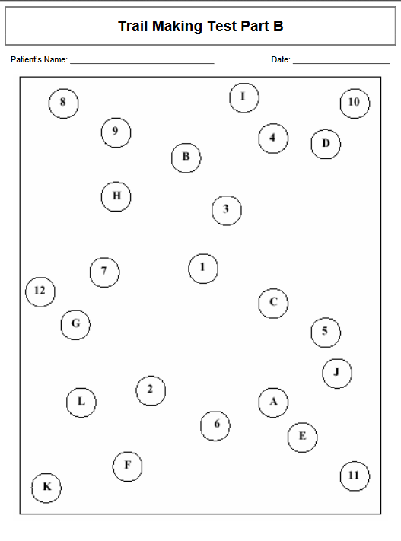
Trails Making Test Parts A & B
Notes:
Trails A & B (public domain version; decided against an app version because of lack of normative data)
Scores: time to completion A; Time to completion B (do we also want number of errors for each?)
the patient should draw lines to connect the numbers in ascending order. In Part B, the circles include both numbers (1 – 13) and letters (A – L); as in Part A, the patient draws lines to connect the circles in an ascending pattern, but with the added task of alternating between the numbers and letters (i.e., 1-A-2-B-3-C, etc.). The patient should be instructed to connect the circles as quickly as possible, without lifting the pen or pencil from the paper. Time the patient as he or she connects the "trail." If the patient makes an error, point it out immediately and allow the patient to correct it. Errors affect the patient's score only in that the correction of errors is included in the completion time for the task. It is unnecessary to continue the test if the patient has not completed both parts after five minutes have elapsed.

Slide 32
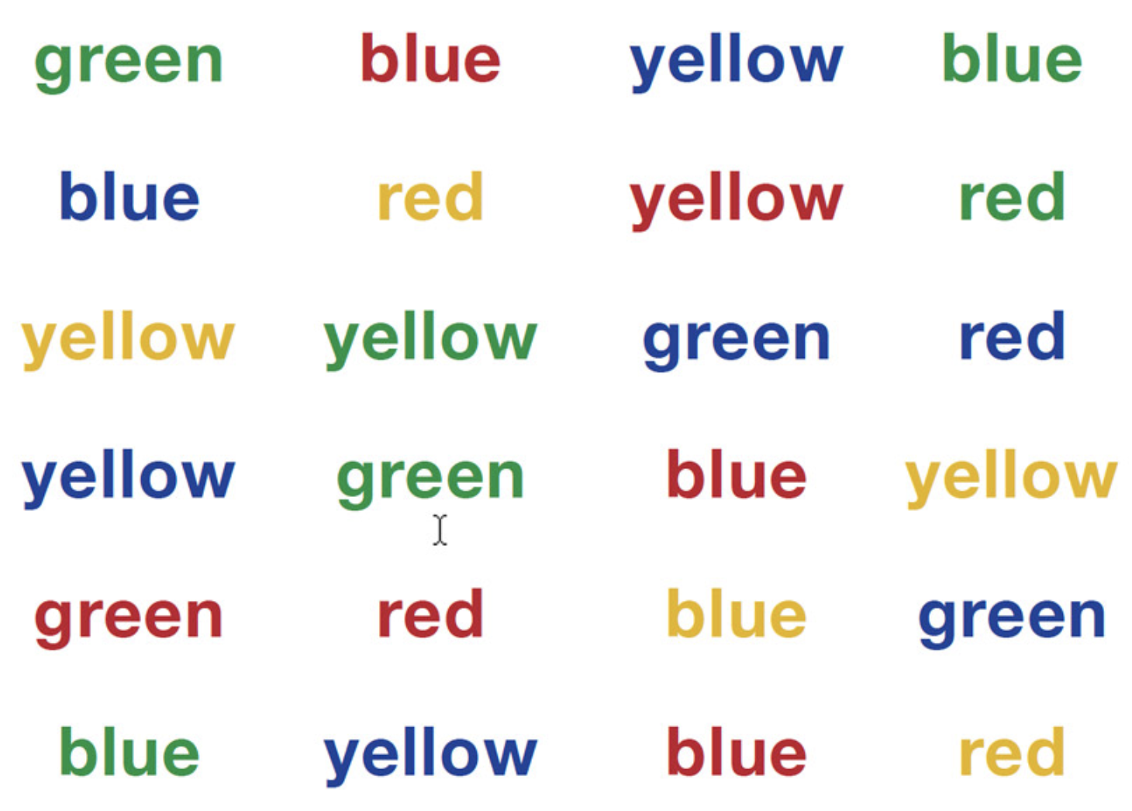
Stroop Test
Notes:
Stroop Test (Golden version; https://www.parinc.com/Products/Pkey/435)
Scores: # completed in 45 seconds word reading; # completed in 45 seconds color naming; # completed in 45 seconds interference
The Stroop Color and Word Test is based on the observation that individuals can read words much faster than they can identify and name colors. The cognitive dimension tapped by the Stroop is associated with cognitive flexibility, resistance to interference from outside stimuli, creativity, and psychopathology—all of which influence the individual’s ability to cope with cognitive stress and process complex input. It measures cognitive processing and provides valuable diagnostic information on brain dysfunction and cognition.
Useful as a screener or as part of a general battery
The test-taker reads color words or names ink colors from different pages as quickly as possible within a time limit.
The test yields three scores based on the number of items completed on each of the three stimulus sheets. An Interference score is useful in determining the individual’s cognitive flexibility, creativity, and reaction to cognitive pressures.

Slide 33
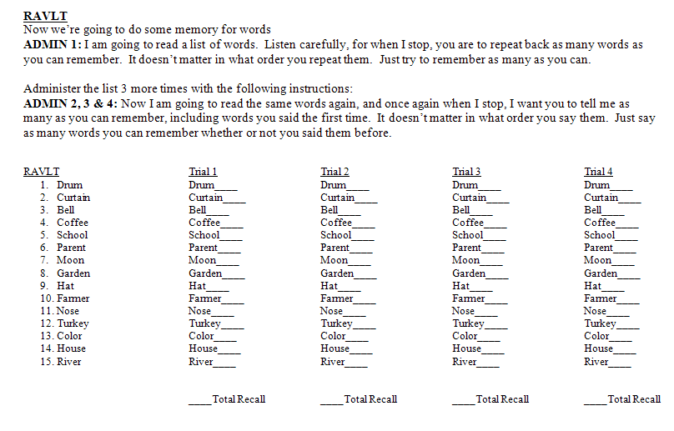
Rey Auditory Verbal Learning Test (RAVLT)
Notes:
Rey Auditory Verbal Learning Test (RAVLT) –public domain (we decided to use this over the Toolbox version as the 20-minute delay is important)
Test takers hear 15 nouns and are asked to recall the words immediately, after hearing an interference list of 15 different words, after a 20 minute delay, and to positively identify the words from a list of words containing non-target words.

Slide 34
Controlled Oral Word Association Test (COWAT)
60 seconds per letter (F-A-S) and Category (Animals)
Notes:
Controlled Oral Word Association Test (FAS and categories—animals) – public domain
Scores: # words in 60 second F; # words in 60 second A; # words in 60 second S; # animals in 60 seconds (do we want errors and perseverations?—leaning towards no)

