Slide 1


Brain Oxygen Optimization in Severe TBI Phase 3
Outcomes Overview and Follow Up
Kim Boase
University of Washington

Slide 2
Successful Trial Requirements
Purpose: To outline the role the study coordinator and PI play in the success of the 6 month follow-up.
We have 2 goals:
Obtain complete and valid data at the 6 month evaluation
Study coordinator documents pre-injury information
Well-trained outcome examiners
Data quality checks
Excellent follow-up rates
Study coordinators are among the first to establish relationships with families and patients
Notes:
We’ve heard all day the care, training and attention to detail required at the beginning of the trial. The 6 month outcome evaluation will show whether or not this new treatment is beneficial for severely injured patients. Similarly, we need to base decisions on quality data at the 6 month outcome.
Outcome evaluation will document your hard work.

Slide 3
Communication is Key
Communication between the study coordinator and the local blinded outcome examiner is essential.
Determine roles of each team member.
Obtain pre-injury information
Monthly calls
Scheduling the 6 month outcome evaluation
Making reminder calls for the 6 month appointment
Arranging transportation, reminder letters
Who follows up with a no show
Notes:
There are many ways tasks could fall through the cracks in this trial. Few patients. Time span of final outcome. Study coordinator is also part time
Ideally it would be good to have the outcome examiner handling many of the tasks listed here but in some cases it will fall to the study coordinator or other staff.
SAEs discovered by the local examiner need to get relayed to the study coordinator

Slide 4
Building Relationships
The study coordinator will be one of the first team members to begin building a relationship with the patient and their family.
Once the treatment phase has ended, the local outcome examiner can begin to get involved.
If possible, the study coordinator should introduce the outcome examiner to the patient and their family.
The study coordinator can explain to the patient and their family the role each will play in the following 6 months.

Slide 5
Successful 6 Month Outcome Evaluations
Complete pre-injury information
  Educational level for Trail Making Test
  Prior work and school status for the GOSE-R
Obtain good contact information
Identify any language barriers
Provide other information that can impact testing (aphasia, motor impairments etc.)

Slide 6
Pre-Injury Information
How far did you go through school? How many years of school have you completed? _____ (0 years – 20 years)
Years of Education
Level of Education
What is the highest level achieved in school? (years in ( ) should correspond to 1a above ) ____ 0-8 (0-8 years) ____ 9-11 (9-11 years) ____ GED (0-11) ____ High School Diploma (12) ____ Vocational/Technical Training (12) ____ 1 to 3 years of College, AA degree, no degree (13-15 years) ____ BA, BS (16 or 17 years) ____ MA, MS (18 or 19 years) ____ JD (19 years) ____ MD, PhD, DDS (20 years)
Notes:
Found on the demographics form

Slide 7
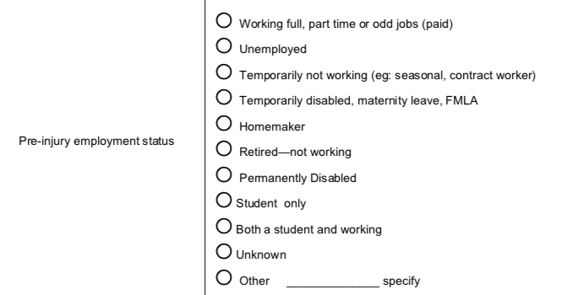
Pre-Injury Information
Notes:
Found on the demographics form

Slide 8
Pre-Injury Information
Is English the first language of the participant?
____ Yes
____ No Specify native language __________________________
____ Unknown
Will an interpreter be required for the monthly calls or the 6 month follow-up?
____ No
____ Yes
____ Unknown
Notes:
Found on the demographics form

Slide 9
Contact Information
Try to obtain at least 3 different points of contact:
  Names
  Relationship to participant
  Addresses
  Email
  Phone numbers
  Social media such as Messenger
  Note discharge information
  Name of the facility
  Phone number
Notes:
Don’t get 3 of the same contact phone number
This information will be entered into an alternate database – further instructions will be coming
Know where abouts no matter what.

Slide 10
Monthly Calls
Purpose
  Maintain contact with the participant and family
  Alert participant and family to 6 month follow-up
  Update contact information and any missing pre-injury data
  Get basic information about how the participant is recovering
  SAE
  If possible, this is a good opportunity for the local outcome examiner to begin establishing a relationship with the family.
  Establish a call log. In the case of a participant being lost to follow-up, the call log will be reviewed by the SIREN Operations Committee.
Notes:
If the examiner is completing the monthly calls any SAE will need to be reported to the study coordinator for additional follow-up.
We want it monthly but doesn’t have to be + or – so many days
Once the pre injury information is compete you don’t have to keep asking for it.
Make them conversational and relaxed/informal

Slide 11
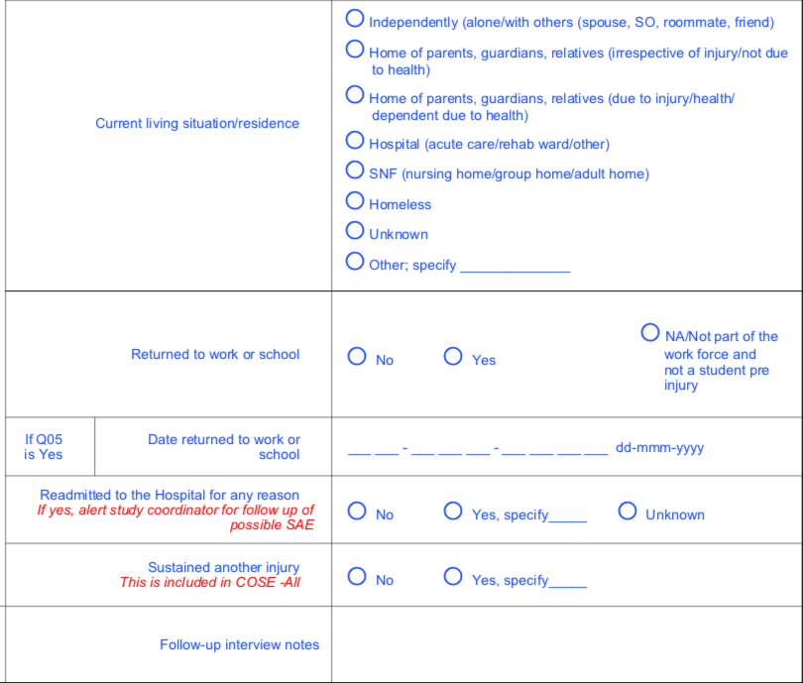
Monthly Calls
Notes:
In the case the participant is lost to follow-up the information from the monthly calls could be used as a source of recovery indicators.
Follow up notes: any pertinent information that may be beneficial for the outcome evaluation.
Found on the Monthly calls interview
Assisted living, not SNF

Slide 12
Scheduling the Outcome Evaluation
Coordinate between the local outcome examiner and the central examiner.
A Google calendar system will be established for scheduling the central examiners.
Try to be flexible and accommodate the needs of the participants, their families and caregivers.
Send a confirmation letter with pertinent information.
Reminder calls, texts, emails one week before the appointment, as well as the day before. Encourage a confirmation from the participant.
Arrange transportation if necessary.
Arrange for an interpreter if necessary.
Confirm that adequate space is available for the testing to take place.
Notes:
The goal is to make the experience as easy and convenient for the participant and their family as possible.
Learn as we go along.

Slide 13
6 Month Outcome Evaluation
The appointment will look similar to the following:
The local examiner will greet the participant and begin the assessment with a basic orientation task (GOAT)
The central examiner will then be introduced and brought into the exam via the phone.
The GOSE-R will be completed by the central examiner.
The local examiner will complete the remainder of the assessment.
The 2 examiners will touch base when the evaluation is complete.
Notes:
The goal is to make the experience as easy and convenient for the participant and their family as possible.
Learn as we go along.

Slide 14
Helpful Information for Outcome Examiners
Language preference
Interpreter requirements
Basic information (if known) about how the participant is doing, such as: aphasias, motor limitations, mobility issues, significant peripheral injuries, vision or hearing impairments.
Will someone bring the participant to the appointment?
Current living situation
Notes:
The Central examiner will be in touch with the local examiner. All the GOSEs will be done over the phone so some basic information can be helpful for it’s administration.

Slide 15
Characteristics of a Good Outcome Examiner
Often someone with a psychology background (BA level is typical)
Excellent interpersonal skills
Someone who is able to work with varied populations. Someone who is able to strike a balance between getting the testing completed while maintaining sensitivity and empathy.
Exhibits patience, can create a relaxed, friendly environment
Detail oriented
Good communication skills
Notes:
An outcome examiner’s role requires them to develop a good rapport, elicit the best possible effort from the patient, get the patient through what can be a difficult battery of tasks.
Time, resources and know it’s important

Slide 16
Odds and Ends
Space: Outcome testing should take place in a quiet room. Should ensure privacy. Have a table or comfortable working surface.
Test materials need to be kept together and accessible.
Payment: Participants can be reimbursed for any incurred expenses including travel and parking. The study can cover costs of app arranged transport such as Uber or Lyft; taxis and bus fare.
Referral to MD for follow-up: Be prepared to assist participants who would like to be seen by a medical professional (eg: Physiatrist, Neurologist, Rehab Therapies)
Procedure for High Suicide Risk: A procedure has been put in place for the trial. Each site will need to have a plan for participants needing intervention.
Notes:
Payment for completing the 6 month outcome is being discussed.
Suicide protocol will be discussed in the Outcomes MOP which is still being worked on.

Slide 17
PI and Study Coordinator Responsibilities
PI Responsibilities
General oversight including communication between all study team members.
Hiring an outcome examiner
Acquiring space for the assessments and test materials.
Plan for high suicide risk
Plan for medical follow up
Study Coordinator Responsibilities.
Communication with outcome examiners
Obtaining pre-injury information and contact information
In some cases, conducting the monthly calls.
In some cases, scheduling the 6 month evaluation.
Questions?
Notes:
We want all sites to arrange task assignments in a way that works best for them. The goal is to get the best Outcome data we can.

