Slide 1
Hyperbaric Oxygen Brain Injury Treatment Trial: A Multicenter Phase II Adaptive Clinical Trial
Nicholas Mohr, MD
Associate Professor of Emergency Medicine and Anesthesia Critical Care
Site Investigator, HOBIT
Saul Wilson, MD
Assistant Professor of Neurosurgery

Slide 2
Need for a Trial
Outcome from severe TBI has been flat lined for several decades
No specific treatment despite multiple randomized clinical trials
Medical and economic costs of severe TBI are large
HBO₂ has significant potential as a treatment

Slide 3
Potential Mechanisms for HBO2 Efficacy
Pre-clinical findings
  Depressed mitochondrial function following injury is restored
  ATP production is improved
  Ischemia induced brain cell loss is attenuated
  Neuronal apoptosis is reduced
  Cognitive deficits are markedly attenuated
  Intracranial hypertension is reduced

Slide 4
Potential Mechanisms for HBO₂ Efficacy
In 186 CMRO₂ studies in 65 patients, Obrist found patients with GCS scores < 8 had CMRO₂ levels below 1.6 which is less than half of normal (3.3 ml/100 gm/min)
The lower the GCS, the lower the CMRO₂
Reduced CMRO₂ independent of anatomic pathology
Obrist, J Neurosurg 61:241, 1984

Slide 5
Low Cerebral Metabolic Rate is Associated with Poor Outcome
Jaggi and Obrist, J Neurosurg 72:176-182, 1990

Slide 6
Cerebral Metabolic Rate of Oxygen
*p = 0.01
Rockswold, J Neurosurg 112:1080-1094, 2010

Slide 7
Lactate/Pyruvate Ratio
*p < 0.05 **p < 0.0001
Rockswold, J Neurosurg 112:1080-1094, 2010

Slide 8
Mean Difference of ICP
*p = 0.0010
Rockswold, J Neurosurg 112:1080-1094, 2010

Slide 9
Critical PbtO₂ Level
There was significant improvement in CMRO₂ and L/P ratio when PbtO₂ levels were > 200 mmHg as compared to < 200 mmHg
This level was reached in only 51% of HBO₂ treatments at 1.5 ATA
Lung function (P/F ratio) significantly effects PbtO₂ levels achieved
The PbtO₂ achieved may be the critical factor in 6-month outcome, not the ATA utilized
Rockswold, J Neurotrauma 112:1080-1094, 2010

Slide 10
Inclusion Criteria – HOBIT Trial
Age 16-65 years
Severe TBI, defined as a iGCS of 3 to 8 in the absence of paralytic medication
For patients with a GCS of 7 or 8 or motor score = 5, Marshall CT score > 1
For patients with an alcohol level > 200 mg/dl, Marshall CT score > 1
For patients not requiring a craniotomy/craniectomy or any other major surgical procedure, the first HBO₂ treatment can be initiated within 8 hours of admission
For patients requiring a craniotomy/craniectomy or major surgical procedure, the first HBO₂ treatment can be initiated within 14 hours of admission

Slide 11
Exclusion Criteria
Criteria | Metric | Rationale
First hyperbaric oxygen treatment cannot be initiated within 24 hours of injury | Time to first hyperbaric oxygen treatment | Subjects treated >24 hours are unlikely to benefit
GCS of 3 with mid-position and non-reactive pupils bilaterally (4mm) in the absence of paralytic medication | GCS | Avoid enrolling futile cases.
Penetrating head injury | Clinician exam | Avoid enrolling subjects with very poor prognosis
Pregnant | For women of childbearing age, pregnancy will be assessed either by urine or serum pregnancy test | The effect of hyperbaric oxygen treatment on unborn fetus is unknown
Preexisting neurologic disease (e.g. TBI or stroke or neurodegenerative disorder) with confounding residual neurologic deficits | History obtained from family and review of electronic medical record | Minimize the influence of prior neurologic injury on ascertaining TBI outcome
Prisoner or ward of state | Look for prison guards | Challenges to conducting follow-up assessments

Slide 12
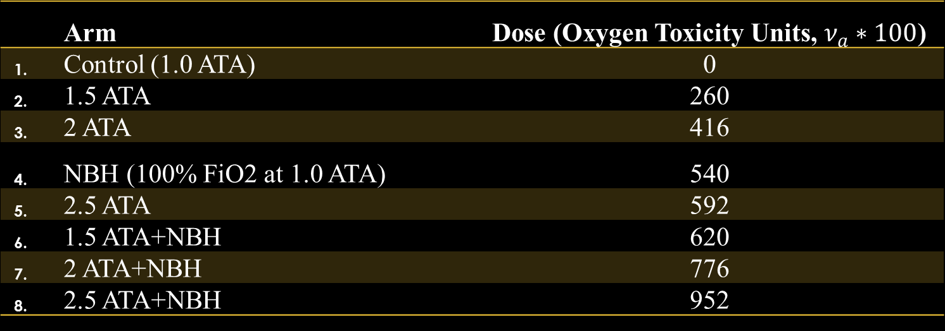
Treatment Arms
 | Arm | Dose (Oxygen Toxicity Units, $ν_{a}∗100$)
1. | Control (1.0 ATA) | 0
2. | 1.5 ATA | 260
3. | 2 ATA | 416
4. | NBH (100% FiO2 at 1.0 ATA) | 540
5. | 2.5 ATA | 592
6. | 1.5 ATA+NBH | 620
7. | 2 ATA+NBH | 776
8. | 2.5 ATA+NBH | 952
Treatments given BID x 5 days

Slide 13
Objectives
Objective 1
  Signal of efficacy: To determine, in subjects with severe TBI, whether there is a > 50% probability of hyperoxia treatment demonstrating improvement in the rate of good neurological outcome versus control in a subsequent confirmatory trial
Objective 2
  Dose selection: To select, in subjects with severe TBI, the combination of treatment parameters (pressure +/- intervening normobaric hyperoxia) that is most likely to demonstrate improvement in the rate of good neurological outcome versus control in a subsequent confirmatory trial

Slide 14
Primary Endpoint
The treatment groups will be compared with respect to the proportion of subjects with favorable outcome at 6 months post randomization utilizing the injury severity adjusted GOS-E

Slide 15
Secondary Endpoints
To analyze the level and duration of intracranial hypertension (> 22 mmHg) in HBO₂-treated versus control groups
To analyze the therapeutic intensity level scores for controlling intracranial pressure in HBO₂-treated subjects compared to controls
At sites utilizing Licox brain tissue partial pressure of oxygen (PO₂) monitoring, analyze the level and duration of brain tissue hypoxia (brain tissue PO₂ < 20 mmHg) in HBO₂-treated groups versus control
To compare the type and rate of serious adverse events (SAEs) between hyperoxia treatment arms and control
Peak PbtO₂ levels during HBO₂ treatments will be correlated with outcome at 6 months

Slide 16
Enrolling Sites
Hennepin County Medical Center / University of Minnesota
University of Maryland
University of Nebraska
Duke University Medical Center
University of Iowa
Ohio State University
University of California - San Diego
University of Alabama - Birmingham
Detroit Receiving
Hamilton General Hospital - Canada
Honor Health / Osborn Medical Center - Scottsdale
Advocate Lutheran General Hospital / University of Illinois
Baylor University Medical Center
Spectrum Health / Michigan State University
Medical College of Wisconsin
University of Kentucky

Slide 17
Oxygen Toxicity Monitoring in HOBIT
No patient will undergo HBO₂ treatment with a P/F ratio < 200 or if a PEEP > 10 cm of H₂O is required to achieve a P/T ratio > 200
Specific attention to adverse events related to HBO₂ treatment, e.g., pulmonary dysfunction
The incidence of pulmonary dysfunction will be compared across treatment groups vs controls

Slide 18
Conclusions
This is a challenging trial involving critically injured patients and a complex intervention
Enrollment is time-sensitive

