Slide 1
Background and Context
Clif Callaway

Slide 2
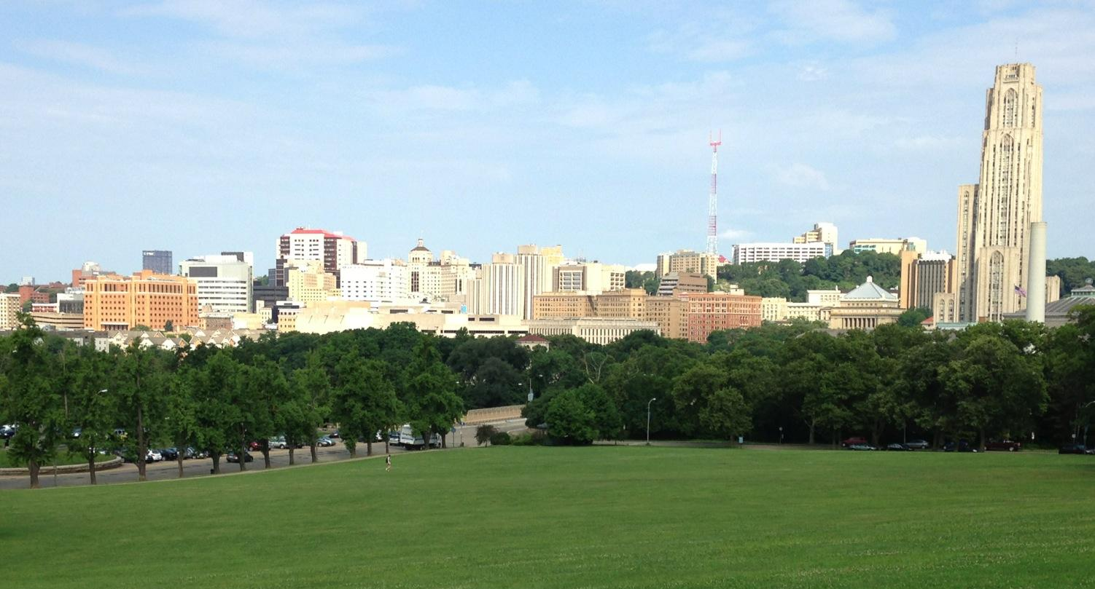
Hypothermia Trials in Cardiac Arrest
Clifton W. Callaway, MD, PhD
University of Pittsburgh

Slide 3
Disclosures
NINDS - studies of hypothermia mechanisms
NHLBI - EMS interventions in resuscitation
ILCOR Task Force on ALS, CoSTR
AHA ECC Committee –Guidelines, etc.

Slide 4
Hypothermia Works
Many laboratory studies in
rats, mice, gerbils, pigs, dogs, sheep

Slide 5
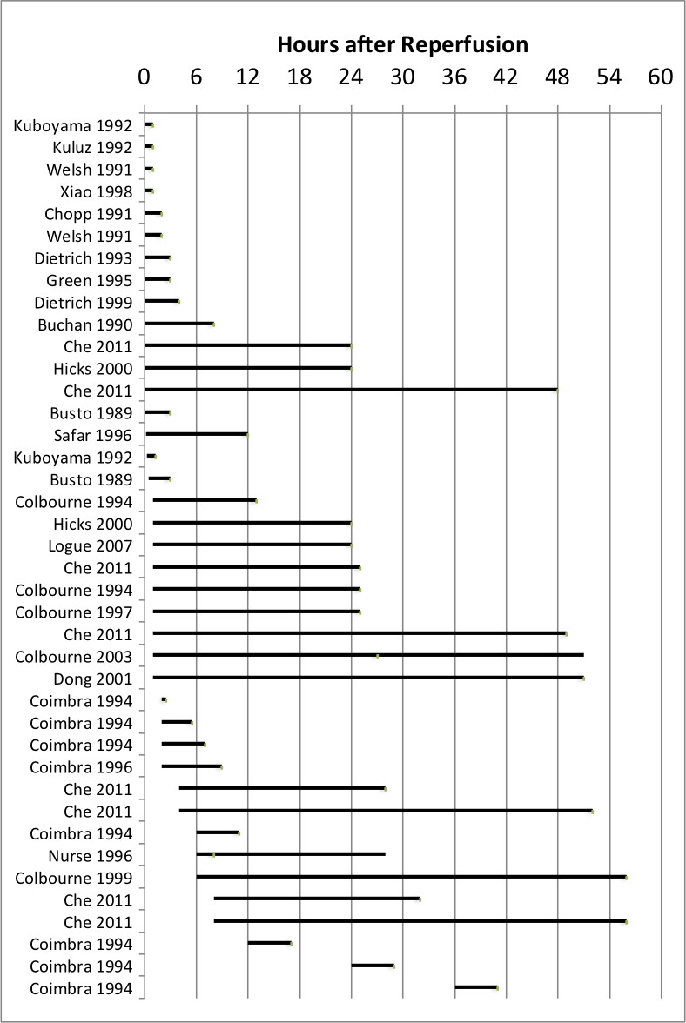
Animal studies of mild-moderate hypothermia (32-34ºC).
Immediate, brief hypothermia has benefit
Benefit of brief hypothermia not long-lasting
Longer duration has lasting benefit
Any delay negates benefit of brief hypothermia
Longer duration has benefit after delay
Brief delay negates benefit of brief or 3-hour hypothermia
Longer (>5 hr) duration has benefit after 6-8 hour delay
No duration has benefit after 8-12 hour delay

Slide 6
How Does Hypothermia Work?
Nobody Knows

Slide 7
Ischemia
Injury
Minutes
Hour
Hours

Slide 8
Ischemia
Injury
Reperfusion
Minutes
Hour
Hours

Slide 9
Ischemia
Injury
Reperfusion
Secondary / Delayed Injury
Minutes
Hour
Hours
Days

Slide 10
Cold during CPR or within minutes of ROSC
Ischemia
Injury
Reperfusion
Secondary / Delayed Injury
Minutes
Hour
Hours
Days

Slide 11
Cold during CPR or within minutes of ROSC
Ischemia
Injury
Cold started > 30 min after ROSC
Reperfusion
Secondary / Delayed Injury
Minutes
Hour
Hours
Days

Slide 12
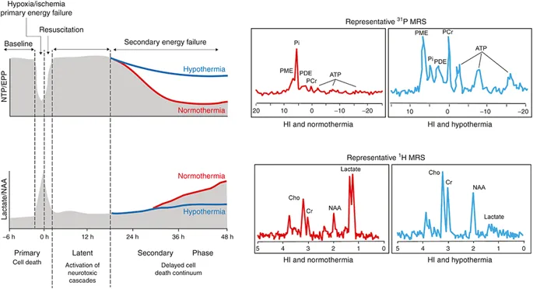
Sheep Brain Ischemia Gunn (2017) Pediatric Research 81: 202–209
ATP
Lactate
0 12 24 48
Hours

Slide 13
What Can Hypothermia Do?
Reduces Seizures
Think – Opposite of Febrile Seizures

Slide 14
What Can Hypothermia Do?
Reduces Seizures
Reduces Swelling
Think – Opposite of Febrile Seizures
Think Ice Sprained Ankle

Slide 15
What Can Hypothermia Do?
Reduces Seizures
Reduces Swelling
Reduces Metabolism
Think – Opposite of Febrile Seizures
Think Ice Sprained Ankle
Tolerate Low Perfusion

Slide 16
Sheep Brain Ischemia Gunn (2017) Pediatric Research 81: 202–209
Seizures
Temperature
Brain Swells
EEG Power
Cortical Impedance
EEG Edge Freq
7 days

Slide 17
Does Hypothermia Work in Humans
RCTs
Many Observational Studies

Slide 18
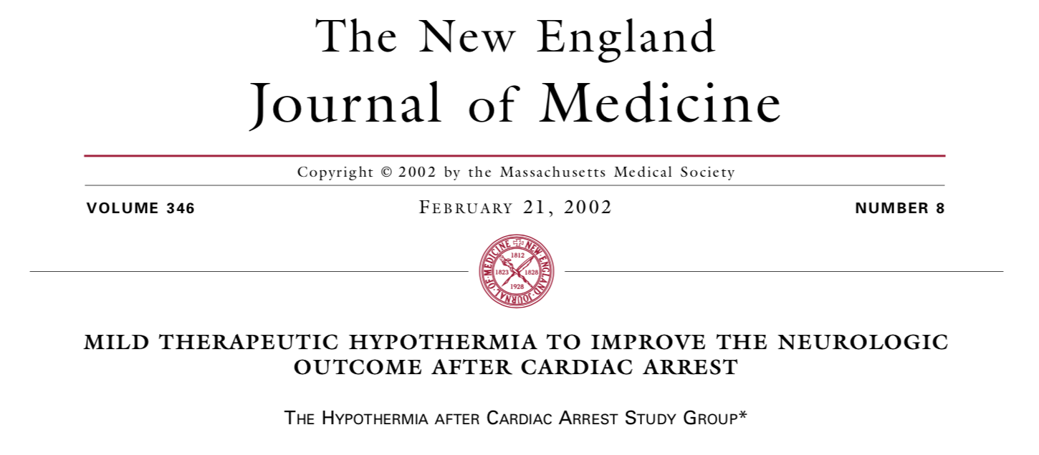
24 hrs x 32-34ºC vs. No temperature control
12 hrs x 33º vs. No temperature control

Slide 19
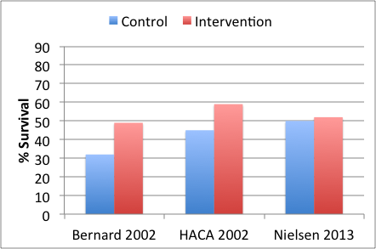
Targeted Temperature Management
Control of temperature at 33ºC or 32-34ºC results in more survival (49-59%) than no temperature control (32-45%).
59%
49%
45%
32%
N=77
N=275
Hypothermia after Cardiac Arrest Study Group 2002; NEJM 346: 549;
Bernard 2002; NEJM 346: 557

Slide 20
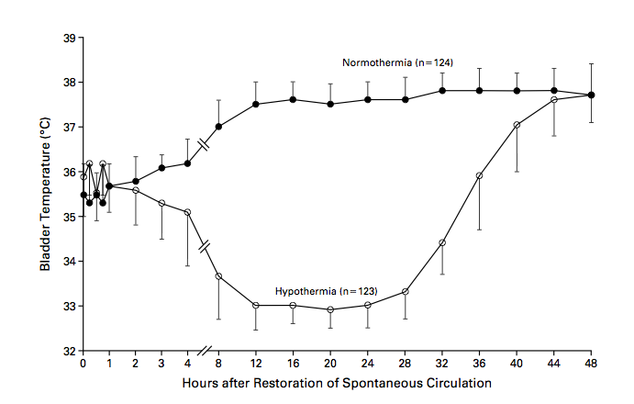
24 hrs x 32-34ºC
4-8 hours

Slide 21
939 subjects
All rhythms
Regimented post-arrest care and prognostication

Slide 22
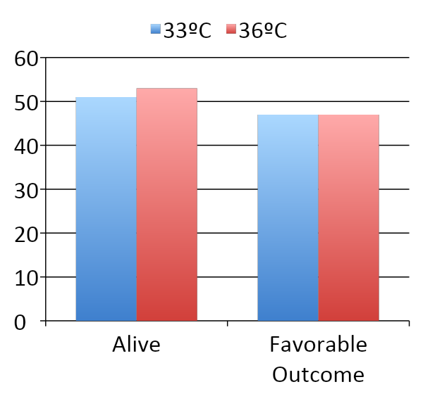
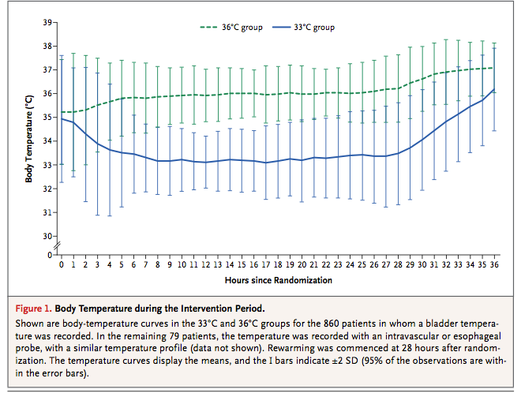
Nielsen 2013 - TTM Trial
This trial enrolled more patients than all prior trials combined (N=939)
Treatment was successfully delivered
No difference in primary or secondary outcomes
50%
52%
48%
48%
% of Subjects

Slide 23
TTM Trial
Control of temperature at 33º or 36ºC results in good outcomes (50-60% survival) that look like the hypothermia arms of the older trials

Slide 24
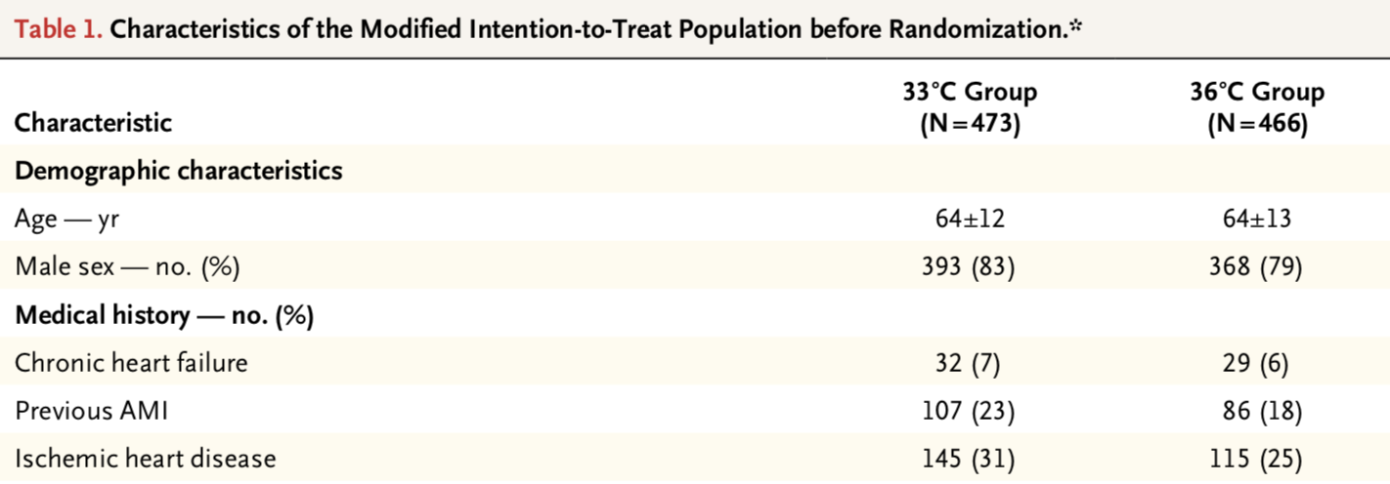
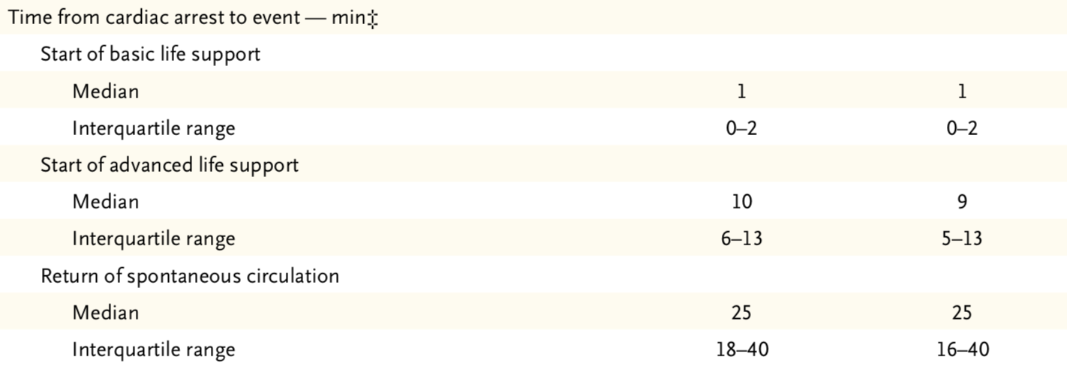
TTM Trial

Slide 25
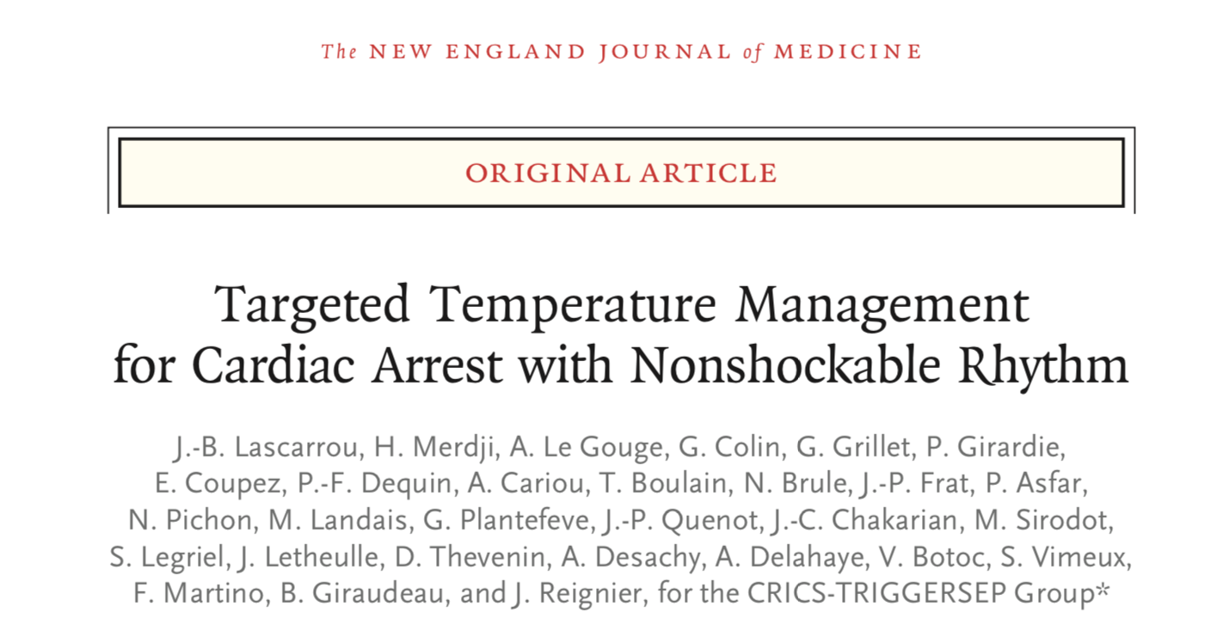
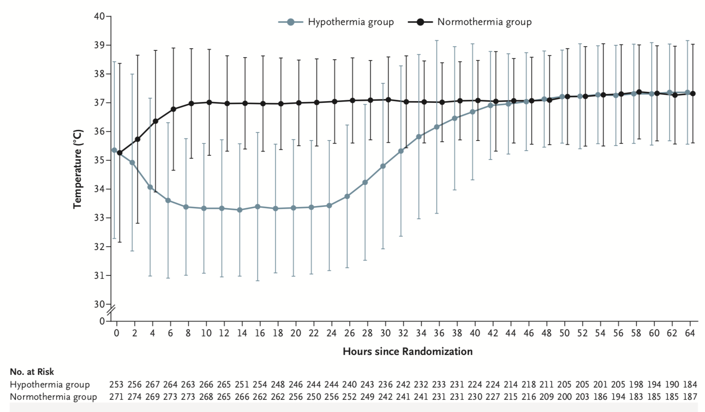
HYPERION Trial
33ºC x 24 hrs
vs.
36.5-37.5ºC

Slide 26
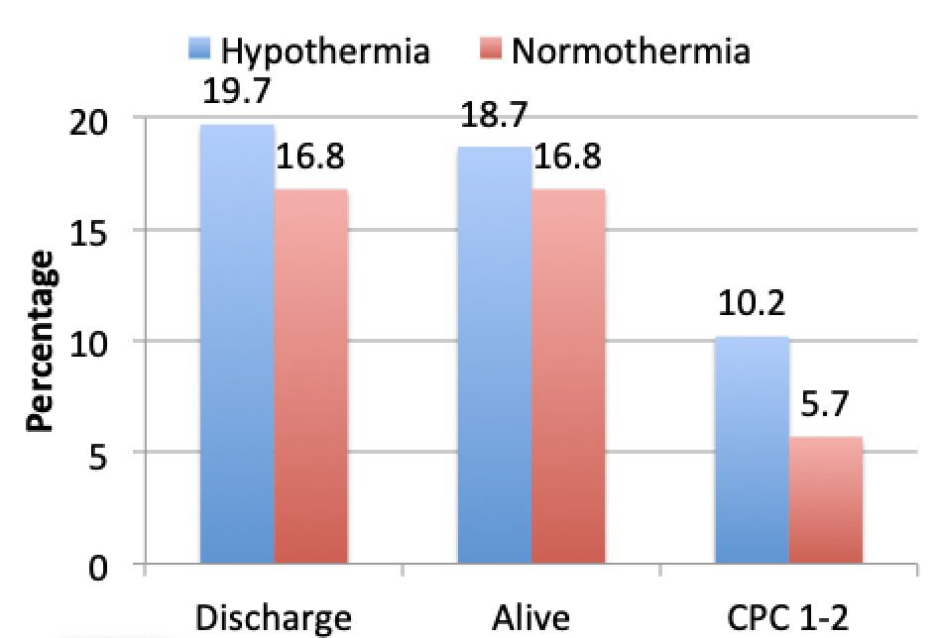
HYPERION (2019)

Slide 27
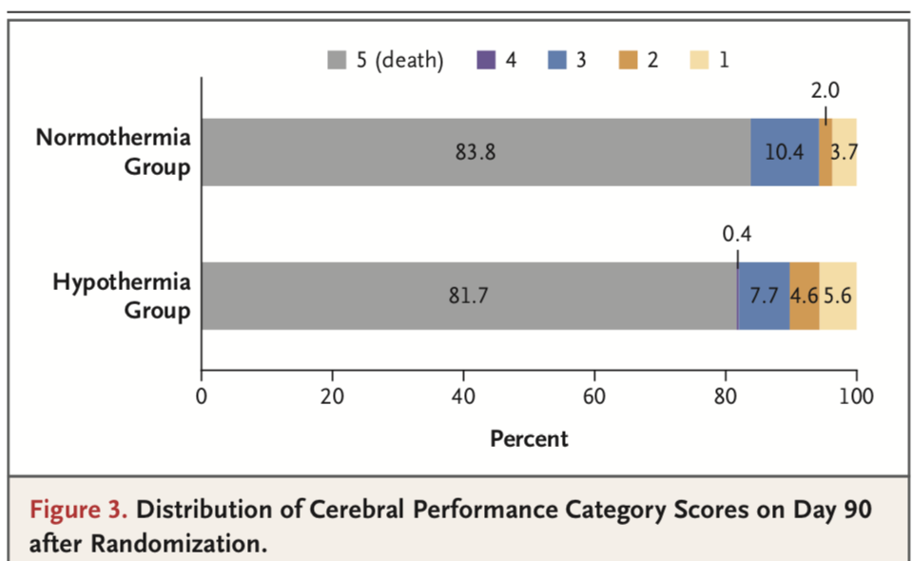
HYPERION (2019)

Slide 28
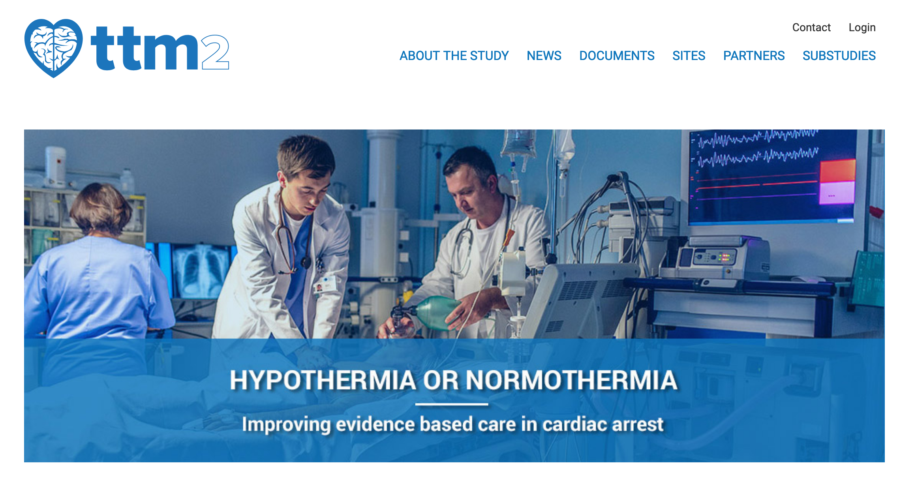
https://TTM2trial.org

Slide 29
TTM2
33ºC x 28 hours vs. Fever Prevention
Fever prevention
No device unless temperature >=37.8ºC
Then turn on device to control temp at 37.5ºC
1900 subjects
Completed enrollment 20 January 2020

Slide 30
Starting Hypothermia Sooner
Ischemia
Injury
Reperfusion
Secondary / Delayed Injury
Minutes
Hour
Hours
Days

Slide 31
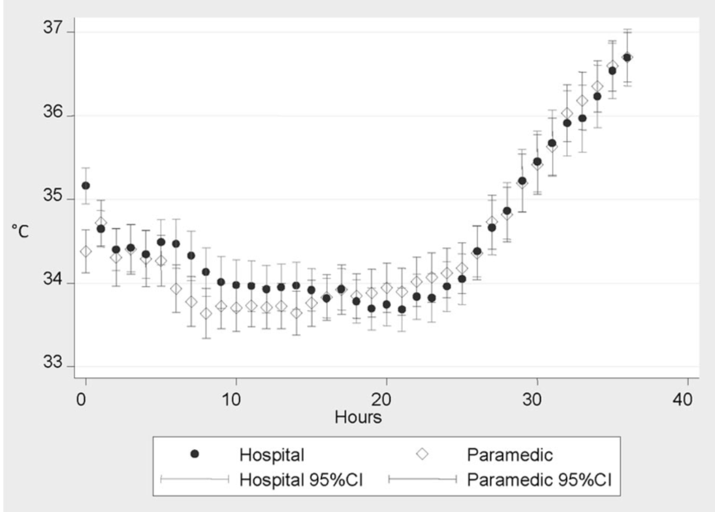
Circulation; 122(7):737-42
Cold (4ºC) IVF started after ROSC
vs.
Similar ED Protocol
33ºC x 24 hrs

Slide 32
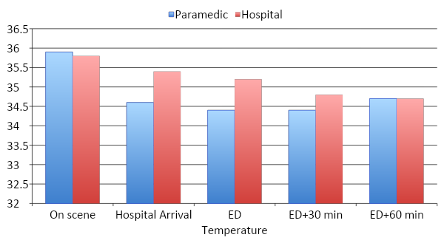
VF – Cooling (N=234) Bernard 2010 Circulation; 122(7):737-42
Temp ºC

Slide 33
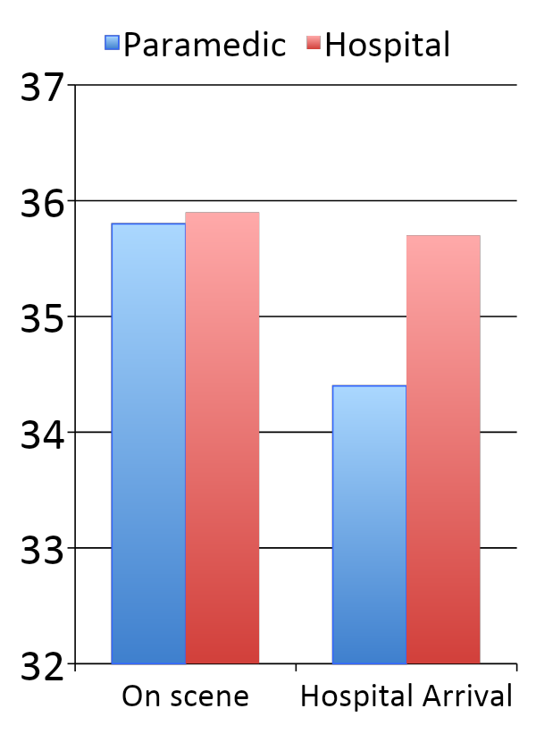
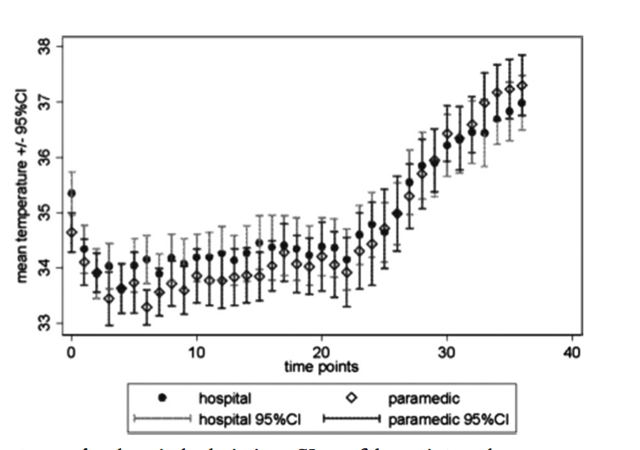
Non VF – Cooling (N=163) Bernard 2010 CCM; 40(3):747-753
Temp ºC

Slide 34
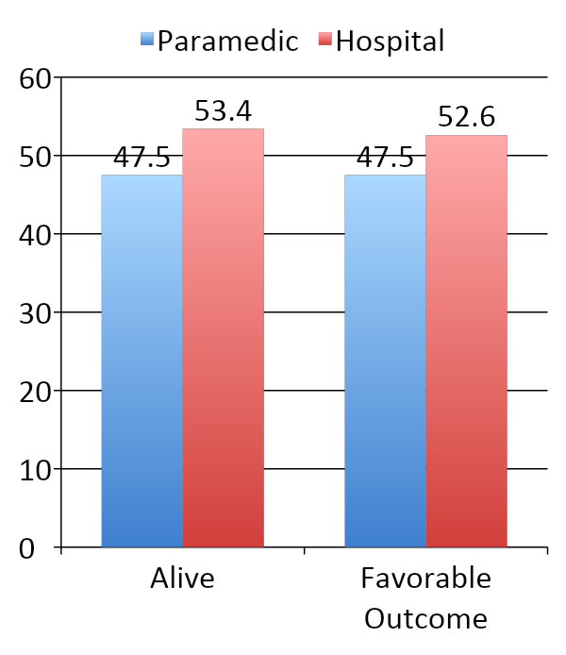
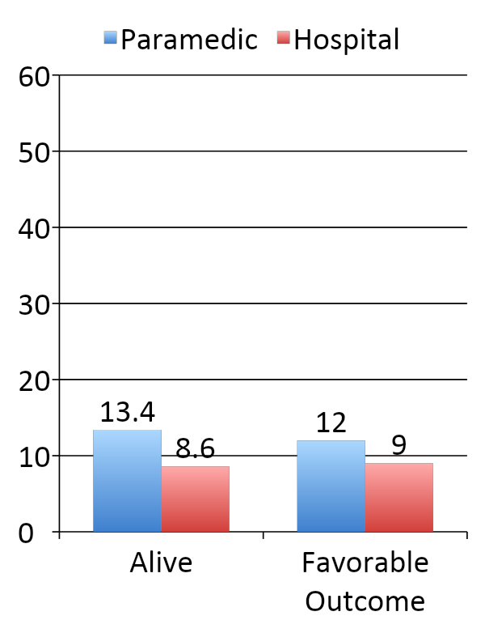
Prehospital Cooling Outcomes Bernard 2010 Circulation; 122(7):737-42; Bernard 2012 CCM; 40(3):747-753
VF
Non-VF
% of Subjects

Slide 35
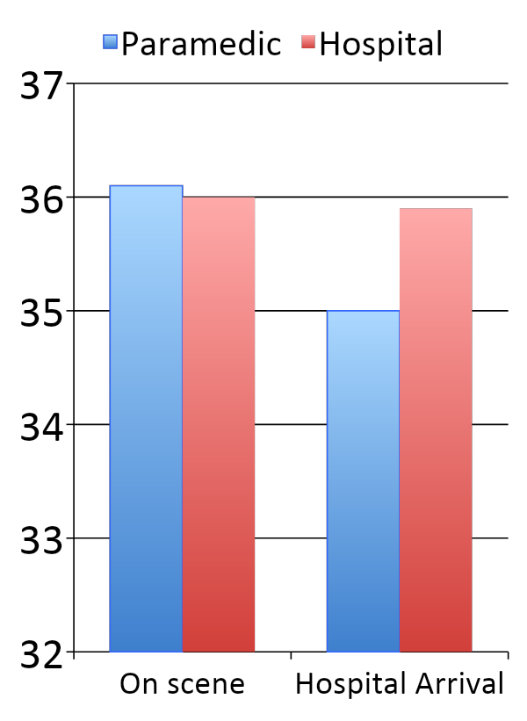
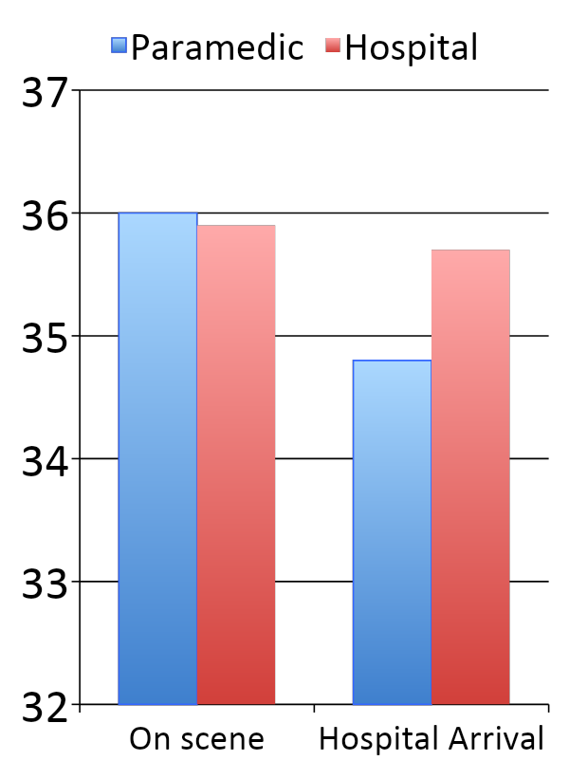
Kim 2014 JAMA; 311: 45-52
Cold IVF in ambulance vs.
ED
No standard treatment in ICU
VF (N=583)
Non-VF (N=776)
Temp ºC

Slide 36
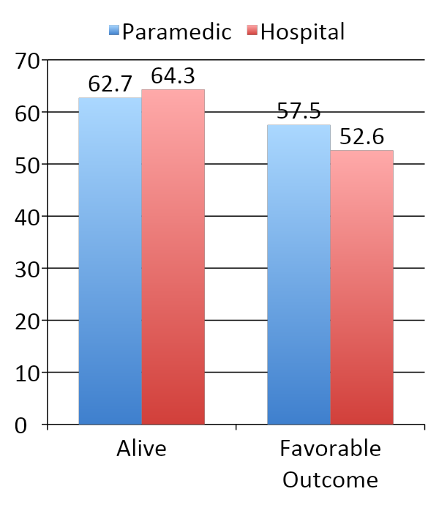
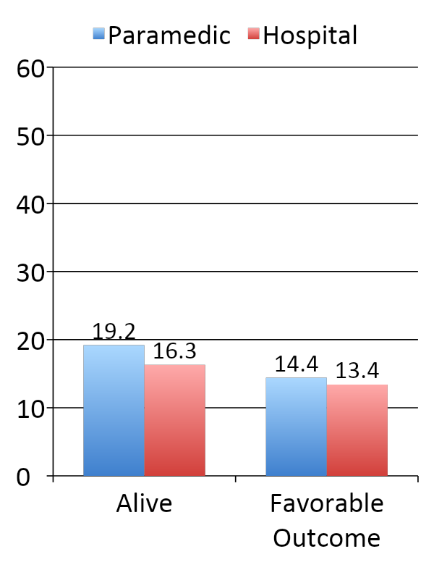
Prehospital Cooling Outcomes Kim 2014; JAMA 311: 45-52
VF (N=583)
Non-VF (N=776)
% of Subjects

Slide 37
Garrett 2011 Resuscitation. 82:21-25
Carolinas Medical Center
In 2009, paramedics adopted cold IVF infusion protocol (up to 2000 ml) to effect “intra-arrest therapeutic hypothermia (IATH)”
Compare outcomes before and after
343 did not receive IATH
208 did receive IATH

Slide 38
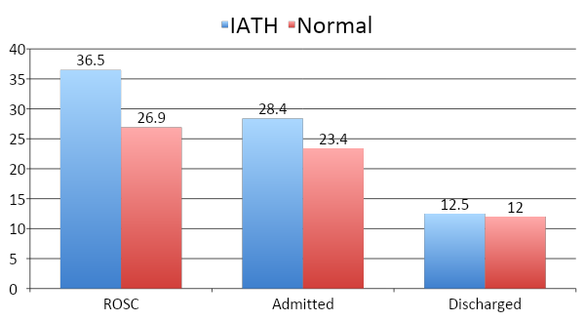
Garrett 2011 Resuscitation. 82:21-25.
N=551

Slide 39
More re-arrest in TH group (26% vs 21%)
More diuresis in TH group (23% vs 17%)

Slide 41
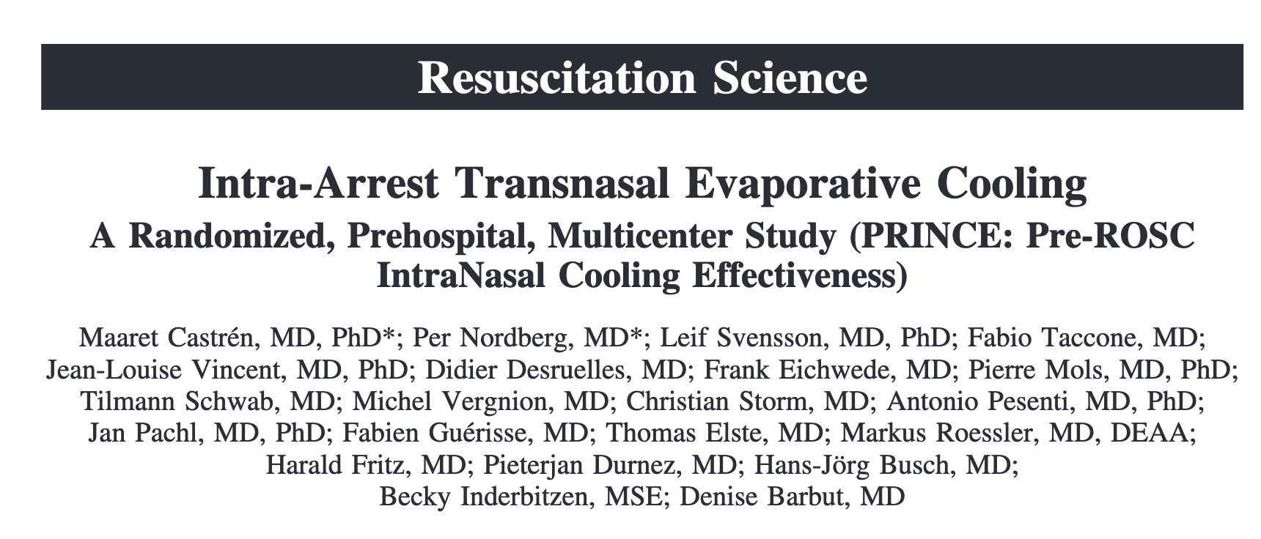
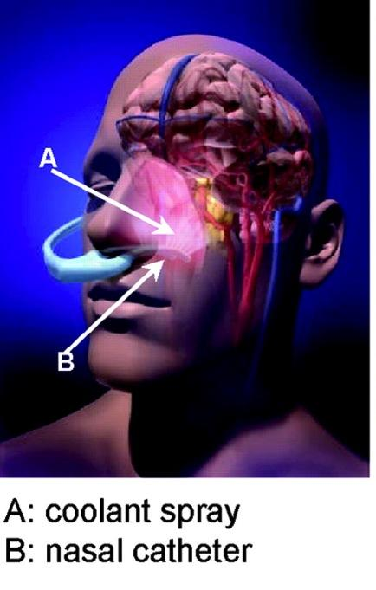
PRINCE Trial
Out-of-Hospital Cardiac Arrest
Immediate application of device delivering intranasal perflurocarbons (Rhino-Chill)
N=200
96 to cooling
104 to standard treatment

Slide 42
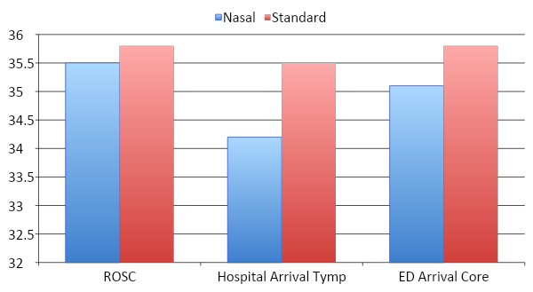
PRINCE – Temperature Curves Castren 2010 Circulation. 122(7):729-36.

Slide 43
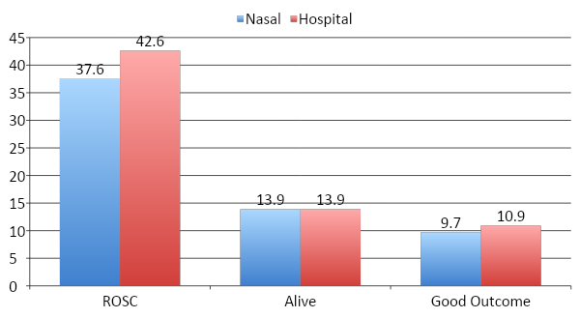
PRINCE – Outcomes Castren 2010 Circulation. 122(7):729-36.
N=200

Slide 44
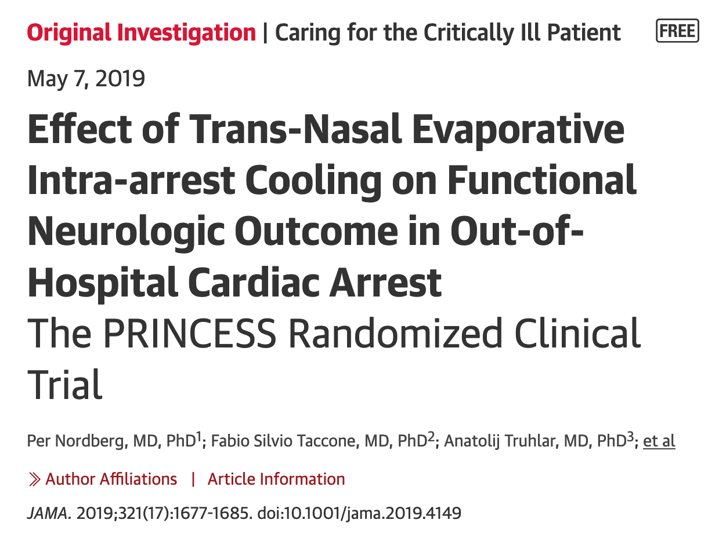
N=671
Start During CPR

Slide 45
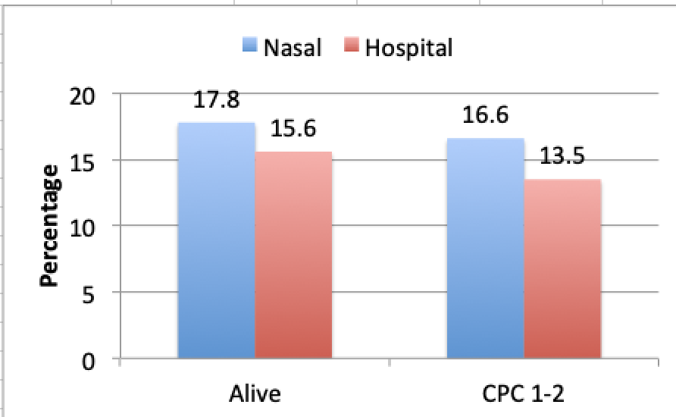
PRINCESS – Outcomes Nordberg 2019 JAMA 321: 1677–1685
Shockable Rhythm
All Patients (N=671)

Slide 46
PRINCESS – Outcomes Nordberg 2019 JAMA 321: 1677–1685
Shockable
Non-Shockable

Slide 47
What about longer exposure?
Brain Swells
7 days

Slide 48
Ask the Children

Slide 49
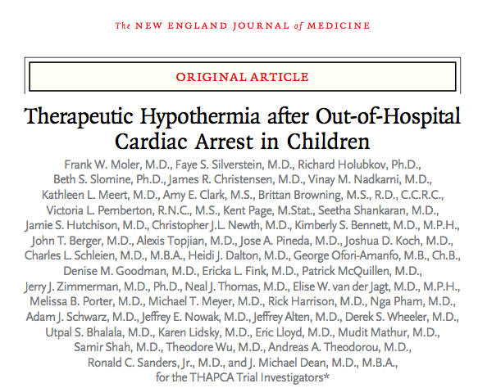
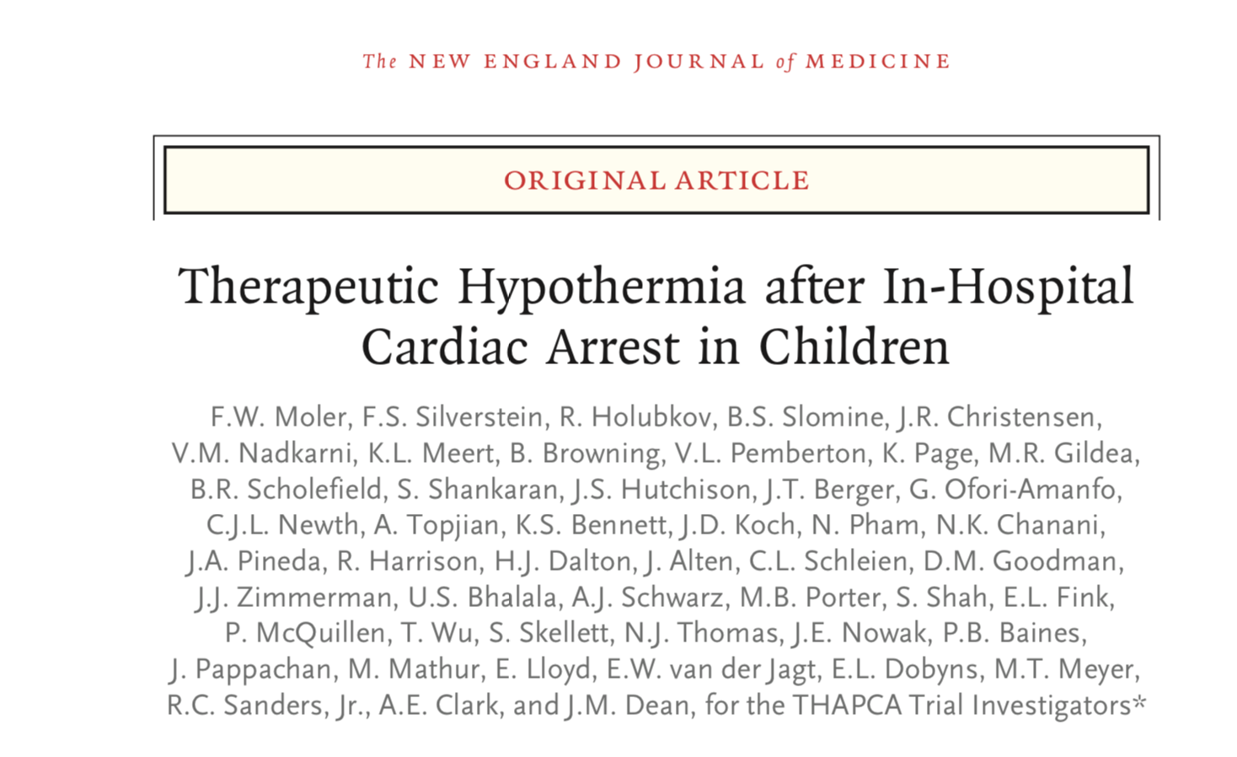
N=295
N=329

Slide 50
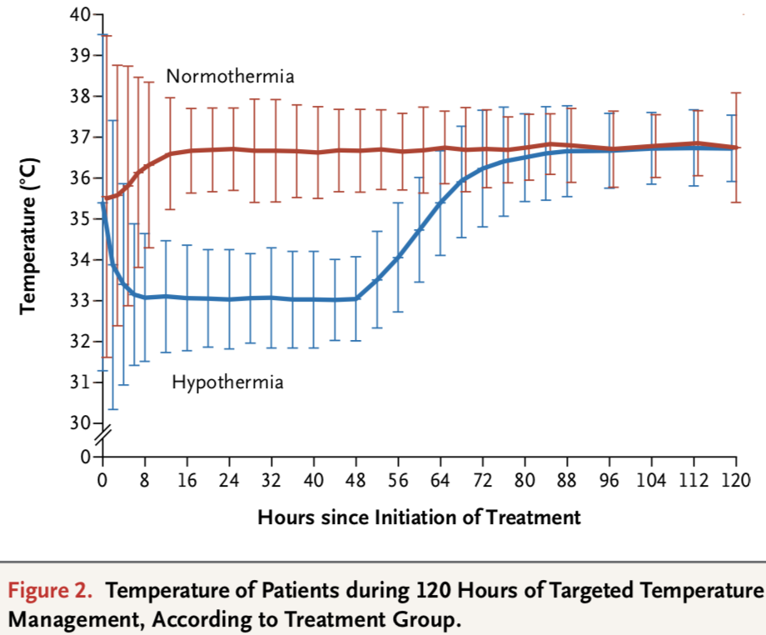
48 hours

Slide 51
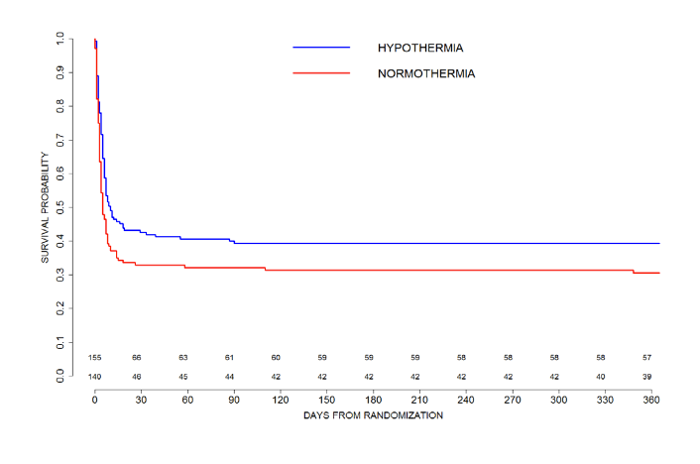
THAPCA- OHCA
38% vs. 29%

Slide 52
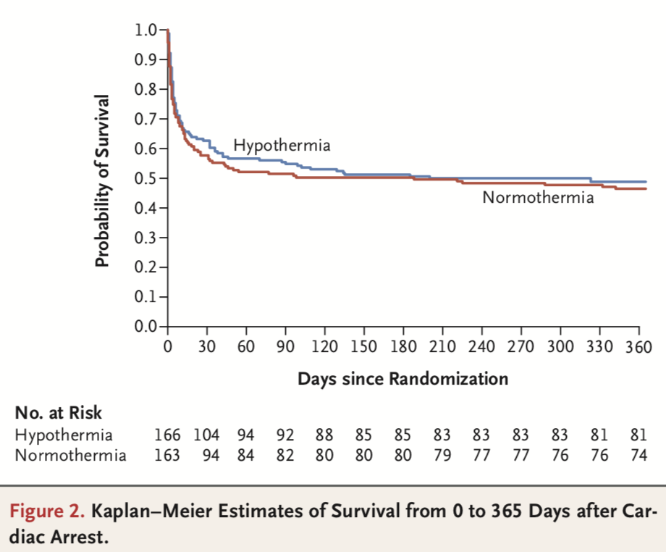
THAPCA- IHCA
49% vs. 46%

Slide 53
THAPCA
Median (IQR) minutes from Arrest to CPR
OHCA: 3 (0-7) vs. 2 (0-8)
IHCA: 0 (0-0) vs. 0 (0-0)
No Difference between 33ºC and 37ºC when no-flow time is near zero

Slide 54
Neonates: >8 RCTs
 | Intervention | Number
Azzopardi (2009) | 33-34ºC vs. 36.8-37.2 x 72 hrs | 325
Bharadwaj (2012) | 33-34ºC vs. 36.5ºC x 72 hrs | 130
Gane (2013) | 33-34ºC vs. 36.5ºC x 72 hrs | 122
Jacobs (2011) | 33-34ºC vs. 36.8ºC x 72 hrs | 221
Joy (2013) | 33-34ºC vs. 36.5ºC x 72 hrs | 160
Li (2009) | 33-34ºC vs. 36.5-37ºC x 72 hrs | 93
Shankaran (2005) | 34.5ºC vs. 36.5-37ºC x 72 hrs | 208
Simbruner (2010) | 33-34ºC vs. 36.5-37.5ºC x 72 hrs | 129
Quality of Evidence: High
Total number of term neonates in trials: 1388
Ongoing studies: combining treatments, selective head cooling

Slide 55
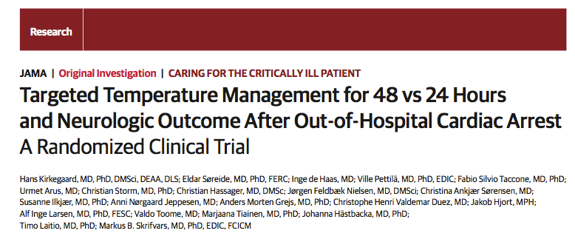
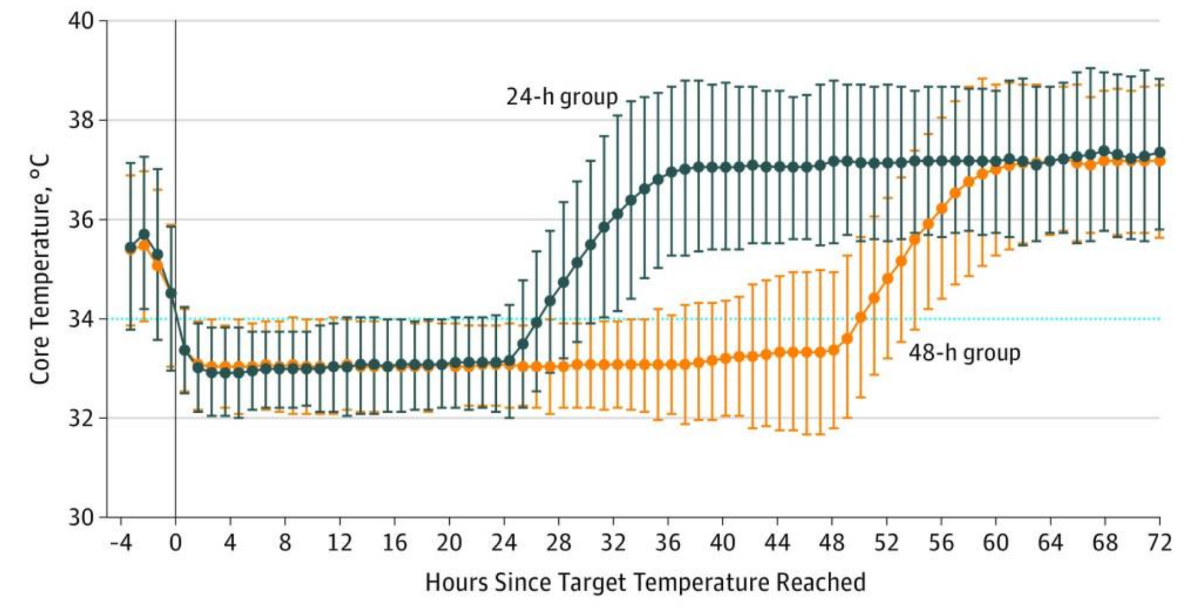
N=354

Slide 56
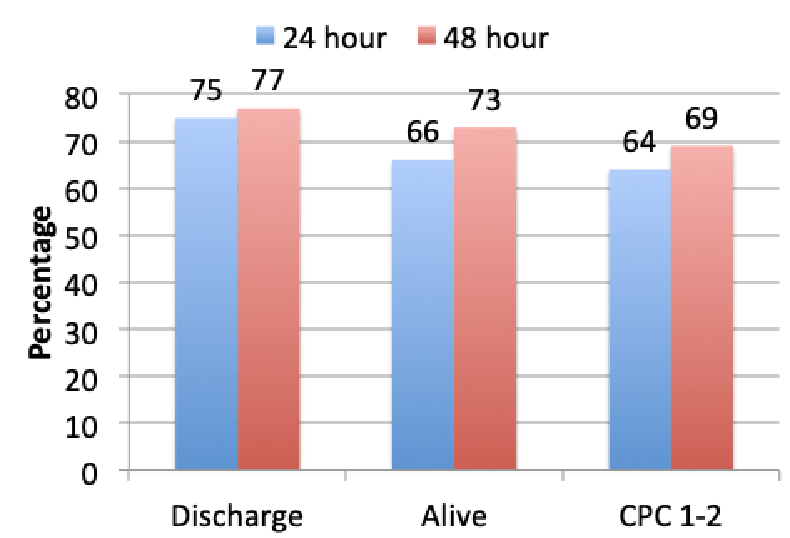
TTM for 48 vs. 24 Hours Kirkegaard 2017 JAMA 318: 341–350
N=354

Slide 57
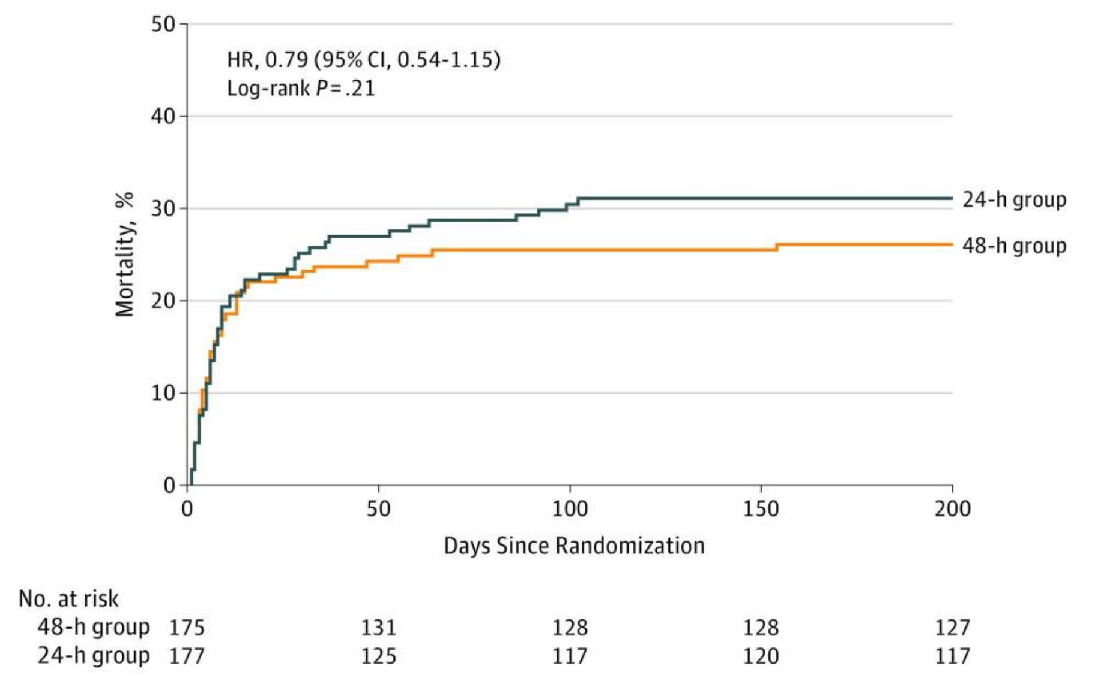
TTM for 48 vs. 24 Hours Kirkegaard 2017 JAMA 318: 341–350
Mortality, %

Slide 58
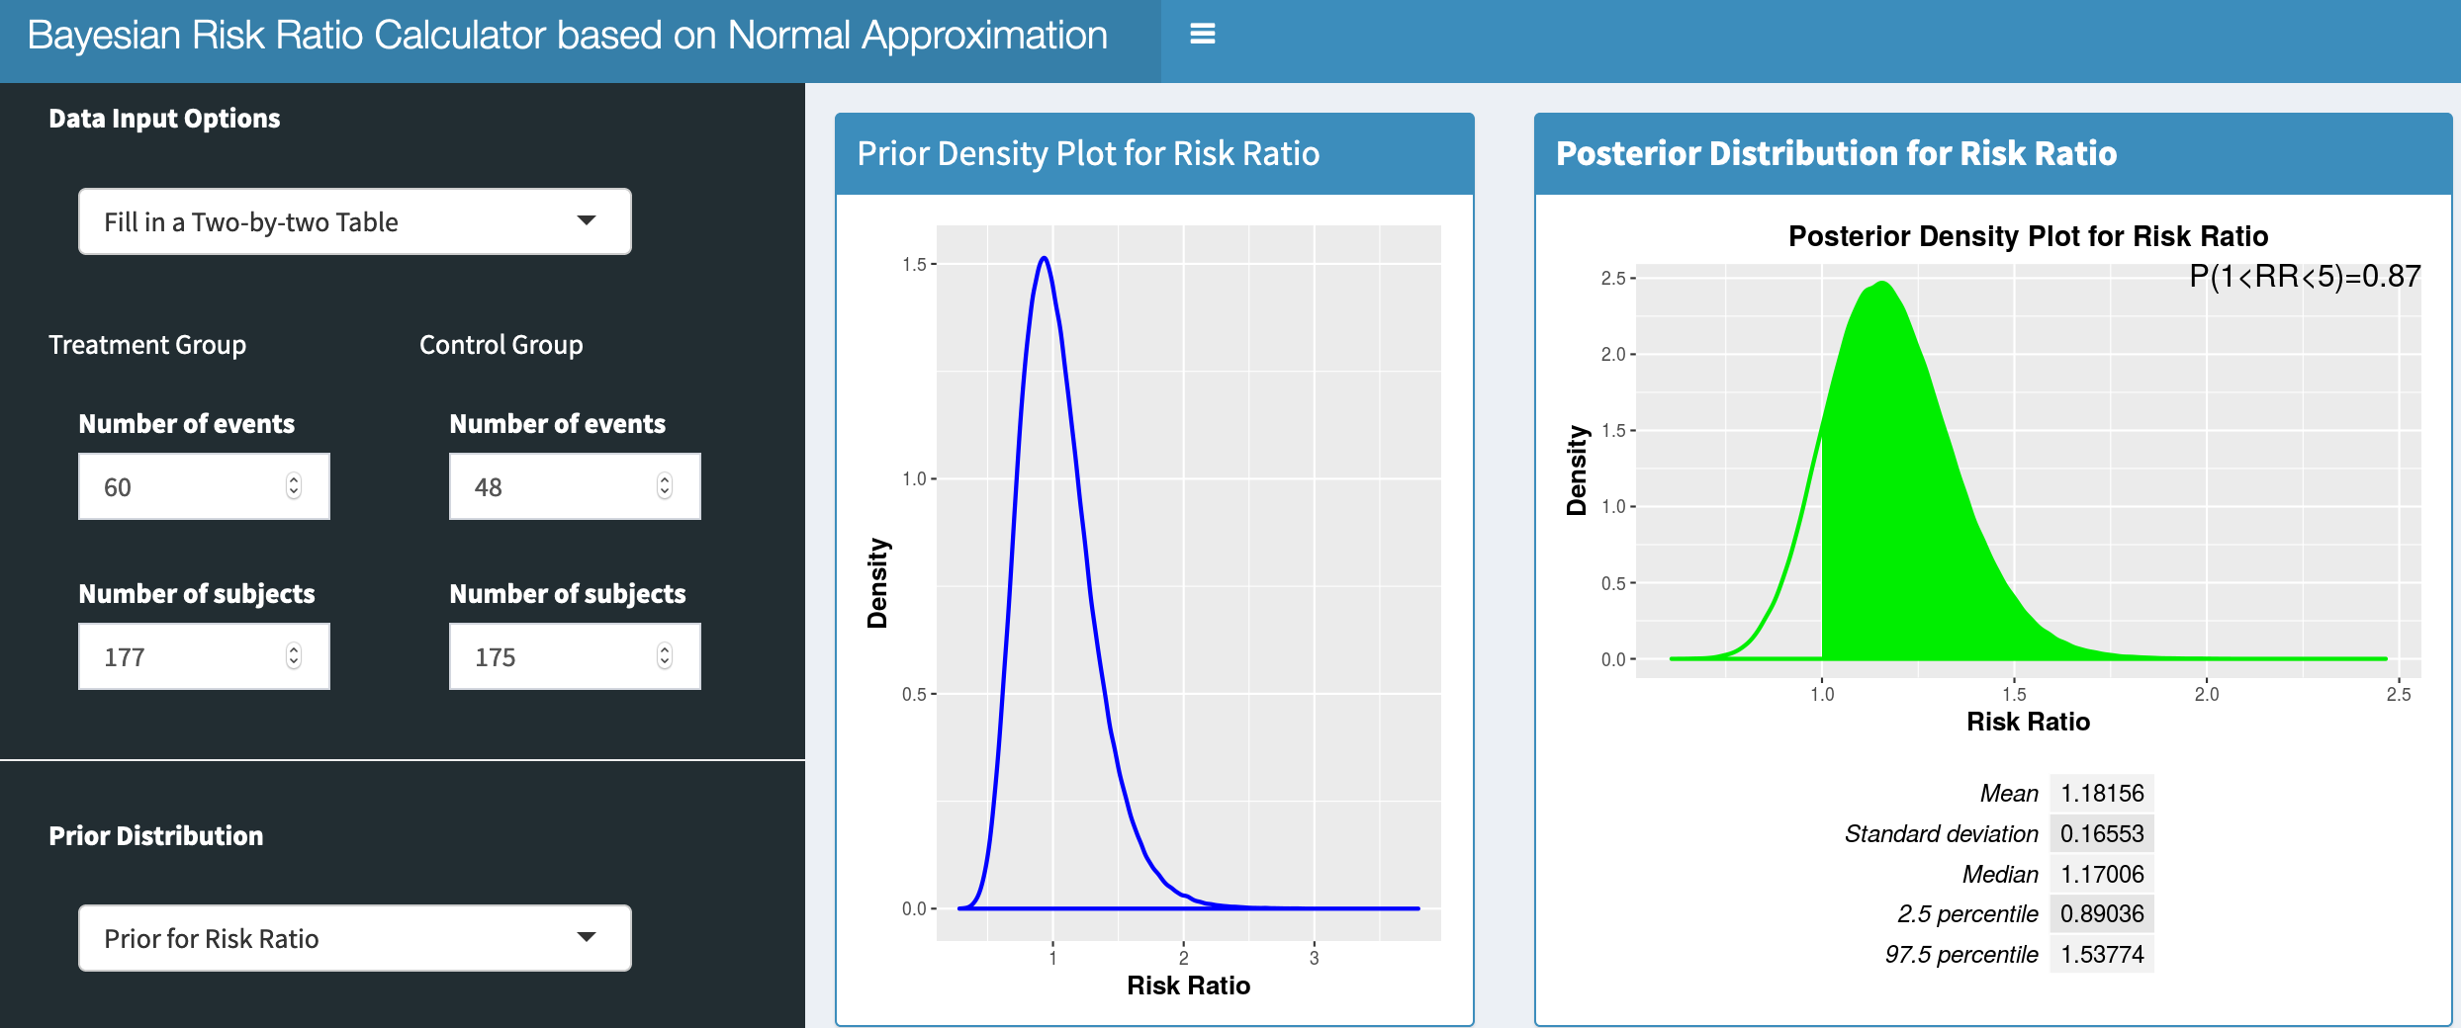
Bayes x Kirkegaard
Prior RR 1.0
Posterior RR 1.18

Slide 59
Comparison | Number of Subjects | Results and Limitations
32-34ºC > No TTM | 275 77 | Pseudo-randomized, wild-type control group, VF only
36ºC = 33ºC | 939 | Excluded sicker patients, median 1 min to CPR
33ºC > Normothermia | 584 | Non-VF only
33ºC vs. Fever Control | 1900 | Results Pending, finished Jan 2020
Prehospital IVF Cooling = Hospital Cooling | 1364 397 | No superiority; More rearrest; largest trials without ICU protocols
Intra-arrest nasal cooling = Hospital Cooling | 677 | No superiority in primary or secondary outcomes
48 hrs >= 24 hrs | 352 | Did not show superiority (87% chance RR for survival > 1.0)

Slide 60
Summary
TTM (32-36ºC) x 24 hrs in adults (2 RCT)
33ºC not superior to 36ºC for lightly injured (1 RCT)
33ºC is superior to 37ºC for more severe (1 RCT)
Very early hypothermia – mostly neutral (5 RCT)
TTM2 – results later this year (1 RCT)
Signal for 48 hrs better than 24 hrs (1 RCT)
Usual durations are 33ºC x 48 hrs in pediatrics
For pediatric OHCA favors 33ºC x 48 hrs (1 RCT)
For pediatric IHCA neutral for 33ºC x 48 hrs (1 RCT)
Usual durations are 33ºC x 72 hrs in neonates
For HIE in neonates, favors 33ºC x 72 hrs (8-10 RCT)

Slide 61
