Slide 1
HOBIT Case 2 Stimuli

Slide 3
BMP
Na+ 145 mmol/L
K+ 3.4 mmol/L
Cl- 108 mmol/L
Bicarbonate 21 mmol/L
Creatinine 1.2 mg/dL
BUN 18 mg/dL
Glucose 155 mg/dL
Calcium 6.4 mg/dL (low)

Slide 4
CBC
WBC 13.8 K/uL
Hemoglobin 11.2 g/dL
Platelets 297 K/uL

Slide 5
OR Report
Procedure(s) and Anesthesia Type:
* EXPLORATORY LAPAROTOMY - General
Pre-Op Diagnosis Codes:
* Splenic Laceration
Post-Op Diagnosis Codes:
* Splenic Laceration
Surgeon(s) and Role:
* Schmitz, Kyle R, MD – Primary
Antibiotics Administered - piperacillin-tazobactam (ZOSYN) 3.375 mg
Intraoperative Findings: splenic laceration s/p splenetcomyIntraprocedure I/O Totals
Output - Intraop EBL (mL) 500 mL
Input - 500ml NaCl 0.9% , 500ml Lactated Ringers Solution

Slide 6
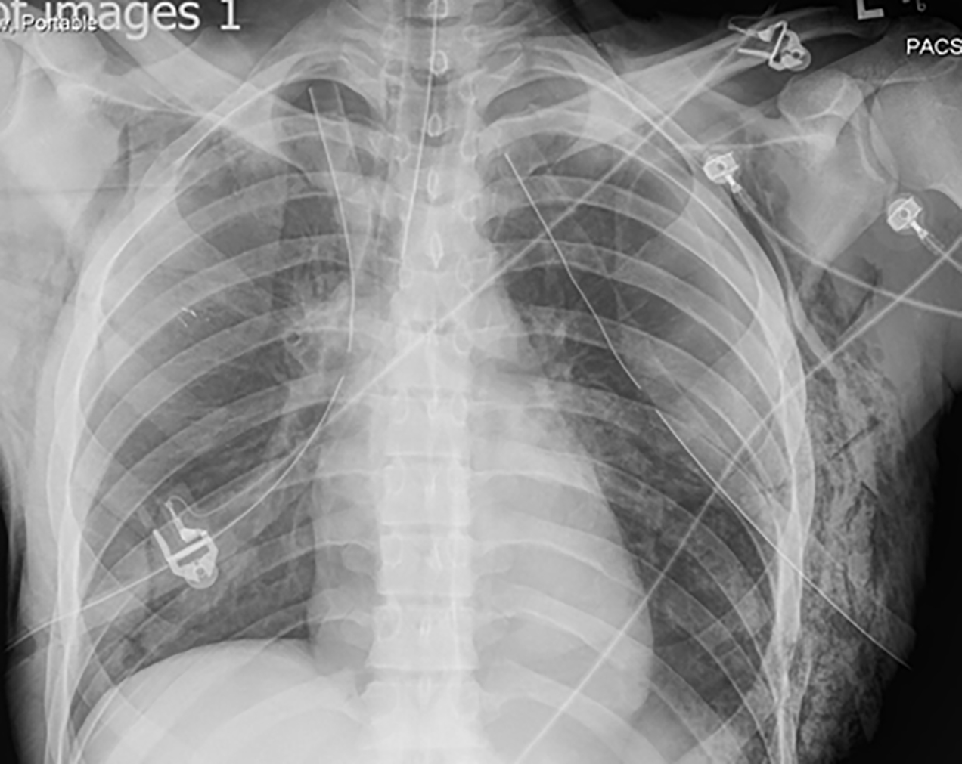
CXR

Slide 7
Lactate & VBG
Lactate
2.8 mmol/L
Urine Tox Negative
VBG
pH = 7.31
pCO2 = 45 mmHg
pO2 = 20 mmHg

Slide 8
BMP
Na+ 145
K+ 2.9 (low)
Cl- 108
Bicarb 21
Creat 1.2
BUN 18
Glucose 105
Calcium 6.4 (low)
Mag 3.1 (low)

