Slide 1
HOBIT Case 1 Stimuli

Slide 2
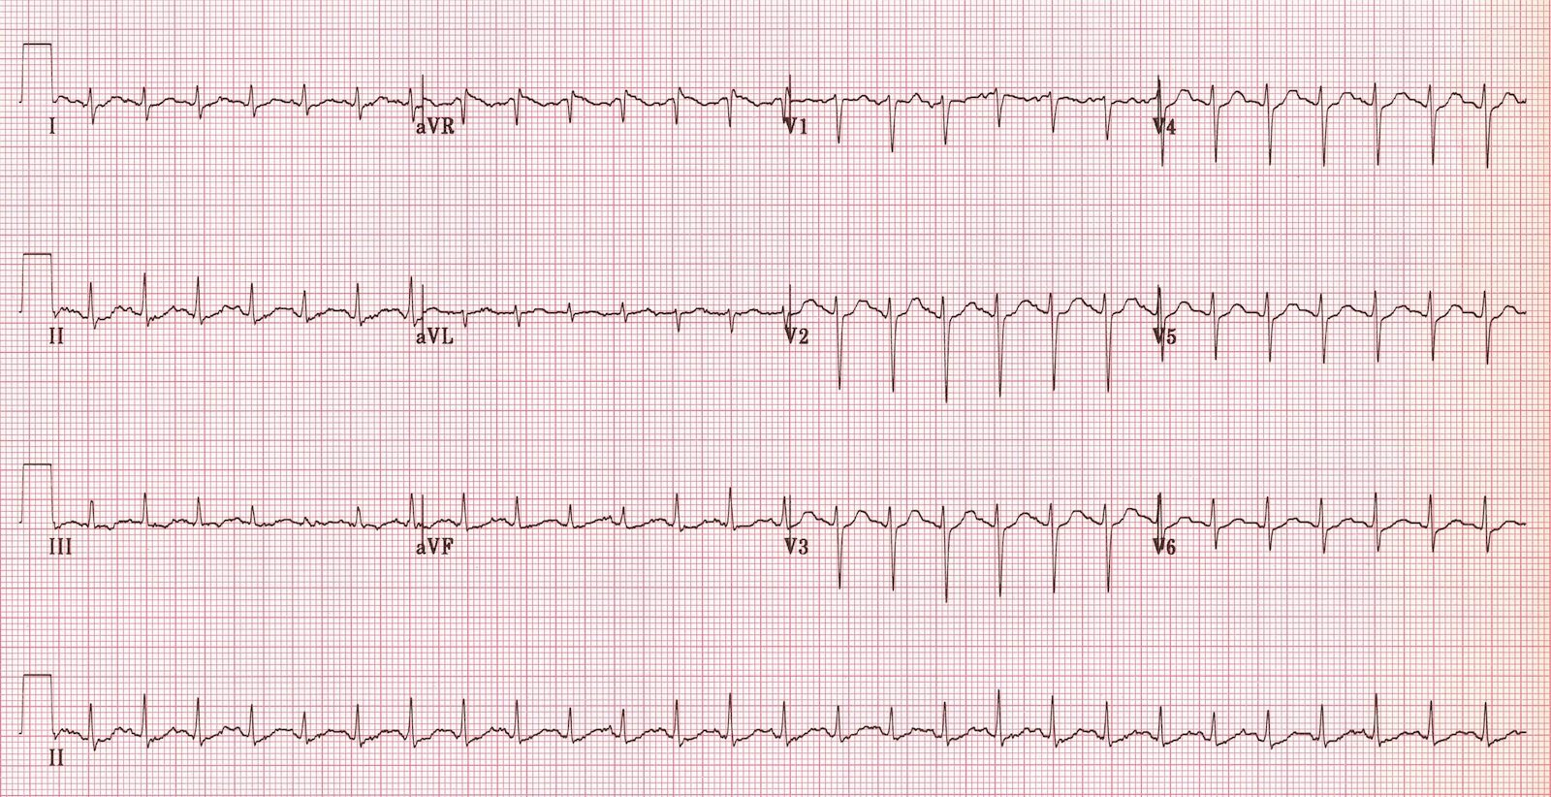
ECG

Slide 3
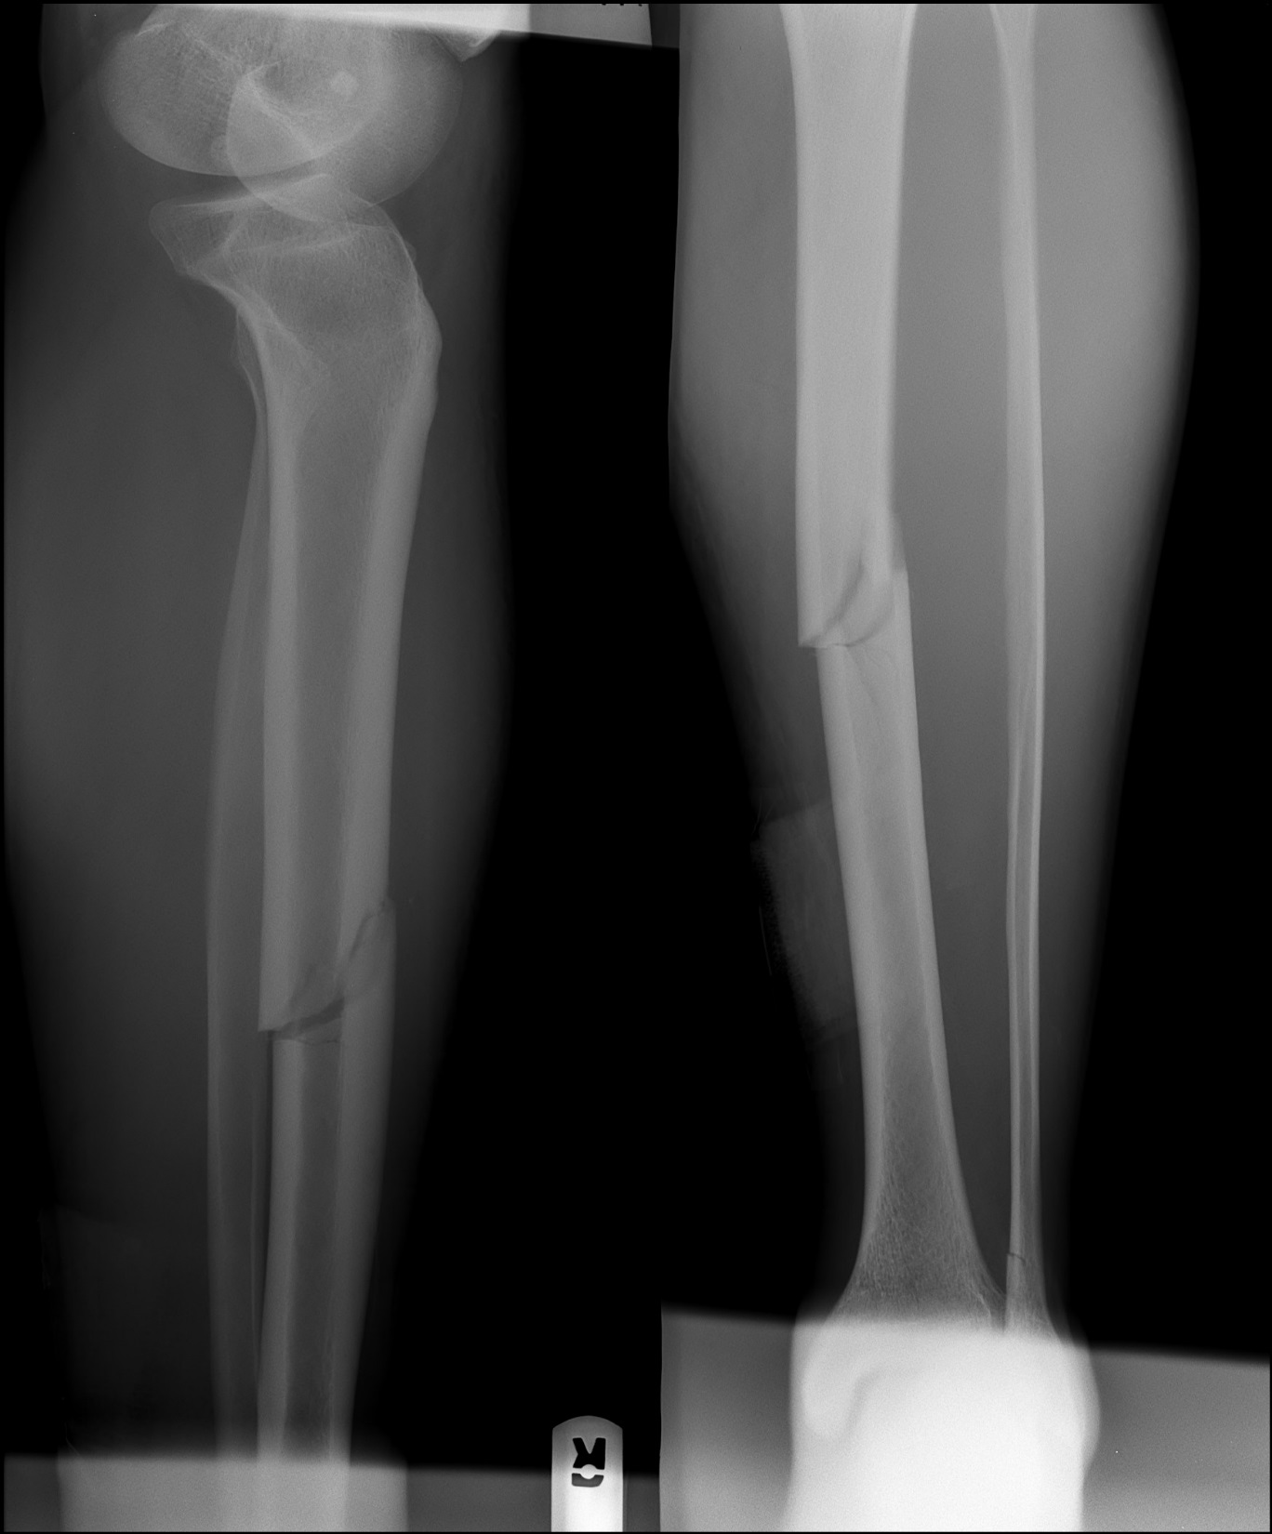
Right Lower Extremity

Slide 4
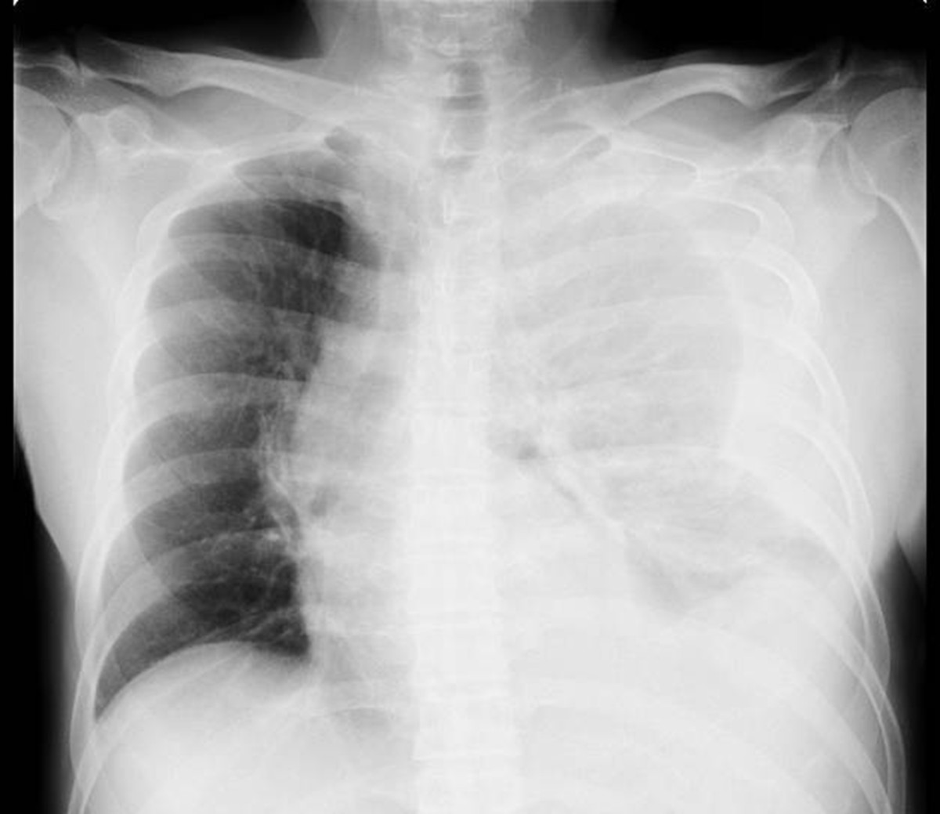
CXR

Slide 5
Head CT scan

Slide 6
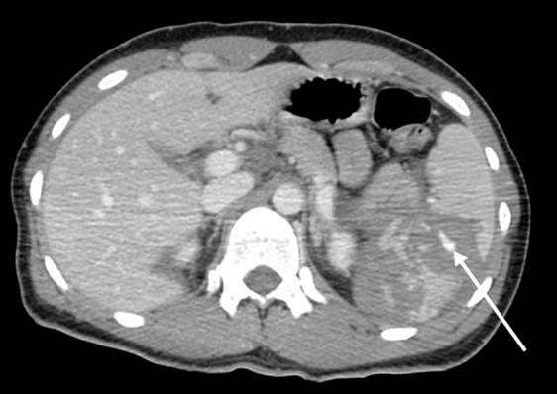
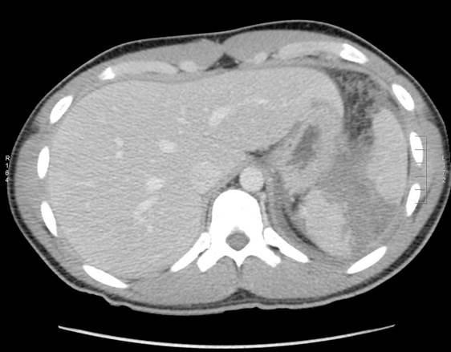
CT Abdomen/Pelvis
Notes:
Neg FAST

Slide 7
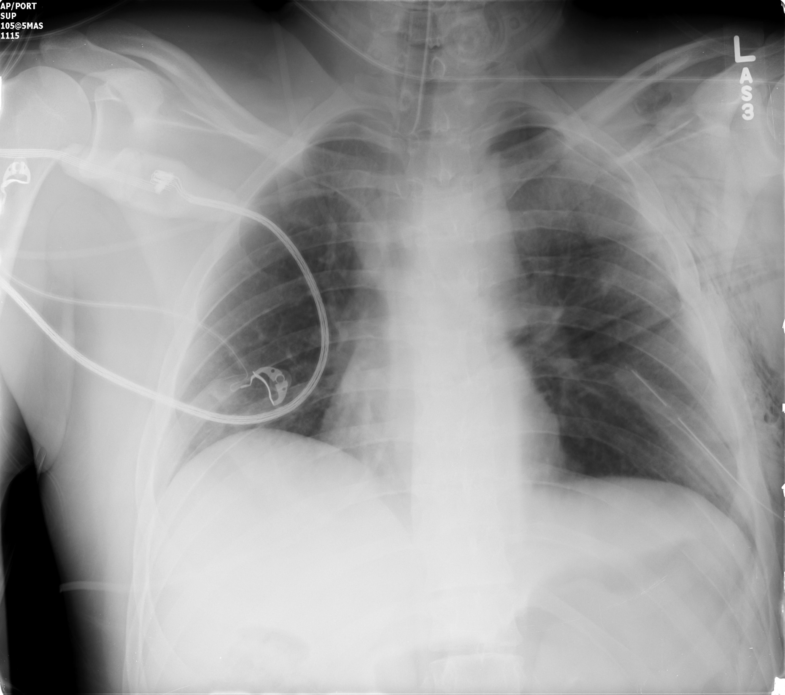
Repeat CXR

Slide 8
CBC
WBC: 13.8 K/uL
Hemoglobin: 7.2 g/dL
Platelets: 237 K/uL

Slide 9
BMP
Na+ 145 mmol/L
K+ 4.5 mmol/L
Cl- 108 mmol/L
Bicarbonate 21 mmol/L
Creatinine 1.2 mg/dL
BUN 18 mg/dL
Glucose 233 mg/dL

Slide 10
LFTs
LFTs
AST 32 IU/L
ALT 65 IU/L
Alkaline Phosphatase 134 IU/L
Bilirubin Direct 0.7 mg/dL
Bilirubin Total 1.4 mg/dL
Albumin 4.3 g/dL

Slide 11
Lactate & VBG
Lactate
3.8 mmol/L
Urine Tox Negative
VBG
pH = 7.31
CO2 = 45 mmHg
O2 = 20 mmHg

