Slide 1
Brain Oxygen Optimization in Severe TBI Phase 3 Clinical Standardization Team Training
Lisa H. Merck MD MPH Associate Professor of Emergency Medicine, Neurosurgery, and Diagnostic Imaging, Brown University Lori Shutter MD, FNCS, FCCM Professor of Critical Care Medicine, Neurology, and Neurosurgery, University of Pittsburgh for the BOOST3 CST

Slide 2
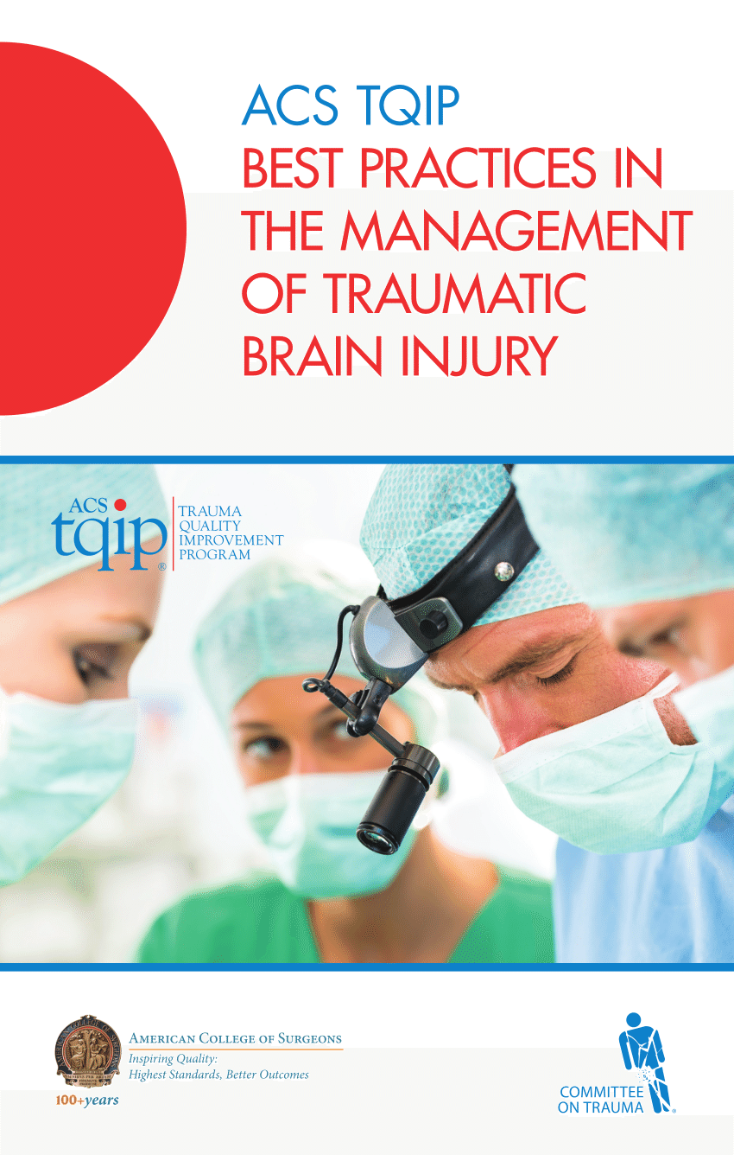
Clinical Standardization Guidelines
Goal directed management of physiologic parameters will be in accordance with recommended treatment guidelines published by the Brain Trauma Foundation and the American College of Surgeons
Clinical management of these parameters
Should be based on local protocols
Will be tracked on the daily CRFs

Slide 3
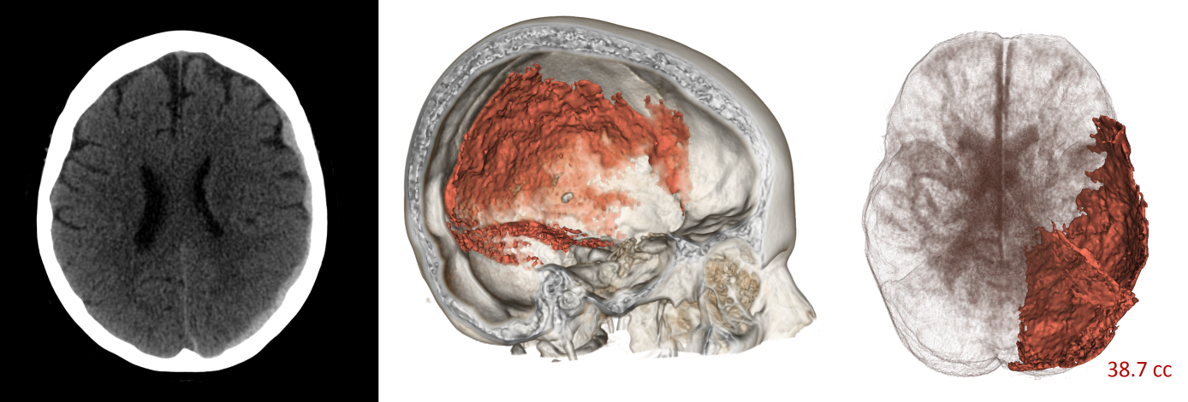
Clinical Standardization Guidelines
We recognize the existence of treatment variability within this heterogeneous population. These guidelines do not circumvent clinical acumen. However, treatment variability has undermined several notable Phase III clinical trials TBI.
Given the heterogeneity of both clinical presentation and clinical therapy in patients with TBI, adherence to the guidelines is imperative if we are to conduct a successful trial.
Wright D, Merck LH: Head Trauma. In Tintinalli JE, Stapczynski JS, Ma OJ, Cline DM, Cydulka R (eds): Emergency Medicine: A Comprehensive Study Guide, 9th edition. McGraw-Hill, Inc 2019, in press

Slide 4
Clinical Standardization Team
Rocco Amonda, MedStar Washington Hospital Center Francis Bernard, University of Montreal Randy Chesnut, University of Washington
Ramon Diaz-Arrastia, University of Pennsylvania
Claude Hemphill, UCSF Luke James, Duke University Medical Center
Ryan Kitagawa, University of Texas - Houston Lisa H. Merck, Brown University
David Okonkwo, University of Pittsburgh Claudia Robertson, Baylor College of Medicine Uzma Samadani, University of Minnesota
Danielle Sandsmark, University of Pennsylvania
Lori Shutter, University of Pittsburgh

Slide 5
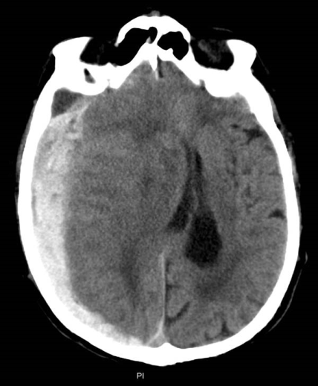
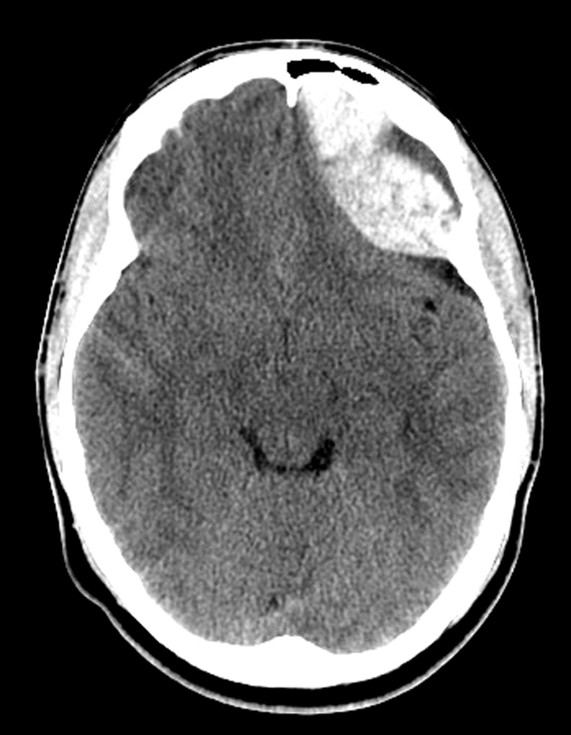
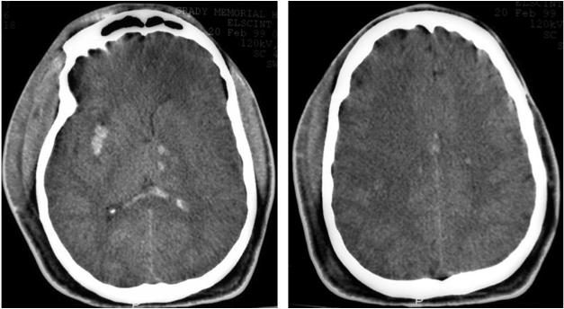
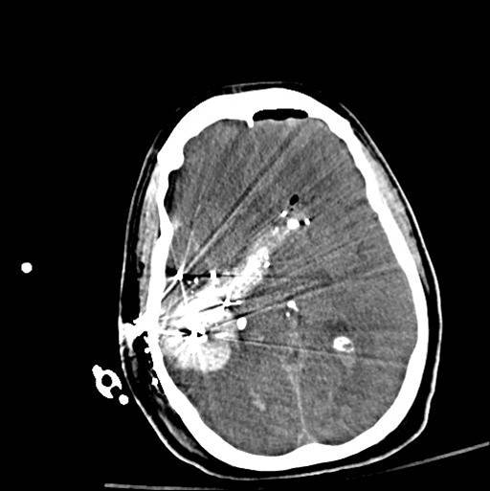
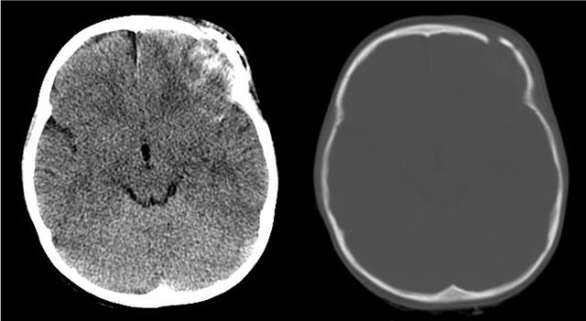
Variability in Observed Outcome
Heterogeneity in disease phenotype Heterogeneity in disease management
Wright D, Merck LH: Head Trauma. In Tintinalli JE, Stapczynski JS, Ma OJ, Cline DM, Cydulka R (eds): Emergency Medicine: A Comprehensive Study Guide, 8th edition. McGraw-Hill, Inc 2015.

Slide 6
Variability in Reported Mortality Rate after TBI
1. Fakhry, S.M., J. Trauma 2004, 56:492-500 | 18%
2. MRC Crash Trial, Curr Opin Crit Care 2003, 9:92-97 | 39%
3. Cooper, D.J., JAMA 2004, 291:1350-1357 | 45%
4. Gan, B.K., Ann Acad Med Singapore 2004, 33:63-67 | 45%
5. Bouillon, B., Res Neu and Science 1999, 14:85-92 *(26% post ED) | 47%
6. Marshall, L.F., Neurosurg 1998, 89:519-525 | 27%
7. Morris, G.F., J Neurosurg 1999 91:737-743 | 23%
8. Hukkelhoven C.W., J. Neurosurg 2002 97:549-557 | 24%
9. Murry, G.D., Acta Neurochir 1999, 141:223-236 | 40%
10. Braakman, R., Neurosurgery 1980, 6:362-370 | 59%
11. GMH Trauma Registry (TRACS) 2000-2002 | 30%
12. Wright DW. ProTECTIII NEJM 2014 17.2%

Slide 7
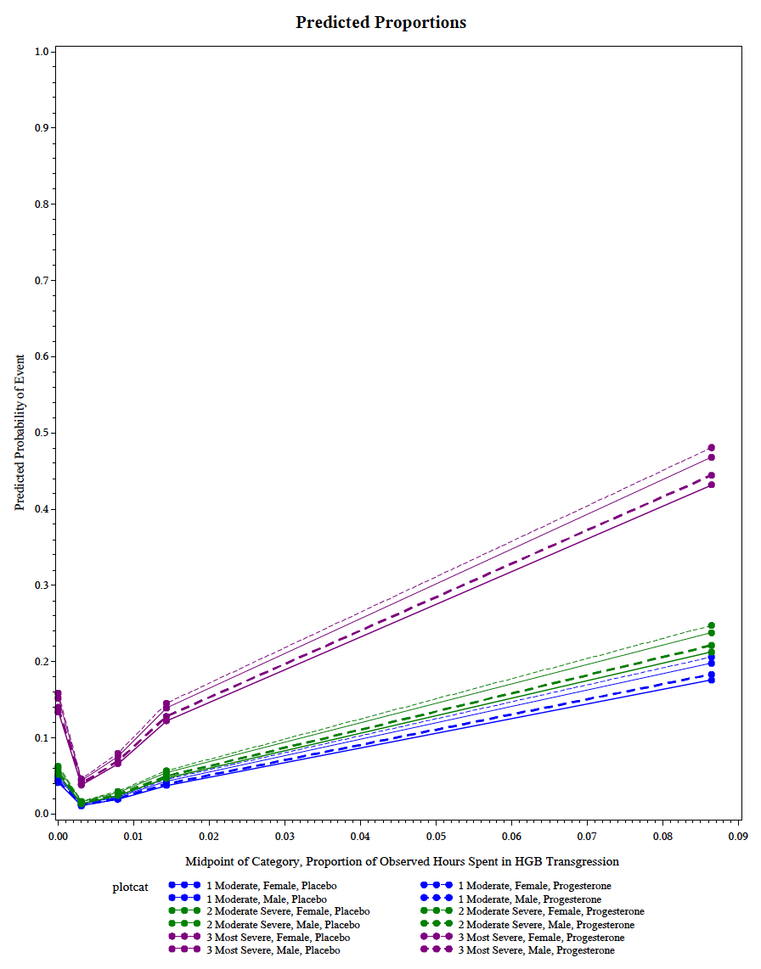
Lessons From ProTECTIII
Proportion of Time Spent with Hgl <8g/dL and Predicted Probability of Death
Robust standardization of care and data management were implemented. Adherence to the guidelines was quantified and daily feedback about compliance were provided to each center.
A significant association between several individual physiologic parameters and outcome was identified.
Lisa H. Merck MD MPH, Sharon D. Yeatts PhD, Geoff Manley MD PhD, Robert Silbergleit MD, Robin Conwit MD, Qi Pauls MS, Michael Frankel MD, Peter Le Roux MD, Yuko Palesch PhD, David W. Wright MD. Goal Directed Therapy in the ProTECTIII Clinical Trial: The Effect of Physiologic Transgressions on Patient Mortality and Functional Outcome after Traumatic Brain Injury. Crit Care Med. 2019 Feb 5

Slide 8
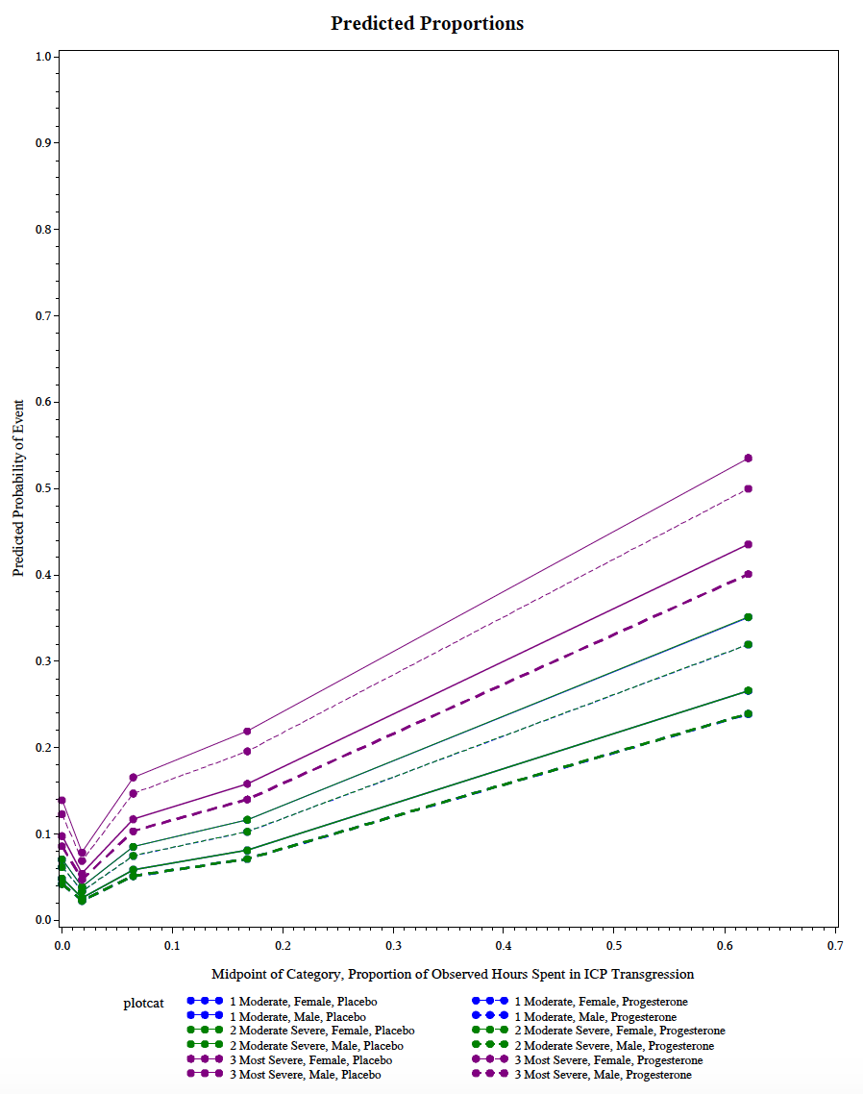
Lessons From ProTECTIII
Proportion of Time Spent with ICP ≥ 20mmHg and Predicted Probability of Death
Robust standardization of care and data management were implemented. Adherence to the guidelines was quantified and daily feedback about compliance were provided to each center.
A significant association between several individual physiologic parameters and outcome was identified.
Lisa H. Merck MD MPH, Sharon D. Yeatts PhD, Geoff Manley MD PhD, Robert Silbergleit MD, Robin Conwit MD, Qi Pauls MS, Michael Frankel MD, Peter Le Roux MD, Yuko Palesch PhD, David W. Wright MD. Goal Directed Therapy in the ProTECTIII Clinical Trial: The Effect of Physiologic Transgressions on Patient Mortality and Functional Outcome after Traumatic Brain Injury. Crit Care Med. 2019 Feb 5

Slide 9
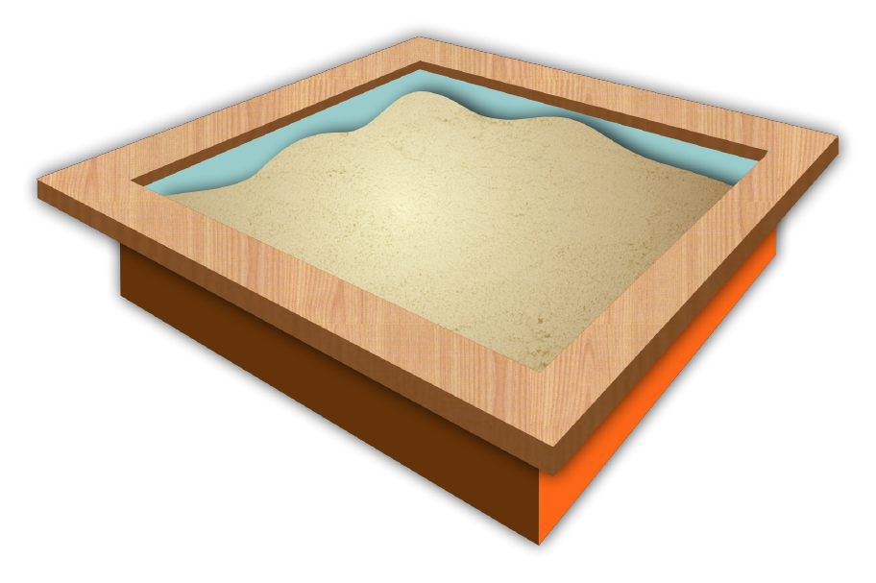
In order to have the best chance of identifying a causal relationship between intervention and outcome, clinical standardization is imperative.
TRAUMA SURGEONS
NEUROSURGEONS
EMS
ED DOCS
NEUROINTENSIVISTS
Courtesy of David Wright MD, Emory University

Slide 10
Clinical Standardization Guidelines
Topics for which we provide guidance are:
Hemodynamic Issues
Temperature management
Respiratory issues
Hematologic issues
Seizure prevention / Management
Withdrawal of care / Brain Death

Slide 11
Clinical Standardization Guidelines
Hemodynamic Issues
Arterial Blood Pressure monitoring for CPP purposes
Standardized to the level of the heart
Temperature Management
Initial goal normothermia (36.5 – 37.5°C).
Hyperthermia (temperature > 38.3° C) managed aggressively per local protocol.
Prophylactic hypothermia is not allowed. It is a Tier 3 treatment option.

Slide 12
Clinical Standardization Guidelines: Respiratory Issues
PaO2, PaCO2, and pH levels will be monitored at least daily
This information will be collected immediately after any FiO2 challenge and whenever an ABG is drawn for clinical management
Target PaO2 is 80-200 mm Hg
In some clinical settings a lower PaO2 is needed. In that situation, PaO2 < 80 mm Hg will be acceptable, if PbtO2 is at target (20 mm Hg) - remember to document.
Elevated PaO2 may be harmful, and further FiO2 increases are not allowed if PaO2 is > 200 mm Hg, unless PbtO2 is persistently < 20 mm Hg when all other variables contributing have been addressed and controlled
A PaO2 <60 mm Hg without documented intervention is a protocol violation

Slide 13
Clinical Standardization Guidelines: Respiratory Issues
Initial PaCO2 should target normocapnia (i.e., 35 - 45 mm Hg)
PaCO2 adjustments should be in small increments (maximum of 5).
Further adjustments should be guided by clinical status (ie, history of CO2 retention, acute uncompensated hypercarbic respiratory failure, pulmonary contusions, etc).
Target pH is 7.35 – 7.45.
When adjusting PaCO2, the pH must also be considered. Further lowering of PaCO2 should not be done if pH > 7.45, and PaCO2 should not be increased if pH is < 7.35.

Slide 14
Clinical Standardization Guidelines: Hematologic Issues
Hemoglobin levels should be maintained > 7.0 g/dL.
Goal INR at time of insertion/removal of intracranial probes is ≤ 1.6.
Correction should be initiated rapidly and will be done per local protocol.
The measures used for correction and resolution of the coagulopathy will be documented on the AE report form and daily CRF.
Goal platelets for insertion/removal of intracranial probes is ≥ 80,000 /ml.
Correction should be initiated rapidly and will be done per local protocol.
The measures used for correction and resolution will be documented on the AE report form and daily CRF.

Slide 15
Clinical Standardization: Seizure Prevention / Management
Use of prophylactic anti-seizure medications (AEDs) is optional
Prophylactic AEDs should be used for 7 days only (unless dev seizure) Phenytoin, levetiracetam, other AEDs may be used according to local protocol
phenytoin loading dose = 20 mg/kg, followed by maintenance dose of 3 - 5 mg/kg/day
AED levels should be monitored per site protocol
Clinical or subclinical seizures (as identified by EEG) should be managed according to site protocol.
AE form should be submitted to reflect onset, duration, and treatment of seizure

Slide 16
Withdrawal of Care / Brain Death
The intent of the study is to optimize therapy for 5 days after randomization.
Withdrawal of care during the first 5 days may be considered in dire circumstances or if requested by the patient’s family.
Site PI to call the study hotline and update study leadership in event of withdrawal of care.
Withdrawal of care is documented on the End of Study form and on the Moberg monitor.
Should the patient progress to brain death, determination is per local protocol.
Participation in the clinical trial will not preclude a patient from consideration as an organ donor.

Slide 17
QUESTIONS?

