Slide 1


Biomarkers in the Brain Oxygen Optimization in Severe TBI Study
PIs: Ramon Diaz-Arrastia, M.D., Ph.D. and Frederick Korley, M.D., Ph.D.

Slide 2

The Need
Limited objective tools for monitoring secondary brain injury

Slide 3
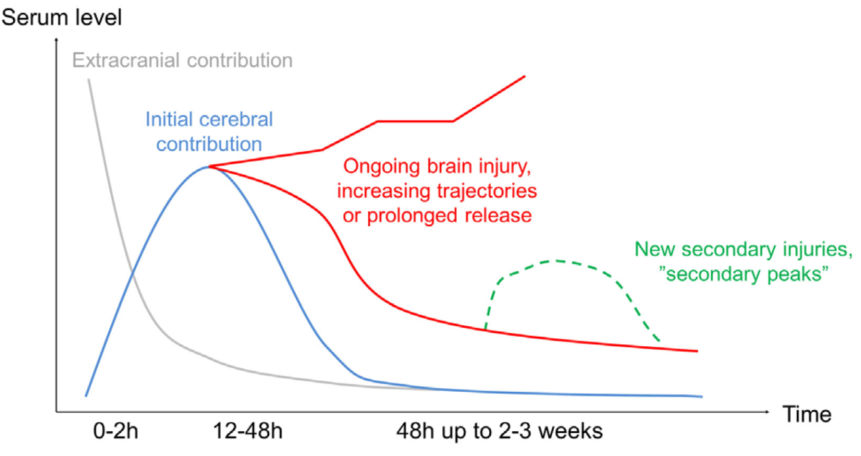
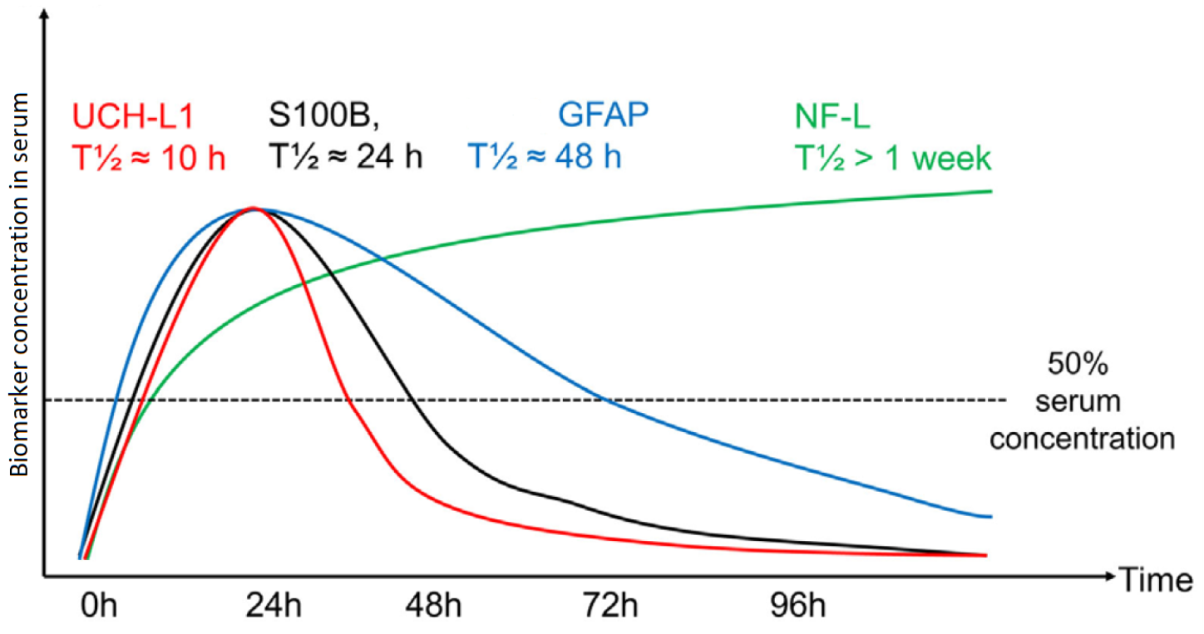
Scientific Rationale

Slide 4
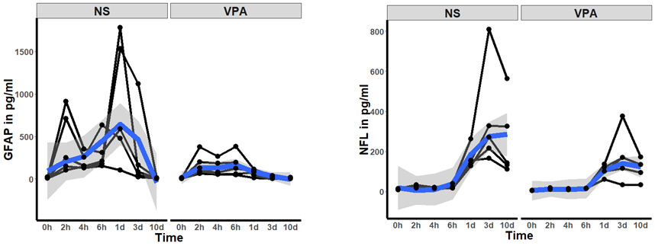
Preliminary evidence
Korley et al. J Neurotrauma. 2018 May 15;35(10):1185-1191

Slide 5
Objectives
Primary: Quantify the effect of total brain tissue hypoxia exposure on brain injury using biofluid-based biomarkers of brain injury.
Secondary:
  Effect of cerebral hypoperfusion on biomarker values
  Effect of PbtO2 guided treatment on biomarker values
  Association between biomarker values and functional outcome
  Create a repository of longitudinal serum, plasma, CSF, mRNA and DNA samples from subjects with severe TBI

Slide 6
Study Population
Inclusion Criteria
  Enrolled in BOOST-3
  Enrolled at Bio-BOOST site
  Able to obtain initial blood sample within 12 hours of injury
Exclusion Criteria
  Profoundly anemic (Hemoglobin < 8 mg/dl)

Slide 7
Informed Consent
Written informed consent from LAR
Initial blood sample may be obtained prior to consent but will only be included in the study after consent is obtained.

Slide 8
Biospecimen Collection Schedule
 | Day 1 | Days 2 - 5 | Day 7 | Day 14 | 6 month
Frequency | Every 8 hours | Every 12 hours and once post-sustained ischemic event | Once | Once | Once
Timing | Q8 (+/- 1 hour) hours after randomization | Q8am and Q8pm (+/- 2 hours) and once post-sustained ischemic event | Q8 am | Q8am | During follow-up visit
Specimen Type | Serum, Plasma, CSF, DNA, RNA | Serum, Plasma, CSF, DNA, RNA | Serum, Plasma, CSF, DNA, RNA | Serum, Plasma, DNA, RNA | Serum, Plasma, DNA, RNA

Slide 9
Biospecimen Processing and Storage
Centrifuge, process and store samples within 2 hours of draw
Store in -70 degrees Fahrenhiet or colder
Ship to biorepository at University of Pittsburg once or twice a year.

Slide 10
Site Qualification Survey
Bit.ly/BioBOOST3

Slide 11


