Slide 1
Ancillary Trial Protocols
Merck, Hirsch/Elmer/May, Rittenberger/Kurz, TBA
Investigator Kick-off Meeting
January 30-31, Clearwater, Florida

Slide 2
Multimodality Phenotyping (Tesla)
Hirsch / Elmer / May

Slide 3
PRECICECAP PREcision Care In Cardiac ArrEst - ICECAP

Slide 4
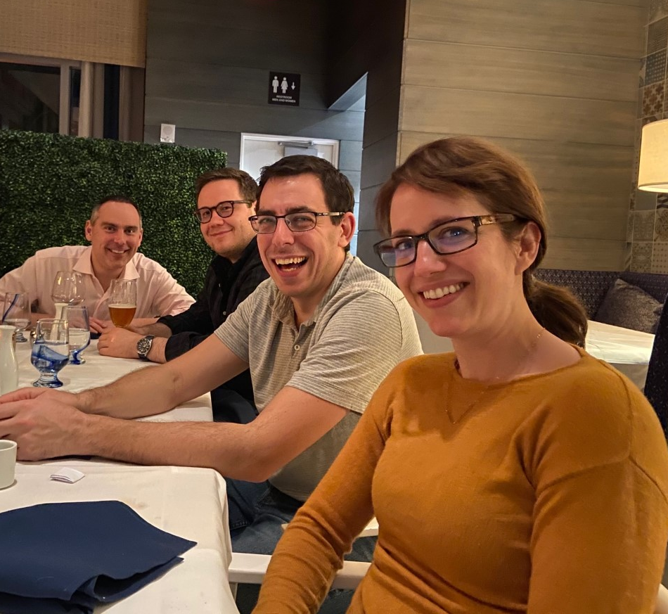
Multidisciplinary Study Team
Jonathan Elmer, University of Pittsburgh
Teresa May, Maine Medical
Romer Geocadin, Johns Hopkins
Zihuai He, Stanford University

Slide 5
Study Background and Aims
The type and severity of post-arrest illness vary across patients, can be quantified, and predict treatment responsiveness.
Systemic physiology is inextricably linked to brain (dys)function.
It is time to move beyond prognostication for poor outcome.
We must harness precision medicine to identify subgroups in order to deliver the best therapies and improve outcomes.
Aim 1: Use advanced analytical approaches to create novel biomarkers from multimodality high-resolution data and test these markers against established predictors to determine optimal duration of hypothermia after cardiac arrest.
Aim 2: To evaluate the performance of novel and established biomarkers to predict 90-day function.

Slide 6
Major limitations in past neuroprognostication research
Past limitation | Importance | How PRECICECAP addresses
Limited population in derivation cohort | Small cohorts and single-center designs lead to uncertainty and limits generalizability | Multicenter approach will allow broad population inclusion and increased generalizability
Post-resuscitation care not standardized | Heterogeneity in clinical care leads to difficulty attributing effect of interventions | Clinical standardization protocol of ICECAP will define posts-resuscitation care
Lack of blinding | Care teams have access to diagnostic test being studied, leading to confounding | Neural network approach allows for unbiased approach to data analysis
Heterogeneous diagnostic testing and withdrawal of life-sustaining therapy | Sites differ in their approach to withdrawal of life-sustaining therapies | Clinical standardization protocol of ICECAP defines prognostication approach
Non-standardized outcomes | Definitions of good and poor outcome vary between studies, and outcome scales have significant limitations | Primary outcome of mRS is a recommended outcome and will be assessed by trained assessors
Do not account for medications, hypothermia and organ dysfunction | Confounding due to medications, shock, organ failure and hypothermia | CRF from both ICECAP and PRECICECAP will allow for detailed assessment of these factors

Slide 7
Multi-Modal Data Collected at Participating Sites
Data Transmitted to Central Repository
(IBM Cloud and DCC)
February 5, 2020! (T-5 days)
Preliminary sites selected
Fingers crossed…
(khirsch@stanford.edu)
Data Quality Reviewed,
Annotation and Artifact Rejection
Multi-Step Data Featurization
Novel Biomarker Signatures (Subgroups) Developed
Novel Biomarkers and Standard Features Compared
Aim 1: To predict treatment response
Aim 2: To predict patient outcome

Slide 8
Blood Phenotyping
Bio ICE
(Honda)
Rittenberger / Kurz / Et al.

Slide 9
Premises
Cardiac Arrest is NOT a binary disease
Witnessed/Unwitnessed
Shockable/Not Shockable
Cardiac/Not Cardiac
Any intervention will help some and hurt some
TPA in stroke early- good
TPA in stroke late- bleeding risk higher

Slide 10
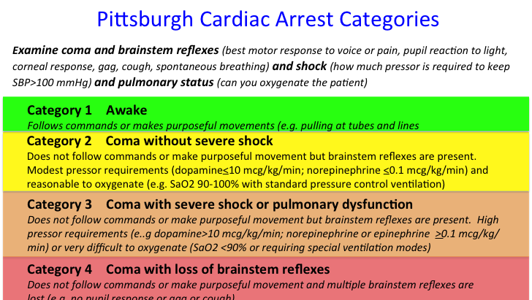
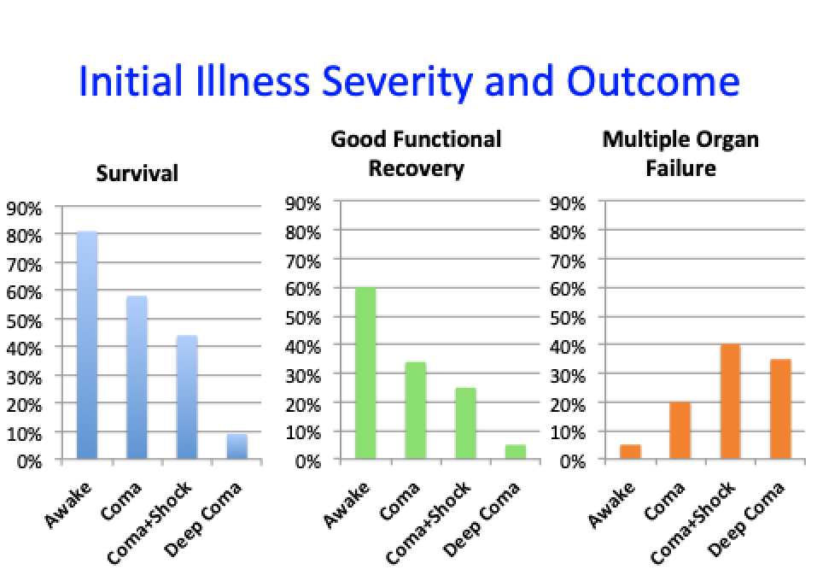
PCAC
1. Awake
2. Coma, Some Reflexes, Mild Shock
3. Coma, Some Reflexes, Severe Shock
4. Missing Brainstem Reflexes
Derivation - Rittenberger 2011; Resuscitation 82: 1399-1404
Validation: Coppler 2015; Resuscitation 89:86-92
Notes:
We can quantify illness severity shortly after hospital arrival. It correlates to survival, good outcome and MOF.

Slide 11
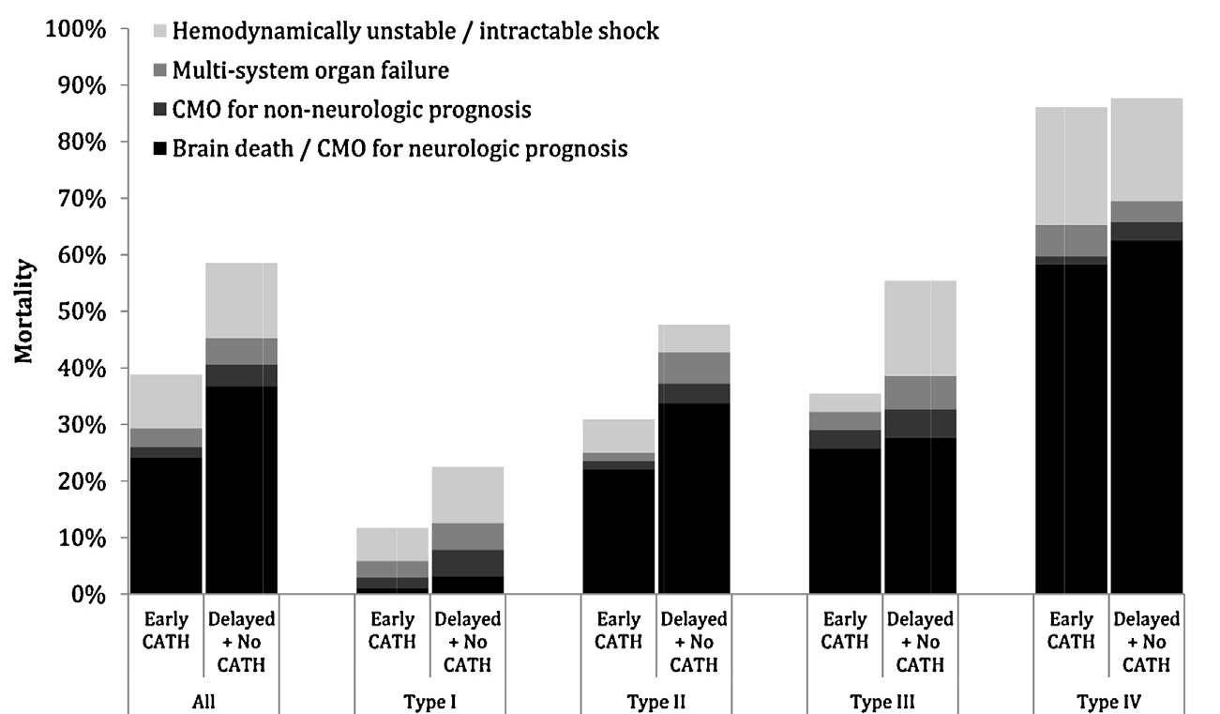
Reynolds et al. Resuscitation 2014
Notes:
This risk stratification can be used to determine if an intervention may benefit the patient

Slide 12
What about TH/TTM?
OR for survival to hospital discharge 33ºC vs 36ºC
PCAC 2: OR 0.71 (95% CI 0.44-1.16)
PCAC 3: OR 2.22 (95% CI 1.16-4.25)
PCAC 4: OR 2.72 (95% CI 1.32-5.63)
Callaway, et al. 2020 (in review)
Notes:
Similarly, recent data have demonstrated that more severe illness severity benefits from TH at 33C

Slide 13
Aims
Determine the optimal duration of therapeutic hypothermia (TH) in adult comatose survivors of cardiac arrest based on initial illness severity.
Determine how accurately longitudinal changes in biomarkers of brain cell death and coagulation dysfunction predict clinical outcome.
Determine the treatment effect of TH duration on: 1) brain cell death; 2) coagulation dysfunction.
Notes:
Using initial illness severity and initial biomarker release patterns, we will determine phenotypes of patients who are most likely to benefit (or suffer harm) from specific durations of TH.
We will also determine if the trajectory of biomarker release is associated with recovery (or death).
We will determine if duration of TH can affect the trajectory of biomarker release and recovery (or death).

