Slide 1
SIREN Overview
Drs. Robert Silbergleit & Sharon Yeatts

Slide 2

Network Overview
P-ICECAP Investigators Meeting

Slide 3





Evolution

Slide 4
Design principles and organizational values
Focus on early treatment.
Focus on meaningful outcomes for patients.
Focus on efficiency.
Focus on collaboration.
Focus on transforming the clinical trials enterprise.

Slide 5
Organizational Structure
EOB
Spokes
HSP
WG
Hubs
NIH
DSMB
Electronic Data Capt. WG
Steering
Comm.
Mgmt
Comm
Imaging
EMS
WG
Pharmacy
CCC
Operations
Committee
DCC
Trial Comm
Critical
Care
WG
Specimen
ER-CIRB
Trial
PI

Slide 6
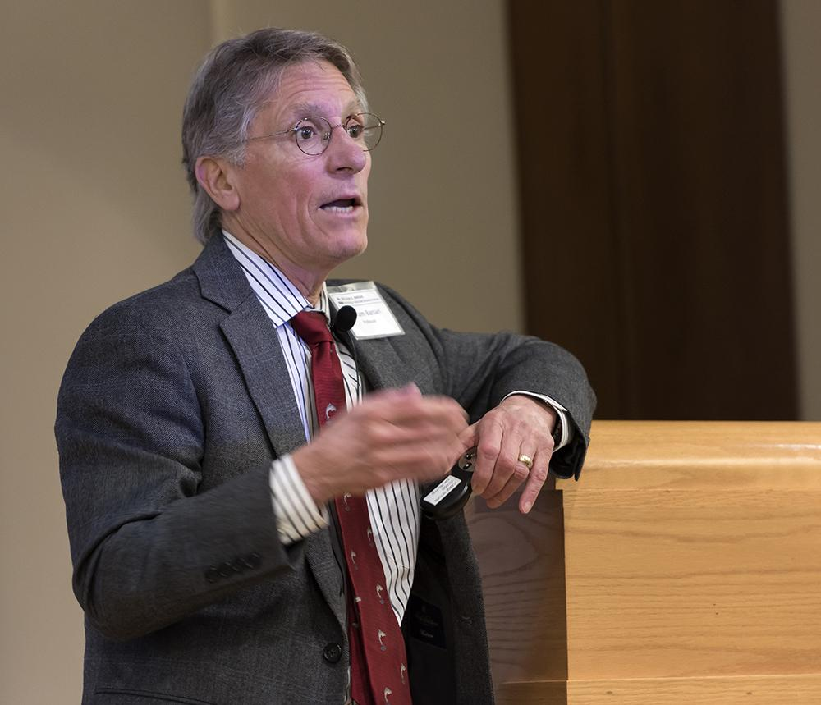
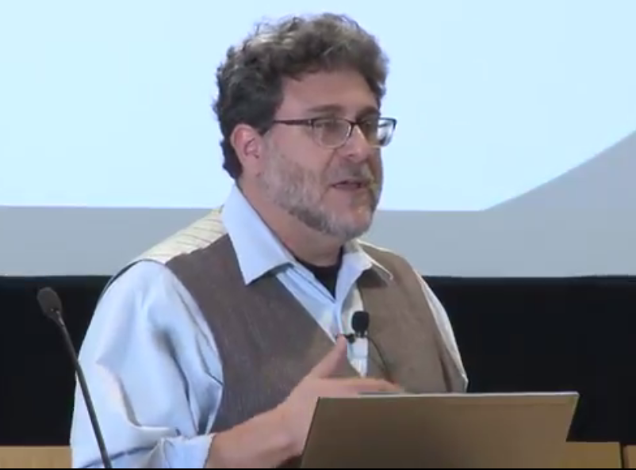
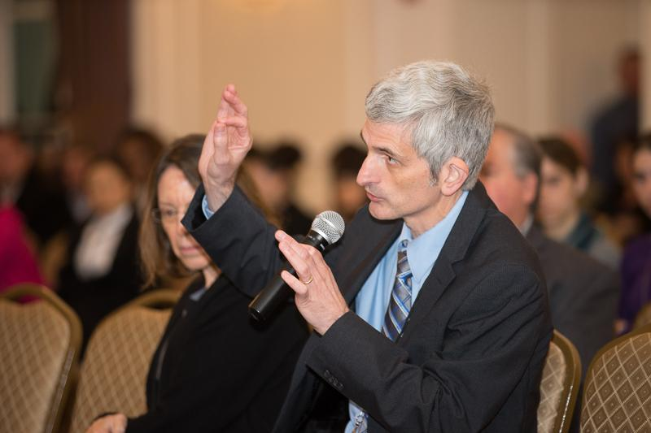

CCC Leadership
William Barsan
SIREN PI
Robert Silbergleit
SIREN Co-PI
Cliff Callaway
SIREN Co-PI
Valerie Stevenson
Finances

Slide 7
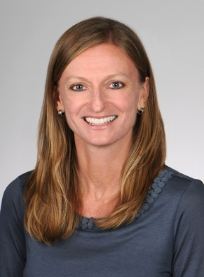
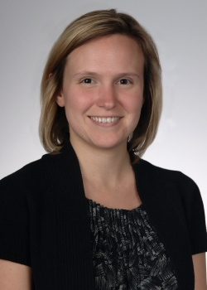


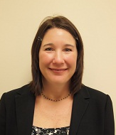
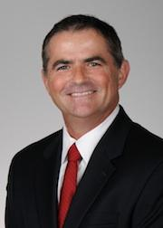
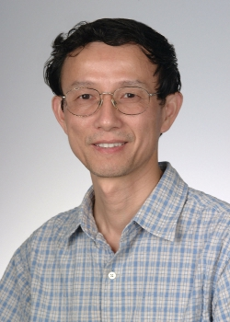
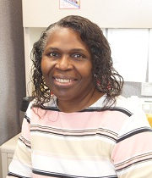
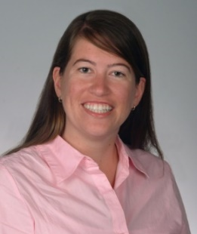
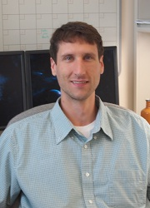
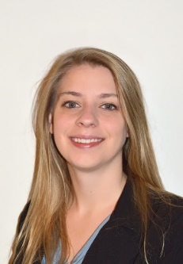
DCC Infrastructure Team
Valerie Durkalski-Mauldin
Co-PI
Sharon Yeatts
Co-PI
Lydia Foster
Biostatistics
Catherine Dillon
Co-Investigator
Wenle Zhao
Co-Investigator
Vanessa Sullivan
Administrator
Sara Butler
Data Mgmt Core Leader
Keith Pauls
IS Core Leader
Chris Arnaud
IT

Slide 8
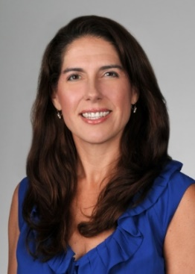
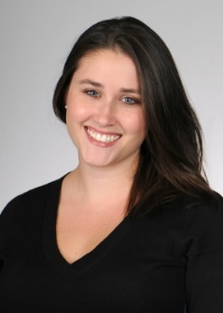
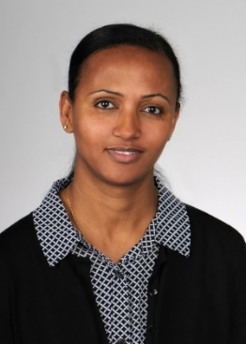
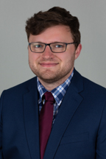
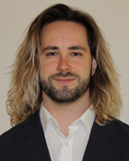
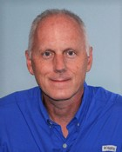
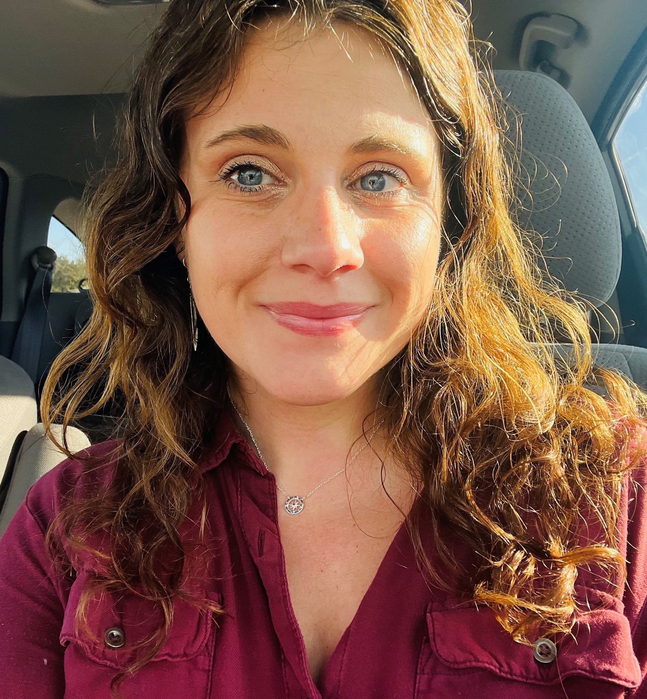
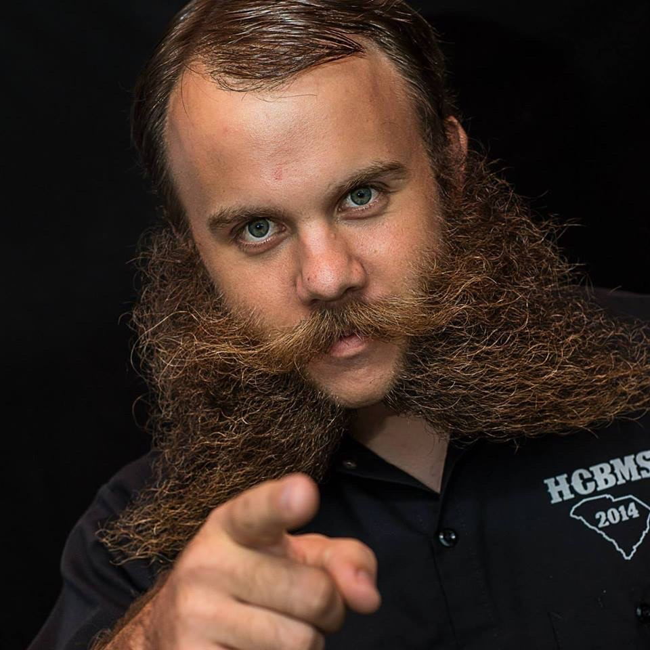
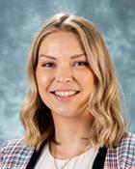
Additional Team Members
Renee Martin
HOBIT DCC PI
Caitlyn Ellerbe
HOBIT Co-Investigator
Abby Teklehaimanot
Biostatistics
HOBIT, BOOST
Jonathan Beall
Biostatistics
BOOST
Grey Clevenger
Biostatistics
ICECAP, P-ICECAP
Peyton Kline
Data Manager
HOBIT, ICECAP, P-ICECAP
Zeke Lowell
Data Manager
BOOST
Liz O’Donohue
Data Manager
ICECAP, P-ICECAP
Dennis Chapman
IT/IS
CCC
Hubs
NIH
External Investigators

Slide 9
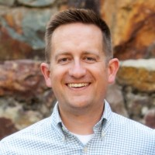
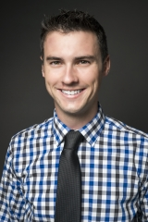
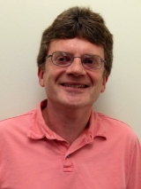
P-ICECAP Team Members
Operations
Biostatistics
Kent Page
Liz O’Donohue
Grey Clevenger
John VanBuren
Peyton Kline
Sara Butler
Keith Pauls
Sharon Yeatts
Richard Holubkov

Slide 10

WebDCU™ - Integrated system built on innovative design
Randomization
External Data
Electronic Data Capture
Drug/Study Material Tracking
Site & Data Monitoring
Central Adjudication
Safety Monitoring
Regulatory Document
Benefit
Data integrity
Trial efficiency
Site & Subject Payment
Notes:
-External data: device data and Redcap Central Call Center (C3PO)

Slide 11
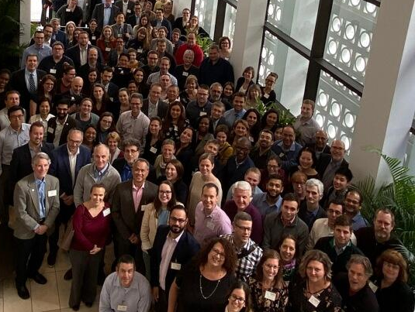

Slide 12
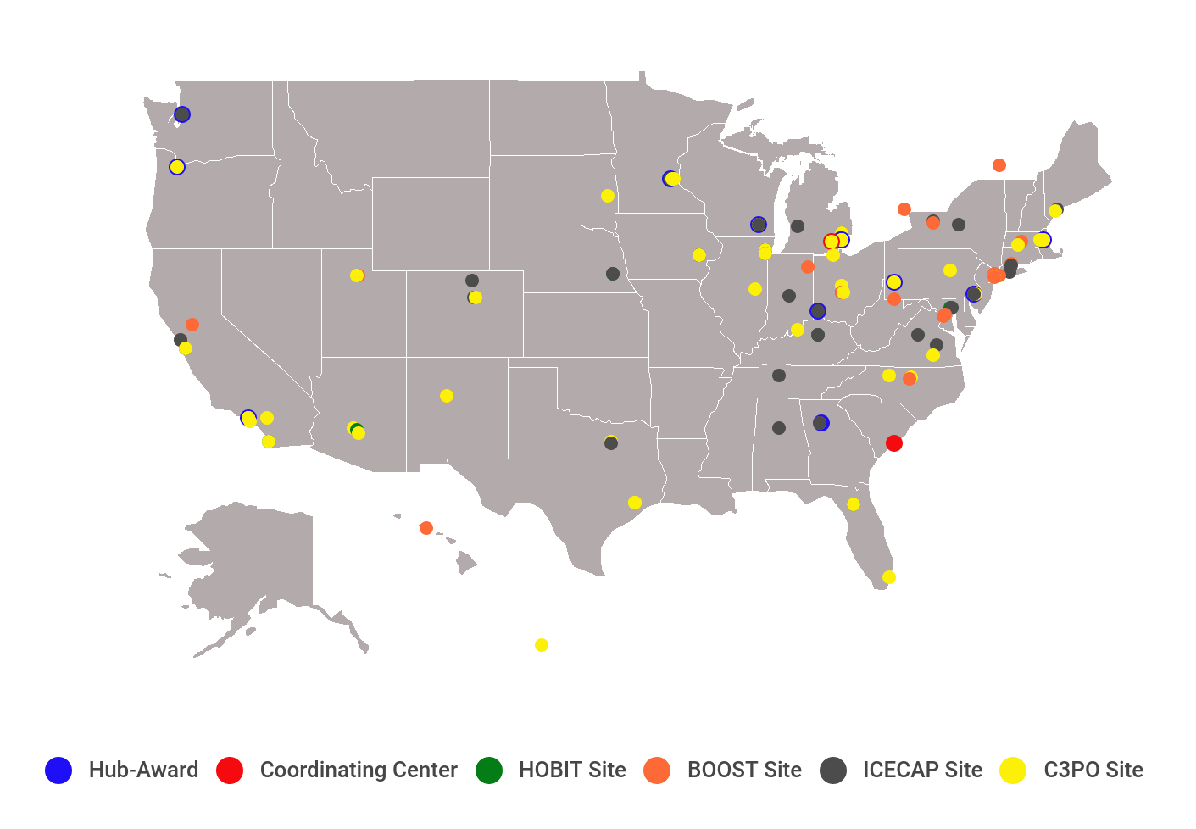

Slide 13

SIREN Clinical Trials

Slide 14
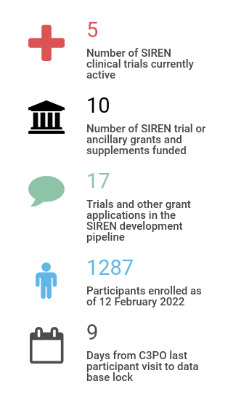
What else are we doing?

Slide 15

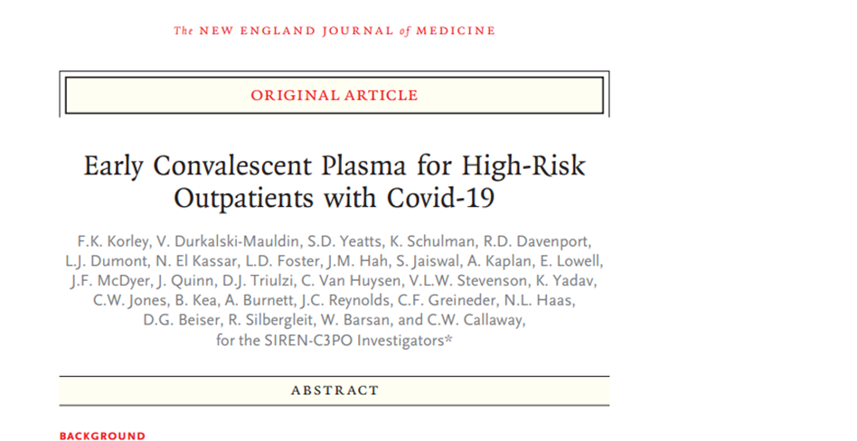

Slide 16

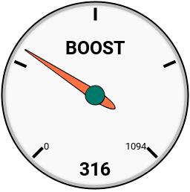



Slide 17

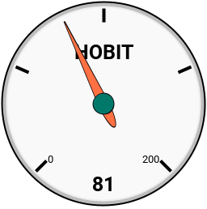
Bio HOBIT

Slide 18

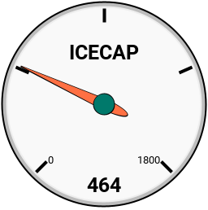


Slide 19


