Slide 1
Screening and Enrollment for P-ICECAP
Moni Weber

Slide 2
2 Truths and a Lie About Moni
Notes:
Frank is not allowed to say anything and must keep a poker face!

Slide 3
Inclusion Criteria
🧊 Age 2 days (CGA> 38 weeks) to < 18 years
🧊 Chest compressions for at least 2 minutes
🧊 Coma or encephalopathy after resuscitation from OHCA
🧊 Requires mechanical ventilation through endotracheal tube or tracheostomy
🧊 Definitive temperature control device initiated
🧊 Randomization within 6 hours of ROSC
🧊 Informed consent from LAR including intent to maintain life support for 120 hours
Notes:
If born 6 weeks early (34 weeks) and is 3 weeks old (37 weeks) - too young. 17 and 364 days= ok to enroll.
Compression max: 60 min
Coma or encephalopathy=GCS motor score of 5 or below
Definitive Temp control (note time started - will need for randomization) BIII, CritiCool or Arctic Sun are what most sites use. Do not use BII.

Slide 4
First Truth/Lie about Moni
I know how to juggle

Slide 5
Exclusion Criteria
Glasgow Coma Motor Score (GCMS) = 6
LAR does not speak English or Spanish
Duration of CPR > 60 minutes
Severe hemodynamic instability requiring continuous infusion of epinephrine or norepinephrine of 2 μg/kg/minute or initiation of ECMO
Pre-existing severe neurodevelopmental deficits with PCPC =5 or progressive degenerative encephalopathy
Pre-existing terminal illness, unlikely to survive to one year
Notes:
GCMS=6 would be a patient lacking any brain injury - we’re not interested
CPR>60 mins are expected to have profound brain injury and may not benefit from hypothermia
Severe hemodynamic insufficiency like this is associated with very high mortality
PCPC=5 (“coma or vegetative”) or progressive degenerative encephalopathy - we would very likely not be able to show a change at a year, so they would not contribute to outcome data
Not surviving for the year due to terminal illness - would also not contribute to outcome data

Slide 6
Exclusion Criteria Cont.
Cardiac arrest associated with brain, thoracic, or abdominal trauma
Active and refractory severe bleeding prior to randomization
Extensive burns or skin lesions incompatible with surface cooling
Planned early withdrawal of life support before 120 hours
Sickle cell anemia
Pre-existing cryoglobulinemia
Non-fatal drowning in ice covered water
Notes:
Severe trauma and refractory severe bleeding raises concern for exacerbating hemorrhage. Cooling for treatment of severe head trauma has been studied previously and showed no benefit on patient outcome
early withdrawal would not allow completion of the intervention and/or outcome determination
Sickle cell and crygoglobulinemia are contraindications for cooling

Slide 7
Exclusion Criteria Cont.
Central nervous system tumor with ongoing chemotherapy
Previous enrollment in P-ICECAP trial
Prisoner
Chronic hypothermia
New post-cardiac arrest diabetes insipidus
Known pregnancy
Notes:
Since the neurologic exam at 12 months is an outcome we are looking at, CNS tumors with chemotherapy is excluded
Prisoner is a vulnerable population we are not including
New post CA Diabetes Insipidus is a marker of profound neurologic injury and these patients may not benefit from hypothermia
if at the time of enrollment you do not know that the patient is pregnant, you can enroll. The protocol does include a pregnancy test. Follow your institution’s and PI’s guidance.

Slide 8
Notes:
Questions about inclusion exclusion criteria?

Slide 9
Second Truth/Lie about Moni
My first research job included entering data as 0s and 1s

Slide 10
Screening for P-ICECAP
Screen ALL surviving out-of-hospital pediatric cardiac arrests
Screen in real time! (Use Screen Failure Form for those not included in study)
This means you will need to set up a system to be notified of all such patients as they arrive.
U Mich: communicate with Survival flight to send out a group page going to all study team members
Make connections in your ED and/ or your P-ICU
Administrative sources
Be creative for your hospital system
Notes:
This form can be found in the WebDCU Toolbox.
Out of Hospital- Doors and Walls definition. Do not include patients declared dead in the Emergency Room.
Real time screening: One of the questions is whether screening was completed within 6 hours of ROSC. You will not get paid for subjects screened outside the 6 hour window!

Slide 11
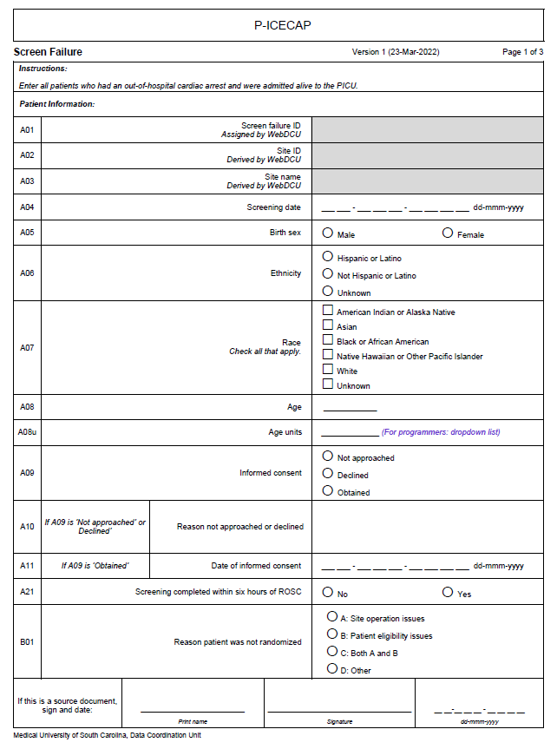
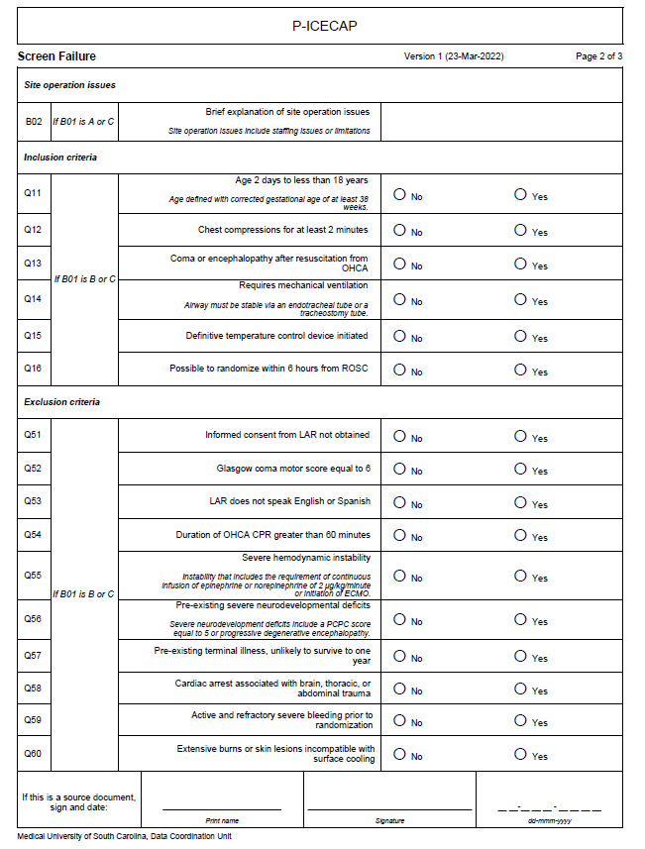
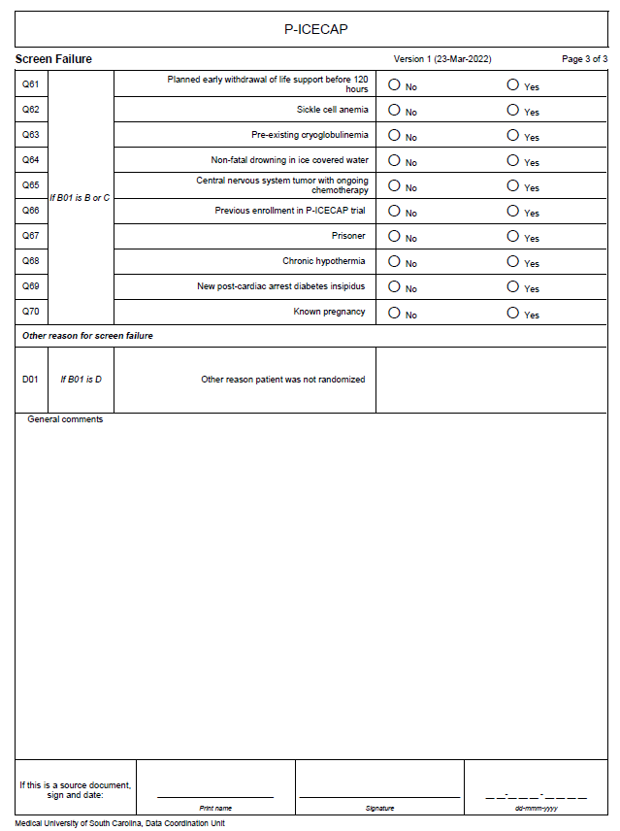
Notes:
This is the Screen Failure CRF The most important question (if you want to get paid for the screen failure) is Screening Completed within 6 hours of ROSC?

Slide 12
Forms You Need to Enter Into WebDCU in Order to Enroll
FIRST: Subject Enrollment Form - Generates the subject ID
SECOND: Eligibility Form - Documents that the patient meets all inclusion and no exclusion criteria
THIRD: Randomization Form - Once this form is submitted treatment assignment will appear on the form

Slide 13
FIRST: Subject Enrollment Form
There are only 2 pieces of information needed:
Date of Birth
Date of Informed Consent Signature
Submitting this form gets you your Study ID!
Notes:
(Age may be changed date of birth - stay tuned)
Enrollment form can be found in the webDCU Toolbox
Once you have SAVED (Bottom of screen) and then SUBMITTED (top of screen) the form will autopopulate with a study ID number

Slide 14
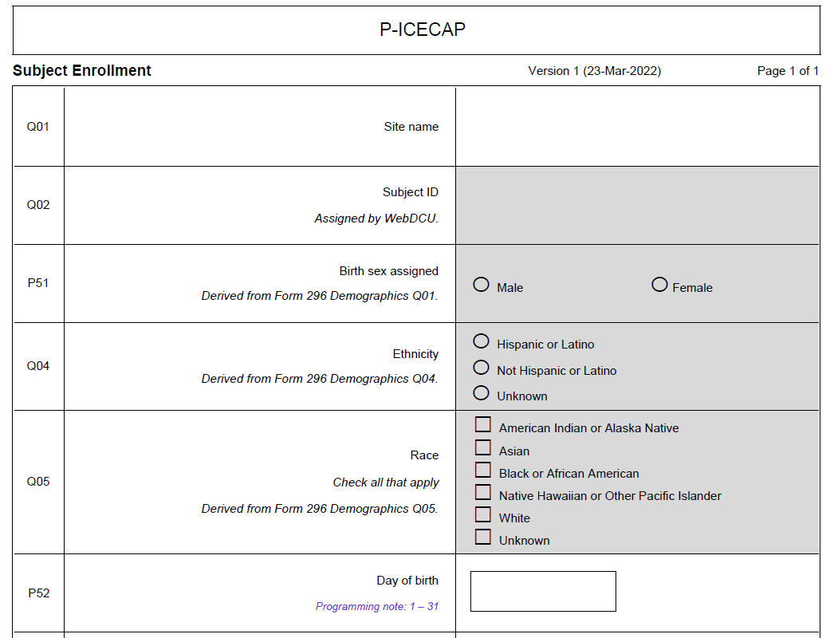
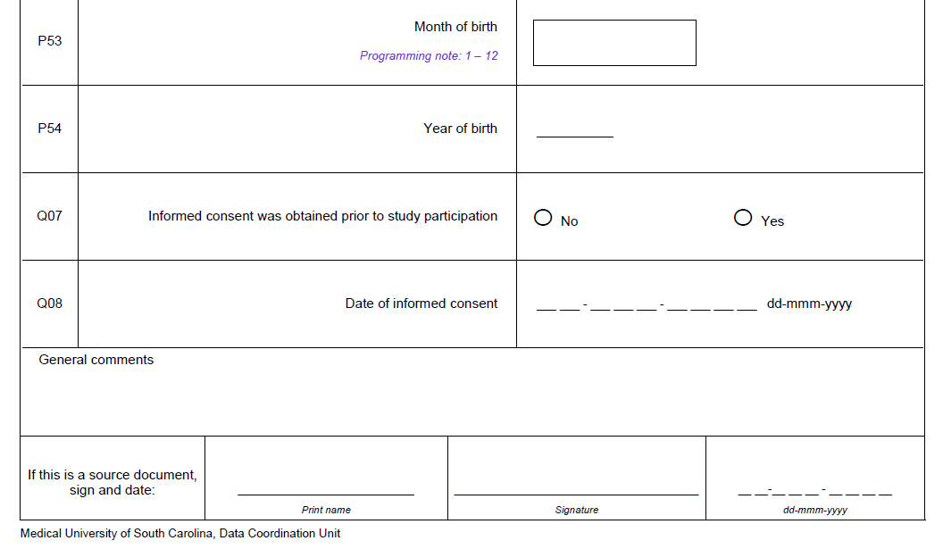
Subject Enrollment CRF
Notes:
This is what the paper CRF looks like, if you want to use it to make sure you have everything in order to enter into webDCU.

Slide 15
Entering Enrollment information in WebDCU
(Disclaimer - this is from ICECAP)
Notes:
So this is about what it will look like in webDCU when you go to enter the Enrollment information. P-ICECAP WebDCU is still in production, so this is actually from the adult study ICEAP. The P-ICECAP Enrollment form will ask you for those 2 pieces of information” date of birth and date of informed consent signature date.

Slide 16
Third Truth/Lie about Moni
My husband and I are twins

Slide 17
Second Eligibility Form
All inclusion criteria must be YES, according to the information you have at the time.
All exclusion criteria must be NO, according to the information you have at the time.
First and last name of the person confirming eligibility
Notes:
I won’t show you the form - it’s just a list of the criteria with yes/no boxes
“According to the information you have at the time” means that we know there will be cases where you might have enrolled someone and, for example find out later that compressions were 62 minutes. Sometimes run sheets take a while to get and you went on oral report at the time.

Slide 18
Randomization Form
Confirmation that patient meets all eligibility requirements
Date of definitive temperature control device initiation
Time of definitive temperature control device initiation
Confirmation that this randomization is within 6 hours of ROSC
Notes:
Confirmation is a Y/N question
date and time of definitive TTM - make sure you have this before randomizing!! What time did you start the Blanketrol III, Arctic Sun, Criticool or other cooling device?
Confirmation of randomization within 6 hours of ROSC - None of the forms I have shown you have asked for the time of ROSC, but you need to know this time in order to confirm this question.
Date and time of ROSC is asked on ED and PICU Code Review and Treatment, which you will enter at a later time point.

Slide 19
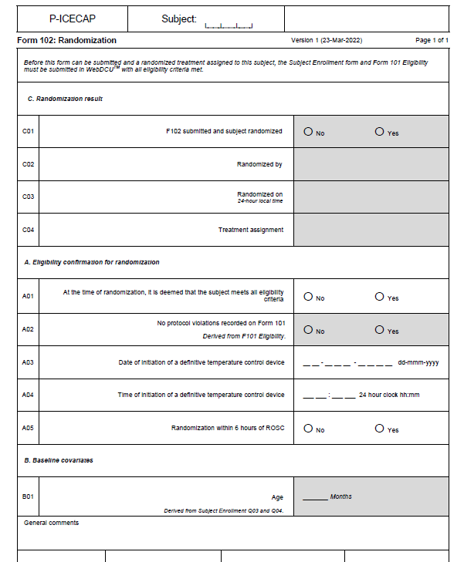
Randomization CRF
Notes:
Here are those 2 important questions! I am emphasizing this because you will not be able to randomize without it and it is something you’ll have to actively seek out.
Sorry, I don’t have a webDCU screenshot of this because when I made this, webDCU was still in production.

Slide 20
Other Things You’ll Learn for Enrollment
Informed Consent (stay tuned… Coming after the break!)
The Do’s and Don’ts
E-Consent process (also a Future RC Zoom session…)
Building rapport with a stressed family
Notes:
Practice your active listening skills… Take tissues with you to consent…

Slide 21
2 Truths and a Lie About Moni
Notes:
Frank is not allowed to say anything and must keep a poker face!

Slide 22
Questions?

