Slide 1
Regulatory Readiness
Carol Van Huysen

Slide 2
Goals for Today
Provide guidance for navigating the required regulatory processes and be released to enroll as quickly and efficiently as possible
Steps and order to take them
Tools and helpful links
Notes:
Frank is not allowed to say anything and must keep a poker face!

Slide 3
Notes:
If born 6 weeks early (34 weeks) and is 3 weeks old (37 weeks) - too young. 17 and 364 days= ok to enroll.
Compression max: 60 min
Coma or encephalopathy=GCS motor score of 5 or below
Definitive Temp control (note time started - will need for randomization) BIII, CritiCool or Arctic Sun are what most sites use. Do not use BII.

Slide 4
Site IRB cedes to Advarra
Reliance agreements exist between site IRB and Advarra
Site does not have direct contact with Advarra

Slide 5
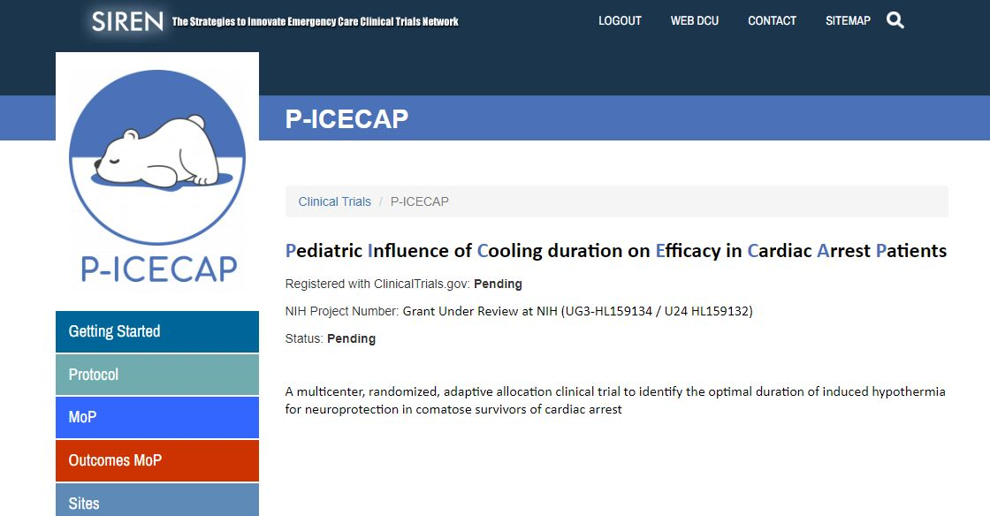
P-ICECAP Website
https://siren.network/clinical-trials/picecap
Notes:
GCMS=6 would be a patient lacking any brain injury - we’re not interested
CPR>60 mins are expected to have profound brain injury and may not benefit from hypothermia
Severe hemodynamic insufficiency like this is associated with very high mortality
PCPC=5 (“coma or vegetative”) or progressive degenerative encephalopathy - we would very likely not be able to show a change at a year, so they would not contribute to outcome data
Not surviving for the year due to terminal illness - would also not contribute to outcome data

Slide 6
P-ICECAP regulatory database serves as the central repository for all regulatory documents
IRB Approvals and other essential documents will be available via the database
Automated emails will be sent for expired, expiring, and missing documents
Notes:
GCMS=6 would be a patient lacking any brain injury - we’re not interested
CPR>60 mins are expected to have profound brain injury and may not benefit from hypothermia
Severe hemodynamic insufficiency like this is associated with very high mortality
PCPC=5 (“coma or vegetative”) or progressive degenerative encephalopathy - we would very likely not be able to show a change at a year, so they would not contribute to outcome data
Not surviving for the year due to terminal illness - would also not contribute to outcome data

Slide 7
Regulatory Document Approval Parameters
User Management
Completing the eDOA (electronic Delegation of Authority) Page 2-3
Regulatory Documents
People Regulatory Document Collection Page 3-5
Site Regulatory Document Collection Page 6-10
Central IRB (CIRB) Tables
Step 1: SITE Overview Page 11-13
Step 2: Site Regulatory Inspection History Page 13
Step 3: Initial Site Submission - P-ICECAP Database Page 14-35
Notes:
GCMS=6 would be a patient lacking any brain injury - we’re not interested
CPR>60 mins are expected to have profound brain injury and may not benefit from hypothermia
Severe hemodynamic insufficiency like this is associated with very high mortality
PCPC=5 (“coma or vegetative”) or progressive degenerative encephalopathy - we would very likely not be able to show a change at a year, so they would not contribute to outcome data
Not surviving for the year due to terminal illness - would also not contribute to outcome data

Slide 8
Electronic Delegation of Authority Log
The eDOA must be completed by the Primary Study Coordinator
Obtain a UM Friends Account – See Getting Started on website
Request a WebDCU database login at picecap-contact@umich.edu
Enter the research team on the eDOA in WebDCU using the detailed instructions in the Regulatory Parameters document.
Notes:
GCMS=6 would be a patient lacking any brain injury - we’re not interested
CPR>60 mins are expected to have profound brain injury and may not benefit from hypothermia
Severe hemodynamic insufficiency like this is associated with very high mortality
PCPC=5 (“coma or vegetative”) or progressive degenerative encephalopathy - we would very likely not be able to show a change at a year, so they would not contribute to outcome data
Not surviving for the year due to terminal illness - would also not contribute to outcome data

Slide 9
Regulatory Document Approval Parameters
People Document: Specific to an individual study team member
Notes:
GCMS=6 would be a patient lacking any brain injury - we’re not interested
CPR>60 mins are expected to have profound brain injury and may not benefit from hypothermia
Severe hemodynamic insufficiency like this is associated with very high mortality
PCPC=5 (“coma or vegetative”) or progressive degenerative encephalopathy - we would very likely not be able to show a change at a year, so they would not contribute to outcome data
Not surviving for the year due to terminal illness - would also not contribute to outcome data

Slide 10
Regulatory People Documents Needed for Startup
All Team Members | Role Dependent
Human Subjects Protection | CV
Good Clinical Practice | Medical License
Protocol Training | Data Training
 | Regulatory Training
 | Investigator Agreement
**Reminder: Please upload all documents as PDFs in WebDCU
Notes:
GCMS=6 would be a patient lacking any brain injury - we’re not interested
CPR>60 mins are expected to have profound brain injury and may not benefit from hypothermia
Severe hemodynamic insufficiency like this is associated with very high mortality
PCPC=5 (“coma or vegetative”) or progressive degenerative encephalopathy - we would very likely not be able to show a change at a year, so they would not contribute to outcome data
Not surviving for the year due to terminal illness - would also not contribute to outcome data

Slide 11
Regulatory Document Approval Parameters
Site Document: Applies to an individual site
Notes:
GCMS=6 would be a patient lacking any brain injury - we’re not interested
CPR>60 mins are expected to have profound brain injury and may not benefit from hypothermia
Severe hemodynamic insufficiency like this is associated with very high mortality
PCPC=5 (“coma or vegetative”) or progressive degenerative encephalopathy - we would very likely not be able to show a change at a year, so they would not contribute to outcome data
Not surviving for the year due to terminal illness - would also not contribute to outcome data

Slide 12
Regulatory Site Documents Needed for Startup
FWA for Institution | Ceding Request to Local IRB
HSP Requirements | Ceding Acknowledgement
Attestation of Training | IRB Approval from Advarra *
Conflict of Interest | IRB Approved Consent Form *
* Populated by database by Advarra

Slide 13
A word about consents…..
The approved Informed Consent Form cannot be modified
Required site specific language may be added in the ‘black box’ section of the approved ICF
Provide the language in a Word document to the CCC

Slide 14
Regulatory Document Approval Parameters
Complete CIRB Tables
Responses in these WebDCU tables enables the CCC to complete and submit your IRB application for you
Site Overview - SIREN Database
Site Regulatory Inspection History - SIREN Database
Initial Site Submission in P-ICECAP database under CIRB

Slide 15
Notes:
GCMS=6 would be a patient lacking any brain injury - we’re not interested
CPR>60 mins are expected to have profound brain injury and may not benefit from hypothermia
Severe hemodynamic insufficiency like this is associated with very high mortality
PCPC=5 (“coma or vegetative”) or progressive degenerative encephalopathy - we would very likely not be able to show a change at a year, so they would not contribute to outcome data
Not surviving for the year due to terminal illness - would also not contribute to outcome data

Slide 16
Complete All Required Training
Protocol Training: Required for all study team members
IM Meeting counts!
Data training: Required for team members responsible for data entry
Regulatory Document Management Training: Required for Primary Study Coordinators or Regulatory Coordinators if applicable
Training modules will soon be on the Education and Training tab of the website
Notes:
GCMS=6 would be a patient lacking any brain injury - we’re not interested
CPR>60 mins are expected to have profound brain injury and may not benefit from hypothermia
Severe hemodynamic insufficiency like this is associated with very high mortality
PCPC=5 (“coma or vegetative”) or progressive degenerative encephalopathy - we would very likely not be able to show a change at a year, so they would not contribute to outcome data
Not surviving for the year due to terminal illness - would also not contribute to outcome data

Slide 17
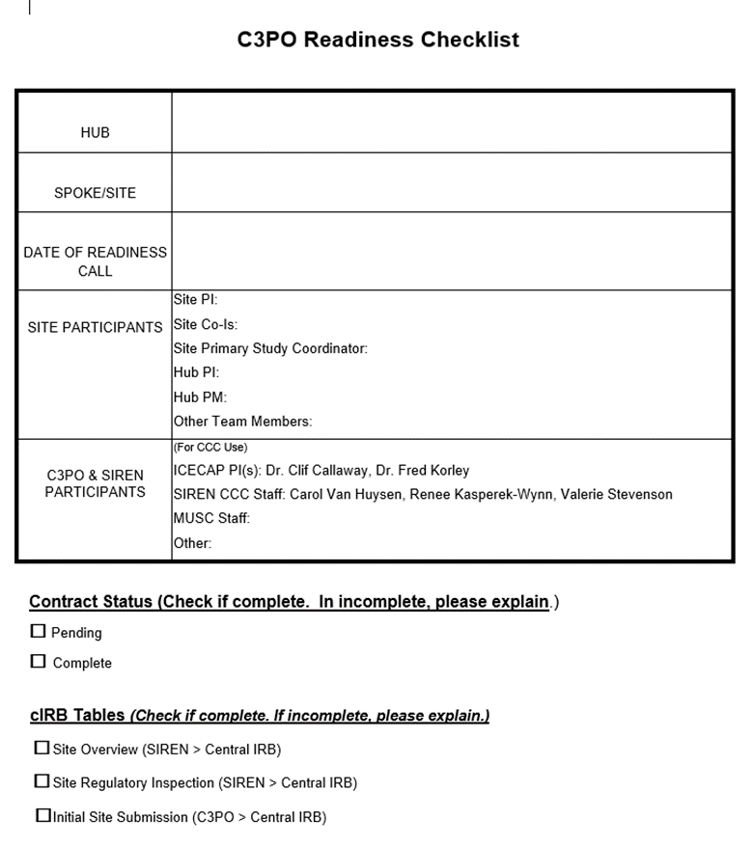
Readiness Checklist and Call
Complete checklist to confirm readiness
List names of site participants who will attend
Respond to all questions in logistics section
Email completed checklist prior to the call
Request CCC schedule a readiness call
Notes:
GCMS=6 would be a patient lacking any brain injury - we’re not interested
CPR>60 mins are expected to have profound brain injury and may not benefit from hypothermia
Severe hemodynamic insufficiency like this is associated with very high mortality
PCPC=5 (“coma or vegetative”) or progressive degenerative encephalopathy - we would very likely not be able to show a change at a year, so they would not contribute to outcome data
Not surviving for the year due to terminal illness - would also not contribute to outcome data

Slide 18
Ongoing Site Management
Be Proactive!
It is the responsibility of each Hub/Site to maintain regulatory compliance, inclusive of site documents and people documents, throughout the duration of the trial
Documents approaching expiration should be reconciled prior to the expiration date
Study team personnel who are out of regulatory compliance should not participate in any trial related activities
Notes:
Severe trauma and refractory severe bleeding raises concern for exacerbating hemorrhage. Cooling for treatment of severe head trauma has been studied previously and showed no benefit on patient outcome
early withdrawal would not allow completion of the intervention and/or outcome determination
Sickle cell and crygoglobulinemia are contraindications for cooling

Slide 19
Review of Next Steps…
Request ceding from IRB
Submit eDOA
Complete the cIRB tables
Follow-up on contract if necessary
Start training - frequent reminders to team!
Work on orderset
Forward site specific language for ICF
Upload Site and People documents as received
Schedule a readiness call
Notes:
Since the neurologic exam at 12 months is an outcome we are looking at, CNS tumors with chemotherapy is excluded
Prisoner is a vulnerable population we are not including
New post CA Diabetes Insipidus is a marker of profound neurologic injury and these patients may not benefit from hypothermia
if at the time of enrollment you do not know that the patient is pregnant, you can enroll. The protocol does include a pregnancy test. Follow your institution’s and PI’s guidance.

Slide 20
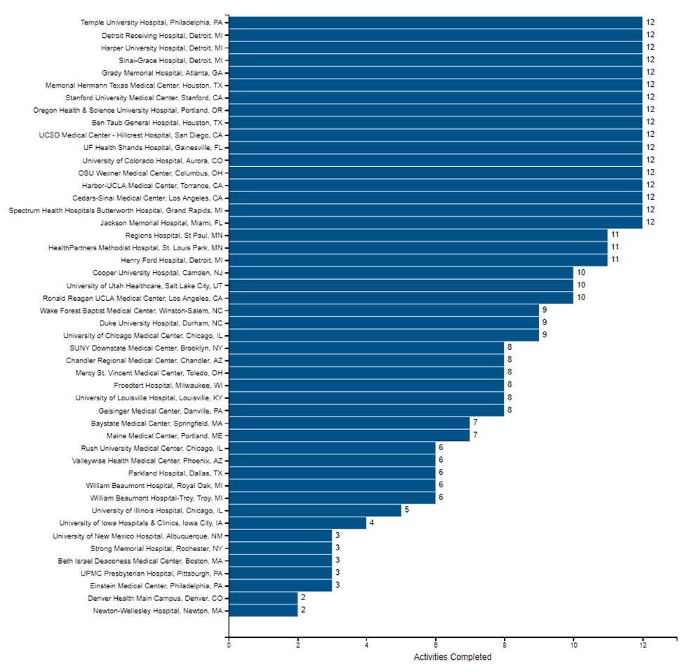
Tracking Readiness in WebDCU
Site Readiness Report
View Progress in the P-ICECAP database under
Site Management > Readiness Report

Slide 21
Join weekly office hours for answers to your questions, or contact us…
picecap-contact@umich.edu
Carol Van Huysen cvanh@umich.edu
Moni Weber monij@umich.edu
Notes:
Since the neurologic exam at 12 months is an outcome we are looking at, CNS tumors with chemotherapy is excluded
Prisoner is a vulnerable population we are not including
New post CA Diabetes Insipidus is a marker of profound neurologic injury and these patients may not benefit from hypothermia
if at the time of enrollment you do not know that the patient is pregnant, you can enroll. The protocol does include a pregnancy test. Follow your institution’s and PI’s guidance.

Slide 22
Questions
Notes:
Since the neurologic exam at 12 months is an outcome we are looking at, CNS tumors with chemotherapy is excluded
Prisoner is a vulnerable population we are not including
New post CA Diabetes Insipidus is a marker of profound neurologic injury and these patients may not benefit from hypothermia
if at the time of enrollment you do not know that the patient is pregnant, you can enroll. The protocol does include a pregnancy test. Follow your institution’s and PI’s guidance.

