Slide 1
BIOMARKERS and Outcome Measures in Neurology Clinical Trials
Jeremy M. Shefner, MD, PhD
Kemper and Ethel Marley Professor and Chair of Neurology
Barrow Neurological Institute

Slide 2
Disclosures
Personal compensation received from Cytokinetics, Biogen, MT Pharma, Brainstorm, Pharnext
Research funding received from Cytokinetics, Biogen, Synapse, Biotie, Amylyx, Brainstorm, ALS Association, MDA, NINDS

Slide 3
What is a Biomarker?
  generally refers to a measurable indicator of some biological state or condition. (Wikipedia)
  a characteristic that is objectively measured and evaluated as an indicator of normal biologic processes, pathogenic processes, or pharmacologic responses to a therapeutic intervention (NIH)
  Definition is so broad that a biomarker can be any one of above
  Functional and clinically relevant endpoints can also be a biomarkers

Slide 4
Six Main Categories of Biomarkers
Biomarker Category | Utility | Examples
Target Engagement | The drug interacts with its intended molecular target in vivo | PET receptor occupancy studies Measurement of molecular complexes in vivo Binding in a surrogate compartment (e.g., lymphocytes)
Pharmacokinetic | The drug reaches its desired molecular site of action | Pharmacokinetics in CSF CNS uptake studies
Pharmacodynamic | The intended molecular effect produces the desired biological effect. Useful for determining therapeutic dose range; potential candidate for becoming a surrogate | Effect on Molecular Target: Effect on Presumed Downstream Marker Plasma proteomics Plasma metabolomics
Diagnosis/ Stratification | The targeted disease state is present, and/or the desired patient population can be stratified to optimize risk benefit ratio and probability of success | Genetics Blood-based makers CSF Imaging
Disease Outcome | Assessment of effect on Clinical or Pathological Disease measures | Clinical Outcome Measures Imaging Anatomical Functional
Safety | Presence and/or severity of potential target organ toxicity is measurable | Biochemical (common/special labs) Electrophysiological (QTc)
Notes:
pk is how body affects a drug while PD is analysis of a drug affects the body
Pk is defined by how a compound is absorbed, distributed metabolized and excreted
PD is the measure of a compounds ability to intereact with it intended targed leading to a biological effect

Slide 5
Integration of Biomarker Strategies into Drug Development Decision Making
PDCR
FIH
Ph.2
Ph.3
Filing
Launch
LCM
Mechanism of Action
Pharmacokinetics
Pharmacodynamics
Disease Dx/Stratification
Disease Progression
Safety
Courtesy of Jesse Cedarbaum

Slide 6
P_{D} Markers: measure of compounds ability to interact with its intended target leading to a biological effect
P_{D} type:
  Biochemical:
    Enzyme substrate
    mRNA/ Protein
  Imaging:
    PET
    MRI
    CT
  Physiology:
    Axonal excitability
    MUNE
P_{D} use:
  Test biological hypothesis in human
  Combine with P_{K}
  Select dose:
    Efficacious range
    Safe range
Notes:
Measure of compounds ability to intereact with its intended target leading to a biological effect

Slide 7
CSF SOD1 as a PD Biomarker for ALS
SOD1 Antisense Oligonucleotides (ASO) lower SOD1 and prolong survival in animal models
SOD1 natural history data suggests we will be able to determine benefit
ASOs safe in prior IONIS/Biogen Phase I in SOD1 ALS
Notes:
Sod-cu2+ + O2- > sod cu1+ + O2 (sod1 is reduced, i.e. gains electron)
Sod-cu1+ + O2- + 2H+ > SOD-Cu2+ + H2O2

Slide 8
Antisense Oligos Decrease CSF in SOD1 G93A Rats
Tim Miller

Slide 9
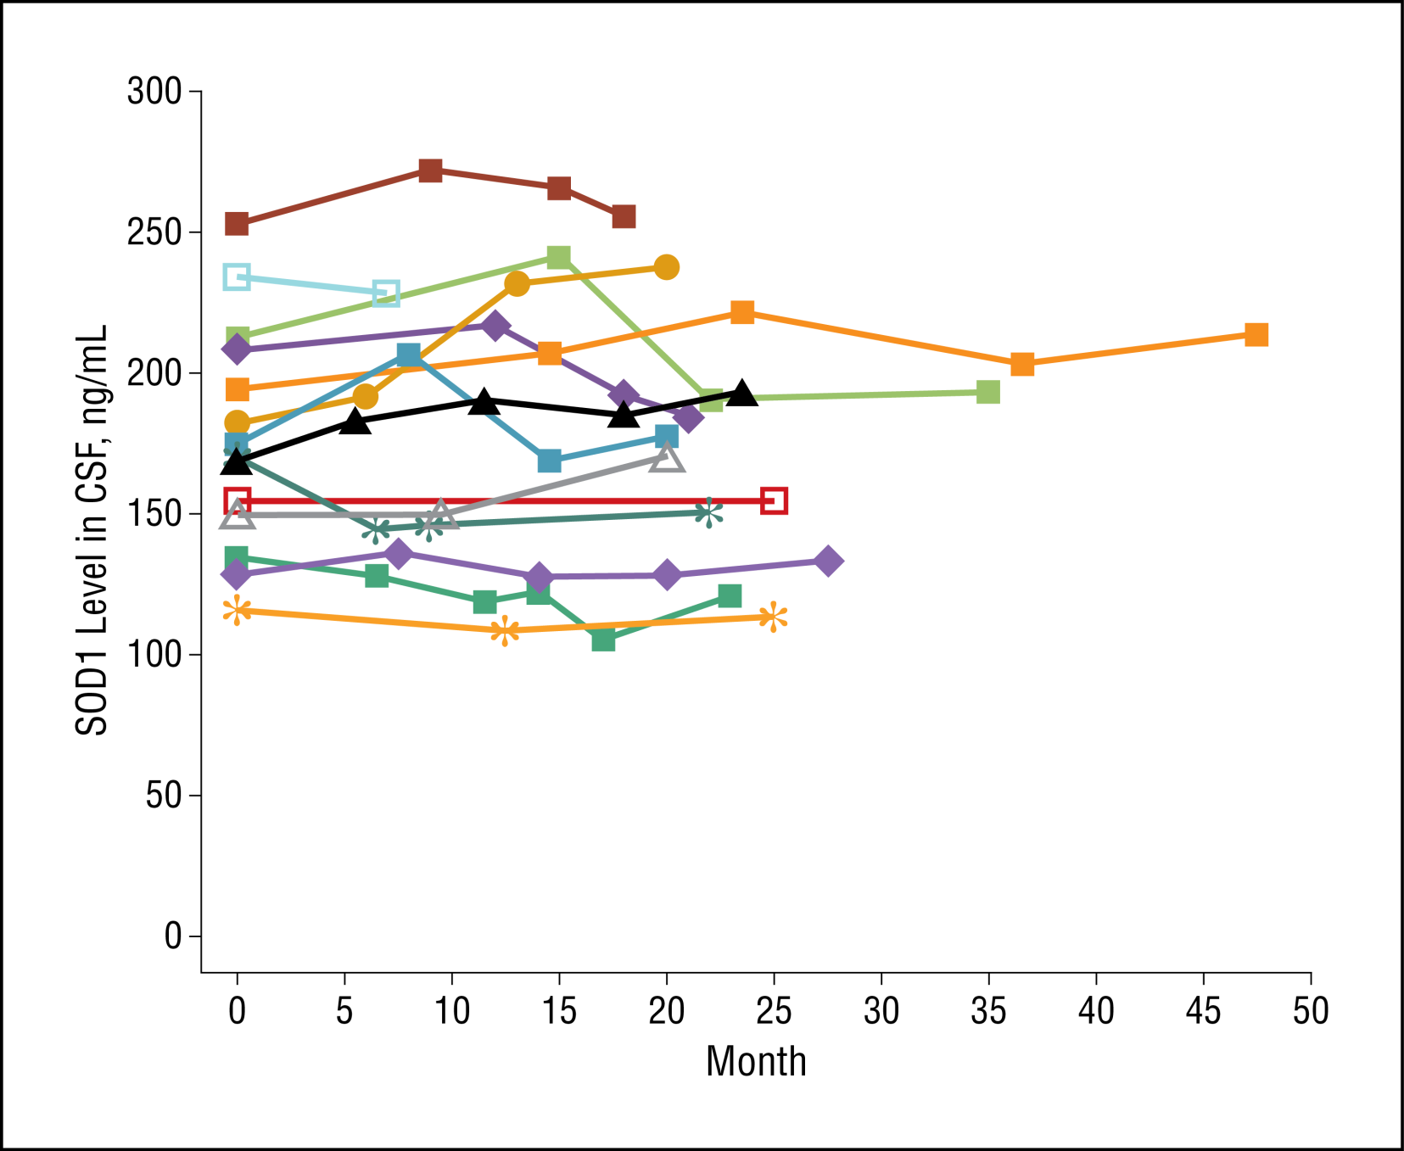
SOD1 in CSF Varies Little Over Time
Winer et al. 2013 , JAMA Neurology 2013

Slide 10
Regulatory T Cell and their function are reduced in ALS
Henkle et al., 2013

Slide 11
pNFH levels correlate with patient survival
Oeckl et al., (2016): Correlation to survival
Steinacker et al, (2015): 253 ALS Subjects
Level of pNFH in the blood or CSF is a prognostic for patient survival
and rate of disease progression

Slide 12
pNFH or NFL levels are relatively stable over time
Turner and colleagues
(2016)
Bowser lab
Level of pNFH or NFL in blood or CSF could be used to monitor drug effects

Slide 13
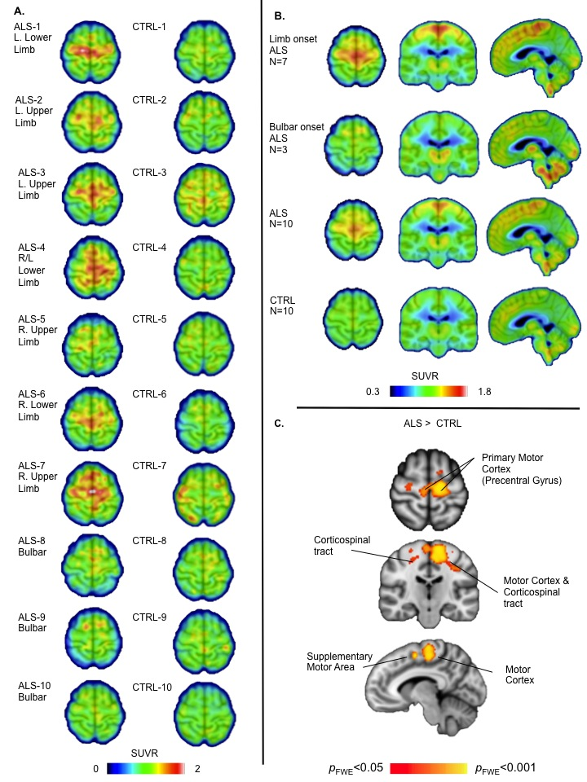
[¹¹C]PBR-28 identifies activated
microglia in ALS
Increased binding to
activated microglia in
Motor cortex and other
areas of interest for ALS.
Potential use as PD marker
in trials that target
microglial activation
(RNS60, ibudilast)
Zurcher et al. NeuroImage:Clinical
7: 409-414 (2015)
Notes:
Depiction of various pharmacodynamic biomarker assessments, including tissue-based (invasive) approaches and noninvasive tools. Use of particular pharmacodynamic assessments may depend on the target of interest as well as the study disease. Assessments may also be complementary to one another.

Slide 14
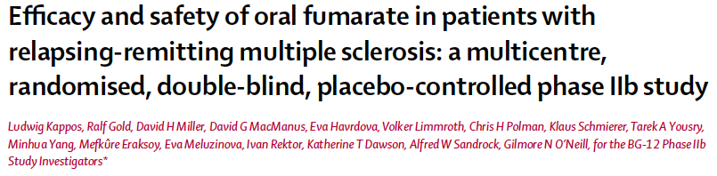
257 patients, 3 doses vs placebo for 24 weeks
Primary endpoint: new GdE lesions
  Clear dose response; lesions reduced by 69% at highest dose
Secondary endpoint: relapse rate
  No dose response; overall, relapse rate declined by 32% (p=0.27)
Kappos et al
Lancet 2008

Slide 15
RRMS: Gd+ lesions
A marker of disease activity
Kappos et al
Lancet 2008

Slide 16
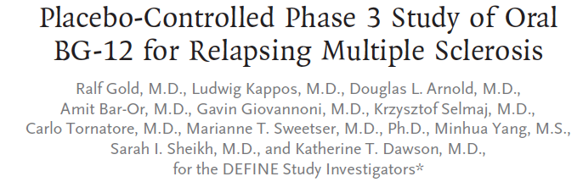
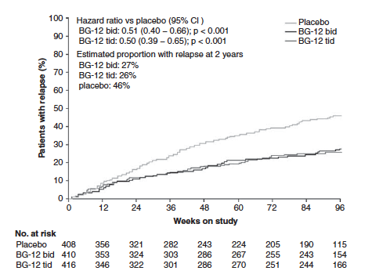

Slide 17
Functional markers serve as intermediate stage endpoints
Strength
Pulmonary function
6 minute walk
Timed up and go
Many others

Slide 18
Methods of assessment can be very important
Strength is a functional marker that may be important in studying many diseases
However, how it is measured affects it’s utility
  Single muscle group
    Vital capacity
    Handgrip
  Global Assessment
    MRC manual muscle testing
      Any number of muscle can be tested on a 0-5 ordinal scale
    Quantitative muscle testing
      TQNE
      HHD

Slide 19
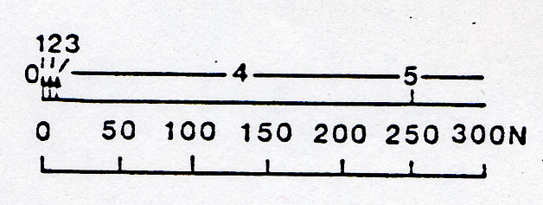
Uneven Steps Between MRC Grades
MMT scale compared with actual dynametric force measurement of the biceps brachii
(modified from van der Ploeg: J Neurol, 1984)

Slide 20
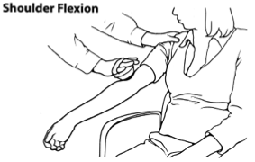
Quantitative Muscle Testing: Standardized Training and Validation
Standardized positions
Video and hands on training
Requirement for demonstration of adequate training
Test-retest reliability criterion

Slide 21
Clinically Relevant Endpoints
Clinically relevant endpoints are required for phase 3 trials
  May be subjective (I feel better) or objective (I can walk across the room better)
  Survival
  Time to event
However:
  Clinical Relevance is often a fuzzy target
    Is vital capacity clinically relevant?
    Is strength clinically relevant?
  Clinical relevance does not necessarily imply relevance to potential therapeutic mechanism
  Issues of variability may limit utility
    Disease related
    Measure related

Slide 22
Functional Scales
Functional Scales are considered clinically relevant
  They directly ask patients about functional capacity, or assess these functions by observation
  However, size of effect that is important is not always clear
  The scale properties are critical and often undefined
    Interval Scaling
    Continuous vs discrete

Slide 23
Functional Scales
Can be disease or attribute specific
Scoring of individual items should have characteristics of an interval scale: i.e., a change of 1 unit should be the same anywhere on the scale
Often comprised of well defined domains capable of assessing different aspects of function

Slide 24
Limitations of Functional Scales
Often combine attributes so it is difficult to attribute a change to a specific function
The minimum clinically significant change is undetermined
Lack of interval scaling may mask small changes
Variability of scoring may limit use or increase sample size
Individual items are usually strikingly non-linear; averaging many items together can create appearance of linearity

Slide 25
Binary/Time to Event
Advantages
  Easy to understand
  Power calculations are straightforward
Disadvantages
  Only subjects who reach endpoint are useful
  Only 1 change of state is deemed important

Slide 26
Time to Event: Survival
Useful only when events are likely to occur
  Stroke
  SAH
  ALS
Depending on disease state and target, may not be sensitive to experimental intervention
  Nuedexta for Emotional Lability
    Approved for ALS, but unlikely to impact survival

Slide 27
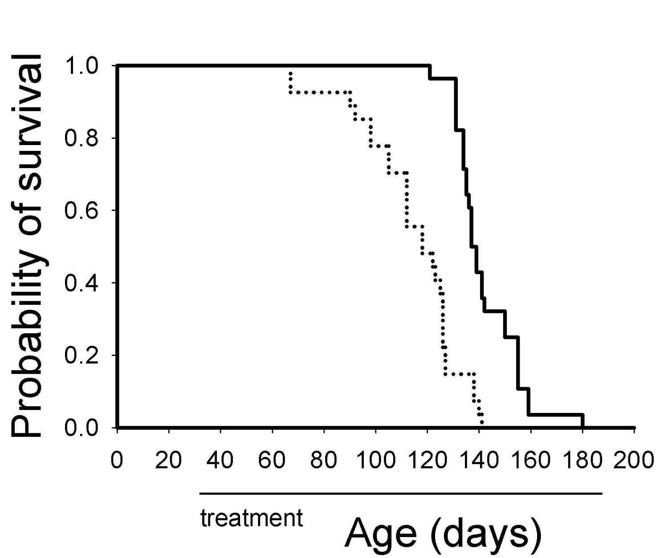
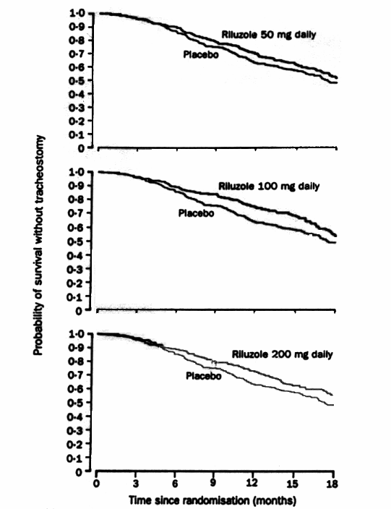
Survival as an outcome measure in ALS
PEOPLE
MICE
From: Drachmann et al., 2000
From Lacomblez et al., 1996

Slide 28
Time to event is an example of a binary endpoint
Time to event endpoints
  Survival
  Hospital readmission
  Time to new vascular event
  Time to initiation of NIV
Other binary endpoints
  Achieving functional independence
  Achieving independent ambulation

Slide 29
How does one choose which biomarker/endpoint is most appropriate?
Development stage
Qualities intrinsic to marker/endpoint
  Relevance to clinically important endpoints
  Variability
    Measurement related
    Disease related
  If a binary endpoint, how many events expected?

Slide 30
Summary
The choice of endpoint is critical in the design of clinical trials
Endpoints should be reliable, meaningful, and sensitive to disease modification
An appropriate choice of endpoint should increase the probability of correctly determining whether the goals of the study are met
The currently available toolbox of measures is not adequate to meaningfully shorten trials or reduce sample size for most neurological diseases

