Slide 1
Selecting the Right Population for Clinical Trials: Selectivity versus Inclusivity
Dr. Laurie Gutmann, MD: University of Iowa Dr. William Meurer, MD, MS: University of Michigan
http://neurotrials.training

Slide 2
Objectives
At the end of this session the learner should be able to
Consider how selecting a trial population can influence the science and the logistics
Understand the process of balancing both a population that will be responsive to an intervention (prognosis) but will exist in sufficient numbers for inference

Slide 3
Early slide on audience response
Description of how to use audience response system

Slide 4
Example of Audience Response
My favorite college football team is?
Ohio State
Michigan
Iowa
West Virginia
None of the Above

Slide 5
Disclosures
Dr. Meurer
No relevant disclosures related to commercial entities
Dr. Gutmann
No relevant disclosures related to commercial entities

Slide 6
Overview of Session
Common issues in population selection for trials
What is enrichment
Major characteristics (severity, age, disease onset) (WM)
Stroke Example (WM)
ALS Example (LG)
Conclusions / Q&A (LG)

Slide 7
Self reported understanding
I understand the concept of population enrichment in clinical trials?
Mostly
Somewhat
Not sure
Probably not
Definitely not

Slide 8
Wait a second
I thought this was a webinar on population selection…

Slide 9
Enrichment – Bob Temple, FDA
“We don’t do clinical trials in a random sample of the population…
Notes:
“We don’t do clinical trials in a random sample of the population. We try to make sure people have the disease we’re studying (entry criteria), have stable disease with stable measurements (lead in periods), do not respond too well to placebo (placebo lead in periods), have disease of some defined severity, and do not have conditions that would obscure benefit. These efforts are all kinds of ENRICHMENT, and almost every clinical trial uses them. There are, in addition, other steps, not as regularly used, that can be taken to increase the likelihood that a drug effect can be detected (if, of course, there is one).”

Slide 10
Enrichment
Entry criteria
Have the disease we are studying
Lead-in period or stable disease
Stable measurements or known expected slope of progression
Placebo response taken into account
Defined disease severity
Absence of conditions that would obscure benefit

Slide 11
Major Enrichment Categories
Practical – to decrease heterogeneity
Prognostic enrichment
Likely to have study endpoint (outcome)
Or large change in endpoint
Predictive enrichment
Patient characteristics
Patient response to similar treatment
Early response of surrogate
Types 2 and 3 may raise generalizability issues later

Slide 12
(Some) Strategies to Decrease Heterogeneity
Carefully consider entry criteria
Find (a priori) likely compliers
Find patients who will not drop out
Consider lead in period to weed out placebo responders
Avoid enrollment of patients with short life expectancy (if long term treatment or outcome measurement)

Slide 13
Option: Choose High Risk Patients
Probability of having outcome events (likely)
Or large change in endpoint measured in study (degenerative disease with well established natural history)
Consider relative versus absolute risk reduction versus base rate
50% RRR
Mortality from 30 to 15%
Mortality from 1 to 0.5%

Slide 14
Option: Choose Likely “Responders”
Predictive enrichment
Patient characteristics
Disease phenotype(hyperdense MCA)
Proteomic
Genomic
Early response to surrogate (NIHSS “non-response” after tPA)

Slide 15
Take Home Message on Population Selection
When we decide who to include in a trial, we are doing enrichment (at some level).
We might not call it that
Be able to contrast this from “enrichment designs” – in which the design helps learn about the population best to study (which are cool – but outside our scope today)

Slide 16
Question 2
Which of the following types of population selection strategies will have the lowest adverse impact on generalizability after the trial is completed?
Selection of patients based on protein or biomarker
Exclusion of older patients
A design that selects out placebo responders
Inclusion of most severe patients
No idea

Slide 17
Issues of Special Interest to Neuroscience Trials
Neurological trial outcomes
Functional (related to age and other comorbidities ALONG with disease)
Distinction between baseline prognosis and treatment effect

Slide 18
Key Aspects of Population
Age
Disease Severity / Prognosis
Onset (Treatment Window)
Comorbidities

Slide 19
Example 1: Stroke Reperfusion
Population | ECASS 2 | NINDS tPA trial
Age | 18-80 | 18+
Severity | Not “Severe” | Measurable deficit
Onset to enrollment | 0-6 hours | 50% 0-90 minutes 50% 91-180 minutes

Slide 20
Consider the population and relationship to presumed treatment
Population Parameter | Biological Rationale | Outcome Measure
Age | No | Yes
Severity | Probably | Yes
Onset to enrollment | Yes | No

Slide 21
Presumed Correlations
 | Age | Severity | Onset to rx
Age | X | Moderate | Minimal
Severity |  | X | High
Onset to rx |  |  | X

Slide 22
Summary Stroke
Fundamental tension
Selecting a population that “will have room” to respond
Restricting the population and limiting generalizability
In early phases
Usually better to establish that treatment works in a sub-set
Broaden population later (NINDS -> ECASS3)

Slide 23
Question 3
In the ECASS 3 stroke trial, which one of these exclusion criteria has the strongest biological rationale
Combination of prior stroke and diabetes
Severe stroke
Patients greater than 4.5 hours from onset
Age over 80
Not fair, you didn’t even present any data from ECASS3

Slide 24
Why are Selection Criteria Important?
Safety of participants in the trial
Anticipated effect of intervention
Reproducibility of results
Generalizability of intervention to the population with the disorder

Slide 25
Selection criteria
Potential to benefit from the intervention
Defined disease
High likelihood that the effect can be detected
Known slope of expected disease progression or stable disease
Expected adverse events shape exclusion criteria
Safety
Competing risks are assessed
Conditions that would obscure benefit
Likelihood of adherence/completion of trial

Slide 26
Consider your role as a helper of patients (good science)
Responsibility to patients in the trial and outside the trial to ask the best questions
Rare disease – participants are precious resource

Slide 27
Potential to benefit
With ALS, original studies looked at time to tracheostomy/ventilator or death as endpoint
Slope of curve from natural history data
allowed less of a lead-in for the studies
Knowing the natural history of the disease important – know the standard slope of progression.
Using natural history/epidemiological data important to look at where on the curve you want to catch patient
-put graph here

Slide 28
Detectable effect
Need to look at select population that will show effect – choose outcome measure/biomarker for disease
Time to trach/death was original outcome measure
ALSFRSr
FVC
New biomarkers?
Be careful to use ones that are validated
To look at effect, you need to choose by severity – too severe/too advanced disease, you won’t be able to measure change in slope of progression.
Survival as outcome

Slide 29
Adverse events/competing risks
Different for ongoing treatments then in one time or intermittent treatment
Loss of appetite or nausea
Some drugs promising in animal models actually showed worse outcome for treated participants due to weight loss/early death
Also have to worry about early withdrawal from trial

Slide 30
Trial completion/adherence to study protocol
Adverse events
Competing trials
Awareness of other trials in your field of study

Slide 31
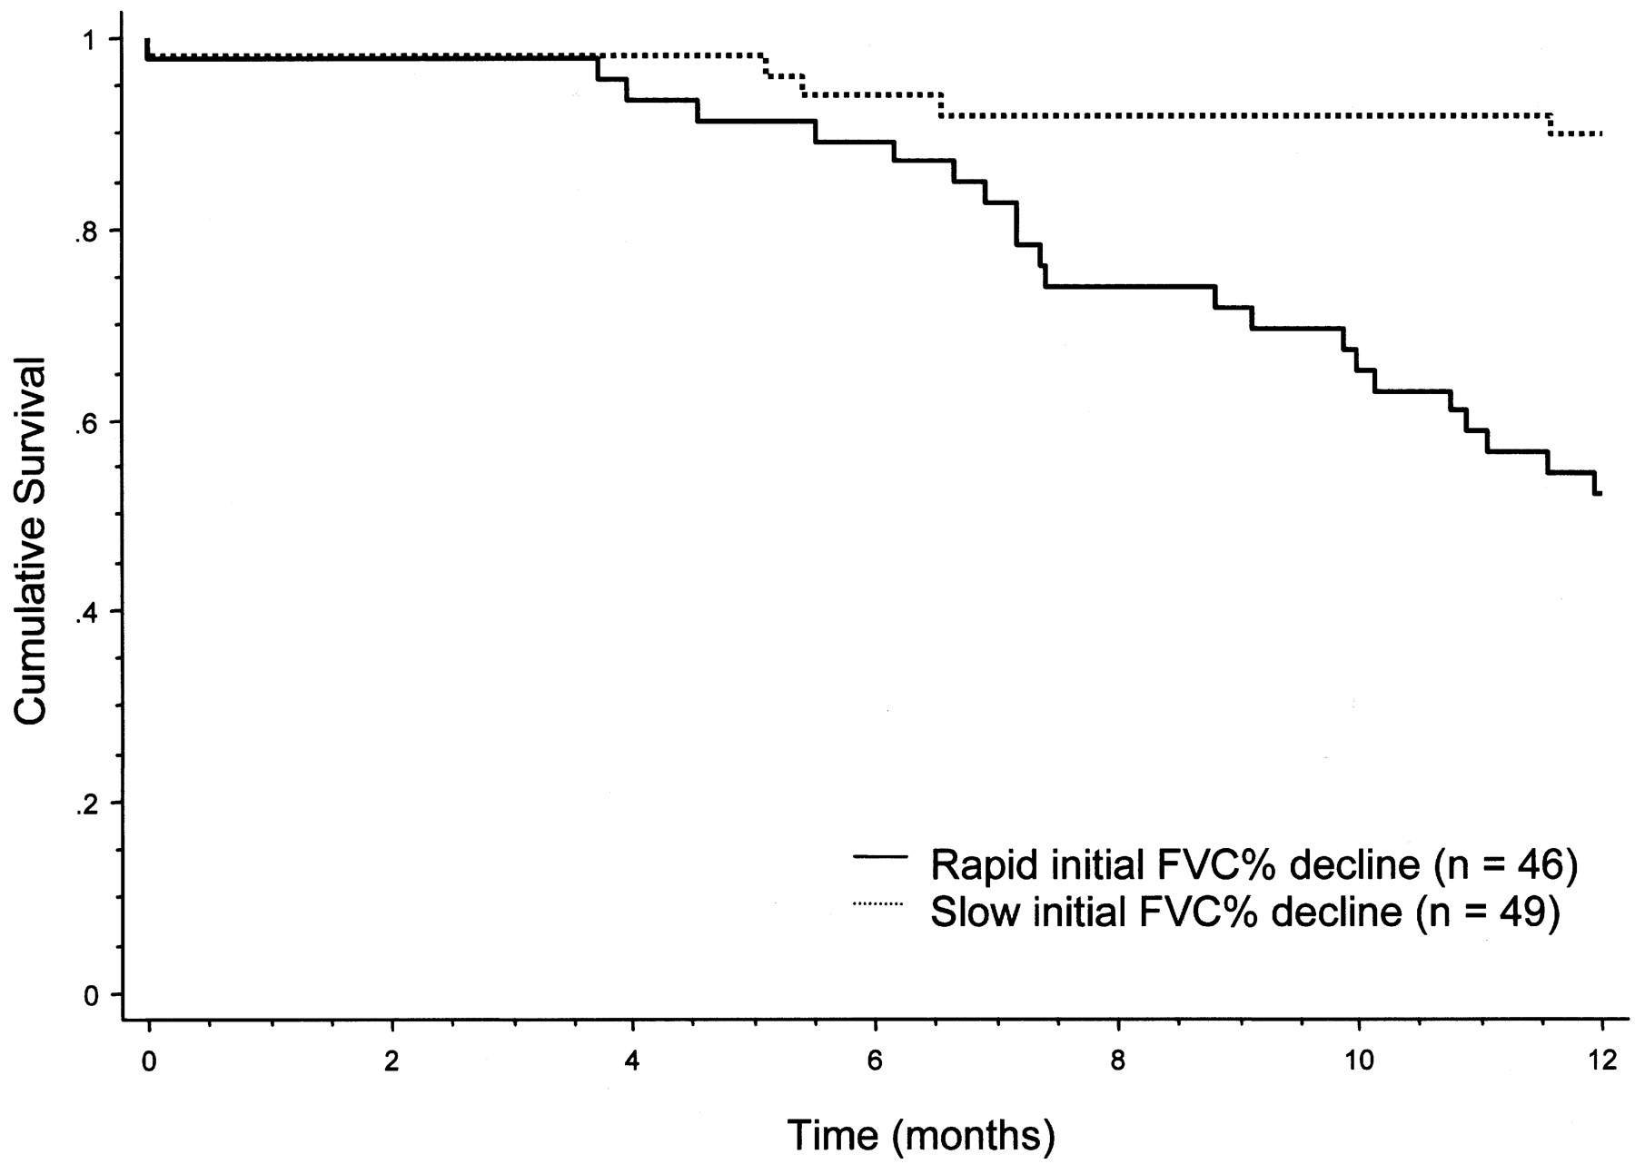
Figure 1. Survival of ALS patients enrolled in the placebo group of the topiramate study according to their rate of decline of forced vital capacity during the first 3 months of study.
Traynor B J et al. Neurology 2004;63:1933-1935
©2004 by Lippincott Williams & Wilkins
Notes:
Figure 1. Survival of ALS patients enrolled in the placebo group of the topiramate study according to their rate of decline of forced vital capacity during the first 3 months of study.

Slide 32
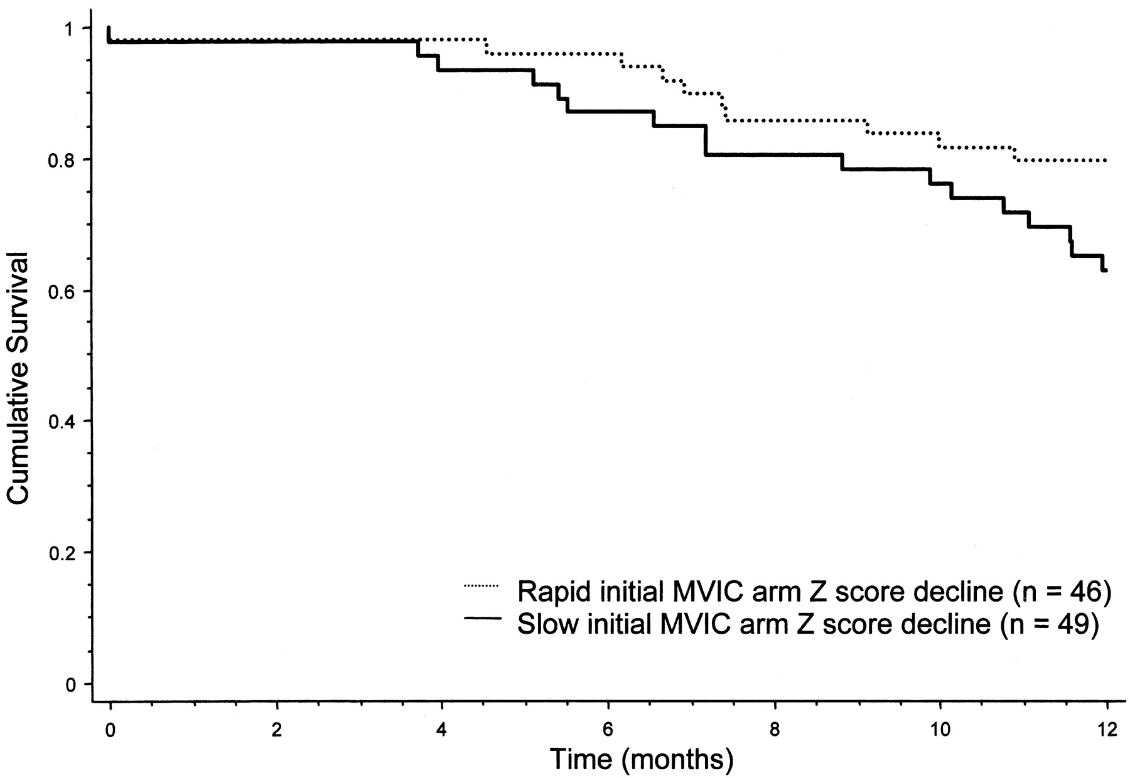
Figure 2. Survival of ALS patients enrolled in the placebo group of the topiramate study according to their rate of decline of maximum voluntary isometric contraction–arm (MVIC-arm) Z score during the first 3 months of study.
Traynor B J et al. Neurology 2004;63:1933-1935
©2004 by Lippincott Williams & Wilkins
Notes:
Figure 2. Survival of ALS patients enrolled in the placebo group of the topiramate study according to their rate of decline of maximum voluntary isometric contraction–arm (MVIC-arm) Z score during the first 3 months of study.

Slide 33
Standard selection criteria
Comparability between studies
Increase heterogeneity and generalizability

Slide 34
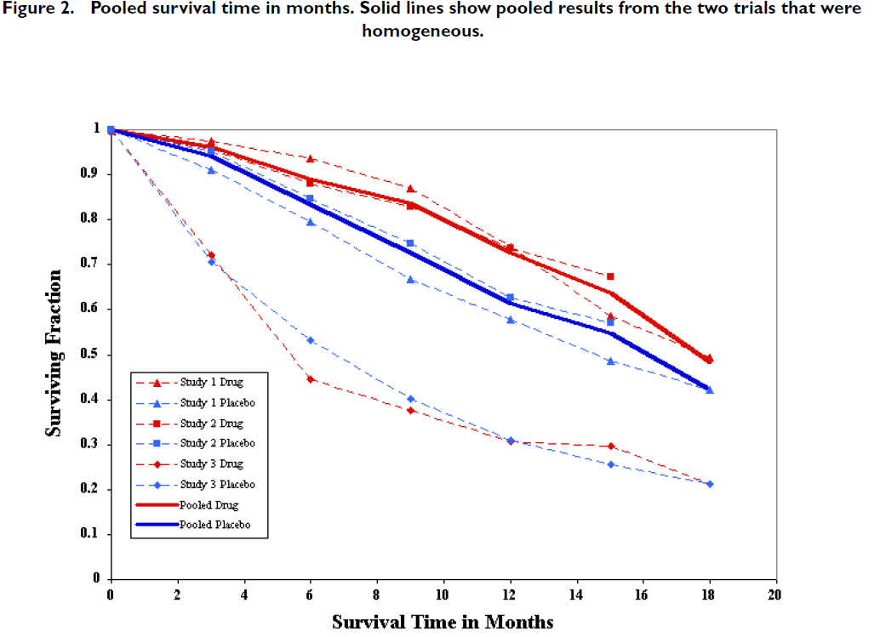

Slide 35
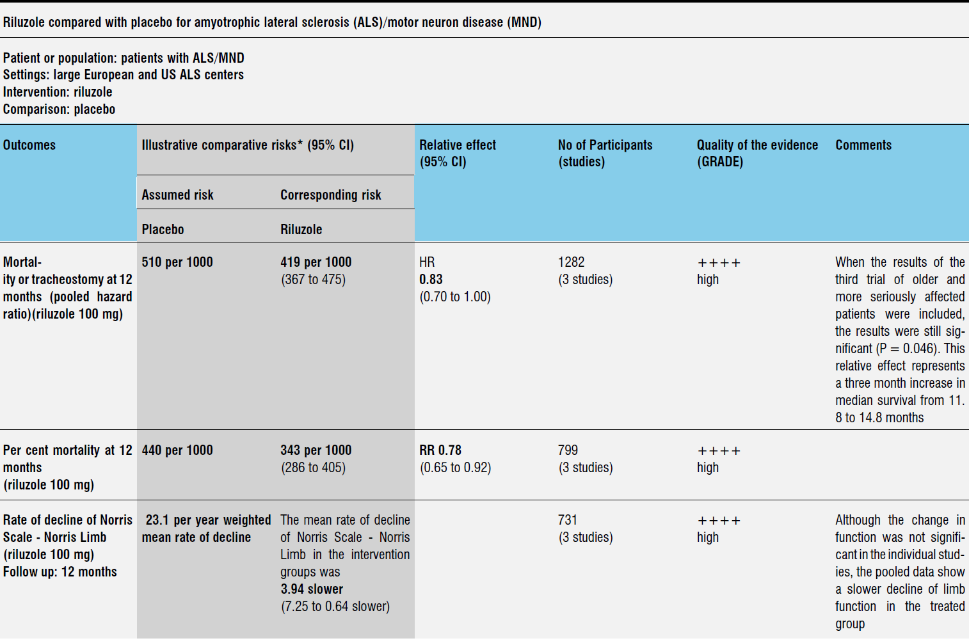

Slide 36
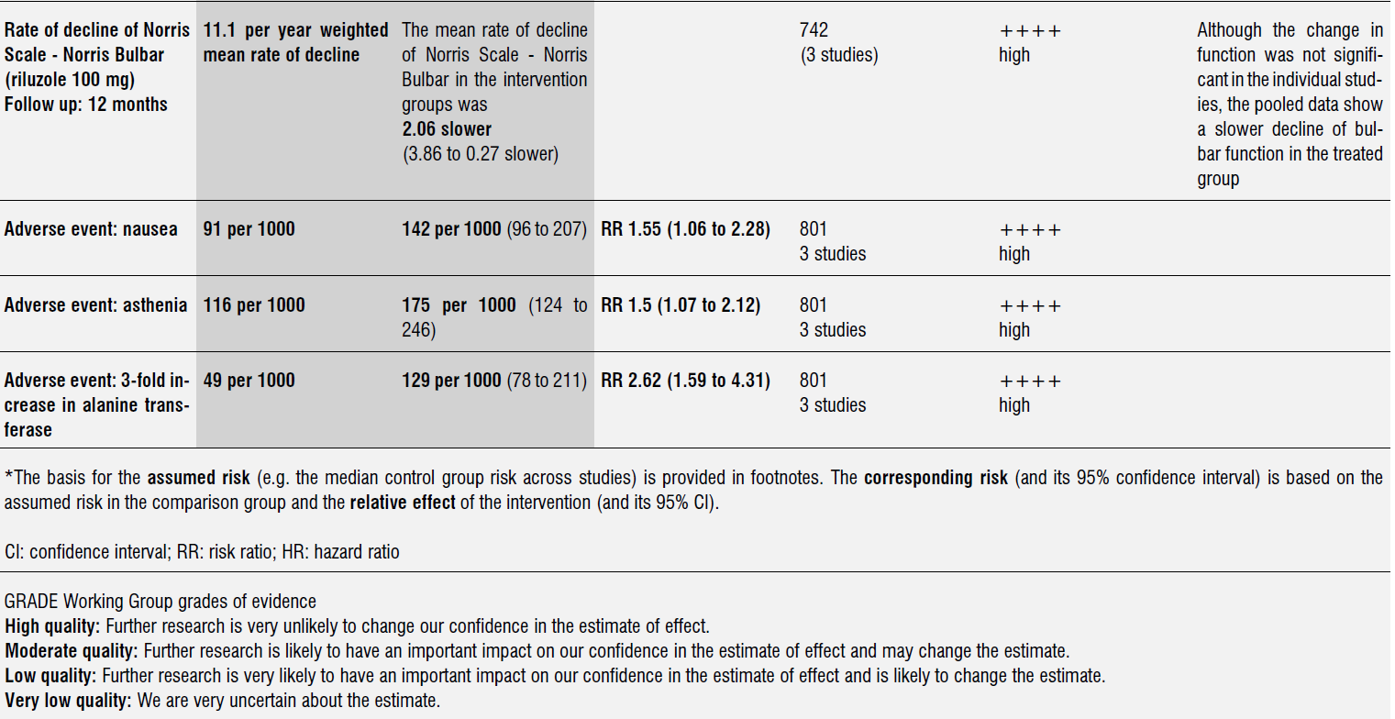

Slide 37
Enrichment
Would it help to focus population?
Bulbar onset
Limb onset
Genetic marker (C9ORF72, SOD1)
Predominantly UMN
Smaller numbers
Would require repeat trial with expanded inclusion criteria to generalize

Slide 38
Question 4
Outcome measures that are useful in ALS trials include:
FVC
ALSFRSr
Survival
QOL scales
Potentially these and more, but must be validated

Slide 39
Conclusions
“We don’t do clinical trials in a random sample of patients…” Bob Temple
Enriching the study population
Selectivity

Slide 40
More information about enrichment
Great slide set:
http://www.fda.gov/ucm/groups/fdagov-public/@fdagov-afda-orgs/documents/document/ucm303485.pdf
Short video from Bob Temple:
http://vimeo.com/58496502

