Slide 1
Asking a good early phase clinical trial question
NINDS Clinical Trials Methodology COURSE 2019

Slide 2
Acknowledgments
NINDS (funding for course)
R25NS088248
U01NS077352
American Academy of Neurology

Slide 3
Disclosures – William Meurer, MD, MS
All non-profit except episodic medico-legal consulting
Funding from NINDS -PI of clinical trials methodology course
Funded co-investigator on NETT/SIREN-CCC and SHINE trial
NIH-NIDCD (cluster RCT studying dizziness intervention)
NIH-NIMHD - PI of trial of hypertension
Co-investigator to improve stroke care in Flint
NIH-NHLBI (co-investigator in cardiac arrest expedited transport/ECMO trial)
AHRQ (dizziness self treatment)
Massey Foundation (studying pupillary response in TBI)
FDA and NIH (reviewer)
Meth Stats Reviewer
Annals Of Emergency Medicine
Academic Emergency Medicine
Senior Editor (paid)
BMC Journal - Trials

Slide 4
Objectives
Consider purpose of clinical trials
Consider goals of clinical trials
Understand potential output of clinical trials

Slide 5
Slides / work derived from various sources
Some slides from recent presentation about a new clinical trial called ICECAP: https://youtu.be/eU4g6upAQo0
Prior webinars – find at webinar tab at
http://neurotrials.training
2014 Bill Barsan – Asking a good clinical trial question
https://youtu.be/9MQHmqYRaOQ
2017 Roger Lewis – Early Phase Trials: Goals and Questions - https://youtu.be/HJkbj2_1WfU
Good to review: Pilot and Feasibility Studies – Dr. Thabane https://youtu.be/bljPT9whkQo

Slide 6
Questions?
I will pause at each section header (looks like the picture at right)
Type them in as comments and I will try to address the ones I see as I go along

Slide 7
Part One
Scope of PROBLEM

Slide 8
Why Clinical Trials Stink

Slide 9
Why Clinical Trials Stink
ANALOGY*: Clinical Trial = Diagnostic Test
 | Clinical Trial | Diagnostic Test
Looking For | Effective Treatment | Disease
1 – Type II Error (Beta) | “Power” | Sensitivity OR True Positive Rate
Type I Error (Alpha) | Significance Level | 1- Specificity OR FALSE Positive Rate
*Note: My analogy does not stink

Slide 10
Clinical Trials are Models with Tons of Guesses Assumptions
Dose from animal models is close
No heterogeneity of effect
Subgroups respond equally
Some subgroups excluded
Effect size to create “reasonable” sample size
“Noise” in outcomes can be understood and overcome
Duration of treatment practical
LESSON: Make many compromises to reduce number of parameters to make model “solvable”

Slide 11
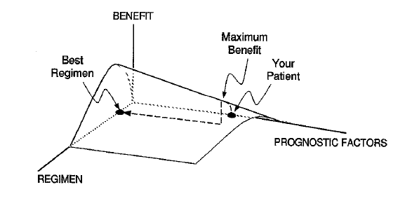
Therapeutic Response Surface
Clin Pharmacol Ther 1997;61:275-91
Notes:
In a commentary by Lewis Sheiner from UCSF, he describes the idea of what we are looking for in a clinical trials. This is a gross oversimplification, but you can think of the regimen axis as containing information on everything about the drug or device including dose, how long to treat, concomitant therapies. The prognostic axis contains all the important ways that patients differ in their outcome either with or without the treatment. The vertical, benefit axis signifies the NET efficacy with toxicity subtracted off. This plane will be flat with zero benefit for a treatment that has no effect on anyone. It is important to point out that this is a biological description and when we conduct clinical trials we are trying to find parts of this surface, but we will never estimate something like this fully with a high degree of accuracy.

Slide 12
Part Two
Progression through PHASES

Slide 13
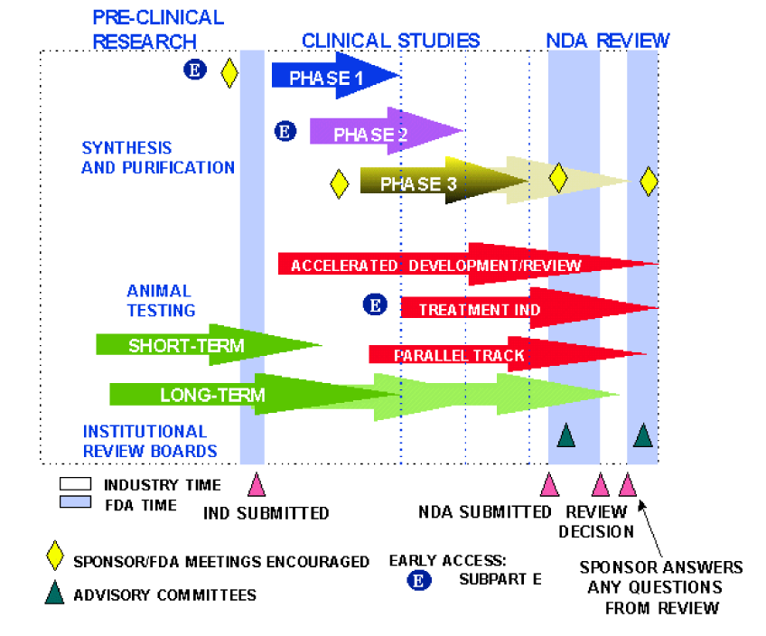
Objectives
Describe how to ask a clinical trial question
Understand potential pitfalls
Describe one motivational example
Notes:
This diagram demonstrates the overall drug development pathway (from the FDA guidelines). Pre-clinical studies inform, the design of human experiments, starting with phase I focusing on pharmacology, phase II focusing on the exploratory space (should trials progress), with phase III focusing on confirming efficacy.

Slide 14
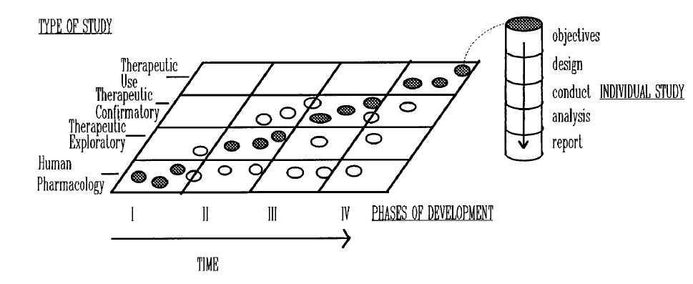
Development of an intervention
Notes:
So this is another way of looking at the goals of clinical trials through the development pathway. While this is focused on drugs, it is reasonable to consider that the development of any interventions should follow a logical, stepwise progression.

Slide 15
Part Three
Progression through PHASES

Slide 16
Crafting a good clinical trial question
Generally – you should have ONE main question
Is X better than Y
Does X improve a patient oriented outcome compared to Y, when administered to this population, for this long, at this dose
Notes:
The 2nd option is a much better clinical trial question.

Slide 17
Can the question be even better?
In phase II: What dose, schedule, and population would hold the most promise for determining that treatment X can be proven to be better than treatment Y in a phase III trial of size N
Either you are asking a really GOOD question or you are asking too many questions at once

Slide 18
What are the risks
FDA / academia worries about
Falsely declaring an ineffective drug efficacious
Academia (should) worry about
Falsely declaring an effective treatment neutral because something was wrong in the clinical trial
Population
Dose
Schedule

Slide 19
What is an Early Phase Trial?
General concept: Learn versus confirm
Learn (e.g, phase I, phase II)
Greater flexibility and number of questions/goals
Willingness to tolerate higher error rates and sources of bias
Not just underpowered confirmatory trials
Confirm (e.g., phase III)
Rigid control of error rates (i.e., type I rate and power)
Prespecification and single primary question/outcome
Setting for the traditional 1:1 randomized RCT

Slide 20
Early Phase Question: 1
Can the drug be tolerated?
Traditional dose-escalation question
Healthy versus diseased population
Is the maximum tolerated dose (MTD) of clinical interest
Pharmacokinetics versus pharmacodynamics
Trial Designs:
3+3 (historical interest)
Continual reassessment method (CRM)

Slide 21
Part Three
(SOME) GOOD QUESTIONS FOR TRIALS

Slide 22
Early Phase Question: 2
Can we establish “proof of concept”?
Addresses underlying assumptions regarding proposed mechanism of action (e.g., does the drug bind the target receptor, does the drug pass the blood-brain barrier)
Assumption is that treatment strategy will not work without this criterion being met (i.e., necessary but not sufficient for success)
Trial design: dose ranging/biomarker or assay

Slide 23
Early Phase Question 3:
What dose(s)* should be investigated further?
Potentially useful doses may span a range of several logs
Dose selection often requires balance of efficacy and toxicity
Common mistake to narrow the dose range under consideration too early
Trial design: Dose finding trials with assessment of efficacy and toxicity (e.g., adaptive dose finding trial)
Could consider intensity of intervention, device settings, schedule (how often) – both for drug, device, behavioral or other non-pharmacologic interventions

Slide 24
Early Phase Question 4:
What outcome(s) should be measured?
Consider likelihood of effect on an outcome versus clinical importance (patient centered)
Consider practical issues, timing of follow up and difficulty in assessment
Reliability and prior validation or use of outcome measures
Can consider multiple outcomes, but with risk of false positive result due to “cherry picking”
Trial design: Intervention/multiple outcomes

Slide 25
Early Phase Question 5:
What disease state(s) should be studied?
Consider availability of subjects, confounding factors and treatments, and established outcome measures
Common to run multiple phase II trials of the same agent in different diseases
Trial design: “Indication finding trial” with multiple diseases enrolled simultaneously to leverage investment in sites and personnel (e.g., using an integrated statistical approach)

Slide 26
Early Phase Question 6:
What population should be enrolled?
Narrow population:
Less variability and easier to interpret results
Difficult to enroll required sample size and less clinical relevance
Broad population
Increased variability, confounding factors
Concerns regarding heterogeneity of the treatment effect (HTE) and low power to detect HTE
To inform the design of a confirm phase trial, you need to enroll a “confirm-phase” population

Slide 27
Early Phase Question 7:
How should a confirmatory study be designed, implemented, and analyzed?
Learn-phase trials should be conducted similarly to confirm-phase trials if they are to inform confirm-phase trial design and conduct
Same population, treatments, and outcomes
Adequate sample size to answer the key questions needed to design confirmatory trial

Slide 28
Early Phase Question 8:
Should a confirmatory study be conducted at all?
We should only run confirmatory trials that have a substantial chance of showing benefit
Key concept: predictive power—the probability of a positive confirmatory trial, considering all the remaining uncertainties
Possible counter-example: trials of treatments to prevent Alzheimer’s disease

Slide 29
Part Four
Wrap UP

Slide 30
At this time – check out CONSORT extensions!

Slide 31
Conclusions
Early phase clinical trials are hard
Getting the question right is crucial
It can be challenging to prioritize

