Slide 1
Ancillary Study Ideas
Dr. Alexis Topjian

Slide 2
Overview
Process
Timing
Grant Mechanisms
Idea Brainstorming

Slide 3
Huge Opportunity
Largest pediatric post cardiac trial ever
Anticipated 900 patient to be enrolled over 5 years, 6th year to complete follow up
Anticipate approximately 50% survival rate approx. 450 survivors

Slide 4
Process
Ancillary study ideas will be presented to the Protocol Review Committee of the Executive Committee for their assessments of study feasibility and interest in collaboration.
EC will review the submitted Grant Proposal
A letter of support will be provided for grant applications

Slide 5
Key Considerations
The proposed study addresses a question of importance.
The proposed study should not compete with other studies
Conduct of the study must not adversely affect the parent study.
Funding will be obtained by the PI and be independent of the parent study.
Procedures for accessing necessary data and records from the parent study are explicit and acceptable

Slide 6
Key Considerations
The proposing PI has the appropriate expertise and facilities to conduct the study.
Plans for publication and authorship of study results are appropriate, including review and approval of manuscripts per the SIREN publication policy.
EC members will be given adequate time to review the draft proposal including a draft grant overview before an initial vote is taken.
90% approval of the EC is required.

Slide 7
Key Considerations
Ancillary studies will not publish before the P-ICEPCAP primary publication
P-ICECAP data primary data will not be unblinded/revealed for ancillaries

Slide 8
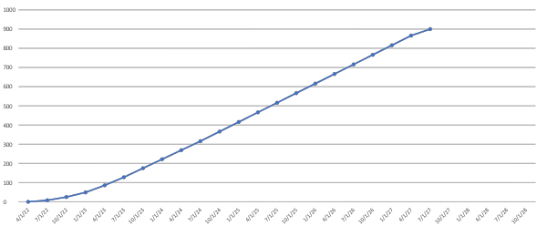
Timeline: PICECAP Anticipated Enrollment
Earliest Start Date/
Resubmission
R01 Deadline
We Are Here

Slide 9
THAPCA Ancillaries
Pharmacology of drugs related to cooling. FUNDED
Funded but near end of trial
Effects of cooling on inflammation, immunity NOT FUNDED
Not funded but close

Slide 10
ICECAP Ancillaries
PREC-ICECAP FUNDED AND ENROLLING
Sub phenotyping cardiac arrest injury with EEG and Hemodynamic Data
COMPACT RESUBMITTED
Biomarker Study
POST-ICECAP PREPARING RESUBMISSION
Long Term Outcomes

Slide 11
Topics
EEG monitoring
Neuroimaging
Biomarkers
Inflammation
Gut microbiome
Subphenotyping/early injury stratification
Long Term Outcomes

Slide 12
Grant Mechanism
NHLBI R01
NINDS R01
American Heart Association
NIH Diversity Supplement
https://grants.nih.gov/grants/guide/pa-files/pa-21-071.html
https://www.nhlbi.nih.gov/grants-and-training/training-and-career-development/nhlbi-research-supplement-application-guidelines

Slide 13
If you are interested.. Next steps
Email about what you are thinking
Synthesize your Aims
Process to submit to the EC will be forthcoming in next couple of weeks

