Slide 1
Milestones & Finance
Valerie Stevenson

Slide 2
Start-up Payment
A one-time payment of $5000 (inclusive of F&A costs) will be paid to up to forty (40) P-ICECAP sites upon the completion of all required trainings, regulatory documents submission, institutionally required approvals, signed and executed contracts and are released to enroll subjects by the Clinical Coordinating Center.
Start-up funds are reduced by $1,000 per calendar month if all start-up requirements are completed after the posted deadline. Sites not included in the original proposal may not be eligible for this start-up payment.

Slide 3
Per-subject Payments
Milestone | I | II | III | IV | V | V a | V b
 | Screening stipend | Enrolled, died during hospitalization OR alive at discharge stipend | 3 Month (VABS III) stipend | 12 month (VABS III) stipend | 12 Month Neurological Appointment scheduled and successfully completed stipend | 12 Month Neurological exam by Neurologist stipend | 12 Month Family expenses for travel to neurological exam
PAYMENT AMOUNT | $100 | $7,000 | $1,000 | $2,000 | $500 | $500 | $150

Slide 4
Per-subject Payments
Sites that are open to enroll will be eligible for subject payment of $7,000 (inclusive of F&A costs) after an eligible subject is enrolled and randomized and all study CRFs required from baseline through hospital discharge are submitted and free of queries. This includes subjects that died prior to discharge.
Sites will be eligible for a second subject payment for the 3 Month (VABS III) visit of $1,000 (inclusive of F&A costs) when the visit is successfully completed and all required study CRFs are submitted and free of queries.
Sites will be eligible for a third and final subject payment of a maximum of $3,150 (inclusive of F&A costs) when the visit is successfully completed and all required study CRFs are submitted and free of queries.
Included in the maximum payment is $2,000 for completion of the 12 month (VABS III), $500 for scheduling and completing the Neurological exam, $500 payment once the neurology exam is completed and $150 for subject reimbursement for travel expenses

Slide 5
Per-subject Payments
Sites will receive payment of $100 for each patient that meets inclusion criteria and is screened within 6 hours of ROSC but is not enrolled. Payment will be made quarterly for patients entered in WebDCU as a screen failure by the site.
The total amount of reimbursements for a single subject shall not exceed $11,150 (inclusive of F&A costs). Procedures, timelines and specific information can be found on the trial website, https://siren.network/clinical-trials/picecap
SIREN SOP for Participant Reimbursement applies. SIREN SOP Participant Reimbursement

Slide 6
Invoicing
You see what we see
Based on contract language
Subject visit reads READY in WebDCU

Slide 7
Invoicing
Invoice creation is not automatic
We generate the invoice for you at least quarterly
Invoices can be found in WebDCU
Retrieve and submit your invoice to your Accounts Receivable office to assist with reconciliation

Slide 8
Invoicing
Data is entered and free of query

Slide 9
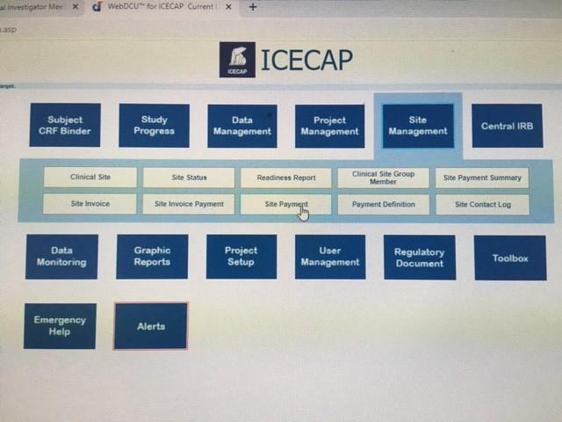

Slide 10
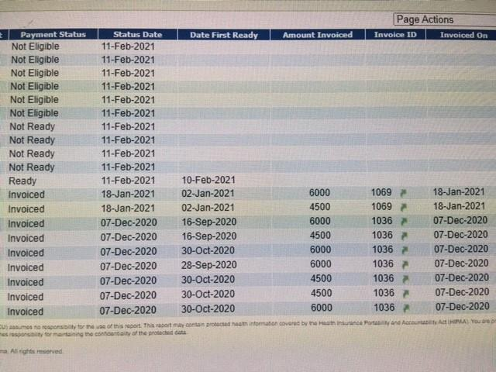

Slide 11
Where’s My Agreement?

Slide 12
Questions?
Contact Teri Behnke @ tbehnke@med.umich.edu

