Slide 1
Virtual Investigators Meeting January 14, 2021
Ramon Diaz-Arrastia, MD, PhD Professor of Neurology, University of Pennsylvania BOOST-3 Study Chair

Slide 2
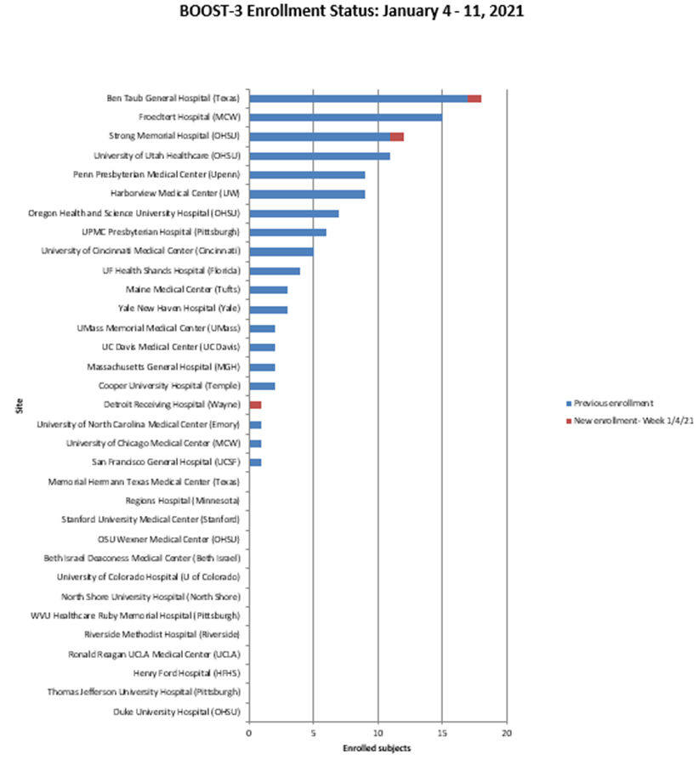
Enrollment to Date n = 114 Sites with enrollment = 20 Sites released to enroll = 34

Slide 3
Enrollment delays
Most sites were closed for COVID19
Many have reopened over time with 4 still closed
Site opening slower than anticipated
Delays in approval by cIRB
First multicenter trial to use a cIRB for EFIC
Difficulties performing EFIC activities with COVID19
All sites should be cIRB approved and open by early 2021

Slide 4
BOOST3 Ancillary Studies
BioBOOST
Blood and CSF biomarkers of CNS injury
Funded by DoD (BA170613, Award W81XWH-19-1-0829)
Separate consent not under EFIC
Approved by DSMB and cIRB
5 sites have ceded IRB approval
Approved by DoD Human Research Protection Office (HRPO)
Subcontracts in progress with clinical sites
Protocol, Manual of Procedures, and CRFs finalized
Investigators Meeting by video-conference on 10/8 and 10/12
3 sites currently open for enrollment
Anticipate first enrollment during January 2020

Slide 5
BOOST3 Ancillary Studies
ELECTROBOOST
Prospective observational study at 18 sites that utilize cEEG as standard of care in severe TBI (n=200)
PIs: Emily Gilmore (contact, Yale), Eric Rosenthal (MGH), Kan Ding (UTSW)
Specific Aims
Demonstrate effects of electrographic seizures (eSz) and high-frequency periodic discharges (HF-PD) on brain oxygenation
Quantify the effects of eSz and HF-PD on functional outcome
Investigate the impact of AED escalation on eSz and HF-PD exposure
Separate consent waived
Approved by NINDS Council; NGA 7/31/2020 (R01 NS117904)
Protocol and MOP Finalized; CRFs in final stages of development
Anticipate first enrollment Q1 2021

Slide 6
BOOST Epileptogenesis Project
Prospective observational study of BOOST-3 and ELECTRO-BOOST participants (n = 200)
Extend FU to 2 years after injury
MRI at 6 months after injury
Participants who screen positive on telephone interview for possible post-traumatic epilepsy will be invited for an in-person evaluation with expert epileptologist
“Gold” standard DISCOVER interview to adjudicate PTE
Hypotheses designed to asses electrophysiologic, imaging, and molecular biomarkers associated with PTE
Submitted to DoD 7/21/2020. Scored 1.6 (Not selected for funding)
Planned re-submission to NIH or DoD

